Slide 1

TRAVEL RECOMMENDATION SYSTEM
PRESENTED BY:
U MOHAN SRINIVAS

Slide 2

INTRODUCTION:
In Today’s data driven era, travelers seek personalized and hassle-free solutions for trip planning. The travel recommendation system (TRS) harnesses the capabilities of database connectivity to deliver tailored travel suggestions. By analyzing user preferences, behavior, and demographic data, the TRS offers recommendations for destinations, accommodations and activities.

Slide 3
PROJECT AIM AND OBJECTIVES
The aim of this project is to develop a comprehensive Travel Recommendation System (TRS) that leverages database connectivity to provide personalized and tailored travel recommendations to users.
The objectives of the TRS are:
Personalized Travel Experience
Enhanced User Engagement
Accuracy and Relevance
Scalability and Adaptability
Customer Satisfaction
Collaboration and Partnerships
Ethical Considerations
Key functionalities :
User registration and login.
Search and filtering options.
Recommendation algorithms.
Personalization features.
Booking integration.

Slide 4
Database Connectivity
Description of database architecture:
This system relies on a relational database model, which organizes data into tables with defined relationships, facilitating efficient storage and also performs the retrieval of information related to users, destinations, bookings, and other relevant entities.
Data storage and retrieval processes:
Data is securely stored within the database, ensuring integrity and confidentiality.
Retrieval of stored data is conducted through the execution of Structured Query Language (SQL) queries by the backend application. These queries enable the extraction of specific data subsets based on defined criteria, ensuring flexibility and responsiveness in accessing information.

Slide 5
User Interface:
Home page
Search and filter options
Recommendation results page
User profile/dashboard
Welcome to our Travel Recommendation System
Easily refine your search based on destination, date, budget, and preferences
It has the Discovered personalized travel options tailored for clients
Manage your bookings, preferences, and past activities from your personalized dashboard

Slide 6
DATA FLOW DIAGRAM
A data flow diagram (DFD) visually represents how data moves through a system, showing inputs, processes, outputs, and data stores. It simplifies understanding of a system's data flow, aiding in analysis and design.
A data flow diagram (DFD) visually represents how data moves through a system, showing inputs, processes, outputs, and data stores. It simplifies understanding of a system's data flow, aiding in analysis and design.
User interactions trigger requests to the backend server."
"Backend processes requests, retrieves data from the database, and generates recommendations."
"Recommended options are presented to the user via the frontend interface."
"Booking and transaction data are securely handled and stored in the database."

Slide 7
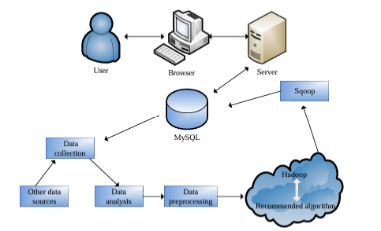

Slide 8
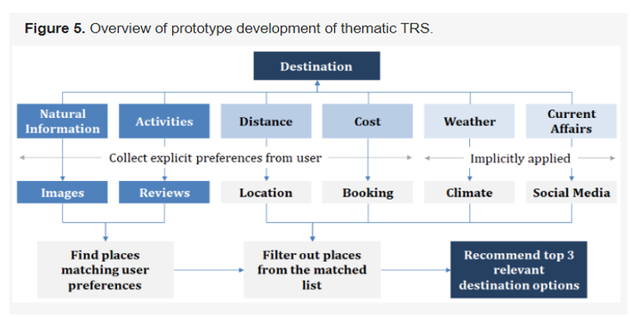
OVERVIEW OF THE DEVELOPMENT OF THEMATIC TRS

Slide 9
PROS & Cons
Performance and Scalability:
Our system has been meticulously crafted to optimize performance and ensure scalability to meet growing demands. By leveraging efficient coding practices and infrastructure design, we've minimized latency and response times, delivering a seamless user experience. Additionally, we've implemented horizontal scaling techniques, allowing our system to distribute workload across multiple servers effortlessly.
Through continuous monitoring and optimization, we're committed to maintaining peak performance levels, even as user traffic increases. This dedication to performance and scalability guarantees that our Travel Recommendation System remains agile and responsive, capable of scaling up to support the evolving needs of our users without compromising efficiency.

Slide 10
Conclusion:
Our Travel Recommendation System with Database Connectivity offers a comprehensive solution for personalized travel planning. By leveraging database connectivity, we have created a dynamic platform that tailors recommendations to individual preferences, providing users with a seamless and enjoyable travel experience.
The integration of database connectivity plays a critical role in ensuring data integrity, efficiency, and scalability. It enables us to store and manage vast amounts of information related to users, destinations, and bookings securely, while also facilitating quick and responsive data retrieval for enhanced user interactions.
With our robust database infrastructure in place, we are well-equipped to meet the evolving needs of travelers and deliver exceptional service.

