Slide 1
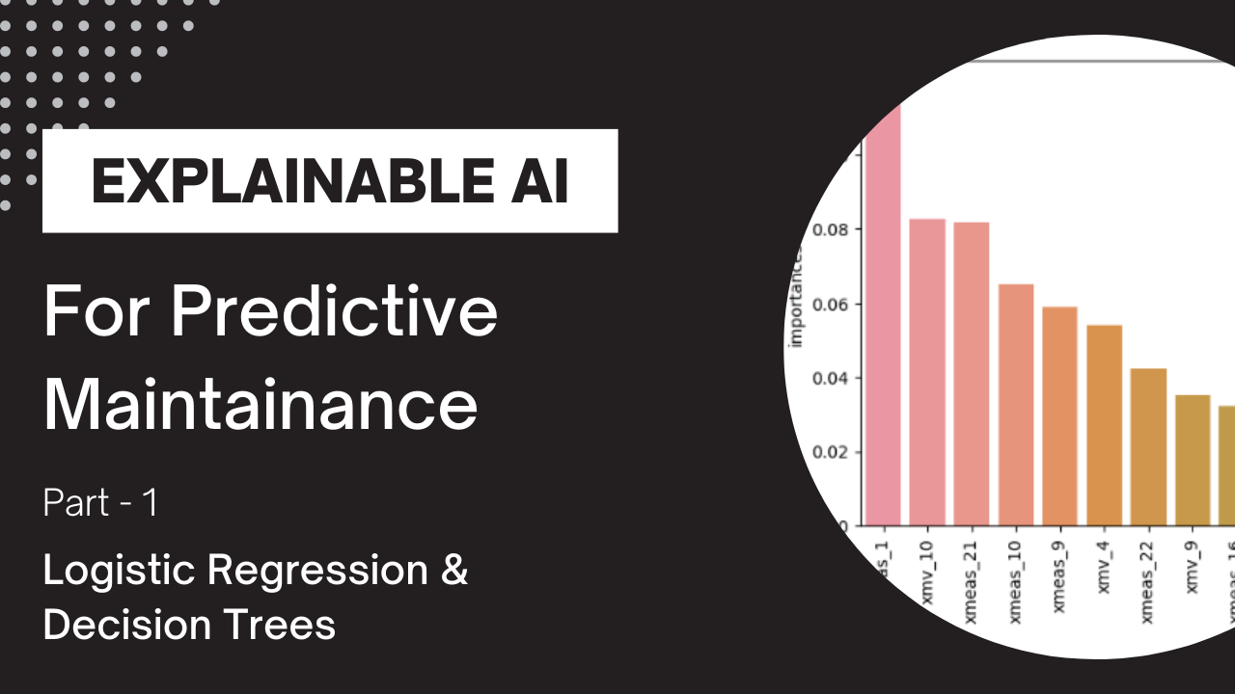

Slide 2
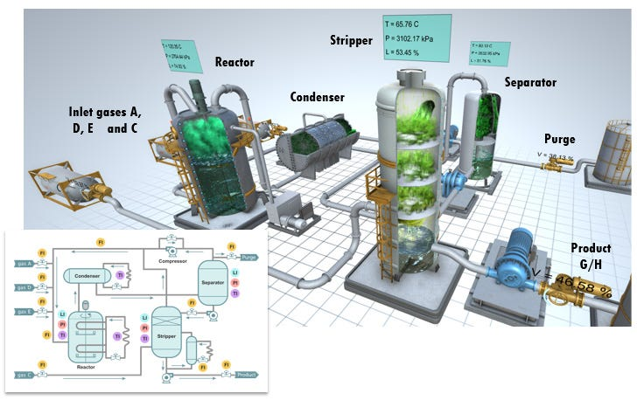
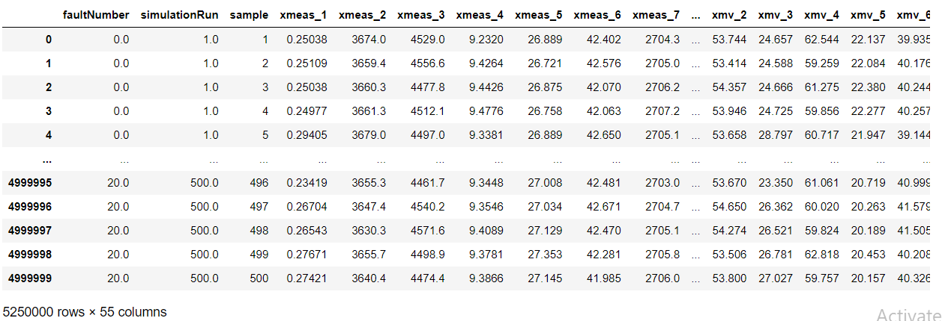




Dataset
$$X_{1}$$
$$X_{2}$$
Sensor Values
$$…$$
$$X_{52}$$
20 different fault types were introduced

Slide 3



Supervised Learning
Black Box Model
$$X$$
$$Y$$
Input Features
Target label
WHY ????

Slide 4
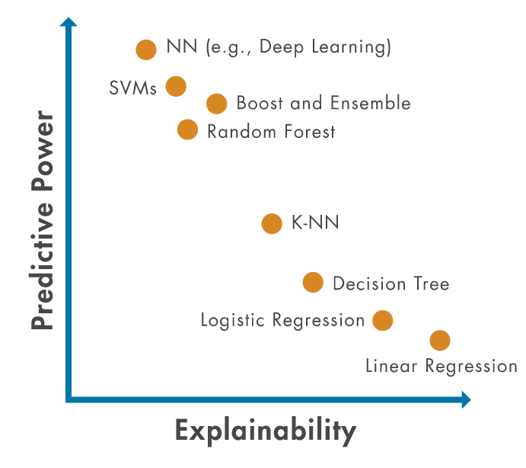
Explainable AI (XAI)

Slide 5


Logistic regression

Slide 6
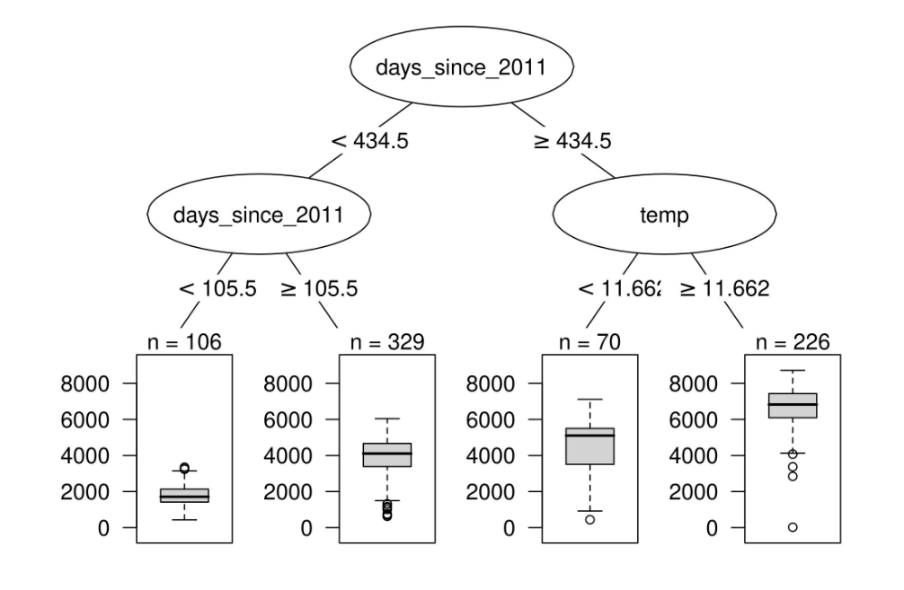
Decision Trees

Slide 7
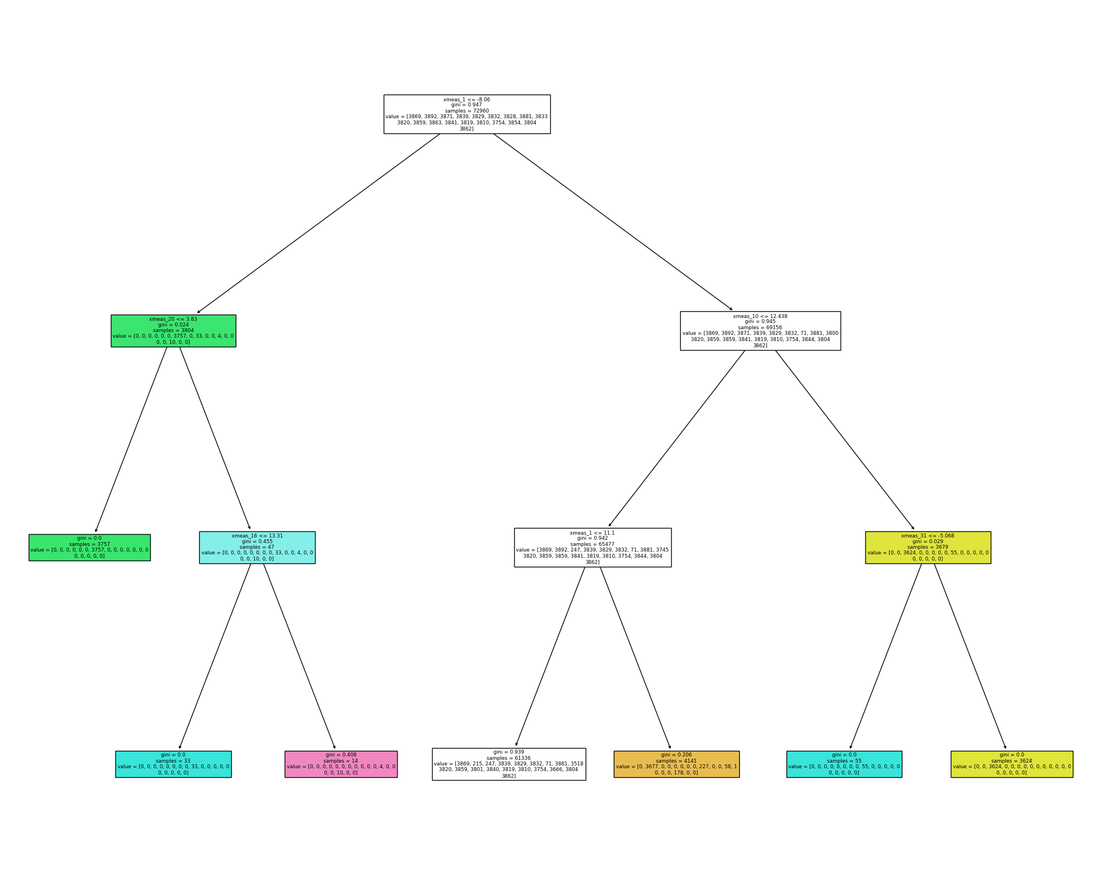
Decision Trees
https://medium.com/data-science-in-your-pocket/how-feature-importance-is-calculated-in-decision-trees-with-example-699dc13fc078

Slide 8
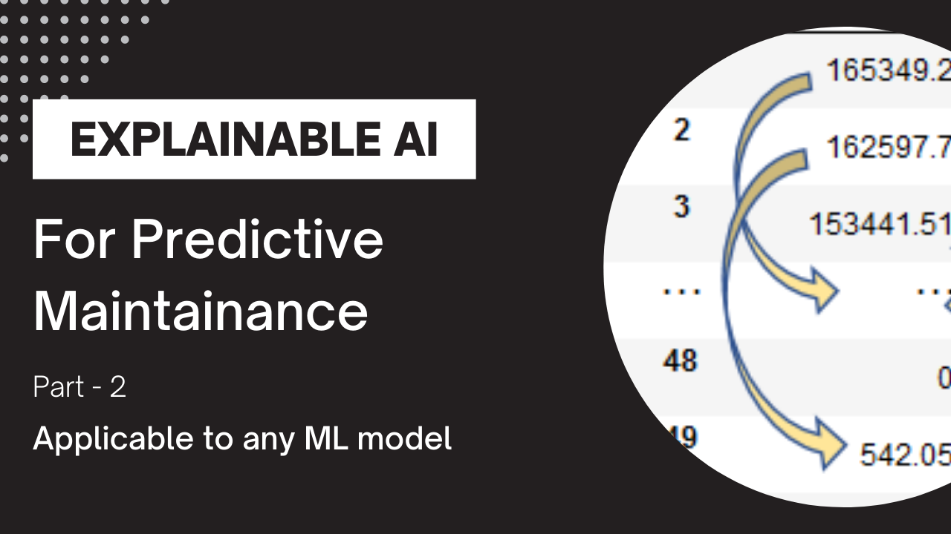

Slide 9
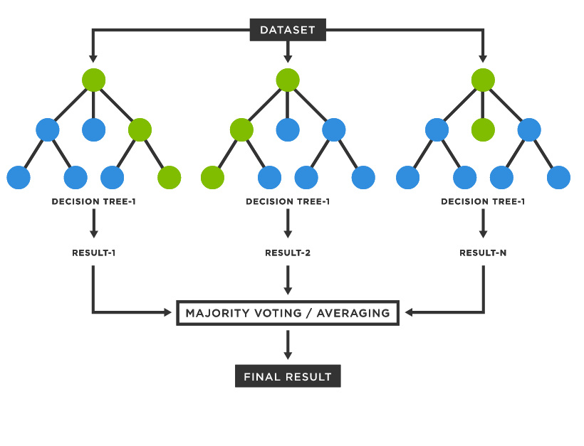
Random Forest (Avg Feature Importance of Decision Trees)

Slide 10
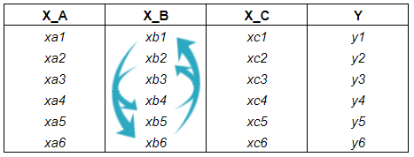



Accuracy
Target label
Black Box Model
$$X$$
$$\hat{Y}$$
$$Y$$
Input Features
Prediction

Slide 11
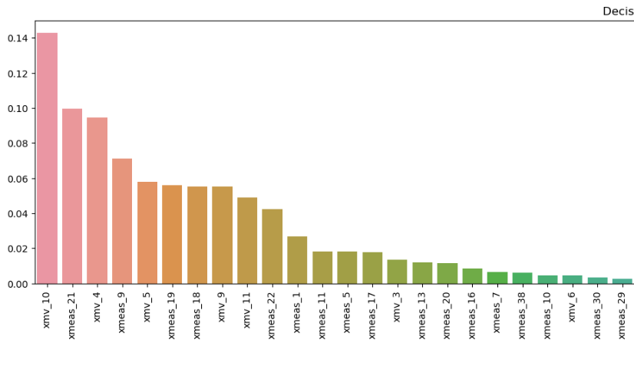

Slide 12


Slide 13

SHAP (Shapley Additive Explanations)

Slide 14
Steps of SHAP
Expected Value
Feature Permutation
SHAPLY Value Calculation
Visualization

Slide 15
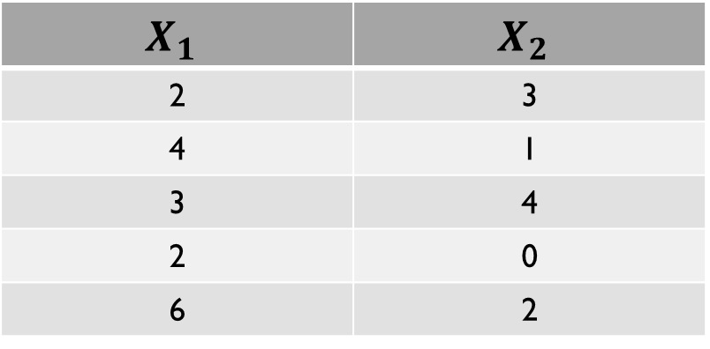
Expected Value / Base Value
$$X_{1}$$ | $$X_{2}$$
2 | 3
4 | 1
3 | 4
2 | 0
6 | 2
Y
85
94
82
88
96
Black Box Model
E(Y) is the value of target when$X_{1}$and $X_{2}$ are chosen randomly
Important: In this example, whenever I say randomly chosen, I make the feature value =0.
(It is not ideal for all case but for the sake of simplicity it can be assumed)

Slide 16
What is Local Explanation!
Input Sensor Measurements
Predicted Fault
Black Box Model
Which Features are Important for this Fault ?

Slide 17
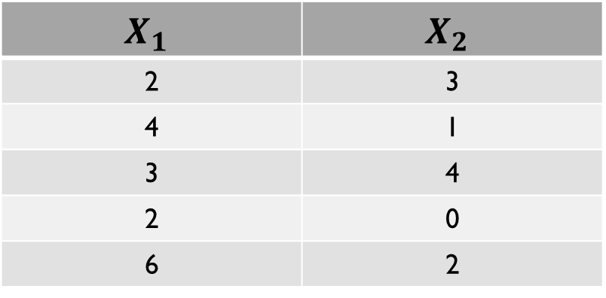
Example Dataset for SHAP explanation
$$X_{1}$$ | $$X_{2}$$
2 | 3
4 | 1
3 | 4
2 | 0
6 | 2
Y
85
94
82
88
96
Black Box Model

Slide 18
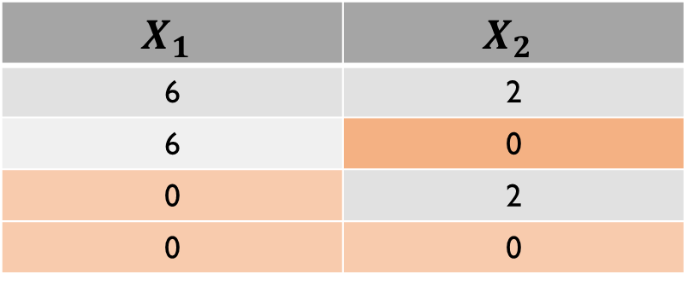


Feature Permutation
$$X_{1}$$ | $$X_{2}$$
6 | 2
Y
96
Permutation of Features
$$X_{1}$$ | $$X_{2}$$
6 | 2
6 | 0
0 | 2
0 | 0
Y
96
101.03
67.55
67.67
Black Box Model
$$E(Y)$$

Slide 19









SHAPLY value estimation
$$X_{1}$$ | $$X_{2}$$
6 | 2
6 | 0
0 | 2
0 | 0
Y
96
101.03
67.55
67.67
Black Box Model
Feature Importance of $X_{1}$
Feature Importance of $X_{2}$
F($X_{1}$, $X_{2}$) – F(0, $X_{2}$) = 28.45
F($X_{1}$, $X_{2}$) – F($X_{1}$,0) = -5.03
F($X_{1}$, 0) – F(0,0) = 33.66
F(0, $X_{2}$) – F(0,0) = -0.12
SHAPLY value $X_{1}$= (28.45+33.66)/2 = 31.055
SHAPLY value $X_{2}$= -2.575

Slide 20







$$X_{1}$$ | $$X_{2}$$
6 | 2
Y
96
SHAPLY value $X_{1}$= 31.055
SHAPLY value $X_{2}$= -2.575
$$E\left(X\right)=67.67$$
$$96$$
$$SHAP X_{1}$$
31.055
$$SHAP X_{2}$$
-2.575

Slide 21
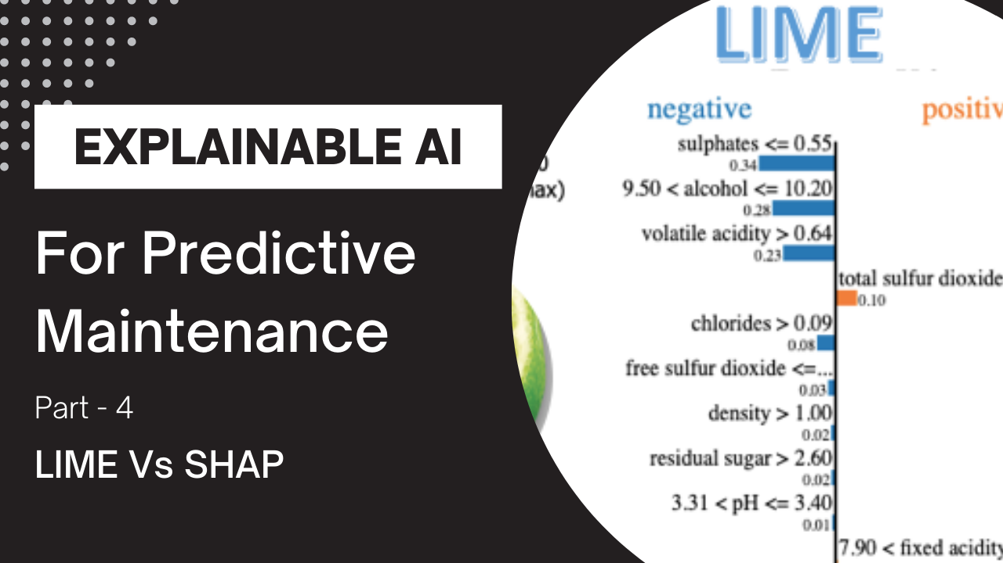

Slide 22
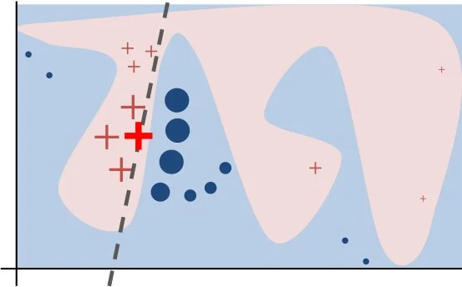
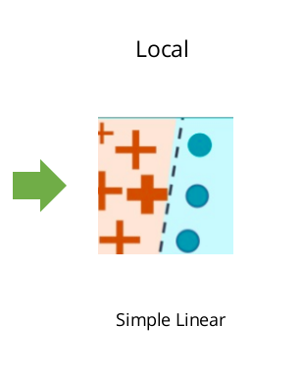



Local Interpretable Model agnostic Explanations (LIME)
Lasso Regression
$$x_{2}$$
$$h_{\left\{LIME\right\}}=θ_{1}x_{1}+θ_{2}x_{2}$$
$$x_{1}$$

Slide 23
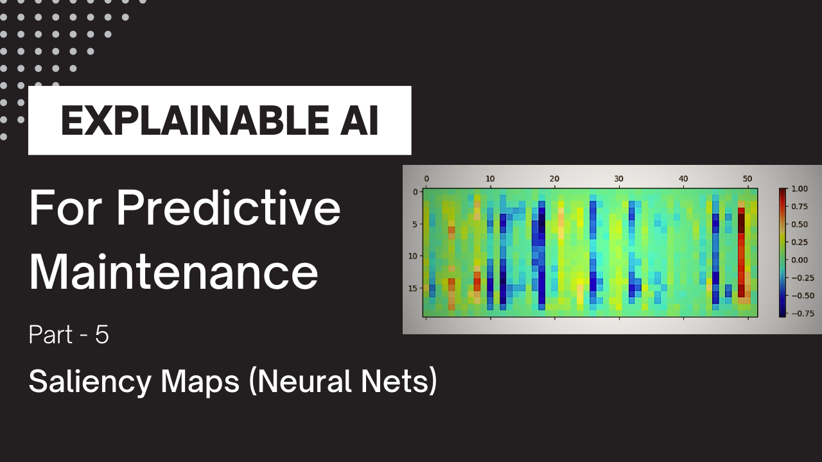

Slide 24
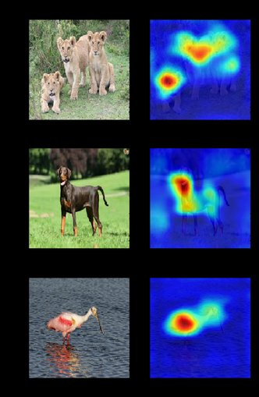
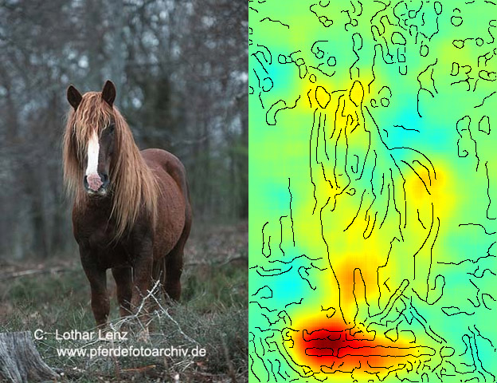
Saliency Maps (Which pixels are more important)
Good Model
Cheater Model

Slide 25
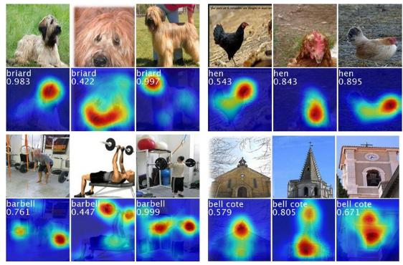
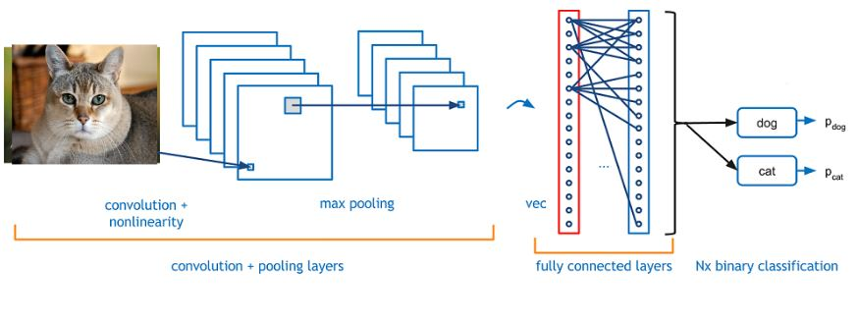



Saliency Maps Working
$$F(img)$$
Back Propagation
$$\frac{∂F(img)}{∂w}$$
Saliency Maps
$$\frac{∂F(img)}{∂ (img)}$$

