Slide 1


Slide 2




Slide 3
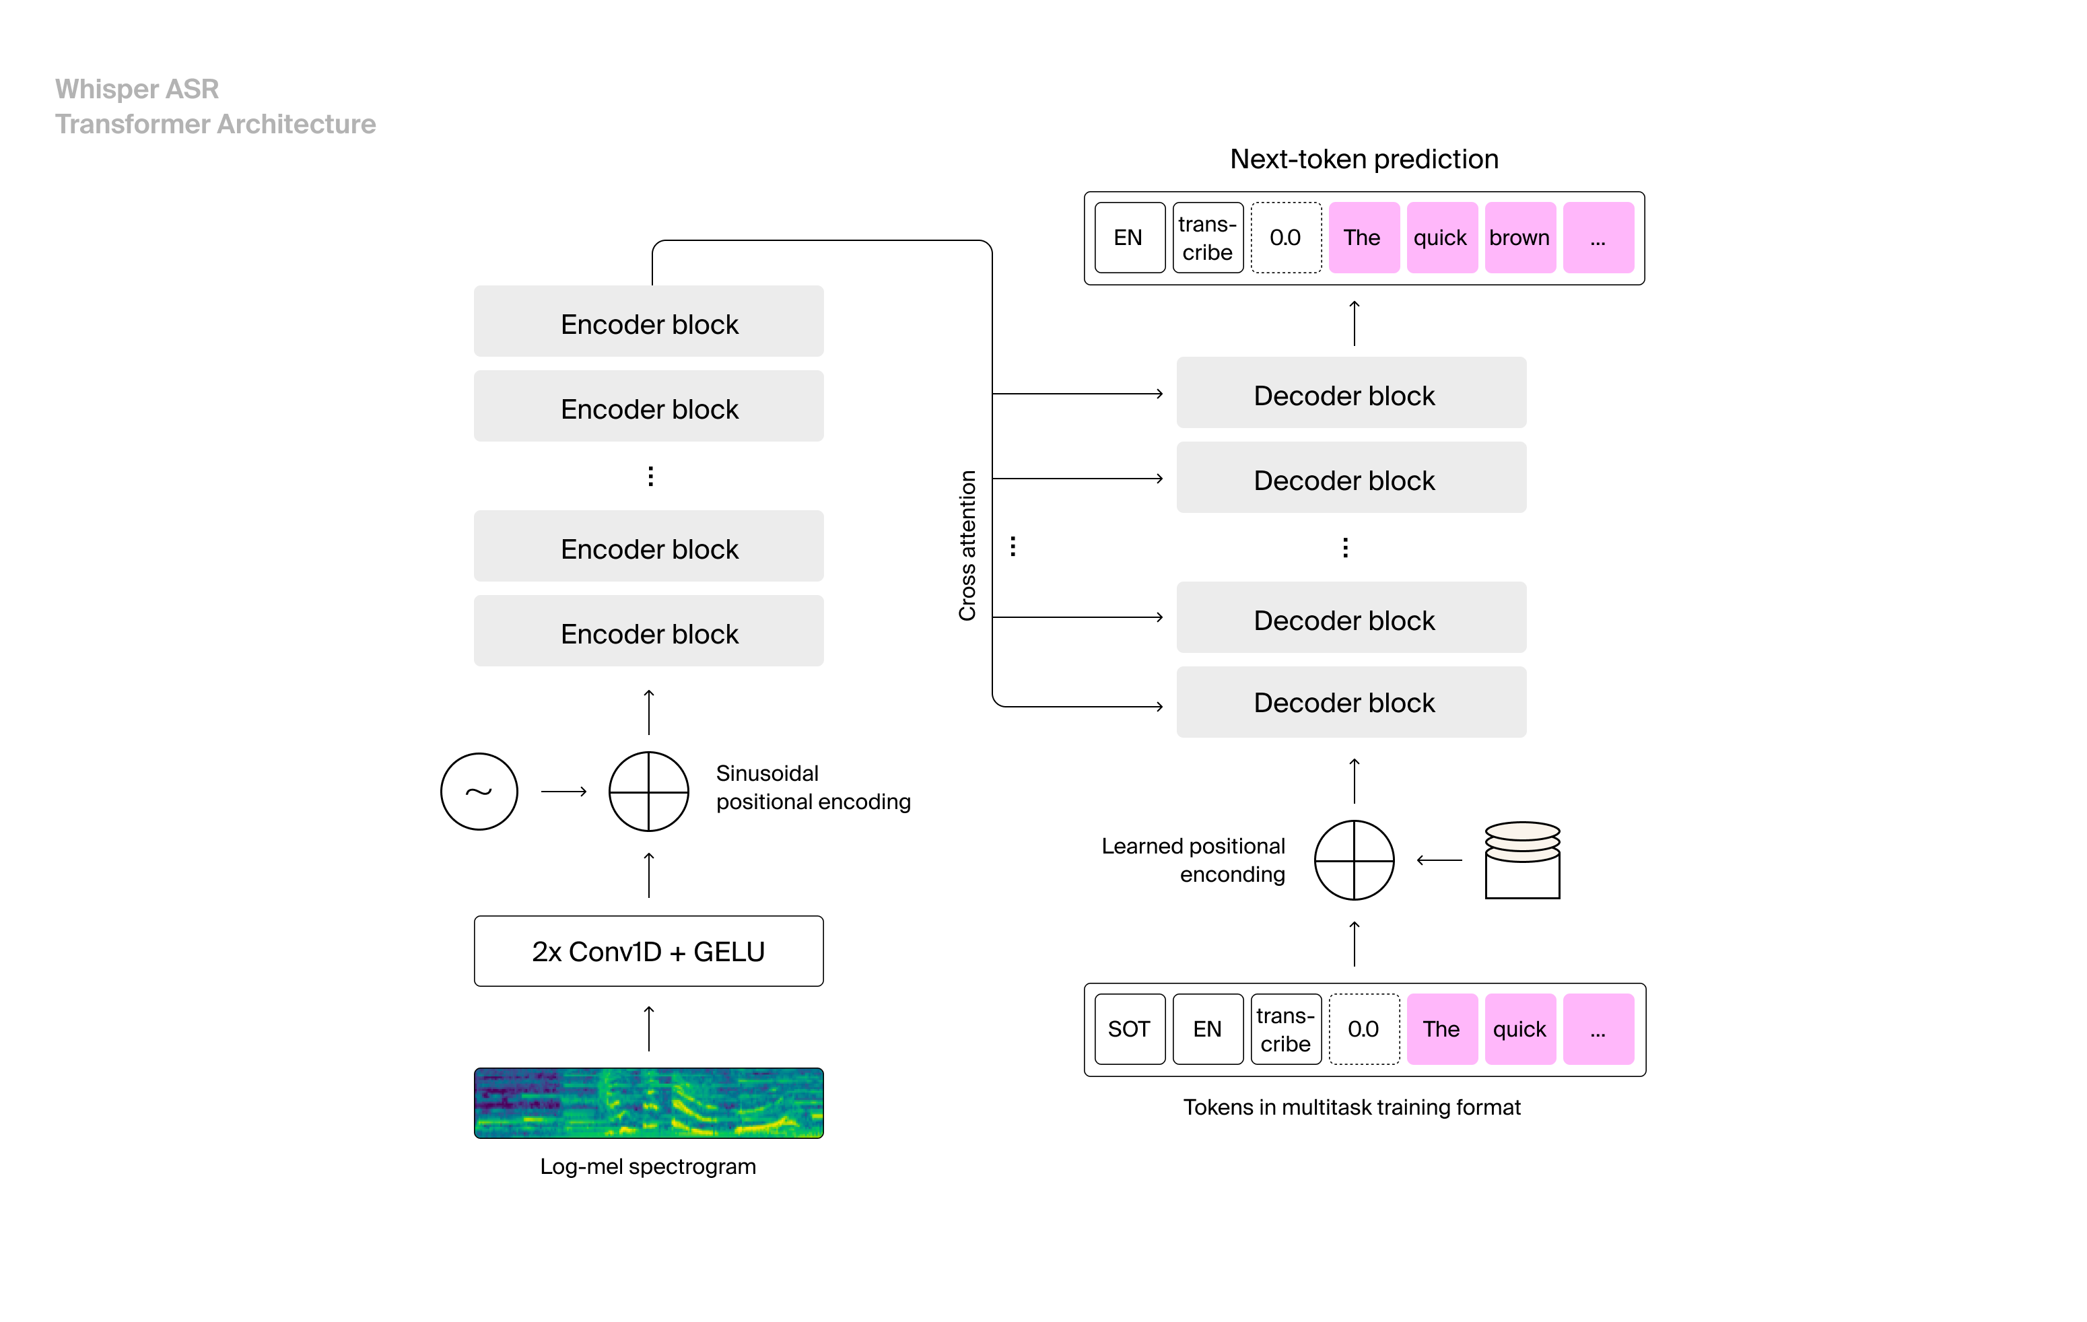
Fine tuning
The Whisper Model

Slide 4
Fine Tuning WHISPER On New Languages (ODIA)

Slide 5
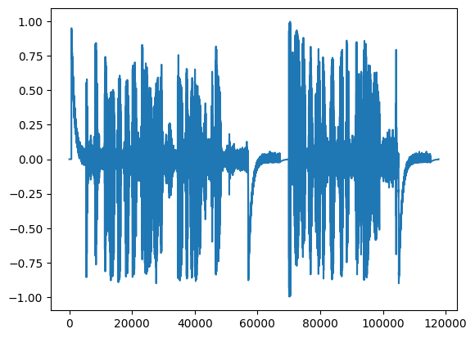
WHISPER
Transcription: Hi How are you?
Not great for low resource languages
"en": "english", "zh": "chinese", "de": "german", "es": "spanish", "ru": "russian", "ko": "korean", "fr": "french", "ja": "japanese", "pt": "portuguese", "tr": "turkish", "pl": "polish", "ca": "catalan", "nl": "dutch", "ar": "arabic", "sv": "swedish", "it": "italian", "id": "indonesian", "hi": "hindi", "fi": "finnish", "vi": "vietnamese", "he": "hebrew", "uk": "ukrainian", "el": "greek", "ms": "malay", "cs": "czech", "ro": "romanian", "da": "danish", "hu": "hungarian", "ta": "tamil", "no": "norwegian", "th": "thai", "ur": "urdu", "hr": "croatian", "bg": "bulgarian", "lt": "lithuanian", "la": "latin", "mi": "maori", "ml": "malayalam", "cy": "welsh", "sk": "slovak", "te": "telugu", "fa": "persian", "lv": "latvian", "bn": "bengali", "sr": "serbian", "az": "azerbaijani", "sl": "slovenian", "kn": "kannada", "et": "estonian", "mk": "macedonian", "br": "breton", "eu": "basque", "is": "icelandic", "hy": "armenian", "ne": "nepali", "mn": "mongolian", "bs": "bosnian", "kk": "kazakh", "sq": "albanian", "sw": "swahili", "gl": "galician", "mr": "marathi", "pa": "punjabi", "si": "sinhala", "km": "khmer", "sn": "shona", "yo": "yoruba", "so": "somali", "af": "afrikaans", "oc": "occitan", "ka": "georgian", "be": "belarusian", "tg": "tajik", "sd": "sindhi", "gu": "gujarati", "am": "amharic", "yi": "yiddish", "lo": "lao", "uz": "uzbek", "fo": "faroese", "ht": "haitian creole", "ps": "pashto", "tk": "turkmen", "nn": "nynorsk", "mt": "maltese", "sa": "sanskrit", "lb": "luxembourgish", "my": "myanmar", "bo": "tibetan", "tl": "tagalog", "mg": "malagasy", "as": "assamese", "tt": "tatar", "haw": "hawaiian", "ln": "lingala", "ha": "hausa", "ba": "bashkir", "jw": "javanese", "su": "sundanese", "yue": "cantonese",

Slide 6
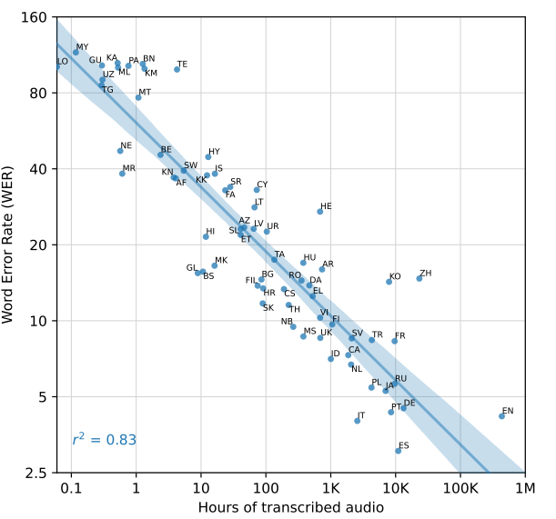

Slide 7
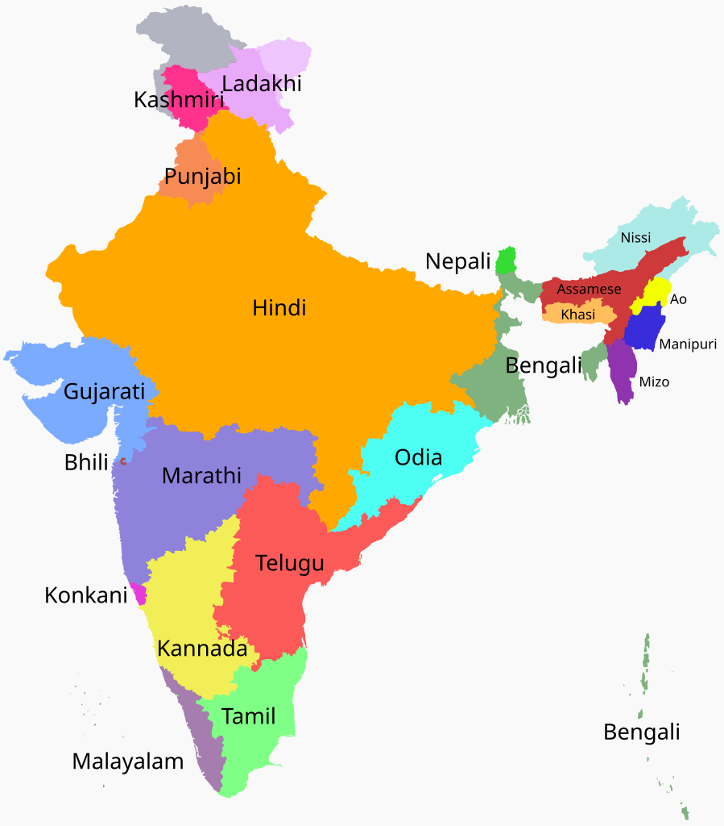
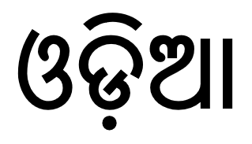
ODIA Language

Slide 8

What about for Other languages
Answer: Fine tuning of Whisper for a specific language
1- Check if the tokenizer supports the language
2- Find an ASR Dataset for the language

Slide 9
Testing tokenizer compatibility
Import
Import the tokenizer
Encode
Encode the text into tokens
Decode
Decode the tokens back to text

Slide 10
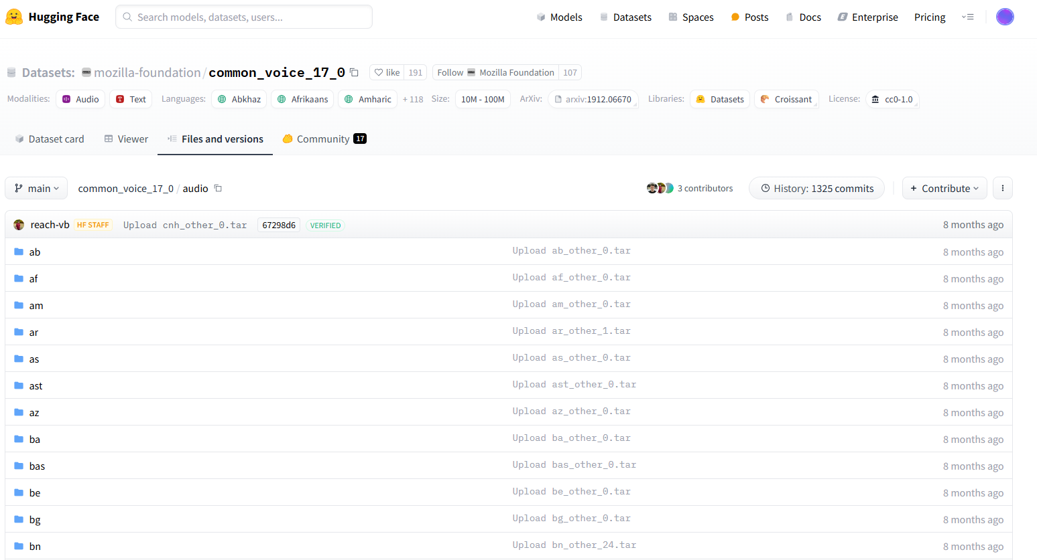
Odia ASR Dataset
Dataset for ASR (Multi-Lingual)

Slide 11
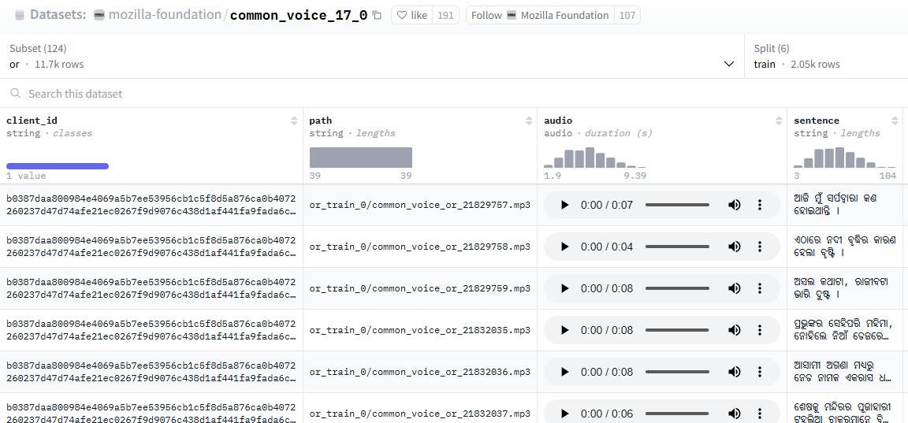
Odia ASR Dataset
Dataset for ASR (ODIA)

Slide 12
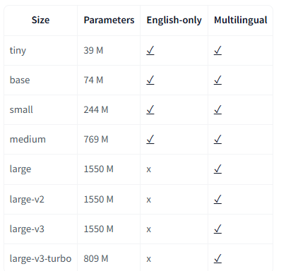

Whisper Model

Slide 13


Slide 14
Sampling rate=16000
Mel-spectrogram

Slide 15
Oscar Kilo Papa Mike Bravo descend flight level one hundred level one hundred Oscar Kilo Papa Mike Bravo
<|startoftranscript|><|en|><|transcribe|><|notimestamps|>Oscar Kilo Papa Mike Bravo descend flight level one hundred level one hundred Oscar Kilo Papa Mike Bravo <|endoftext|>
50258, 50259, 50359, 50363, 46, 4417, 289, 591, 10720, 21102, 6602, 28861, 16333, 7018, 1496, 472, 3262, 1496, 472, 3262, 20718, 591, 10720, 21102, 6602, 28861, 220, 50257

Slide 16

50258, 50259, 50359, 50363, 46,
4417, 289,
591, 10720, 21102, 6602, 28861, 16333, 7018, 1496, 472, 3262, 1496, 472, 3262, 20718, 591, 10720, 21102, 6602, 28861, 220, 50257
Input
WHISPER
Output

Slide 17
The size of the output is not fixed
50258, 50259, 50359, 50363, 46, 4417, 289, 591, 10720, 21102, 6602, 28861, 16333, 7018, 1496, 472, 3262, 1496, 472, 3262, 20718, 591, 10720, 21102, 6602, 28861, 220, 50257
So, we fix the length to 448 and pad the rest with -100
tensor([[50258, 50259, 50359, 50363, 46, 4417, 289, 591, 10720, 21102, 6602, 28861, 16333, 7018, 1496, 472, 3262, 1496, 472, 3262, 20718, 591, 10720, 21102, 6602, 28861, 220, 50257, -100, -100, -100, -100, -100, -100, -100, -100, -100, -100, -100, -100, -100, -100, -100, -100, -100, -100, -100, -100, -100, -100, -100, -100, -100, -100, -100, -100, -100, -100, -100, -100, -100, -100, -100, -100, -100, -100, -100, -100, -100, -100, -100, -100, -100, -100, -100, -100, -100, -100, -100, -100, -100, -100, -100, -100, -100, -100, -100, -100, -100, -100, -100, -100, -100, -100, -100, -100, -100, -100, -100, -100, -100, -100, -100, -100, -100, -100, -100, -100, -100, -100, -100, -100, -100, -100, -100, -100, -100, -100, -100, -100, -100, -100, -100, -100, -100, -100, -100, -100, -100, -100, -100, -100, -100, -100, -100, -100, -100, -100, -100, -100, -100, -100, -100, -100, -100, -100, -100, -100, -100, -100, -100, -100, -100, -100, -100, -100, -100, -100, -100, -100, -100, -100, -100, -100, -100, -100, -100, -100, -100, -100, -100, -100, -100, -100, -100, -100, -100, -100, -100, -100, -100, -100, -100, -100, -100, -100, -100, -100, -100, -100, -100, -100, -100, -100, -100, -100, -100, -100, -100, -100, -100, -100, -100, -100, -100, -100, -100, -100, -100, -100, -100, -100, -100, -100, -100, -100, -100, -100, -100, -100, -100, -100, -100, -100, -100, -100, -100, -100, -100, -100, -100, -100, -100, -100, -100, -100, -100, -100, -100, -100, -100, -100, -100, -100, -100, -100, -100, -100, -100, -100,
...
-100, -100, -100, -100, -100, -100, -100, -100, -100, -100, -100, -100, -100, -100, -100, -100, -100, -100, -100, -100, -100, -100, -100, -100, -100, -100, -100, -100, -100, -100, -100, -100, -100, -100, -100, -100, -100, -100, -100, -100, -100, -100, -100, -100, -100, -100, -100, -100]])

Slide 18
TRAINING
CE Loss
Output
Target
50283, 50358, 50359, 50363, 20718, 4417, 289, 11, 10720, 11, 6602, 28861, 11, 281, 1496, 2319, 3262, 50257, 472, 3262, 422, 591, 10720, 21102, 6602, 28861, 50257
50258, 50259, 50359, 50363, 46,
4417, 289,
591, 10720, 21102, 6602, 28861, 16333, 7018, 1496, 472, 3262, 1496, 472, 3262, 20718, 591, 10720, 21102, 6602, 28861, 220, 50257
Input
WHISPER

Slide 19
Evaluation of ASR Model: Word Error Rate

Slide 20


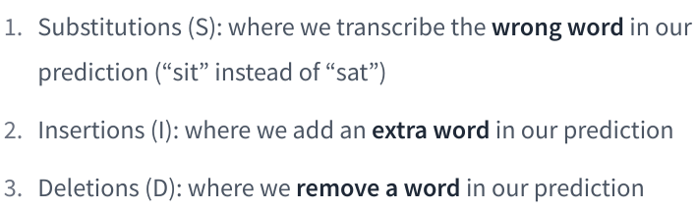
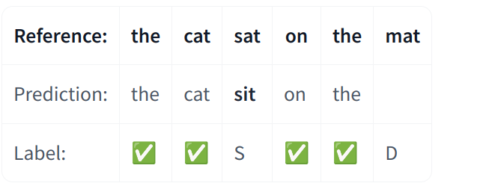
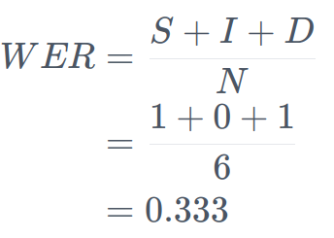
Word Error Rate (WER)
Source: https://huggingface.co/learn/audio-course/en/chapter5/evaluation

Slide 21
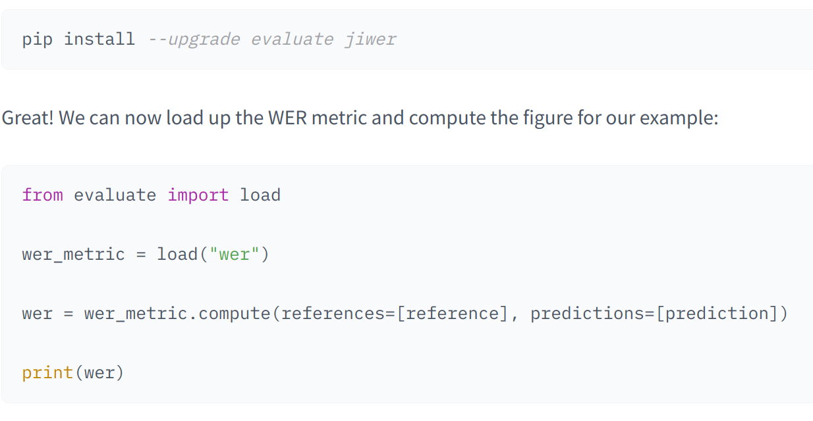
Word Error Rate (WER)

Slide 22
Fine Tuning

Slide 23
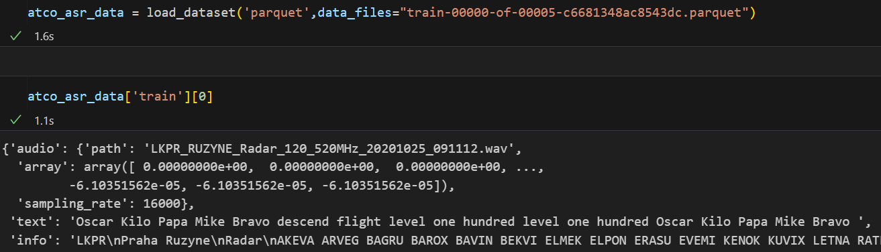
Dataset Creation

Slide 24
Dataset Creation
Input
Output
50258, 50259, 50359, 50363, 46,
4417, 289,
591, 10720, 21102, 6602, 28861, 16333, 7018, 1496, 472, 3262, 1496, 472, 3262, 20718, 591, 10720, 21102, 6602, 28861, 220, 50257
Dataset
Query index ---->
for that index ---->

Slide 25
Dataset Creation
Input
Output
Dataset
80, 3000
80, 3000
80, 3000
.
.
.
.
80, 3000
25
18
73
.
.
.
.
49
Query index ---->
for that index ---->

Slide 26
Dataset Creation
Input
Output
Dataset
80, 3000
80, 3000
80, 3000
.
.
.
.
80, 3000
25
18
73
.
.
.
.
49
60
60
60
.
.
.
.
60
Query index ---->
for that index ---->

