Slide 1

Data Mining
Techniques, Applications, and Challenges
Mohanraj

Slide 2

Introduction to Data Mining
- Data mining is the process of discovering patterns and knowledge from large amounts of data.
- Involves techniques from statistics, machine learning, and database systems.
- Used to transform raw data into useful information.

Slide 3

Importance of Data Mining
- Helps in decision-making.
- Identifies patterns and trends.
- Enhances business intelligence.
- Used in various fields like healthcare, finance, and marketing.

Slide 4
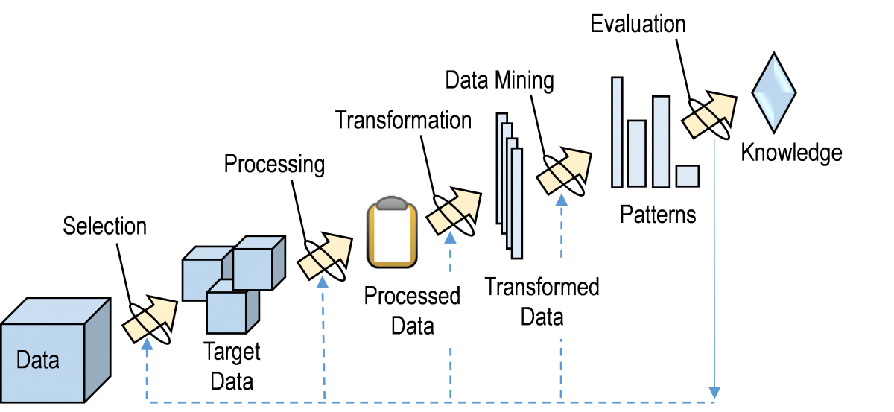
Data Mining Process

Slide 5
Data mining process
1. Data Collection
2. Data Cleaning
3. Data Integration
4. Data Transformation
5. Data Mining
6. Pattern Evaluation
7. Knowledge Representation

Slide 6
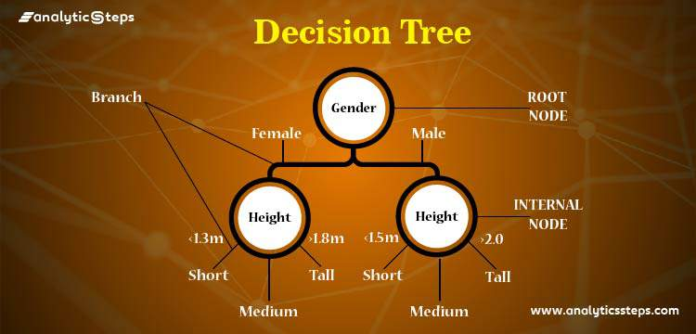
Techniques of Data Mining
- Classification (e.g., Decision Trees, Naïve Bayes)
- Clustering (e.g., K-Means, DBSCAN)
- Association Rule Mining (e.g., Apriori, FP-Growth)
- Regression Analysis
- Anomaly Detection

Slide 7
Applications of Data Mining
- Healthcare: Disease prediction, patient management.
- Finance: Fraud detection, credit risk analysis.
- Retail: Customer behavior analysis, recommendation systems.
- Social Media: Sentiment analysis, trend prediction.
- Cybersecurity: Intrusion detection, threat analysis.

Slide 8
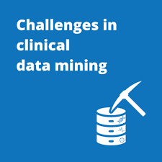
Challenges in Data Mining
- Data quality issues (incomplete or noisy data).
- Scalability with large datasets.
- Ethical concerns (privacy and security).
- Computational complexity.

Slide 9
Future Trends in Data Mining
- Integration with Artificial Intelligence and Deep Learning.
- Automated data mining with AI-powered tools.
- Privacy-preserving data mining.
- Real-time and stream data mining.

Slide 10
Data Mining vs. Machine Learning
- Data Mining: Focuses on discovering hidden patterns from data.
- Machine Learning: Focuses on building models that learn from data.
- Data Mining often uses Machine Learning techniques.
- ML is used for predictive analytics, while Data Mining is more about insights.

Slide 11
Tools for Data Mining
- WEKA: Open-source machine learning software.
- RapidMiner: Data science platform.
- KNIME: Data analytics platform.
- Python (Pandas, Scikit-learn, TensorFlow, etc.).
- R Programming: Statistical computing and graphics.

Slide 12
Data Mining in Business Intelligence
- Helps in customer segmentation.
- Forecasting sales and demand.
- Detecting fraud in transactions.
- Improving customer relationships through recommendation systems.
- Enhancing supply chain management.

Slide 13
Ethical and Privacy Concerns in Data Mining
- User data privacy and consent.
- Risk of biased decision-making.
- Data security and protection laws (GDPR, CCPA).
- Misuse of personal data by corporations.
- Need for transparency and accountability.

Slide 14
Real-World Examples of Data Mining
- Google: Search engine optimizations and ad targeting.
- Amazon: Personalized recommendations.
- Netflix: Movie and show recommendations.
- Banks: Credit scoring and fraud detection.
- Healthcare: Predicting disease outbreaks and patient diagnosis.

Slide 15
Types of Data Used in Data Mining
- Structured Data: Databases, spreadsheets.
- Semi-Structured Data: XML, JSON files.
- Unstructured Data: Text, images, videos.
- Big Data: Large-scale datasets from IoT, social media, and sensors.

Slide 16
Role of AI in Data Mining
- AI enhances data mining through deep learning.
- Automated pattern recognition.
- AI-powered predictive analytics.
- Improves accuracy and efficiency of data mining processes.

Slide 17
Data Preprocessing in Data Mining
- Data Cleaning: Handling missing and noisy data.
- Data Integration: Combining data from multiple sources.
- Data Transformation: Normalization, feature scaling.
- Data Reduction: Dimensionality reduction techniques like PCA.

Slide 18
Industry Adoption of Data Mining
- Banking & Finance: Risk assessment, fraud detection.
- Retail & E-commerce: Customer behavior analysis.
- Healthcare: Disease prediction, patient care optimization.
- Manufacturing: Predictive maintenance and quality control.

Slide 19


