Slide 1
Unit I - Introduction to Python
SESSION 1

Slide 2
History
Developed in 1980
Guido van Rossum
ABC programming language, UNIX glob()
Proposal to DARPA
  Easy, English-like,open source, simple

Slide 3
Python
Very high level
Stable
Mature
Dynamic
Object Oriented
Cross Platform

Slide 4
Why Python?
Software Quality
Developer productivity
Program Portability
Support Libraries
Component Integration

Slide 5
What can I do with Python?
Systems Programming
GUI
Internet Scripting
Database Programming
Numeric & Scientific Programming
Gaming, Images, Serial Ports,XML and more

Slide 6
General Advantages over other languages
Dynamic Typing
Heterogeneous Data Structures
Automatic Memory Management
Mixed Mode Programming
Third Party Utilities

Slide 7
Who uses Python?
YouTube
BitTorrent
Intel, CISCO, QuadComm
Industrial Light & Magic, Pixar
JPMorgan Chase, UBS, Getco, and Citadel
NASA, Los Alamos, Fermilab, JPL
iRobot

Slide 8
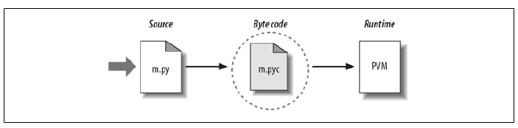
Interpreter
Script vs Module
Interpreter calls Compiler – Modules
.pyc
.pyw and pythonw

Slide 9
Interpreter
Byte Code Translation(.pyc)
PVM
  Iterates through byte code
  Executes instruction one by one
  No build or make steps
  Byte code is not machine code
  Python representation

Slide 10
Interpreter
python sample.py
PATH directory
Other environment variables
  PYTHONHOME
  PYTHONPATH
  PYTHONSTARTUP
Options
  -i,-E,-c,-t,-tt….

Slide 11
Variations
Cpython
IronPython
Jython
StacklessPython

Slide 12
1. Lexical Structure
Lines and Indentation
  Logical Lines
  Physical Lines
  Blank Lines
  Continuation Lines
  Comments
  No Delimiters
  Indentation

Slide 13
Lexical Structure
Character Set
  Coding Directive Comment
Tokens
  Identifiers, Keywords, Operators, Delimiters and Literals
Statements

Slide 14
Tokens
Identifiers
  Name given for variable, class, function, modules
  Starts with letter or underscore(_)
  Case Sensitive
  Conventions
    Class Names -Capitals
    Single Leading Underscore - private
    Double Leading Underscore – strongly private
    Starts and ends with double underscore - predefined

Slide 15
Tokens
Keywords
Operators
Delimiters
Literals

Slide 16
Lexical Structure
Statements
  Simple
    Expression
    Assignment
  Compound
    Header + colon + block

Slide 17
Unit I - Introduction to Python
SESSION 2
Data Types, Assignments and Expressions, Control Flow
Statements

Slide 18
2. DataTypes
Numbers – Integer, Floating Point, Complex
Sequences – List, Tuples, Strings
Sets
Dictionaries
None
Callables
Boolean Values
type(obj), isinstance(obj,type)

Slide 19
3. Variables
No declarations
Existence begins when you bind object to name
Unbind/Rebind
Garbage Collection
Global/Local

Slide 20
Object Attributes & Items
Attribute – obj.attribute
Item – obj[index/key]
Callable attributes – methods
No strong distinction callable vs non-callable

Slide 21
Assignment
Plain
  name = value
  x.attr = value
  x[k]=value
  str[0:5]=value
  a=b=c=0
  a,b,c = “chr”
  a,b = b,a

Slide 22
Assignment
Augmented
  Binary operator followed by =
  +=,-=,*=,/=,//=,%= ……..
  Only one target
  Never creates target
  __iadd__ → Modifies object
  Else creates new object and rebinds

Slide 23
del
Unbinds references
Does not delete objects
  del a,b,c

Slide 24
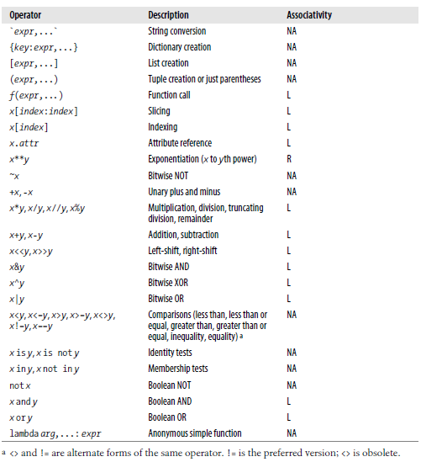
Expressions and Operators

Slide 25
Expressions and Operators
Comparison Chaining
  a < b <= c <d
  Is same as “a < b and b <= c and c <= d”
Short Circuiting Operators
  and / or
Ternary Operator
  a if test else b

Slide 26
Control Flow
Things that are False
The boolean value False
The numbers 0 (integer), 0.0 (float) and 0j (complex).
The empty string "".
The empty list [], empty dictionary {} and empty set set().
Things that are True
The boolean value True
All non-zero numbers.
Any string containing at least one character.
A non-empty data structure.

Slide 27
If
>>> smiles = "BrC1=CC=C(C=C1)NN.Cl"
>>> bool(smiles)
True
>>> not bool(smiles)
False
>>> if not smiles:
... print "The SMILES string is empty"
...
The “else” case is always optional

Slide 28
Use “elif” to chain subsequent tests
>>> mode = "absolute"
>>> if mode == "canonical":
... smiles = "canonical"
... elif mode == "isomeric":
... smiles = "isomeric”
... elif mode == "absolute":
... smiles = "absolute"
... else:
... raise TypeError("unknown mode")
...
>>> smiles
' absolute '
>>>
“raise” is the Python way to raise exceptions

Slide 29
Boolean logic
Python expressions can have “and”s and “or”s:
if (ben <= 5 and chen >= 10 or
chen == 500 and ben != 5):
print “Ben and Chen“

Slide 30
Range Test
if (3 <= Time <= 5):
print “Office Hour"

Slide 31
For
>>> names = [“Ben", “Chen", “Yaqin"]
>>> for name in names:
... print smiles
...
Ben
Chen
Yaqin

Slide 32
Tuple assignment in for loops
data = [ ("C20H20O3", 308.371),
("C22H20O2", 316.393),
("C24H40N4O2", 416.6),
("C14H25N5O3", 311.38),
("C15H20O2", 232.3181)]
for (formula, mw) in data:
print "The molecular weight of %s is %s" % (formula, mw)
The molecular weight of C20H20O3 is 308.371
The molecular weight of C22H20O2 is 316.393
The molecular weight of C24H40N4O2 is 416.6
The molecular weight of C14H25N5O3 is 311.38
The molecular weight of C15H20O2 is 232.3181

Slide 33
Break, continue
Checking 3
The square is 9
Checking 1
Ignoring
Checking 4
The square is 16
Checking 1
Ignoring
Checking 5
The square is 25
Checking 9
Exiting for loop
>>>
>>> for value in [3, 1, 4, 1, 5, 9, 2]:
... print "Checking", value
... if value > 8:
... print "Exiting for loop"
... break
... elif value < 3:
... print "Ignoring"
... continue
... print "The square is", value**2
...
Use “break” to stop
the for loop
Use “continue” to stop
processing the current item

Slide 34
Range()
“range” creates a list of numbers in a specified range
range([start,] stop[, step]) -> list of integers
When step is given, it specifies the increment (or decrement).
>>> range(5)
[0, 1, 2, 3, 4]
>>> range(5, 10)
[5, 6, 7, 8, 9]
>>> range(0, 10, 2)
[0, 2, 4, 6, 8]
How to get every second element in a list?
for i in range(0, len(data), 2):
print data[i]

Slide 35
Quick Way
>>> lst= [ x for x in open("text.txt","r").readlines() ]
>>> lst
['Chen Lin\n', 'clin@brandeis.edu\n', 'Volen 110\n', 'Office Hour: Thurs. 3-5\n', '\n', 'Yaqin Yang\n', 'yaqin@brandeis.edu\n', 'Volen 110\n', 'Offiche Hour: Tues. 3-5\n']
Ignore the header?
for (i,line) in enumerate(open(‘text.txt’,"r").readlines()):
if i == 0: continue
print line

Slide 36
Using dictionaries to count occurrences
>>> for line in open('names.txt'):
... name = line.strip()
... name_count[name] = name_count.get(name,0)+ 1
...
>>> for (name, count) in name_count.items():
... print name, count
...
Chen 3
Ben 3
Yaqin 3

Slide 37
Unit I - Introduction to Python
SESSION 3
Sequences and Dictionaries

Slide 38
Sequences
Containers
  With items of different data types
  Accessible via slicing or indexing
Sequences in Python
  Immutable
    Tuples
    Strings
  Mutable
    Lists

Slide 39
Sequences
Tuples
  t = (5,6.8,9+4j,”Hello”)
Lists
  l = [4,7,”Nice”,800000]
Strings
  s = “This is Python Class”

Slide 40
Sequences in general
len
min
max
sum
Sequence Conversions
  list(), tuple()
Concatenation & Repetition
  +, *
Membership Testing
  in, not in

Slide 41
Sequences in general
Indexing
  Positive and Negative Index
  Let L be the length of the list l
  Positive
    0,1,2……. L-1 (No larger)
  Negative
    -1,-2,-3….-L (No smaller)
    l[-n] indicates same item as l[L-n] denotes
  Index not be >=L or <-L

Slide 42
Sequences in general
Slicing
  S[i:j] , starting from ith item, included to the jth item, excluded.
  All arguments are optional
  Empty slice
    j<=i
    i>=L
  Extended Syntax
    S[i:j:k]
    S[::2] or S[::-1]

Slide 43
Strings
find | lower
replace | upper
lstrip | capitalize
rstrip | isalpha
lfind | isnum
rfind | isalnum
split | index

Slide 44
Lists
Slices in assignment
  Empty list as RHS, Slice or List as LHS
  Empty slice of L as LHS, Another list as RHS
  Entire list slice as LHS, Another list as RHS
del
  del x[1]
Augmented assignments
  L*=n
  If n<0?

Slide 45
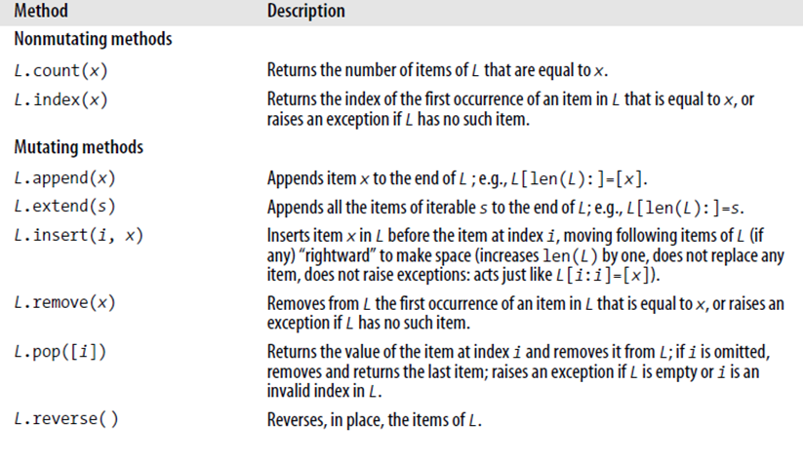
List Methods

Slide 46
Dictionaries
Key-value pairs
Unordered and hence not a sequence
Key – Immutable
Values – Mutable/Immutable
len() is applicable
Iterable

Slide 47
Dictionaries
dic = {1:”One”,”Two”:”II”,3.0:”Three”}
Accessing element
  dic[1] → “One”
  dic[“Two”] → “II”
  dic.get(“Three”,”No such key”)
Adding element
  dic[key] = value
  dic[“Four”] = 4

Slide 48
Dictionaries
Traversal
Get keys (arbitary order)
  for k in dic.keys():
  print(k)
Get values(arbitary order)
  for k in dic.values():
  print(k)
Get items/key-value pairs(arbitary order)
  for k,vin dic.items():
  print(“Key”,k)
  print(“Value”,v)

Slide 49
Dictionaries
Other methods
  dic.clear()
  dic.update(another_dic)
  dic.setdefault(k,x)
  dic.pop(k[,x])
  dic.popitem()

Slide 50

List Comprehensions
Concise and direct way of traversing a list
lc-clauses

Slide 51
Other Statements
break
continue
else clause for loops
pass

Slide 52
Functions
Group of statements that execute on request
  Built-in
  User-defined
Function call - Request to execute
Arguments – Data upon which the functions operate
Return – Always returns value. If return is not specified ,”None” is returned

Slide 53
Functions
Functions are objects
  Passed as argument to another function
  Passed as return value
  Could be bound to a variable
  Item in a container

Slide 54
Functions
Define a function
  def fn_name(parameters):
  statement(s)
fn_name – variable that gets bound to fn obj when def executes
Parameters – variables that get bound to values passed during fn call

Slide 55
Functions
Fn Body – executes only when fn is called
Parameters
  Mandatory/Positional
  Optional (identifier = expression)
    Default values is assigned when def executes
    Same object gets bound, when no value provided
  *Identifier or **identifier
Order
  Positional
  Keyword
  *seq
  **dict

Slide 56
Attributes of function object
def statement sets attributes
__name__
__defaults__
__doc__

Slide 57
Calling Functions
Immutable Objects
  Pass by value
Mutable Objects
  Pass by reference
*seq, **dict
  Can also be passed when the corresponding form is not defined in parameters
  But must match the numbers

Slide 58
Namespaces
Local
Global
Nested Functions
  Inner function
    Can access (not rebind) outer function’s variables (free variables)
    Closure

Slide 59
Lambda expressions
If function body is a single return expression
lambda paramters: expression
lambda is an expression, not a statement
lambda’s body is a single expression, not a block of statements

