Slide 1
Introduction To Files

Slide 2
To read information from a File
Open the file and associate the file with a file variable.
A command to read the information.
A command to close the file.

Slide 3
Opening Files
Prepares the file for reading:
Links the file variable with the physical file (references to the file variable are references to the physical file).
Positions the file pointer at the start of the file.
Format:¹
<file variable> = open(<file name>, "r")
Example:
(Constant file name)
inputFile = open("data.txt", "r")
OR
(Variable file name: entered by user at runtime)
filename = input("Enter name of input file: ")
inputFile = open(filename, "r")

Slide 4
Reading Information From Files
Typically reading is done within the body of a loop
Each execution of the loop will read a line from the file into a string
Format:
for <variable to store a string> in <name of file variable>:
<Do something with the string read from file>
Example:
for line in inputFile:
print(line) # Echo file contents back onscreen

Slide 5
Closing The File
Although a file is automatically closed when your program ends it is still a good style to explicitly close your file as soon as the program is done with it.
What if the program encounters a runtime error and crashes before it reaches the end? The input file may remain ‘locked’ an inaccessible state because it’s still open.
Format:
<name of file variable>.close()
Example:
inputFile.close()

Slide 6
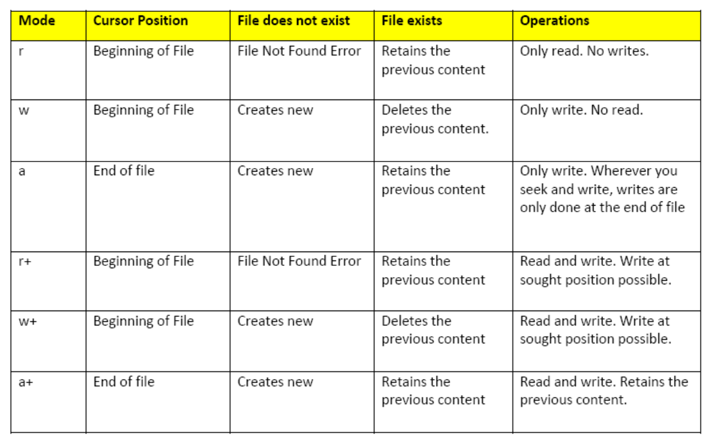
Modes of opening a file

Slide 7
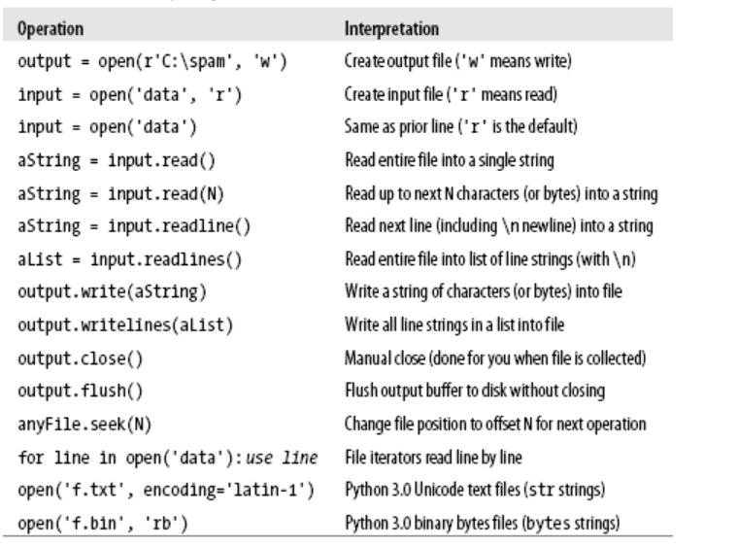
Common File Operations

Slide 8
Sample Reference Programs

Slide 9
Example Program: data_processing.py
inputFile = open ("employees.txt", "r")
print ("Reading from file input.txt")
for line in inputFile:
name,job,income = line.split(',')
last,first = name.split()
income = int(income)
income = income + (income * BONUS)
print("Name: %s, %s\t\t\tJob: %s\t\tIncome $%.2f"
%(first,last,job,income))
print ("Completed reading of file input.txt")
inputFile.close()
# EMPLOYEES.TXT
Adama Lee,CAG,30000
Morris Heather,Heroine,0
Lee Bruce,JKD master,100000

Slide 10
Exceptions: File Example
Name of the online example: file_exception.py
Input file name: Most of the previous input files can be used e.g. “input1.txt”
inputFileOK = False
while (inputFileOK == False):
try:
inputFileName = input("Enter name of input file: ")
inputFile = open(inputFileName, "r")
except IOError:
print("File", inputFileName, "could not be opened")
else:
print("Opening file", inputFileName, " for reading.")
inputFileOK = True
for line in inputFile:
sys.stdout.write(line)
print ("Completed reading of file", inputFileName)
inputFile.close()
print ("Closed file", inputFileName)

Slide 11
# Still inside the body of the while loop (continued)
finally:
if (inputFileOK == True):
print ("Successfully read information from file",
inputFileName)
else:
print ("Unsuccessfully attempted to read information
from file", inputFileName)

Slide 12


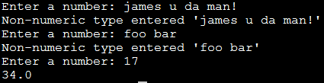
Exception Handling: Keyboard Input
Name of the online example: exception_validation.py
inputOK = False
while (inputOK == False):
try:
num = input("Enter a number: ")
num = float(num)
except ValueError: # Can’t convert to a number
print("Non-numeric type entered '%s'" %num)
else: # All characters are part of a number
inputOK = True
num = num * 2
print(num)

