Slide 1
Data Visualization: Empowering Business with Effective Insights
Communicating insights and Analysis

Slide 2
Data cleaning and Preparation
The data was loaded into Power BI
where I performed cleaning steps including removal of cancelled orders
Handling missing customer IDs, correcting data types, and creating calculated fields for revenue and quantity.
I validated totals at each step to ensure accuracy before building visuals.

Slide 3
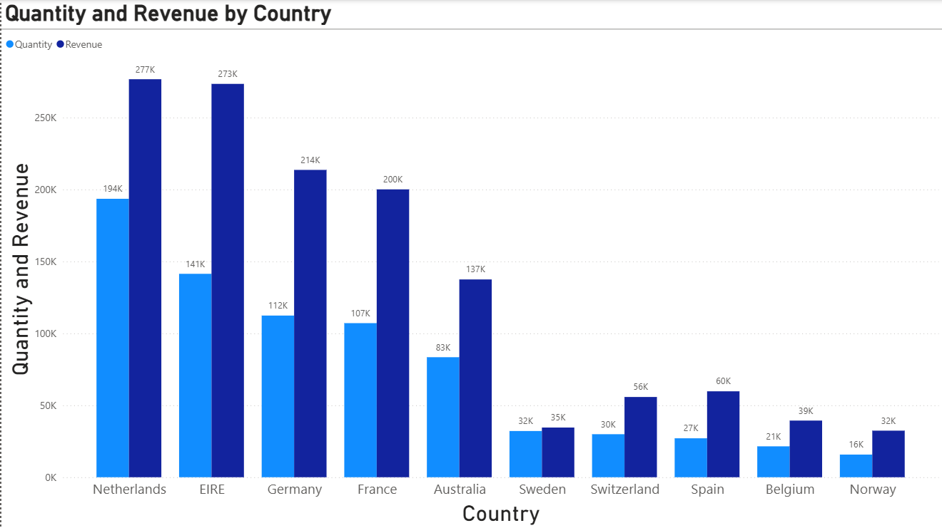
Which regions generate the highest and lowest revenue?
CEO takeaway:
Double down on top regions. Investigate whether low regions are fixable or simply not worth aggressive investment.

Slide 4
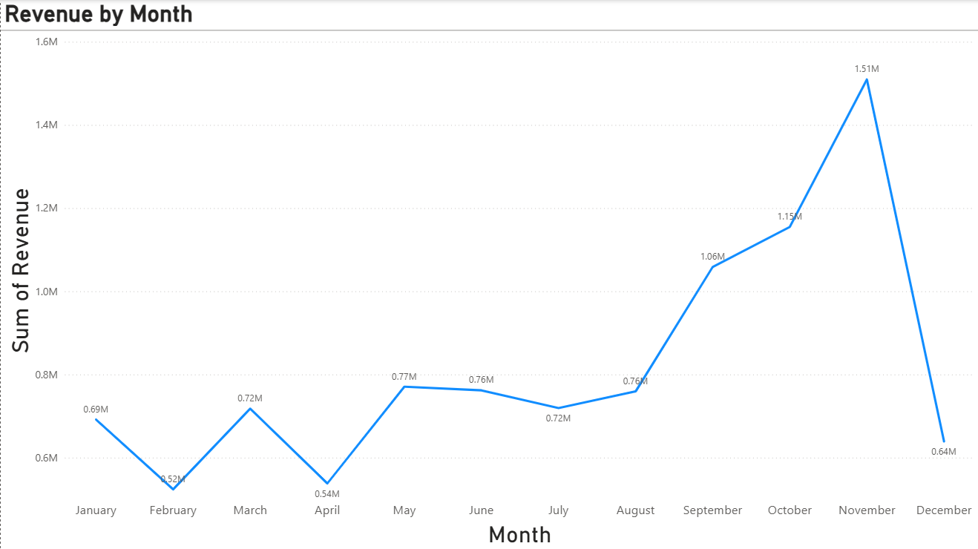
Monthly trend, biggest changes, and seasonality
CEO takeaway:
The business is seasonal. Planning inventory, staffing, and marketing around Sep–Nov is critical. December needs validation before any panic.

Slide 5
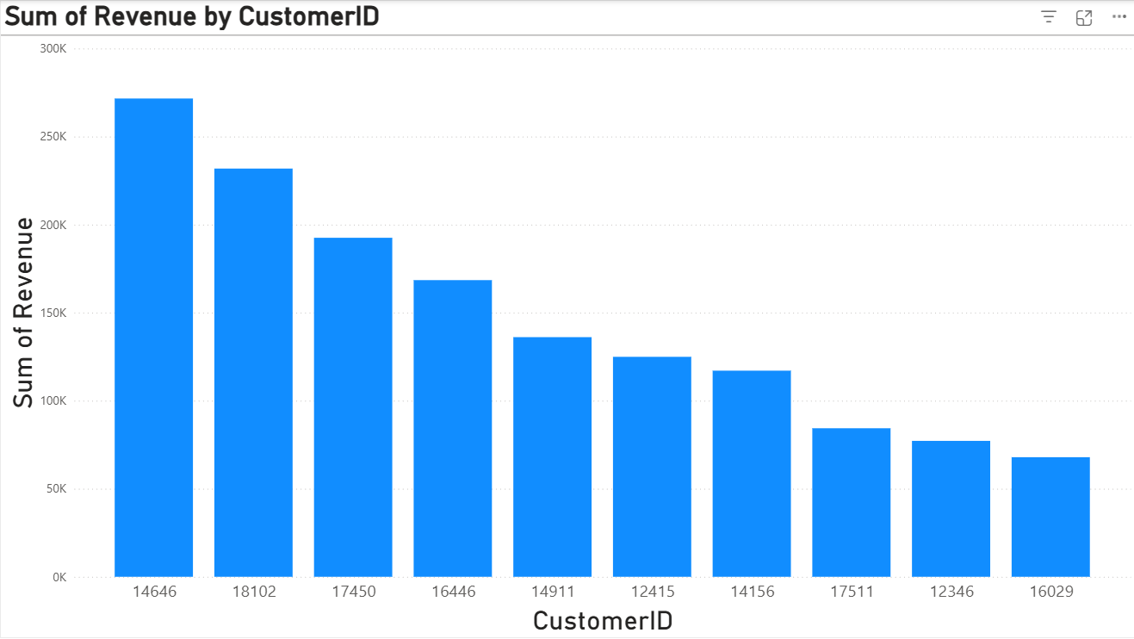
Top customers and revenue concentration
CEO takeaway:
Protect top customers, but don’t become hostage to them.

Slide 6
Repeat customers and ordering behavior
CMO takeaway: Retention exists. Marketing should amplify it, not chase only new customers.

Slide 7
Time between repeat orders
CMO takeaway: There’s enough repeat behavior to justify lifecycle marketing.

Slide 8
Revenue from repeat customers and top repeat buyers
CMO takeaway: Different campaigns for different buyer types. Discounts for volume buyers, exclusivity for high spenders.

Slide 9
To Summarize:
Revenue is regionally concentrated, with strong seasonality.
November is the most critical month for business performance.
A small group of customers drives a large portion of revenue.
Repeat purchasing behavior presents clear opportunities for targeted marketing.
These insights can be used to optimize inventory planning, regional strategy, and customer-focused marketing campaigns.

