Slide 1

Prepared By :- Ravindra Engle
28 November 2017
www.snipe.co.in
1
Notes:
1

Slide 2

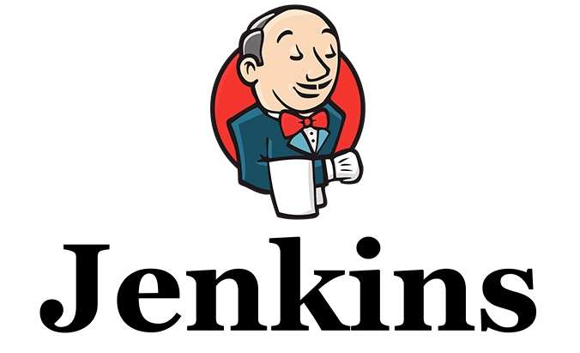
Jenkins – CI :-

Slide 3
What is Jenkins ?
It is a Continuous Integration Server.
It is an Open Source Tool.
It is written in Java.
It has over 1000+ Plug-ins which makes it widely accepted tool for CI.

Slide 4
How it Works ?
Notice a Change
Check out the Source Code
Execute the build tests
Record and Publish results
Notify Developers

Slide 5
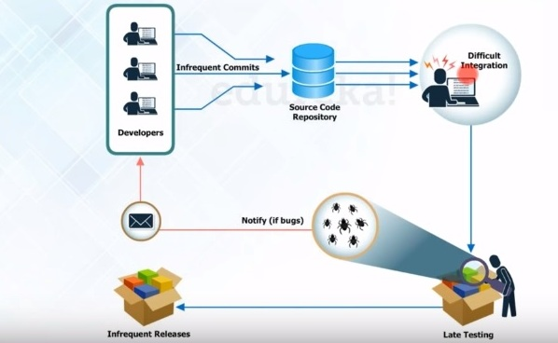
Process Before CI :-
Group of developers make changes to the Source code that is present in Source code repository.
( Source code repository may be Git, Subversion etc)

Slide 6
When the code is written in the repository it will be build by tools like Ant, Maven etc.
The build application is then sent for testing, if they find a bug they will notify the developer.
If there are no bugs it will be sent for production server for release.

Slide 7
Problems Before CI :-
Developers have to wait till the complete software is developed for the test result.
If it fails, locating and fixing bugs is very difficult.
Developer need to check the entire code of the software for bugs.

Slide 8
Software delivery process was slow.
Continuous feedback relating to coding, build failures and test status were not available.

Slide 9
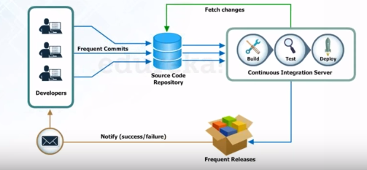
Process after CI :-
After every change to the source code an auto build is
triggered and is automatically deployed on the test server.

Slide 10
If the test result shows any bug in the code the developer have to check the last change made to the code.
This Increases the frequency of new software release.
The Concerned teams are notified with feedback.

Slide 11
Alternatives to Jenkins :-
Travis CI
Buildbot
Bamboo
JetBrains TeamCity
11

Slide 12
Jenkins Plugins :-
Build Tools
Test Frameworks
Ant
Maven
MSbuild
Cmake
Gradle
Junit
Nunit
MSTest
Selenium
Fitnesse

Slide 13
Thank You

