Slide 1
FrameNet
Universität des Saarlandes
Fachrichtung Computer Linguistik
wS 05
Seminar: „ Lexikalische Semantik“
Seminarleitung: Manfred Pinkal
Referenten: Irena Dotcheva

Slide 2
What is FrameNet?
- an on-line lexical resource for contemporary English - more than 8,900 lexical units - more than 625 semantic frames
- more than 135,000 annotated sentences - information about the semantic and syntactic combinatorial possibilities (valences) of each item analyzed
How does it work?

Slide 3
The Structure of the FrameNet Database
The Lexical Database
Frames and Frame Elements (Entity-Relationship-Diagramm of FrameNet)
Lemmas, Lexemes, Word Forms and Parts of Speech
Frames, Lemmas and Lexical Units
Frame-to-Frame and FE-to-FE Relations

Slide 4
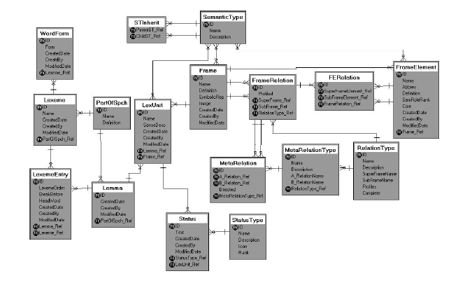

Slide 5
Word Form – one of the forms of the word differing by inflection
Lexeme – any of the inflectional versions of a word, represented by the uninflected stem: the singular of a noun, the unmarked infinitive of a verb, the plain form of an adjective, or the single form of an uniflected word
need – need, needs, needed, needing
tree, trees
Lemma – composed of one or more lexemes to handle multiword expressions
go broke

Slide 6
Lexeme Entry – MWE, such as verb+particle (take off), N-N compounds (family practitioner), and longer constructions (Martin Luther King Day)
Lexical Unit – an association between a lemma and a frame, corresponding roughly to dictionary senses. Each LU has a link to a single frame and a single lemma.

Slide 7
Frame-to-Frame and FE-to-FE Relations
Frame Inheritance
Full Inheritance – if f.B inherits from f.A, there must be a FE in B corresponding to each FE in A; the FE in B can have a different name from that in A but there must be a binding between them. Child frames can have additional FEs not found in their parents.
The Revenge frame inherits from Reward_and_punishments frame
Monotonic Inheritance – if a parent frame or FE has a semantic type, the semantic type of the child frame or FE must be the same as or a subtype of the semantic type of the parent.
Multiple Inheritance – a child frame (and its FEs) can have any number of parents.

Slide 8
Agent [Agt]
The Agent is the person doing the rewarding or punishing. Jake's REWARDS to his best workers were very generous.
Evaluee [Eval]
Evaluee is the person or thing about whom/which a judgment has made and to whom reward/punishment is dealt. With verbs, the Evaluee is typically expressed as Object. The boss REWARDED you for your diligence.
Reason [Reas]
Typically, there is a constituent expressing the Reason for theAgent's judgment. It is usually a 'for'-PP, e.g. I PUNISHED him for his impudence.
Response_action [Action]
The reward or punishment given to the Evaluee by the Agent. If a person be guilty of impiety let him be PUNISHED with death.
Avenger [Agt]
The Avenger exacts revenge from the Offender for the Injury.
Injured_Party [Injrd_prty]
This frame element identifies the constituent that encodes who or what suffered the Injury at the hands of the Offender. Sometimes, an abstract concept such a person's honour or their blood is presented as the element that has suffered the Injury. These also constitute instances of Injured_Party
Injury [Injry]
The Injury is the injurious action committed by the Offender against the Injured_Party. This Frame Element need not always be realized, although it is conceptually necessary.
Offender [Off]
The Offender has committed the earlier Injury for which the Avenger seeks revenge.
Punishment [Pun]
The Avenger carries out a Punishment in order to exact revenge on the Offender.

Slide 9
Subframe Relation - The child frame is a subevent of a complex event represented by the parent.
Criminal process
Arrest
Arraignment
Trial
Sentencing

Slide 10
Uses Relation – like Inheritance but less strict: the child frame presupposes the parent frame as background, e.g the Statement frame "uses" (or presupposes) the Communication frame; however, not all parent FEs need to be bound to child FEs
Statement & Communication
We cannot say that Statement inherits Communication, or we would violate the principle of full inheritance.

Slide 11
Addressee [Add]
The Addressee receives a Message from the Communicator. The company must be able to COMMUNICATE to potential customers the way in which its product would satisfy their needs, and provide competitive value.
Communicator [Com]
The person who uses language in the written or spoken modality to convey a Message to another person. He finds it hard to COMMUNICATE with people, not least his separated parents .
Medium [Medium]
The physical or abstract setting in which the Message is conveyed. Opinions are usually COMMUNICATED over the telephone and are often given within 24 hours.
Message [Msg]
Message A proposition or set of propositions that the Communicator wants the Addressee to believe or take for granted. How do you COMMUNICATE to them that you really like them ?
Topic [Top]
Topic is the entity that the proposition or propositions conveyed relate to, that they are about. Had someone COMMUNICATED to the capital about the flagrant disregard of the religious
Medium [Medium]
Medium is the physical entity or channel used by the Speaker to transmit the statement. Kim PREACHED to me over the phone.
Message [Msg]
The Message is the FE that identifies the content of what the Speaker is communicating to the Addressee. It can be expressed as a clause or as a noun phrase. Evelyn SAID that she was not ready to leave. Evelyn REPORTED the whole incident.
Speaker [Spkr]
The Speaker is the person who produces the Message (whether spoken or written). It is normally expressed as the External Argument of predicative uses of the TARGET word, or as the Genitive modifier of the noun. Evelyn SPOKE feelingly about what happened. Evelyn made a persuasive STATEMENT. Evelyn's STATEMENT was quite persuasive.
Topic [Top]
The Topic is the subject matter to which the Message pertains. It is normally expressed as a PP Complement headed by "about", but in some cases it can appear as a direct object. Evelyn SPOKE candidly about her past. The teacher MENTIONED the recent campus incidents.

Slide 12
‘See Also’ Relation
Filling & Placing
She loaded the wagon with hay.
She loaded the hay onto the wagon.

Slide 13
The Annotation Database
Subcorpora and Sentences
Annotation Sets, Layers and Labels
Corpora, Documents and Paragraphs

Slide 14
Annotation Sets, Layers and Labels
text | Helmut | saw | A tall, black figure | Against the snow
FE | Perceiver-passive |  | Phenomenon | Ground
PT | NP |  | NP | PP
GF | Ext |  | Obj | Comp

Slide 15
Semantic Types
Positive versus Negative Evaluation
Judgement verbs: praise and criticize
Experiencer_subject verbs: like and hate
Frugality adjectives: generous and stingy
Month name
Typing of FE: sentient

Slide 16
Types of information in the Database
Things Not Included
No phonological, morpological or etymological information about the words in the database.
No information about lexical relations between the words, such as synonymy, antonymy, or hyponymy
No statistical information about frequency of occurrence of syntactic patterns or about LUs
Things Included
Lexical entries for individual words
Descriptions of frames and frame elements
Annotated subcorpora

Slide 17
What is it good for?
Lexicography
NLP Applications
Semantic Research
FrameNet Abroad

Slide 18
http://www.sfs.nphil.uni-tuebingen.de/lsd/GermaNet-Workshop/PSteiner.pdf

