Slide 1
NAME: MOHAN SANTOSH AMBEKAR
MIS NO: 111708007
SUBJECT: SPOS PROJECT
COLLEGE: COEP

Slide 2
INTRODUCTION

Slide 3
Xv6 operating system
Xv6 is a teaching operating system developed in the summer of 2006 for MIT's operating systems course.
xv6 is a modern reimplementation of sixth edition unix in ANSI C for multiprocessor x86 and RISC-V systems.
XV6 is a lightweight operating system.

Slide 4
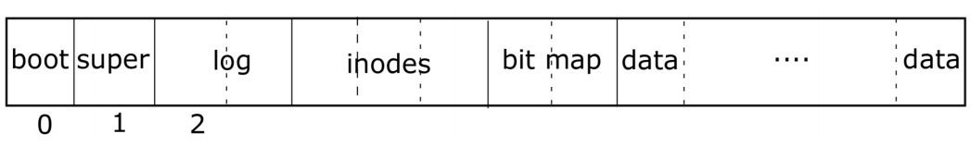
File system in xv6
Layout of file system
Block 0, 1, 2 are fixed
Block 0: Boot code
Block 1: Super Block, Store metadata about the file system
Block 2: Log area, Use for transactions. Maintain consistency in case of a power outrage or system shutdown accidentally

Slide 5
File system in xv6
Inodes: Unnamed files
Bitmap: An area to check which blocks are in use
Data area: Actual data located

Slide 6
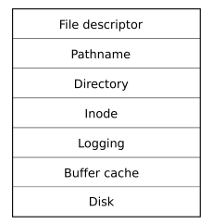
File system in xv6
Bottom up Approach
File descriptors
Recursive lookup
Directory Inodes
Inodes and Block allocator
Logging
Buffer Cache
Disk

Slide 7
Topic
The project is based on implementation of pwd command in xv6 operating system.
pwd stands for print working directory.
It prints the path of the working directory, starting from the root.

Slide 8
MOTIVATION

Slide 9
Need for pwd command
Xv6 operating system consists of various system calls and functions.
The commands like cd, mkdir, ls are already present in the system.
But many times it is necessary to know the current working directory.
A function like pwd is not present in the system and so there is a need of such a command.

Slide 10
PROJECT GOAL

Slide 11
Goal
The goal of the project is to implement pwd command in the system without disturbing any other part.
A system call is needed and pwd userspace program is also needed.
The project deals with the file system topic.
A few functions are needed to be added to implement this command in the shell.

Slide 12
Design Architecture

Slide 13
System call
syscall pwd is assigned an id in syscall.h file.
Then to syscall.c definition for system call is added.
A pwd function is needed to be defined for user code as well.
A header definition for the pwd function is added to user.h.
To define the actual function, we need to use assembly (to issue the interrupt to switch to kernel mode). That’s already done and defined as SYSCALL macro. A definition for pwd is added to usys.S file.

Slide 14
System call
pwd, when called by user code, will use the definition in user.h file.
This will be linked to the assembly function generated by the SYSCALL macro.
This function moves the SYS_pwd constant into %eax and then issues the interrupt, switching to kernel mode.
sysfile.c will include the implementation for system call.

Slide 15
System call
int sys_pwd(void) {
char *p;
int n;
struct proc *curproc = myproc();
if(argint(1, &n) < 0 || argptr(0, &p, n) < 0)
return -1;
return name_for_inode(p, n, curproc->cwd);
}

Slide 16
Inode
In Xv6 (and most Unix file systems), the inode, short for 'index node' (though this may be a backronym), is a number pointing to a specific block on the disk that holds information about the file.
On xv6, the inode struct stores only a few pieces of data. However, the inode is a layer of abstraction below the concept of the filesystem hierarchy and file names.
The filesystem hierarchy is created with special inodes - type T_DIR - which contain a series of dirent structures. Each dirent is a tuple of a string name and an inode which references the file associated with that name.

Slide 17
Directory extraction
int name_of_inode(struct inode *ip, struct inode *parent, char buf[DIRSIZ]) {
uint off;
struct dirent de;
for (off = 0; off < parent->size; off += sizeof(de)) {
if (readi(parent, (char*)&de, off, sizeof(de)) != sizeof(de))
panic("couldn't read dir entry");
if (de.inum == ip->inum) {
safestrcpy(buf, de.name, DIRSIZ); return 0;
}
}
return -1;
}

Slide 18
Directory extraction
Directories in the xv6 filesystem are files whose contents are a just a series of dirent structures.
Dirent is just a structure of a ushort inode id and a name.
That means all this loop does is loop over every directory entry in the directory, loading it into de with readi.
If the inode is not found -1 is returned. This happens when the file system is broken.

Slide 19
Directory extraction
int name_for_inode(char* buf, int n, struct inode *ip) {
int path_offset;
struct inode *parent;
char node_name[DIRSIZ];
if (ip->inum == namei("/")->inum) {
buf[0] = '/';
return 1;
}
else if (ip->type == T_DIR) {

Slide 20
Directory extraction
parent = dirlookup(ip, "..", 0);
ilock(parent);
if (name_of_inode(ip, parent, node_name)) {
panic("could not find name of inode in parent!");
}
path_offset = name_for_inode(buf, n, parent);
safestrcpy(buf + path_offset, node_name, n - path_offset); path_offset += strlen(node_name);
if (path_offset == n - 1) {
buf[path_offset] = '\0';
return n;
} else {
buf[path_offset++] = '/';
}

Slide 21
Directory extraction
iunlock(parent);
return path_offset;
}
else if (ip->type == T_DEV || ip->type == T_FILE) {
panic("process cwd is a device node / file, not a directory!");
} else {
panic("unknown inode type");
}
}

Slide 22
Directory extraction
namei is a wrapper which turns a full path into a inode.
If the node is root buf is set to “\”.
The inode types are defined in stat.h as T_DIR, T_FILE, and T_DEV - a device node.
The parent reference is grabbed with dirlookup. ilock makes sure the inode is loaded from disk.
Next, name_of_inode function is called and string manipulation is done.
Finally the inode is released with iput and length of the path is returned

Slide 23
Testing code
#include "types.h"
#include "user.h"
#define MAX_PATH 512
int main(int argc, char *argv[]) {
char path[MAX_PATH];
pwd(path, MAX_PATH);
printf(0, "%s\n", path);
exit();
}

Slide 24
OUTCOME

Slide 25
Result
The pwd command was implemented properly with no errors.
The command prints the complete path of the current working directory.
The previous system gets added with one sytem call pwd .
The function recursively derives the path of the current working directory.

Slide 26
Future work
The pwd command works in all directories but the other commands like cd, ls, mkdir don’t work in the other directories except root directory.
If these commands work in all directories then pwd will work at its best.

