Slide 1

HUSTLERTECH ENTERPRISE AI
HUSTLERTECH VISION
Next-Generation Enterprise AI Vision & Unified Video Management System
Autonomous Real-Time Threat Detection, Low-Latency Streaming, Visual Automation Rules, and Regulatory Compliance for Banking, NBFCs, Retail & Critical Infrastructure.
HUSTLERTECH PRESENTATION | SOLUTIONS & BUSINESS DEVELOPMENT LEAD
Josphine Sololo — Business Development & Solutions Engineering Lead
Direct Contact: +254 727 417410 | Email: jmweshsololo@gmail.com
Sub-Second Streaming
Ultra-low-latency HLS/WebRTC with synced multi-camera playback.
Visual Rule Automation
No-code geometric zone designer with 36+ pre-seeded banking rules.
Anti-Storm AI Engine
Zero alarm fatigue with Redis fencing tokens & state cooldowns.

Slide 2
MARKET CHALLENGES & OPERATIONAL PAIN POINTS
The Critical Security Dilemma: Why Traditional CCTV Fails
95% Footage Unmonitored
HUMAN ATTENTION FAILURE
After just 20 minutes of continuous monitoring, security guards miss over 95% of active scene anomalies due to severe visual fatigue.
Alarm Storms & Noise
HIGH FALSE POSITIVE RATES
Legacy motion sensors trigger dozens of false alerts for shadows, insects, or light shifts, forcing SOC operators to disable notifications entirely.
Hours Lost in Forensics
DELAYED INCIDENT RESOLUTION
Scrubbing through hours of unsynchronized video across isolated cameras delays incident response, evidence gathering, and police reporting.
Regulatory Non-Compliance
ZERO AUDIT TRAIL ENFORCEMENT
High-security facilities (Gold Loans, Banks, Vaults) struggle to prove dual-custody access, perimeter integrity, and continuous retention.
THE HUSTLERTECH SOLUTION: Transform passive, forensic-only cameras into an active, intelligent, deterministic defense and compliance ecosystem.
HustlerTech Technologies | Enterprise AI Vision & Video Management System | Confidential Client Presentation

Slide 3
END-TO-END DISTRIBUTED DESIGN
HustlerTech High-Assurance System Architecture
1. Edge Reverse Proxy (Caddy / TLS)
Enterprise ingress with automatic SSL/TLS termination, rate limiting, and HTTP/2 multiplexing for smooth video transport.
2. FastAPI / Go High-Throughput Core
Microservices processing live metadata, WebRTC signaling, ONVIF discovery, and multi-tenant security enforcement at <20ms latency.
3. Distributed Redis & Celery Cluster
Asynchronous task queue handles real-time alert deduplication, siren relay automation, and push escalations with zero lock contention.
4. Multi-Tier Hybrid Storage Architecture
Hot NVMe local indexing for instant seek, paired with cold S3 compliance archiving ensuring complete regulatory retention at 1/5th cloud storage cost.
INSPECTION LAYER
YOLOv8 Edge Detectors • RTSP/ONVIF Feeds • Hardware Accelerated Decoders
ARBITRATION LAYER
Redis Fencing Tokens • Anti-Storm De-duplication • Spatial Ray-Casting
PRESENTATION LAYER
Sub-Second WebRTC Video Matrix • React SOC Console • Mobile App Hub
COMPLIANCE VAULT
SHA-256 Audit Trail Ledger • Tamper-Proof Incident Bundles • Court-Ready
HustlerTech Technologies | Enterprise AI Vision & Video Management System | Confidential Client Presentation

Slide 4
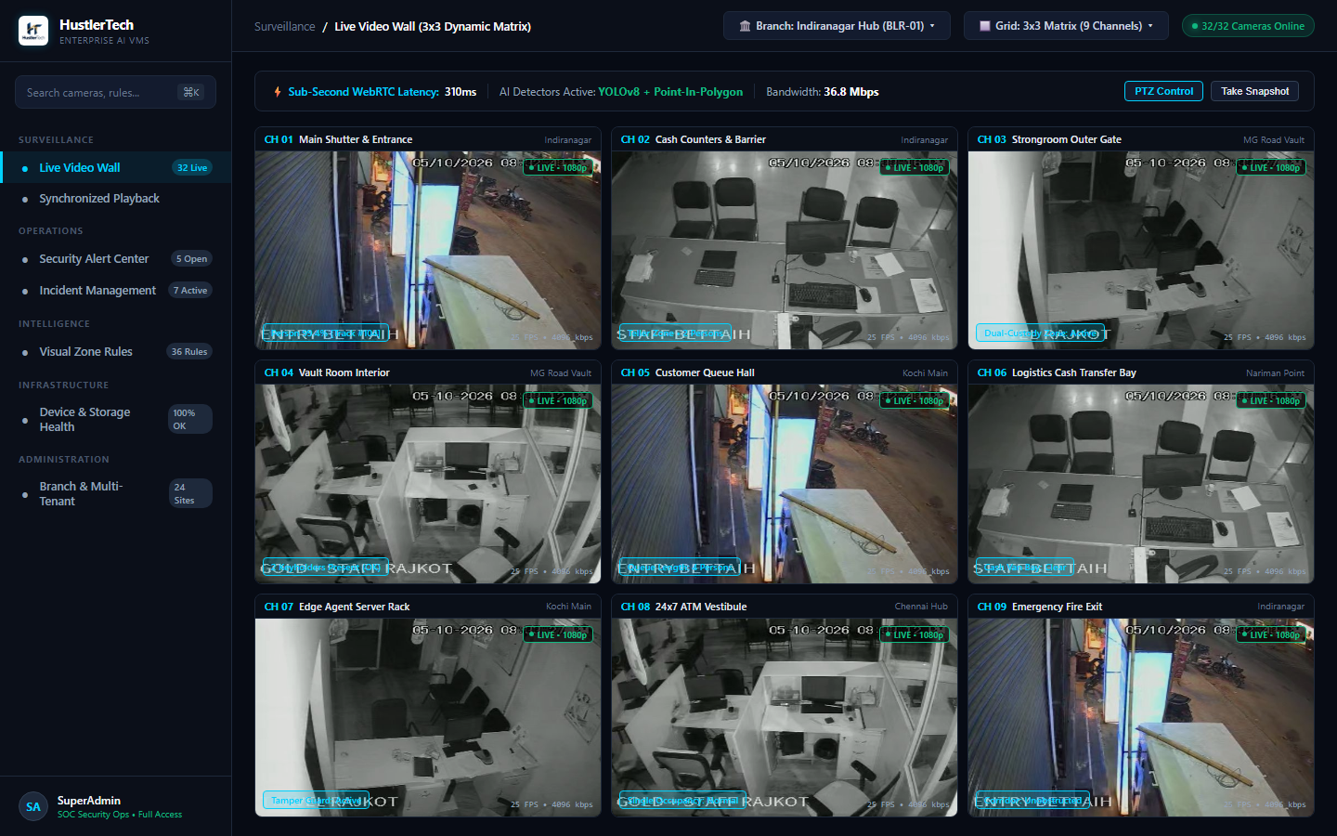
SURVEILLANCE OPERATIONS
Real-Time Multi-Stream Command Wall (3x3 / Dynamic Matrix)
• Sub-Second WebRTC Streaming
Live ultra-low latency streams delivered to browsers without plugins or heavy desktop client software.
• Multi-Site Channel Switching
Switch dynamically between HQ, branches, remote vault rooms, and ATMs within 200 milliseconds.
• Integrated HUD Metadata
Direct visual bounding boxes display detected personnel, badges, queue lengths, and directional paths.
• Adaptive Bandwidth Scaling
Dynamic sub-stream negotiation ensures flawless multi-view even across constrained 4G branch links.
HustlerTech Technologies | Enterprise AI Vision & Video Management System | Confidential Client Presentation

Slide 5
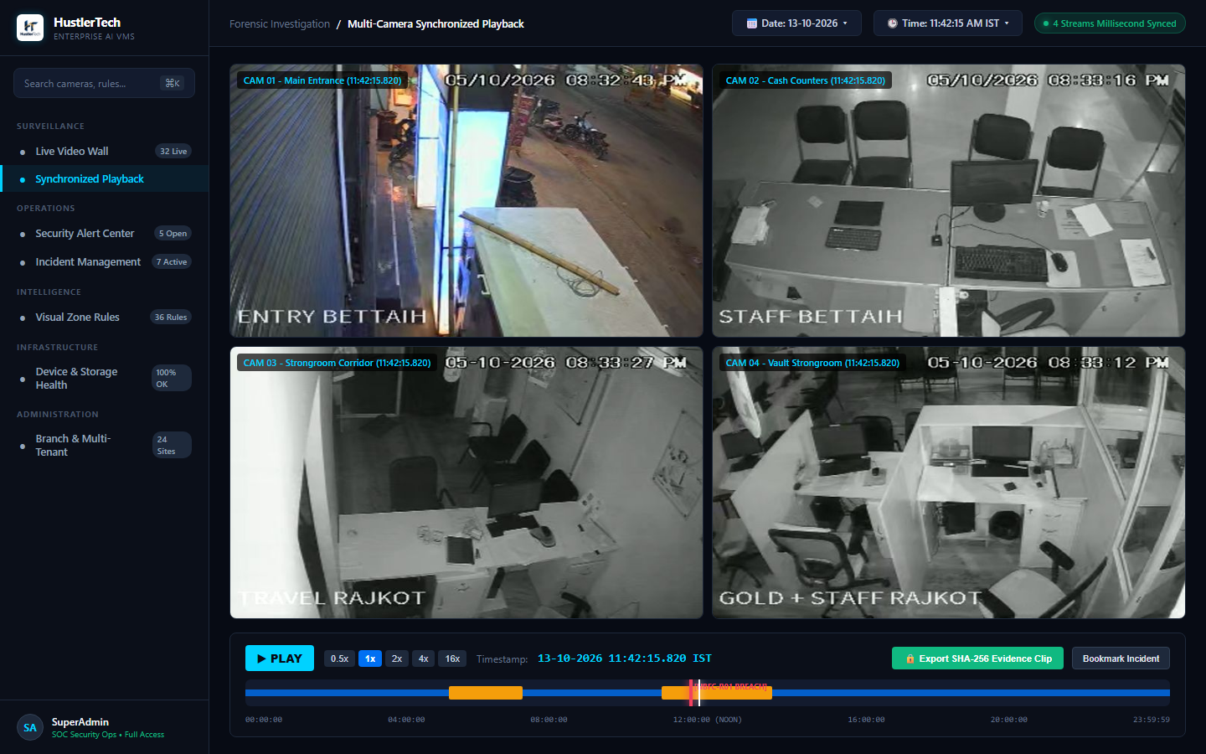
INCIDENT INVESTIGATION & EVIDENCE
Multi-Angle Synchronized Forensic Playback
• Frame-Accurate Clock Synchronization
Play back up to 4 camera angles simultaneously with sub-frame time lock across different physical NVRs.
• Visual AI Event Heatmap
Instantly jump directly to breach points, door openings, or perimeter motion without scrubbing dead footage.
• One-Click Cryptographic Export
Export court-admissible signed MP4 evidence packages sealed with verifiable SHA-256 integrity hashes.
• Variable Playback Control
High-speed scrubbing from 0.25x up to 32x speed with instantaneous reverse play and frame stepping.
HustlerTech Technologies | Enterprise AI Vision & Video Management System | Confidential Client Presentation

Slide 6
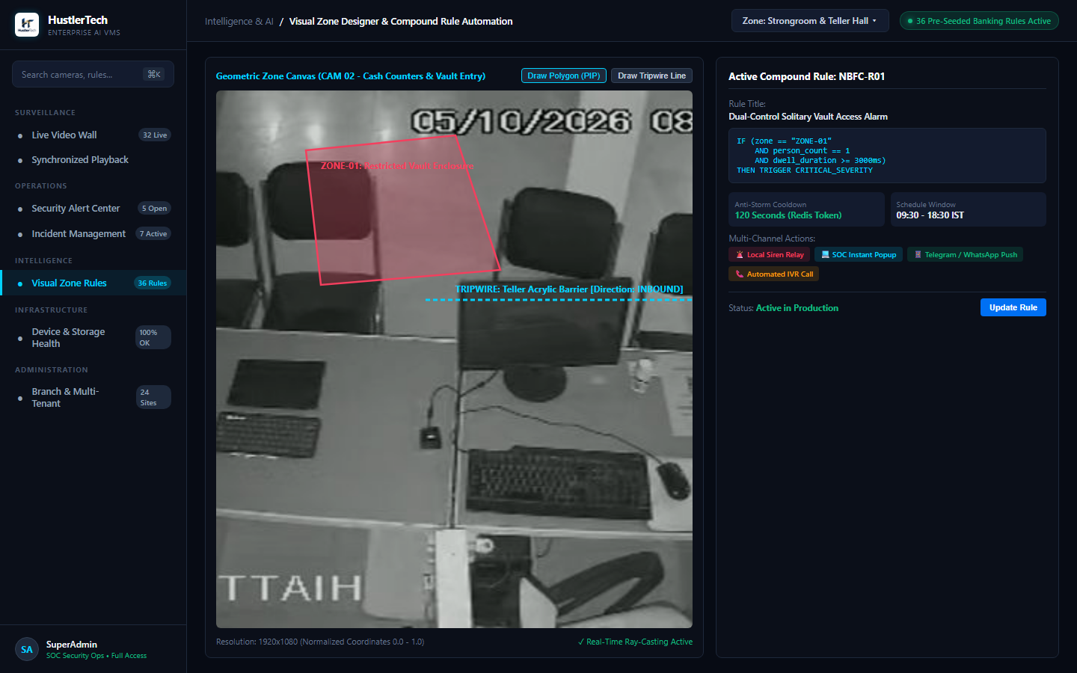
ENTERPRISE INTELLIGENCE ENGINE
Visual No-Code Zone Designer & Compound Automation
• Geometric Polygon Canvas
Draw precise restricted zones, tripwires, teller counter boundaries, and vault perimeters with pixel-level ray-casting.
• Compound Boolean Logic
Combine signals: IF [Zone = 'Vault'] AND [Staff_Count < 2] AND [Dwell > 10s] THEN trigger critical alert.
• Multi-Action Dispatch Orchestrator
Simultaneously sound on-site sirens, trigger SOC popup alerts, dispatch Telegram/WhatsApp notices, and place automated IVR calls.
• Operational Schedule Constraints
Enforce business-hour schedules (e.g., active during branch closing 18:30 to 09:30 only).
HustlerTech Technologies | Enterprise AI Vision & Video Management System | Confidential Client Presentation

Slide 7
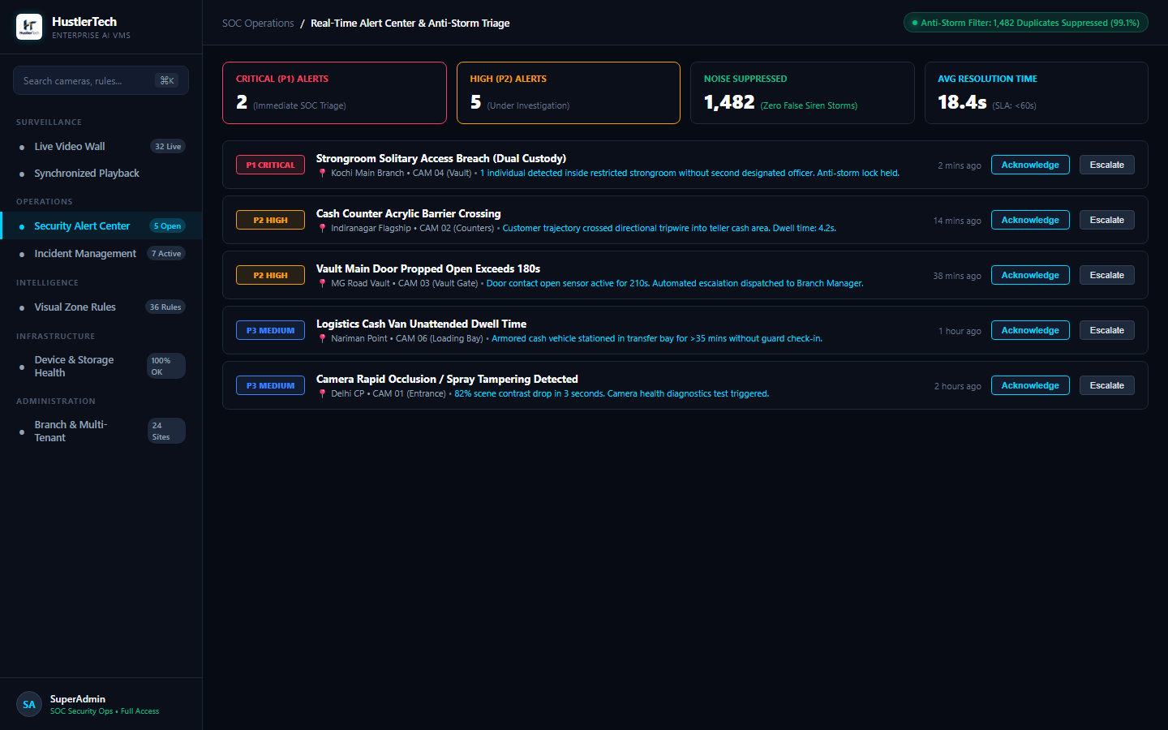
SOC INCIDENT PREVENTION
Anti-Storm Alert Operations & Intelligent Triage
• The Alert Storm Problem Solved
Traditional AI systems generate 1,500 redundant alerts/min if a person lingers in a zone. HustlerTech eliminates this completely.
• Distributed Redis Fencing Tokens
Applies dynamic state cooldowns (e.g. 120s window) suppressing repeated notifications while keeping state active.
• Guaranteed Human SLA (<60s)
Triaged alerts automatically escalate to backup supervisors if not acknowledged within predefined SLA thresholds.
• 99.1% Operational Noise Reduction
Operators focus exclusively on genuine security exceptions rather than clearing repetitive false alarms.
HustlerTech Technologies | Enterprise AI Vision & Video Management System | Confidential Client Presentation

Slide 8
PRE-SEEDED REGULATORY COMPLIANCE
Out-of-the-Box Security Rules for Banking & NBFCs
Dual-Custody Vault Access
ZONE: VAULT & STRONGROOM
Alerts immediately if only 1 individual enters the vault room without a verified second keyholder.
Cash Counter Acrylic Jumping
ZONE: TELLER / CASH AREA
Detects customer crossing over teller partitions into restricted teller cash drawers.
Armored Cash Van Unattended Dwell
ZONE: LOADING BAY / GATE
Triggers high-priority escalation if cash vehicle is left unattended for >15 minutes.
Night Movement in Strongroom
ZONE: VAULT (POST-HOURS)
Instantaneous P1 critical siren and SOC dispatch for any motion detected after 18:30 closing.
Camera Tampering / Occlusion
ZONE: ALL BRANCH CAMERAS
Detects camera spraying, lens obscuring, defocusing, or directional displacement within 3 seconds.
After-Hours Guard Absence / Sleeping
ZONE: BRANCH SECURITY POST
Monitors mandatory physical guard presence and alerts if guard is absent during night shift.
HustlerTech Technologies | Enterprise AI Vision & Video Management System | Confidential Client Presentation

Slide 9
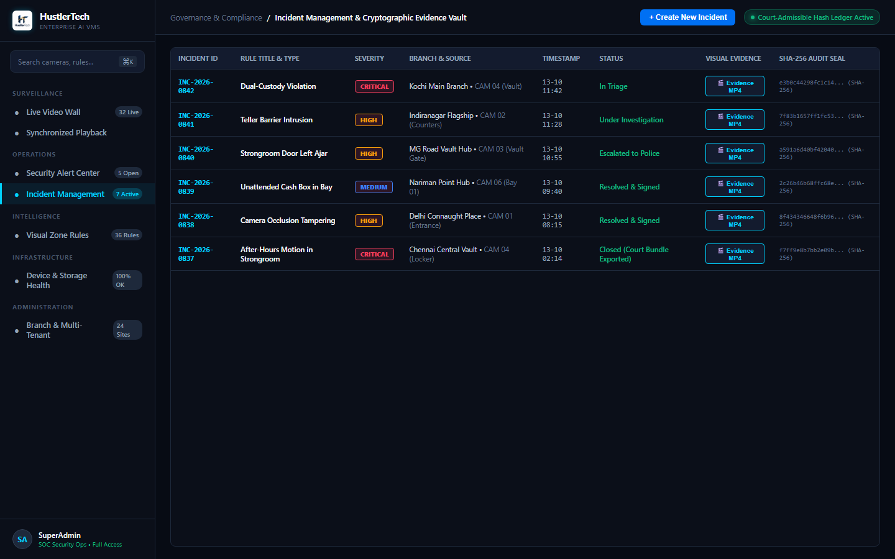
FORENSIC INTEGRITY & POLICE DISPATCH
Incident Management & Cryptographic Evidence Vault
• Immutable SHA-256 Hashes
Every video clip and incident record receives an unalterable SHA-256 cryptographic seal ensuring court admissibility.
• End-to-End Investigation Lifecycle
Transition smoothly from Initial Triage -> Under Investigation -> Law Enforcement Escalation -> Resolved.
• One-Click Police Evidence Dossier
Generate automated PDF evidence packages with embedded timestamps, operator signatures, and video download links.
• Zero-Tamper Chain of Custody
Strict RBAC controls and audit logging protect video evidence against accidental or malicious internal deletion.
HustlerTech Technologies | Enterprise AI Vision & Video Management System | Confidential Client Presentation

Slide 10
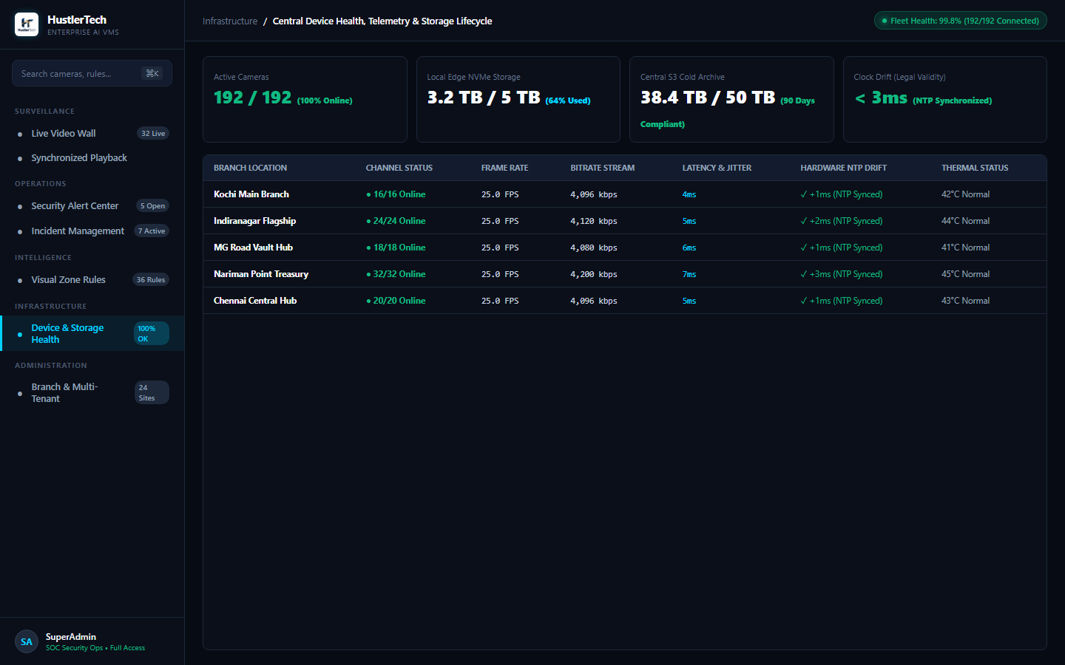
HIGH AVAILABILITY INFRASTRUCTURE
Central Device Health, Telemetry & Storage Lifecycle
• Real-Time Camera Uptime Monitoring
Continuous heartbeat telemetry across thousands of channels detects offline cameras within 5 seconds.
• Sub-Millisecond Clock Drift Sync
Maintains NTP synchronization (<3ms drift) across all branch NVRs to guarantee legal validity of recordings.
• Tiered Retention Management
Automatic pruning and lifecycle rotation: 30 days local NVMe + 90 days cold S3 archival compliant with central banking norms.
• Bitrate & Thermal Diagnostics
Monitors edge encoder health, stream packet loss, and operating temperatures to preemptively replace faulty units.
HustlerTech Technologies | Enterprise AI Vision & Video Management System | Confidential Client Presentation

Slide 11
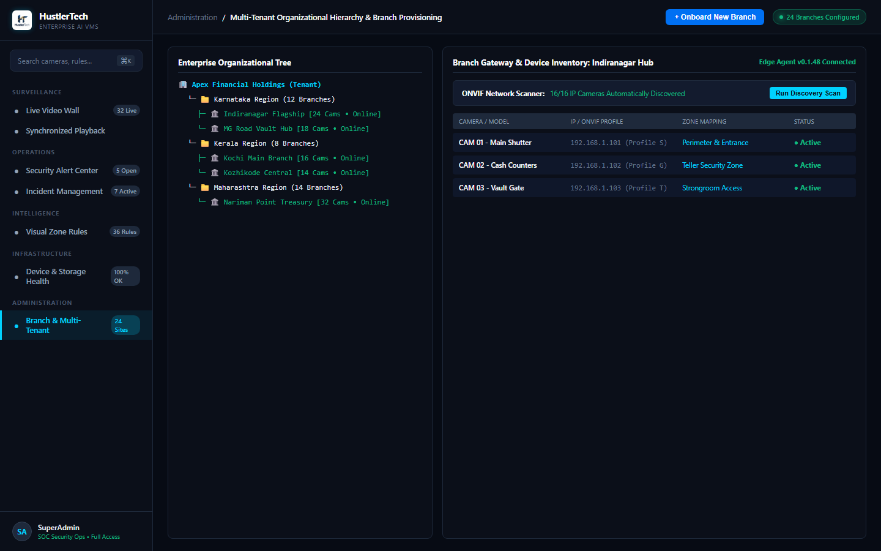
SCALABILITY & ENTERPRISE GOVERNANCE
Multi-Tenant Hierarchy & 15-Minute Branch Onboarding
• Geographic Tenant Hierarchy
Organize security operations across National HQ -> Regional Clusters -> Hubs -> Individual Branch Cameras.
• Automated ONVIF Discovery
Scan local branch subnets and ingest existing Hikvision, Dahua, Axis, and CP Plus cameras with zero manual IP config.
• Granular Role-Based Access (RBAC)
Assign distinct roles: Branch Managers view local streams only; National SOC teams oversee all zones.
• Edge Agent Zero-Touch Provisioning
Branch gateways configure automatically using encrypted deployment tokens in under 15 minutes.
HustlerTech Technologies | Enterprise AI Vision & Video Management System | Confidential Client Presentation

Slide 12
THE QUANTIFIABLE VALUE DELIVERED BY HUSTLERTECH
Measurable Business ROI & Operational Impact
85%
Reduction in False Alarms
Eliminate alarm fatigue with deterministic Redis anti-storm token filtering.
70%
Faster Incident Resolution
Scrub multi-camera synchronized timeline instead of hunting across isolated DVRs.
100%
Regulatory Audit Compliance
Immutable SHA-256 hashes & automated dual-custody verification satisfy all banking audits.
4x
Increase in Guard Productivity
Automate routine perimeter monitoring so on-site guards focus exclusively on real verified threats.
ZERO HARDWARE REPLACEMENT REQUIRED
HustlerTech works with your existing IP camera infrastructure without requiring expensive proprietary hardware replacements, slashing initial capital expenditures (CAPEX) while drastically reducing ongoing security staffing OPEX.
HustlerTech Technologies | Enterprise AI Vision & Video Management System | Confidential Client Presentation

Slide 13
SEAMLESS ADOPTION WORKFLOW
Turnkey Deployment in Under 48 Hours
Step 1: Network Ingestion & Camera Discovery
Connect edge gateway to local LAN; auto-scan ONVIF feeds and map existing cameras into organizational hierarchy.
Step 2: Visual Zone & Compliance Rule Configuration
Draw physical zones on high-risk cameras; activate pre-seeded banking templates (vault, acrylic barrier, after-hours motion).
Step 3: Alert Notification & Siren Relay Integration
Configure notification channels (SOC dashboards, SMS/WhatsApp gateways, automated IVR, physical strobe relays).
Step 4: Central SOC Command Activation
Begin live multi-branch surveillance, synchronized forensic playback, and court-admissible incident tracking.
HustlerTech Technologies | Enterprise AI Vision & Video Management System | Confidential Client Presentation

Slide 14
ARCHITECTED TO FIT YOUR INFRASTRUCTURE
Deployment Flexibility & System Compatibility
On-Premises Edge Appliance
HIGHEST SECURITY & PRIVACY
• Deploys directly on local branch hardware or edge AI microservers.
• Zero continuous cloud bandwidth requirement.
• Local video storage with POSIX NVMe indexing.
• Ideal for high-security banking branches and air-gapped vaults.
Hybrid Enterprise Architecture
BEST OF BOTH WORLDS
• Edge inference & local recording at branch level.
• Central cloud management for SOC command center & compliance.
• Low WAN bandwidth consumption with metadata-only synchronization.
• Clustered multi-branch aggregation across regional offices.
Fully Cloud-Managed VMS
MAXIMUM SCALABILITY & AGILITY
• Direct secure gateway streaming to cloud infrastructure (AWS/GCP/Azure).
• Unlimited tiered storage retention with automatic S3 archival.
• Global accessibility from any authenticated device or SOC terminal.
• Instant zero-maintenance updates and elastic scaling.
HustlerTech Technologies | Enterprise AI Vision & Video Management System | Confidential Client Presentation

Slide 15
HUSTLERTECH ENTERPRISE VISION SYSTEMS
Ready to Transform Your Surveillance?
HustlerTech upgrades existing video surveillance networks into an intelligent, proactive, and compliant security command ecosystem.
DIRECT CONTACT / BUSINESS DEVELOPMENT & SOLUTIONS LEAD
Josphine Sololo — Business Development & Solutions Engineering Lead
Phone: +254 727 417410 | Email: jmweshsololo@gmail.com
Recommended Next Steps: 48-Hour Live Proof-of-Concept Pilot • Zero Disruption Deployment
Thank You! Let's Proceed to the Live Product Demo & Q/A

