Slide 1
CLIENT DEMO
OM Systems
Security operations, made visible.
OM
Enterprise Surveillance OS
A unified operating layer for live video, AI alerts, incident response, evidence, and fleet health.
Prepared for client demonstration
06 September 2026
OM Systems / Security Operations Platform
01

Slide 2
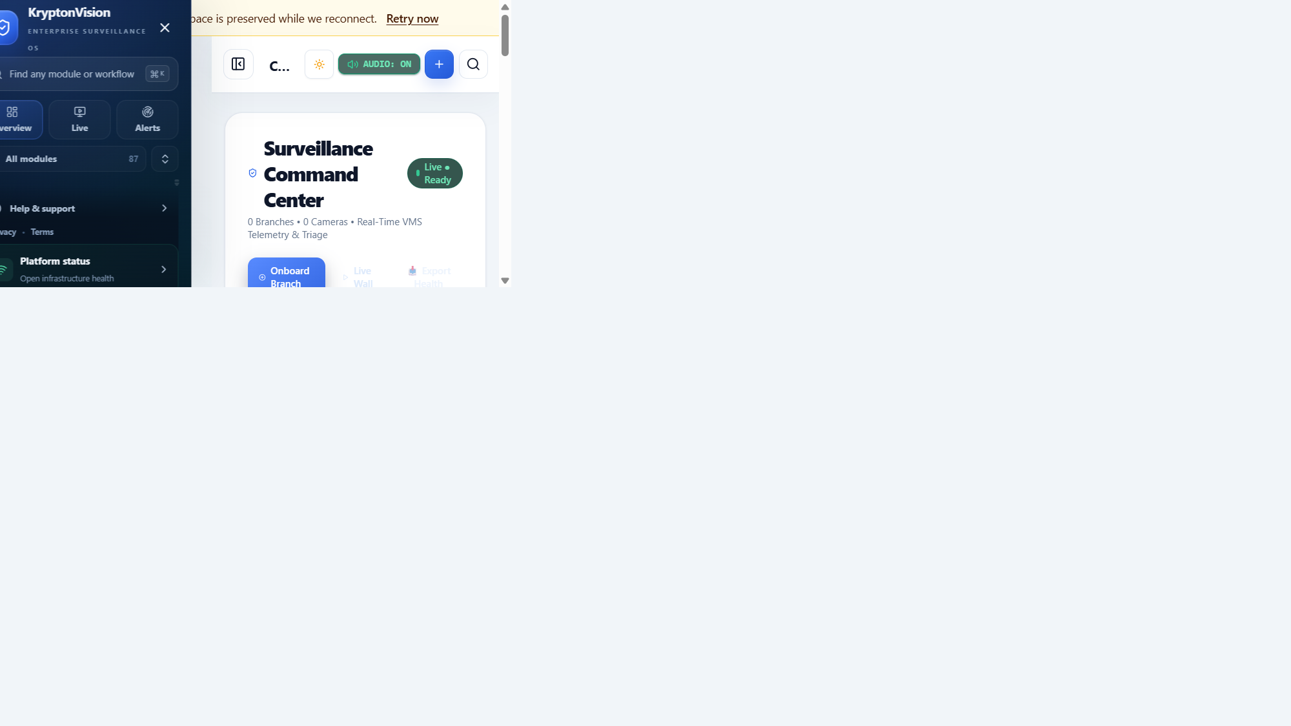
THE OPERATING CHALLENGE
From camera feeds to operational decisions
Most teams have visibility. The gap is turning visibility into a repeatable response.
Fragmented context
Cameras, alerts, branches, and incidents live in separate views.
Alert overload
Operators need confidence, prioritization, and suppression of noise.
Slow handoffs
Evidence and ownership are often assembled after the fact.
OM Systems brings the workflow together in one operational surface.
OM Systems / Security Operations Platform
02

Slide 3
ONE OPERATING SURFACE
See the whole environment at a glance
The Command Center gives operators a fast starting point for every shift.
01
02
03
Fleet overview
Live readiness
Action shortcuts
A role-aware workspace for command, triage, and escalation.
OM Systems / Security Operations Platform
03

Slide 4
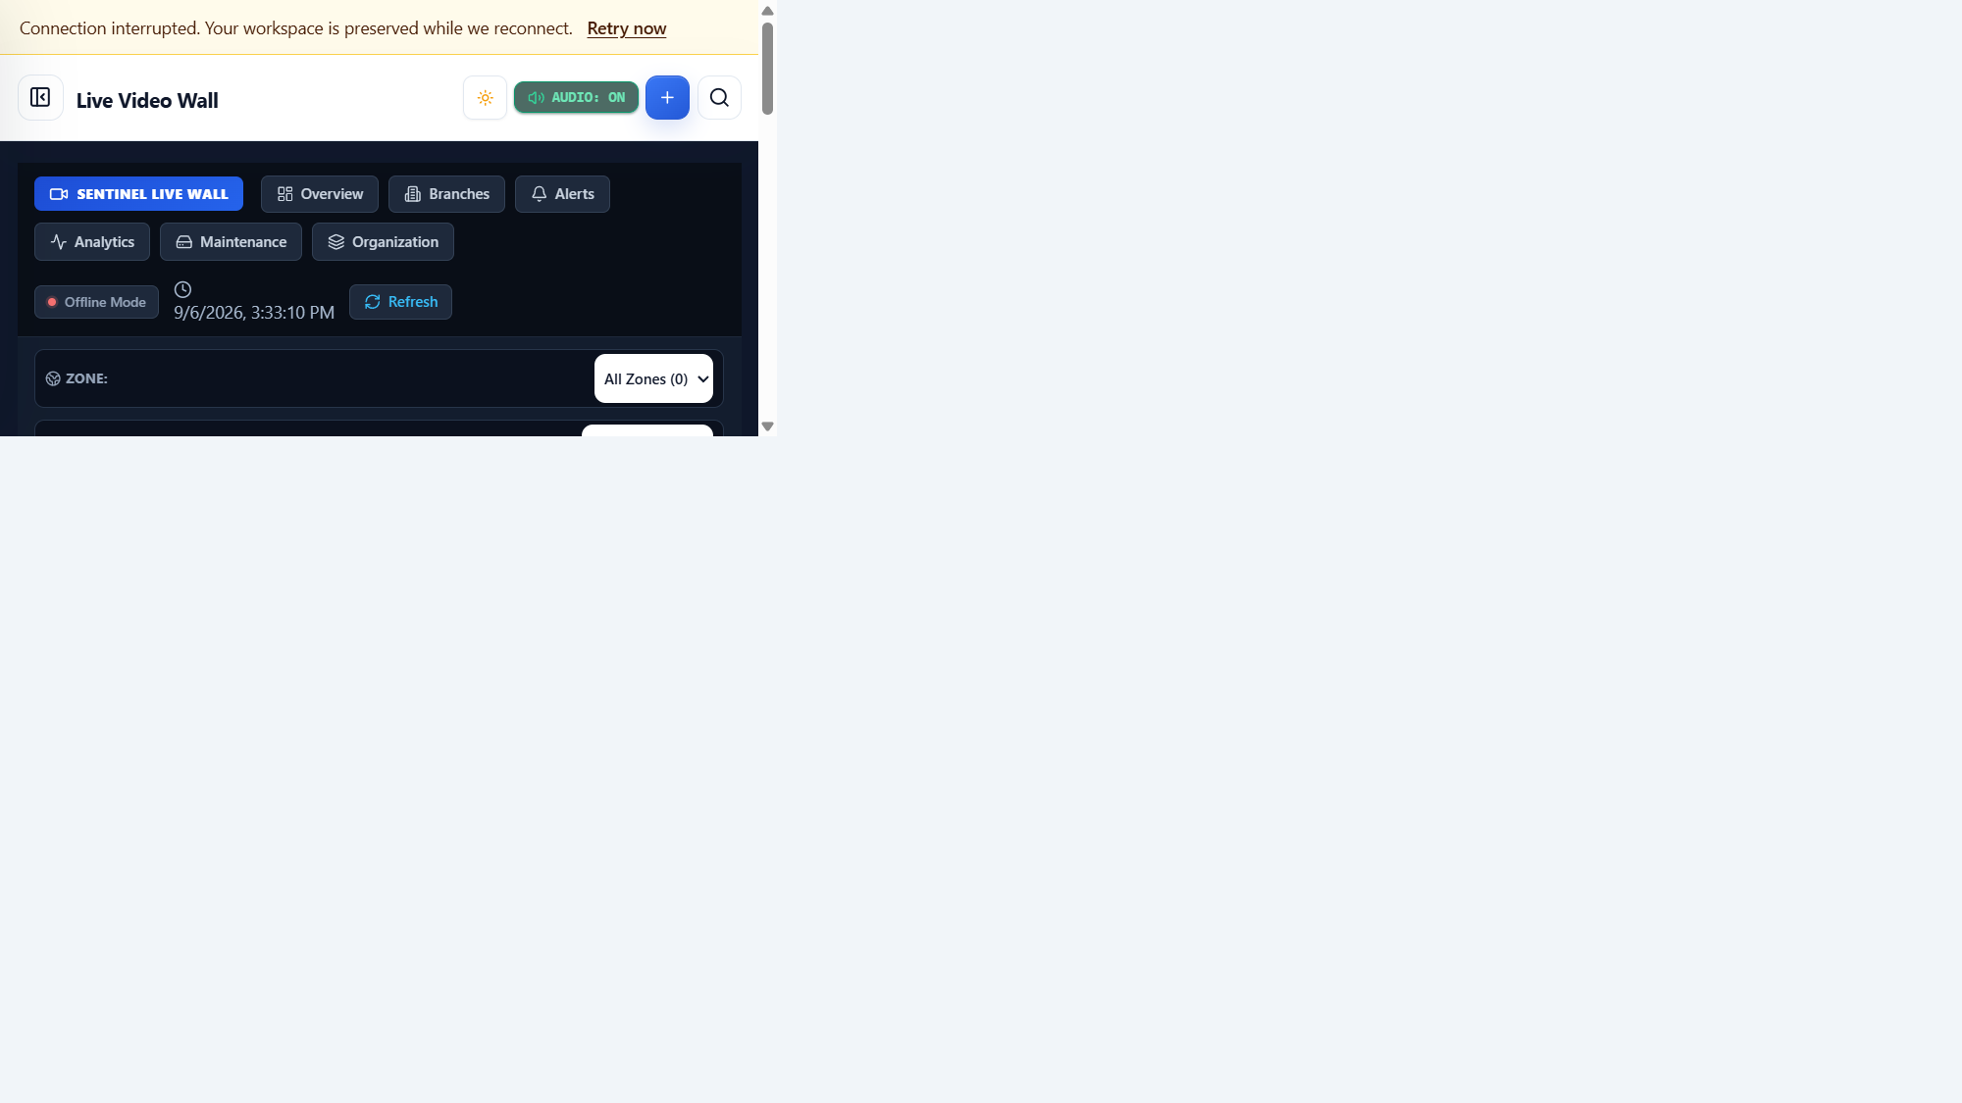
LIVE MONITORING
Move from overview to live video in one click
Filter by area, branch, camera status, and operational priority while keeping the fleet in view.
Multi-camera wall
A single workspace for live streams and camera readiness.
Operational filters
Narrow the view by branch, zone, status, or priority.
Capacity-aware
Keep operator attention and viewer capacity aligned.
OM Systems / Security Operations Platform
04

Slide 5

AI INTELLIGENCE
Turn detections into prioritized work
AI Alerts & Incidents brings camera, branch, zone, evidence, and incident context together.
Confidence-aware
Reduce noise before it reaches the operator.
Context-rich
Understand what happened and where.
One-click conversion
Promote a meaningful alert into a tracked incident.
OM Systems / Security Operations Platform
05

Slide 6
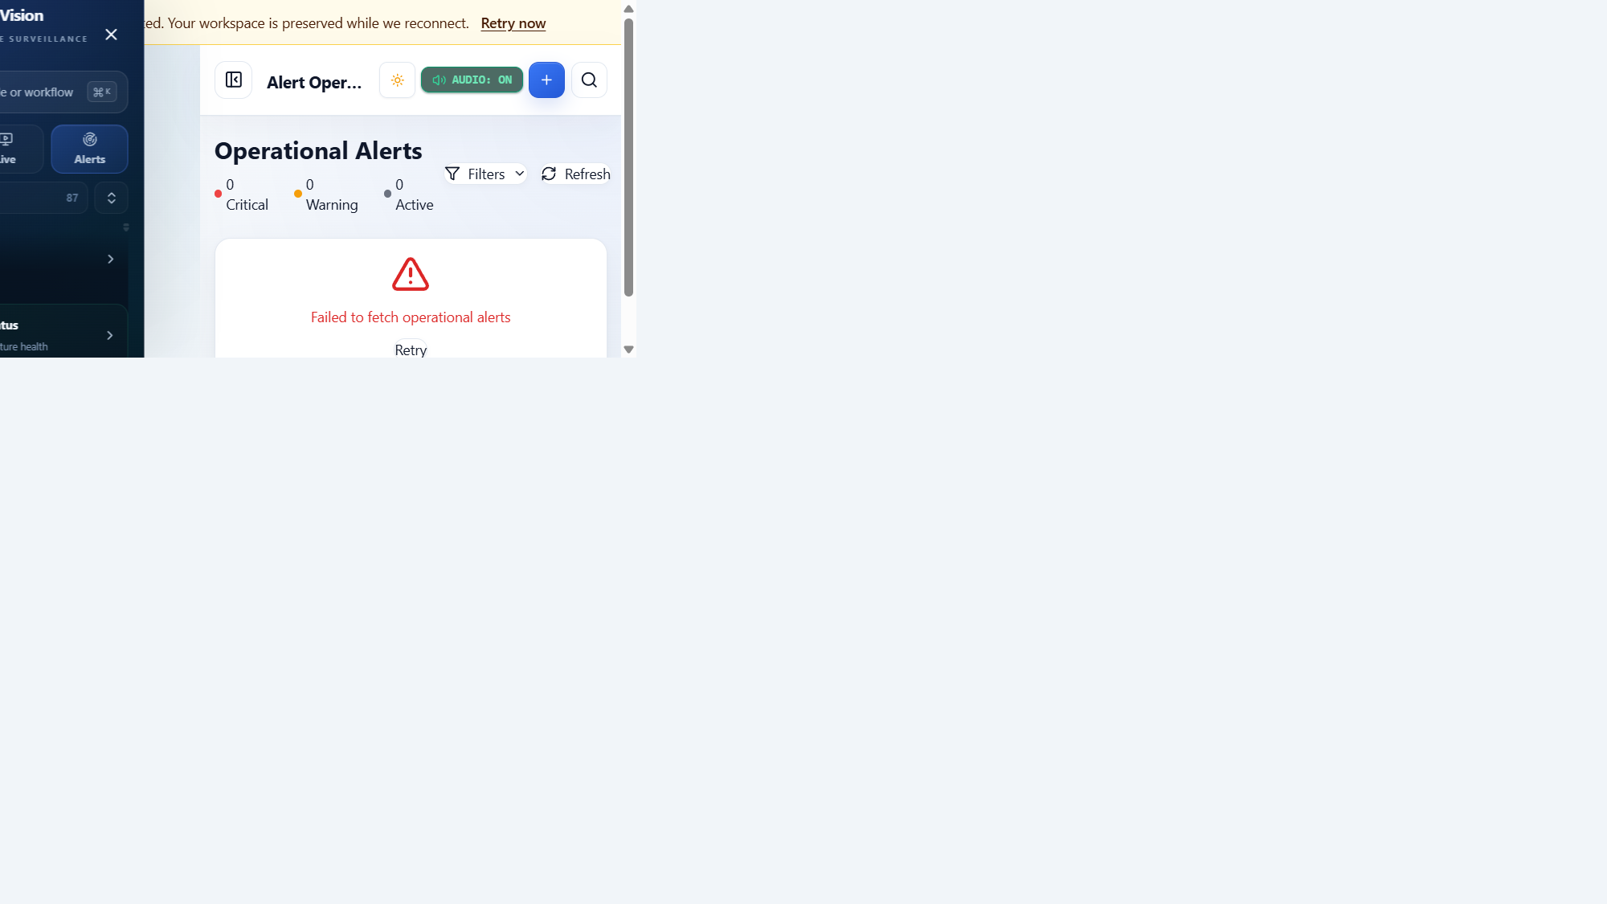
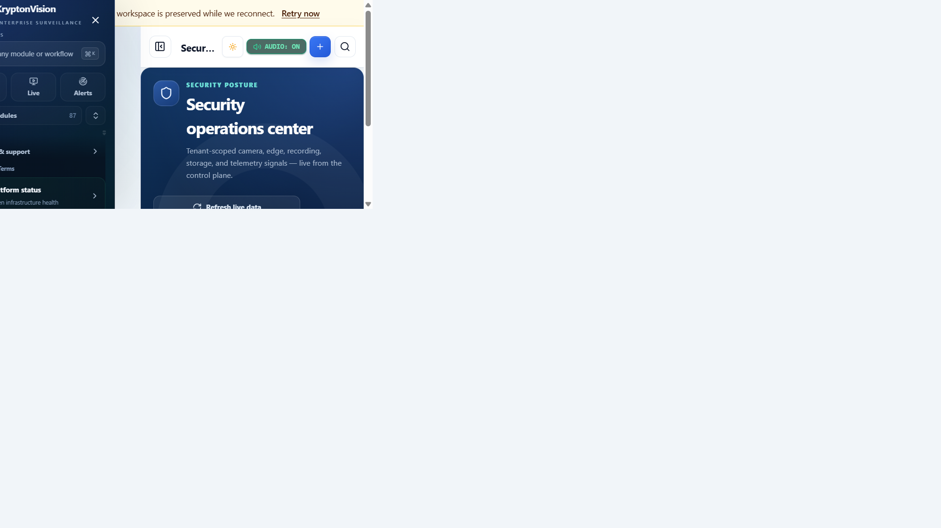
RESPONSE WORKFLOW
From alert to accountable resolution
The platform keeps the response chain connected, auditable, and ready for handoff.
01
02
03
04
Detect
→
Triage
→
Respond
→
Learn
AI or system signal enters the operating queue.
Operator validates severity, context, and evidence.
Create ownership, incident workflow, and next action.
Close with outcome, evidence, and audit history.
OM Systems / Security Operations Platform
06

Slide 7
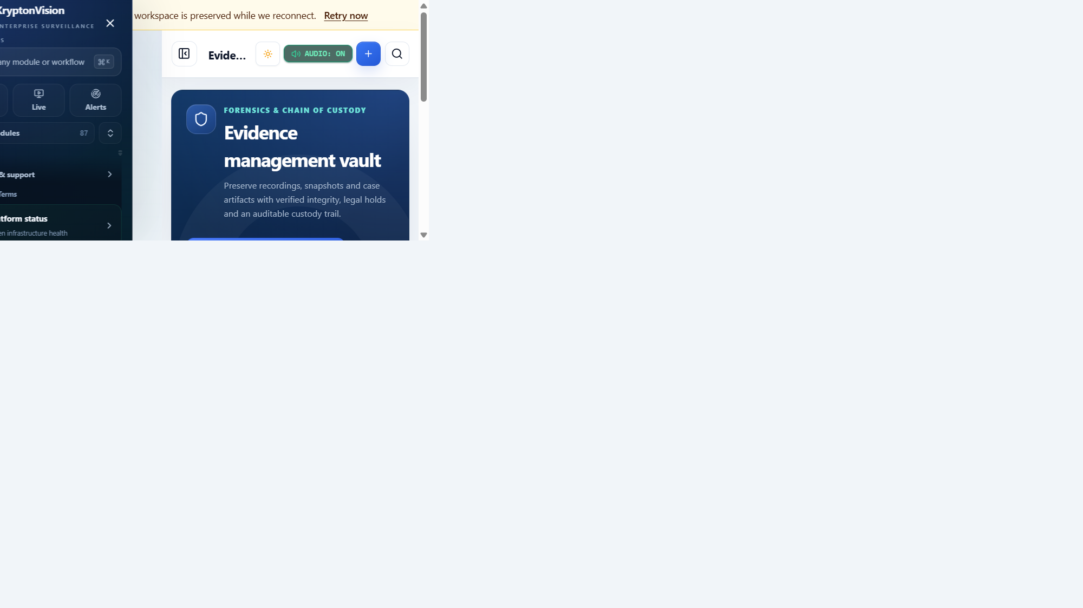
TRUST & GOVERNANCE
Make every action defensible
Operational confidence depends on evidence, auditability, and a clear system of record.
Evidence context
Snapshots, clips, and alert context travel with the workflow.
Access control
Role-aware views keep operators focused on their scope.
Fleet health
Camera, storage, connectivity, and recorder status stay visible.
OM Systems / Security Operations Platform
07

Slide 8
DEMO CLOSE
A practical path to operational maturity
Start with visibility. Add intelligence. Standardize response. Scale with confidence.
01
02
03
See
Decide
Act
Live fleet visibility
Prioritized AI context
Connected incident workflow
Suggested next step
Thank you
Choose one branch or operational workflow for a focused pilot demo.
OM Systems / Security Operations Platform
08

