Slide 1
KRYPTONLOGIC TECHNOLOGIES
KRYPTONVISION
Next-Generation Enterprise AI Vision & Unified Video Management System
Autonomous Real-Time Threat Detection, Low-Latency Streaming, Visual Automation Rules, and Regulatory Compliance for Banking, NBFCs, Retail & Critical Infrastructure.
Sub-Second Streaming
Ultra-low-latency HLS/WebRTC with synced multi-camera playback.
Visual Rule Automation
No-code geometric zone designer with 36+ pre-seeded banking rules.
Anti-Storm AI Engine
Zero alarm fatigue with Redis fencing tokens & state cooldowns.

Slide 2
MARKET CHALLENGES & OPERATIONAL PAIN POINTS
The Critical Security Dilemma: Why Traditional CCTV Fails
95% Footage Unmonitored
HUMAN ATTENTION FAILURE
After just 20 minutes of continuous monitoring, security guards miss over 95% of active scene anomalies due to severe visual fatigue.
Alarm Storms & Noise
HIGH FALSE POSITIVE RATES
Legacy motion sensors trigger dozens of false alerts for shadows, insects, or light shifts, forcing SOC operators to disable notifications entirely.
Hours Lost in Forensics
DELAYED INCIDENT RESOLUTION
Scrubbing through hours of unsynchronized video across isolated cameras delays incident response, evidence gathering, and police reporting.
Regulatory Non-Compliance
ZERO AUDIT TRAIL ENFORCEMENT
High-security facilities (Gold Loans, Banks, Vaults) struggle to prove dual-custody access, perimeter integrity, and continuous retention.
THE KRYPTONVISION SOLUTION: Transform passive, forensic-only cameras into an active, intelligent, deterministic defense and compliance ecosystem.
KryptonLogic | KryptonVision AI Video Platform | Confidential Client Demo

Slide 3
END-TO-END DISTRIBUTED DESIGN
KryptonVision High-Assurance System Architecture
1. Edge Reverse Proxy (Caddy / TLS)
Enterprise ingress with automatic SSL/TLS termination, rate limiting, and HTTP/2 multiplexing for smooth video transport.
2. High-Performance Media Gateway
Microservices handling ONVIF/RTSP discovery, sub-second HLS transmuxing, and WebRTC streaming across 100+ concurrent cameras.
3. Autonomous AI Analytics Engine
GPU/NPU-accelerated neural networks (YOLOv8, background subtraction) running real-time point-in-polygon & tripwire crossing.
4. Distributed Redis 7 & PostgreSQL 16
Zero process-local state: Stream leases, viewer allocations, and camera ownership coordinated with epoch-based distributed locks.
5. Dual-Tier Storage Architecture
POSIX/NVMe edge recording vault for ultra-fast scrubbing + automated tiered retention to S3/NFS/SMB archives.
DATA & EVALUATION PIPELINE
[RTSP / ONVIF IP Streams]
└─ Multi-brand camera feeds ingested securely at edge
|
v [AI Detectors: YOLOv8 / Edge NPU]
└─ Detects Persons, Vehicles, Bags, PPE, and Scene Tampering
|
v [Persistent Multi-Object Tracker]
└─ Assigns persistent Track IDs across frames for temporal continuity
|
v [Geometric Zone Engine (Ray-Casting)]
└─ Calculates Point-in-Polygon (PIP) & directional line crossings
|
v [Compound Rule & Schedule Evaluator]
└─ Evaluates Boolean conditions (AND/OR/NOT) against IST operating windows
|
v [Anti-Storm Deduplication & Cooldown]
└─ Redis fencing tokens suppress spam; updates evidence clips continuously
|
v [Multi-Action Dispatcher]
└─ Dispatches SOC alerts, relays sirens, pushes webhooks & initiates calls
KryptonLogic | KryptonVision AI Video Platform | Confidential Client Demo

Slide 4
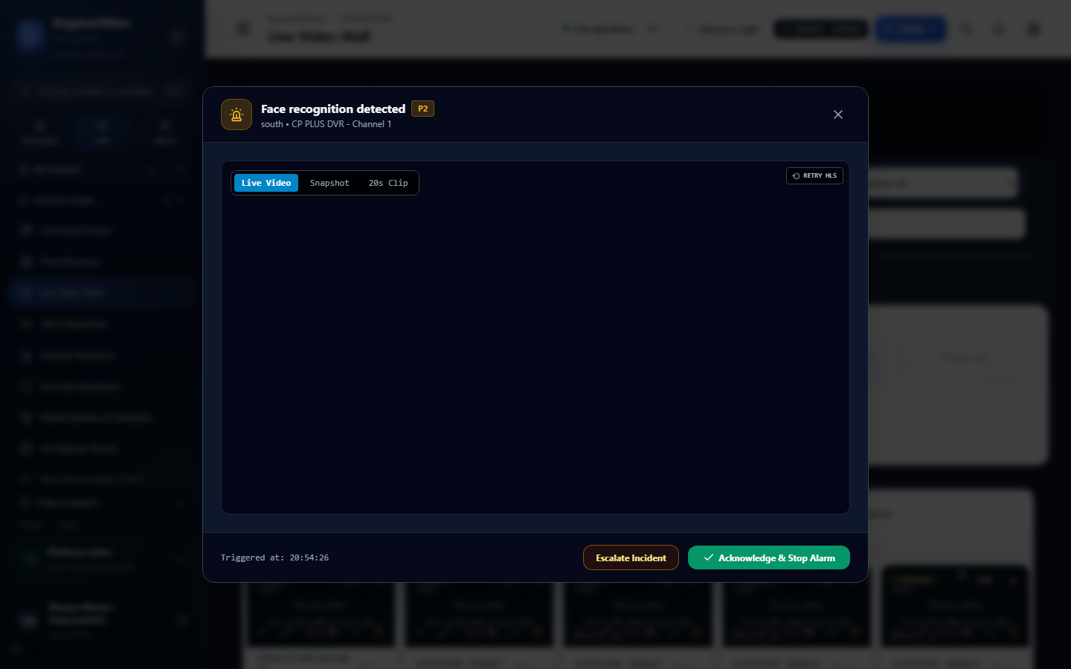
CORE USER EXPERIENCE — REAL-TIME MONITORING
Unified Command Center & Live Video Wall
• Sub-Second Streaming Latency (<400ms)
Live feeds are served with sub-second response times using WebRTC and low-latency HLS transmuxing.
• Dynamic Matrix & Video Wall Grids
Seamless switching between 1x1, 2x2, 3x3, 4x4, and custom camera wall matrices across multiple monitor outputs.
• Real-Time AI Bounding Overlays
Live visual indicators, bounding boxes, confidence metrics, and active zone overlays directly on the canvas.
• Instant PTZ & Camera Controls
Pan, Tilt, and Zoom with presets, instant optical zoom, and one-click forensic snapshot captures.
• Edge Fault Auto-Recovery
Built-in stream heartbeat detection with zero-flicker automatic reconnection if network bandwidth dips.
KryptonVision Live Multi-Stream Video Wall (/surveillance/live)
KryptonLogic | KryptonVision AI Video Platform | Confidential Client Demo

Slide 5
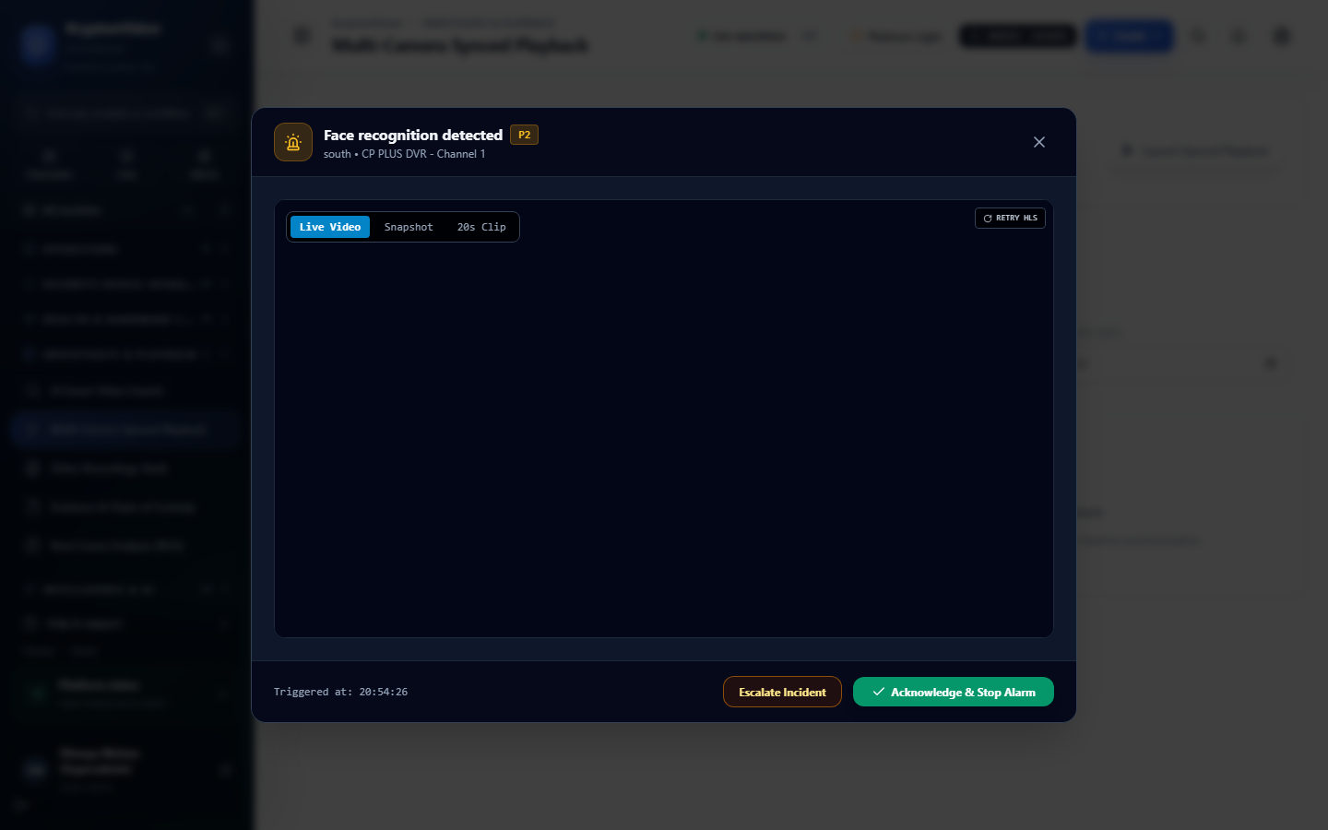
FORENSIC INVESTIGATION & EVIDENCE REVIEW
Multi-Camera Synchronized Playback & Time-Travel
• Synchronized Multi-Angle Scrubbing
Scrub up to 16 camera angles simultaneously in perfect millisecond synchronization to follow suspect movement across doors and corridors.
• Multi-Color Activity Heatmap Timeline
Visual timeline bar instantly differentiates continuous recordings, motion triggers, and high-severity AI compliance alerts.
• Sub-Second Forensic Seek
Jump directly to the exact timestamp of an incident with zero buffer lag, eliminating hours of manual footage scanning.
• Variable Speed & Jog-Shuttle Control
Fluid playback speeds from 0.25x slow-motion review up to 32x high-speed scanning with single-frame jog-stepping.
• Instant Evidence Clipping
Select in/out timeline points directly from the playback view to export digitally signed MP4/MKV evidence clips.
Synchronized Multi-Camera Playback & Visual Heatmap (/surveillance/playback)
KryptonLogic | KryptonVision AI Video Platform | Confidential Client Demo

Slide 6
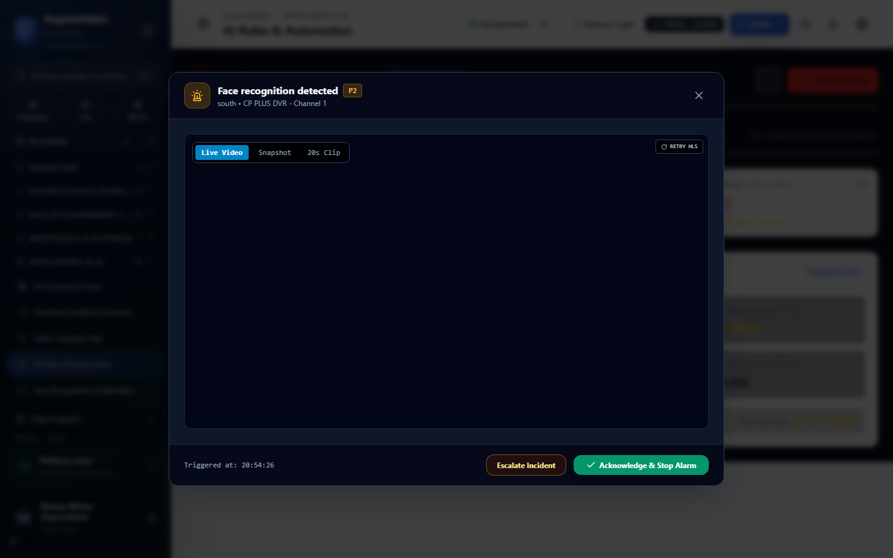
NO-CODE CONFIGURATION & AUTOMATION WORKSPACE
Visual Zone Designer & Compound Rule Engine
• No-Code Geometric Drawing Canvas
Administrators can draw Polygons (vaults, counters, restricted zones) and Tripwires (entry lines, barriers) directly over live video.
• Resolution-Independent Normalized Coordinates
Zones use normalized coordinates (0.0 to 1.0), ensuring detection accuracy even if camera resolution or aspect ratio shifts.
• Compound Boolean Logic (AND / OR / NOT)
Eliminates false triggers by chaining multi-sensor conditions (e.g., PERSON_COUNT > 2 AND CASH_DRAWER == OPEN).
• Timezone-Aware Operational Schedules
Schedules adhere to IST (Asia/Kolkata) with business-hours, after-hours, 24x7, and branch opening/closing dual custody windows.
• Shadow Mode & Rule Simulation
Test rules against historical video archives in a safe simulation lab before promoting them to live enforcement.
Visual Zone Designer & Rule Configuration Workspace (/analytics/rules)
KryptonLogic | KryptonVision AI Video Platform | Confidential Client Demo

Slide 7
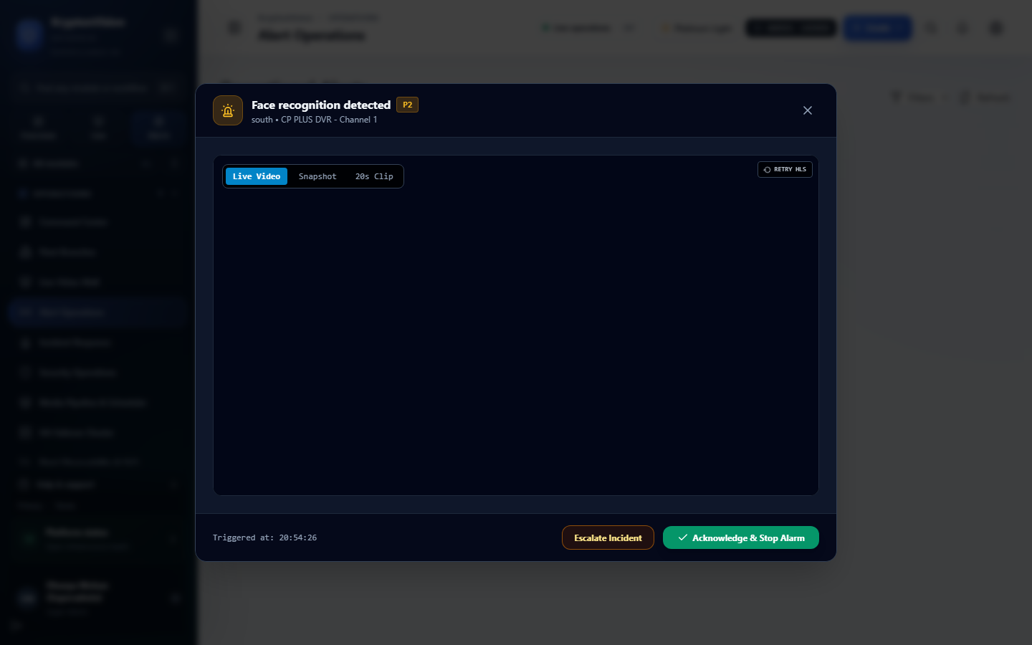
ELIMINATING ALARM FATIGUE IN THE SOC
Anti-Storm Deduplication & Intelligent Alert Dispatch
• The Alert Storm Problem Solved
Traditional AI systems generate 1,500 redundant alerts/min if a person lingers in a zone. KryptonVision eliminates this completely.
• Distributed Redis Fencing Tokens
Guarantees that multiple cluster nodes never evaluate the same frame track concurrently, preventing race condition duplicates.
• Configurable Cooldown State Machine
Rules enter an intelligent cooldown (60s–300s) after firing. Ongoing tracking clips are updated silently without spamming sirens.
• Persistence Duration Filter (durationMs)
Conditions must hold true continuously for a defined duration (e.g., 3s) before firing, eliminating flickers and false alarms.
• Multi-Channel Instant Escalation
Configurable dispatch matrix: SOC dashboard alerts, local relay sirens, webhooks, Telegram/WhatsApp alerts, and automated phone calls.
SOC Alert Operations & Triage Management (/operations/alerts)
KryptonLogic | KryptonVision AI Video Platform | Confidential Client Demo

Slide 8
36+ READY-TO-USE REGULATORY RULE TEMPLATES
Pre-Seeded Enterprise & Banking Compliance Engine
Vault & Strongroom Security [NBFC-R01 to R07]
Pledge Counters & Cash Halls [NBFC-R08 to R14]
• Dual-Control Solitary Access Alarm (Person count == 1 inside vault)
• Vault Over-Occupancy Alarm (>2 persons in strongroom)
• Strongroom Door Open Too Long (>180s without closure)
• After-Hours Vault Motion Intrusion (Critical severity alert)
• Unattended Open Vault (Door unlocked with 0 personnel present)
• Customer Crossing Teller Acrylic Barrier line
• Cash Counter Crowd Surge (>5 persons in counter area)
• Unattended Cash Counter (Drawer unlocked with teller away >120s)
• Teller Hall Loitering (>15 mins dwell time without transaction)
• Queue SLA Breach Alert (Queue length >8 persons for >3 mins)
Logistics & Cash Van Security [NBFC-R15 to R19]
Perimeter & Anti-Tamper Integrity [NBFC-R25 to R36]
• Cash Van Arrival Unmonitored (Armed guard missing from bay)
• Cash Transfer Line Crossing (Corridor unauthorized intrusion)
• Cash Box Left Unattended in Bay (>30s stationary package)
• Cash Van Extended Dwell Time (>30 mins in transfer bay)
• Emergency Corridor & Exit Route Obstruction
• Camera Spray / Blinding / Rapid Occlusion (<5s alert)
• Camera Lens Displacement / Defocusing attempt
• Continuous Recording Gap Exceeds SLA (>30s gap detected)
• Branch Shutter / Roof / Skylight Tampering attempt
• Edge Gateway Offline Heartbeat Interruption
KryptonLogic | KryptonVision AI Video Platform | Confidential Client Demo

Slide 9
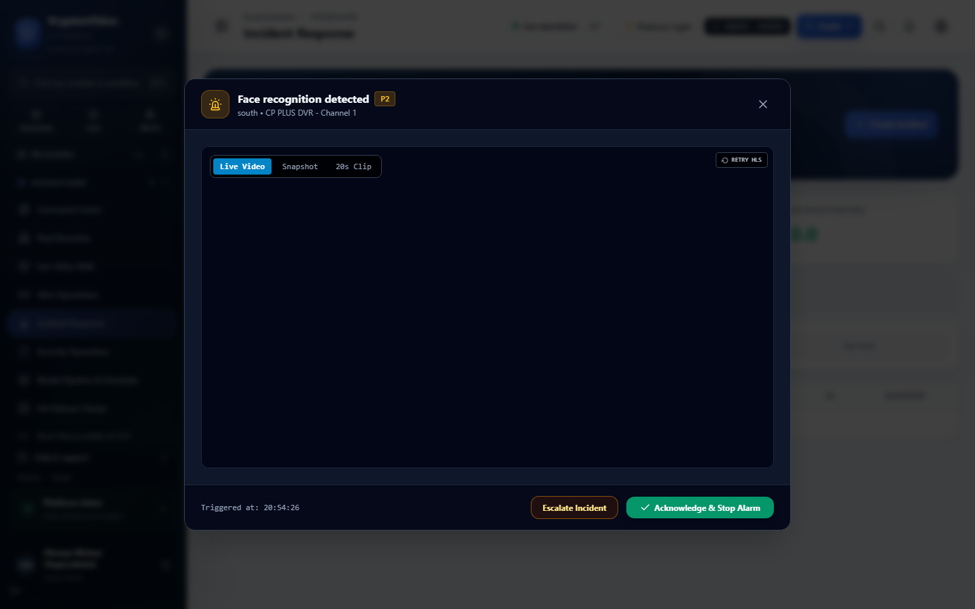
VERIFIABLE CHAIN OF CUSTODY & REGULATORY AUDIT
Incident Response & Tamper-Proof Evidence Vault
• End-to-End Incident Lifecycle
Seamless progression from live Alert -> Operator Acknowledgment -> Evidence Annotation -> Police / Legal Escalation.
• Cryptographic Evidence Packaging
One-click export of court-admissible evidence bundles sealed with SHA-256 hashes and digital watermarks to prevent tampering.
• Immutable Audit Ledger
Every operator interaction, stream view, PTZ motion, configuration change, and video export is written to an immutable log.
• Operator Feedback Loop (Precision Tuning)
Operators mark detections as True Positive or False Alarm, providing ground-truth data for continuous AI model retraining.
• External Regulatory Reporting
Generates compliant compliance PDF/CSV reports ready for RBI / Internal Audit inspection within seconds.
Incident Response & Evidence Packaging (/operations/incidents)
KryptonLogic | KryptonVision AI Video Platform | Confidential Client Demo

Slide 10
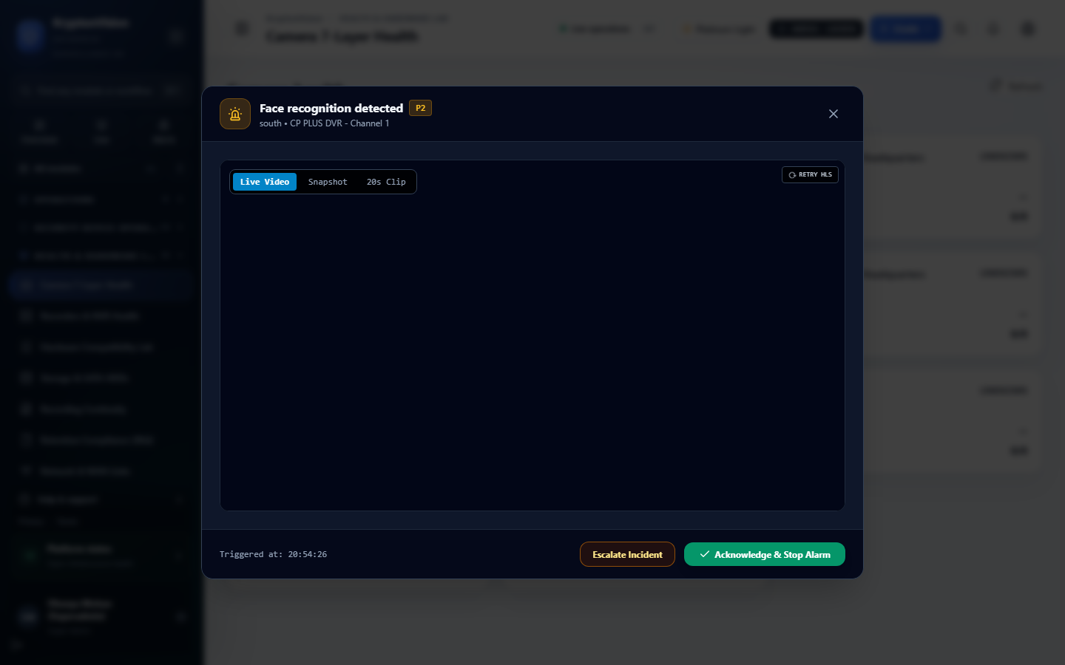
INFRASTRUCTURE VISIBILITY & PROACTIVE MAINTENANCE
Central Device Health, Diagnostics & Storage Lifecycle
• Live Stream Quality Telemetry
Continuous real-time monitoring of camera FPS, bitrate, jitter, dropped frames, and packet loss across every branch.
• Automated Camera Clock Drift Alerts
Alerts if a camera's hardware clock diverges from the server NTP by >1000ms, safeguarding legal timestamp validity.
• Automated Maintenance Workorders
Automatically flags offline cameras, degraded streams, or lens obstructions, generating tickets for field service teams.
• Storage Retention & Capacity Guard
Monitors storage disk volumes. Automatically triggers retention alerts when volume space drops below 15%.
• Multi-Tier Storage Architecture
Optimizes cost by writing high-speed recordings to local SSDs while automatically transferring cold archives to cloud S3/NAS.
Central Camera Health & Diagnostic Diagnostics (/maintenance/cameras)
KryptonLogic | KryptonVision AI Video Platform | Confidential Client Demo

Slide 11
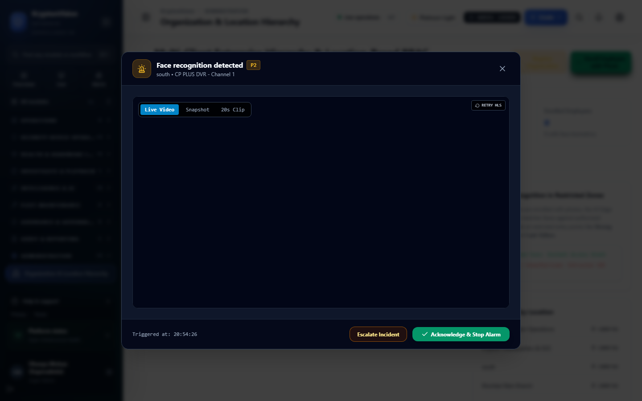
SCALABLE ORGANIZATIONAL MANAGEMENT & ACCESS CONTROL
Multi-Tenant Hierarchy & Enterprise Governance
• Hierarchical Organizational Tree
Native multi-tier hierarchy: Tenant (Org) -> Region (North/South) -> Branch (Indiranagar) -> Zone (Vault/Counter) -> Camera.
• Strict Scoped Access (RBAC & ABAC)
Predefined banking roles: Super Admin, Tenant Admin, SOC Operator, Branch Manager, Auditor, and Maintenance Engineer.
• Branch Onboarding Wizard
Zero-friction branch provisioning with automated ONVIF network discovery and bulk camera channel assignment in minutes.
• Device-Agnostic Interoperability
No proprietary camera lock-in. Connects seamlessly with any ONVIF Profile S/G/T or standard RTSP camera (Hikvision, Dahua, Axis, Hanwha, CP Plus).
• Immutable Security Auditing
Every login, token grant, permission change, and camera configuration update is recorded forever in an append-only ledger.
Organization & Multi-Branch Hierarchy Administration (/admin/organization)
KryptonLogic | KryptonVision AI Video Platform | Confidential Client Demo

Slide 12
THE QUANTIFIABLE VALUE DELIVERED BY KRYPTONVISION
Measurable Business ROI & Operational Impact
>92% Reduction
IN FALSE ALARMS
Compound boolean rules and intelligent cooldown state machines filter out environmental noise, letting SOC operators focus on genuine security breaches.
80% Faster
INCIDENT INVESTIGATION
Multi-camera synchronized playback and visual event heatmaps slash video forensic review times from hours to just minutes.
100% Compliance
AUDIT ADHERENCE
Automated dual-custody verification, strongroom duration controls, and tamper logging ensure effortless regulatory compliance.
4x Operator Scale
COST OPTIMIZATION
A single SOC operator can effectively monitor over 150+ cameras with intelligent automated triage, versus only 20-30 on traditional VMS.
TOTAL COST OF OWNERSHIP (TCO) ADVANTAGE:
KryptonVision works with your existing IP camera infrastructure without requiring expensive proprietary hardware replacements, slashing initial capital expenditures (CAPEX) while drastically reducing ongoing security staffing OPEX.
KryptonLogic | KryptonVision AI Video Platform | Confidential Client Demo

Slide 13
STRUCTURED AGENDA FOR TODAY'S PRODUCT PRESENTATION
Live Demonstration Walkthrough Flow
Step 1: Central Command & Live Video Wall
Experience sub-second multi-camera video streaming, dynamic grid arrangement, and instant PTZ response.
Step 2: Visual Zone Designer & Rule Creation
Watch how simple it is to draw a polygon zone over a live stream and activate a compound security rule in under 60 seconds.
Step 3: Real-Time Threat Trigger & Anti-Storm Alert
Observe live event detection in action with intelligent deduplication, cooldown suppression, and automated dispatch.
Step 4: Synchronized Playback & Forensic Investigation
Seamlessly scrub through multi-angle historical video, inspect heatmap markers, and jump precisely to breach moments.
Step 5: Evidence Packaging & Audit Integrity
Generate a digitally signed, tamper-proof evidence bundle with cryptographic SHA-256 hash sealing.
KryptonLogic | KryptonVision AI Video Platform | Confidential Client Demo

Slide 14
ARCHITECTED TO FIT YOUR INFRASTRUCTURE
Deployment Flexibility & System Compatibility
On-Premises Edge Appliance
HIGHEST SECURITY & PRIVACY
• Deploys directly on local branch hardware or edge AI microservers.
• Zero continuous cloud bandwidth requirement.
• Local video storage with POSIX NVMe indexing.
• Ideal for high-security banking branches and air-gapped vaults.
Hybrid Enterprise Architecture
BEST OF BOTH WORLDS
• Edge inference & local recording at branch level.
• Central cloud management for SOC command center & compliance.
• Low WAN bandwidth consumption with metadata-only synchronization.
• Clustered multi-branch aggregation across regional offices.
Fully Cloud-Managed VMS
MAXIMUM SCALABILITY & AGILITY
• Direct secure gateway streaming to cloud infrastructure (AWS/GCP/Azure).
• Unlimited tiered storage retention with automatic S3 archival.
• Global accessibility from any authenticated device or SOC terminal.
• Instant zero-maintenance updates and elastic scaling.
KryptonLogic | KryptonVision AI Video Platform | Confidential Client Demo

Slide 15
KRYPTONLOGIC TECHNOLOGIES
Ready to Transform Your Surveillance?
KryptonVision upgrades existing video surveillance networks into an intelligent, proactive, and compliant security command ecosystem.
RECOMMENDED NEXT STEPS: 48-HOUR PILOT / PROOF-OF-CONCEPT
Deploy KryptonVision on 5-10 existing cameras in your live environment with zero disruption. Experience real-time alerts, visual rules, and synchronized playback within 48 hours.
Thank You! Let's Proceed to the Live Product Demo & Q/A

