Slide 1

ENTERPRISE PROPOSAL & PITCH DECK
SENTINEL GRID™
Next-Generation AI Video Surveillance & Centralized Operations Platform
Transform Existing CCTV Infrastructure into an Autonomous, Proactive Safety & Security Command Center.
Developed by Hustler Technologies / OmSystems | 100% Hardware Agnostic | Prices in KES | Confidential

Slide 2
EXECUTIVE CONTEXT
The Critical Flaws of Conventional CCTV Surveillance
Silent Hardware & HDD Failures
Over 60% of hard drive corruptions and camera disconnects are discovered only AFTER a crime occurs and footage is requested.
Human Operator Blind Spots
Human guards experience fatigue within 20 minutes. Monitoring 20+ branches simultaneously on standard monitors is physically impossible.
Passive Recording vs. Proactive Response
Traditional systems only record disasters. By the time someone notices an intrusion or fire, thousands in damages have already occurred.
Compliance & Audit Penalties
Regulatory mandates and corporate insurance policies demand 30 to 90 days retention. Missing footage causes massive financial and legal fines.

Slide 3
THE SOLUTION
Sentinel Grid™: Autonomous Multi-Branch AI Intelligence
100% Brand Agnostic
No camera replacement needed. Connects instantly to existing Hikvision, Dahua, CP PLUS, and ONVIF/RTSP feeds.
Sub-Second WebRTC Video
Ultra-low latency (300-800ms) live streaming directly inside modern web browsers with adaptive bitrate optimization.
24/7 Hardware Telemetry
Real-time monitoring of HDD S.M.A.R.T. health, network bandwidth, camera offline status, and dirty lens detection.
Automated AI Alerts (<30s)
Instant detection of Helmet/PPE safety, perimeter breach, after-hours intrusion, vault dual-control, and fire/smoke.
P1 to P4 Incident Escalation
Automatic emergency dispatch: Onscreen video popup, audio sirens, automated phone calls, SMS, and email broadcasts.
Guaranteed Retention Compliance
Live visual tracking of 30/60/90-day retention policies with immediate red flags for any storage breaches.

Slide 4
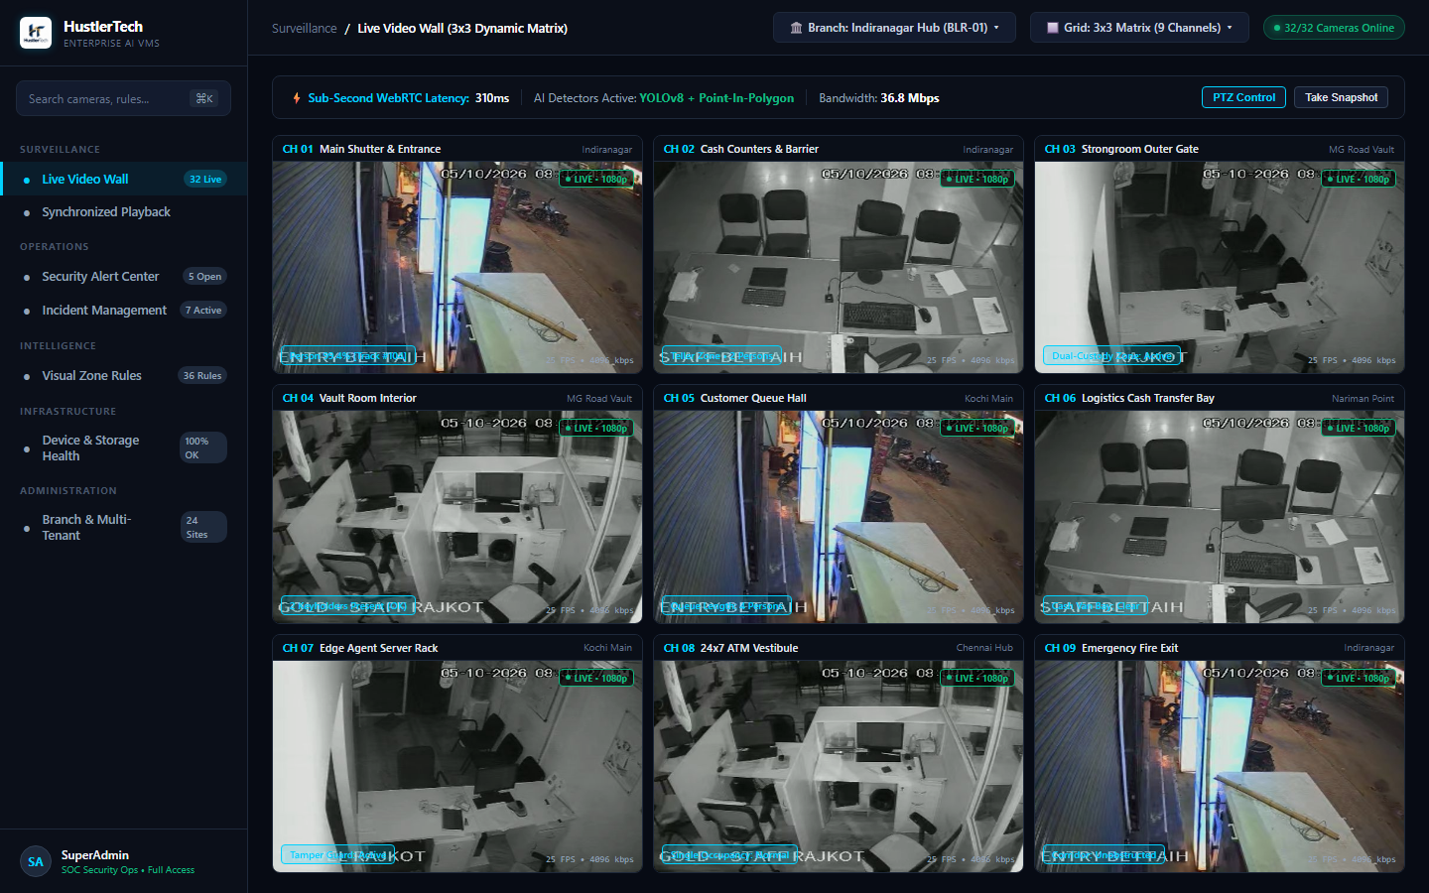
MODULE 01 / CENTRALIZED SURVEILLANCE
Live Video Wall & Sub-Second WebRTC Streaming
• High-Density Multi-Camera Grid
Switch effortlessly between 1, 4, 9, 16, 25, and 36 camera grids across multiple branches.
• Ultra-Low Latency (300-800ms)
WebRTC powered live video with real-time response—no sluggish RTSP lag or heavy desktop plugins.
• Bandwidth Adaptive Streaming
Automatic switching between HD main-stream and low-bandwidth sub-streams based on operator network.
• Interactive Browser PTZ Controls
Pan, tilt, optical zoom, and digital magnification directly from modern web browsers.

Slide 5
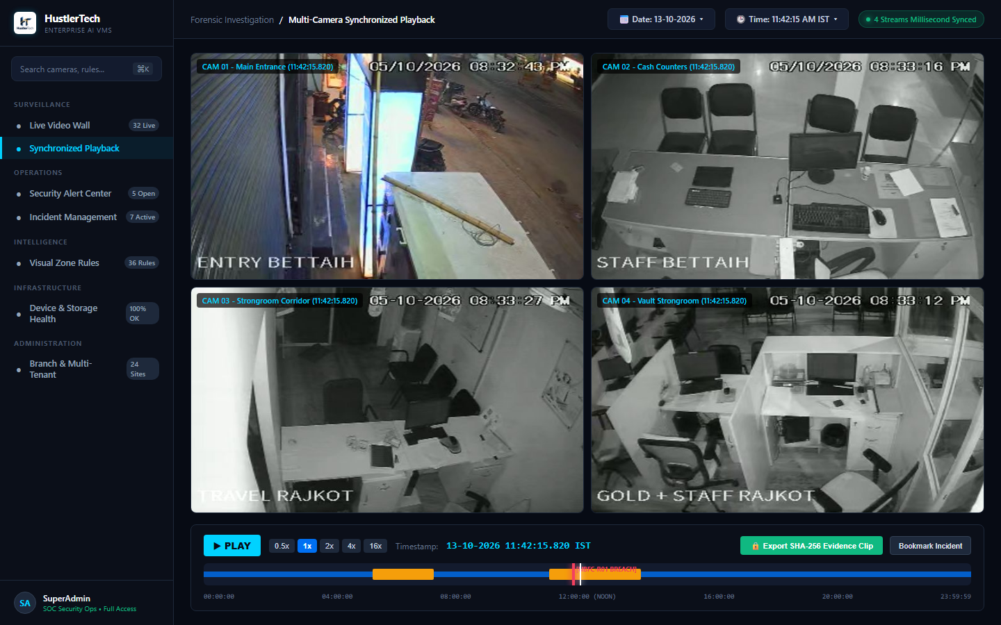
MODULE 02 / FORENSICS & INVESTIGATION
Synchronized Multi-Camera Timeline Playback
• Synchronized Multi-Angle Scrubbing
Replay an incident simultaneously across up to 4 camera angles at the exact millisecond timestamp.
• Precision Speed Controls
Navigate critical evidence with 0.25x slow-motion, frame-by-frame stepping, and up to 4x fast forward.
• Tamper-Proof Video Clip Export
1-click export of verified MP4 footage with cryptographic checksums and digital timestamps.
• Incident Bookmarking
Tag, annotate, and save critical video segments for legal holds, police inquiries, and internal audits.

Slide 6
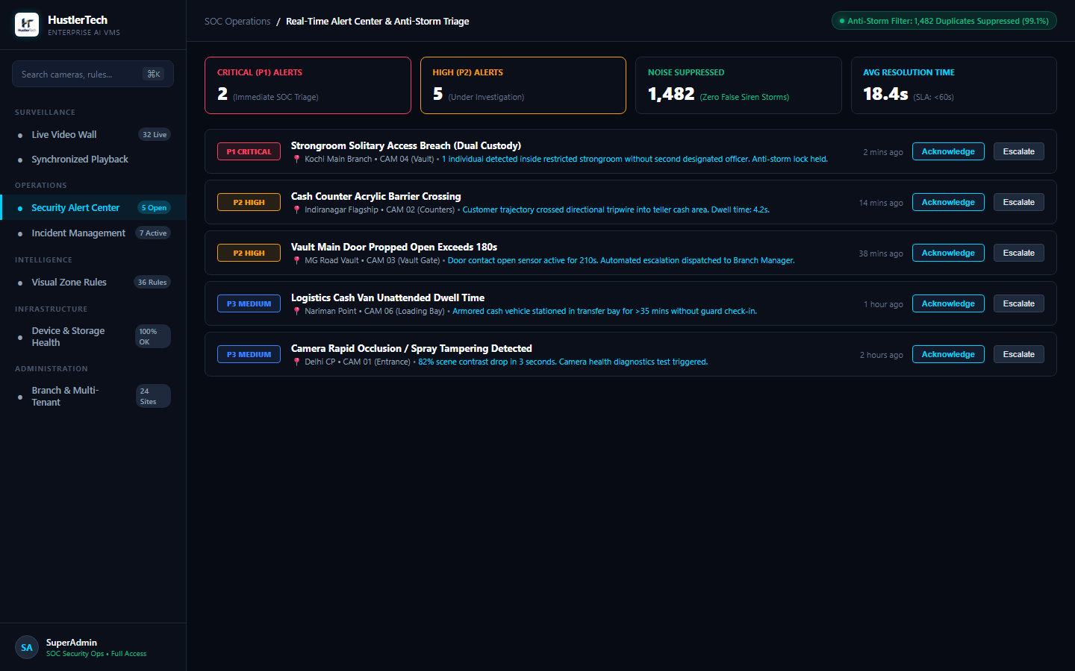
MODULE 03 / AUTOMATED ESCALATION
Proactive Alert Operations & 4-Tier Escalation Matrix
• P1 to P4 Priority Classification
Eliminate alarm fatigue with strict categorization from P1 (Critical Threat) to P4 (Audit Log).
• Automated Multi-Channel Dispatch
P1 alerts trigger onscreen flashing popups, audio sirens, automatic telephone calls, SMS, and emails.
• 1-Click Live Video Popup
Clicking any incoming alert instantly renders the live camera feed plus pre/post event video clips.
• Operator Acknowledge & Escalate
Strict accountability—every alert requires operator confirmation with escalation audit trails.

Slide 7
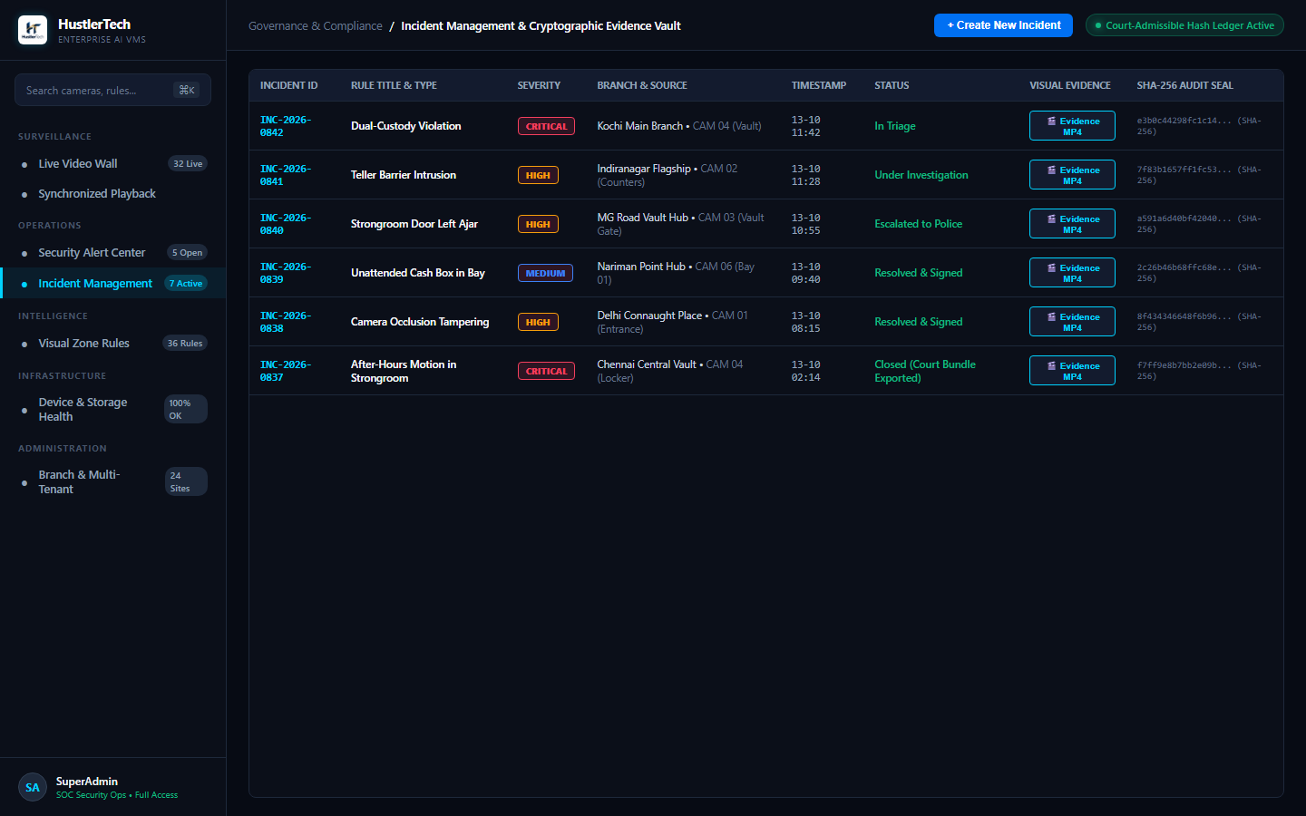
MODULE 04 / COMPLIANCE & GOVERNANCE
Incident Lifecycle Management & Evidence Security
• Structured SOP Workflows
Guides operators and guards through standardized corporate checklists during critical events.
• Immutable Digital Audit Log
Every camera view, playback session, alert dismissal, and video download is permanently logged.
• Evidence Locking Protection
Prevents incident video segments from being automatically overwritten by rolling retention schedules.
• Root-Cause Analysis (RCA)
Attach forensic notes, witness statements, and disciplinary outcomes to formal incident cases.

Slide 8
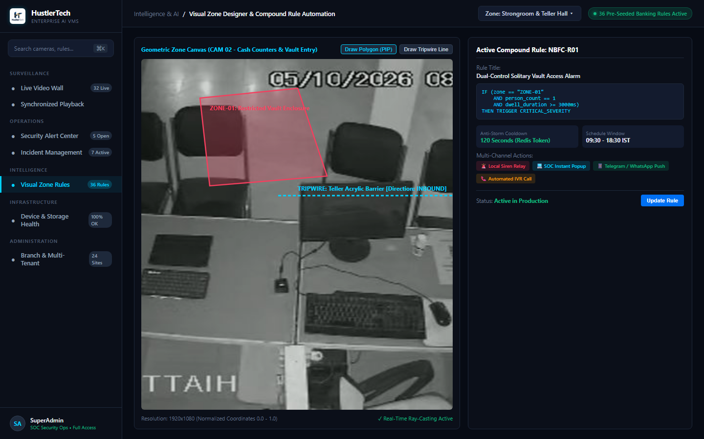
MODULE 05 / AI COMPUTER VISION
Enterprise AI Analytics & Safety Compliance Rules
• Helmet & PPE Safety Compliance
Real-time detection of helmet violations on moving personnel and riders (field-tested and validated).
• Perimeter Intrusion & Tripwires
Virtual boundary lines and exclusion zones detecting trespassers and loiterers instantly.
• Banking & Retail Intelligence
Vault dual-control verification, cashier teller occupancy, queue dwell times, and footfall heatmaps.
• Early Fire & Smoke Warning
Detects visible flames and smoke clouds seconds before traditional heat/smoke detectors activate.

Slide 9
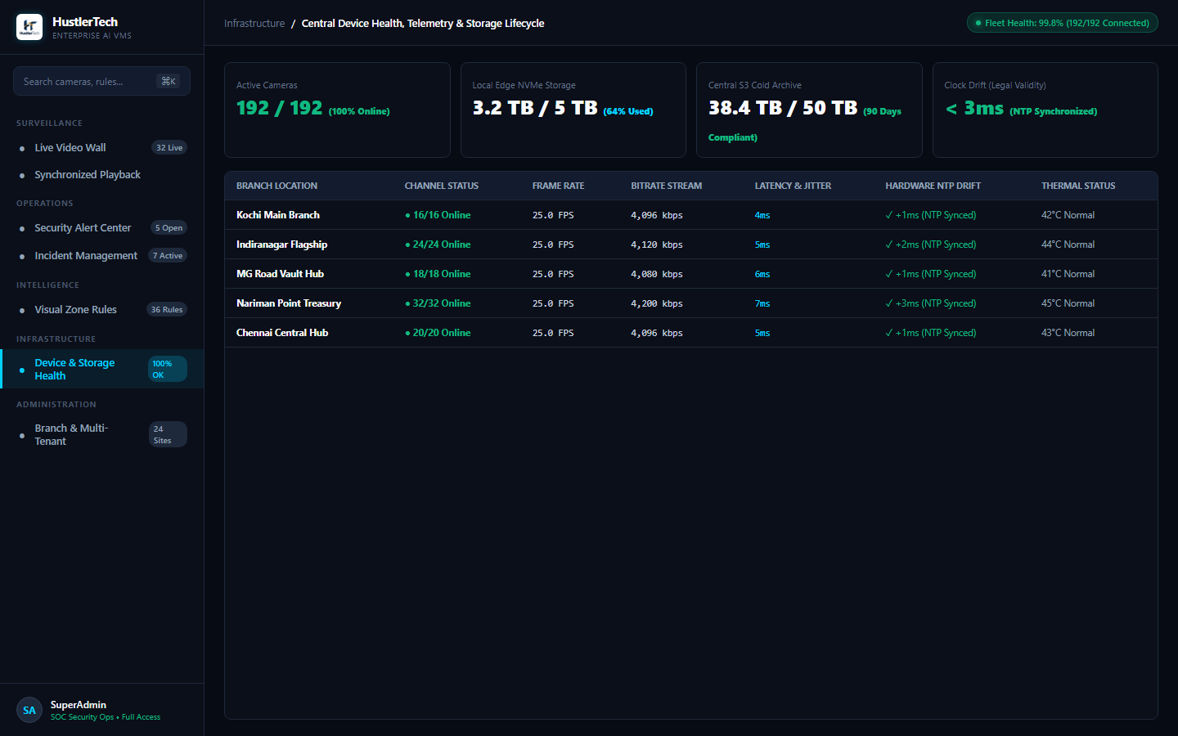
MODULE 06 / PREDICTIVE MAINTENANCE
24/7 Hardware Diagnostics & Retention Compliance
• S.M.A.R.T. HDD Failure Warning
Predictive alerts on failing hard disk sectors before valuable recordings are permanently lost.
• Camera Video Quality Auditing
Automated detection of dirty/obscured lenses, defocus blur, camera tampering, and night-vision IR failure.
• Regulatory Retention Guard
Real-time monitoring of mandatory 30/60/90-day retention policies with bright red violation badges.
• Network & Recorder Reachability
Instant alerts when an NVR or network switch loses broadband connectivity or electricity.

Slide 10
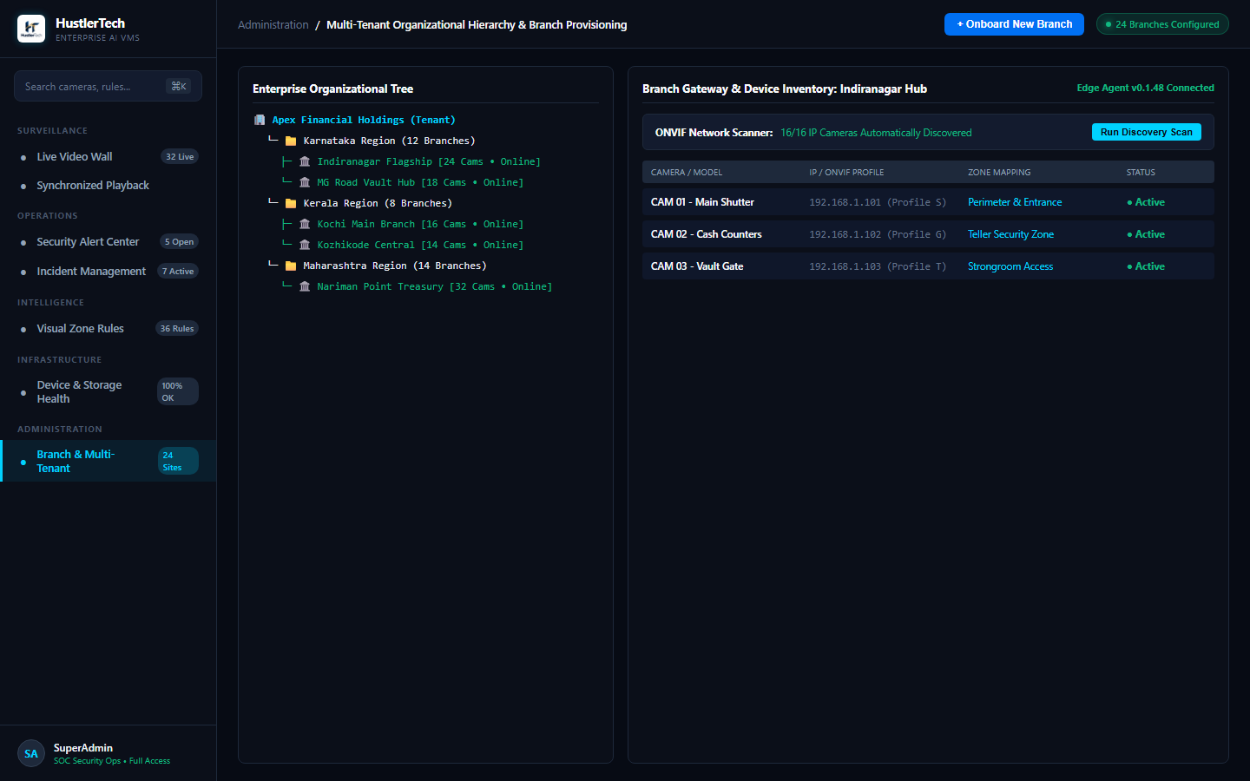
MODULE 07 / CENTRALIZED ADMINISTRATION
Multi-Branch & Role-Based Access Governance
• Central HQ to Branch Hierarchy
Manage 10 to 400+ branches from a single unified enterprise command console.
• Granular Role-Based Access (RBAC)
Assign distinct roles: Super Admin, Regional Manager, Branch Manager, Security Officer, or Auditor.
• Branch Isolation Security
Branch managers only see their designated premises; corporate headquarters oversees the entire fleet.
• Automated Scheduled Digests
Automated daily and weekly operations reports delivered straight to management email in PDF and Excel.

Slide 11
COMMERCIAL PROPOSAL / MODEL A
One-Time Investment (CapEx / Perpetual Platform Ownership)
Item / Module | Scope & Capabilities Included | Price (KES)
Core Server License (Perpetual) | Centralized Control Plane, Command Center Dashboard, PostgreSQL DB Schema, RBAC, Automated Reporting Engine | KES 195,000 (One-Time)
VMS Channel License (Per Camera) | Live video streaming, synchronized multi-camera playback, timeline scrubbing, digital zoom & MP4 export | KES 3,500 – 4,500 / cam
Hardware Health & Retention Pack | Automated HDD S.M.A.R.T. diagnostics, camera tamper/offline alert, 60/90-day retention compliance monitor | KES 1,200 / cam
Enterprise AI Analytics Pack | Choice of Helmet/PPE Safety Detection, Perimeter Intrusion, Line-Crossing, or Vault Monitoring | KES 5,500 – 7,500 / AI cam
Implementation & Commissioning | Server deployment, media gateway setup, branch edge agent integration, network tuning, and admin training | KES 75,000 – 120,000
Annual Maintenance (From Year 2) | Software updates, security patches, device compatibility updates, and priority L2/L3 support (Year 1 FREE) | 18% per annum
💡 Best Suited For: Organizations with existing on-premise servers or CapEx budgets seeking full software asset ownership and minimal ongoing expenditure.

Slide 12
COMMERCIAL PROPOSAL / MODEL B
Recurring Subscription (OpEx / Cloud & Hybrid SaaS in KES)
MOST POPULAR
Tier 1: Essential VMS & Health
KES 280
per camera / month
──────────────────────
✓ Live Video Wall (up to 36 grids)
✓ Synchronized Timeline Playback
✓ 24/7 Camera & HDD Health Telemetry
✓ Regulatory Retention Days Guard
✓ Daily Downloadable PDF/Excel Reports
✓ Standard Business Hours Support
Tier 2: Pro Smart VMS + Security
KES 550
per camera / month
──────────────────────
✓ Everything in Essential VMS
✓ Perimeter Intrusion & Tripwire Detection
✓ After-Hours Presence Alerting
✓ P1–P4 Instant Multichannel Escalation
✓ Live Video Popup with Snapshot Evidence
✓ 24/7 Priority Support & Incident Ticketing
Tier 3: Enterprise AI Intelligence
KES 850
per camera / month
──────────────────────
✓ Everything in Pro Smart VMS
✓ Helmet & PPE Compliance AI Detection
✓ Banking Vault / Teller Dual-Control Rules
✓ Retail Queue Times & Heatmaps
✓ Continuous Custom AI Model Retraining
✓ Dedicated Account Manager & SLA
☁️ Base Platform Cloud Fee: KES 7,500 / month per organization (Includes dedicated server instance, SSL, DB backups, WebRTC relay & unlimited users).

Slide 13
FINANCIAL ANALYSIS / 3-YEAR TCO
CapEx vs. OpEx: 3-Year Investment Breakdown in KES (100 Cameras / 25 Branches)
Financial Dimension | Model A: One-Time CapEx (Perpetual) | Model B: Recurring SaaS (OpEx)
Year 1 Upfront Initial Cost | KES 807,500 (Core + Camera Licenses + Setup) | KES 37,500 (Branch Remote Onboarding)
Year 1 Recurring Cost | KES 0 (1st Year Comprehensive Warranty Included) | KES 750,000 (Monthly Subscriptions + Cloud)
Year 2 Recurring Cost | KES 145,000 (Optional 18% AMC & Updates) | KES 750,000 (Subscription Maintained)
Year 3 Recurring Cost | KES 145,000 (Optional 18% AMC & Updates) | KES 750,000 (Subscription Maintained)
Total 3-Year Investment | KES 1,097,500 (Lowest 3-Year TCO) | KES 2,287,500 (Zero Upfront Risk)
Balance Sheet Impact | Capital Asset (Depreciable over 3-5 Years) | Operating Expense (100% Tax Deductible)
Software Upgrades & AI | Included under active AMC | Continuous automatic cloud deployment

Slide 14
DEPLOYMENT & ONBOARDING
Rapid 14-Day Implementation & Fleet Rollout Plan
Phase 1: Days 1–3
Phase 2: Days 4–7
Phase 3: Days 8–11
Phase 4: Days 12–14
Network & Camera Audit
• Audit existing IP cameras & NVRs
• Validate ONVIF/RTSP streams
• Assess branch internet bandwidth
• Map camera physical locations
Pilot Deployment
• Deploy Edge Agent on 2–3 pilot sites
• Establish sub-second WebRTC link
• Configure centralized live video wall
• Validate HDD S.M.A.R.T. telemetry
AI Calibration & Alerts
• Calibrate Helmet & PPE detection
• Define perimeter & intrusion zones
• Configure P1-P4 escalation matrix
• Test SMS, Email & Phone dispatch
Fleet Rollout & Handover
• Roll out remaining branch agents
• Configure user roles & permissions
• Conduct operator & manager training
• Formal production sign-off

Slide 15
NEXT STEPS
Ready to Experience Sentinel Grid™ in Action?
We invite you to experience the platform through a Zero-Risk, 7-Day Live Pilot on 2–3 of your existing branches in Kenya.
Step 1: Select 2-3 Branches
Choose representative retail, branch, or warehouse locations for initial setup.
Step 2: 30-Minute Remote Setup
Our engineers install the lightweight Edge Agent remotely without disrupting business.
Step 3: Live Executive Evaluation
Your leadership gets immediate access to the live wall, health telemetry, and AI alerts.
Hustler Technologies / OmSystems Enterprise Sales Team | Email: contact@omsystems.com | Confidential

