Slide 1

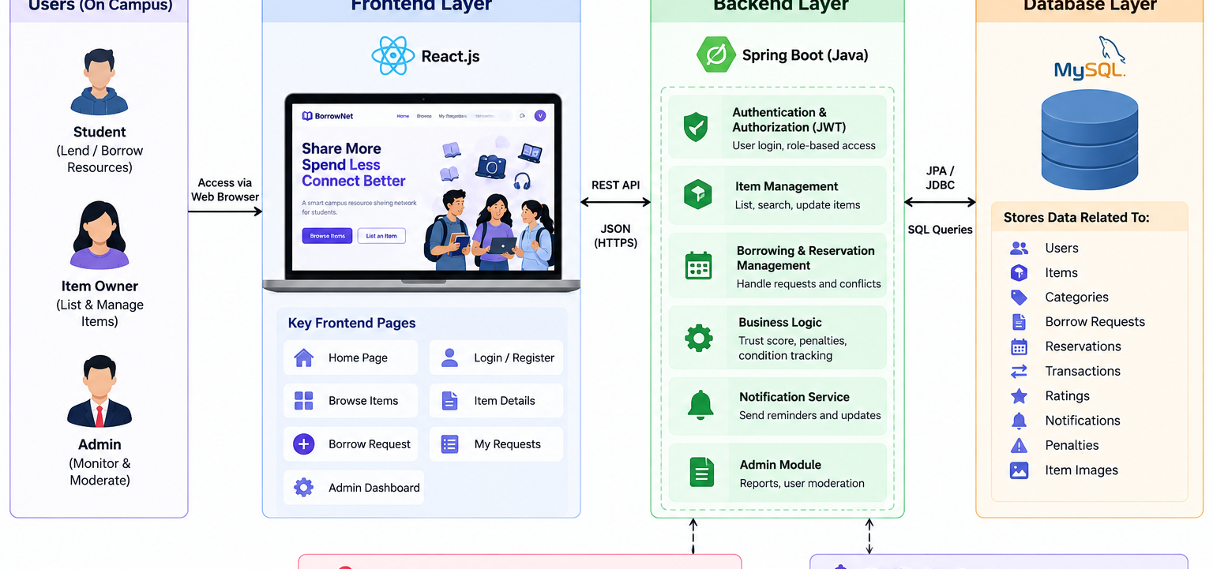
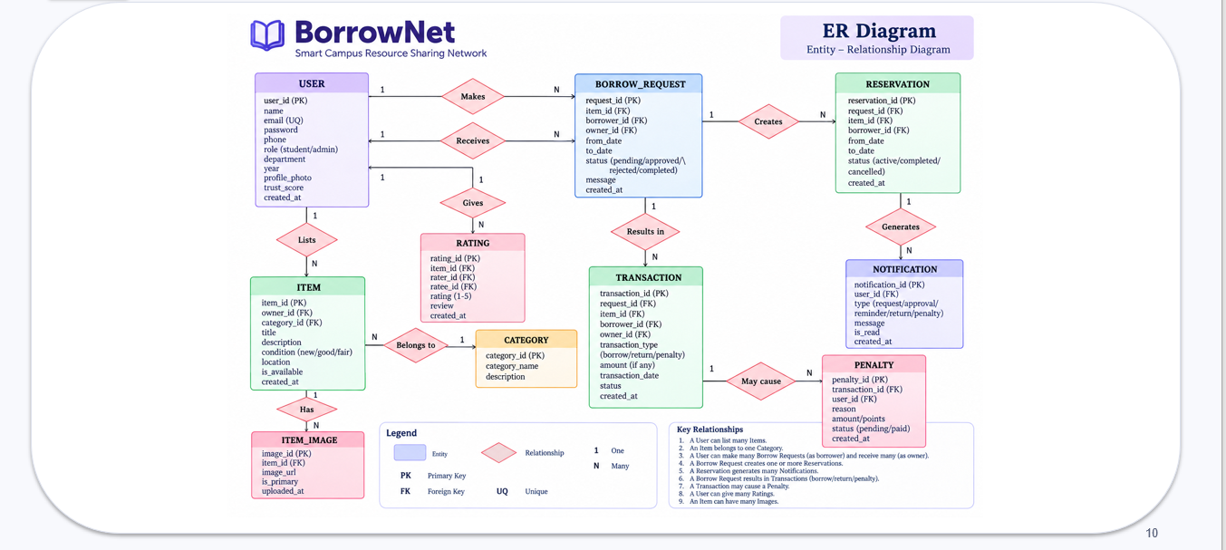
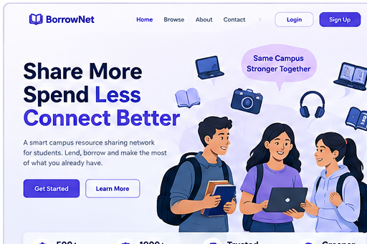
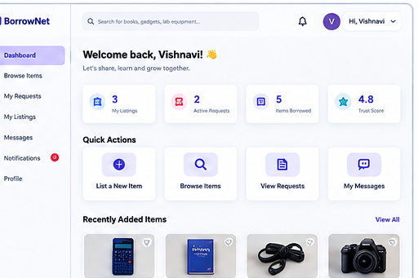
BorrowNet – Smart Campus Resource Sharing Network
Team ID: 30 | Section: SEC 10 | V Vaishanavi – 2520090117 | Y Mohana Priya – 2520090176
Guide: Dr Divya Priya
Abstract
Tools & Technologies
BorrowNet is a smart campus resource-sharing network for lending and borrowing short-term-use resources such as calculators, books, chargers, lab equipment and project components.
It centralizes listing, availability, requests, reservations, returns and accountability.
Benefit: affordable, transparent and trackable campus sharing.
Front-End: React.js
Back-End: Java + Spring Boot + REST APIs
Database: MySQL
Security: JWT + role-based access
Tools: Git/GitHub, Postman, VS Code, MySQL Workbench
Core data: Users, Items, Categories, Requests, Reservations, Transactions, Ratings, Notifications & Penalties
Problem Statement & Objectives
Problem: Informal sharing through friends/groups makes availability, reservations, returns, condition and accountability difficult to track.
Objectives:
• Centralize resource listing and search
• Manage requests, approval and reservations
• Track returns, ratings and penalties
• Maintain secure records and notifications
System Architecture
Existing vs Proposed System
Feature | Existing System | BorrowNet Proposed
Resource discovery | Friends / groups | Centralized search & listings
Availability | Manual checking | Availability tracking
Borrowing | Informal requests | Request + owner approval
Reservations | No structured flow | Conflict-aware reservations
Accountability | Limited tracking | Transactions + ratings + penalties
ER Diagram & Database Design
Feasibility Study
Technical: React.js + Java/Spring Boot + REST APIs + MySQL are suitable for implementation.
Economic: Open-source tools keep software cost low.
Operational: Simple campus workflow—list → search → request → approve → borrow → return.
Schedule: Frontend, backend, database and testing can progress in parallel.
Implementation Screenshots
Results & Testing
Conclusion
Future Scope
Testing focus:
• Registration/login validation
• Item CRUD and search
• Borrow request & approval
• Reservation conflict checks
• Return and transaction tracking
• Database/API validation
BorrowNet creates a structured, backend-driven campus sharing workflow.
It connects students, resources, requests, reservations and transactions while improving transparency, security and accountability.
• AI resource recommendations
• Demand prediction
• Mobile app + QR pickup/return
• Smart reminders
• Usage analytics
References: Spring Boot Documentation | React.js Documentation | MySQL Documentation | REST API & JWT references | BorrowNet ER model
QR
GitHub

