Slide 1
INSTRUCTIONS
Use Font size 22 to 28 and Font Style Times New Roman (body)
Do not change the Template: Heading / Title of the slides
Do not change font style or colours
Do not copy paste paragraphs: use only Bullet Points
Maximum slide Limit is 20 only
As per the number of supervisor allotted adopt slide-2 or slide-3
Please display the required meaningful Content or images or tables
Change the footer accordingly using insert tab then click on header & footer tab and edit it
Save the PPT with Register No, Dept and Review no, example: 23xxxxxxxxx_CSE

Slide 2

Title: Workshop Seminar Enrollment Coordination Interface
Student Name: Y . Mohana Priya
Student ID: 2520090176
Cluster:04
Section: 15
Under the Guidance
of
Supervisor Name: Surekha . P
Assistant Professor
Department of CSE

Slide 3
OUTLINE
Abstract
Existing System
Proposed System
System Architecture
Project Modules
Objectives
Co’s Attainments - FWD
Co1
Co2 …….. 5. Co5
Co’s Attainments - DSA
Co1
Co2 …….. 5. Co5
Screen Shots for FWD & DSA
Conclusion
Geo-Tagged Photos

Slide 4
Abstract
Workshop Hub is a web-based platform designed to help students discover and register for skill development workshops.
Provides a centralized interface to browse workshops based on category, availability and schedule.
Users can view detailed workshop information and register through an interactive interface.
Developed using HTML, CSS and JavaScript for responsive web design.
Improves accessibility and awareness of educational workshops for students.

Slide 5
Existing System
Workshop information is scattered across different websites and platforms.
Students must manually search multiple sources to find suitable workshops.
Limited information about workshop schedules and seat availability.
No centralized platform for browsing and registering workshops.
Difficult for students to track upcoming learning opportunities.

Slide 6
Proposed System
Workshop Hub provides a centralized platform for discovering workshops.
Users can easily browse workshops in one interface.
Displays workshop details such as description, date and availability.
Students can quickly register through a simple registration interface.
Improves user experience and accessibility compared to existing systems.

Slide 7
System Architecture
User interacts with the system through a web browser.
Frontend interface developed using HTML, CSS and JavaScript.
Workshop information is displayed dynamically in the interface.
Users search and register for workshops through the application.
Architecture follows a simple client-side web application model.

Slide 8
Project Modules
Home Module – Displays introduction and featured workshops.
Workshop Listing Module – Shows all available workshops.
Workshop Detail Module – Provides complete workshop information.
Registration Module – Allows students to enroll in workshops.
Navigation Module – Enables searching and browsing workshops.

Slide 9
Objectives
Provide an easy platform to discover skill development workshops.
Allow students to register quickly for events and learning programs.
Display workshop details and seat availability clearly.
Improve accessibility of educational workshops.
Develop a responsive and user-friendly web application.

Slide 10
CO’s Attainments - FWD
CO1 – Understand web fundamentals, HTML structure and CSS styling.
CO2 – Design structured webpages using forms, semantic HTML and CSS layouts.
CO3 – Apply JavaScript concepts to create dynamic web applications.
CO4 – Implement DOM manipulation, event handling and browser storage.
CO5 – Integrate APIs, optimize performance and deploy responsive websites.

Slide 11
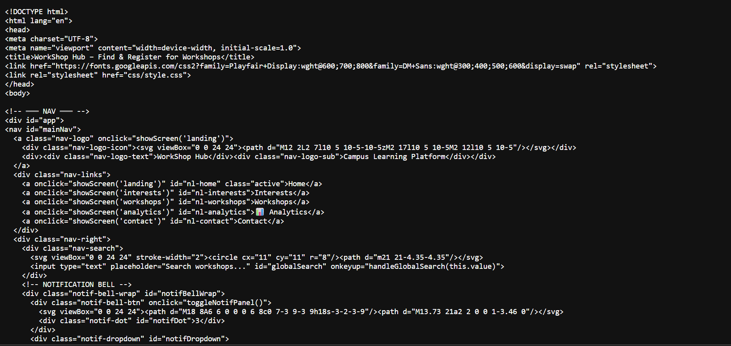
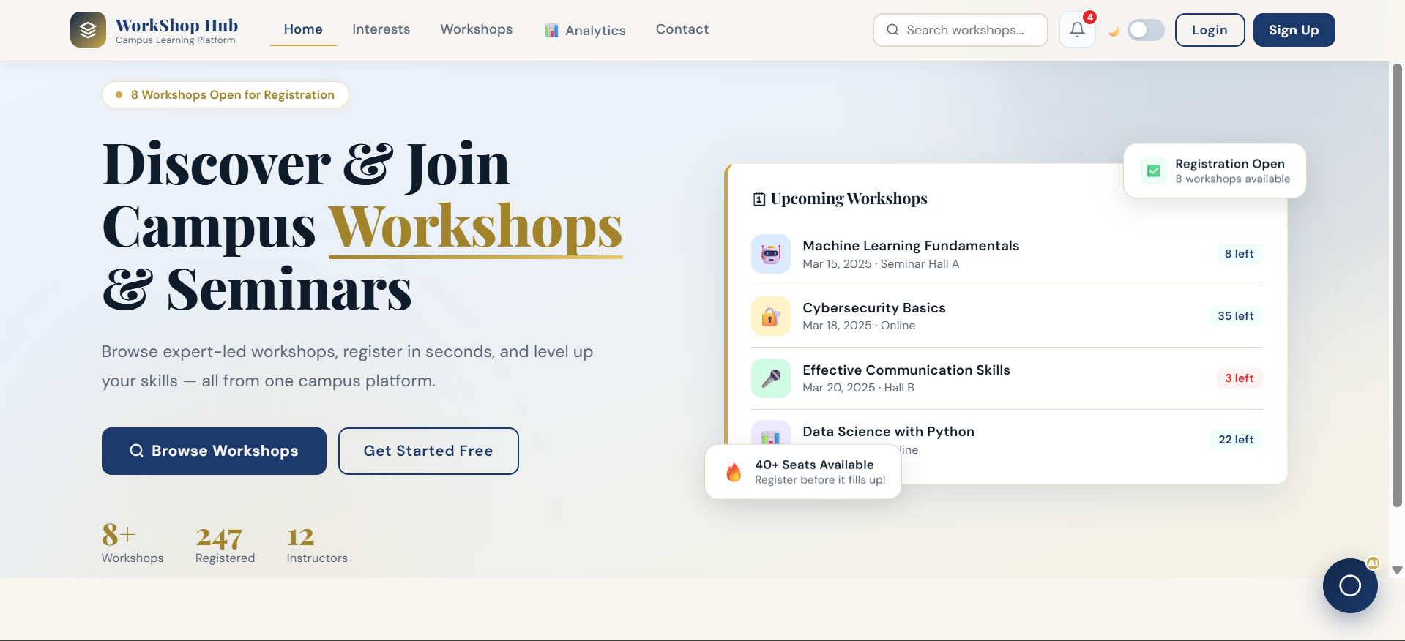
Screenshots for FWD

Slide 12
Conclusion
Workshop Hub simplifies the process of finding and registering for workshops.
Provides a centralized platform for students to explore learning opportunities.
User-friendly design enhances usability and accessibility.
Demonstrates the practical application of FWD concepts.
Future enhancements may include database integration and authentication.

Slide 13
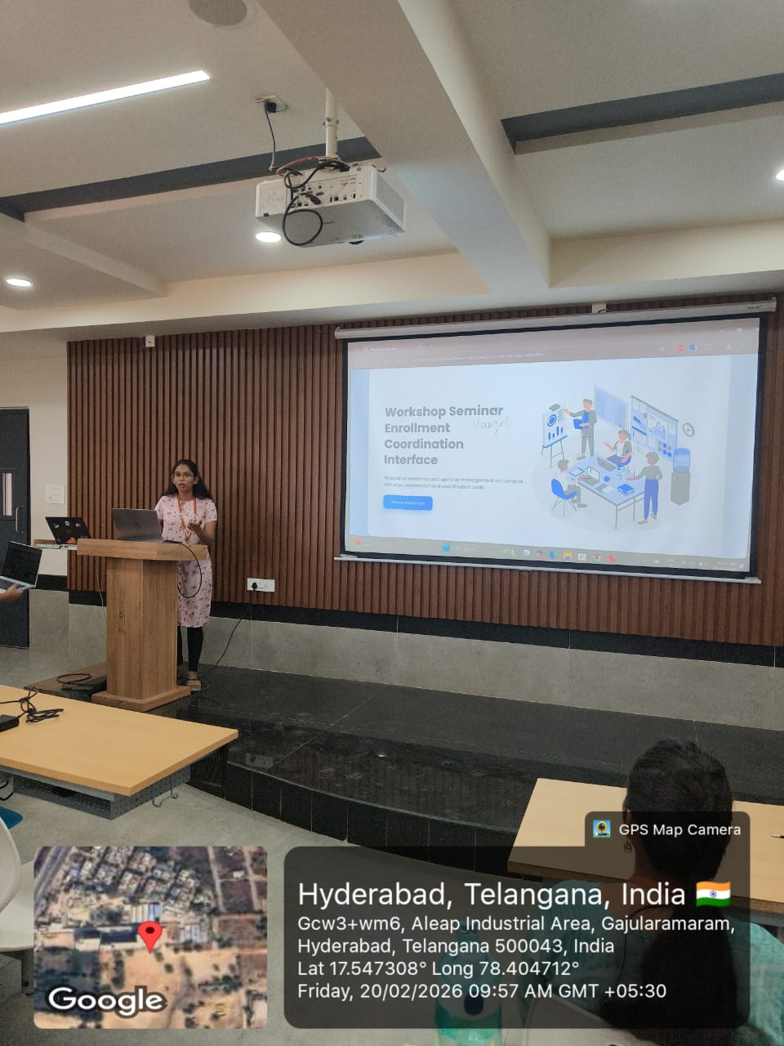
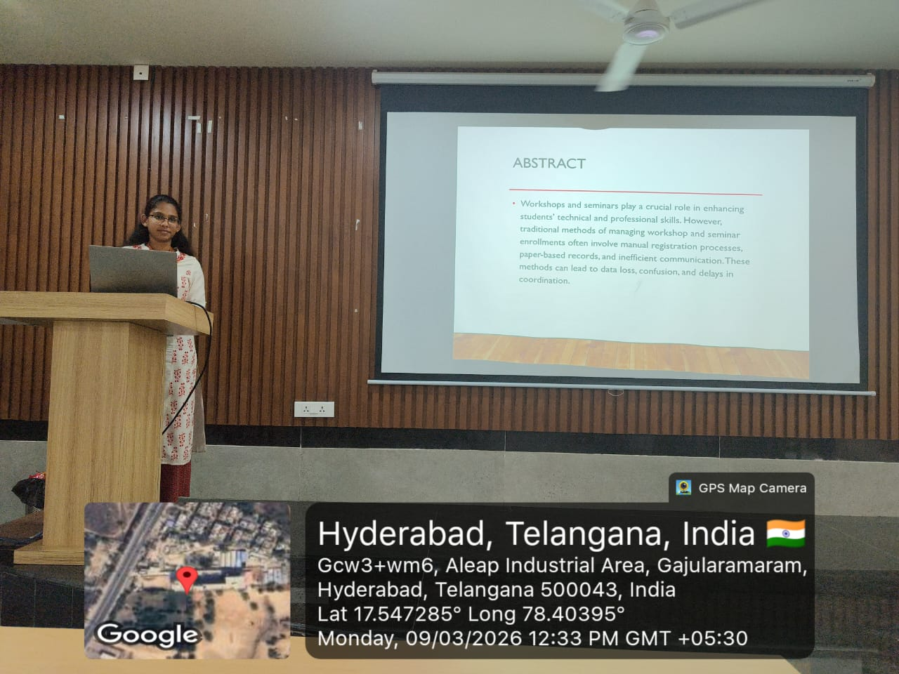
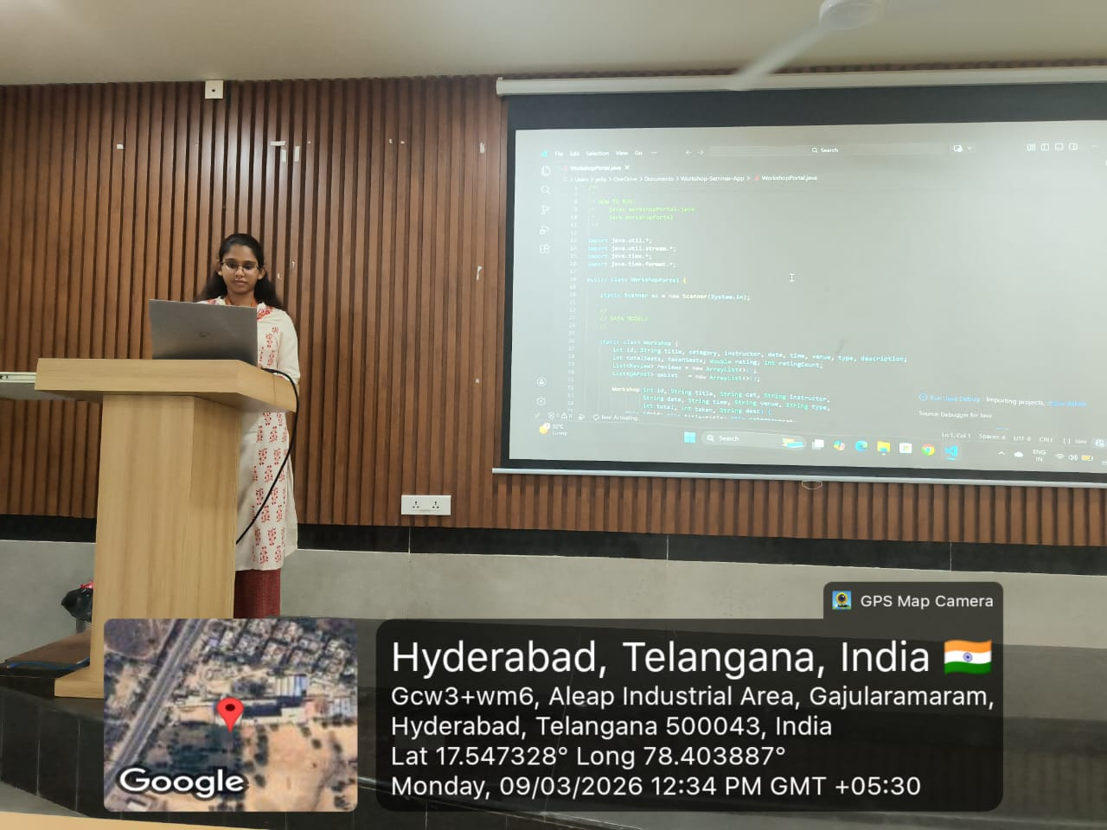
Geo-Tag Photos

Slide 14
THANK YOU

