Slide 1
Online Chatbot based Ticketing System
DEPARTMENT OF CSE-AIML (CSM) – IV-II Sem
Project Review
Batch 10:
Team Members
1. K. Mohana Priya (21BQ1A4290)
2.K. Pavani (21BQ1A4281)
3. K. Anvesh Naik (21BQ1A4282)
4.K. Suvarna Raju (22BQ5A4207)
Project Guide:
Mr. Sd Beeban Basha,
Associate Professor,
Dept.of CSM,
VVIT

Slide 2
Online chatbot based Ticketing System
DEPARTMENT OF CSE-AIML (CSM) – IV-II Sem
Project Review
Batch 10:
Project Description:
The Online Chatbot-Based Ticketing System is an intelligent solution designed to simplify and enhance the process of booking tickets for museums. Combining conversational AI with a user-friendly interface, the system allows users to book tickets, manage bookings, and explore museum information through natural language interactions.
This system streamlines ticketing by integrating multilingual support, dynamic pricing, real-time availability checks, and secure payment gateways. It also offers personalized recommendations, accessibility features, and notifications to improve user experience. By leveraging advanced technologies like Natural Language Processing (NLP), Machine Learning, and cloud integration, the chatbot ensures seamless communication, scalability, and efficiency.
The chatbot addresses common challenges like long queues, inefficient manual processes, and lack of personalization, transforming the ticketing experience into a fast, hassle-free journey.
Project Functional Requirements: (Features)
User Registration and Authentication
Multilingual Support
Conversational Interface
Museum Search and Recommendations
Dynamic Pricing
Automated Ticket Booking and Confirmation
Booking Management
Notifications and Alerts
Analytics and Reporting
Accessibility Features
Virtual guided tours
Real-Time Crowd Prediction
Exhibit Insights
Chat Context Awareness
Payment Gateway

Slide 3
Online chatbot based Ticketing System
DEPARTMENT OF CSE-AIML (CSM) – IV-II Sem
Project Review
Batch 10:
Project Tools Required:
Frontend: React.js, HTML, CSS, JavaScript
Backend: Node.js, Python (Django)
Database: MySQL for transactional data, MongoDB for flexible museum metadata
Cloud Services: AWS, Azure, or GCP for scalability and disaster recovery
Machine Learning: TensorFlow, Scikit-learn for recommendation and crowd prediction
Security: JWT for authentication, AES for encryption
Payment Integration: Razorpay, PayPal, or Stripe

Slide 4
Online Chatbot based Ticketing System
DEPARTMENT OF CSE-AIML (CSM) – IV-II Sem
Project Review
Batch 10:
Member | Feature
Mohana Priya | Multilingual Support Accessibility Features Analytics and Reporting Real time Crowd Prediction
Pavani | Museum Search and Recommendations Automated Ticket Booking and Confirmation Booking Management Exhibit Insights
Anvesh Naik | User Registration and Authentication Conversational Interface Virtual guided Tours Notifications and Alerts
Suvarna Raju | Dynamic Ticket Pricing Payment Integration Chat Context Awareness

Slide 5
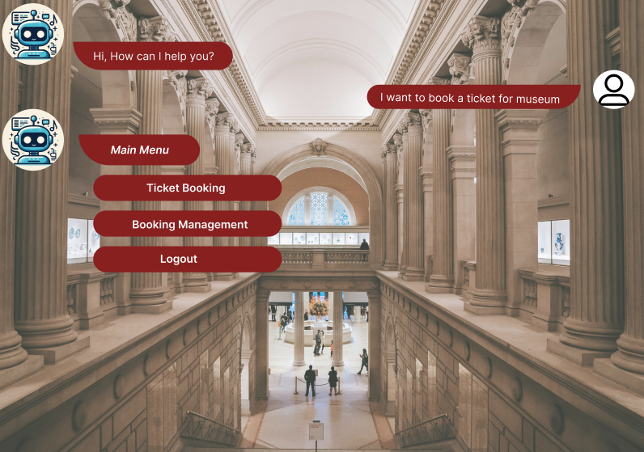
Online Chatbot based Ticketing System
DEPARTMENT OF CSE-AIML (CSM) – IV-II Sem
Project Review
Batch 10:

