Slide 1
HANDSPEAK AI: REAL-TIME SIGN LANGUAGE INTERPRETER FOR SEAMLESS COMMUNICATION

Slide 2
ABSTRACT:
The proposed system, HandSpeak AI: Real-Time Sign Language Interpreter for Seamless Communication, aims to bridge the communication gap between the hearing-impaired community and the general public by providing an intelligent, real-time sign language recognition framework. Leveraging advanced Convolutional Neural Networks (CNNs) and computer vision techniques, the system captures hand Signs through accurately interprets signs representing alphabets A to Z of sign language. The recognized signs are instantly converted into readable text or accessible interactions in diverse social and professional settings. Designed to operate efficiently on both desktop and Web platforms, this AI-powered interpreter promotes inclusivity, enhances accessibility, and empowers users with improved communication capabilities in real-time.
Keywords: Sign Language Recognition, Real-Time Interpreter, HandSpeak AI, CNN, Computer Vision, A-Z Hand Signs, Accessibility, Inclusivity, Human-Computer Interaction, Deaf Communication

Slide 3
EXISTING SYSTEM:
Continuous sign language recognition (CSLR) plays a crucial role in facilitating communication between deaf and hearing individuals. A key aspect of achieving precise CSLR is the alignment of the video segment of each sign with its gloss, namely its corresponding text representation in natural language. However, the coarticulation phenomenon, where contextual dependencies between adjacent signs blur the boundaries of individual signs, poses a significant challenge to this task. In this paper, we propose a novel boundary-aware sentence-gloss alignment network for CSLR to address this challenge. Our network first designs a task-relevant boundary-aware similarity measurement, evaluating sign frames by both appearance and their recognition contribution, mitigating coarticulation-induced transition noise to restore precise boundaries. For enhanced alignment, we propose a hierarchical sentence-gloss alignment: coarse sentence-level alignment reduces cross-modal disparity, while fine-grained gloss-level alignment refines video-to-token mapping. Finally, an adaptive class-divergence loss sharpens gloss decoding by maximizing inter-class discrimination. Our proposed framework provides a simple and effective solution to mitigate the boundary ambiguity caused by coarticulation, optimizing continuous sign language recognition algorithms from a new perspective. Extensive experiments conducted on four public sign language recognition (SLR) datasets demonstrate that our proposed boundary-aware sentence-gloss alignment network learns precise alignments and achieves state-of-the-art performance.

Slide 4
Drawbacks:
High computational cost due to complex boundary-aware similarity and hierarchical alignment processes.
Requires large annotated datasets with precise sentence-gloss alignment for effective training.
Sensitive to video quality and hand Sign occlusions, affecting recognition accuracy.
Struggles with performance on low-resource or mobile devices due to heavy model complexity.
Coarticulation effects may still persist in highly dynamic or rapid signing sequences.

Slide 5
INTRODUCTION:
Hand Sign are an important part of nonverbal communication and form an integral part of our interactions with the environment. Notably, sign language is a set of hand Sign that is valuable to millions of disabled people. However, deaf/dumb users experience difficulty in communicating with the outside world as most neither understand nor can use sign language. Gesture recognition and classification platforms can aid in translating the Sign to those who do not understand sign language. There are two major approaches in the classification of hand Sign. The first approach is the vision-based approach. This involves the use of cameras to acquire the pose and movement of the hand and algorithms to process the recorded images. Although this approach is popular, it is very computationally intensive, as images or videos have to undergo significant preprocessing to segment features such as the image’s color, pixel values, and shape of hand.

Slide 6
PROPOSED SYSTEM:
The proposed system, HandSpeak AI: Real-Time Sign Language Interpreter for Seamless Communication, aims to develop an intelligent, real-time hand Sign recognition framework capable of accurately interpreting the Sign Language (SL) alphabet from A to Z. By leveraging advanced Convolutional Neural Network (CNN) architectures and computer vision techniques, the system will process live video streams to detect and classify hand Signs corresponding to each alphabet letter. This AI-powered solution is designed to bridge communication gaps between hearing-impaired individuals and non-signers by instantly translating recognized hand signs into readable text outputs. The system will be optimized for deployment on web platforms, and assistive communication tools, ensuring accessibility, efficiency, and inclusivity in various social, educational, and professional environments.

Slide 7
Advantages:
Enables real-time translation of sign language alphabets into text.
Leverages advanced computer vision for high-accuracy recognition.
Supports deployment on web platforms for broad accessibility.
Improves inclusivity in social, educational, and professional spaces.
Reduces dependency on human interpreters for basic sign communication.
Scalable and adaptable for future multi-language and Sign extensions.
User-friendly and non-invasive for everyday communication scenarios.

Slide 8
Review of Literature Survey:
Title : Hand Gesture Recognition Based on Computer Vision: A Review of Techniques
Author : Munir Oudah 1 , Ali Al-Naji 1,2,* and Javaan Chahl 2
Year : 2020
Hand Sign are a form of nonverbal communication that can be used in several fields such as communication between deaf-mute people, robot control, human–computer interaction (HCI), home automation and medical applications. Research papers based on hand Sign have adopted many different techniques, including those based on instrumented sensor technology and computer vision. In other words, the hand sign can be classified under many headings, such as posture and gesture, as well as dynamic and static, or a hybrid of the two. This paper focuses on a review of the literature on hand gesture techniques and introduces their merits and limitations under different circumstances. In addition, it tabulates the performance of these methods, focusing on computer vision techniques that deal with the similarity and difference points, technique of hand segmentation used, classification algorithms and drawbacks, number and types of Sign, dataset used, detection range (distance) and type of camera used. This paper is a thorough general overview of hand gesture methods with a brief discussion of some possible applications.

Slide 9
Title : Hand Gesture Recognition with Skin Detection and Deep Learning Method
Author : Hanwen Huang1 , Yanwen Chong2*
Year : 2019
Gesture recognition, although has been exploring for many years, is still a challenging problem. Complex background, camera angles and illumination conditions make the problem more difficult. Thus, this paper presents a fast and robust method for hand gesture recognition based on RGB video. First we detect the skin based on their color. Then we extract the contour and segment the hand region. Finally we recognize the gesture. The results of experiment demonstrate that the proposed method are efficient to recognize gesture with a higher accuracy than the state of the art.

Slide 10
ENVIRONMENTAL REQUIREMENTS:
Software Requirements:
Operating System : Windows 10 or later
Simulation Tool : Anaconda with Jupyter Notebook
Language : Python
Hardware requirements:
Processor : intel i3 or later
Hard disk : minimum 10 GB
RAM : minimum 4 GB

Slide 11
Aim:
Hand Gesture is one of the major factors in our communication society. There are lot of Sign languages that are actively present in the world. So we can’t able to classify the action easily. So this project can easily classify the hand gesture.
Objectives:
The goal is to develop a deep learning model for Hand gesture classification by convolutional neural network algorithm for potentially classifying the results in the form of best accuracy by comparing the CNN architectures.

Slide 12
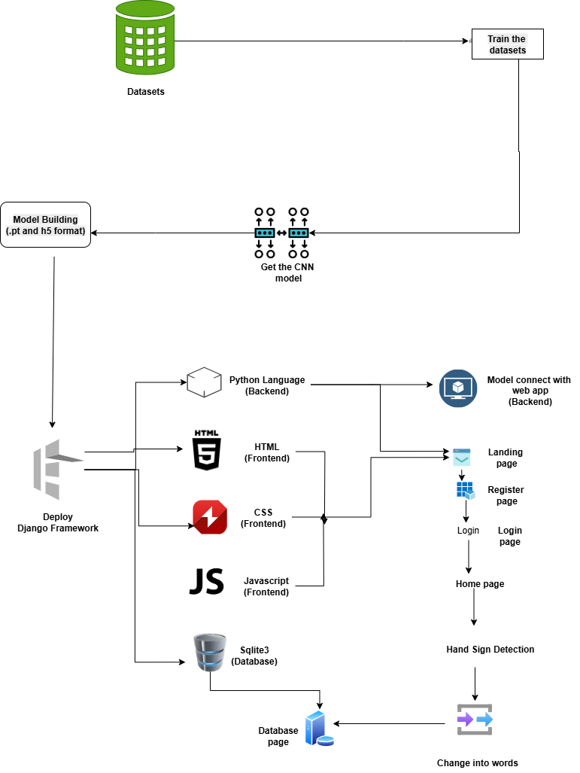
System Architecture:

Slide 13
LIST OF MODULES
1. Manual Net
2. Google Net
3. Mobile Net.
4. Deployment

Slide 14
MODULE DESCRIPTION 1. Data Preparation:
The dataset collection is the very important part of our project. The collection of the dataset is based on the hand posture. Using open CV we can access the live videos. With the help of open CV we record the videos frame by frame. First we record the videos one by one. And save the hand position data as a image in a folder. We repeat this process for the Sign which are needed for us.

Slide 15
2. GOOGLE NET: architecture:
"GoogleNet," also known as "Inception-v1," is a deep learning architecture for image classification. It was developed by a team of researchers at Google, led by Christian Szegedy, and was the winner of the ImageNet Large Scale Visual Recognition Challenge (ILSVRC) in 2014.
The main innovation in the GoogleNet architecture is the use of the "Inception module," which incorporates multiple parallel convolutional operations of different filter sizes to capture features at various scales. This allows the network to learn both fine-grained and high-level abstract features efficiently.
Key features of the GoogleNet architecture:
Inception Module: The Inception module consists of a combination of 1x1, 3x3, and 5x5 convolutional filters, along with max-pooling operations. The idea behind this module is to allow the network to learn features at different spatial scales and capture both local and global patterns effectively. Additionally, 1x1 convolutions are used to reduce the dimensionality of the input channels, which helps in reducing computational complexity.
Multiple Stacked Inception Modules: GoogleNet consists of multiple stacked Inception modules to create a deep network. These modules are designed to capture increasingly complex patterns as the network goes deeper. The inclusion of multiple Inception modules also allows the network to be computationally efficient, as it can utilize different filter sizes simultaneously.
Auxiliary Classifiers: GoogleNet includes auxiliary classifiers at intermediate layers of the network. These auxiliary classifiers serve as "side branches" and are used to combat the vanishing gradient problem during training. They add extra supervision to the network and help in better gradient flow during backpropagation.
Global Average Pooling: Instead of using fully connected layers at the end of the network, GoogleNet employs global average pooling. This operation computes the average value for each feature map in the last convolutional layer, resulting in a single vector that is used as input to the final softmax layer for classification. Global average pooling reduces the number of parameters and helps prevent overfitting.
GoogleNet was one of the early deep learning architectures to demonstrate the effectiveness of deep networks in image classification tasks. It achieved top accuracy in the ILSVRC 2014 competition while being more computationally efficient compared to other models available at the time. Since its introduction, several improved versions of the Inception architecture, such as Inception-v2, Inception-v3, and Inception-v4, have been developed by the research community.

Slide 16
3. MOBILENET architecture:
MobileNet is a family of deep learning architectures designed for efficient on-device image classification and computer vision tasks. It was developed by Andrew G. Howard, Menglong Zhu, Bo Chen, Dmitry Kalenichenko, Weijun Wang, Tobias Weyand, Marco Andreetto, and Hartwig Adam from Google in 2017.
The key motivation behind MobileNet is to create neural network architectures that are computationally lightweight, allowing them to run efficiently on mobile devices with limited resources (e.g., smartphones) and embedded systems. The focus is on achieving a good trade-off between model accuracy and model size or computational complexity.
MobileNet achieves this efficiency through the use of two main techniques:
Depthwise Separable Convolutions: Similar to the Xception architecture, MobileNet utilizes depthwise separable convolutions. This factorizes a standard convolution into two separate operations: depthwise convolution and pointwise convolution.
Depthwise Convolution: In this step, each channel of the input feature map is convolved with its own set of filters independently, just like in Xception. This reduces the computational cost significantly as it requires fewer operations compared to a standard convolution.
Pointwise Convolution: Following the depthwise convolution, a 1x1 pointwise convolution is applied to combine the output channels from the depthwise convolution. This helps capture cross-channel interactions and create the final output feature map.
Width Multiplier: MobileNet introduces a hyperparameter called the "width multiplier" (usually denoted by the Greek letter "α"). The width multiplier scales the number of channels in each layer of the network. By reducing the number of channels in each layer, the model becomes more compact and computationally efficient. The width multiplier allows for easy control over the model's size and computational cost, trading off accuracy for efficiency.
MobileNet comes in different versions, denoted as MobileNetV1, MobileNetV2, and MobileNetV3, each introducing improvements over the previous version. MobileNetV2, for example, introduced inverted residual blocks and linear bottlenecks to improve performance. MobileNetV3 further optimized the architecture with the use of h-swish activation and other refinements.
MobileNet has been widely adopted in various applications, such as real-time image classification on mobile devices, object detection, and semantic segmentation. Its efficiency and effectiveness have made it a popular choice for deploying deep learning models on resource-constrained devices and platforms.

Slide 17
Deployment:
Deploying the model in Django Framework and predicting output
In this module the trained deep learning model is converted into hierarchical data format file (.h5 file) which is then deployed in our django framework for providing better user interface and predicting the output.
Django:
Django is a high-level Python web framework that enables rapid development of secure and maintainable websites. Built by experienced developers, Django takes care of much of the hassle of web development, so you can focus on writing your app without needing to reinvent the wheel. It is free and open source, has a thriving and active community, great documentation, and many options for free and paid-for support.

Slide 18
Prediction of hand Gesture:
After training the model we have to use the trained model to use for deployment. In this deployment model we use opencv to access the live video. It capture the videos and it will help to recognize the pattern and make it sequential data and those recognized data will flow through our trained model. Finally the model will predict the gesture and it will display the text based on the sign gesture.

Slide 19
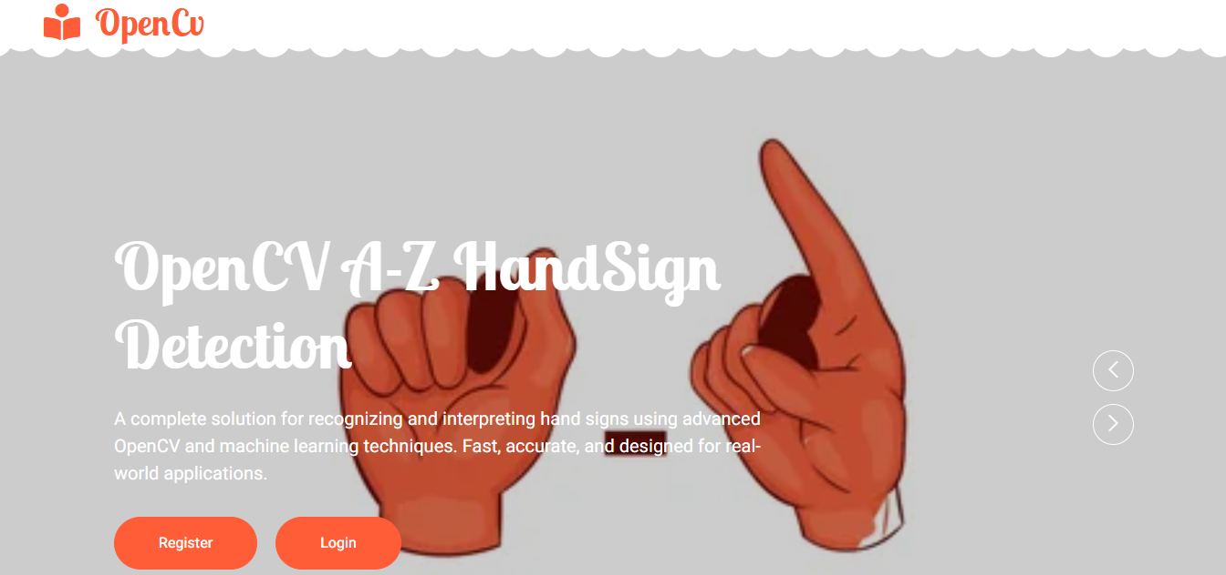
OUTPUT SCREENSHOT:

Slide 20
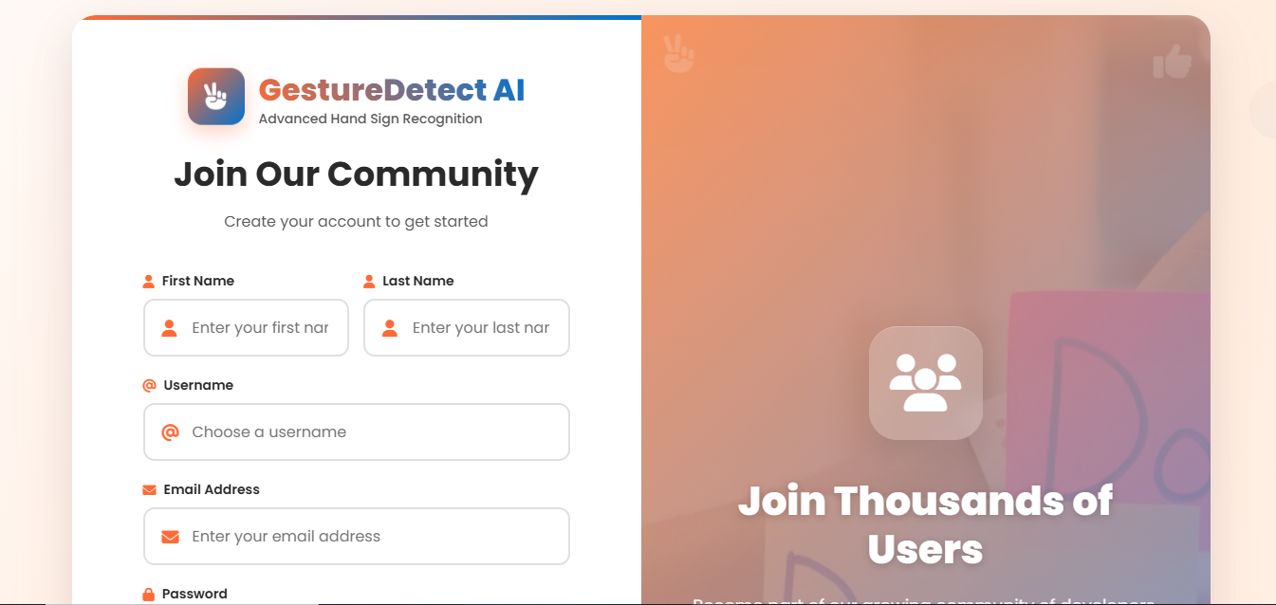
OUTPUT SCREENSHOT:

Slide 21
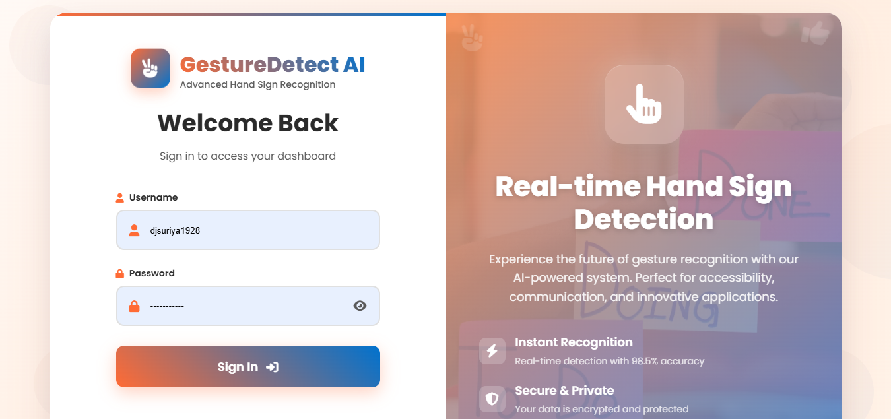
OUTPUT SCREENSHOT:

Slide 22
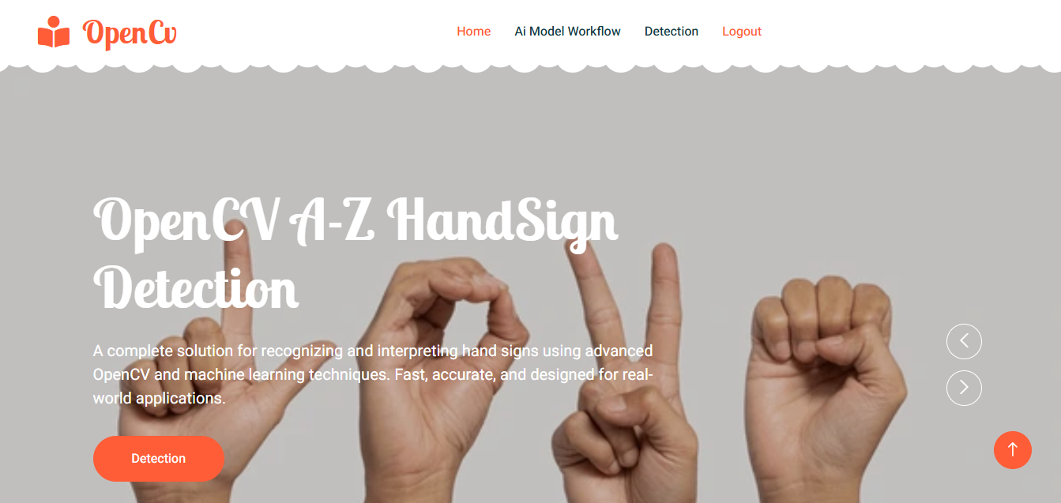
OUTPUT SCREENSHOT:

Slide 23
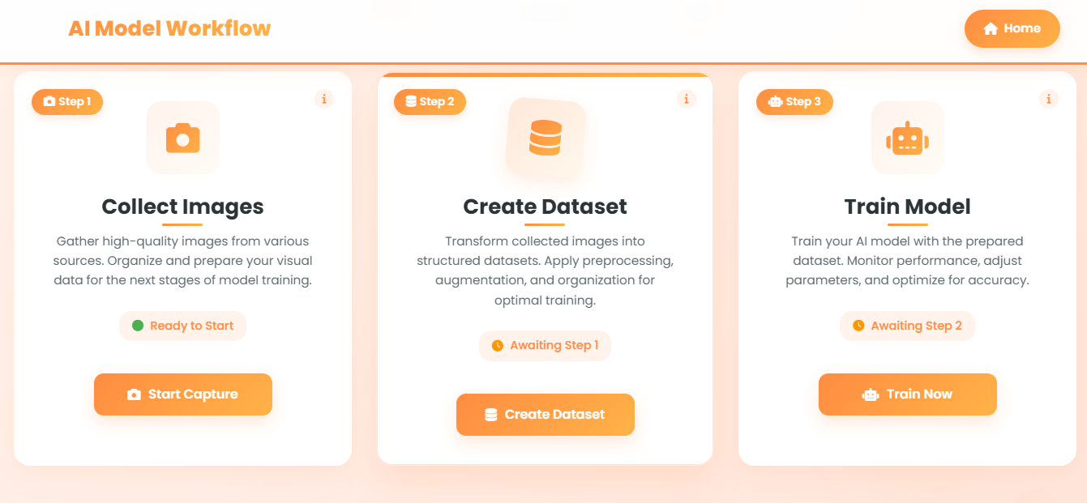
OUTPUT SCREENSHOT:

Slide 24
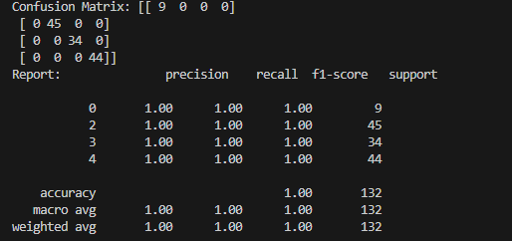
OUTPUT SCREENSHOT:

Slide 25
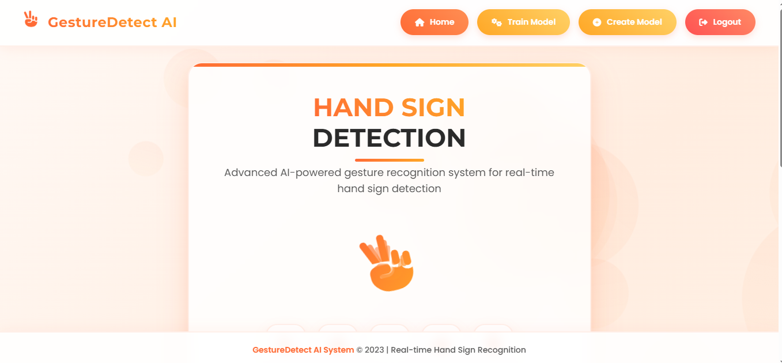
OUTPUT SCREENSHOT:

Slide 26
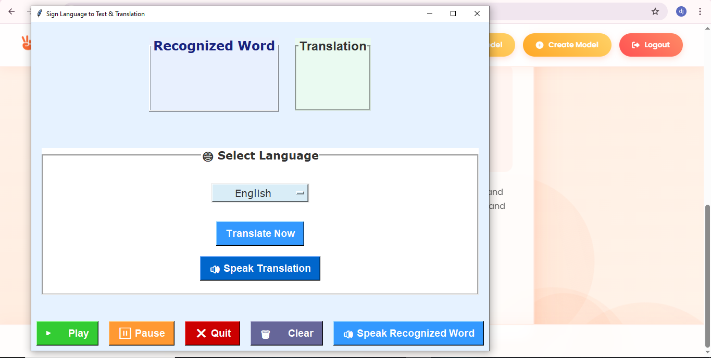
OUTPUT SCREENSHOT:

Slide 27
Conclusion:
It focused how image from given dataset (trained dataset) in field and past data set used predict the pattern of different gesture using NN model. This brings some of the following different live sign prediction. We applied NN where the accuracy and loss of the neural network makes better classification and the .h5 file is taken from there and that is deployed in real time.

Slide 28
Future Work:
An OpenCV-based hand gesture recognition system leverages advanced computer vision techniques to accurately detect and interpret hand Sign in real-time. The core of the system involves hand segmentation to isolate the hand from its background, followed by hand tracking to monitor its movements using algorithms such as Kalman Filters. Key features include contour detection to outline hand shapes and landmark detection to pinpoint critical hand features like fingertips and knuckles. The system employs machine learning models or deep learning approaches, such as Convolutional Neural Networks, to classify and recognize specific Sign. To ensure real-time performance, the system is optimized for low latency and efficient resource usage. Robustness is achieved through techniques that handle varying lighting conditions and occlusions. Additionally, the user interface incorporates feedback mechanisms and customization options, while the system is designed for integration with various applications and cross-platform support. Data collection and annotation of diverse gesture datasets are crucial for training accurate models, with data augmentation techniques enhancing the system's overall performance.

