Slide 1

Project Title -Seasonal Agriculture Performance Analysis
Student Name:Modugumudi Mohana Ravali
Collage Name:Seshadri Rao Gudlavalleru Engineering College
AICTE STU ID : STU699084d162a4a1771078865

Slide 2

PROBLEM STATEMENT
Agricultural activities are influenced by seasonal variations in environmental conditions, farming practices, resource availability and market conditions. As a result, agricultural performance may differ from one season to another. However, raw agricultural data does not clearly explain how agricultural performance changes across seasons or what patterns can be observed in different seasonal conditions. The problem is to analyze the given agricultural dataset and investigate seasonal differences in agricultural performance by identifying meaningful patterns, trends, relationships and variations within the available data.

Slide 3
Project Description
Seasonal Agriculture Performance Analysis is a data analysis project that studies agricultural production and crop yield across different crops, seasons, and regions. The project uses historical agricultural data and applies data preprocessing, exploratory data analysis, statistical analysis, and visualization techniques to identify important patterns and trends. Python libraries such as Pandas, NumPy, Matplotlib, and Seaborn are used for data processing and visualization. The system compares crop-wise and season-wise performance, analyzes average yield and production trends, and identifies high- and low-performing crops. The generated insights can help farmers, agricultural planners, researchers, and policymakers make better data-driven decisions regarding crop selection and seasonal agricultural planning.

Slide 4

WHO ARE THE END USERS?
Farmers – To understand seasonal crop performance and identify better-performing seasons and crops.
Agricultural Planners – To use seasonal trends and agricultural data for better planning and decision-making.
Agricultural Researchers – To study relationships between seasons, environmental conditions, resources, and crop performance.
Agricultural Organizations/Government Departments – To support evidence-based agricultural planning and policies.
Students and Data Analysts – To explore agricultural datasets and understand seasonal patterns through data analytics.

Slide 5

Technology Used
      Python
      Google Colab
      Pandas
      NumPy
      Matplotlib
      Seaborn
      CSV
      Jupyter Notebook
      GitHub

Slide 6
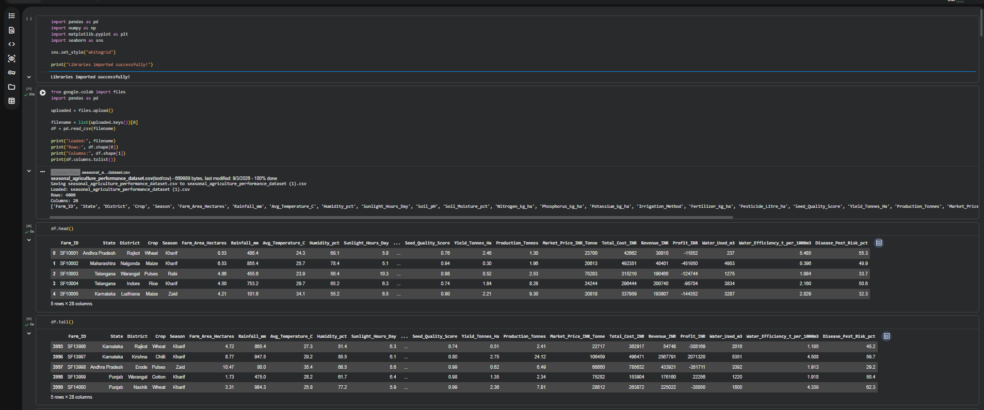
RESULTS

Slide 7
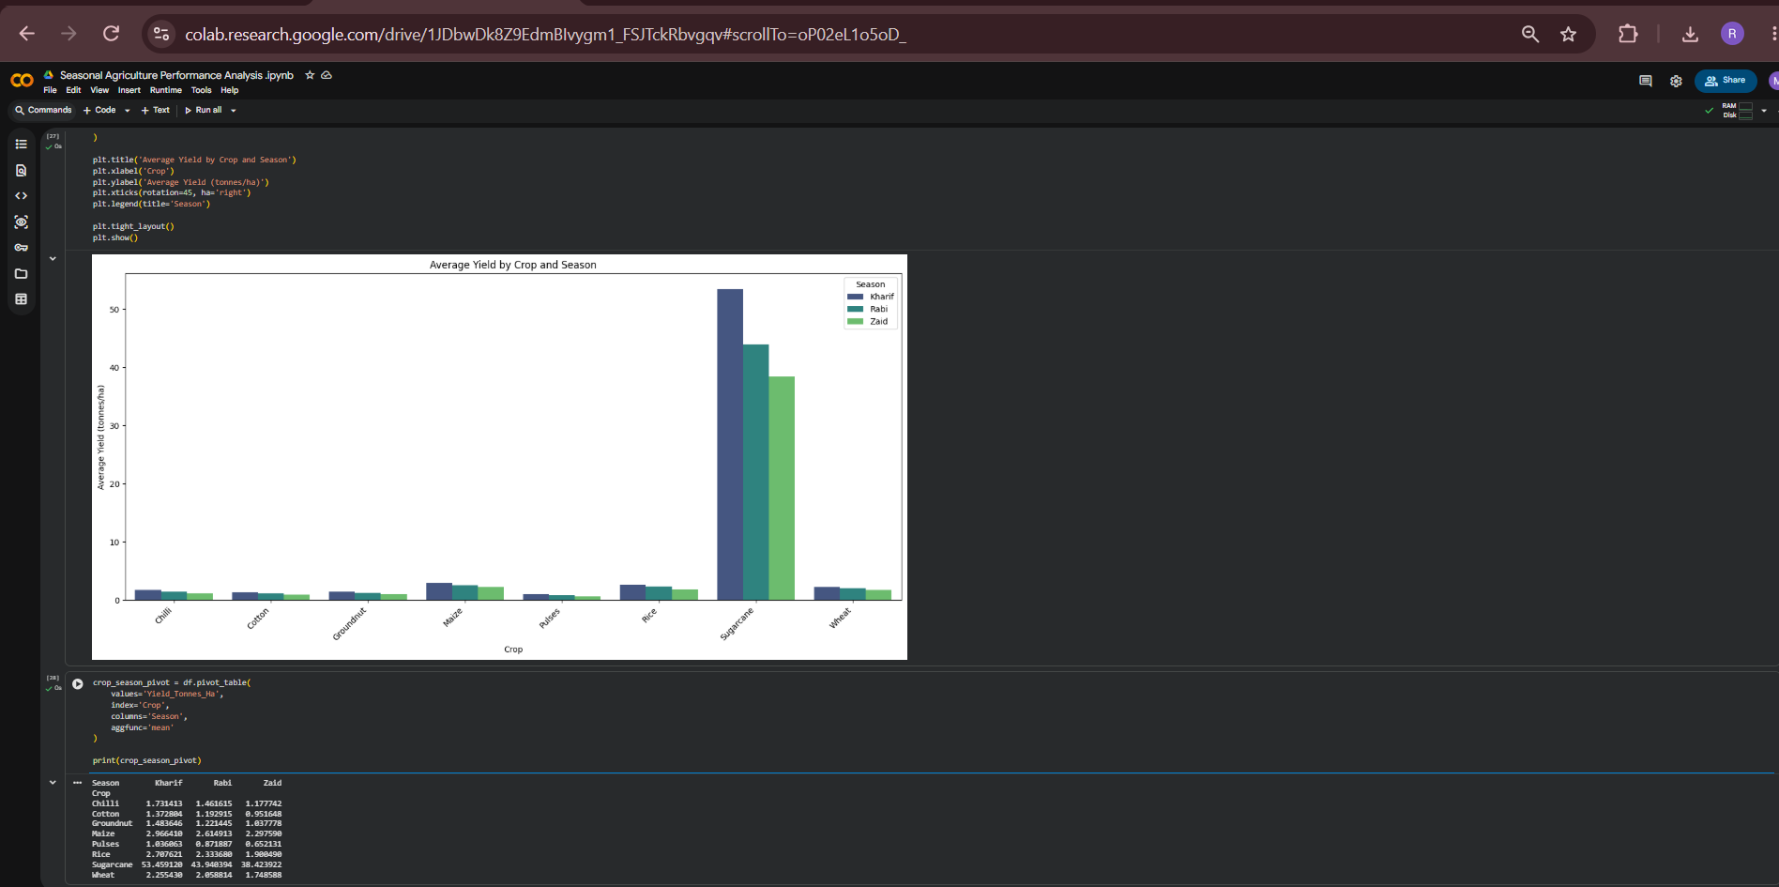
RESULTS

Slide 8
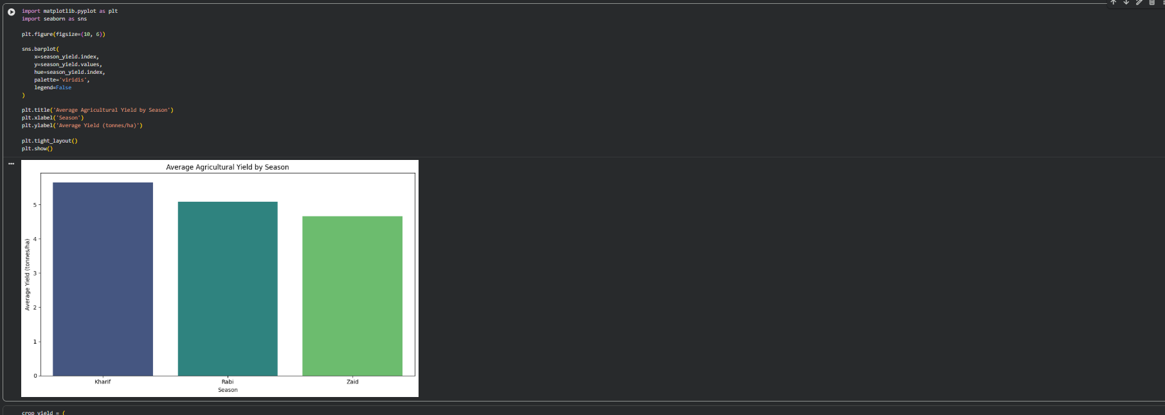
RESULTS

Slide 9
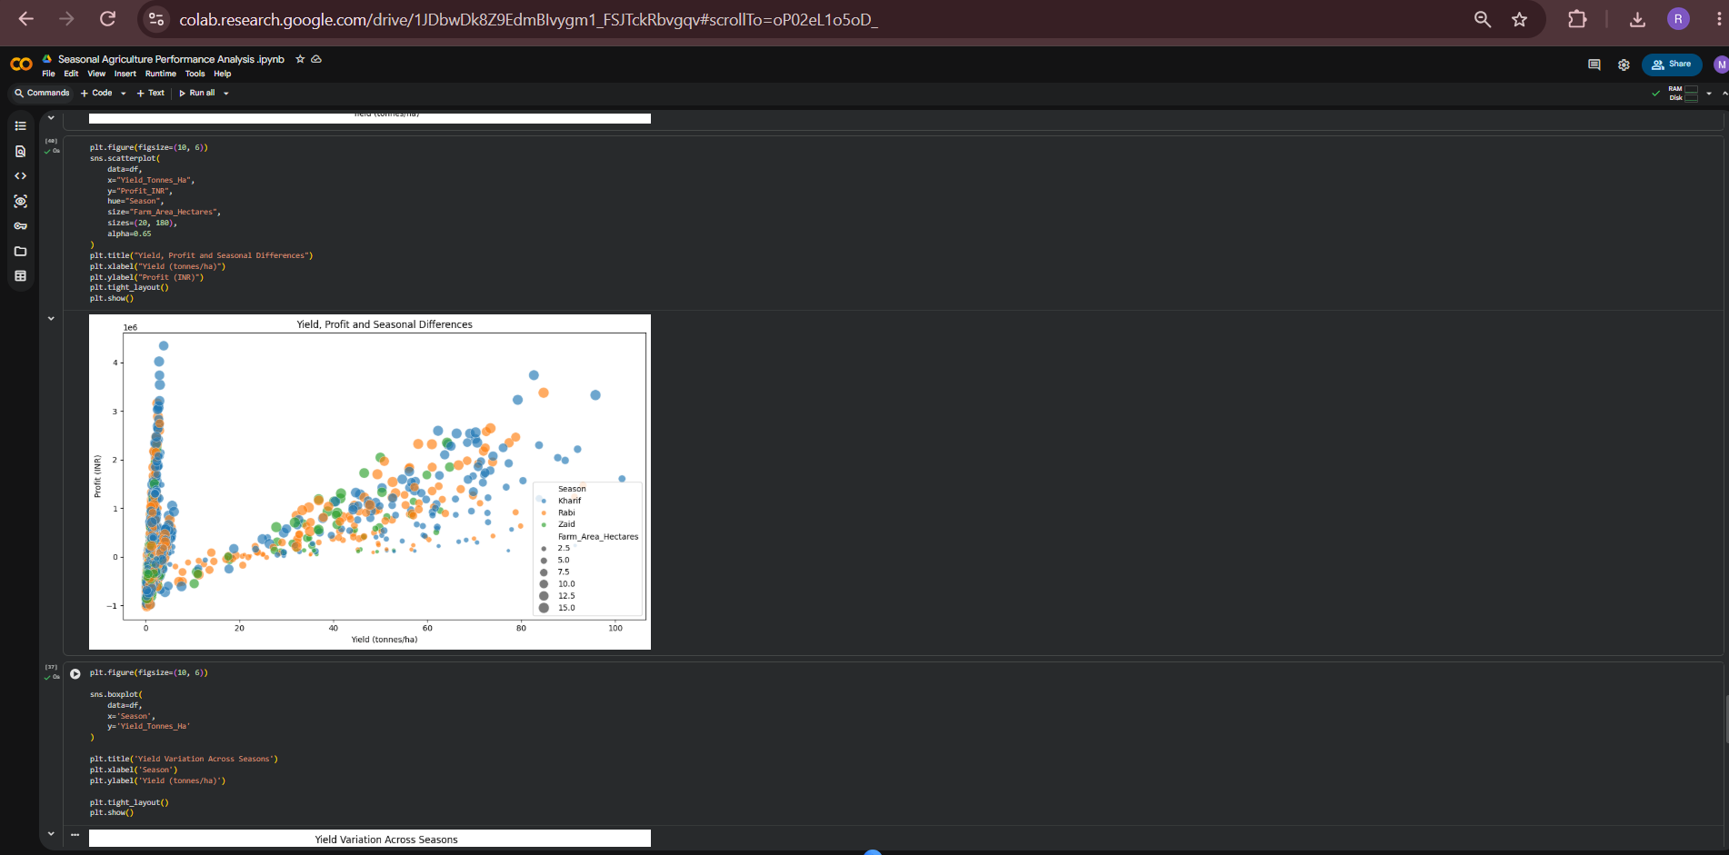
RESULTS

Slide 10
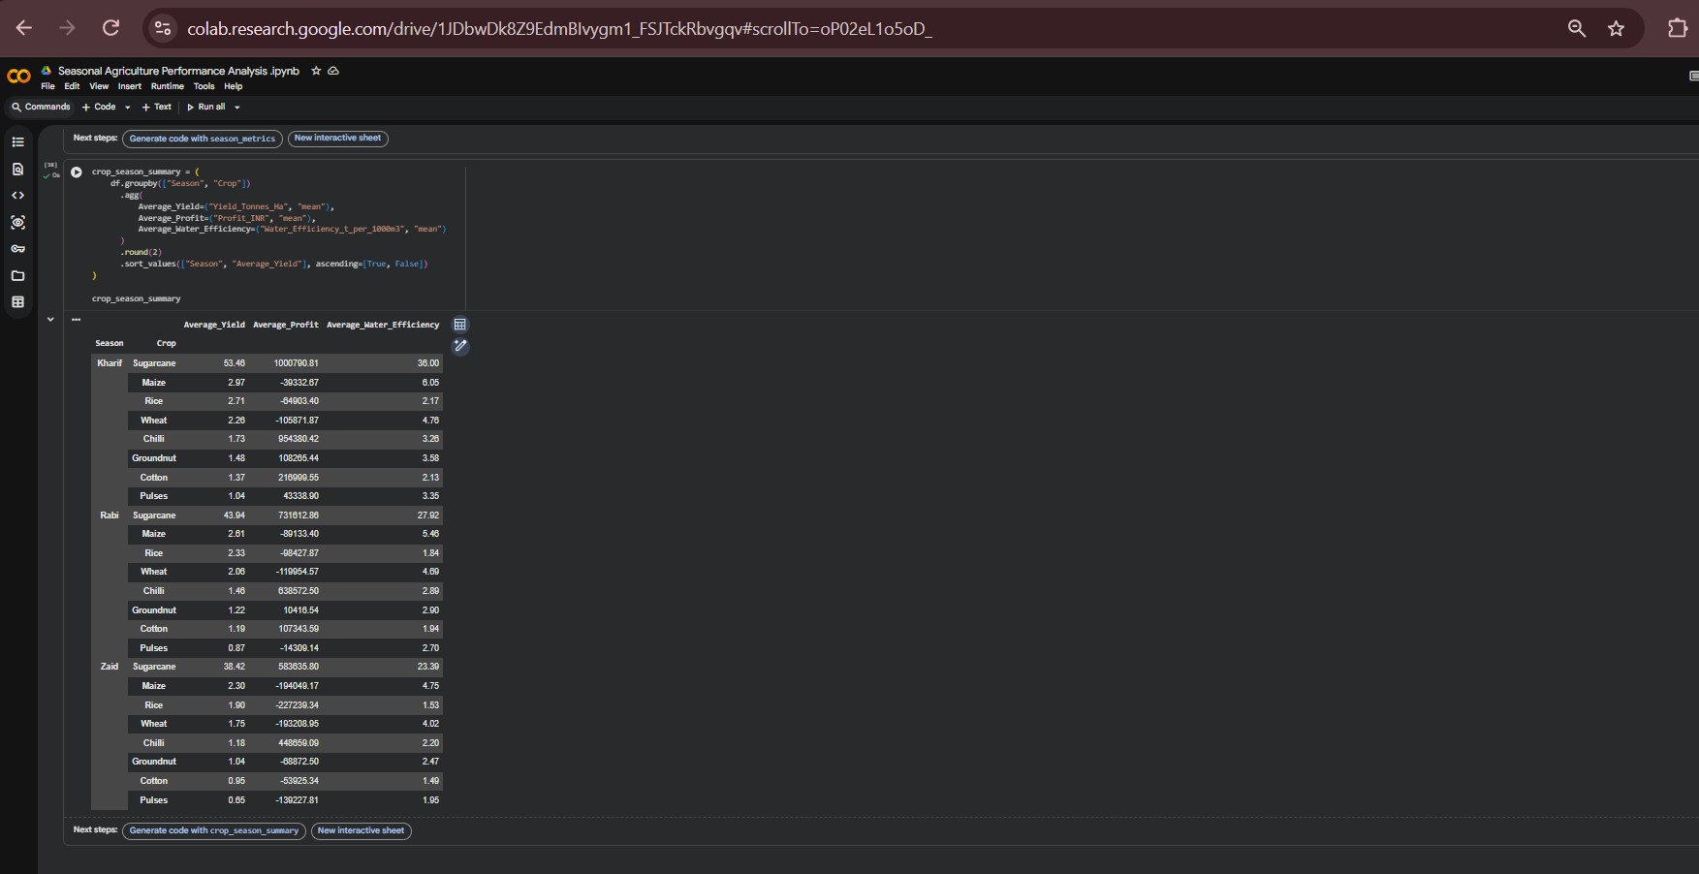
RESULTS
[Add screen shots of your code ]

Slide 11
Future scope
Crop Yield Prediction: Develop machine learning models to predict crop yield based on historical and environmental data.
Weather Integration: Integrate real-time weather data such as temperature, rainfall, humidity, and soil conditions for more accurate analysis.
Crop Recommendation: Recommend suitable crops based on season, soil conditions, location, and expected yield.
Real-Time Monitoring: Connect IoT sensors to monitor soil moisture, temperature, humidity, and other agricultural parameters.
Disease Detection: Add image-based crop disease detection using deep learning and computer vision.
Market Price Prediction: Analyze historical market data to predict crop prices and help farmers make better selling decisions.

Slide 12
GitHub Link
https://github.com/mohanaravali8/-Seasonal-Agriculture-Performance-Analysis

Slide 13

VOIS Course completion certificate -

Slide 14

.
.

