Slide 1
Kalman Filter Intuition
Part-1
Notes:
Hi, This video is to help you quick intuition on Kalman Filter

Slide 2

0 second
120 Beats Per Minute
Notes:
Heart rate monitor example

Slide 3
0 second
120 Beats Per Minute
5 second
130 Beats Per Minute

Slide 4
0 second
120 Beats Per Minute
5 second
130 Beats Per Minute
12 second
130 Beats Per Minute

Slide 5
0 second
120 Beats Per Minute
5 second
130 Beats Per Minute
12 second
130 Beats Per Minute
15 second
60 Beats Per Minute

Slide 6
0 second
120 Beats Per Minute
5 second
130 Beats Per Minute
12 second
130 Beats Per Minute
15 second
60 Beats Per Minute
20 second
135 Beats Per Minute

Slide 7
0 second
120 Beats Per Minute
5 second
130 Beats Per Minute
12 second
130 Beats Per Minute
15 second
60 Beats Per Minute
20 second
135 Beats Per Minute
25 second
140 Beats Per Minute

Slide 8
Kalman Filter Intuition
Part-2
Notes:
Hi, This video is to help you quick intuition on Kalman Filter

Slide 9
Past predictions
New Measure
Kalman Gain (Weight)
Uncertainty in new measure
Uncertainty in past predictions
Notes:
It’s the balance between what was known from the past with the new data we are gaining

Slide 10

Optimistic
Skepticism
Notes:
Human perception
Bias
Learning from new experience and changing our belief

Slide 11
x
LIDAR Signal
o
RADAR Signal
Vehicle actual path
x
o
x
Estimated path
o
x
o
x
x
x
o
x
x
x
x
o
x
o
o
x
x
x
x
o
x
x
o
o
o
x
o
o
x
x
x
x
o
o
o
x
o
x
x
o
Notes:
Sensor fusion

Slide 12
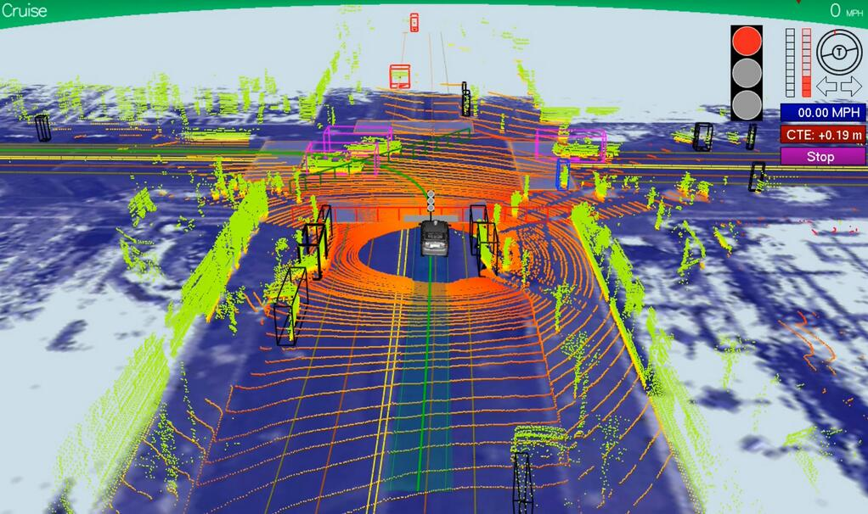
Notes:
Applications in self driving car to do localization(where we are with the environment) and path planning
GPS (driving inside a tunnel)

Slide 13
Kalman Filter Intuition
Part-3
Notes:
Hi, This video is to help you quick intuition on Kalman Filter

Slide 14
Predict
New state
New uncertainty
Output
Update
Error
Kalman Gain
Updated state
Updated uncertainty
Input

Slide 15

Predict
$$x^{′}=Ax+Bu+w$$
Output
$$P=APA^{T}+Q$$
Update
Error
Kalman Gain
Updated state
Updated uncertainty
Input

Slide 16

Predict
$$x^{′}=Ax+Bu+w$$
Output
$$P=APA^{T}+Q$$
Update
Error
Kalman Gain
Updated state
Updated uncertainty
Input

Slide 17



Predict
$$x^{′}=Ax+Bu+w$$
Output
$$P=APA^{T}+Q$$
Update
$$y=z−x′$$
$$K=\frac{PH^{T}}{R+H{PH}^{T}}$$
Error
Kalman Gain
Updated state
Updated uncertainty
(z)
Input
$$x=x′+K[y −Hx^{′}]$$
$$P=\left(I−KH\right)P$$

Slide 18
Learn more
http://www.ilectureonline.com/lectures/subject/SPECIAL%20TOPICS/26/190
https://github.com/mohanaravind/kalman-filter

