Slide 1
SPLUNK

Slide 2
What is Splunk?
Splunk is a software platform widely used for monitoring, searching, analyzing and visualizing the machine-generated data in real time.
It performs capturing, indexing, and correlating the real time data in a searchable container and produces graphs, alerts, dashboards and visualizations.
Splunk provides easy to access data over the whole organization for easy diagnostics and solutions to various business problems.

Slide 3
Why Splunk?
Offers enhanced GUI and real-time visibility in a dashboard.
It reduces troubleshooting and resolving time by offering instant results.
Helps you to monitor any business metrics and make an informed decision.
Splunk allows you to accept any data type like .csv, json, log formats, etc.

Slide 4
Splunk versions
Splunk is available in three versions:
Splunk Enterprise edition is used by large IT business.
Splunk Cloud is a hosted platform. It can be availed from Splunk or using AWS cloud platform.
Splunk Light is a free version. It has limited functionalities and feature compared to other versions.

Slide 5
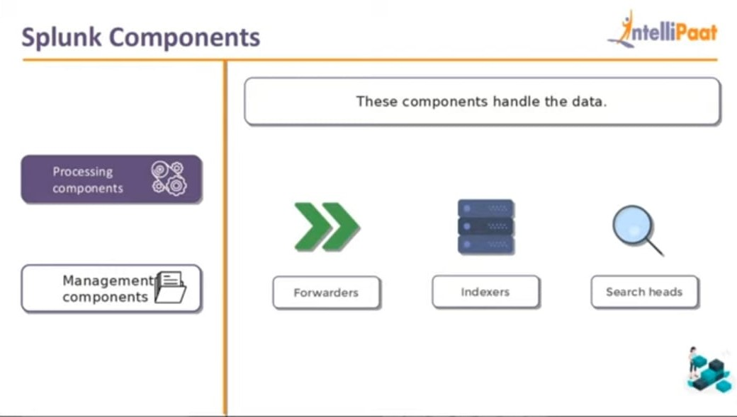
Processing Components

Slide 6
SPLUNK COMPONENTS

Slide 7
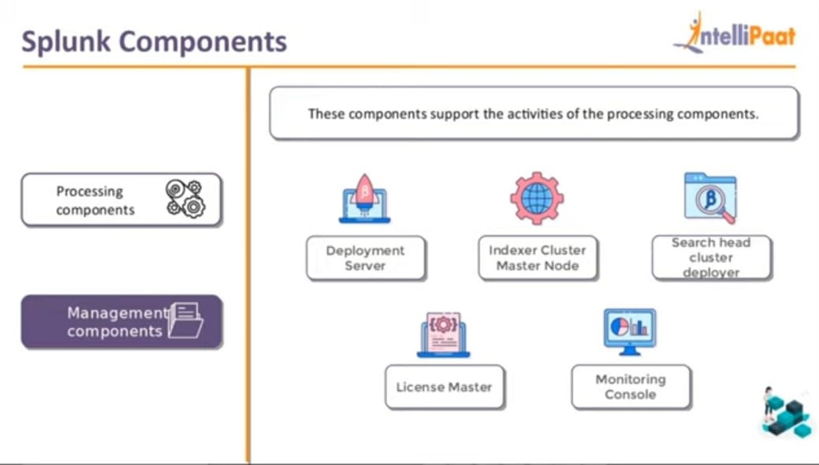
Management Components

Slide 8
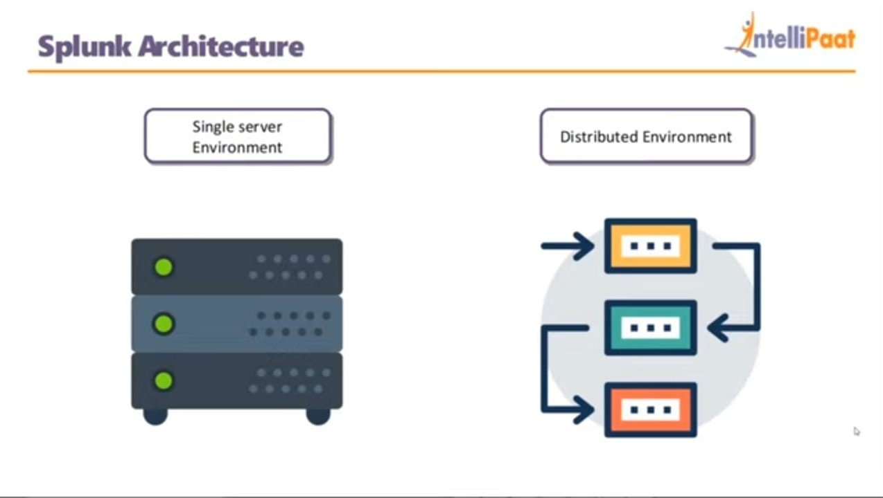
Splunk Architecture Classification

Slide 9
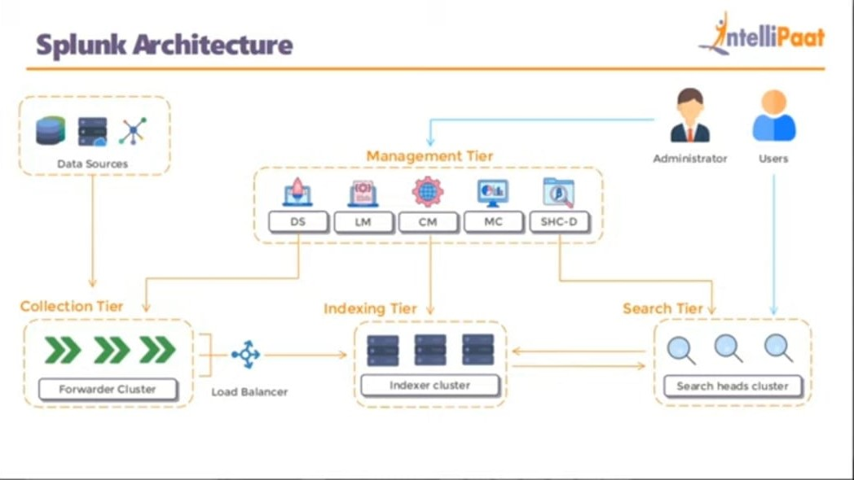
Splunk Architecture

Slide 10
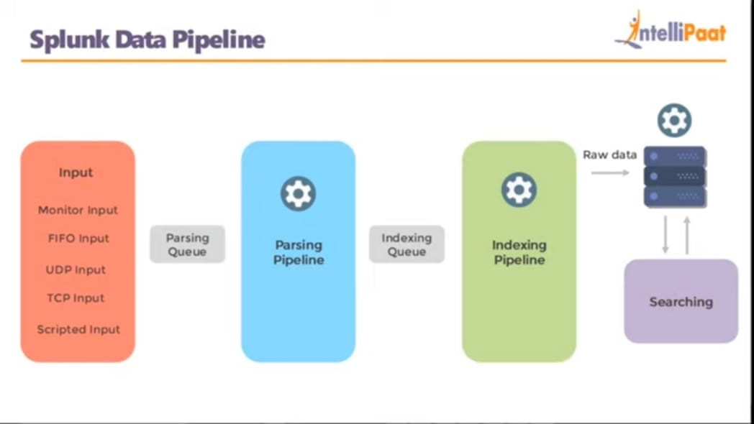
Splunk Data Pipeline

Slide 11

UseCase
Domino’s Pizza
Interactive Maps
Real time Feedback
Payment Methods
Monitor the Performance

Slide 12
Advantages
Simple to implement.
Save searches and tag useful information to make your system smarter.
Set up alerts to automate the monitoring of the system for specific recurring events.
Continually index all of your IT data in real time.

Slide 13
Disadvantages
It can get expensive for large data volumes.
Dashboards are functional but not as effective as some other monitoring tools.
Searches are difficult to understand, especially regular expressions and search syntax.

Slide 14
Tasks
1.add data from local files and use delimiter method to seperate values in dataset.
2.create a table view and generate summary for specified columns.
3.add data from file monitoring and create a dashboard.
4.create a table view and remove duplicates from data.

Slide 15
Thank you

