Slide 1
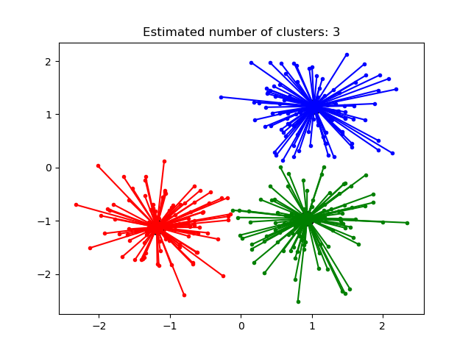
Affinity Propagation Clustering
Affinity Propagation is a clustering algorithm that
groups similar data points
into a cluster
AP identifies clustering by exchanging messages between data points iteratively
The algorithm operates as a competition between data points to become "leaders" (exemplars)

Slide 2
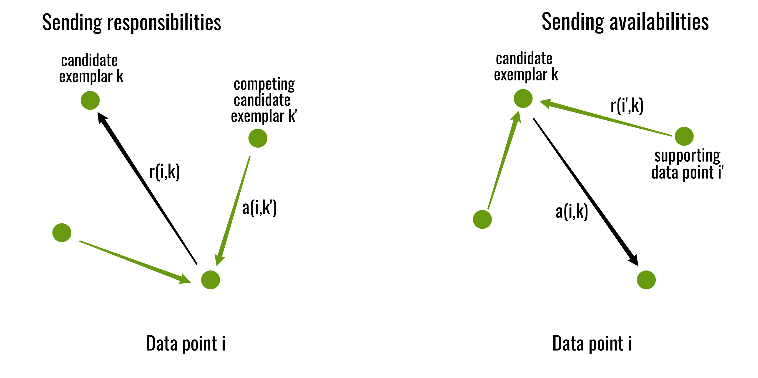
Affinity Propagation algorithm iteratively updates two primary matrices until they converge:
Responsibility(r(i,k)): Sent from point i to candidate exemplar k. It quantifies how well-suited k is to serve as the exemplar for i, relative to other candidates
Availability(a(i,k)): Sent from candidate exemplar k back to point i. It represents how appropriate it is for i to choose k as its exemplar, considering support from other points for k.

Slide 3
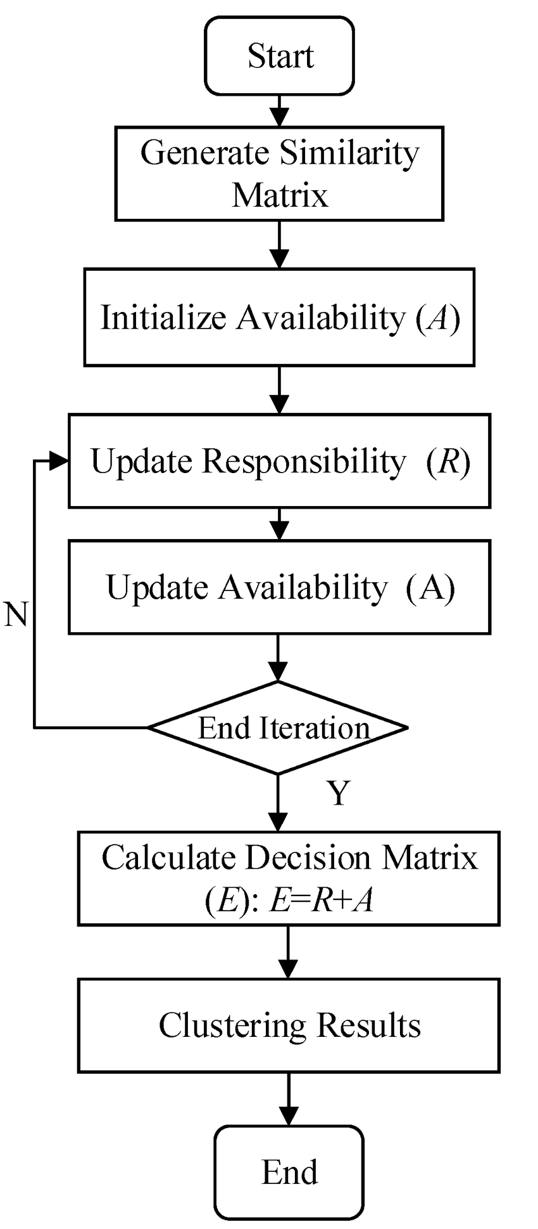
Affinity Propagation Process

Slide 4
Affinity Propagation Advantages and Disadvantages
Advantages of Affinity Propagation:
The algorithm does not require the number of clusters to be specified beforehand,
which is a major advantage over other methods.
Affinity Propagation is deterministic once parameters are set, ensuring consistent
results across multiple runs.
Disadvantages Affinity Propagation:
The primary drawback is its time and memory complexity, which scales quadratically
with the number of data points. This makes it unsuitable for very large datasets without
adaptations like mini-batch processing.

Slide 5
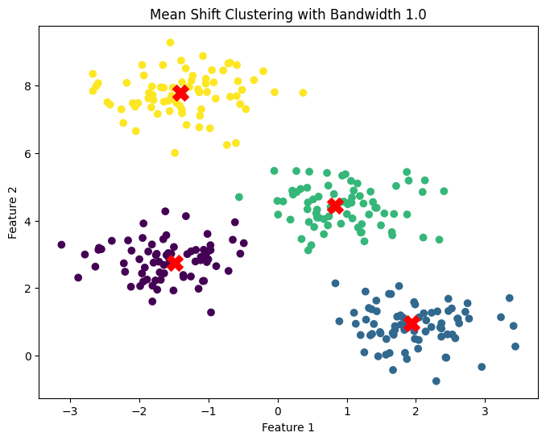
MeanShift Clustering
The Mean-Shift clustering algorithm is a non-parametric clustering algorithm that works by iteratively shifting the mean of a data point towards the densest area of the data.
The densest area of the data is determined by the kernel function, which is a function that assigns weights to the data points based on their distance from the mean.

Slide 6
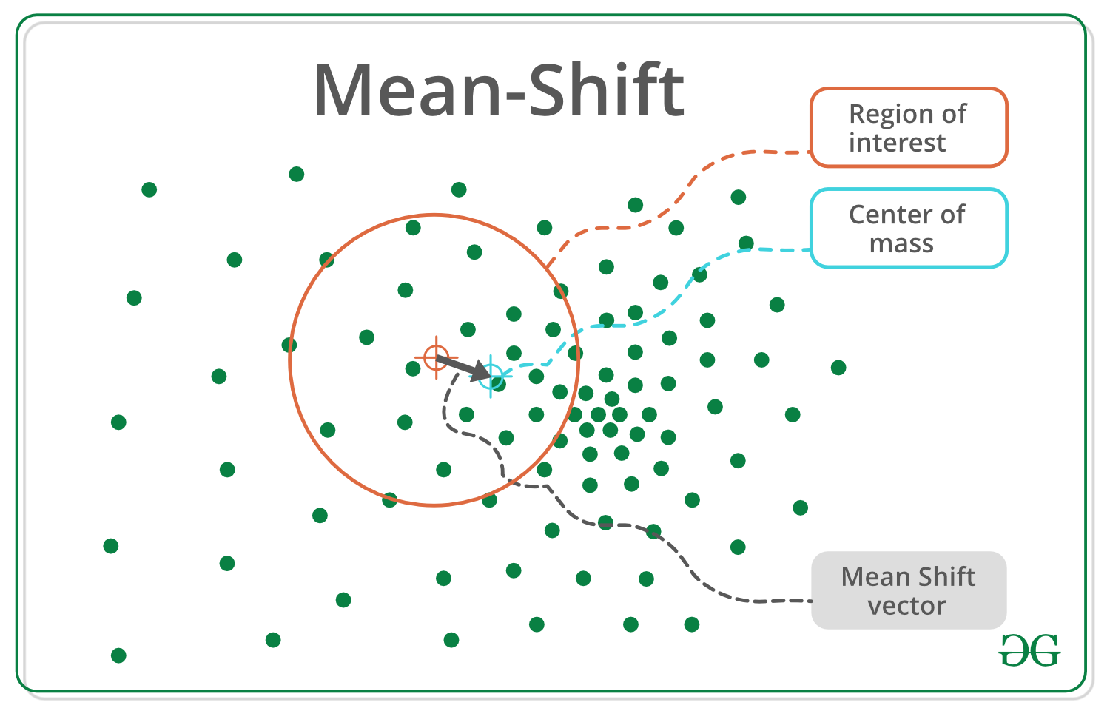
MeanShift Clustering process
Step 1 − First, start with the data points assigned to a cluster of their own.
Step 2 − Next, this algorithm will compute the centroids.
Step 3 − In this step, location of new centroids will be updated.
Step 4 − Now, the process will be iterated and moved to the higher density region.
Step 5 − At last, it will be stopped once the centroids reach at position from where it cannot move further.

Slide 7
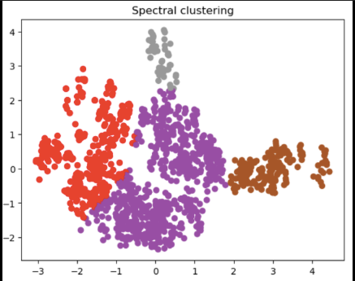
Spectral Clustering
Spectral clustering treats data points as nodes in a graph, transforming the clustering task into a graph-partitioning problem.It groups data points by treating them as a connected
graph, rather than just measuring distance.
It's a method that utilizes the characteristics of a data affinity matrix to identify patterns within the data.
Spectral clustering is particularly effective in dealing with complex and non-convex data structures.

Slide 8
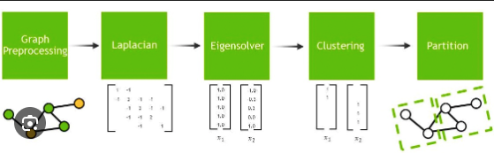
Spectral Clustering process
Simple Step-by-Step Process:
Step1-Construct Similarity Graph: Determine which points are "connected" (close to each other) to build a graph.
Step2-Create Matrices: Calculate a Laplacian matrix (
) from the graph (essentially organizing connection info).
Step3-Eigenvalue Decomposition: Find the eigenvectors (the "spectrum") of this matrix.
Step4-Dimension Reduction: Map the data into a lower-dimensional space using these eigenvectors.
Step5-Cluster: Apply standard K-Means clustering to these new, transformed data points.

Slide 9
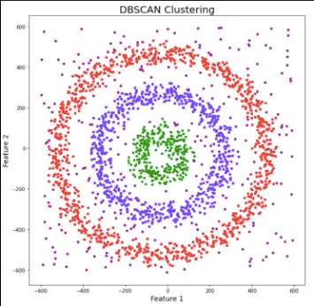
DBSCAN Clustering
The DBSCAN (Density-Based Spatial Clustering of Applications with Noise) algorithm is one of the most common density-based clustering algorithms. The DBSCAN algorithm requires two parameters: the minimum number of neighbors (minPts) and the maximum distance between core data points (eps).

Slide 10
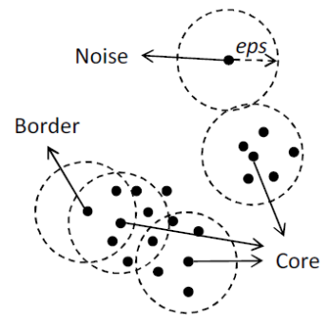
DBSCAN Clustering process
The DBSCAN Clustering algorithm works as follows −
Step1:Randomly select a data point that
has not been visited.
Step2:If the data point has at least
minPts neighbors within distance eps, create a new cluster and add the data
point and its neighbors to the cluster.
Step3:If the data point does not have at least minPts neighbors within distance
eps, mark the data point as noise and continue to the next data point.
Step4:Repeat steps 1-3 until all data points have been visited..

Slide 11
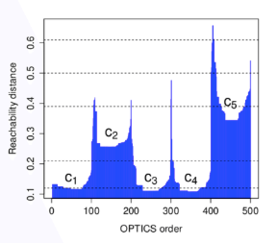
OPTICS Clustering
OPTICS (Ordering Points To Identify the Clustering Structure) is a density-based algorithm that groups data points by finding densely packed regions and separating them from sparse areas. It works by ordering points so that closely packed points are adjacent, effectively identifying clusters of varying densities and irregular shapes without requiring a predetermined cluster count.

Slide 12
Optics Clustering process
Step-by-Step Process:
Define Core Distance: For every point, the algorithm measures the distance to its
nearest neighbor. If a point has enough neighbors (density) within a specific radius, it is considered a core point, signifying it is inside a cluster.
Define Reachability Distance: This measures how close a point is to a dense cluster. It is either the core distance of a neighbor or the actual distance between points, whichever is greater.
Order the Data: Instead of grouping instantly, OPTICS orders the data points based on their reachability distances, ensuring closely packed points are processed together.
Create a Reachability Plot: The algorithm produces a plot (a graph) that acts like a map, where valleys represent clusters (high density) and peaks represent the gaps or boundaries between them.
Extract Clusters: By analyzing the "valleys" in the ordered plot, you can identify clusters of varying density

Slide 13
Advantages and Disadvantages of OPTICS
Advantages of OPTICS Clustering −
Ability to handle clusters of varying densities − OPTICS can handle clusters that have varying densities, unlike some other clustering algorithms that require clusters to have uniform densities.
Ability to handle noise − OPTICS can identify noise data points that do not belong to any cluster, which is useful for removing outliers from the dataset.
Hierarchical clustering structure − OPTICS produces a hierarchical clustering structure that can be useful for analyzing the dataset at different levels of granularity.
Disadvantages of OPTICS Clustering -
Sensitivity to parameters − OPTICS requires careful tuning of its parameters, such as the min_samples and xi parameters, which can be challenging.
Computational complexity − OPTICS can be computationally expensive for large datasets, especially when using a high min_samples value.

