Slide 1
ADA Boosting
(Adaptive Boosting)
Builds multiple models on subsets of the dataset in a sequential manner
Each model learns from the previous models’ mistakes
All the weak models predictions are combined to get a "strong model"
Single depth decision trees called "stumps"

Slide 2
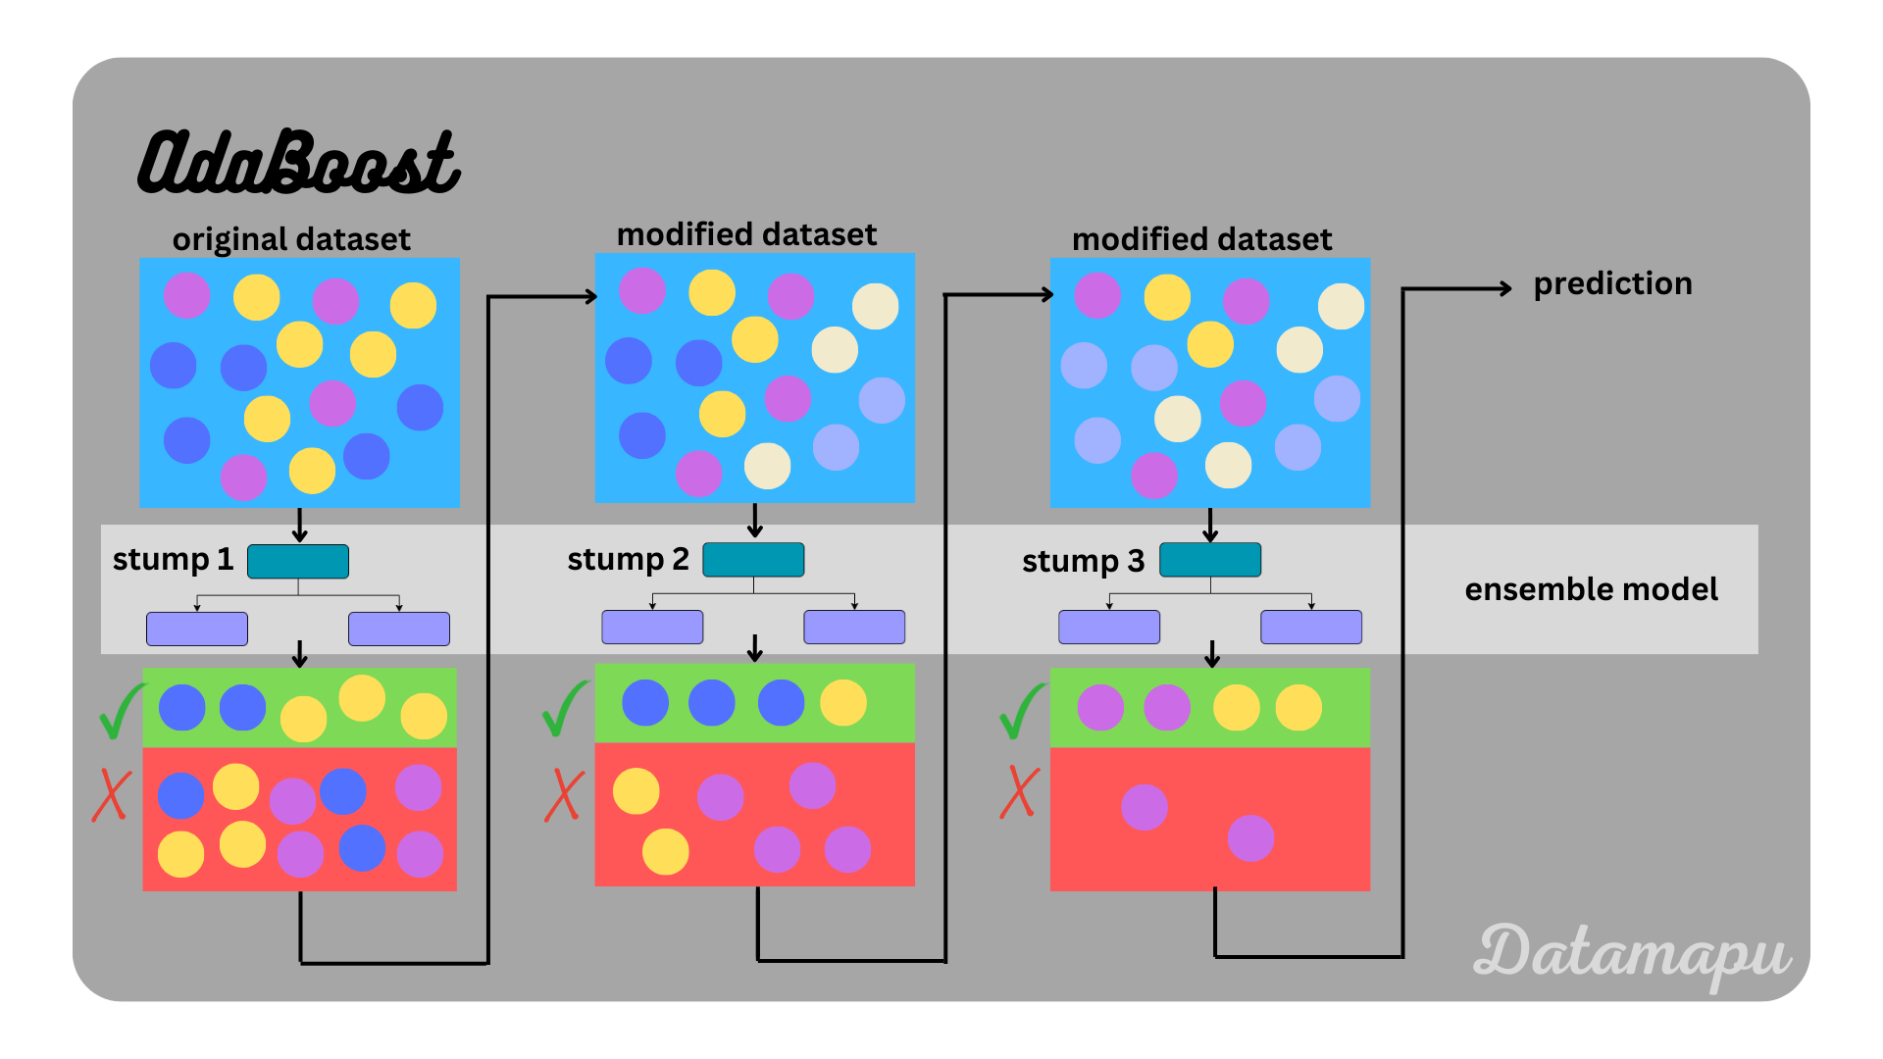

Slide 3
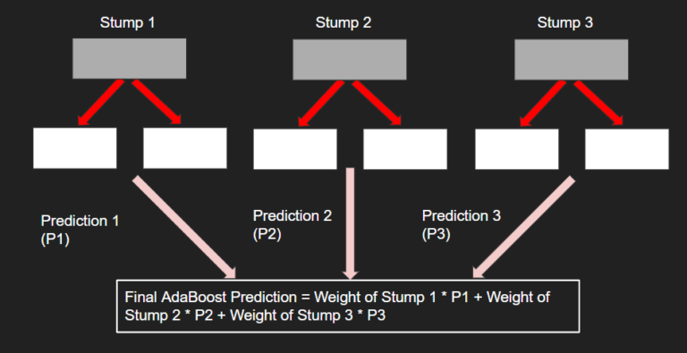

Slide 4
