Slide 1
LightGBM
(Light Gradient Boosting Machine)
Uses leaf-wise growth strategy
Histogram based learning
Optimized for speed and efficient memory usage
Handles large datasets with millions of rows and columns
Supports parallel and distributed computing
Optimization techniques - Gradient-based One-Side Sampling & Exclusive Feature Bundling

Slide 2
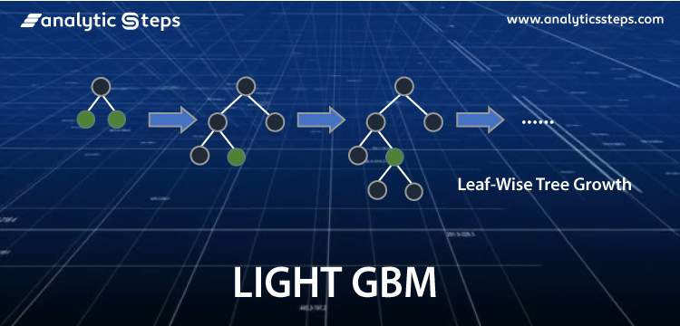

Slide 3
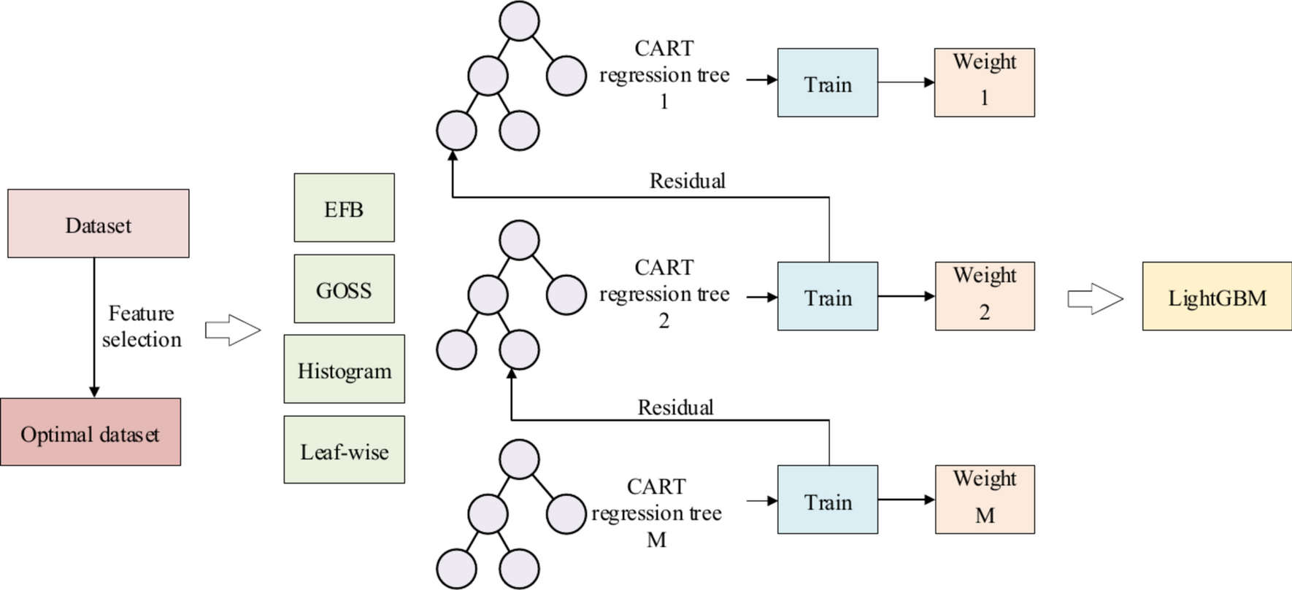

Slide 4
