Slide 1
XG Boosting
(Extreme Gradient Boosting)
Combines multiple weak models to create a strong model
Automatically handles missing data without requiring imputation
Reduce overfitting and improve model performance
Faster and more accurate
Better suited for large-scale, complex datasets

Slide 2
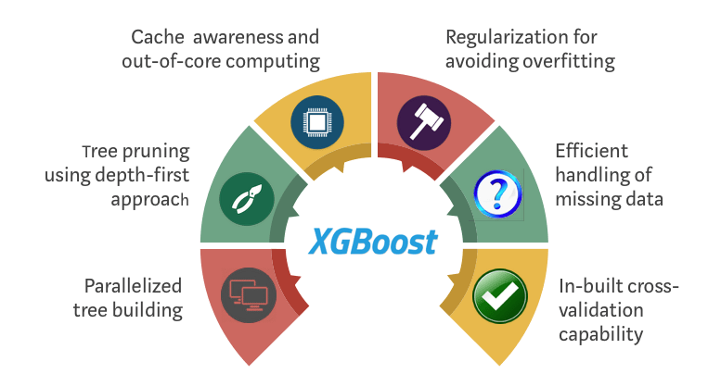

Slide 3
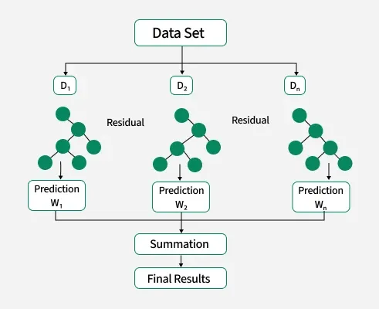

Slide 4
