Slide 1
UNIVERSITY COLLEGE OF ENGINEERING VILLUPURAM
Final Project
PRESENTED BY : Mohanavarshini S
REG NO : 422521104024
YEAR : 3rd
DEPARTMENT : Computer Science and Engineering.
EMAIL ID : mohanasivagurunathan@gmail.com

Slide 2
PROJECT TITLE
Google Stock Price Prediction using LSTM
Introduction:
Leveraging Long Short-Term Memory (LSTM) networks to capture sequential patterns in historical stock data for forecasting future price movements.

Slide 3


AGENDA
Problem Statement.
Project Overview.
Who are the end users?
Our solution and its value proposition.
The wow in our solution.
Modelling.
Results.
3/21/2024 Annual Review

Slide 4

PROBLEM STATEMENT
Volatility: Stock prices are subject to significant fluctuations, making it challenging to accurately predict future movements.
Non-linear relationships: Stock price movements often exhibit non-linear patterns, making it difficult to capture using traditional linear models.
Data scarcity: Historical stock market data may be limited, especially for companies with shorter operating histories, limiting the effectiveness of prediction models.
External factors: Stock prices can be influenced by a wide range of external factors such as geopolitical events, economic indicators, and natural disasters, adding complexity to prediction models.
Market inefficiency: Stock markets may not always reflect all available information efficiently, leading to inefficiencies that can complicate prediction efforts.

Slide 5
Overfitting: Prediction models may be susceptible to overfitting, where they perform well on historical data but fail to generalize to new data, reducing their predictive accuracy.
Noise in data: Stock market data may contain noise and random fluctuations, making it difficult to distinguish meaningful patterns from random variations.
Behavioral biases: Investor behavior, such as herd mentality and emotional responses to market events, can lead to irrational price movements that are challenging to predict.
Regulatory changes: Changes in regulations and policies can impact stock prices and market dynamics, introducing additional uncertainty into prediction models.
Black swan events: Unexpected and rare events, such as financial crises or pandemics, can have a significant impact on stock markets, making prediction even more challenging.

Slide 6
PROJECT OVERVIEW
Data Collection
Data Preprocessing
Feature Selection
Model Selection
Model Training
Deployment
Evaluation and Refinement
Prediction
Model Evaluation

Slide 7

WHO ARE THE END USERS?
Individual and Institutional Investors
Financial Analysts and Advisors
High-Frequency Traders
Risk Managers
Portfolio Managers

Slide 8
OUR SOLUTION AND ITS VALUE PROPOSITION
Our solution provides accurate predictions of stock prices, enabling users to anticipate market movements and make informed investment decisions.
By identifying potential risks and opportunities in advance, our solution helps users mitigate risks and optimize their investment strategies.
Users can optimize asset allocation and maximize returns by incorporating our predictions into their investment portfolios.
Our solution empowers users with actionable insights, enabling them to confidently navigate market uncertainties and achieve their financial goals.

Slide 9

THE WOW IN OUR SOLUTION
Real-time monitoring of stock price.
Customized prediction of models.
Accurate predictions by utilizing advanced analytical methods.
Offering a competitive edge in the financial landscape, our solution sets the benchmark for predictive analytics.

Slide 10
MODELLING
Data Preparation:
The script imports necessary libraries and loads the training dataset ('Google_Stock_Price_Train.csv'). It then preprocesses the data by scaling it using MinMaxScaler and reshaping it to create input sequences (X_train) and corresponding output labels (y_train) for training the LSTM model.
Model Architecture:
The script defines a Sequential model using Keras with several LSTM layers followed by dropout regularization to prevent overfitting. The model is compiled with the Adam optimizer and Mean Squared Error loss function.
Model Training:
The compiled model is trained using the training data (X_train, y_train) for a specified number of epochs and batch size.

Slide 11
Testing Data Preparation:
The script loads the testing dataset ('Google_Stock_Price_Test.csv') and preprocesses it similarly to the training data. It creates input sequences (X_test) for testing.
Prediction:
The trained model is used to predict the stock prices for the testing data (X_test). The predicted prices are then inverse-transformed to obtain the actual stock prices.
Visualization:
The script plots the real Google stock prices from the testing dataset and the predicted stock prices generated by the model to visualize the performance of the model.

Slide 12
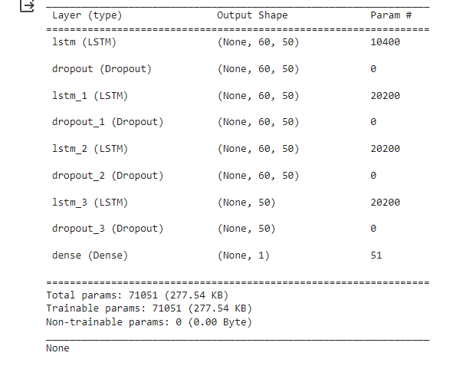
RESULTS

Slide 13
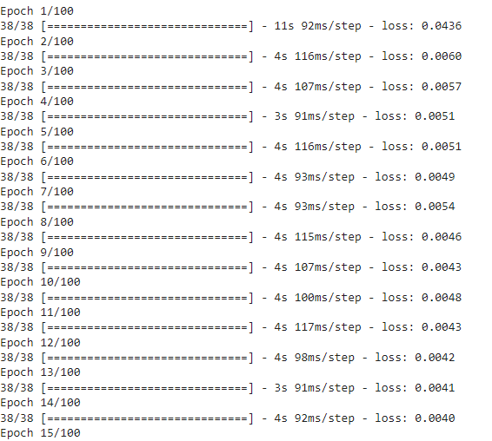
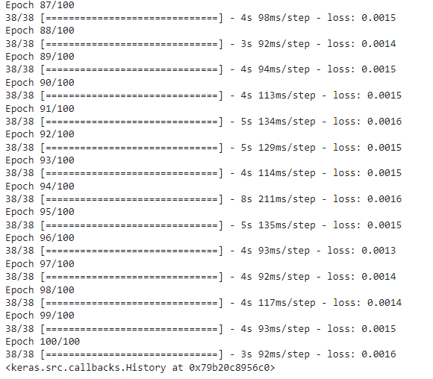

Slide 14
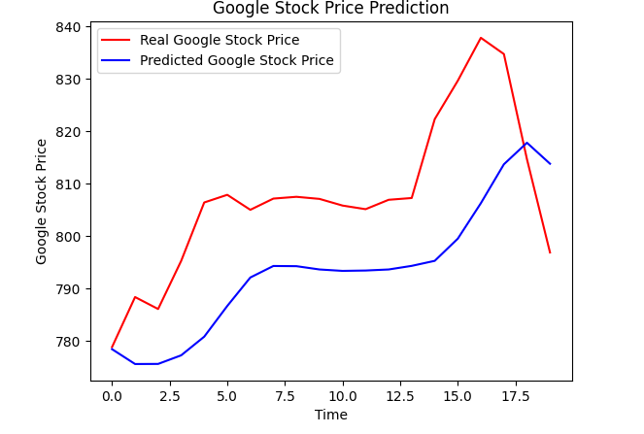

Slide 15
CONCLUSION
Using Long Short-Term Memory (LSTM) models for stock market prediction yields accurate forecasts by leveraging historical data patterns. These models provide insights to investors, aiding in informed decision-making and risk management. With LSTM's ability to capture long-term dependencies, it offers a competitive advantage, enhancing portfolio performance and optimizing asset allocation strategies. By incorporating LSTM-based predictions, users gain a clear edge in navigating dynamic market conditions, ultimately maximizing returns and achieving financial objectives.

