Slide 1

B.E. Final Year Project presentation
ISBM College of Engineering, Pune
Domain for our Project : Machine Learning
Project Title:
Stock Price Prediction
using Stacked LSTM
Team Members
Sujan Shaikh 42
Vaishnavi Jadhav 71
Mohan Badhekar 17
Project Guide :
Prof. B. B. Gite

Slide 2
Introduction
Overview of stock market and stock price prediction.
Why LSTMs are a good choice for stock price prediction
Explanation of LSTMs

Slide 3
Stock Market and Price Prediction
Stock Market is a dynamic system where people can buy and sell Currencies, Equities and Derivatives. So, Stock Market has given investors the chance of gaining money through investing money.
Stock Markets are affected by many factors causing the uncertainty and high risk volatility in market.
For better ROI and minimize the risk, Stock Price prediction plays important role.

Slide 4
Why LSTM is Good Choice
Time-series prediction technique used in real-world applications such as weather forecasting and financial market prediction.
It uses continuous data in a period of time to predict the result in the next time unit.
Time-series algorithms are based on LSTM, which is special type of RNN.

Slide 5
Explanation of LSTM
LSTM is a special network structure with three ‘Gate’ structures. This Gates are placed in an LSTM unit.
These Gates namely Input Gate, Forgetting Gate and Output Gate.
While information enters the LSTM’s Network, it can be selected by rules. Only the information confirms to the algorithm will be left and the information that does not confirms the algorithm will be forgotten through the forgetting gate.

Slide 6
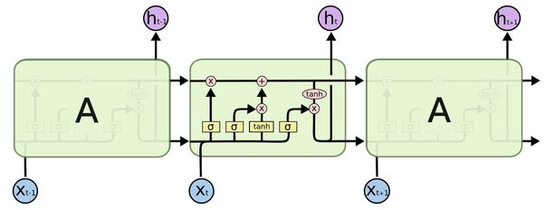
Fig. : LSTM architecture

Slide 7
Forget Gate :
It is responsible for removing information from the cell state.
Input Gate :
Regulates what values need to be added to the cell state and similar to Forget Gate and acts as a filter.
Output Gate :
Creating a vector and scaling the values to the range -1 to +1. Sending it out as a output and also to the hidden state of the next cell.

Slide 8
Implementation Steps
Data Collection
Data Preprocessing
Model Design
Model Training and Evaluation
Model Deployment

Slide 9
Data Collection
The required dataset is collected from the Tiingo’s official website through the API Key.
Tiingo provides the dataset from last 5 years.
The Collected data is in csv format.

Slide 10
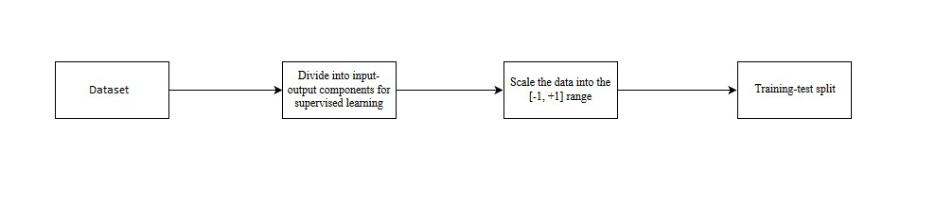
Data Preprocessing
Fig. : Preproprocessing of Data

Slide 11
Model Design
Sequential model with 3 LSTM layers followed by a Dense layer.
Each layer with 50 memory units.
Loss function used is mean squared error (MSE) and optimizer used is Adam.

Slide 12
Model Training and Evaluation
The model will be trained for 100 epochs, with a batch size of 64.
Results of the training process is calculated by RMSE performance metrics.
Comparison of the model’s performance on the training and testing data.

Slide 13
Model Deployment
Use of the trained model to make predictions on new, unseen stock price data

Slide 14
Conclusion
In this project, we are predicting closing stock price of any organization using LSTM algorithm for prediction. We have applied datasets belonging to Google, Apple, Amazon and Tesla Stocks and achieved 80% accuracy for this datasets.
We want to develop a web application for predicting closing price of stocks.
We want to add sentiment analysis for better analysis.

Slide 15
Thank You !

