Slide 1

…WELCOME…

Slide 2
Project on E-Medicare Presented By
Group-01
Aarika Bhanupriya
Abishek Kumar
Aspati Venkateswarlu
Biradar Pooja
Chintapalli Vijaya Lakshmi
Javangula Manichand
Manam Prameela
Meenakshi Sundaram B
Pradheep S
Prithviraj Nitin Vichare
Saurabh Bhairu Kesarkar

Slide 3
OUTLINE
INTRODUCTION
ENVIRONMENT
AUTHENTICATION & AUTHORIZATION
OPERATIONS
USE CASE DIAGRAM
ER DIAGRAM
DB SCHEMA
DATA ORGANIZATION
REST APIS TO BE BUILT
OUTPUT PICTURES
REFFERENCES
CONCLUSION

Slide 4
Introduction
Medicare is a company that supplies medicines and a couple of other healthcare essentials at an affordable price. It was established in 2012 .
Medicare it is a company which provides online platform to buy medicines online.
Only the admin has the legal rights to login and view the product lists also update the product, delete the product and add the products. Customer can register and buy the medicines also he can add to the cart the medicine.

Slide 5
Environment
The system will be developed on any Windows OS machine using J2EE, Hibernate and Spring.
Intel hardware machine (PC P4-2.26 GHz, 8 GB RAM, 64 Bit,40 GB HDD)
Angular, HTML, CSS, JS, TS
Server – Apache Tomcat 8
Database – Oracle SQL
JRE 11
Spring Boot
Postman & JUnit

Slide 6
Authentication & Authorization
Authentication:
Any end-user should be authenticated using a unique Email ID and Password.
Authorization:
The operations supported and allowed would be based on the user type. For
example, Administrator has the rights to add product information and view product details.

Slide 7
Operations
Operations
Admin
Customer
Login to Portal
View the product list and users
Add/Edit/delete the product details
He/She can logout.
Register into the application
After, login into application
Buy medicines
Add to cart
Make Payment
He/She can logout.

Slide 8
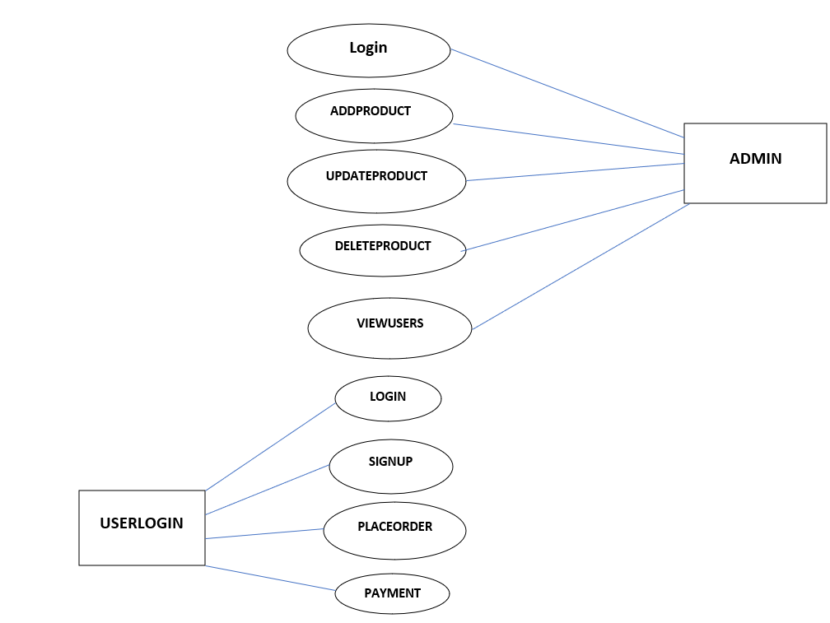
Use Case Diagram:

Slide 9
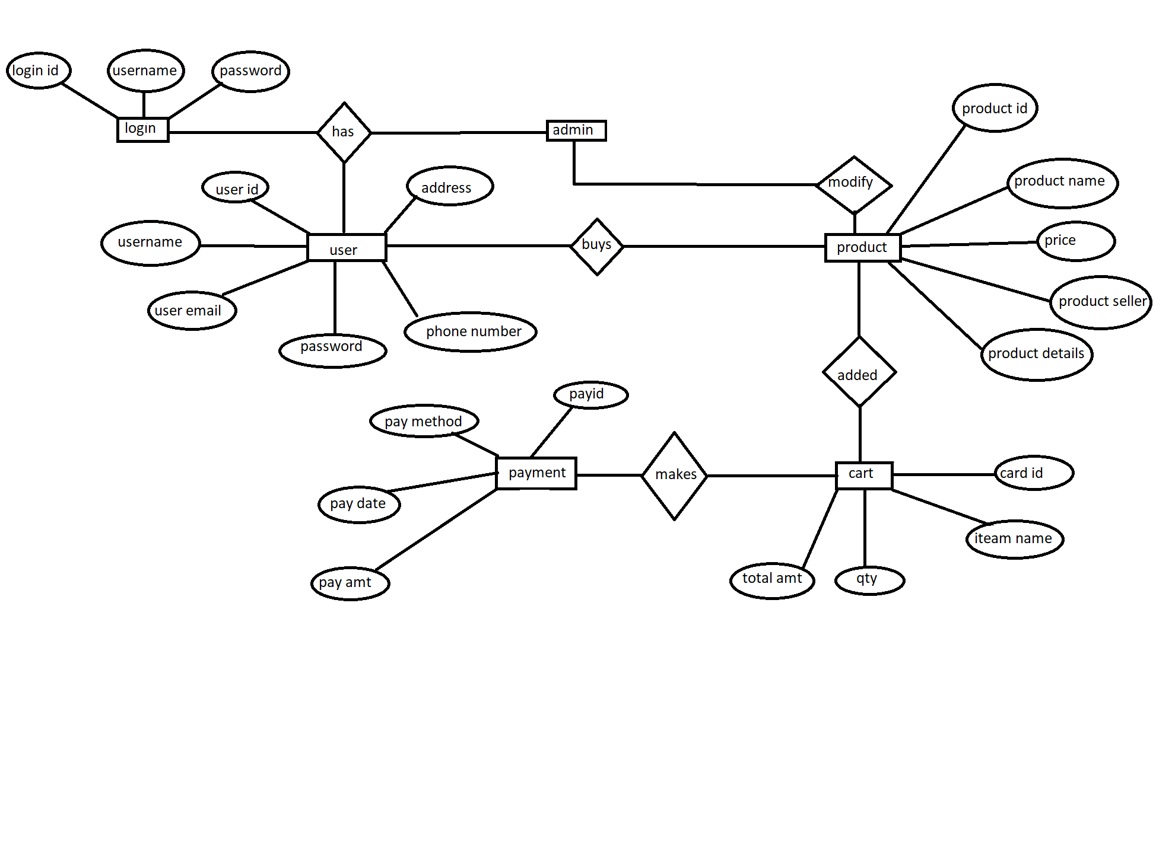
ER Diagram

Slide 10
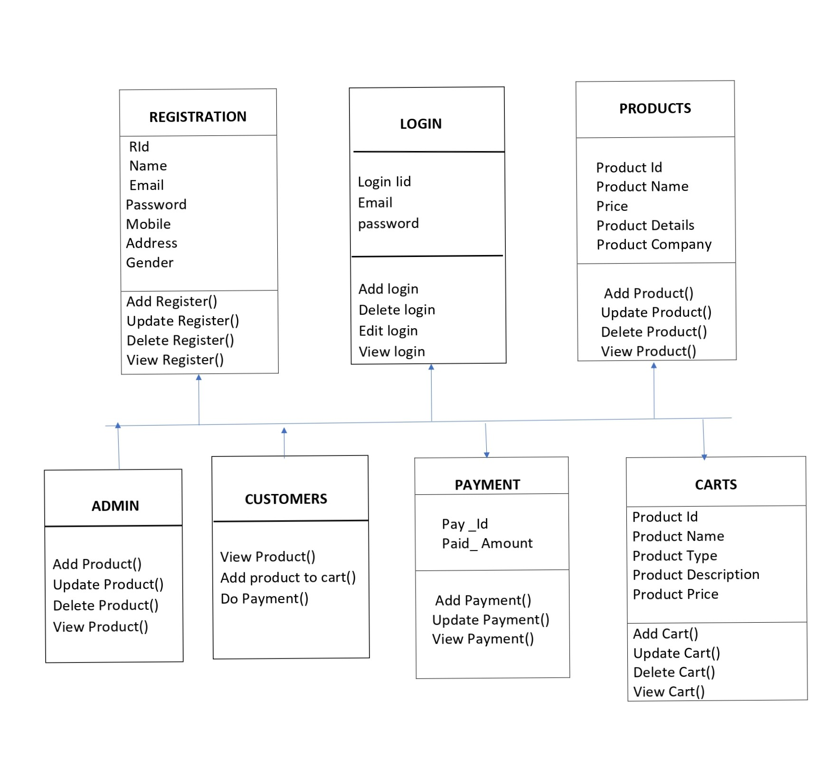
DB Schema

Slide 11
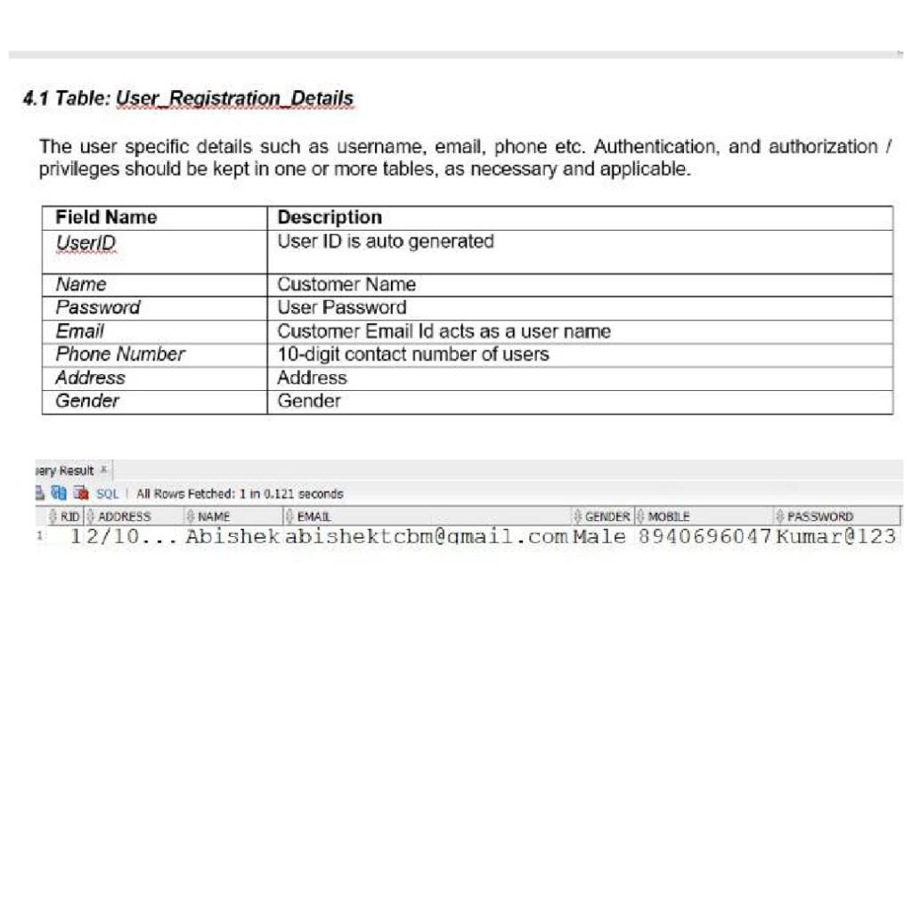
Data Organization
This section explains the data storage requirements of the customers and indicative data description along with suggested table (database) structure. The following section explains few of the tables (fields) with description. However, in similar approach need to be considered for all other tables.

Slide 12
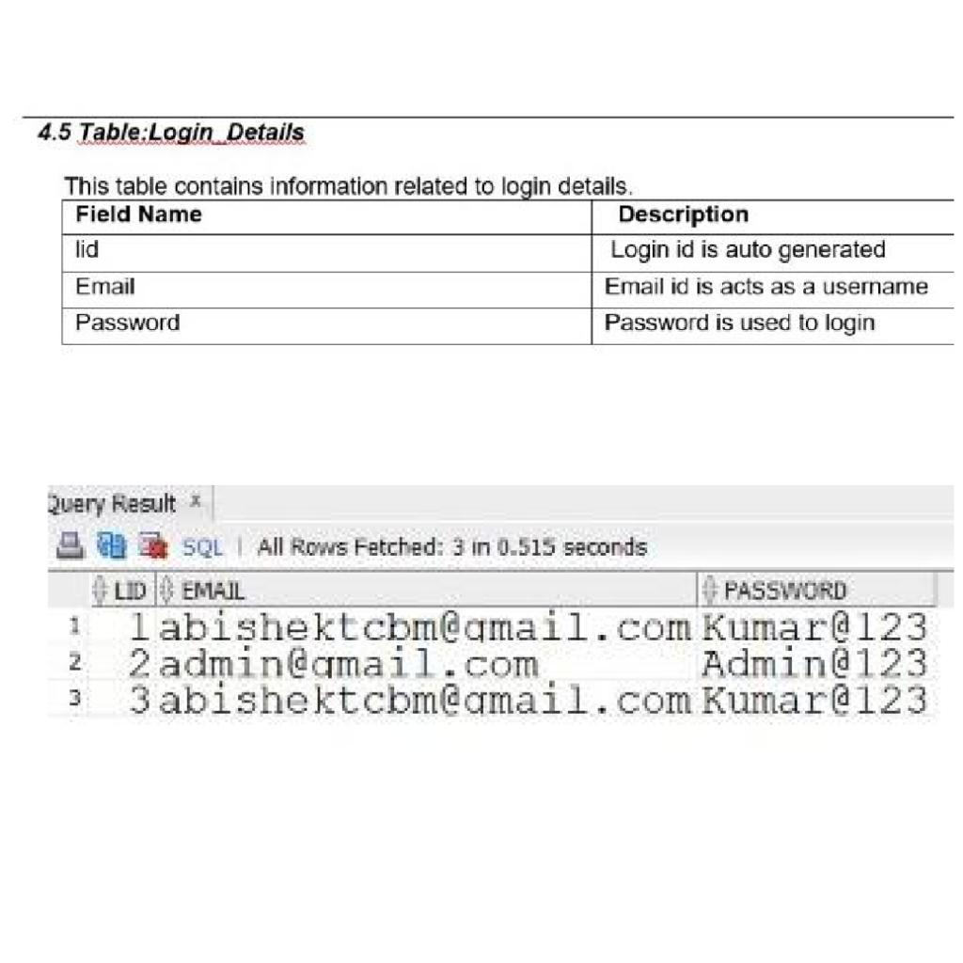

Slide 13
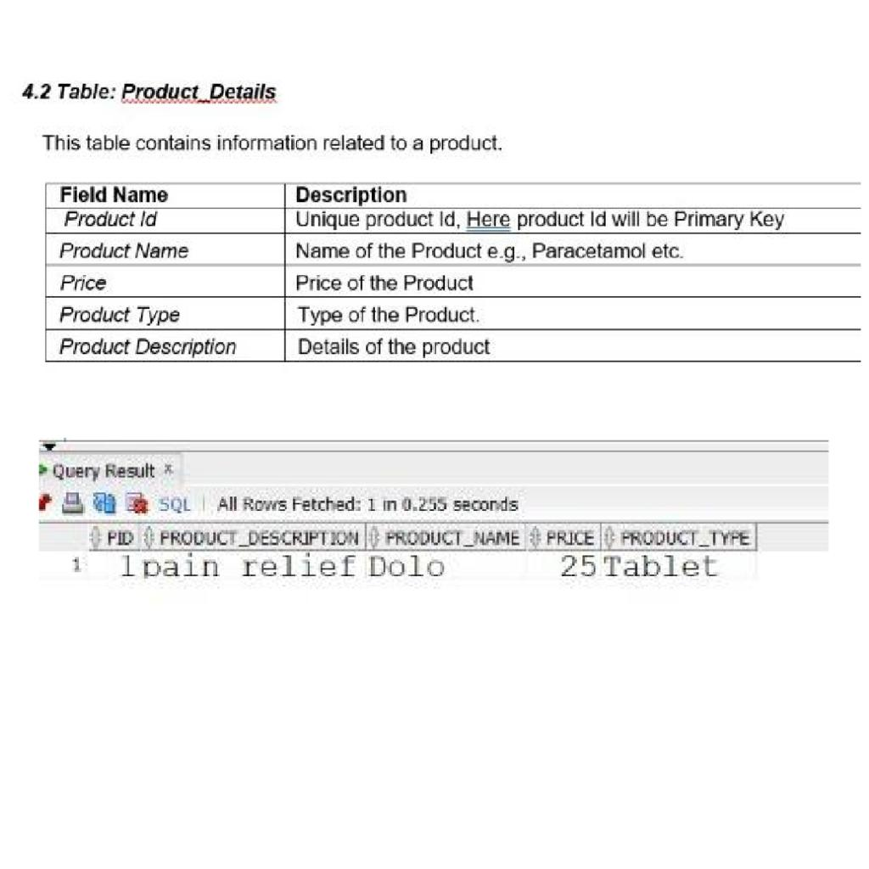

Slide 14
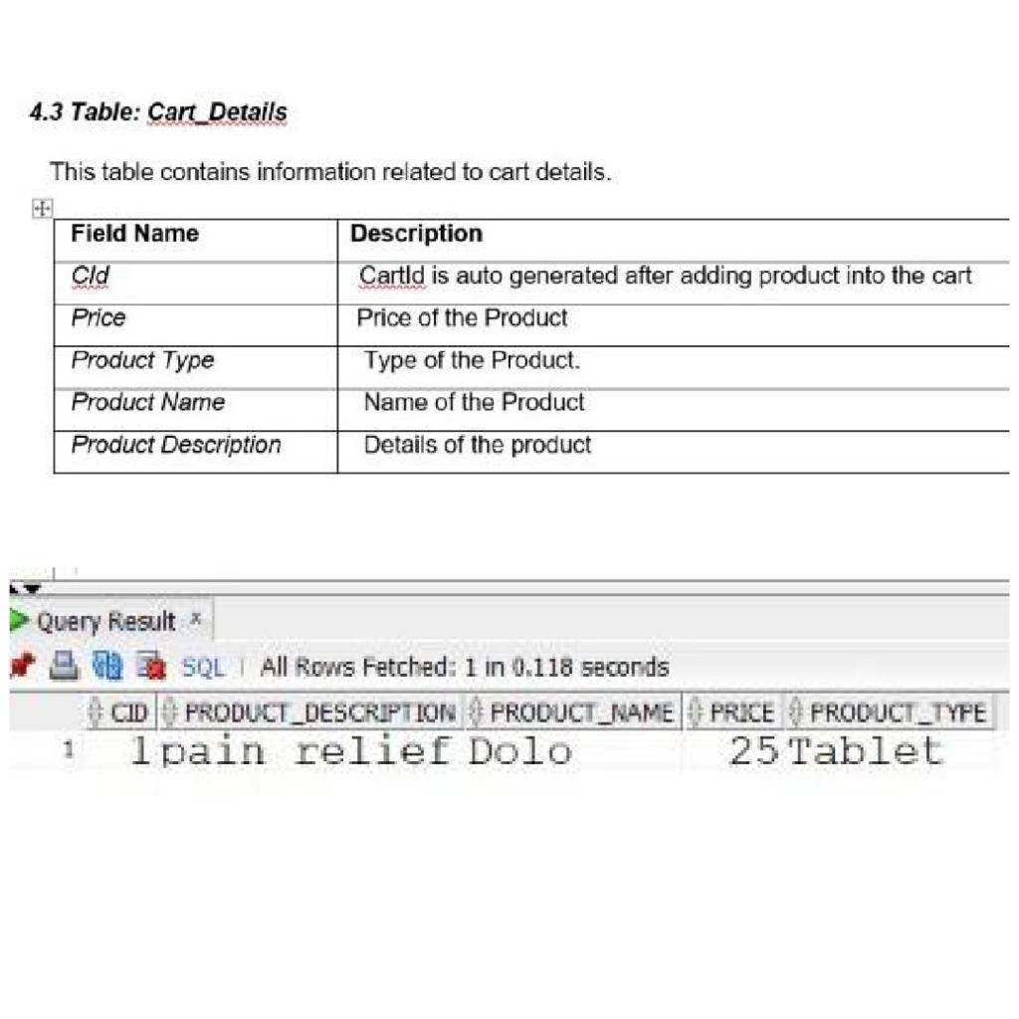

Slide 15
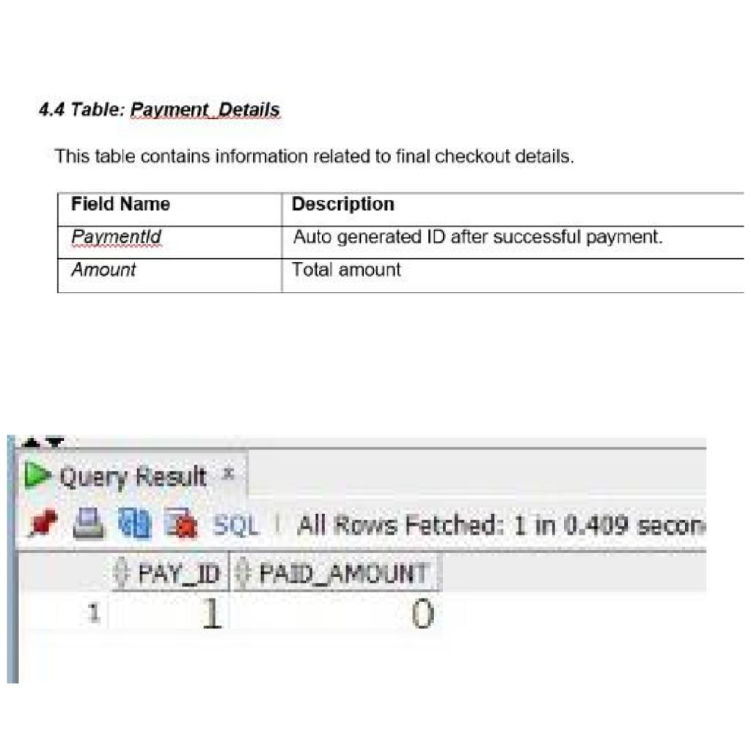

Slide 16
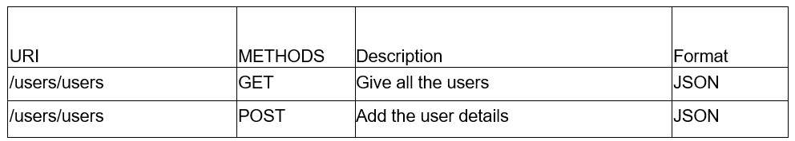
REST APIs to be Built
User Entity
a) Will have fetchUserByEmailId method.
b) Add the User details

Slide 17
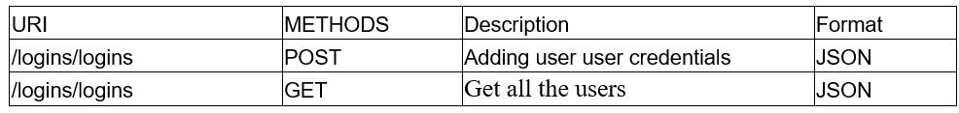
Login Entity

Slide 18
Cart Entity

Slide 19
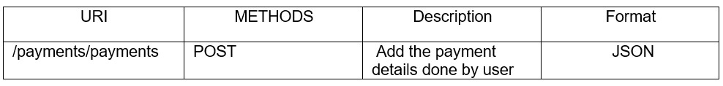
Payment Entity

Slide 20
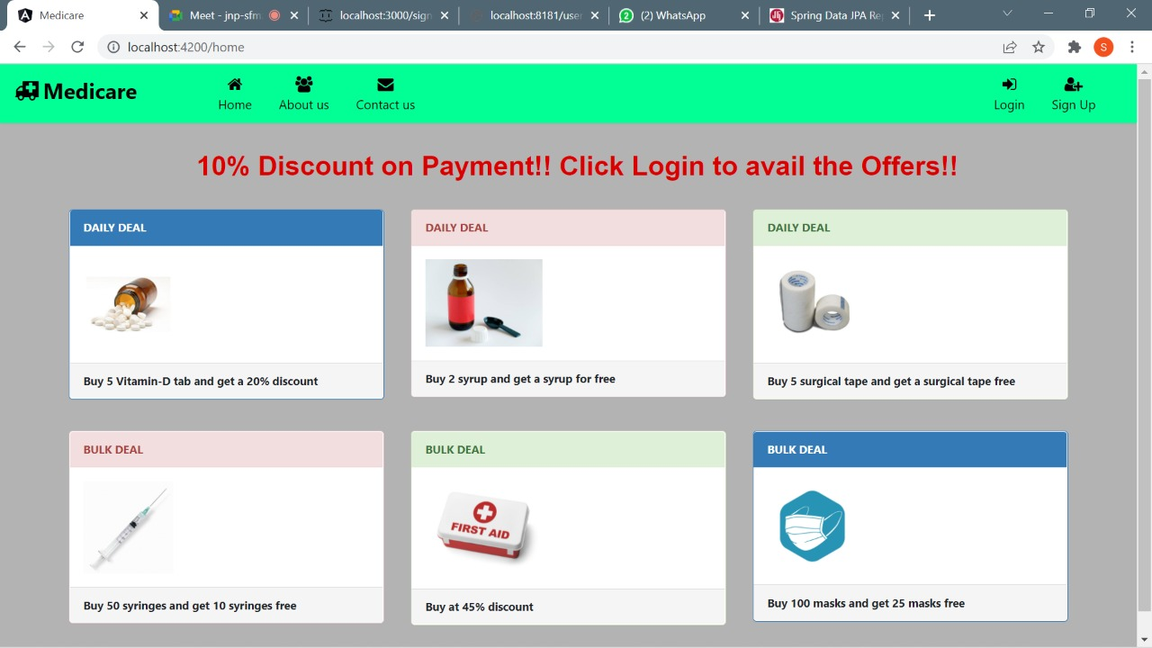
OUTPUT PICTURES
Home Page:

Slide 21
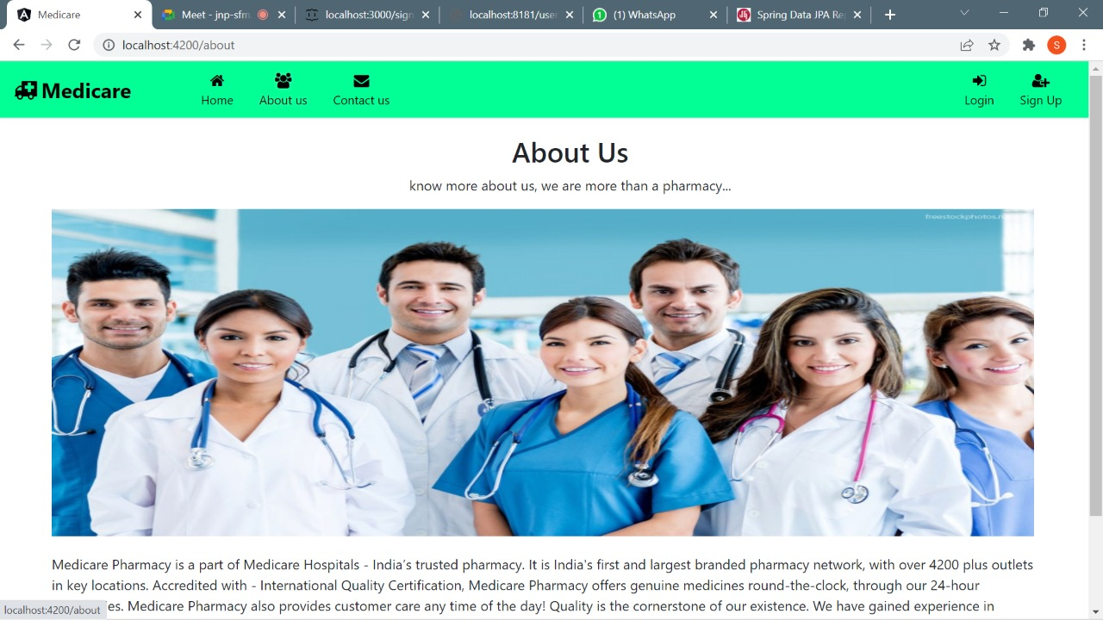
About US:

Slide 22
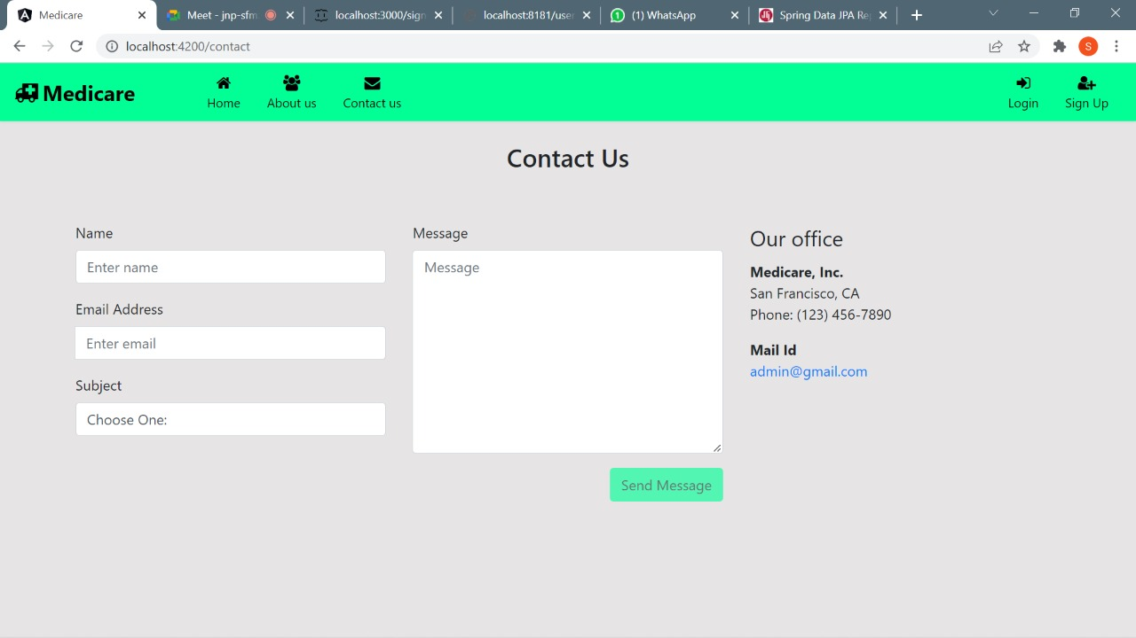
Contact US:

Slide 23
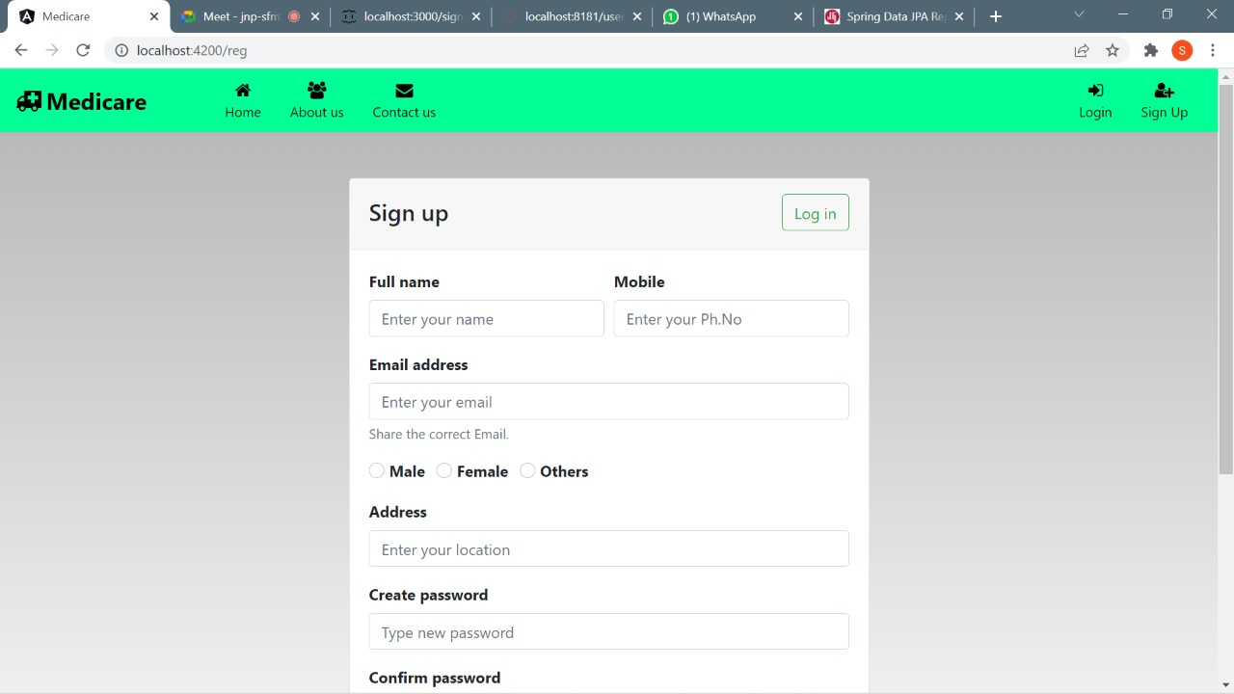
Sign Up:

Slide 24
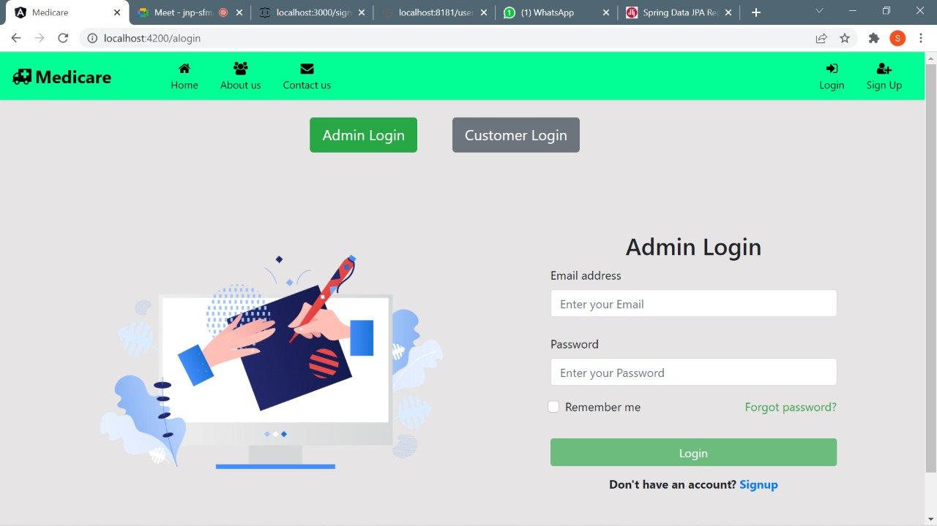
Admin Login:

Slide 25
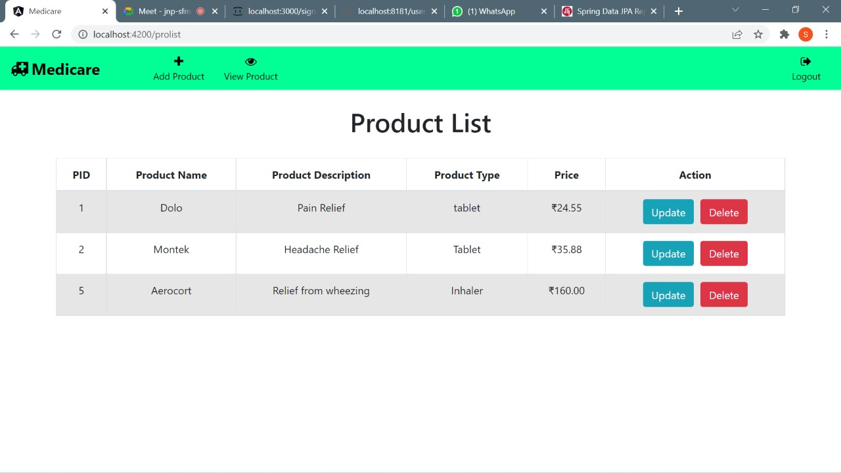
Admin Product View:

Slide 26
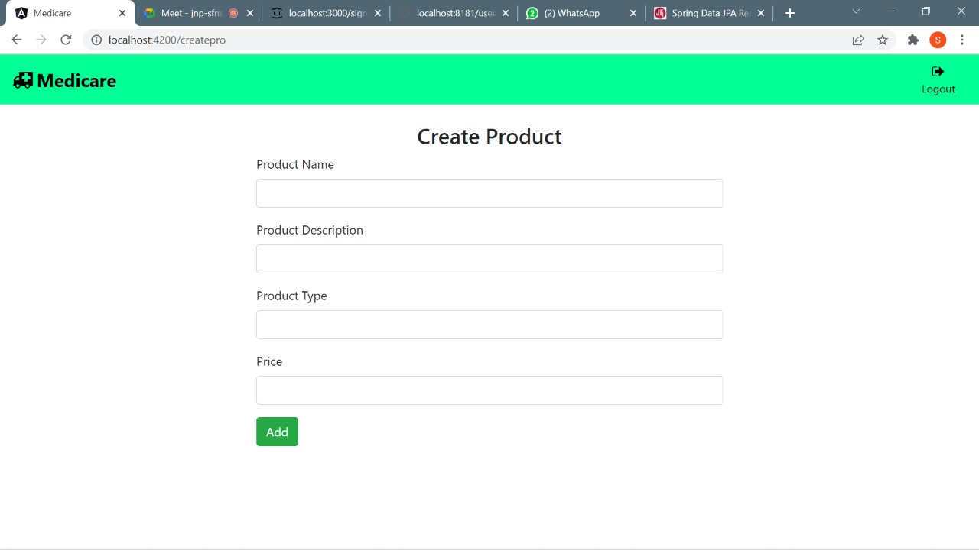
Add Product:

Slide 27
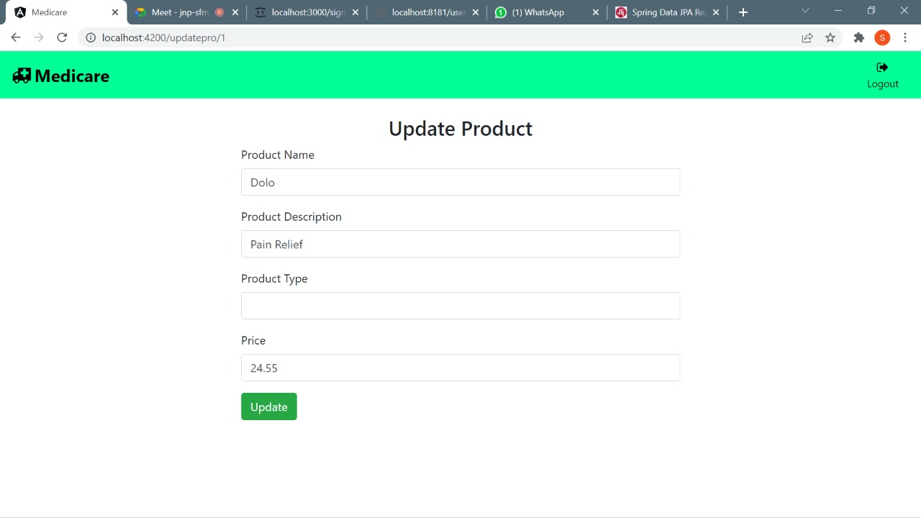
Update Product:

Slide 28

Customer Login:

Slide 29
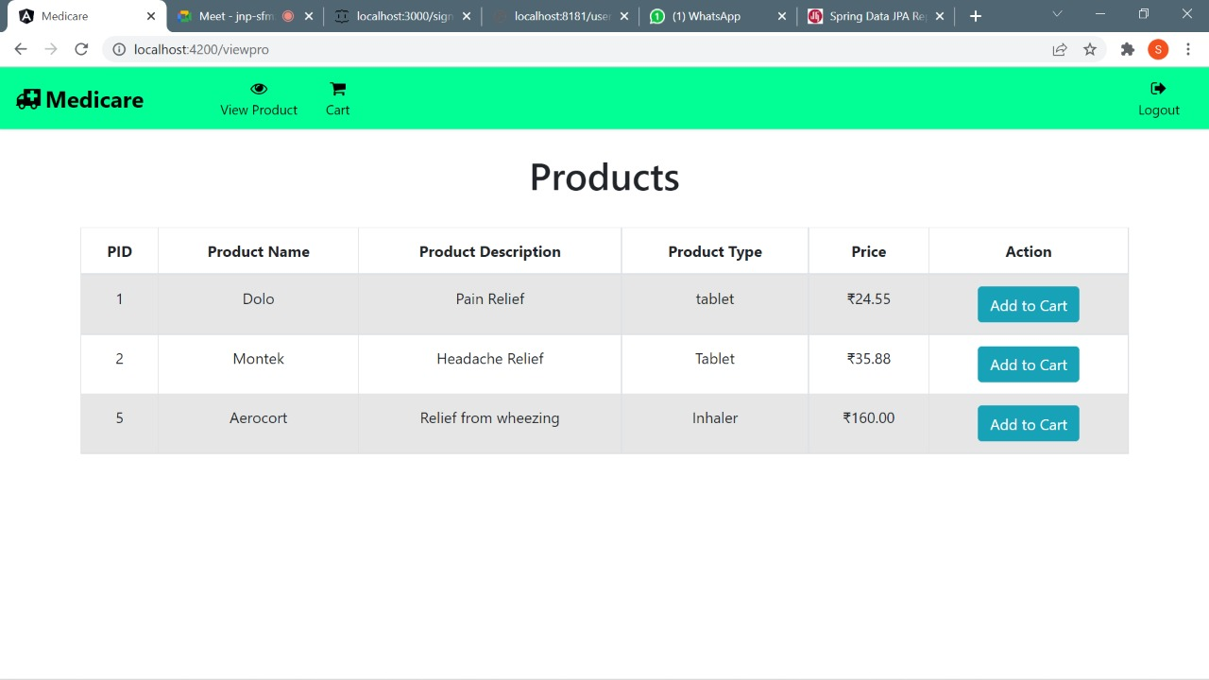
Customer Product View:

Slide 30
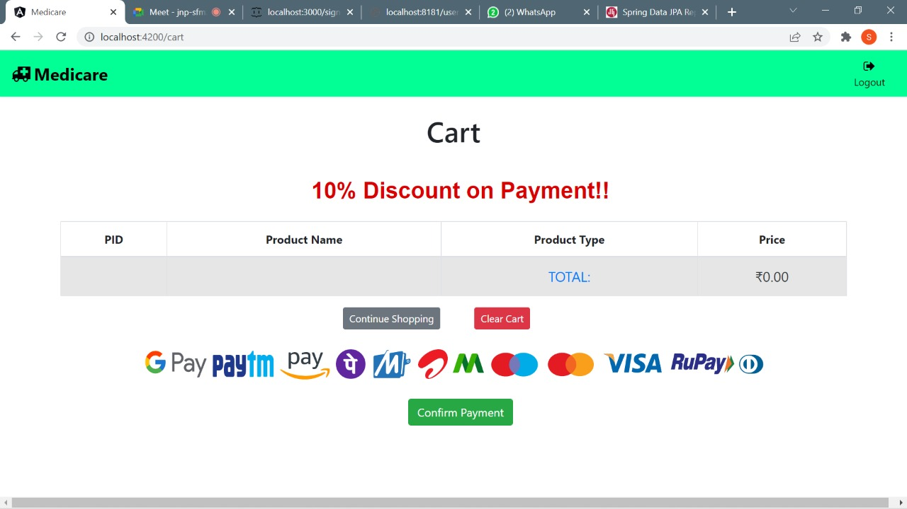
Cart:

Slide 31
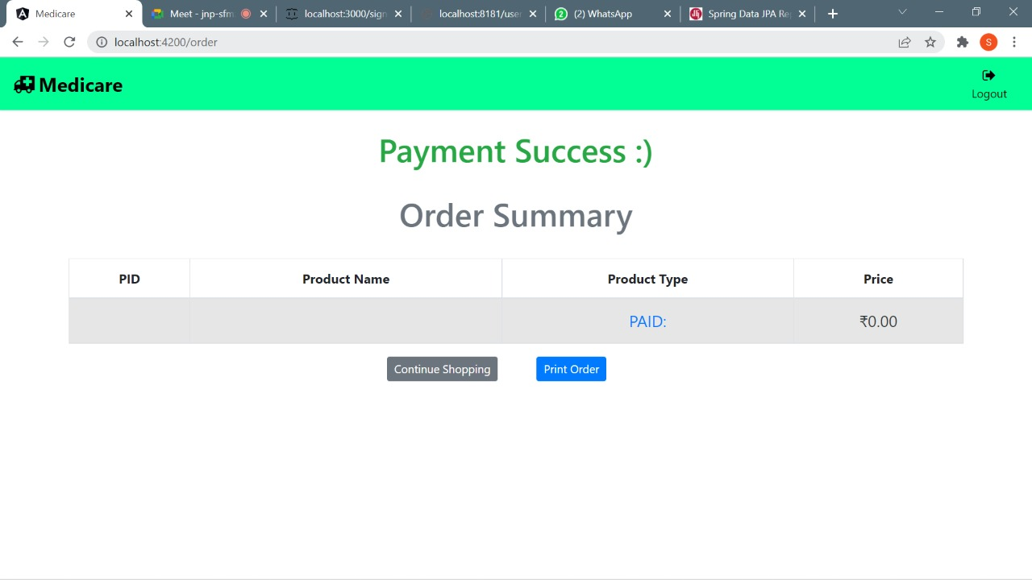
Order:

Slide 32
REFFERENCES
[1] Sonal Kasliwal, H.D.Gadade and Sushma Kotkar (2016), Employee Monitoring System , International Journal of Innovative Research in Advanced Engineering (IJIRAE) SSN: 2349-2763, No03, Vol 3, pp. 1-4
[2] Aparna Chandran (2013), Employee Monitoring System, International Journal of Computer Science & Engineering Technology (IJCSET) ISSN: 2229-3345 Vol. 4 No. 04, page 451-452
[3] Shermin Sultana1, Ishrat Jahan Mouri and Asma Enayet1 (2015), A Smart Time And Attendance Tracking System International Journal Of Computer Science, Engineering And Information Technology (Ijcseit), Vol. 5, No.1,

Slide 33
Conclusion
This project is built keeping in mind that it is to be used by only one user that is the admin. According to the requested requirement the admin can add, manipulate, update and delete all employee data in his organization. The required records can be easily viewed by the admin anytime time he wants in an instant. The payment of the employee is based on monthly basis. The main objective of this framework is to save time, make the system cost effective and management records efficiently

Slide 34

Thank
You….

