Slide 1
Convolutional neural networks: an overview and application in radiology

Slide 2


Bibliography
Author Name | Designation | University
Rikiya Yamashita | Research Fellow, Pathology | Memorial Sloan Kettering Cancer Center
Mizuho Nishio | M.D., Ph.D. | Kyoto University
Richard Kinh Gian Do | Doctor, Radiologist | Memorial Sloan Kettering Cancer Center
Kaori Togashi | Department Chair of Medical School | Kyoto University
Published online : 22 June 2018

Slide 3
Abstract
Convolution Neural Network(CNN), a part of artificial neural networks has become dominant in various computer vision tasks
Uses multiple building blocks such as convolution layers, pooling layers, and fully connected layers.
Application, challenges and future directions in the field of radiology
Small dataset and overfitting challenges

Slide 4
Introduction
ImageNet Large Scale Visual Recognition Competition (ILSVRC) in 2012
Diabetic retinopathy screening, lesion detection and classification, and metastasis detection
Applied to radiology as well

Slide 5
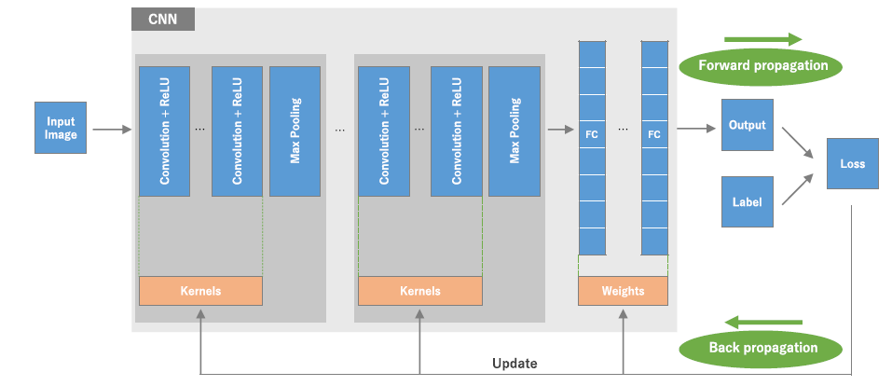
What is CNN: the big picture
Convolution and pooling layers for future extraction
Fully connected layer maps the extracted futures into final output.

Slide 6
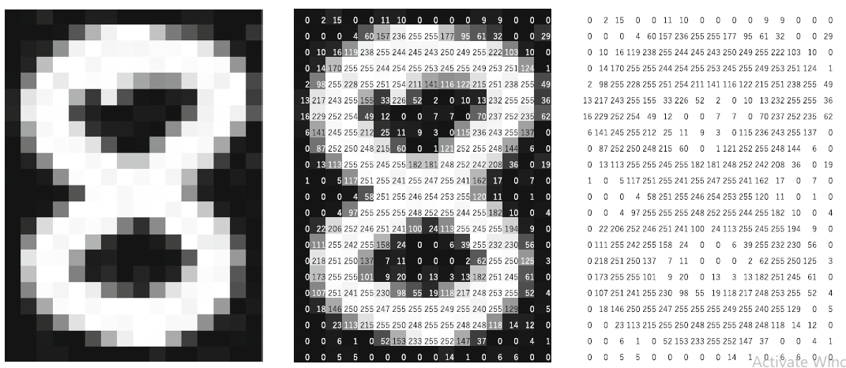
What is CNN: the big picture
Extracted features can hierarchically and progressively become more complex.
Optimizing parameters such as kernels is called training, which is performed so as to minimize the difference between outputs and ground truth labels

Slide 7
How is CNN different from other methods employed in radiomics?
Hand-crafted feature extraction techniques, such as texture analysis
Does not require hand-crafted feature extraction
Do not necessarily require segmentation of tumors or organs by human experts
Data hungry
Computationally expensive
Requiring graphical processing units (GPUs)

Slide 8
Building blocks of CNN architecture
Repetition of stack of several convolution layers
A pooling layer
One or more fully connected layers

Slide 9
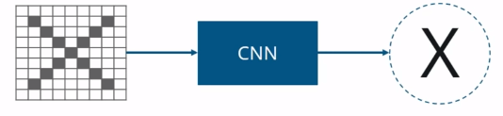
How CNN works?
Convolution Neural Network has following layers:
Convolution
ReLU Layer
Pooling
Fully Connected

Slide 10
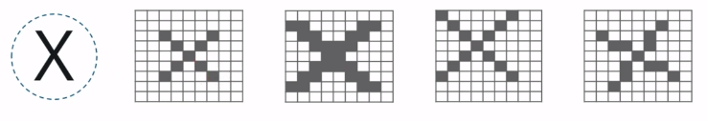
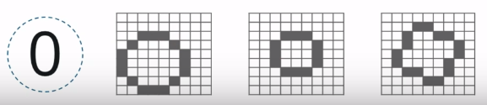
Classify all deformed images
Have to find deformed images of X, and not only the original ‘X’

Slide 11
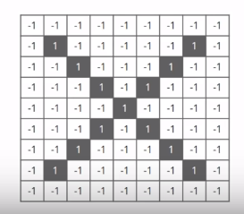
Assigning values based on pixel
A computer understands an image using numbers at each pixels.
Here, let us take black pixel will have value 1 and white pixel have value -1.
Using normal techniques, computers compare the images

Slide 12
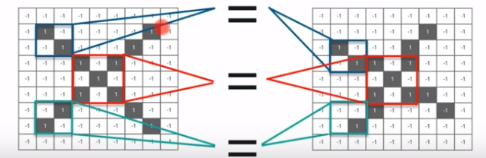
Comparing with the original image
CNN compares the image piece by piece called features.
By finding rough feature matches, in roughly the same position in two images, CNN gets a lot better at seeing similarity than whole-image matching schemes.

Slide 13
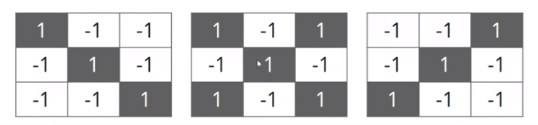
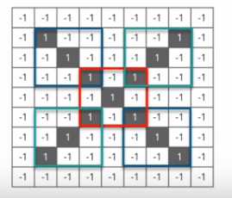
Evaluating with each Kernel
Take 3 features or filters from the data that needs to be trained
There are small pieces of bigger image. Choose a
Feature and put it on the input image, if it matches then
the image is classified correctly.

Slide 14
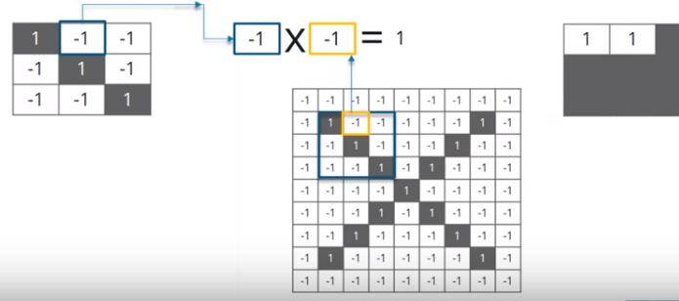
Convolution Layer
Move up the feature/filter to every possible position on the image
Line up the feature on the image
Multiply each image pixel by the corresponding feature pixel

Slide 15
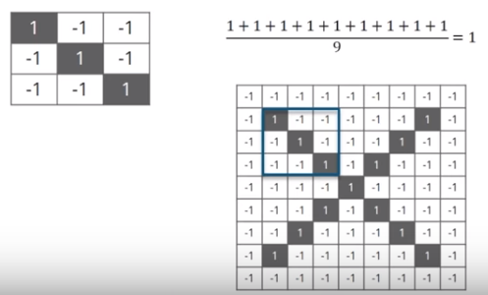
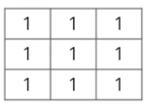
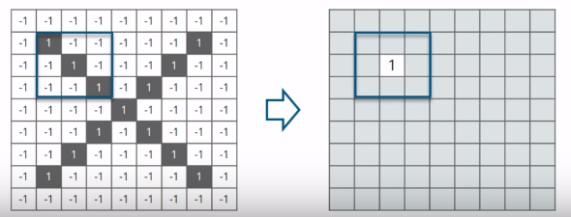
Steps involved in Convolution Layer
To keep track of where that feature was, we create a map and put the value of the filter at that place

Slide 16
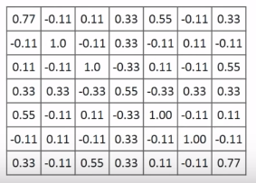
Convolution Layer output
Move the feature to every other positions of the image and the output is tabulated

Slide 17
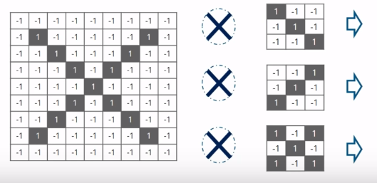
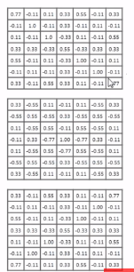
Convolution Layer Output
Perform the convolution with every other filters

Slide 18
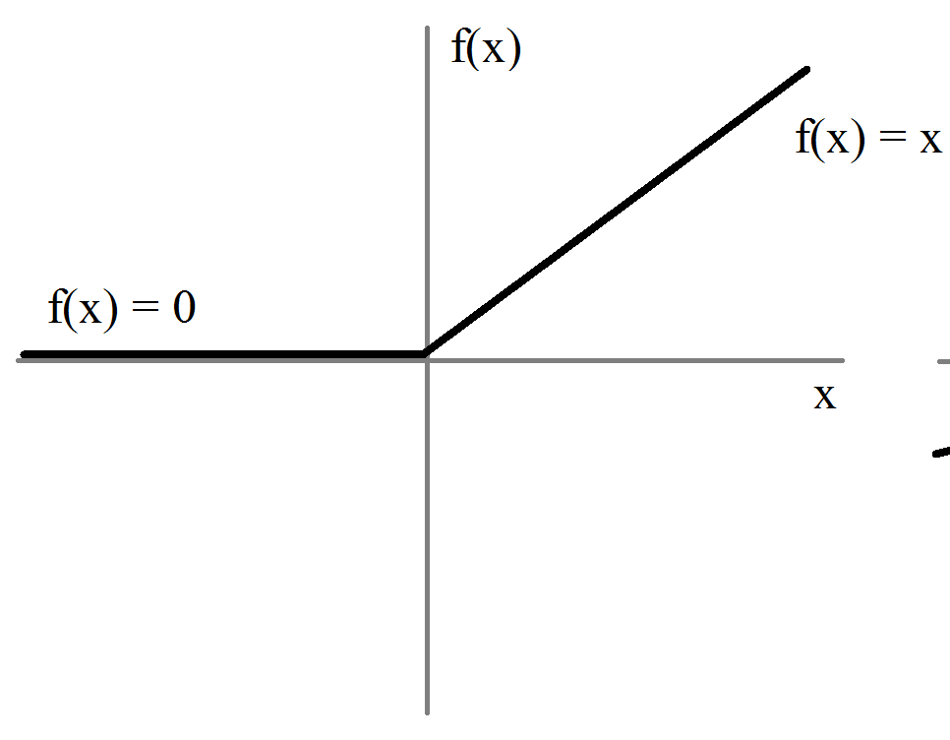
ReLU Layer
ReLU – Rectified Linear Unit
Activation function that activates a node if the input is above certain quantity and has linear relationship with the dependent variable.

Slide 19
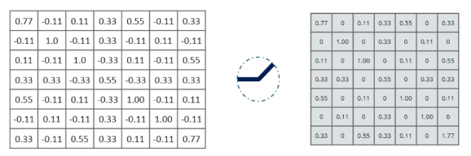
Output of one feature

Slide 20
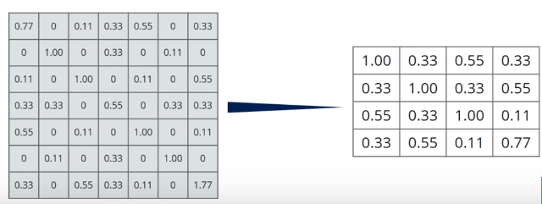
Pooling Layer
Shrink the image stack to smaller size
Window size(usually 2 or 3), strides(usually 2)
Take the maximum value
Convolution → ReLU → Pooling

Slide 21
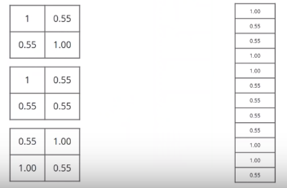

Fully Connected Layer
This is the final layer where the actual classification happens
The filtered and shrinked images are put into single list.
Stacking up the layers
Repeat Convolution, ReLU and pooling on the output of first iteration.

Slide 22
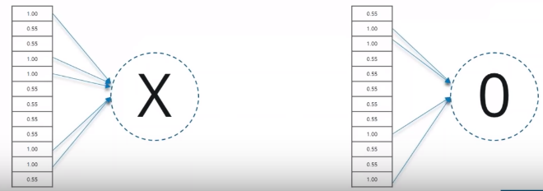
Output
For ‘X’ there are different elements that are high and for ‘O’ different elements are high.

Slide 23
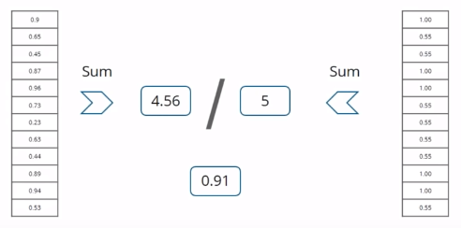
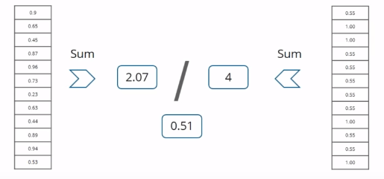
Prediction
List of new input image

Slide 24
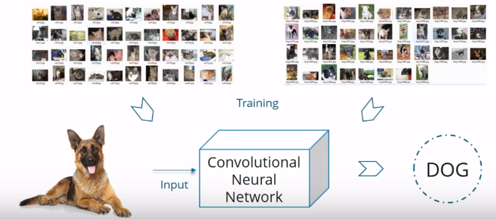
CNN Use-Case
Train our model on Dog and Cat images.
Once trained, provide an input. It will classify the image.

Slide 25
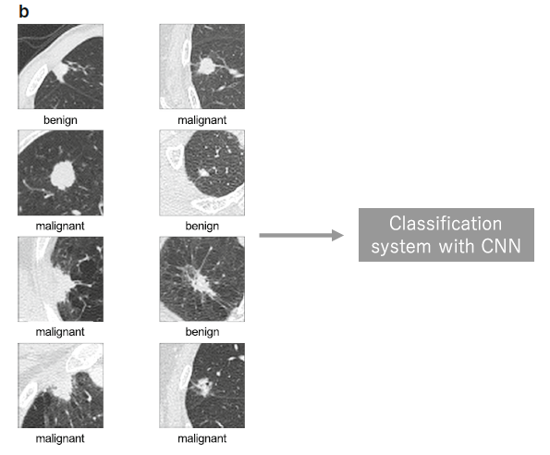
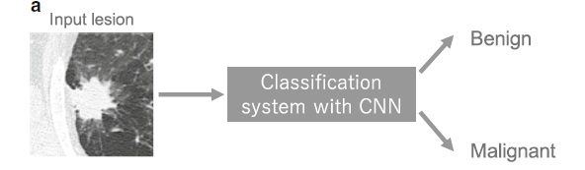
Applications in Radiology - Classification
Lung nodules - Benign and Malignant

Slide 26

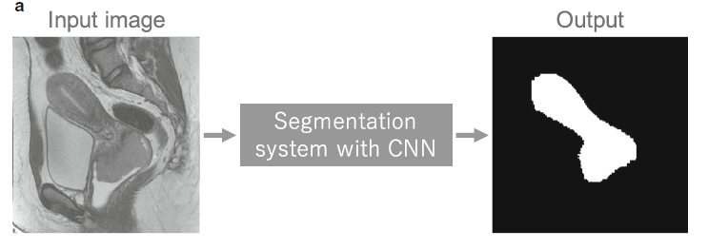
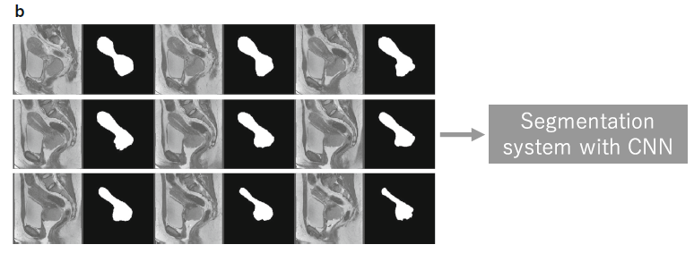
Applications in Radiology - Segmentation
A schematic illustration of the system for segmenting a uterus with a malignant tumor and representative examples of its training data.
Segmentation system with CNN in deployment phase and training data used in the training phase.

Slide 27
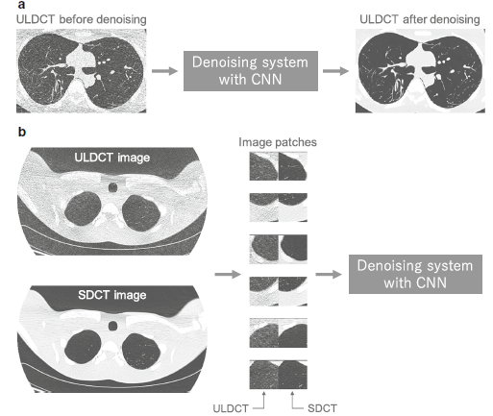
Applications in Radiology - Detection
ULDCT- Ultra Low Dose CT Scan
SDCT- Standard-Dose CT Scan
Detect pulmonary tuberculosis on chest radiographs.
The dataset of 1007 chest radiographs was used.
Healthy cases was 0.99, which was obtained by ensemble of the AlexNet and GoogLeNet 2D-CNNs.

Slide 28
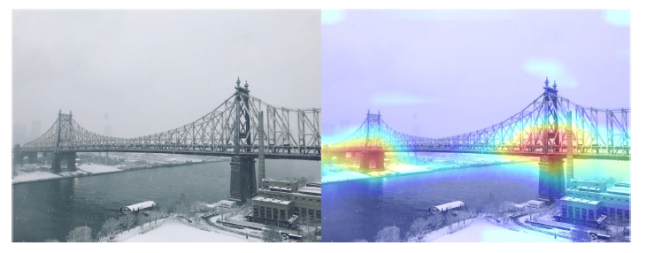
Applications - Others
A heatmap for the category of “bridge pier” generated by a method called Grad-CAM , is superimposed (right image), which indicates the discriminative image regions used by the CNN for the classification

Slide 29
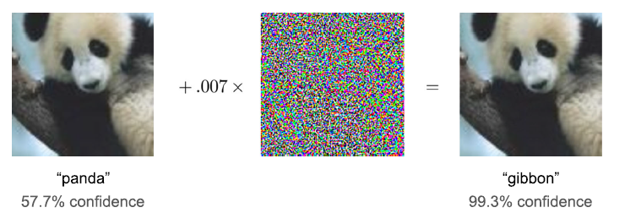
Challenges and Future directions
Although deep learning requires a large number of training data, building such a large-scale training data of radiological images is a challenging problem
Needs to process huge amount of data
GPU’s are required. Costly and demands enormous workload by experts.
Dedicated medical pretrained networks can probably be proposed

Slide 30
Conclusion
Convolutional neural networks (CNNs) have accomplished astonishing achievements across a variety of domains, including medical research,
Such an image classification and object detection, it is not a panacea
Being familiar with key concepts and advantages of CNN as well as limitations of deep learning is essential in order to leverage it in radiology research with the goal of improving radiologist performance and, eventually, patient care.

Slide 31
Queries?

Slide 32
THANK YOU

