Slide 1
Retail Giant Sales Forcasting
Balaji Ramaswamy
Bhumit Trivedi
Mohandas Amarnathan
Raunak Mukhia

Slide 2
Metadata Summary: Variables considered in analysis
Number of Transaction Records | 51290
Number of markets | 7
Number of segmetns | 3
Problem Statement: Predict 6 months of Sales and Quantity for the top two categories of Market and Segment.
Market | Segment | Mean Profit | Sd Profit | CV
EU | Consumer | 3930.9939 | 2454.1398 | 0.6243052
APAC | Consumer | 4642.0325 | 2934.3785 | 0.6321323
LATAM | Consumer | 2513.1861 | 1662.4295 | 0.6614828
APAC | Corporate | 2702.8591 | 1886.8305 | 0.6980869
EU | Corporate | 2570.7079 | 1963.5252 | 0.7638072
LATAM | Corporate | 1205.7379 | 978.0003 | 0.8111217
US | Corporate | 1916.232 | 1920.8479 | 1.0024089
US | Consumer | 2794.1502 | 2828.7698 | 1.01239
APAC | Home Office | 1738.4428 | 1818.3736 | 1.0459784
US | Home Office | 1256.2225 | 1377.0048 | 1.0961473
EU | Home Office | 1265.5845 | 1413.0343 | 1.1165073
LATAM | Home Office | 898.6486 | 1056.5392 | 1.1756978
Africa | Consumer | 995.2521 | 1313.3196 | 1.3195849
Canada | Consumer | 230.4214 | 321.5098 | 1.3953122
Canada | Corporate | 148.1312 | 230.0144 | 1.5527751
Africa | Corporate | 430.9784 | 765.4631 | 1.7761054
Africa | Home Office | 425.2618 | 761.2168 | 1.7899957
EMEA | Consumer | 531.9286 | 1164.0039 | 2.1882709
Canada | Home Office | 124.1292 | 278.479 | 2.2434607
EMEA | Corporate | 260.3986 | 1163.2273 | 4.4671024
EMEA | Home Office | 122.2138 | 718.7085 | 5.8807467
Top two Market segment with lowest CV are EU/Consumer and APAC/Consumer
Markets
Africa
APAC
Canada
EMEA
EU
LATAM
US
Segments
Consumer
Corporate
Home Office

Slide 3
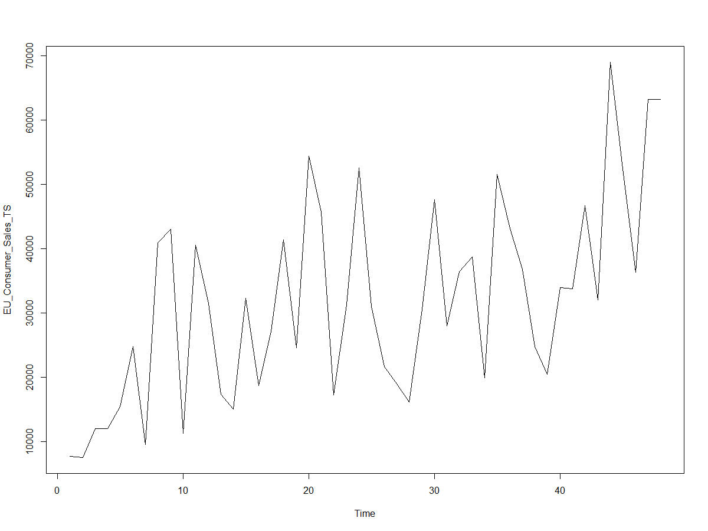
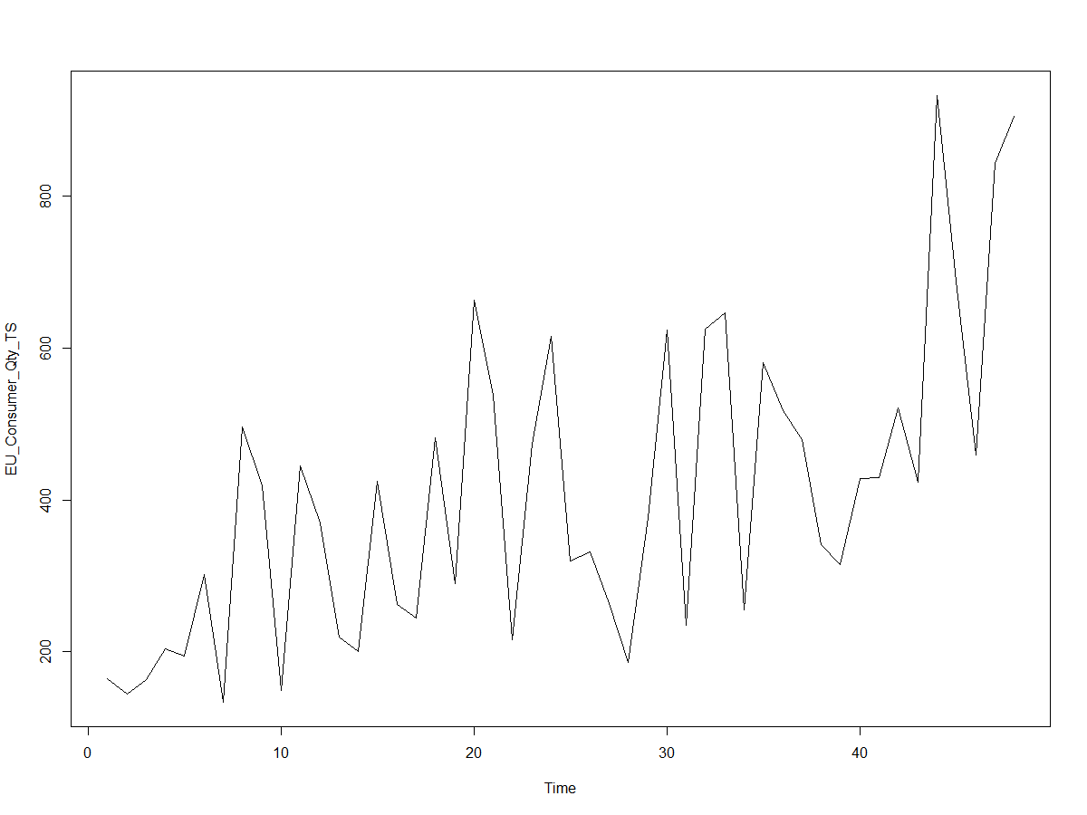
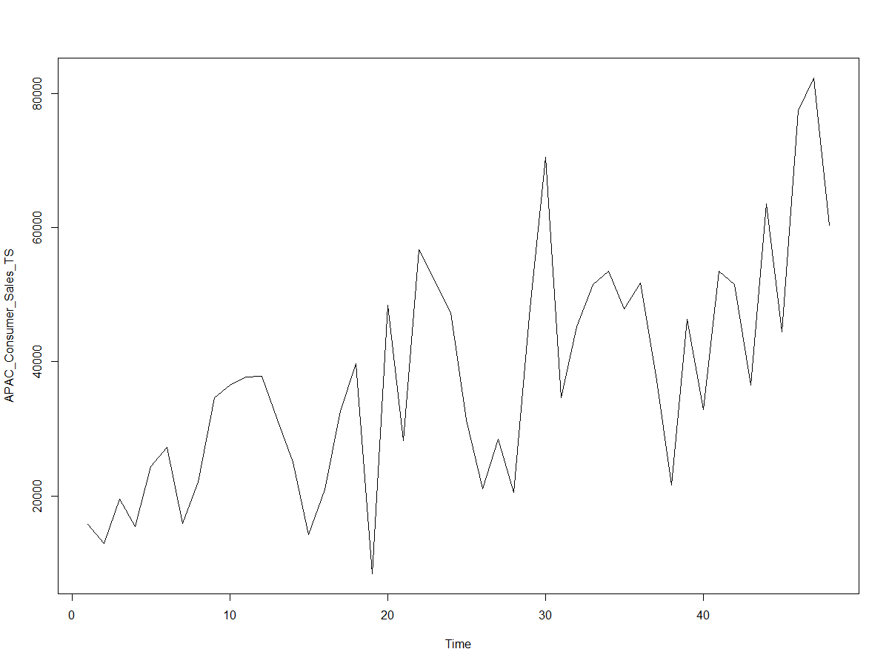
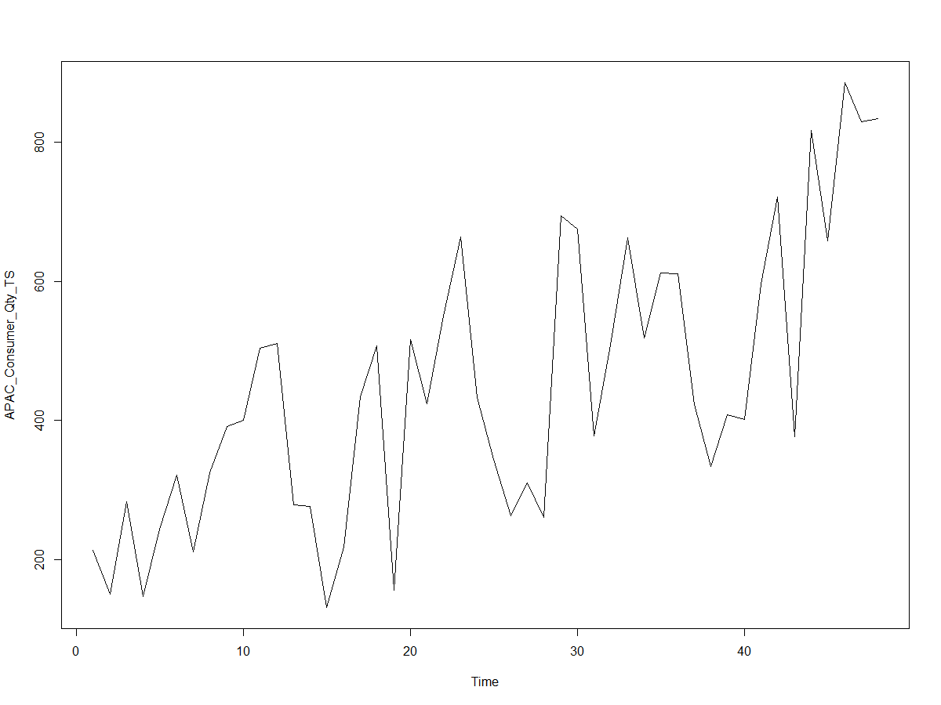
Time Series Used for Prediction
EU-Consumer - Sales
EU-Consumer - Quantity
APAC-Consumer - Sales
APAC-Consumer - Quantity

