Slide 1
Welcome
To
Transportation Model
Problem Statement:-(To build an Ecosystem model for Road Transportation to provide the passengers an ease in travel,find information’s on road blocks,routes traffic and related weather conditions,To help passenger travelling on daily bases or who are new to the city. )

Slide 2
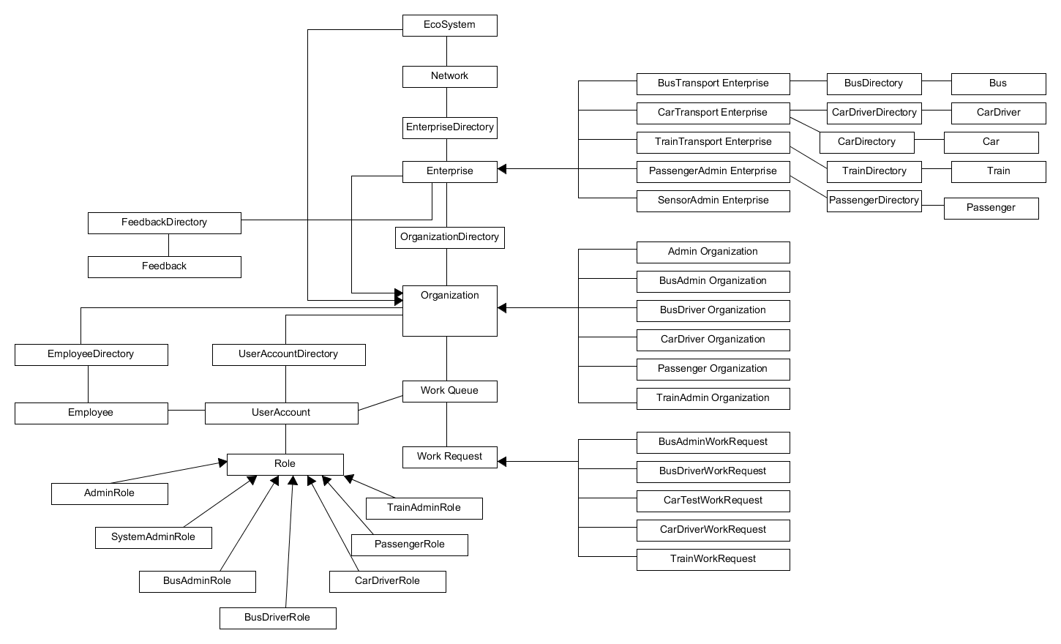
Object Model

Slide 3
Project Work Flow:-
Registration
System Admin creates a Network and adds required Enterprises(bus/train/car) under the network
System Admin also creates Enterprise Admins and their corresponding user accounts
Each Enterprise Admin further creates user accounts for respective enterprise employees (admins and drivers)
Passengers register themselves to the system using the Sign Up option in the app.
Bus Transportation:-
Bus Admin creates the bus and its schedule along with the journey fare and available seats.
Bus Driver selects a bus from the available list and assigns bus for duty
Passenger selects a bus on which seats are available and books a seat for the journey
Bus Driver can send periodic notifications to the Passengers
Passengers can login to the system and view such notifications
Car Transportation:-
Car Driver adds a list of cars to the system. The information also includes car start and drop points along with the journey fare.
Passenger selects a suitable car from the list and books the car for the journey.
Car Driver can send periodic notifications to the Passengers
Passengers can login to the system and view such notifications
Train Transportation:-
Train Admin creates a train schedule including source and destination along with the fare and available seats
Passenger selects a train on which seats are available and books a seat for the journey
Train Driver can send periodic notifications to the Passengers
Passengers can login to the system and view such notifications

Slide 4
IOT Features:-
Sensor Feature(Car Transportation)
The sensor would act like it’s placed on the car and it gives the car driver information about the speed, fuel, tyre pressure and temperature.
The car driver can view the information and accordingly control his activities.

Slide 5
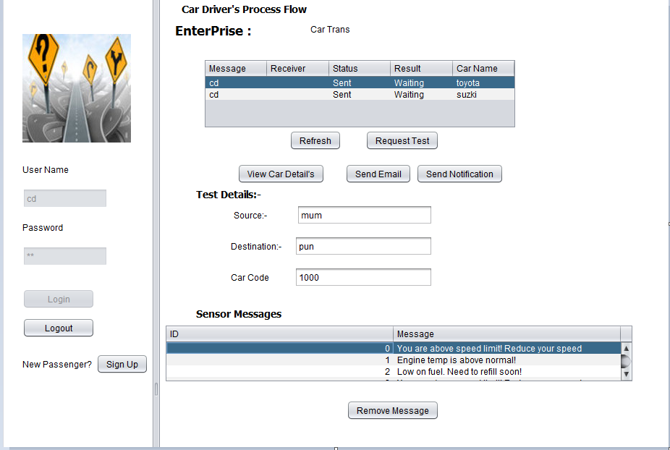
Car Sensor Information

Slide 6
Additional Features:-
The driver could give the passengers timely updates or notifications about their travel like any delay in journey or some general information on the weather condition so that the passenger could plan their travel accordingly.
The Passengers can send email regarding the services offered to them.
The Passenger could browse through location maps.
The passenger could view the current weather conditions.
Also provided the passenger with a calculator functionality.
The system admin could get stats from the system like the total number of bookings done spilt by each enterprise (car/train/bus).
The system admin could view all the responses from the passenger about their experience also if there is any accidents for each of the enterprise(car/train/bus)

Slide 7
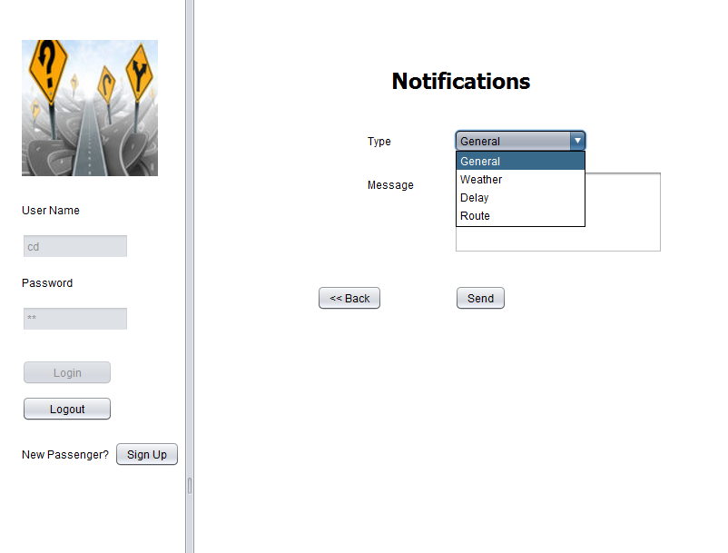
Notification Messages

Slide 8
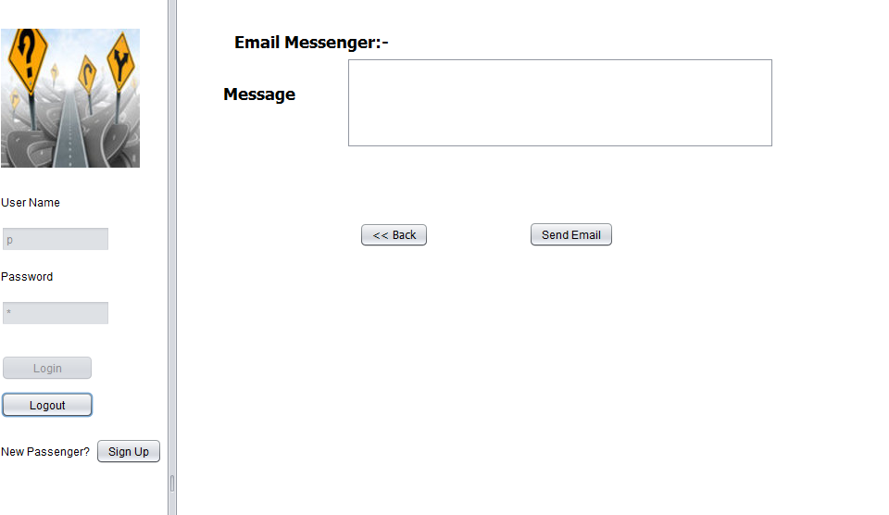
Email Messenger

Slide 9
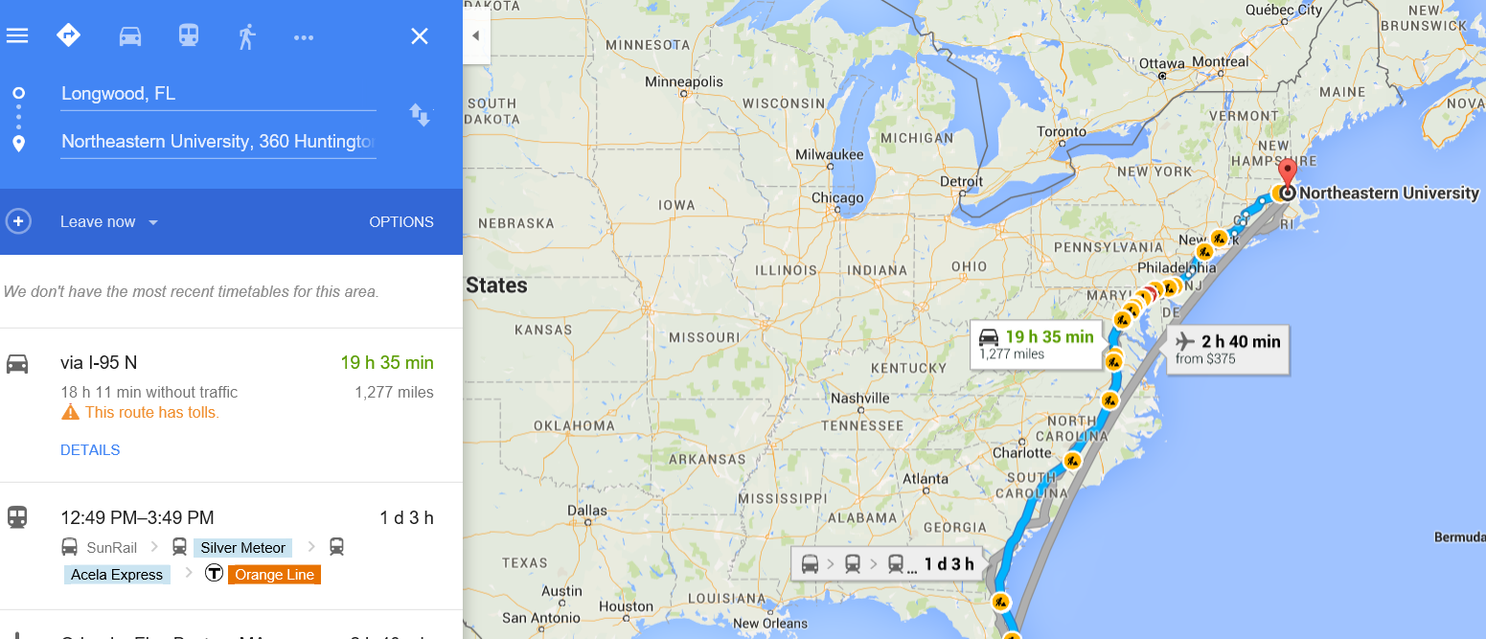
Maps:-

Slide 10
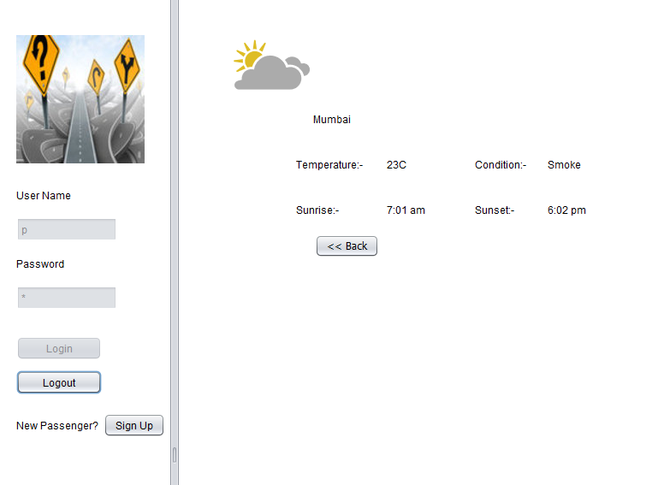
Weather Conditions:-

Slide 11
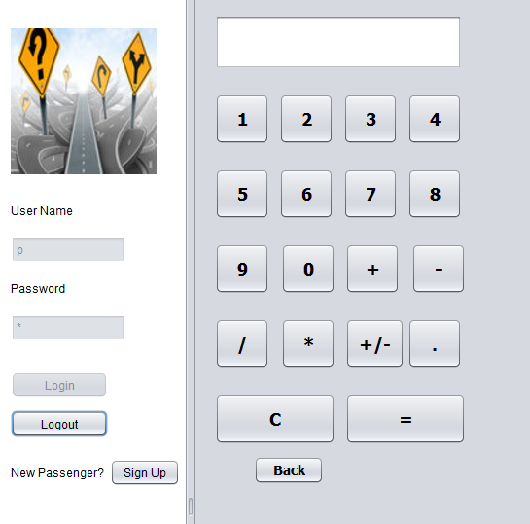
Calculator for passenger fares

Slide 12
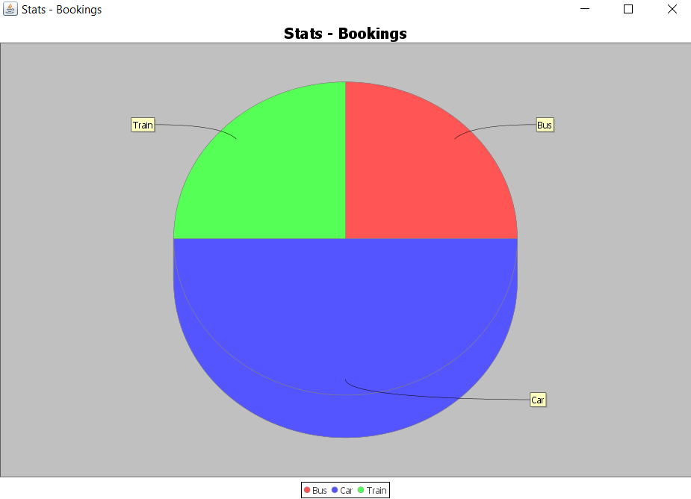
Pie-Chart Showing count of passengers

Slide 13
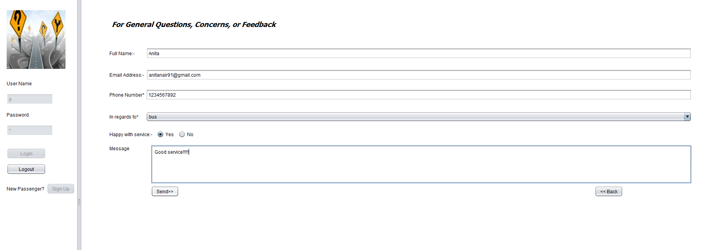
Passenger Feedback Form

Slide 14
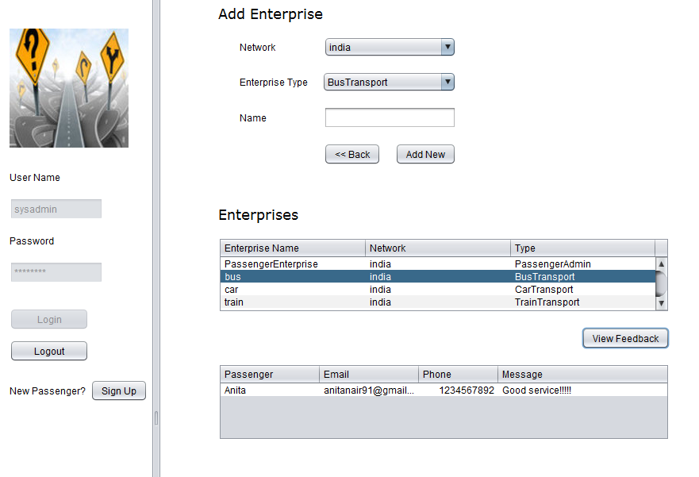
System Admin Views responses from Passengers for(Bus,Car,Train)

Slide 15
Thank You
By Anita Mohandas

