Slide 1

3D Model Viewer with OpenGL
By
Osama Hosam

Slide 2
What to view?
The viewer should be able to load the following 5 models:
1. Cube
2. Teapot
3. Jack
4. A mesh from "WINEGLASS.3VN" file
5. A mesh from “PAWN.3VN” file
These models should be loaded by pressing the corresponding keys 1, 2, 3, 4, 5. (At any time, only a single object is displayed and manipulated).

Slide 3
int model_num=3;
void display()
{
glMatrixMode(GL_PROJECTION);
glLoadIdentity(); ….
….
switch(model_num)
{
case 1:
glutSolidCube(1.0);
break;
case 2:
glutSolidTeapot(1.0);
break;
case 3:
my3VNMesh.Draw();
break;
case 4:
jack();
break;
case 5:
arbit3VNMesh.Draw();
break;
}
…….
glFlush();
}

Slide 4
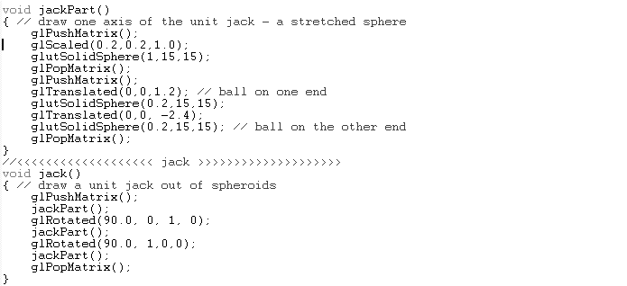

Slide 5
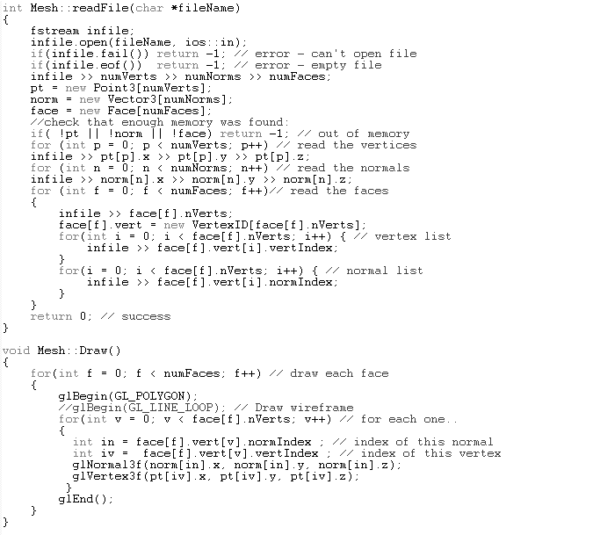

Slide 6
Change material color
The user should be able to change the material color of the current model by pressing key "m".
At least 5 different colors should be provided (and toggled each time the key is pressed).

Slide 7
int model_num=3;
void display()
{
glMatrixMode(GL_PROJECTION);
glLoadIdentity(); ….
….
//Get the current color counter and convert it to binary
//That will give different diffusion color related to the
//value of the color_counter;
int cc=color_counter;
int c=0;
int bin[4];
int rem=0;
while(c<4)
{
rem=cc%2;
cc /= 2;
bin[c++]=rem;
}
//put the corresponding binary value into the diffusion matrix
GLfloat mat_diffuse[] = { bin[0], bin[1], bin[2], bin[3] };
//GLfloat mat_diffuse[] = { 1.0, 0.0, 0.0, 1.0 };
glMaterialfv(GL_FRONT, GL_DIFFUSE, mat_diffuse);
//glColor3d(0,1,1);
…….
glFlush();
}

Slide 8
Coordinates
The viewer displays 3 axes as 3D objects (red for x-axis, green for y-axis, blue for z-axis).
The object is initially centered at the global origin O (when loaded).

Slide 9
void axis(double length)
{ // draw a z-axis, with cone at end
glPushMatrix();
glBegin(GL_LINES);
glVertex3d(0, 0, 0); glVertex3d(0, 0, length); // along the z-axis
glEnd();
glTranslated(0, 0,length -0.2);
//glutWireCone(0.04, 0.2, 12, 9);
glutSolidCone(0.04, 0.2, 12, 9);
glPopMatrix();
}

Slide 10
glClear(GL_COLOR_BUFFER_BIT | GL_DEPTH_BUFFER_BIT); // clear the screen
{
GLfloat mat_diffuse[] = { 0.0, 0.0, 1.0, 1.0 };
glMaterialfv(GL_FRONT, GL_DIFFUSE, mat_diffuse);
glColor3d(0,0,1); // blue lines for wireframe
axis(2); // z-axis
}
glPushMatrix();
{
GLfloat mat_diffuse[] = { 1.0, 0.0, 0.0, 1.0 };
glMaterialfv(GL_FRONT, GL_DIFFUSE, mat_diffuse);
glRotated(90, 0, 1.0, 0);
glColor3d(1,0,0); // red lines for wireframe
axis(2); // x-axis
}
glPopMatrix();
glPushMatrix();
{
GLfloat mat_diffuse[] = { 0.0, 1.0, 0.0, 1.0 };
glMaterialfv(GL_FRONT, GL_DIFFUSE, mat_diffuse);
glRotated(-90.0, 1, 0, 0);
glColor3d(0,1,0); // green lines for wireframe
axis(2); // y-axis
}

Slide 11
Transformations
Rotation: The user first presses "r" to set the transformation mode to rotation. Then uses "x" for x-roll with positive angle, and "X" for x-roll with negative angle. If the user keeps the key pressed down, rotation should be done continuously (use double buffer for smooth animation). Similarly, "y" and "Y" are used for y-roll, and "z" and "Z" for z-roll.

Slide 12
Transformations
Translation: The user first presses "t" to set the transformation mode to translation. Then "x" for positive x-translation, and "X" for negative x-translation. Similarly, "y", "Y", "z", "Z" are used for y- or z-translation.

Slide 13
Transformations
Scaling: Only uniform scaling is allowed (Sx = Sy = Sz). The user first presses "s" to set the transformation mode to scaling. Then "x" for expanding (Sx > 1), and "X" for shrinking (0 < Sx < 1). No negative scaling factor is allowed.

Slide 14
Transformations
Note that the user may perform a series of transformations in a row (for example, first scale by factor 3.5, then translate by (3.0, 2.5, -1.9), then rotate by ..., then translate by ... ), in which case their accumulated effect must show on the transformed object.

