Slide 1
AI For Business Leaders Course
Project Steps: Delivering an ML/AI Strategy

Slide 2
AI for Business Leaders
Project Step 2C
First Prioritization Grid

Slide 3
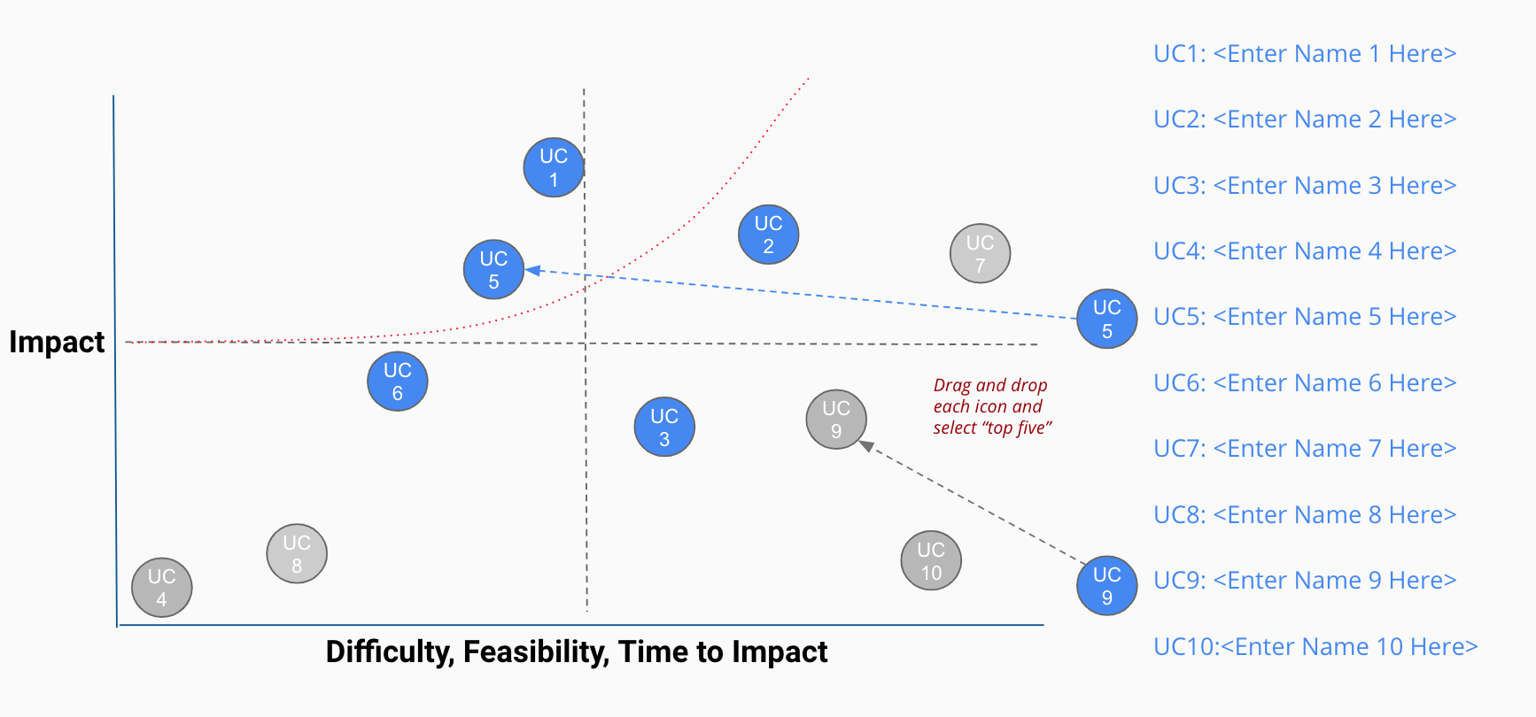
Your First Prioritization Grid
DIRECTIONS: For each of your use cases, review your answers to the 5V questions in Step 2A, and the operations you chose in Step 2B.
Then on the grid on the next slide, not this slide, move each blue use case icon to a place indicating how you see this use case’s impact and feasibility.
(Recall that the upper left quadrant is usually the most desirable, as it indicates we expect less time and effort to achieve greater impact.)
UC 2
Drag and drop icons for each use case
Remember to think about both axes!

Slide 4
First Prioritization Grid
(Follow directions on previous slide)
high
UC 1
UC1: Quality Control with CV
UC 1
UC 4
UC 2
UC2: Recruiting Screener
UC 3
UC 3
UC3: Car detection of customer ID
Impact
UC 5
UC 2
UC 4
UC4: Car maintenance Expectation
UC 5
UC5: Supply Chain Costs Predictor
low
low
Feasibility, difficulty, time needed
high

Slide 5
Now Prioritize and Eliminate Three Use Cases
1) Review the locations of your use cases on the grid on the previous slide. Remember we want to prioritize use cases for AI and ML that offer the greatest impact for the least difficulty.
2) Now in the grid on the previous slide change the color from blue to grey for two use case circles you want to de-prioritize.
3) This leaves your top three use cases in blue that you want to move forward with in the rest of the project.

Slide 6
Nice work, you’ve completed Step 2C of the project!

Slide 7
AI for Business Leaders
Project Step 3
Architectures for Top 3 Use Cases

Slide 8
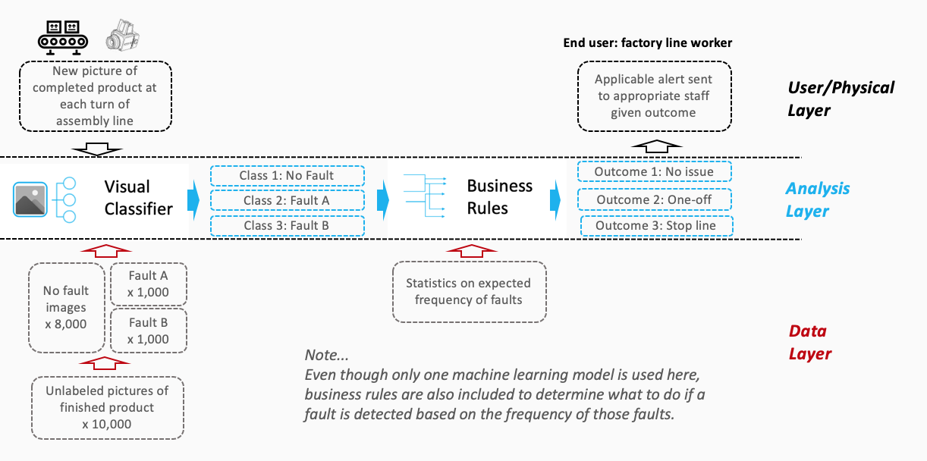

Creating High Level Architectures
For the top three use cases you prioritized in Project Step 2C, you’ll now create a high level architecture for each.
For this step, be sure to review Lesson 3 but also recognize that this process allows significant creative freedom.
Keep a focus on… - Data flow/direction - Clear view on inputs/outputs - Simplicity
Drag and drop capabilities into Analysis Layer
Identify relevant User/Physical and Data Layer attributes
Use arrows to show data flow, input/output
Use annotations to help explain difficult concepts

Slide 9

















Your AI/ML Toolkit - List of Capabilities
Generic ML Capabilities
Natural Language Processing
Voice/Speech Processing
Computer Vision
Other Capabilities
Drawing Tools
User/Physical Layer
Analysis Layer
Data Layer

Slide 10
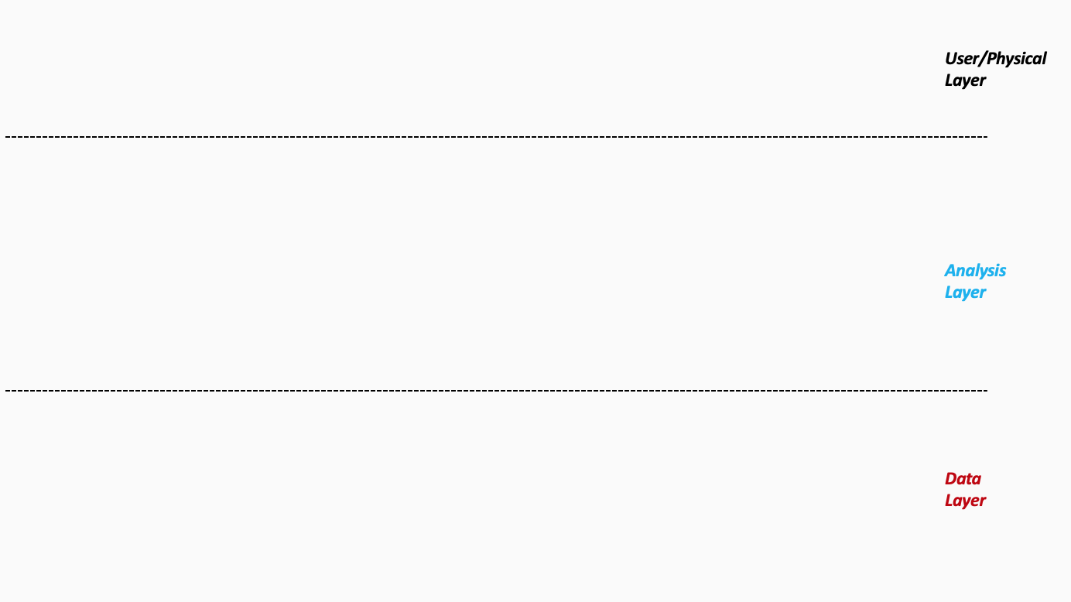
Architecture 1/3 - UC1: Quality Control with Computer Vision
Notes:
Please follow the directions on slide 8. Copy and paste the desired icons provided you on slide 9 onto this page.

Slide 11


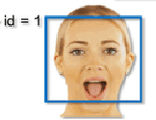
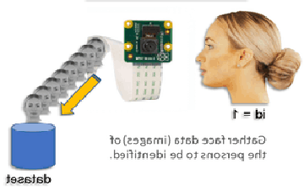
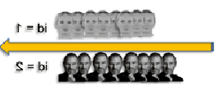
Architecture 2/3 – Car Detection of Customer ID
Signals to confirm user ID
Retrieve the corresponding user ID from DB
Automatically Respond to the User
Notes:
Please follow the directions on slide 8. Copy and paste the desired icons provided you on slide 9 onto this page.

Slide 12
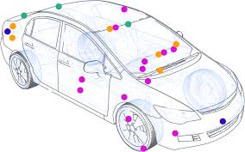
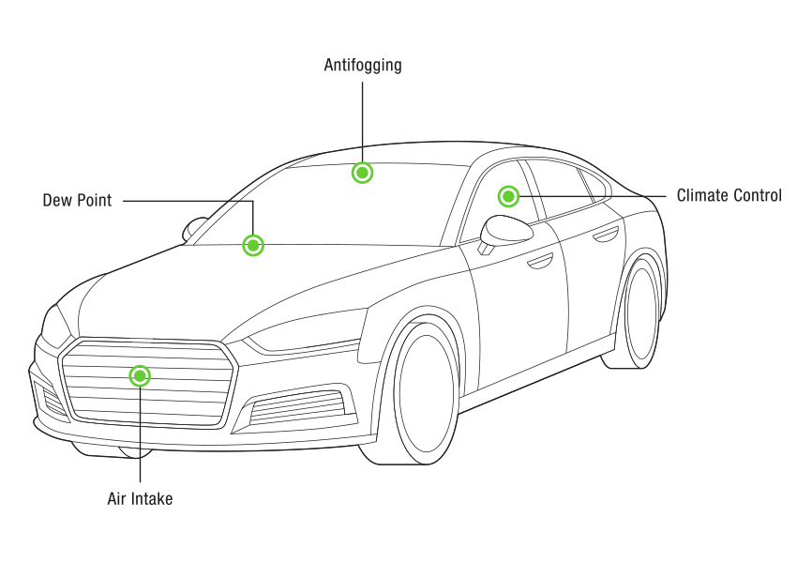

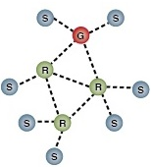
Architecture 3/3 - Car maintenance Expectation
Car user maybe asked to contact cloud from within the car to update latest regression formula
Car Owner see red lights on car screen, lights are originally green colored
Sensor reading
Confidence > 80%
Regression Formula
Probability of failure in Next two weeks
IoT is used in this scheme, sensor data is sent to the cloud for analysis
Sensor Network
Car fleet with sensors
Notes:
Please follow the directions on slide 8. Copy and paste the desired icons provided you on slide 9 onto this page.

Slide 13
Excellent, you’ve completed Step 3 of the project!

Slide 14
AI for Business Leaders
Project Step 4C
Second Prioritization Grid

Slide 15
Your Second Prioritization Grid
Based on new information from your further analyses of your use cases in step 4A and 4B, you’ll engage in the same exercise as you did before in Step 2C to update your prioritization.
Move onto the grid the three use cases that you have been working with in steps 4A and 4B.
You MAY choose different use cases and shift your focus, if you feel these exercises have caused you to significantly revise your prior evaluations.
UC 2
Drag and drop icons for each use case
Remember to think about both axes!

Slide 16
Second Prioritization Grid
high
UC 1
UC 1
UC1: Quality Control with CV
UC 4
UC 2
UC2: Optimal tax strategy predictor
Impact
UC 3
UC3: Car detection of customer ID
UC 3
UC 4
UC4: Car maintenance Expectation
UC 5
UC5: Supply Chain Costs Predictor
low
Note: You only need to locate three of these onto the grid.
low
Feasibility
high

Slide 17
Now Prioritize and Eliminate One More Use Case
1) Review the locations of your use cases on the grid on the previous slide. Remember we want to prioritize use cases for AI and ML that offer the greatest impact for the least difficulty.
2) Now in the grid on the previous slide change the color from blue to grey for one use case circle you want to de-prioritize.
3) This leaves your top two use cases in blue that you want to move forward with in the rest of the project. But you may still change these later.

Slide 18
Terrific, you’ve completed Step 4C of the project!

Slide 19
AI for Business Leaders
Project Step 5
Operational Considerations:
Accuracy, Bias, and Ethics

Slide 20
Accuracy, Bias, and Ethics Concerns
For each of your two remaining use cases, on the next two slides please write 2-3 paragraphs discussing how success will be measured and monitored.
Start by focusing on model characteristics such as accuracy and bias, and speak to what success would look like.
Comment on any other operational concerns, including ethical limitations, that could influence success.
For each concern you raise, comment on how you would measure or monitor this concern on an ongoing basis.

Slide 21
First Use Case
Please write 2-3 paragraphs here, following the guidelines on slide 21.
The quality control can be controlled totally on visual classification. In which it can be either binary classifier, so the classifier can detect the existence/absence of the defect. But the defect will be then examined manually, i.e. extra step is needed.
This methods takes too much time and effort and may need labor work. Another idea is to divide the classification into multiple types (classes). And train the classifier on the labels, one label for each defect. We can classify as much labels as we need due to the existence of deep neural networking.
Business rule are then be implied to see what you will do with the defective devices. After discovery, what the quality engineer will do ? Will he count the number of defectives and if increased on threshold he will stop line/machine? Or he will calculate some probability and if the probability of defective > threshold he will stop line/machine. Or he will simply git rid of the defective device.
One concern for multiple classes is the existence of new class of defectives. We shall train the model again

Slide 22
Second Use Case
Please write 2-3 paragraphs here, following the guidelines on slide 21.
The basic principle is to use the reading from the sensors in the automobile to check for the expected upcoming failure. Regression can use the failure as a dependent variable and the reading from the sensors as the independent variable. It is expected to have direct relationship between the sensor readings and the expectation of failure.
One concern is that we can expect the existence or upcoming failure only in short amount of time. Time is needed to be at least 2 weeks which might not be feasible with sensor readings. Engineers may involve more sensors readings to overcome this problem.
The second concern is to know which sensor is more important than others regarding failure. One way to see which sensor(s) are vital is to stop him during the test period. Results may lead us to which sensors are effective than others.

Slide 23
Well done! You’ve completed Step 5 of the project!

Slide 24
AI for Business Leaders
Project Step 6B
Feedback and Final Prioritization Grid

Slide 25
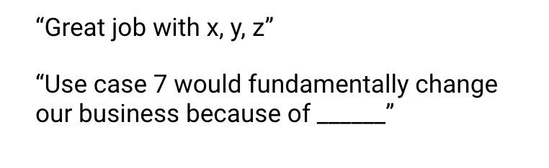
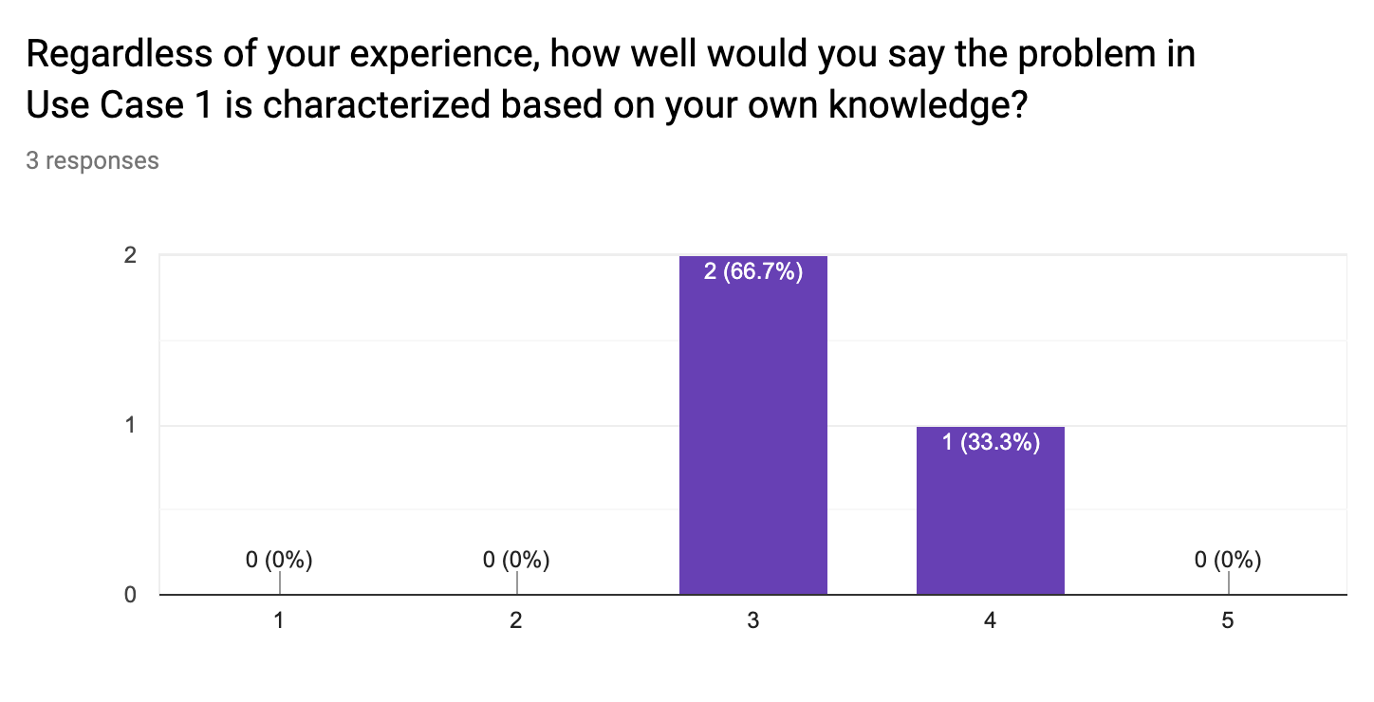
Feedback Visualization
Verbatim Quote Example
Depending on how you chose to gather feedback -- survey, phone call, etc. -- you will have a mix of quantitative and qualitative results.
Use the following pages to document your key takeaways in the form of verbatim quotes and visualizations.
For verbatim quotes, you should use direct quotes that indicate the support and critiques you encountered.
For visualizations, feel free to use the graph provided in your Google Form.
Visualization Example

Slide 26
Verbatim Quotes - Quality Control with CV
The computer vison-based approach proposed is helpful in detecting detectives without labor intervention
With high quality cameras, the automation process will be accurate
Adopting deep neural networks in the classification phase will enable more accurate classification in addition to more classes can be handled at the same time.

Slide 27
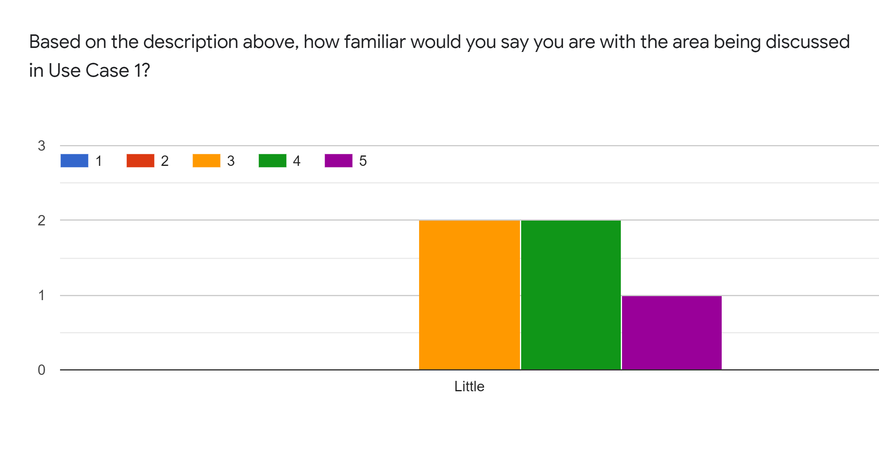
Visualization - Quality Control with CV
Copy/paste or create any relevant graphics here

Slide 28
Verbatim Quotes : Car maintenance Expectation
Thanks to AI models, we can expect the next car failure ahead of time.
Multiple reading of sensors is not totally dependable. Hardware failure of sensors may occur
Some sensor readings may not be important in the expectation process. A method must be found to found those sensors.

Slide 29
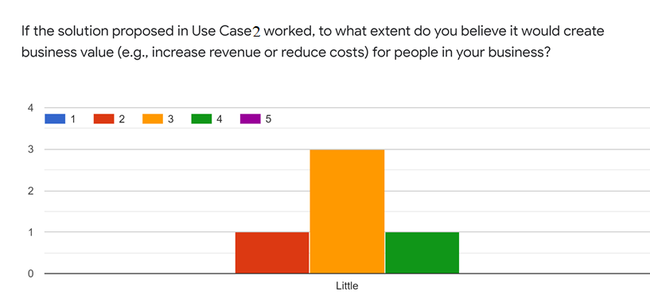
Visualization - Car maintenance Expectation
Copy/paste or create any relevant graphics here

Slide 30
Your Final Prioritization Grid
Based on the feedback you’ve gathered, and all of the previous information for each use case, you’ll now engage in the same prioritizing exercise as you have twice before.
You MAY choose to re-prioritize use cases and shift your focus if you feel these exercises have caused you to significantly revise your prior evaluations.
At the end of this exercise, you should have a final point of view on the use cases you’ll advocate in your ML/AI strategy!
UC 2
Drag and drop icons for each use case
Remember to think about both axes!

Slide 31
Final Prioritization Grid
high
UC 1
UC 1
UC1: <Enter Name 1 Here>
UC 3
UC 2
UC2: <Enter Name 2 Here>
Impact
UC 3
UC3: <Enter Name 3 Here>
UC 4
UC4: <Enter Name 4 Here>
UC 5
UC5: <Enter Name 5 Here>
Note: You only need to move 2 of these use cases onto the grid.
low
low
Feasibility
high

Slide 32
Nice work, you’ve completed Step 6B of the project!

