Slide 1
Data Mining:
Concepts and Techniques
(3rd ed.)
— Chapter 4 —
Jiawei Han, Micheline Kamber, and Jian Pei
University of Illinois at Urbana-Champaign &
Simon Fraser University
©2011 Han, Kamber & Pei. All rights reserved.

Slide 2
Chapter 4: Data Warehousing and On-line Analytical Processing
Data Warehouse: Basic Concepts
Data Warehouse Modeling: Data Cube and OLAP
Data Warehouse Design and Usage
Data Warehouse Implementation
Data Generalization by Attribute-Oriented Induction
Summary

Slide 3
OLAP Software
Some popular OLAP server software programs include:
Oracle Express Server
https://www.oracle.com/technetwork/database/options/olap/index.html
Hyperion Solutions Essbase
Pentaho (Mondrian)
https://community.hitachivantara.com/docs/DOC-1009853-mondrian
documentation https://mondrian.pentaho.com/documentation/installation.php
Data Mining: Concepts and Techniques

Slide 4
What is a Data Warehouse?
Defined in many different ways, but not rigorously.
  A decision support database that is maintained separately from the organization’s operational database
  Support information processing by providing a solid platform of consolidated, historical data for analysis.
“A data warehouse is a subject-oriented, integrated, time-variant, and nonvolatile collection of data in support of management’s decision-making process.”—W. H. Inmon
Data warehousing:
  The process of constructing and using data warehouses

Slide 5
Data Warehouse—Subject-Oriented
Provide a simple and concise view around particular subject issues by excluding data that are not useful in the decision support process
Data Warehouse—Integrated
Constructed by integrating multiple, heterogeneous data sources, relational databases, flat files, on-line transaction records
Data Warehouse—Time Variant
The time horizon for the data warehouse is significantly longer than that of operational systems
  Operational database: current value data
  Data warehouse data: provide information from a historical perspective (e.g., past 5-10 years)

Slide 6
Data Warehouse—Nonvolatile
A physically separate store of data transformed from the operational environment
Operational update of data does not occur in the data warehouse environment
  Does not require transaction processing, recovery, and concurrency control mechanisms
  Requires only two operations in data accessing:
    initial loading of data and access of data

Slide 7

OLTP vs. OLAP

Slide 8
Why a Separate Data Warehouse?
High performance for both systems
  DBMS— tuned for OLTP: access methods, indexing, concurrency control, recovery
  Warehouse—tuned for OLAP: complex OLAP queries, multidimensional view, consolidation
Different functions and different data:
  missing data: Decision support requires historical data which operational DBs do not typically maintain
  data consolidation: DS requires consolidation (aggregation, summarization) of data from heterogeneous sources
  data quality: different sources typically use inconsistent data representations, codes and formats which have to be reconciled
Note: There are more and more systems which perform OLAP analysis directly on relational databases

Slide 9
Data Warehouse: A Multi-Tiered Architecture
Monitor
&
Integrator
OLAP Server
Other
sources
Metadata
Analysis
Query
Reports
Data mining
Operational
DBs
Extract
Transform
Load
Refresh
Data
Warehouse
Serve
Data Marts
Data Sources
Data Storage
OLAP Engine
Front-End Tools

Slide 10
Three Data Warehouse Models
Enterprise warehouse
  collects all of the information about subjects spanning the entire organization
Data Mart
  a subset of corporate-wide data that is of value to a specific groups of users. Its scope is confined to specific, selected groups, such as marketing data mart
    Independent vs. dependent (directly from warehouse) data mart
Virtual warehouse
  A set of views over operational databases
  Only some of the possible summary views may be materialized

Slide 11
Extraction, Transformation, and Loading (ETL)
Data extraction
  get data from multiple, heterogeneous, and external sources
Data cleaning
  detect errors in the data and rectify them when possible
Data transformation
  convert data from legacy or host format to warehouse format
Load
  sort, summarize, consolidate, compute views, check integrity, and build indicies and partitions
Refresh
  propagate the updates from the data sources to the warehouse

Slide 12
Metadata Repository
Meta data is the data defining warehouse objects. It stores:
Description of the structure of the data warehouse
  schema, view, dimensions, hierarchies, derived data defn, data mart locations and contents
Operational meta-data
  data lineage (history of migrated data and transformation path), currency of data (active, archived, or purged), monitoring information (warehouse usage statistics, error reports, audit trails)
The algorithms used for summarization
The mapping from operational environment to the data warehouse
Data related to system performance
  warehouse schema, view and derived data definitions
Business data
  business terms and definitions, ownership of data, charging policies

Slide 13
Chapter 4: Data Warehousing and On-line Analytical Processing
Data Warehouse: Basic Concepts
Data Warehouse Modeling: Data Cube and OLAP
Data Warehouse Design and Usage
Data Warehouse Implementation
Data Generalization by Attribute-Oriented Induction
Summary

Slide 14
From Tables and Spreadsheets to
Data Cubes
A data warehouse is based on a multidimensional data model which views data in the form of a data cube
A data cube, such as sales, allows data to be modeled and viewed in multiple dimensions
  Dimension tables, such as item (item_name, brand, type), or time(day, week, month, quarter, year)
  Fact table contains measures (such as dollars_sold) and keys to each of the related dimension tables
In data warehousing literature, an n-D base cube is called a base cuboid. The top most 0-D cuboid, which holds the highest-level of summarization, is called the apex cuboid. The lattice of cuboids forms a data cube.

Slide 15
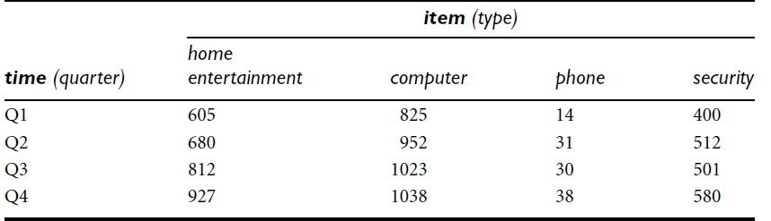
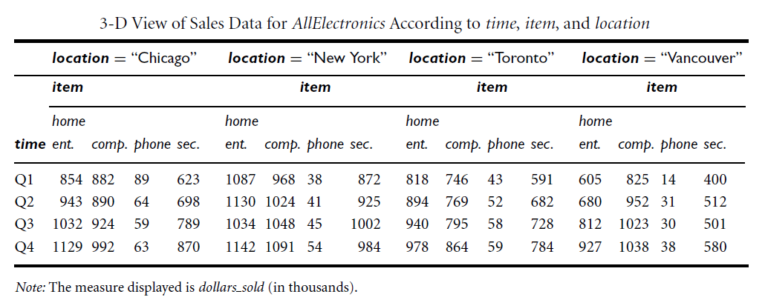
Data Cube: A Multidimensional Data Model
2D
3D

Slide 16
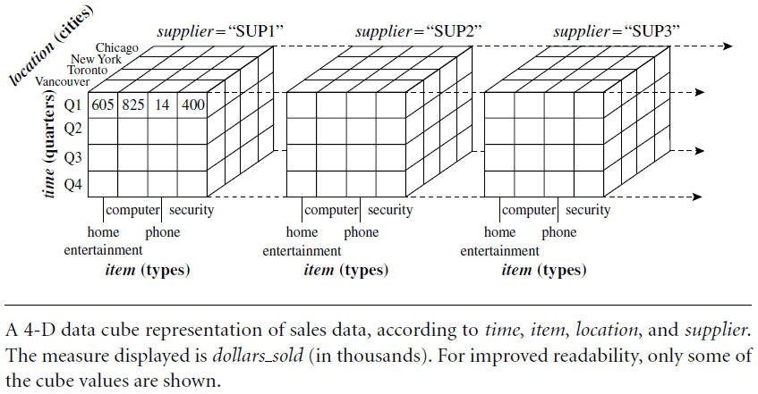
Data Cube: A Multidimensional Data Model
4D

Slide 17
Cube: A Lattice of Cuboids
all
0-D (apex) cuboid
time
item
location
supplier
1-D cuboids
time,location
item,location
location,supplier
time,item
2-D cuboids
time,supplier
item,supplier
time,location,supplier
3-D cuboids
time,item,location
time,item,supplier
item,location,supplier
4-D (base) cuboid
time, item, location, supplier

Slide 18
A Sample Data Cube
Total annual sales
of TVs in U.S.A.
all
Date
Product
TV
1Qtr
2Qtr
3Qtr
4Qtr
sum
PC
U.S.A
product
date
country
VCR
sum
Canada
Country
Mexico
product,date
product,country
date, country
sum
All, All, All
product, date, country

Slide 19
Conceptual Modeling of Data Warehouses
Modeling data warehouses: dimensions & measures
  Star schema: A fact table in the middle connected to a set of dimension tables
  Snowflake schema: A refinement of star schema where some dimensional hierarchy is normalized into a set of smaller dimension tables, forming a shape similar to snowflake
  Fact constellations: Multiple fact tables share dimension tables, viewed as a collection of stars, therefore called galaxy schema or fact constellation

Slide 20
Example of Star Schema
time
time_key
day
day_of_the_week
month
quarter
year
item
item_key
item_name
brand
type
supplier_type
Sales Fact Table
time_key
item_key
branch_key
branch
location
location_key
branch_key
branch_name
branch_type
location_key
street
city
state_or_province
country
units_sold
dollars_sold
avg_sales
Measures

Slide 21
Example of Snowflake Schema
time
item
time_key
day
day_of_the_week
month
quarter
year
item_key
item_name
brand
type
supplier_key
supplier
Sales Fact Table
supplier_key
supplier_type
time_key
item_key
branch_key
branch
location
location_key
location_key
street
city_key
branch_key
branch_name
branch_type
units_sold
dollars_sold
city
city_key
city
state_or_province
country
avg_sales
Measures

Slide 22
Example of Fact Constellation
time
time_key
day
day_of_the_week
month
quarter
year
item
Shipping Fact Table
item_key
item_name
brand
type
supplier_type
Sales Fact Table
time_key
time_key
item_key
shipper_key
item_key
branch_key
from_location
branch
location_key
location
to_location
branch_key
branch_name
branch_type
units_sold
location_key
street
city
province_or_state
country
dollars_cost
dollars_sold
units_shipped
avg_sales
shipper
Measures
shipper_key
shipper_name
location_key
shipper_type

Slide 23
A Concept Hierarchy:
Dimension (location)
all
all
region
Europe
...
North_America
country
Germany
...
Spain
Canada
...
Mexico
city
Frankfurt
...
Vancouver
...
Toronto
office
L. Chan
...
M. Wind

Slide 24
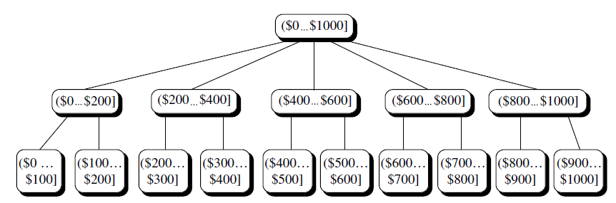
A Concept Hierarchy:
Dimension (location)
A concept hierarchy for price.

Slide 25
Data Cube Measures: Three Categories
Distributive: if the result derived by applying the function to n aggregate values is the same as that derived by applying the function on all the data without partitioning
    E.g., count(), sum(), min(), max()
Algebraic: if it can be computed by an algebraic function with M arguments (where M is a bounded integer), each of which is obtained by applying a distributive aggregate function
    E.g., avg(), min_N(), standard_deviation()
Holistic: if there is no constant bound on the storage size needed to describe a subaggregate.
    E.g., median(), mode(), rank()

Slide 26
Typical OLAP Operations
Roll up (drill-up): summarize data
  by climbing up hierarchy or by dimension reduction
Drill down (roll down): reverse of roll-up
  from higher level summary to lower level summary or detailed data, or introducing new dimensions
Slice and dice: project and select
Pivot (rotate):
  reorient the cube, visualization, 3D to series of 2D planes
Other operations
  drill across: involving (across) more than one fact table
  drill through: through the bottom level of the cube to its back-end relational tables (using SQL)

Slide 27
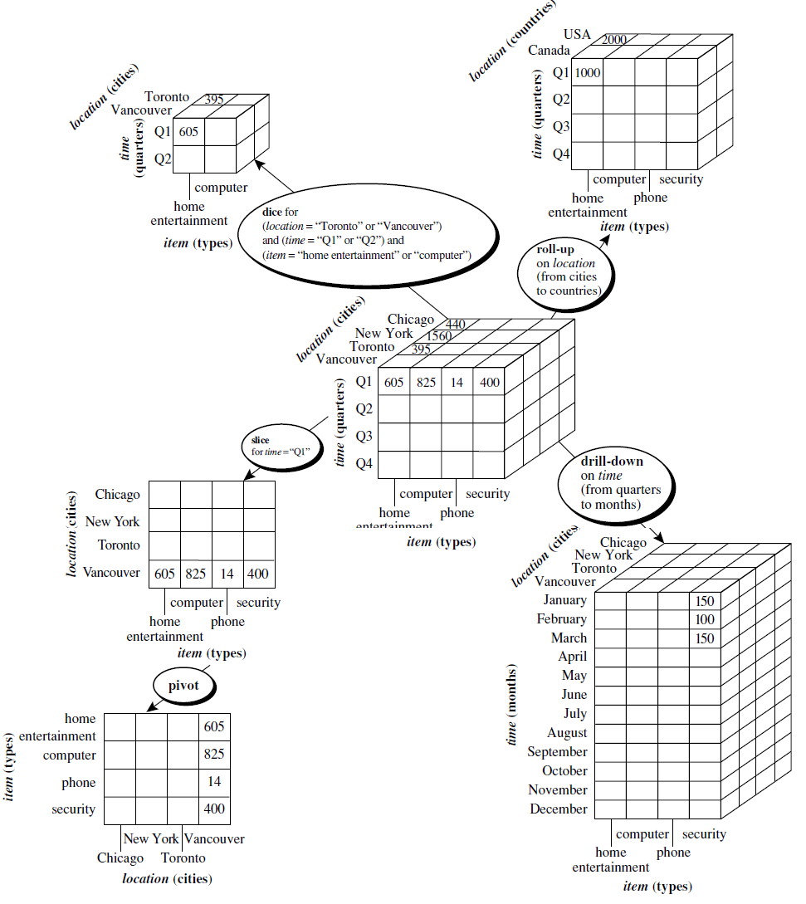
Typical OLAP Operations

Slide 28
Chapter 4: Data Warehousing and On-line Analytical Processing
Data Warehouse: Basic Concepts
Data Warehouse Modeling: Data Cube and OLAP
Data Warehouse Design and Usage
Data Warehouse Implementation
Data Generalization by Attribute-Oriented Induction
Summary

Slide 29
Design of Data Warehouse: A Business Analysis Framework
Four views regarding the design of a data warehouse
  Top-down view
    allows selection of the relevant information necessary for the data warehouse
  Data source view
    exposes the information being captured, stored, and managed by operational systems
  Data warehouse view
    consists of fact tables and dimension tables
  Business query view
    sees the perspectives of data in the warehouse from the view of end-user

Slide 30
Data Warehouse Usage
Three kinds of data warehouse applications
  Information processing
    supports querying, basic statistical analysis, and reporting using crosstabs, tables, charts and graphs
  Analytical processing
    multidimensional analysis of data warehouse data
    supports basic OLAP operations, slice-dice, drilling, pivoting
  Data mining
    knowledge discovery from hidden patterns
    supports associations, constructing analytical models, performing classification and prediction, and presenting the mining results using visualization tools

Slide 31
Chapter 4: Data Warehousing and On-line Analytical Processing
Data Warehouse: Basic Concepts
Data Warehouse Modeling: Data Cube and OLAP
Data Warehouse Design and Usage
Data Warehouse Implementation
Data Generalization by Attribute-Oriented Induction
Summary

Slide 32

Efficient Data Cube Computation
Data cube can be viewed as a lattice of cuboids
  The bottom-most cuboid is the base cuboid
  The top-most cuboid (apex) contains only one cell
  How many cuboids in an n-dimensional cube with L levels?
Materialization of data cube, materialization=precalculation
  Compute every (cuboid) (full materialization), compute no cubiods (no materialization), or some cuboids (partial materialization)
  Selection of which cuboids to materialize
    Based on size, sharing, access frequency, etc.

Slide 33
The “Compute Cube” Operator
Cube definition and computation in DMQL
    define cube sales [item, city, year]: sum (sales_in_dollars)
    compute cube sales
Transform it into a SQL-like language (with a new operator cube by, introduced by Gray et al.’96)
    SELECT item, city, year, SUM (amount)
    FROM SALES
    CUBE BY item, city, year
Need compute the following Group-Bys
    (date, product, customer),
    (date,product),(date, customer), (product, customer),
    (date), (product), (customer)
    ()
()
(city)
(item)
(year)
(city, item)
(city, year)
(item, year)
(city, item, year)

Slide 34
Efficient Processing OLAP Queries
Determine which operations should be performed on the available cuboids
  Transform drill, roll, etc. into corresponding SQL and/or OLAP operations, e.g., dice = selection + projection
Determine which materialized cuboid(s) should be selected for OLAP op.
  Let the query to be processed be on {brand, province_or_state} with the condition “year = 2004”, and there are 4 materialized cuboids available:
    1) {year, item_name, city}
    2) {year, brand, country}
    3) {year, brand, province_or_state}
    4) {item_name, province_or_state} where year = 2004
    Which should be selected to process the query?

Slide 35
Chapter 4: Data Warehousing and On-line Analytical Processing
Data Warehouse: Basic Concepts
Data Warehouse Modeling: Data Cube and OLAP
Data Warehouse Design and Usage
Data Warehouse Implementation
Data Generalization by Attribute-Oriented Induction
Summary

Slide 36
Attribute-Oriented Induction
Not confined to categorical data nor particular measures
How it is done?
  Collect the task-relevant data (initial relation) using a relational database query
  Perform generalization by attribute removal or attribute generalization
  Apply aggregation by merging identical, generalized tuples and accumulating their respective counts
  Interaction with users for knowledge presentation

Slide 37
Attribute-Oriented Induction: An Example
Example: Describe general characteristics of graduate students in the University database
Step 1. Fetch relevant set of data using an SQL statement, e.g.,
    Select * (i.e., name, gender, major, birth_place, birth_date, residence, phone#, gpa)
    from student
    where student_status in {“Msc”, “MBA”, “PhD” }
Step 2. Perform attribute-oriented induction
Step 3. Present results in generalized relation, cross-tab, or rule forms

Slide 38



Class Characterization: An Example
Initial Relation
Prime Generalized Relation

Slide 39
Basic Principles of Attribute-Oriented Induction
Data focusing: task-relevant data, including dimensions, and the result is the initial relation
Attribute-removal: remove attribute A if there is a large set of distinct values for A but (1) there is no generalization operator on A, or (2) A’s higher level concepts are expressed in terms of other attributes
Attribute-generalization: If there is a large set of distinct values for A, and there exists a set of generalization operators on A, then select an operator and generalize A
Attribute-threshold control: typical 2-8, specified/default
Generalized relation threshold control: control the final relation/rule size

Slide 40
Attribute-Oriented Induction: Basic Algorithm
InitialRel: Query processing of task-relevant data, deriving the initial relation.
PreGen: Based on the analysis of the number of distinct values in each attribute, determine generalization plan for each attribute: removal? or how high to generalize?
PrimeGen: Based on the PreGen plan, perform generalization to the right level to derive a “prime generalized relation”, accumulating the counts.
Presentation: User interaction: (1) adjust levels by drilling, (2) pivoting, (3) mapping into rules, cross tabs, visualization presentations.

Slide 41
Presentation of Generalized Results
Generalized relation:
  Relations where some or all attributes are generalized, with counts or other aggregation values accumulated.
Cross tabulation:
  Mapping results into cross tabulation form (similar to contingency tables).
  Visualization techniques:
  Pie charts, bar charts, curves, cubes, and other visual forms.
Quantitative characteristic rules:
  Mapping generalized result into characteristic rules with quantitative information associated with it, e.g.,

Slide 42
Chapter 4: Data Warehousing and On-line Analytical Processing
Data Warehouse: Basic Concepts
Data Warehouse Modeling: Data Cube and OLAP
Data Warehouse Design and Usage
Data Warehouse Implementation
Data Generalization by Attribute-Oriented Induction
Summary

Slide 43
Exercise
Suppose that a data warehouse for Big University consists of the four dimensions student, course, semester, and instructor, and two measures count and avg grade. At the lowest conceptual level (e.g., for a given student, course, semester, and instructor combination), the avg grade measure stores the actual course grade of the student. At higher conceptual levels, avg grade stores the average grade for the given combination.
(a) Draw a snowflake schema diagram for the data warehouse.
(b) Starting with the base cuboid [student, course, semester, instructor], what specific OLAP operations (e.g., roll-up from semester to year) should you perform in order to list the average grade of CS courses for each Big University student.
(c) If each dimension has five levels (including all), such as “student < major < status < university < all”, how many cuboids will this cube contain (including the base and apex cuboids)?

Slide 44
Exercise
Suppose that a data warehouse for Big University consists of the four dimensions student, course, semester, and instructor, and two measures count and avg grade. At the lowest conceptual level (e.g., for a given student, course, semester, and instructor combination), the avg grade measure stores the actual course grade of the student. At higherconceptual levels, avg grade stores the average grade for the given combination.
(a) Draw a snowflake schema diagram for the data warehouse.
(b) Starting with the base cuboid [student, course, semester, instructor], what specific OLAP operations (e.g., roll-up from semester to year) should you perform in order to list the average grade of CS courses for each Big University student.
(c) If each dimension has five levels (including all), such as “student < major < status < university < all”, how many cuboids will this cube contain (including the base and apex cuboids)?
Suppose that a data warehouse consists of the four dimensions date, spectator, location, and game, and the two measures count and charge, where charge is the fare that a spectator pays when watching a game on a given date. Spectators may be students, adults, or seniors, with each category having its own charge rate.
(a) Draw a star schema diagram for the data warehouse.
(b) Starting with the base cuboid [date, spectator, location, game], what specific OLAP operations should you perform in order to list the total charge paid by student spectators at GM Place in 2010?

Slide 45
Summary
Data warehousing: A multi-dimensional model of a data warehouse
  A data cube consists of dimensions & measures
  Star schema, snowflake schema, fact constellations
  OLAP operations: drilling, rolling, slicing, dicing and pivoting
Data Warehouse Architecture, Design, and Usage
  Multi-tiered architecture
  Business analysis design framework
Implementation: Efficient computation of data cubes
  Partial vs. full vs. no materialization
  Indexing OALP data: Bitmap index and join index
  OLAP query processing
Data generalization: Attribute-oriented induction

