Slide 1
Data Mining:
Concepts and Techniques
(3rd ed.)
— Chapter 5 —
Jiawei Han, Micheline Kamber, and Jian Pei
University of Illinois at Urbana-Champaign &
Simon Fraser University
©2011 Han, Kamber & Pei. All rights reserved.

Slide 2
Chapter 5: Mining Frequent Patterns, Association and Correlations: Basic Concepts and Methods
Basic Concepts
Frequent Itemset Mining Methods
Which Patterns Are Interesting?—Pattern Evaluation Methods
Summary

Slide 3
What Is Frequent Pattern Analysis?
Frequent pattern: a pattern (a set of items, subsequences, substructures, etc.) that occurs frequently in a data set
First proposed by Agrawal, Imielinski, and Swami [AIS93] in the context of frequent itemsets and association rule mining
Motivation: Finding inherent regularities in data
  What products were often purchased together?— Beer and diapers?!
  What are the subsequent purchases after buying a PC?
  What kinds of DNA are sensitive to this new drug?
  Can we automatically classify web documents?
Applications
  Basket data analysis, cross-marketing, catalog design, sale campaign analysis, Web log (click stream) analysis, and DNA sequence analysis.

Slide 4
Why Is Freq. Pattern Mining Important?
Freq. pattern: An intrinsic and important property of datasets
Foundation for many essential data mining tasks
  Association, correlation, and causality analysis
  Sequential, structural (e.g., sub-graph) patterns
  Pattern analysis in spatiotemporal, multimedia, time-series, and stream data
  Classification: discriminative, frequent pattern analysis
  Cluster analysis: frequent pattern-based clustering
  Data warehousing: iceberg cube and cube-gradient
  Semantic data compression: fascicles
  Broad applications

Slide 5
Basic Concepts: Frequent Patterns
Tid | Items bought
10 | Beer, Nuts, Diaper
20 | Beer, Coffee, Diaper
30 | Beer, Diaper, Eggs
40 | Nuts, Eggs, Milk
50 | Nuts, Coffee, Diaper, Eggs, Milk
itemset: A set of one or more items
k-itemset X = {x₁, …, x_{k}}
(absolute) support, or, support count of X: Frequency or occurrence of an itemset X
(relative) support, s, is the fraction of transactions that contains X (i.e., the probability that a transaction contains X)
An itemset X is frequent if X’s support is no less than a minsup threshold
Customer
buys both
Customer
buys diaper
Customer
buys beer

Slide 6
Basic Concepts: Association Rule
Computer -> antivirus software [support D 2%,confidence D 60%].
Rule support and confidence are two measures of rule interestingness. They respectively reflect the usefulness and certainty of discovered rules.
A support of 2% for the above Rule means that 2% of all the transactions under analysis show that computer and antivirus software are purchased together.
A confidence of 60% means that 60% of the customers who purchased a computer also bought the software

Slide 7
Basic Concepts: Association Rules
Tid
Items bought
Find all the rules X → Y with minimum support and confidence
  support, s, probability that a transaction contains X ∪ Y
  confidence, c, conditional probability that a transaction having X also contains Y
Let minsup = 50%, minconf = 50%
Freq. Pat.: Beer:3, Nuts:3, Diaper:4, Eggs:3, {Beer, Diaper}:3
10
Beer, Nuts, Diaper
20
Beer, Coffee, Diaper
30
Beer, Diaper, Eggs
40
Nuts, Eggs, Milk
50
Nuts, Coffee, Diaper, Eggs, Milk
Customer
buys both
Customer
buys diaper
Customer
buys beer
Association rules: (many more!)
  Beer → Diaper (60%, 100%)
  Diaper → Beer (60%, 75%)

Slide 8
Closed Patterns and Max-Patterns
A long pattern contains a combinatorial number of sub-patterns, e.g., {a₁, …, a₁₀₀} contains (₁₀₀¹) + (₁₀₀²) + … + (₁¹₀⁰₀⁰) = 2¹⁰⁰ – 1 = 1.27*10³⁰ sub-patterns! permutations
Solution: Mine closed patterns and max-patterns instead
An itemset X is closed if X is frequent and there exists no super-pattern Y כ X, with the same support as X (proposed by Pasquier, et al. @ ICDT’99)
An itemset X is a max-pattern if X is frequent and there exists no frequent super-pattern Y כ X
Closed pattern is a lossless compression of freq. patterns
  Reducing the # of patterns and rules

Slide 9
Closed Patterns and Max-Patterns
My dataset:
1: A,B,C,E
2: A,C,D,E
3: B,C,E
4: A,C,D,E
5: C,D,E
6: A,D,E
minsupp=50%
{A} = 4 ; not closed due to {A,E}
{B} = 2 ; not frequent => ignore
{C} = 5 ; not closed due to {C,E}
{D} = 4 ; closed, but not maximal due to e.g. {A,D}
{E} = 6 ; closed, but not maximal due to e.g. {D,E}
{A,B} = 1; not frequent => ignore
{A,C} = 3; not closed due to {A,C,E}
{A,D} = 3; not closed due to {A,D,E}
{A,E} = 4; closed, but not maximal due to {A,D,E}
{B,C} = 2; not frequent => ignore
{B,D} = 0; not frequent => ignore
{B,E} = 2; not frequent => ignore
{C,D} = 3; not closed due to {C,D,E}
{C,E} = 5; closed, but not maximal due to {C,D,E}
{D,E} = 4; closed, but not maximal due to {A,D,E}
{A,B,C} = 1; not frequent => ignore
{A,B,D} = 0; not frequent => ignore
{A,B,E} = 1; not frequent => ignore
{A,C,D} = 2; not frequent => ignore
{A,C,E} = 3; maximal frequent
{A,D,E} = 3; maximal frequent
{B,C,D} = 0; not frequent => ignore
{B,C,E} = 2; not frequent => ignore
{C,D,E} = 3; maximal frequent
{A,B,C,D} = 0; not frequent => ignore
{A,B,C,E} = 1; not frequent => ignore
{B,C,D,E} = 0; not frequent => ignore
Notes:
Not closed : معنها ان فيه مجموعة عناصر عددهم اعلى وتكرارهم اعلى او مساوي
Not maximal : معناها ان فيه مجموعة عناصر عددهم اعلى(عشان كده تكون ليست ماكيسمال) ومعديين مينيمم سبورت

Slide 10
Chapter 5: Mining Frequent Patterns, Association and Correlations: Basic Concepts and Methods
Basic Concepts
Frequent Itemset Mining Methods
Which Patterns Are Interesting?—Pattern Evaluation Methods
Summary

Slide 11
Scalable Frequent Itemset Mining Methods
Apriori: A Candidate Generation-and-Test Approach
Improving the Efficiency of Apriori
FPGrowth: A Frequent Pattern-Growth Approach

Slide 12
The Downward Closure Property and Scalable Mining Methods
The downward closure property of frequent patterns
  Any subset of a frequent itemset must be frequent
  If {beer, diaper, nuts} is frequent, so is {beer, diaper}
  i.e., every transaction having {beer, diaper, nuts} also contains {beer, diaper}
Scalable mining methods: Three major approaches
  Apriori
  Freq. pattern growth
  Vertical data format approach

Slide 13
Apriori: A Candidate Generation & Test Approach
Apriori pruning principle: If there is any itemset which is infrequent, its superset should not be generated/tested!
Method:
  Initially, scan DB once to get frequent 1-itemset
  Generate length (k+1) candidate itemsets from length k frequent itemsets
  Test the candidates against DB
  Terminate when no frequent or candidate set can be generated

Slide 14
The Apriori Algorithm—An Example
Sup_{min} = 2
Itemset | sup
{A} | 2
{B} | 3
{C} | 3
{D} | 1
{E} | 3
Database TDB
Itemset | sup
{A} | 2
{B} | 3
{C} | 3
{E} | 3
L₁
Tid | Items
10 | A, C, D
20 | B, C, E
30 | A, B, C, E
40 | B, E
C₁
1st scan
C₂
Itemset | sup
{A, B} | 1
{A, C} | 2
{A, E} | 1
{B, C} | 2
{B, E} | 3
{C, E} | 2
C₂
L₂
Itemset
{A, B}
{A, C}
{A, E}
{B, C}
{B, E}
{C, E}
Itemset | sup
{A, C} | 2
{B, C} | 2
{B, E} | 3
{C, E} | 2
2nd scan
C₃
Itemset
{B, C, E}
3rd scan
L₃
Itemset | sup
{B, C, E} | 2

Slide 15
Implementation of Apriori
How to generate candidates?
  Step 1: self-joining L_{k}
  Step 2: pruning
Example of Candidate-generation
  L₃={abc, abd, acd, ace, bcd}
  Self-joining: L₃*L₃
    abcd from abc and abd
    acde from acd and ace
  Pruning:
    acde is removed because ade is not in L₃
  C₄ = {abcd}

Slide 16
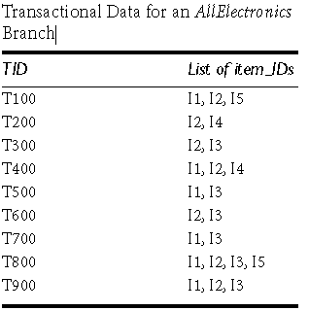
Apriori-Example 2
Let’s look at a concrete example, based on the AllElectronics transaction database, D, of the following Table. There are nine transactions in this database, that is, |D\ = 9. We use Next slide to illustrate the Apriori algorithm for finding frequent itemsets in D.

Slide 17
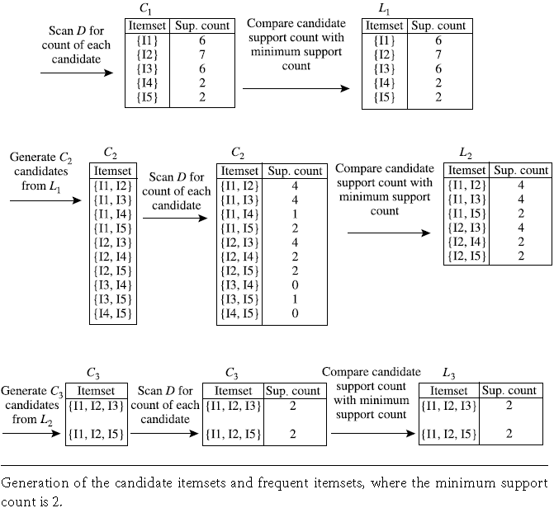
Example2: Solution

Slide 18
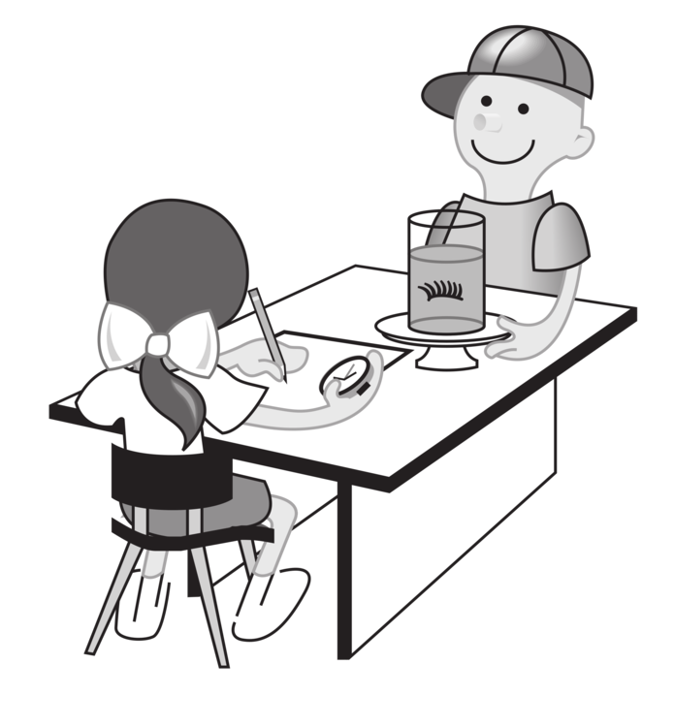
LAB: Apriori with Weka
Open Weka -> explorer
Load the fp.arff to the explorer
Click Associate tab
Apriori
Start
Paper : Using Apriori with WEKA for Frequent Pattern Mining, Paresh Tanna

Slide 19
Scalable Frequent Itemset Mining Methods
Apriori: A Candidate Generation-and-Test Approach
Improving the Efficiency of Apriori
FPGrowth: A Frequent Pattern-Growth Approach
Mining Close Frequent Patterns and Maxpatterns

Slide 20
Pattern-Growth Approach: Mining Frequent Patterns Without Candidate Generation
Bottlenecks of the Apriori approach
  Breadth-first (i.e., level-wise) search
  Candidate generation and test
    Often generates a huge number of candidates
The FPGrowth Approach
  Depth-first search
  Avoid explicit candidate generation
Major philosophy: Grow long patterns from short ones using local frequent items only
  “abc” is a frequent pattern
  Get all transactions having “abc”, i.e., project DB on abc: DB|abc
  “d” is a local frequent item in DB|abc → abcd is a frequent pattern

Slide 21
Construct FP-tree from a Transaction Database
TID Items bought (ordered) frequent items
100 {f, a, c, d, g, i, m, p} {f, c, a, m, p}
200 {a, b, c, f, l, m, o} {f, c, a, b, m}
300 {b, f, h, j, o, w} {f, b}
400 {b, c, k, s, p} {c, b, p}
500 {a, f, c, e, l, p, m, n} {f, c, a, m, p}
min_support = 3
{}
Header Table
Item frequency head
f 4
c 4
a 3
b 3
m 3
p 3
Scan DB once, find frequent 1-itemset (single item pattern)
Sort frequent items in frequency descending order, f-list
Scan DB again, construct FP-tree
f:4
c:1
c:3
b:1
b:1
a:3
p:1
m:2
b:1
F-list = f-c-a-b-m-p
p:2
m:1

Slide 22
Partition Patterns and Databases
Frequent patterns can be partitioned into subsets according to f-list
  F-list = f-c-a-b-m-p
  Patterns containing p
  Patterns having m but no p
  …
  Patterns having c but no a nor b, m, p
  Pattern f
Completeness and non-redundency

Slide 23
Find Patterns Having P From P-conditional Database
Starting at the frequent item header table in the FP-tree
Traverse the FP-tree by following the link of each frequent item p
Accumulate all of transformed prefix paths of item p to form p’s conditional pattern base
{}
Header Table
Item frequency head
f 4
c 4
a 3
b 3
m 3
p 3
f:4
c:1
Conditional pattern bases
item cond. pattern base
c f:3
a fc:3
b fca:1, f:1, c:1
m fca:2, fcab:1
p fcam:2, cb:1
c:3
b:1
b:1
a:3
p:1
m:2
b:1
p:2
m:1

Slide 24
From Conditional Pattern-bases to Conditional FP-trees
For each pattern-base
  Accumulate the count for each item in the base
  Construct the FP-tree for the frequent items of the pattern base
m-conditional pattern base:
  fca:2, fcab:1
{}
Header Table
Item frequency head
f 4
c 4
a 3
b 3
m 3
p 3
f:4
c:1
All frequent patterns relate to m
m,
fm, cm, am,
fcm, fam, cam,
fcam
{}
c:3
b:1
b:1

f:3

a:3
p:1
m:2
b:1
c:3
p:2
m:1
a:3
m-conditional FP-tree

Slide 25
Recursion: Mining Each Conditional FP-tree
{}
{}
Cond. pattern base of “am”: (fc:3)
f:3
c:3
f:3
am-conditional FP-tree
c:3
{}
Cond. pattern base of “cm”: (f:3)
a:3
f:3
m-conditional FP-tree
cm-conditional FP-tree
{}
Cond. pattern base of “cam”: (f:3)
f:3
cam-conditional FP-tree

Slide 26
A Special Case: Single Prefix Path in FP-tree
Suppose a (conditional) FP-tree T has a shared single prefix-path P
Mining can be decomposed into two parts
  Reduction of the single prefix path into one node
  Concatenation of the mining results of the two parts
{}
a₁:n₁
a₂:n₂
a₃:n₃
{}
r₁
b₁:m₁
C₁:k₁
a₁:n₁
+

r₁
=
b₁:m₁
C₁:k₁
a₂:n₂
C₂:k₂
C₃:k₃
a₃:n₃
C₂:k₂
C₃:k₃

Slide 27
Benefits of the FP-tree Structure
Completeness
  Preserve complete information for frequent pattern mining
  Never break a long pattern of any transaction
Compactness
  Reduce irrelevant info—infrequent items are gone
  Items in frequency descending order: the more frequently occurring, the more likely to be shared
  Never be larger than the original database (not count node-links and the count field)

Slide 28
The Frequent Pattern Growth Mining Method
Idea: Frequent pattern growth
  Recursively grow frequent patterns by pattern and database partition
Method
  For each frequent item, construct its conditional pattern-base, and then its conditional FP-tree
  Repeat the process on each newly created conditional FP-tree
  Until the resulting FP-tree is empty, or it contains only one path—single path will generate all the combinations of its sub-paths, each of which is a frequent pattern

Slide 29
Scaling FP-growth by Database Projection
What about if FP-tree cannot fit in memory?
  DB projection
First partition a database into a set of projected DBs
Then construct and mine FP-tree for each projected DB
Parallel projection vs. partition projection techniques
  Parallel projection
    Project the DB in parallel for each frequent item
    Parallel projection is space costly
    All the partitions can be processed in parallel
  Partition projection
    Partition the DB based on the ordered frequent items
    Passing the unprocessed parts to the subsequent partitions

Slide 30
Partition-Based Projection
Parallel projection needs a lot of disk space
Partition projection saves it
Tran. DB
fcamp
fcabm
fb
cbp
fcamp
p-proj DB
fcam
cb
fcam
m-proj DB
fcab
fca
fca
b-proj DB
f
cb
…
a-proj DB
fc
…
c-proj DB
f
…
f-proj DB
…
am-proj DB
fc
fc
fc
cm-proj DB
f
f
f
…

Slide 31
Scalable Frequent Itemset Mining Methods
Apriori: A Candidate Generation-and-Test Approach
Improving the Efficiency of Apriori
FPGrowth: A Frequent Pattern-Growth Approach
Mining Close Frequent Patterns and Maxpatterns

Slide 32
Mining Frequent Closed Patterns: CLOSET
Flist: list of all frequent items in support ascending order
  Flist: d-a-f-e-c
Divide search space
  Patterns having d
  Patterns having d but no a, etc.
Find frequent closed pattern recursively
  Every transaction having d also has cfa → cfad is a frequent closed pattern
J. Pei, J. Han & R. Mao. “CLOSET: An Efficient Algorithm for Mining Frequent Closed Itemsets", DMKD'00.
Min_sup=2
TID | Items
10 | a, c, d, e, f
20 | a, b, e
30 | c, e, f
40 | a, c, d, f
50 | c, e, f

Slide 33
CLOSET+: Mining Closed Itemsets by Pattern-Growth
Itemset merging: if Y appears in every occurrence of X, then Y is merged with X
Sub-itemset pruning: if Y כ X, and sup(X) = sup(Y), X and all of X’s descendants in the set enumeration tree can be pruned
Hybrid tree projection
  Bottom-up physical tree-projection
  Top-down pseudo tree-projection
Item skipping: if a local frequent item has the same support in several header tables at different levels, one can prune it from the header table at higher levels
Efficient subset checking

Slide 34
MaxMiner: Mining Max-Patterns
1st scan: find frequent items
  A, B, C, D, E
2nd scan: find support for
  AB, AC, AD, AE, ABCDE
  BC, BD, BE, BCDE
  CD, CE, CDE, DE
Since BCDE is a max-pattern, no need to check BCD, BDE, CDE in later scan
R. Bayardo. Efficiently mining long patterns from databases. SIGMOD’98
Tid | Items
10 | A, B, C, D, E
20 | B, C, D, E,
30 | A, C, D, F
Potential max-patterns

Slide 35
Chapter 5: Mining Frequent Patterns, Association and Correlations: Basic Concepts and Methods
Basic Concepts
Frequent Itemset Mining Methods
Which Patterns Are Interesting?—Pattern Evaluation Methods
Summary

Slide 36



Interestingness Measure: Correlations (Lift)
play basketball ⇒ eat cereal [40%(2000/5000), 66.7%(2000/3000)] is misleading
  The overall % of students eating cereal is 75% > 66.7%.
play basketball ⇒ not eat cereal [20%, 33.3%] is more accurate, although with lower support and confidence
Measure of dependent/correlated events: lift
 | Basketball | Not basketball | Sum (row)
Cereal | 2000 | 1750 | 3750
Not cereal | 1000 | 250 | 1250
Sum(col.) | 3000 | 2000 | 5000

Slide 37

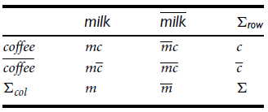

Which Null-Invariant Measure Is Better?
IR (Imbalance Ratio): measure the imbalance of two itemsets A and B in rule implications
Kulczynski and Imbalance Ratio (IR) together present a clear picture for all the three datasets D₄ through D₆
  D₄ is balanced & neutral
  D₅ is imbalanced & neutral
  D₆ is very imbalanced & neutral

Slide 38
Chapter 5: Mining Frequent Patterns, Association and Correlations: Basic Concepts and Methods
Basic Concepts
Frequent Itemset Mining Methods
Which Patterns Are Interesting?—Pattern Evaluation Methods
Summary

Slide 39
Summary
Basic concepts: association rules, support-confident framework, closed and max-patterns
Scalable frequent pattern mining methods
  Apriori (Candidate generation & test)
  Projection-based (FPgrowth, CLOSET+, ...)
  Vertical format approach (ECLAT, CHARM, ...)
Which patterns are interesting?
  Pattern evaluation methods

