Slide 1

Logic Design
Ch 1
Number Systems & Codes
Instructor : Hasan Al Serhan
IT Department
Al Balqa Applied University

Slide 2
Number Systems & Codes
Number Systems
Information Representations
Positional Notations
Decimal (base 10) Number System
Other Number Systems & _x000b_Base-R to Decimal Conversion
Decimal-to-Binary Conversion
  Sum-of-Weights Method
  Repeated Division-by-2 Method (for whole numbers)
  Repeated Multiplication-by-2 Method (for fractions)

Slide 3
Number Systems & Codes
Conversion between Decimal and other Bases
Conversion between Bases
Binary-Octal/Hexadecimal Conversion
Binary Arithmetic Operations
Negative Numbers Representation
  Sign-and-magtitude
  1s Complement
  2s Complement
Comparison of Sign-and-Magnitude and Complements

Slide 4
Number Systems & Codes
Complements
  Diminished-Radix Complements
  Radix Complements
2s Complement Addition and Subtraction
1s Complement Addition and Subtraction
Overflow
Fixed-Point Numbers
Floating-Point Numbers
Arithmetics with Floating-Point Numbers

Slide 5
Number Systems & Codes
Codes
Binary Coded Decimal (BCD)
Gray Code
  Binary-to-Gray Conversion
  Gray-to-Binary Conversion
Other Decimal Codes
Self-Complementing Codes
Alphanumeric Codes
Error Detection Codes

Slide 6
Information Representation
Numbers are important to computers
  represent information precisely
  can be processed
For example:
  to represent yes or no: use 0 for no and 1 for yes
  to represent 4 seasons: 0 (autumn), 1 (winter), 2(spring) and 3 (summer)
  NRIC number: a letter, 7 digits, and a check code
  matriculation number (8 alphanumeric) to represent individual students

Slide 7
Information Representation
Elementary storage units inside computer are electronic switches. Each switch holds one of two states: on (1) or off (0).
We use a bit (binary digit), 0 or 1, to represent the state.
ON
OFF

Slide 8
Information Representation
Storage units can be grouped together to cater for larger range of numbers. Example: 2 switches to represent 4 values.
0 (00)
1 (01)
2 (10)
3 (11)

Slide 9
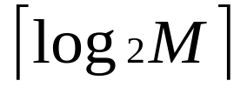
Information Representation
In general, N bits can represent 2^{N} different values.
For M values, bits are needed.
1 bit → represents up to 2 values (0 or 1)
2 bits → rep. up to 4 values (00, 01, 10 or 11)
3 bits → rep. up to 8 values (000, 001, 010. …, 110, 111)
4 bits → rep. up to 16 values (0000, 0001, 0010, …, 1111)
32 values → requires 5 bits
64 values → requires 6 bits
1024 values → requires 10 bits
40 values → requires 6 bits
100 values → requires 7 bits

Slide 10
Positional Notations
Position-independent notation
  each symbol denotes a value independent of its position: Egyptian number system
Relative-position notation
  Roman numerals symbols with different values: I (1), V (5), X (10), C (50), M (100)
  Examples: I, II, III, IV, VI, VI, VII, VIII, IX
  Relative position important: IV = 4 but VI = 6
Computations are difficult with the above two notations

Slide 11
Positional Notations
Weighted-positional notation
  Decimal number system, symbols = { 0, 1, 2, 3, …, 9 }
  Position is important
  Example:(7594)₁₀ = (7x10³) + (5x10²) + (9x10¹) + (4x10⁰)
  The value of each symbol is dependent on its type and its position in the number
  In general, (a_{n}a_{n-1}… a₀)₁₀ = (a_{n} x 10^{n}) + (a_{n-1} x 10^{n-1}) + … + (a₀ x 10⁰)

Slide 12

Positional Notations
Fractions are written in decimal numbers after the decimal point.
  2 = (2.75)₁₀ = (2 x 10⁰) + (7 x 10⁻¹) + (5 x 10⁻²)
  In general, (a_{n}a_{n-1}… a₀ . f₁f₂ … f_{m})₁₀ = (a_{n} x 10^{n}) + (a_{n-1}x10^{n-1}) + … + (a₀ x 10⁰) + (f₁ x 10⁻¹) + (f₂ x 10⁻²) + … + (f_{m} x 10^{-m})
The radix (or base) of the number system is the total number of digits allowed in the system.

Slide 13
Decimal (base 10) Number System
Weighting factors (or weights) are in powers-of-10:
… 10³ 10² 10¹ 10⁰.10⁻¹ 10⁻² 10⁻³ 10⁻⁴ …
To evaluate the decimal number 593.68, the digit in each position is multiplied by the corresponding weight:
5×10² + 9×10¹ + 3×10⁰ + 6×10⁻¹ + 8×10⁻² = (593.68)₁₀

Slide 14
Other Number Systems &
Base-R to Decimal Conversion
Binary (base 2): weights in powers-of-2.
  Binary digits (bits): 0,1.
Octal (base 8): weights in powers-of-8.
  Octal digits: 0,1,2,3,4,5,6,7.
Hexadecimal (base 16): weights in powers-of-16.
  Hexadecimal digits: 0,1,2,3,4,5,6,7,8,9,A,B,C,D,E,F.
Base R: weights in powers-of-R.

Slide 15
Other Number Systems &
Base-R to Decimal Conversion
(1101.101)₂ = 1×2³ + 1×2² + 1×2⁰ + 1×2⁻¹ + 1×2⁻³ = 8 + 4 + 1 + 0.5 + 0.125 = (13.625)₁₀
(572.6)₈ = 5×8² + 7×8¹ + 2×8⁰ + 6×8⁻¹ = 320 + 56 + 2 + 0.75 = (378.75)₁₀
(2A.8)₁₆ = 2×16¹ + 10×16⁰ + 8×16⁻¹ = 32 + 10 + 0.5 = (42.5)₁₀
(341.24)₅ = 3×5² + 4×5¹ + 1×5⁰ + 2×5⁻¹ + 4×5⁻² = 75 + 20 + 1 + 0.4 + 0.16 = (96.56)₁₀

Slide 16
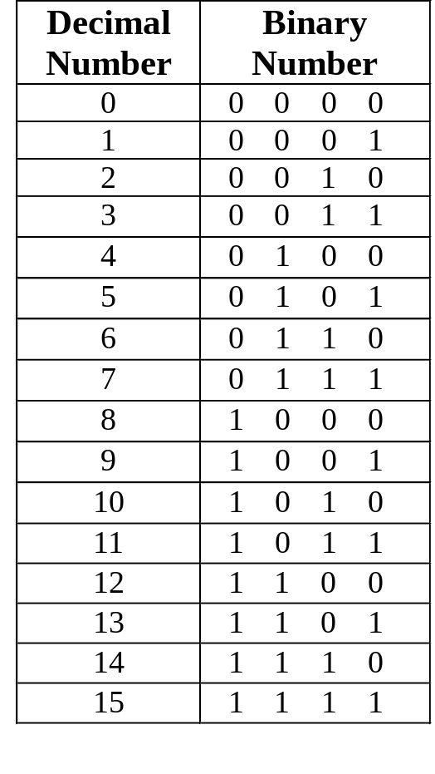
Other Number Systems &
Base-R to Decimal Conversion
Counting in Binary
Assuming non-negative values, n bits → largest value 2^{n} – 1.
Examples: 4 bits → 0 to 15;
6 bits → 0 to 63.
range of m values → log₂m bits

Slide 17
Solve it yourself (Exercise 1.1)
The binary number 1011011 is equal to the decimal number
a. 63 b. 91 c. 92 d. 139
Which of the following has the largest value?
a. (110)₁₀ b. (10011011)₂ c. (1111)₅ d. (9A)₁₆ e. (222)₈
3. What is the weight of the digit ‘3’ in the base-7 number 12345?
a. 3 b. 5 c. 7 d. 14 e. 49
4. If (321)₄ = (57)₁₀, what is the decimal equivalent of (32100000)₄?
a. 57 × 10⁵ b. 57 × 10⁴ c. 57 × 4⁵ d. 57 × 4¹⁰
e. This is too difficult.

Slide 18
Decimal-to-Binary Conversion
Method 1: Sum-of-Weights Method
Method 2:
  Repeated Division-by-2 Method (for whole numbers)
  Repeated Multiplication-by-2 Method (for fractions)

Slide 19
Sum-of-Weights Method
Determine the set of binary weights whose sum is equal to the decimal number.
(9)₁₀ = 8 + 1 = 2³ + 2⁰ = (1001)₂
(18)₁₀ = 16 + 2 = 2⁴ + 2¹ = (10010)₂
(58)₁₀ = 32 + 16 + 8 + 2 = 2⁵ + 2⁴ + 2³ + 2¹ = (111010)₂
(0.625)₁₀ = 0.5 + 0.125 = 2⁻¹ + 2⁻³ = (0.101)₂

Slide 20
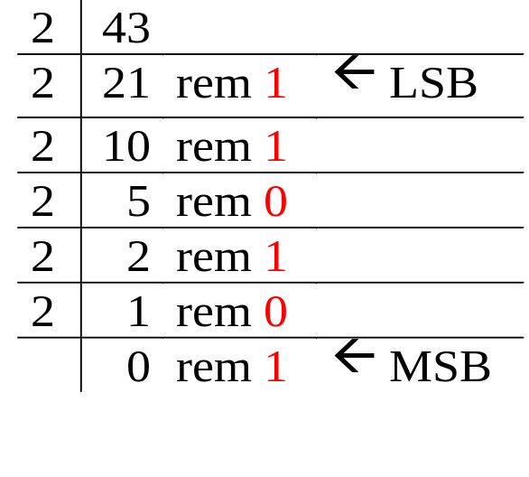
Repeated Division-by-2 Method
To convert a whole number to binary, use successive division by 2 until the quotient is 0. The remainders form the answer, with the first remainder as the least significant bit (LSB) and the last as the most significant bit (MSB).
(43)₁₀ = (101011)₂

Slide 21
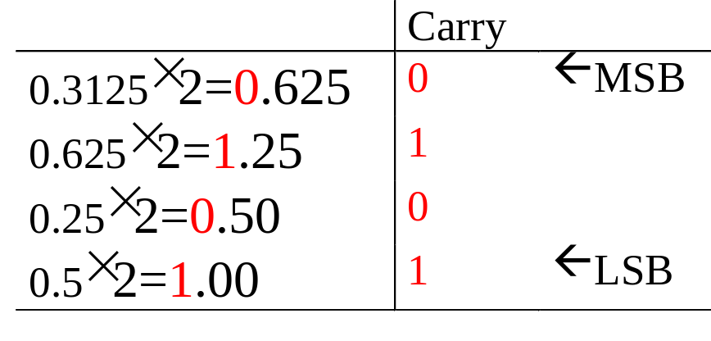
Repeated Multiplication-by-2 Method
To convert decimal fractions to binary, repeated multiplication by 2 is used, until the fractional product is 0 (or until the desired number of decimal places). The carried digits, or carries, produce the answer, with the first carry as the MSB, and the last as the LSB.
(0.3125)₁₀ = (.0101)₂

Slide 22
Conversion between Decimal and other Bases
Base-R to decimal: multiply digits with their corresponding weights.
Decimal to binary (base 2)
  whole numbers: repeated division-by-2
  fractions: repeated multiplication-by-2
Decimal to base-R
  whole numbers: repeated division-by-R
  fractions: repeated multiplication-by-R

Slide 23
Solve it yourself (Exercise 1.2)
Q. Convert each of the following decimal numbers to the bases below, where x represents the maximum number of digits in the fraction part: binary (x=5), base 7 (x=3), octal (x=2) and hexadecimal numbers (x=1).
(a) 12.345 (b) 0.07 (c) 2000

Slide 24
Conversion between Bases
In general, conversion between bases can be done via decimal:
Shortcuts for conversion between bases 2, 4, 8, 16.
Base-2 Base-2
Base-3 Base-3
Base-4 Decimal Base-4
… ….
Base-R Base-R

Slide 25
Binary-Octal/Hexadecimal Conversion
Binary → Octal: Partition in groups of 3
  (10 111 011 001 . 101 110)₂ = (2731.56)₈
Octal → Binary: reverse
  (2731.56)₈ = (10 111 011 001 . 101 110)₂
Binary → Hexadecimal: Partition in groups of 4
  (101 1101 1001 . 1011 1000)₂ = (5D9.B8)₁₆
Hexadecimal → Binary: reverse
  (5D9.B8)₁₆ = (101 1101 1001 . 1011 1000)₂

Slide 26
Solve it yourself (Exercise 1.3)
1. The unsigned binary number (110001)₂ is equal to the octal number
a. (49)₈ b. (31)₈ c. (61)₈ d. (15)₈ e. none above
2. Convert 1001101 (base 2) to
(i) decimal, (ii) octal, (iii) hexadecimal, (iv) base 4.

Slide 27
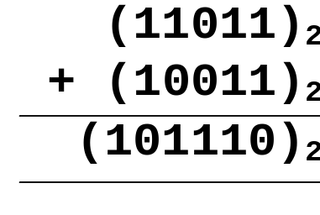
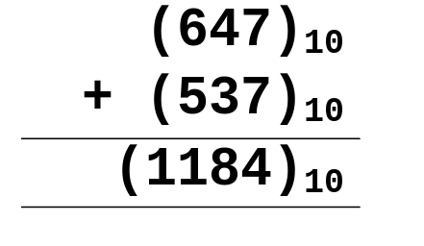
Binary Arithmetic Operations
ADDITION
Like decimal numbers, two numbers can be added by adding each pair of digits together with carry propagation.

Slide 28
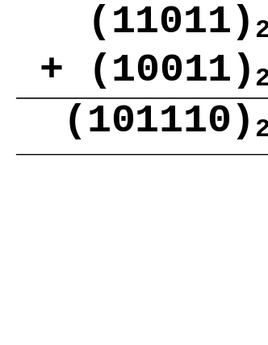
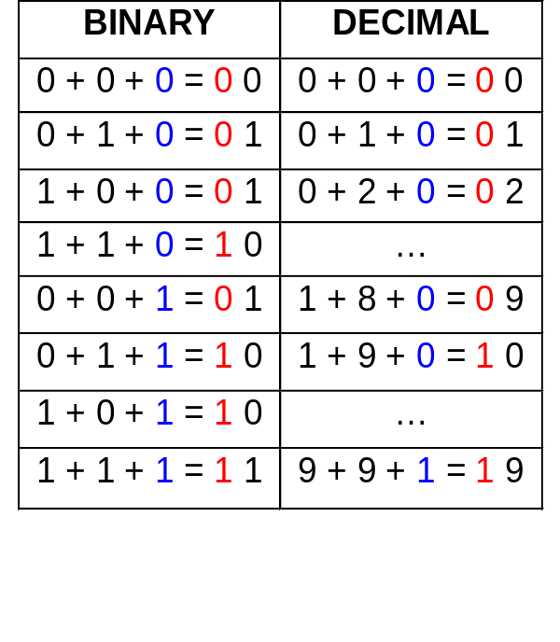
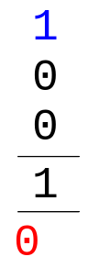
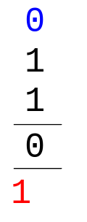
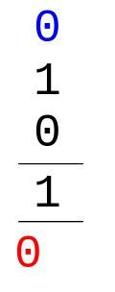
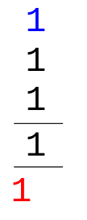
Binary Arithmetic Operations
Digit addition table:
Carry in
Carry out

Slide 29
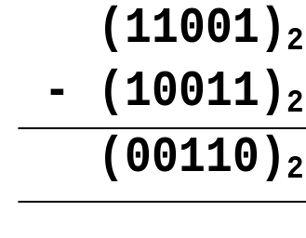
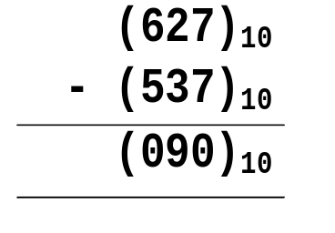
Binary Arithmetic Operations
SUBTRACTION
Two numbers can be subtracted by subtracting each pair of digits together with borrowing, where needed.

Slide 30
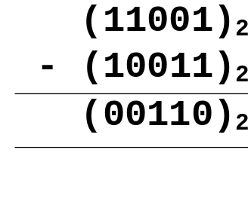
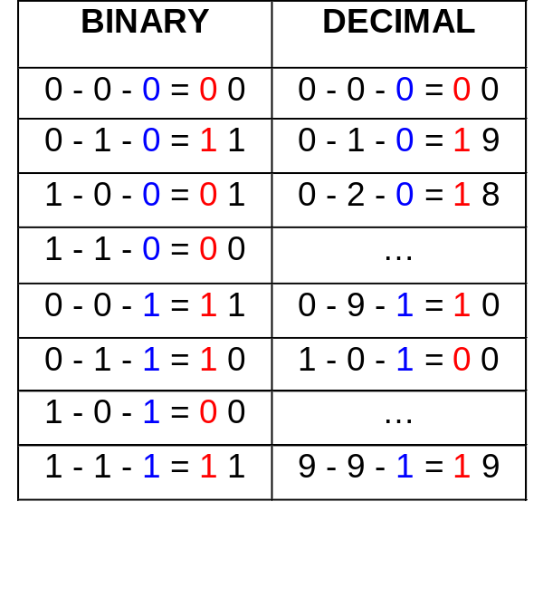
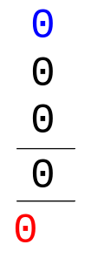
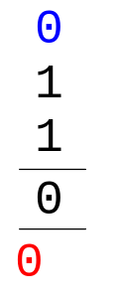
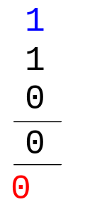
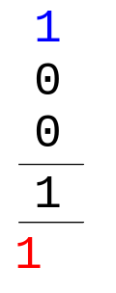
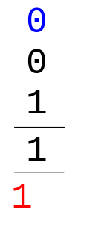
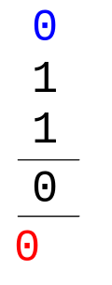
Binary Arithmetic Operations
Digit subtraction table:
Borrow

Slide 31
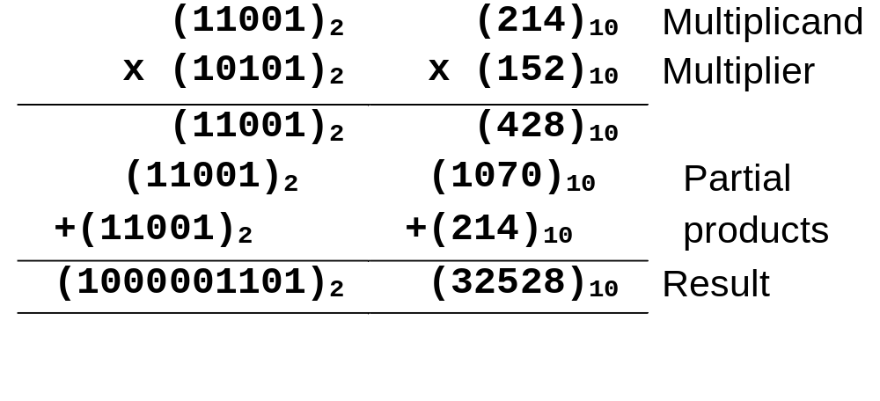
Binary Arithmetic Operations
MULTIPLICATION
To multiply two numbers, take each digit of the multiplier and multiply it with the multiplicand. This produces a number of partial products which are then added.

Slide 32
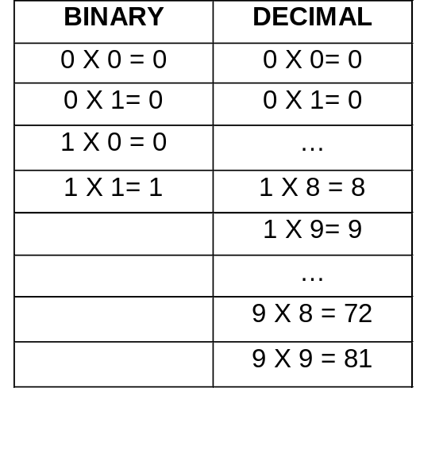
Binary Arithmetic Operations
Digit multiplication table:
DIVISION – can you figure out how this is done?
Think of the division technique (shift & subtract) used for decimal numbers and apply it to binary numbers.

Slide 33
Solve it yourself (Exercise 1.4)
1. What is (1011)₂ × (101)₂?
a. (10000)₂ b. (110111)₂ c. (111111)₂
d. (111011)₂ e. (101101)₂
2. Perform the following:
a) 10111110 b) 11010010 c) 11100101
+ 10001101 - 01101101 - 00101110
-------------- --------------- ---------------
-------------- --------------- ----------------

Slide 34
Negative Numbers Representation
Till now, we have only considered how unsigned (non-negative) numbers can be represented. There are three common ways of representing signed numbers (positive and negative numbers) for binary numbers:
  Sign-and-Magnitude
  1s Complement
  2s Complement

Slide 35
Negative Numbers:
Sign-and-Magnitude
Negative numbers are usually written by writing a minus sign in front.
  Example:
  - (12)₁₀ , - (1100)₂
In computer memory of fixed width, this sign is usually represented by a bit:
  0 for +
  1 for -

Slide 36
Negative Numbers:
Sign-and-Magnitude
Example: an 8-bit number can have 1-bit sign and 7-bits magnitude.
sign
magnitude

Slide 37
Negative Numbers:
Sign-and-Magnitude
Largest Positive Number: 0 1111111 +(127)₁₀
Largest Negative Number: 1 1111111 -(127)₁₀
Zeroes: 0 0000000 +(0)₁₀
1 0000000 -(0)₁₀
Range: -(127)₁₀ to +(127)₁₀
Signed numbers needed for negative numbers.
Representation: Sign-and-magnitude.

Slide 38
Negative Numbers:
Sign-and-Magnitude
To negate a number, just invert the sign bit.
Examples:
- (0 0100001)_{sm} = (1 0100001)_{sm}
- (1 0000101)_{sm} = (0 0000101)_{sm}

Slide 39
1s and 2s Complement
Two other ways of representing signed numbers for binary numbers are:
  1s-complement
  2s-complement

Slide 40
1s Complement
Given a number x which can be expressed as an n-bit binary number, its negative value can be obtained in 1s-complement representation using:
- x = 2^{n} - x - 1
Example: With an 8-bit number 00001100, its negative value, expressed in 1s complement, is obtained as follows:
-(00001100)₂ = - (12)₁₀
= (2⁸ - 12 - 1)₁₀
= (243)₁₀
= (11110011)_{1s}

Slide 41
1s Complement
Essential technique: invert all the bits.
Examples: 1s complement of (00000001)_{1s} = (11111110)_{1s}
1s complement of (01111111)_{1s} = (10000000)_{1s}
Largest Positive Number: 0 1111111 +(127)₁₀
Largest Negative Number: 1 0000000 -(127)₁₀
Zeroes: 0 0000000
1 1111111
Range: -(127)₁₀ to +(127)₁₀
The most significant bit still represents the sign:
0 = +ve; 1 = -ve.

Slide 42
1s Complement
Examples (assuming 8-bit binary numbers):
(14)₁₀ = (00001110)₂ = (00001110)_{1s}
-(14)₁₀ = -(00001110)₂ = (11110001)_{1s}
-(80)₁₀ = -( ? )₂ = ( ? )_{1s}

Slide 43
2s Complement
Given a number x which can be expressed as an n-bit binary number, its negative number can be obtained in 2s-complement representation using:
- x = 2^{n} - x
Example: With an 8-bit number 00001100, its negative value in 2s complement is thus:
-(00001100)₂ = - (12)₁₀
= (2⁸ - 12)₁₀
= (244)₁₀
= (11110100)_{2s}

Slide 44
2s Complement
Essential technique: invert all the bits and add 1.
Examples:
2s complement of
(00000001)_{2s} = (11111110)_{1s} (invert)
= (11111111)_{2s} (add 1)
2s complement of
(01111110)_{2s} = (10000001)_{1s} (invert)
= (10000010)_{2s} (add 1)

Slide 45
2s Complement
Largest Positive Number: 0 1111111 +(127)₁₀
Largest Negative Number: 1 0000000 -(128)₁₀
Zero: 0 0000000
Range: -(128)₁₀ to +(127)₁₀
The most significant bit still represents the sign:
0 = +ve; 1 = -ve.

Slide 46
2s Complement
Examples (assuming 8-bit binary numbers):
(14)₁₀ = (00001110)₂ = (00001110)_{2s}
-(14)₁₀ = -(00001110)₂ = (11110010)_{2s}
-(80)₁₀ = -( ? )₂ = ( ? )_{2s}

Slide 47
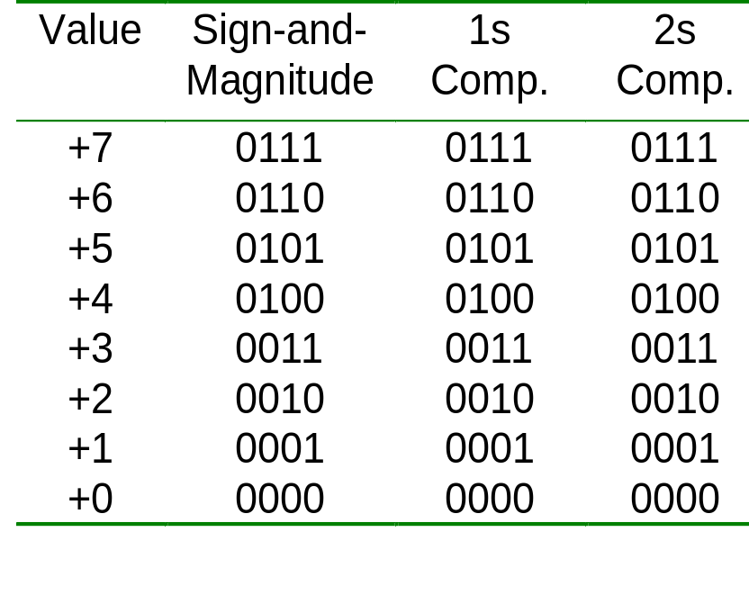
Comparisons of Sign-and-Magnitude and Complements
Example: 4-bit signed number (positive values)

Slide 48
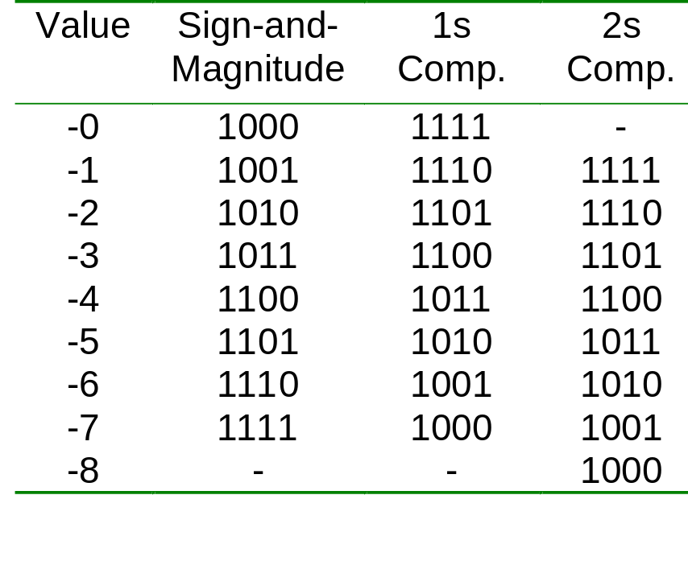
Comparisons of Sign-and-Magnitude and Complements
Example: 4-bit signed number (negative values)

Slide 49
Complements (General)
Complement numbers can help perform subtraction. With complements, subtraction can be performed by addition. Hence, A – B can be performed by A + (-B) where (-B) is represented as the complement of B.
In general for Base-r number, there are:
(i) Diminished Radix (or r-1’s) Complement
(ii) Radix (or r’s) Complement
For Base-2 number, we have seen:
(i) 1s Complement
(ii) 2s Complement

Slide 50
Diminished-Radix Complements
Given an n-digit number, x_{r}, its (r-1)’s complement is:
  (r^{n} - 1) - x
  E.g.: (r-1)’s complement, or 9s complement, of (22)₁₀ is:
  (10² - 1) - 22 = (77)_{9s} [This means –(22)₁₀ is (77)_{9s}]
  (r-1)’s complement, or 1s complement, of (0101)₂ is:
  (2⁴- 1) - 0101 = (1010)_{1s} [This means –(0101)₂ is (1010)_{1s}]
  Same as inverting all digits:
  (10² - 1) - 22 = 99 - 22 = (77)_{9s}
  (2⁴ - 1) - 0101 = 1111 - 0101 = (1010)_{1s}

Slide 51
Radix Complements
Given an n-digit number, x_{r}, its r’s-complement is:
  r^{n} - x
  E.g.: r’s-complement, or 10s complement, of (22)₁₀ is:
  10² - 22 = (78)_{10s} [This means –(22)₁₀ is (78)_{10s}]
  r’s-complement, or 2s complement, of (0101)₂ is:
  2⁴ - 0101 = (1011)_{2s} [This means –(0101)₂ is (1011)_{2s}]
  Same as inverting all digits and adding 1:
  (10²) - 22 = (99+1) - 22 = 77 + 1 = (78)_{10s}
  (2⁴) - 0101 = (1111+1) - 0101 = 1010 +1 = (1011)_{2s}

Slide 52
2s Complement Addition/Subtraction
Algorithm for addition, A + B:
Perform binary addition on the two numbers.
Ignore the carry out of the MSB (most significant bit).
Check for overflow: Overflow occurs if the ‘carry in’ and ‘carry out’ of the MSB are different, or if result is opposite sign of A and B.
Algorithm for subtraction, A – B:
A – B = A + (–B)
Take 2s complement of B by inverting all the bits and adding 1.
Add the 2s complement of B to A.

Slide 53
2s Complement Addition/Subtraction
Examples: 4-bit binary system
Which of the above is/are overflow(s)?
+3 0011
+ +4 + 0100
---- -------
+7 0111
---- -------
-2 1110
+ -6 + 1010
---- -------
-8 11000
---- -------
+6 0110
+ -3 + 1101
---- -------
+3 10011
---- -------
+4 0100
+ -7 + 1001
---- -------
-3 1101
---- -------

Slide 54
2s Complement Addition/Subtraction
More examples: 4-bit binary system
Which of the above is/are overflow(s)?
-3 1101
+ -6 + 1010
---- -------
-9 10111
---- -------
+5 0101
+ +6 + 0110
---- -------
+11 1011
---- -------

Slide 55
1s Complement Addition/Subtraction
Algorithm for addition, A + B:
Perform binary addition on the two numbers.
If there is a carry out of the MSB, add 1 to the result.
Check for overflow: Overflow occurs if result is opposite sign of A and B.
Algorithm for subtraction, A – B:
A – B = A + (–B)
Take 1s complement of B by inverting all the bits.
Add the 1s complement of B to A.

Slide 56
1s Complement Addition/Subtraction
Examples: 4-bit binary system
+3 0011
+ +4 + 0100
---- -------
+7 0111
---- -------
+5 0101
+ -5 + 1010
---- -------
-0 1111
---- -------
-2 1101
+ -5 + 1010
---- ------
-7 10111
---- + 1
------
1000
-3 1100
+ -7 + 1000
---- -------
-10 10100
---- + 1
-------
0101

Slide 57
Solve it yourself (Exercise 1.5)
1. In a 6-bit 2’s complement binary number system, what is the decimal value represented by (100100)_{2s}?
a. -4 b. 36 c. -36 d. -27 e. -28
2. In a 6-bit 1’s complement binary number system, what is the decimal value represented by (010100)_{1s}?
a. -11 b. 43 c. -43 d. 20 e. -20
3. For 2’s complement binary numbers, the range of values for 5-bit numbers is
a. 0 to 31 b. -8 to +7 c. -8 to +8
d. -15 to +15 e. -16 to +15

Slide 58
Solve it yourself (Exercise 1.5)
4. In a 4-bit twos-complement scheme, what is the result of this operation: (1011)_{2s} + (1001)_{2s}?
a. 0100 b. 0010 c. 1100 d. 1001 e. overflow
5. Assuming a 6-bit system, perform subtraction with the following unsigned binary numbers by taking first the 1's complement, and then, the 2's complement, of the second value and adding it with the first value:
(a) 011010 – 010000 (26 – 16)
(b) 011010 – 001101 (26 – 13)
(c) 000011 – 010000 (3 – 16)

Slide 59
Overflow
Signed binary numbers are of a fixed range.
If the result of addition/subtraction goes beyond this range, overflow occurs.
Two conditions under which overflow can occur are:
(i) positive add positive gives negative
(ii) negative add negative gives positive

Slide 60
Overflow
Examples: 4-bit numbers (in 2s complement)
Range : (1000)_{2s} to (0111)_{2s} or (-8₁₀ to 7₁₀)
(i) (0101)_{2s} + (0110)_{2s}= (1011)_{2s}
(5)₁₀ + (6)₁₀= -(5)₁₀ ?! (overflow!)
(ii) (1001)_{2s} + (1101)_{2s} = (10110)_{2s} discard end-carry
= (0110)_{2s}
(-7)₁₀ + (-3)₁₀ = (6)₁₀ ?! (overflow!)

Slide 61
Fixed Point Numbers
The signed and unsigned numbers representation given are fixed point numbers.
The binary point is assumed to be at a fixed location, say, at the end of the number:
Can represent all integers between –128 to 127 (for 8 bits).
binary point

Slide 62
Fixed Point Numbers
In general, other locations for binary points possible.
Examples: If two fractional bits are used, we can represent:
  (001010.11)_{2s} = (10.75)₁₀
  (111110.11)_{2s} = -(000001.01)₂
  = -(1.25)₁₀
integer part
binary point
fraction part

Slide 63
Floating Point Numbers
Fixed point numbers have limited range.
To represent very large or very small numbers, we use floating point numbers (cf. scientific numbers). Examples:
0.23 x 10²³ (very large positive number)
0.5 x 10⁻³² (very small positive number)
-0.1239 x 10⁻¹⁸ (very small negative number)

Slide 64
Floating Point Numbers
Floating point numbers have three parts:
sign, mantissa, and exponent
The base (radix) is assumed (usually base 2).
The sign is a single bit (0 for positive number, 1 for negative).
sign
mantissa
exponent

Slide 65
Floating Point Numbers
Mantissa is usually in normalised form:
(base 10) 23 x 10²¹ normalised to 0.23 x 10²³
(base 10) -0.0017 x 10²¹ normalised to -0.17 x 10¹⁹
(base 2) 0.01101 x 2³ normalised to 0.1101 x 2²
Normalised form: The fraction portion cannot begin with zero.
More bits in exponent gives larger range.
More bits for mantissa gives better precision.

Slide 66
Floating Point Numbers
Exponent is usually expressed in complement or excess form.
Example: Express -(6.5)₁₀ in base-2 normalised form
-(6.5)₁₀ = -(110.1)₂ = -0.1101 x 2³
Assuming that the floating-point representation contains 1-bit sign, 5-bit normalised mantissa, and 4-bit exponent.
The above example will be represented as
1
11010
0011

Slide 67
Floating Point Numbers
Example: Express (0.1875)₁₀ in base-2 normalised form
(0.1875)₁₀ = (0.0011)₂ = 0.11 x 2⁻²
Assuming that the floating-pt rep. contains 1-bit sign, 5-bit normalised mantissa, and 4-bit exponent.
The above example will be represented as
0
11000
1101
If exponent is in 1’s complement.
0
11000
1110
If exponent is in 2’s complement.
0
11000
0110
If exponent is in excess-8.

Slide 68
Excess Representation
The excess representation allows the range of values to be distributed evenly among the positive and negative value, by a simple translation (addition/subtraction).
Example: For a 3-bit representation, we may use excess-4.
Excess-4 Representation | Value
000 | -4
001 | -3
010 | -2
011 | -1
100 | 0
101 | 1
110 | 2
111 | 3

Slide 69
Excess Representation
Example: For a 4-bit representation, we may use excess-8.
Excess-8 Representation | Value
0000 | -8
0001 | -7
0010 | -6
0011 | -5
0100 | -4
0101 | -3
0110 | -2
0111 | -1
Excess-8 Representation | Value
1000 | 0
1001 | 1
1010 | 2
1011 | 3
1100 | 4
1101 | 5
1110 | 6
1111 | 7

Slide 70
Arithmetics with Floating Point Numbers
Arithmetic is more difficult for floating point numbers.
MULTIPLICATION
Steps: (i) multiply the mantissa
(ii) add-up the exponents
(iii) normalise
Example:
(0.12 x 10²)₁₀ x (0.2 x 10³⁰)₁₀
= (0.12 x 0.2)₁₀ x 10²⁺³⁰
= (0.024)₁₀ x 10³² (normalise)
= (0.24 x 10³¹)₁₀

Slide 71
Arithmetics with Floating Point Numbers
ADDITION
Steps: (i) equalise the exponents
(ii) add-up the mantissa
(iii) normalise
Example:
(0.12 x 10³)₁₀ + (0.2 x 10²)₁₀
= (0.12 x 10³)₁₀ + (0.02 x 10³)₁₀ (equalise exponents)
= (0.12 + 0.02)₁₀ x 10³ (add mantissa)
= (0.14 x 10³)₁₀
Can you figure out how to do perform SUBTRACTION and DIVISION for (binary/decimal) floating-point numbers?

Slide 72
Binary Coded Decimal (BCD)
Decimal numbers are more natural to humans. Binary numbers are natural to computers. Quite expensive to convert between the two.
If little calculation is involved, we can use some coding schemes for decimal numbers.
One such scheme is BCD, also known as the 8421 code.
Represent each decimal digit as a 4-bit binary code.

Slide 73
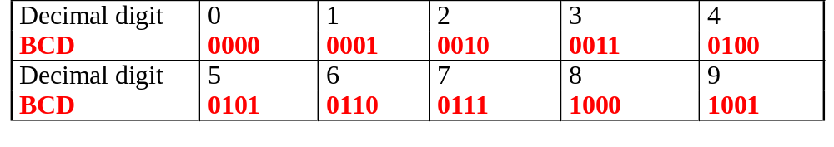
Binary Coded Decimal (BCD)
Some codes are unused, eg: (1010)_{BCD}, (1011) _{BCD}, …, (1111) _{BCD}. These codes are considered as errors.
Easy to convert, but arithmetic operations are more complicated.
Suitable for interfaces such as keypad inputs and digital readouts.

Slide 74
Binary Coded Decimal (BCD)
Examples:
(234)₁₀ = (0010 0011 0100)_{BCD}
(7093)₁₀ = (0111 0000 1001 0011)_{BCD}
(1000 0110)_{BCD} = (86)₁₀
(1001 0100 0111 0010)_{BCD} = (9472)₁₀
Notes: BCD is not equivalent to binary.
Example: (234)₁₀ = (11101010)₂

Slide 75
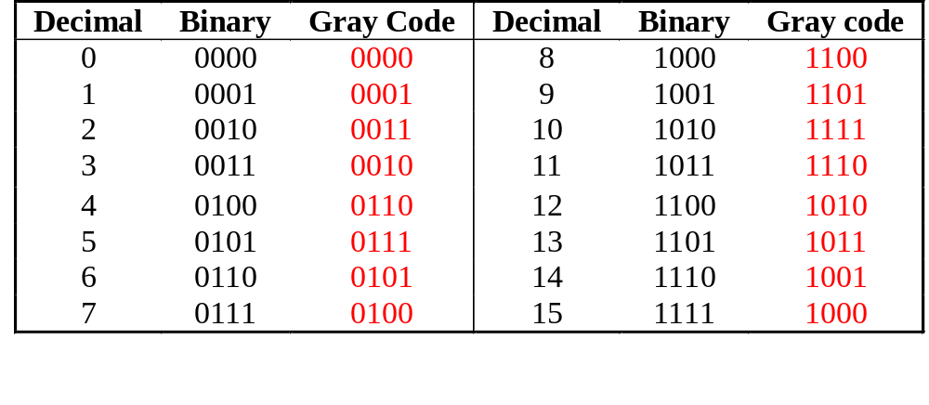
The Gray Code
Unweighted (not an arithmetic code).
Only a single bit change from one code number to the next.
Good for error detection.
Q. How to generate 5-bit standard Gray code?
Q. How to generate n-bit standard Gray code?

Slide 76
The Gray Code
0000
0001
0100
0101
0111
0110
0010
0011
0001
0000
1100
1101
1111
1110
1010
1011
1001
1000
0011
0010
0001
0000
0110
0111
0101
0100
0010
0011
0001
0000
Generating 4-bit standard Gray code.

Slide 77
The Gray Code
0 1 1
0 0 1
sensors
0 1 0
0 0 0
1 1 0
1 0 0
1 1 1
1 0 1
mis-aligned sensors
mis-aligned sensors
0 0 1
0 0 0
1 0 0
1 0 1
0 1 0
1 1 1
0 0 0
1 1 1
0 1 1
1 1 0
0 0 1
1 1 0
1 0 0
1 0 1
0 1 1
0 1 0
Binary coded: 111 → 110 → 000
Gray coded: 111 → 101

Slide 78
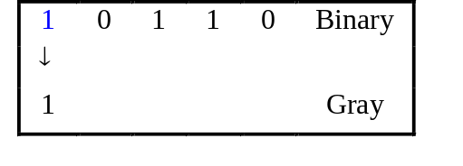
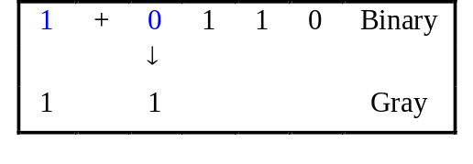
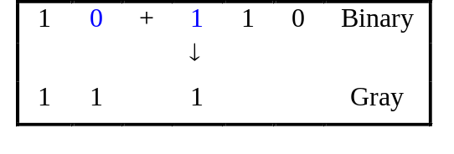
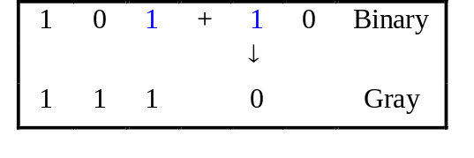
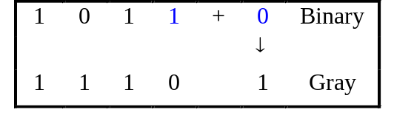
Binary-to-Gray Code Conversion
Retain most significant bit.
From left to right, add each adjacent pair of binary code bits to get the next Gray code bit, discarding carries.
Example: Convert binary number 10110 to Gray code.
(10110)₂ = (11101)_{Gray}

Slide 79
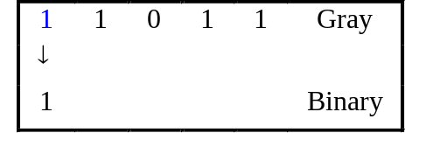
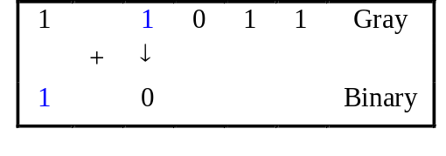
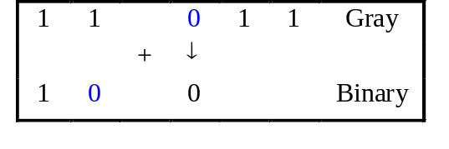
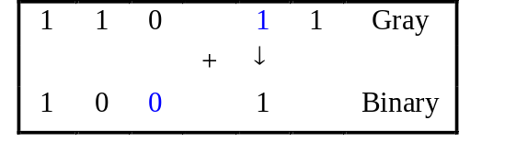
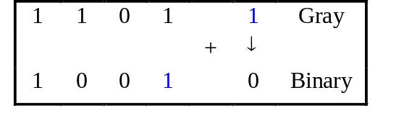
Gray-to-Binary Conversion
Retain most significant bit.
From left to right, add each binary code bit generated to the Gray code bit in the next position, discarding carries.
Example: Convert Gray code 11011 to binary.
(11011)_{Gray} = (10010)₂

Slide 80
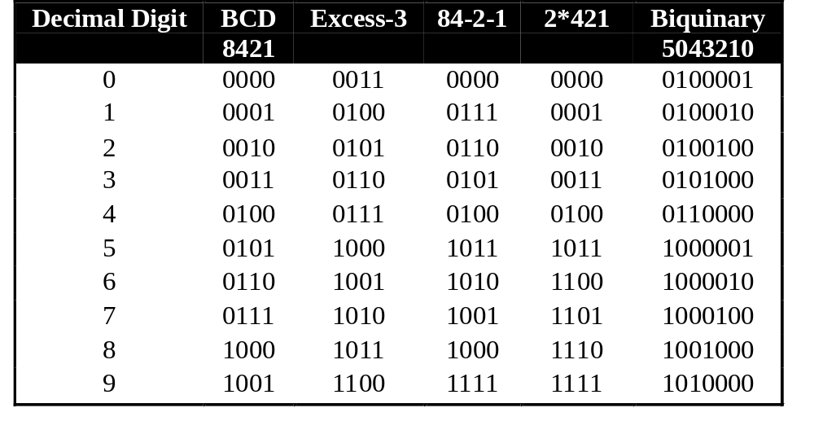
Other Decimal Codes
Self-complementing codes: excess-3, 84-2-1, 2*421 codes.
Error-detecting code: biquinary code (bi=two, quinary=five).

Slide 81
Self-Complementing Codes
Examples: excess-3, 84-2-1, 2*421 codes.
The codes that represent the pair of complementary digits are complementary of each other.
Excess-3 code
0: 0011
1: 0100
2: 0101
3: 0110
4: 0111
5: 1000
6: 1001
7: 1010
8: 1011
9: 1100
241: 0101 0111 0100
758: 1010 1000 1011

Slide 82
Solve it yourself (Exercise 1.6)
1. How to represent 246 in (a) 10-bit binary, (b) BCD, (c) Excess-3 code, (d) 2421 code, (e) 84-2-1 code?
2. [Exam, Sem2 1996/7] The decimal number 573 is represented as 1111 0110 1011 in an unknown self-complementary code. Find the code for the decimal number 642.

Slide 83
Alphanumeric Codes
Apart from numbers, computers also handle textual data.
Character set frequently used includes:
  alphabets: ‘A’ .. ‘Z’, and ‘a’ .. ‘z’
  digits: ‘0’ .. ‘9’
  special symbols: ‘$’, ‘.’, ‘,’, ‘@’, ‘*’, …
  non-printable: SOH, NULL, BELL, …
Usually, these characters can be represented using 7 or 8 bits.

Slide 84
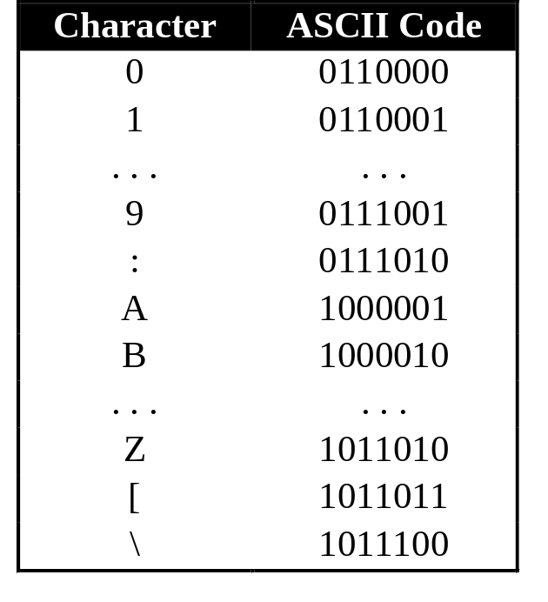
Alphanumeric Codes
Two widely used standards:
  ASCII (American Standard Code for Information Interchange)
  EBCDIC (Extended BCD Interchange Code)
ASCII: 7-bit, plus a parity bit for error detection (odd/even parity).
EBCDIC: 8-bit code.

Slide 85
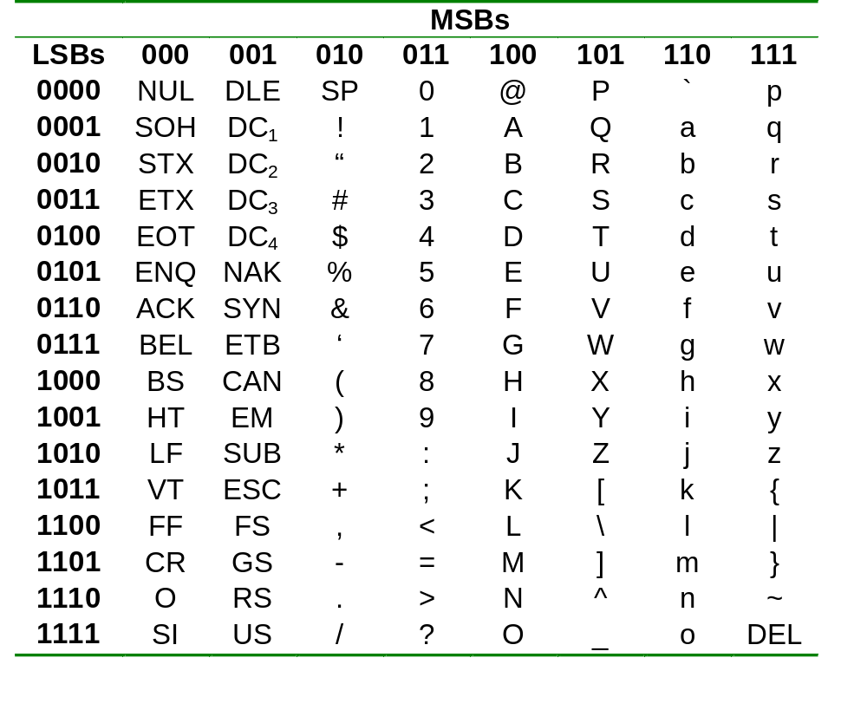
Alphanumeric Codes
ASCII table:

Slide 86
Error Detection Codes
Errors can occur data transmission. They should be detected, so that re-transmission can be requested.
With binary numbers, usually single-bit errors occur.
  Example: 0010 erroneously transmitted as 0011, or 0000, or 0110, or 1010.
Biquinary code uses 3 additional bits for error-detection. For single-error detection, one additional bit is needed.

Slide 87
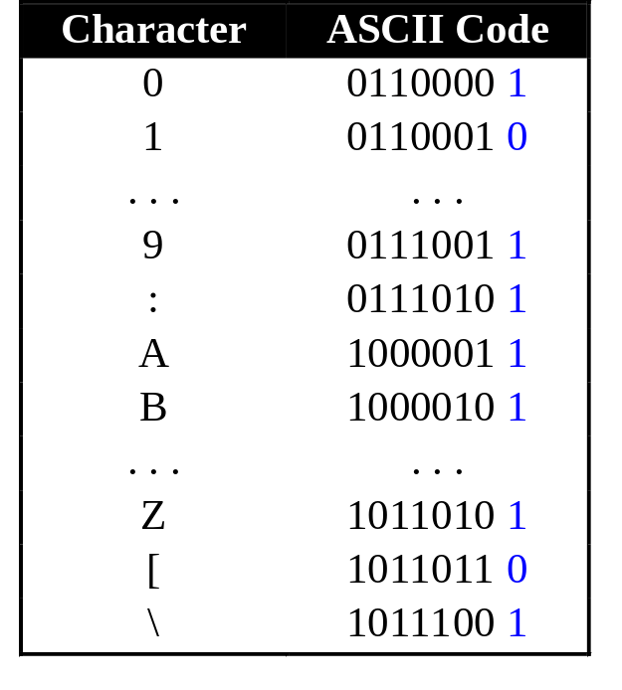
Error Detection Codes
Parity bit.
  Even parity: additional bit supplied to make total number of ‘1’s even.
  Odd parity: additional bit supplied to make total number of ‘1’s odd.
Example: Odd parity.
Parity bits

Slide 88
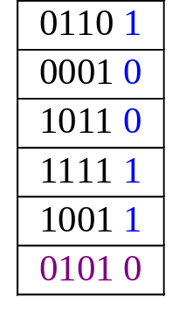
Error Detection Codes
Parity bit can detect odd number of errors but not even number of errors.
  Example: For odd parity numbers,
  10011 → 10001 (detected)
  10011 → 10101 (non detected)
Parity bits can also be
applied to a block of data:
Column-wise parity
Row-wise parity

Slide 89
Error Detection Codes
Sometimes, it is not enough to do error detection. We may want to do error correction.
Error correction is expensive. In practice, we may use only single-bit error correction.
Popular technique: Hamming Code (not covered).

Slide 90
End of segment

