Slide 1

Logic Design
Ch 2 Part A
Boolean Algebra and Logic Gates
Instructor : Hasan Al Serhan
IT Department
Al Balqa Applied University
Notes:
CS1103 Digital Logic Design

Slide 2
Introduction to Logic Gates
Logic Gates
  The Inverter
  The AND Gate
  The OR Gate
  The NAND Gate
  The NOR Gate
  The XOR Gate
  The XNOR Gate
Drawing Logic Circuit
Analysing Logic Circuit

Slide 3
Introduction to Logic Gates
Universal Gates: NAND and NOR
  NAND Gate
  NOR Gate
Implementation using NAND Gates
Implementation using NOR Gates
Implementation of SOP Expressions
Implementation of POS Expressions
Positive and Negative Logic
Integrated Circuit Logic Families

Slide 4
Logic Gates
Gate Symbols
Symbol set 1
Symbol set 2
(ANSI/IEEE Standard 91-1984)
a
b
a
b
&
AND
a.b
a.b
OR
a
b
a
b
≥1
a+b
a+b
NOT
a
a'
a
1
a'
a
b
a
b
&
NAND
(a.b)'
(a.b)'
a
b
a
b
≥1
NOR
(a+b)'
(a+b)'
a
b
a
b
=1
EXCLUSIVE OR
a ⊕ b
a ⊕ b

Slide 5
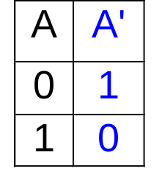
Logic Gates: The Inverter
The Inverter
A
A'
A
A'
Application of the inverter: complement.
Binary number
1
1
0
1
0
0
0
1
0
0
1
0
1
1
1
0
1’s Complement

Slide 6
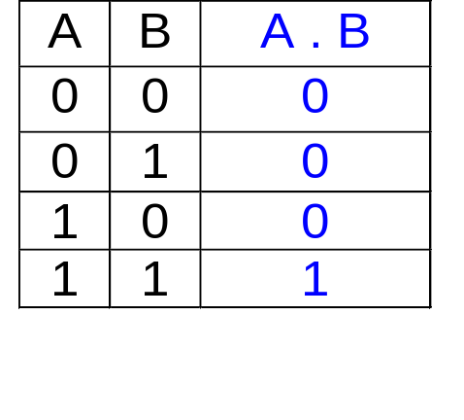
Logic Gates: The AND Gate
The AND Gate
A
B
A
B
&
A.B
A.B

Slide 7
Logic Gates: The AND Gate
Application of the AND Gate
1 sec
A
A
Counter
Enable
Enable
1 sec
Register, decode and frequency display
Reset to zero between Enable pulses

Slide 8
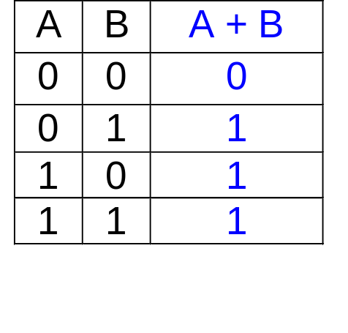
Logic Gates: The OR Gate
The OR Gate
A
B
A
B
≥1
A+B
A+B

Slide 9
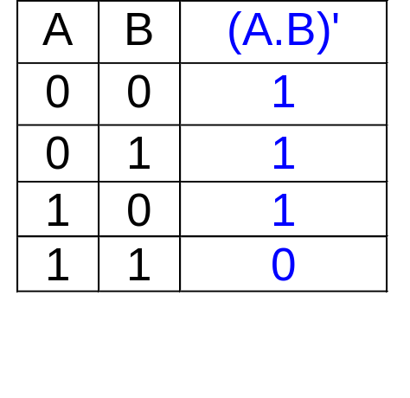
Logic Gates: The NAND Gate
The NAND Gate
A
B
≡
A
B
(A.B)'
A
B
&
(A.B)'
(A.B)'
≡
NAND
Negative-OR

Slide 10
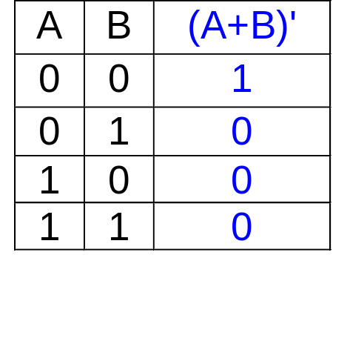
Logic Gates: The NOR Gate
The NOR Gate
A
B
≡
A
B
(A+B)'
A
B
≥1
(A+B)'
(A+B)'
≡
NOR
Negative-AND

Slide 11
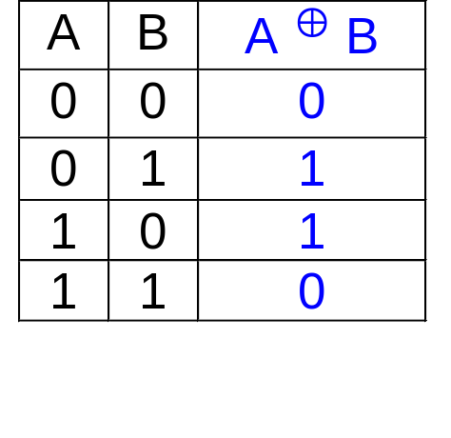
Logic Gates: The XOR Gate
The XOR Gate
A
B
A
B
=1
A ⊕ B
A ⊕ B

Slide 12
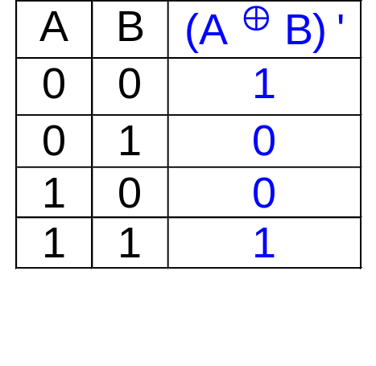
Logic Gates: The XNOR Gate
The XNOR Gate
A
B
A
B
=1
(A ⊕ B)'
(A ⊕ B)'

Slide 13
Drawing Logic Circuit
When a Boolean expression is provided, we can easily draw the logic circuit.
Examples:
(i) F1 = xyz' (note the use of a 3-input AND gate)
x
y
F1
z
z'

Slide 14
Drawing Logic Circuit
(ii) F2 = x + y'z (can assume that variables and their complements are available)
x
F2
y'
z
y'z
(iii) F3 = xy' + x'z
x
xy'
y'
F3
x'
z
x'z

Slide 15
Solve it yourself (Exercise 4.1)
Q1. Draw a logic circuit for BD + BE + D’F
Q2. Draw a logic circuit for
A’BC + B’CD + BC’D + ABD’

Slide 16
Analysing Logic Circuit
When a logic circuit is provided, we can analyse the circuit to obtain the logic expression.
Example: What is the Boolean expression of F4?
A'
B'
C
A'B'
A'B'+C
(A'B'+C)'
F4
F4 = (A'B'+C)' = (A+B).C'

Slide 17
Solve it yourself (Exercise 4.2)
What is Boolean expression of F5?
x
y
F5
z

Slide 18
Universal Gates: NAND and NOR
AND/OR/NOT gates are sufficient for building any Boolean functions.
However, other gates are also used because:
(i) usefulness
(ii) economical on transistors
(iii) self-sufficient
NAND/NOR: economical, self-sufficient
XOR: useful (e.g. parity bit generation)

Slide 19
NAND Gate
NAND gate is self-sufficient (can build any logic circuit with it).
Can be used to implement AND/OR/NOT.
Implementing an inverter using NAND gate:
x
x'
(x.x)' = x' (T1: idempotency)

Slide 20
NAND Gate
Implementing AND using NAND gates:
(x.y)'
x
x.y
y
((xy)'(xy)')' = ((xy)')' idempotency
= (xy) involution
Implementing OR using NAND gates:
x'
x
((xx)'(yy)')' = (x'y')' idempotency
= x''+y'' DeMorgan
= x+y involution
x+y
y
y'

Slide 21
NOR Gate
NOR gate is also self-sufficient.
Can be used to implement AND/OR/NOT.
Implementing an inverter using NOR gate:
x
x'
(x+x)' = x' (T1: idempotency)

Slide 22
NOR Gate
Implementing AND using NOR gates:
x'
x
x.y
((x+x)'+(y+y)')'=(x'+y')' idempotency
= x''.y'' DeMorgan
= x.y involution
y
y'
Implementing OR using NOR gates:
(x+y)'
x
x+y
y
((x+y)'+(x+y)')' = ((x+y)')' idempotency
= (x+y) involution

Slide 23
Implementation using NAND gates
Possible to implement any Boolean expression using NAND gates.
Procedure:
(i) Obtain sum-of-products Boolean expression:
e.g. F3 = xy'+x'z
(ii) Use DeMorgan theorem to obtain expression using 2-level NAND gates
e.g. F3 = xy'+x'z
= (xy'+x'z)' ' involution
= ((xy')' . (x'z)')' DeMorgan

Slide 24
Implementation using NAND gates
x
(xy')'
y'
F3
x'
z
(x'z)'
F3 = ((xy')'.(x'z)') ' = xy' + x'z

Slide 25
Implementation using NOR gates
Possible to implement boolean expression using NOR gates.
Procedure:
(i) Obtain product-of-sums Boolean expression:
e.g. F6 = (x+y').(x'+z)
(ii) Use DeMorgan theorem to obtain expression using 2-level NOR gates.
e.g. F6 = (x+y').(x'+z)
= ((x+y').(x'+z))' ' involution
= ((x+y')'+(x'+z)')' DeMorgan

Slide 26
Implementation using NOR gates
x
(x+y')'
y'
F6
x'
z
(x'+z)'
F6 = ((x+y')'+(x'+z)')' = (x+y').(x'+z)

Slide 27
Implementation of SOP Expressions
Sum-of-Products expressions can be implemented using:
  2-level AND-OR logic circuits
  2-level NAND logic circuits
AND-OR logic circuit
A
F = AB + CD + E
B
C
F
D
E

Slide 28
Implementation of SOP Expressions
NAND-NAND circuit (by circuit transformation)
a) add double bubbles
b) change OR-with-
inverted-inputs to NAND
& bubbles at inputs to
their complements
A
B
C
F
D
E
A
B
C
F
D
E'

Slide 29
Implementation of POS Expressions
Product-of-Sums expressions can be implemented using:
  2-level OR-AND logic circuits
  2-level NOR logic circuits
OR-AND logic circuit
A
G = (A+B).(C+D).E
B
C
D
G
E

Slide 30
Implementation of POS Expressions
NOR-NOR circuit (by circuit transformation):
a) add double bubbles
b) changed AND-with-
inverted-inputs to NOR
& bubbles at inputs to
their complements
A
B
C
D
G
E
A
B
C
D
G
E'

Slide 31
Solve it yourself (Exercise 4.3)
Q1. Draw a logic circuit for BD + BE + D’F using only NAND gates. Use both DeMorgan method and SOP method.
Q2. Transform the following AND-OR Circuit to NAND circuit.
Q3. Using only NOR gates, draw a logic circuit using POS method for (A+B+C’)(B’+C’+D)
x
y
F
z

Slide 32
Positive & Negative Logic
In logic gates, usually:
  H (high voltage, 5V) = 1
  L (low voltage, 0V) = 0
This convention – positive logic.
However, the reverse convention, negative logic possible:
  H (high voltage) = 0
  L (low voltage) = 1
Depending on convention, same gate may denote different Boolean function.

Slide 33
Positive & Negative Logic
A signal that is set to logic 1 is said to be asserted, or active, or true.
A signal that is set to logic 0 is said to be deasserted, or negated, or false.
Active-high signal names are usually written in uncomplemented form.
Active-low signal names are usually written in complemented form.

Slide 34
Positive & Negative Logic
Positive logic:
Active High:
0: Disabled
1: Enabled
Enable
Negative logic:
Active Low:
0: Enabled
1: Disabled
Enable

Slide 35
Integrated Circuit Logic Families
Some digital integrated circuit families: TTL, CMOS, ECL.
TTL: Transistor-Transistor Logic.
  Uses bipolar junction transistors
  Consists of a series of logic circuits: standard TTL, low-power TTL, Schottky TTL, low-power Schottky TTL, advanced Schottky TTL, etc.

Slide 36
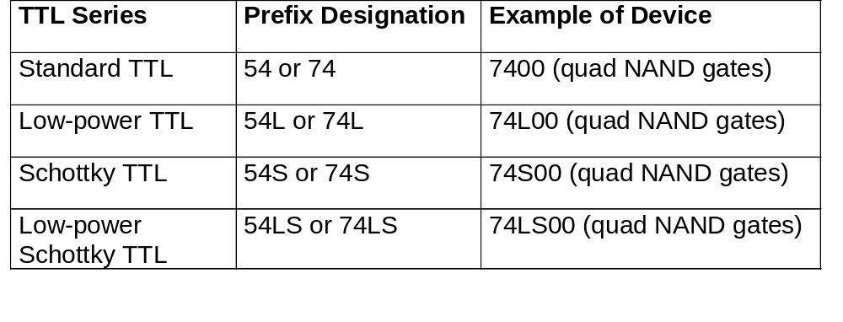
Integrated Circuit Logic Families

Slide 37
Integrated Circuit Logic Families
CMOS: Complementary Metal-Oxide Semiconductor.
  Uses field-effect transistors
ECL: Emitter Coupled Logic.
  Uses bipolar circuit technology.
  Has fastest switching speed but high power consumption.

Slide 38
Integrated Circuit Logic Families
Performance characteristics
  Propagation delay time.
  Power dissipation.
  Fan-out: Fan-out of a gate is the maximum number of inputs that the gate can drive.
  Speed-power product (SPP): product of the propagation delay time and the power dissipation.

Slide 39
Summary
Logic Gates
Drawing Logic Circuit
Analyzing Logic Circuit
AND, OR, NOT
NAND
Given a Boolean expression, draw the circuit.
Given a circuit, find the function.
NOR
Implementation of SOP and POS Expressions
Positive and Negative Logic
Implementation of a Boolean expression using these Universal gates.
Concept of Minterm and Maxterm

Slide 40
End of segment

