Slide 1

Logic Design
Ch 2 Part B
Boolean Algebra and Logic Gates
Instructor : Hasan Al Serhan
IT Department
Al Balqa Applied University

Slide 2
Digital circuits
Boolean Algebra
Two-Valued Boolean Algebra
Boolean Algebra Postulates
Precedence of Operators
Truth Table & Proofs
Duality

Slide 3
Basic Theorems of Boolean Algebra
Boolean Functions
Complement of Functions
Standard Forms
Minterm & Maxterm
Canonical Forms
Conversion of Canonical Forms
Binary Functions

Slide 4

Introduction
Boolean algebra forms the basis of logic circuit design. Consider very simple but common example: if (A is true) and (B is false) then print “the solution is found”. In this case, two Boolean expressions (A is true) and (B is false) are related by a connective ‘and’. How do we define these? This and related things are discussed in this chapter.
In typical circuit design, there are many conditions to be taken care of (for example, when the ‘second counter’ = 60, the ‘minute counter’ is incremented and ‘second counter’ is made 0. Thus it is quite important to understand Boolean algebra. In subsequent chapters, we are going to further study how to minimize the circuit using laws of Boolean algebra (that is very interesting…)

Slide 5
Digital Circuits
Digital circuit can be represented by a black-box with inputs on one side, and outputs on the other.
inputs
Digital circuit
outputs
:
:
The input/output signals are discrete/digital in nature, typically with two distinct voltages (a high voltage and a low voltage).
High
Low
In contrast, analog circuits use continuous signals.

Slide 6
Digital Circuits
Advantages of Digital Circuits over Analog Circuits:
  more reliable (simpler circuits, less noise-prone)
  specified accuracy (determinable)
  but slower response time (sampling rate)
Important advantages for two-valued Digital Circuit:
  Mathematical Model – Boolean Algebra
  Can help design, analyse, simplify Digital Circuits.

Slide 7
Boolean Algebra
What is an Algebra? (e.g. algebra of integers)
set of elements (e.g. 0,1,2,..)
set of operations (e.g. +, -, *,..)
postulates/axioms (e.g. 0+x=x,..)
Boolean Algebra named after George Boole who used it to study human logical reasoning – calculus of proposition.
Events : true or false
Connectives : a OR b; a AND b, NOT a
Example: Either “it has rained” OR “someone splashed water”, “must be tall” AND “good vision”.

Slide 8
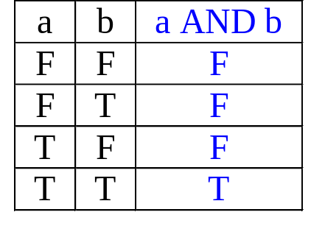
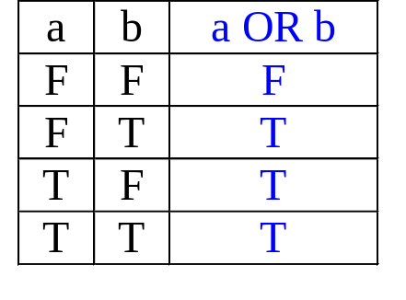
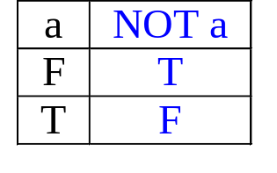
Boolean Algebra
Later, Shannon introduced switching algebra (two-valued Boolean algebra) to represent bi-stable switching circuit.

Slide 9
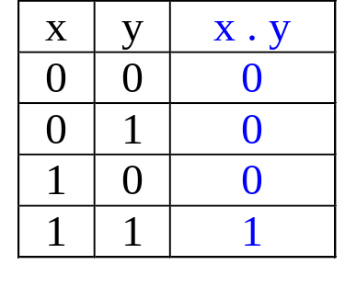
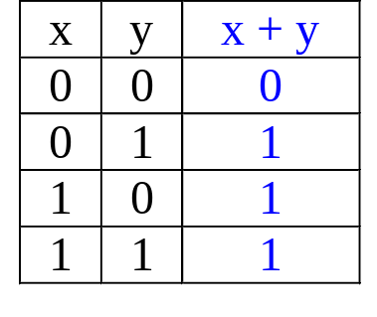
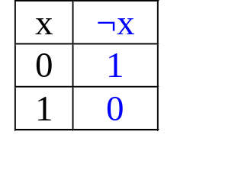
Two-valued Boolean Algebra
Set of Elements: {0,1}
Set of Operations: { ., + , ¬ }
Sometimes denoted by ’, for example a’
x
y
x
y
x.y
x+y
x
x'
Signals: High = 5V = 1; Low = 0V = 0

Slide 10
Boolean Algebra Postulates
A Boolean algebra consists of a set of elements B, with two binary operations {+} and {.} and a unary operation {'}, such that the following axioms hold:
The set B contains at least two distinct elements x and y.
Closure: For every x, y in B,
  x + y is in B
  x . y is in B
Commutative laws: For every x, y in B,
  x + y = y + x
  x . y = y . x

Slide 11
Boolean Algebra Postulates
Associative laws: For every x, y, z in B,
  (x + y) + z = x + (y + z) = x + y + z
  (x . y) . z = (x . y) . z = x . y . z
Identities (0 and 1):
  0 + x = x + 0 = x for every x in B
  1 . x = x . 1 = x for every x in B
Distributive laws: For every x, y, z in B,
  x . (y + z) = (x . y) + (x . z)
  x + (y . z) = (x + y) . (x + z)

Slide 12
Boolean Algebra Postulates
Complement: For every x in B, there exists an element x' in B such that
  x + x' = 1
  x . x' = 0
The set B = {0, 1} and the logical operations OR, AND and NOT satisfy all the axioms of a Boolean algebra.
A Boolean function maps some inputs over {0,1} into {0,1}
A Boolean expression is an algebraic statement containing Boolean variables and operators.

Slide 13
Precedence of Operators
To lessen the brackets used in writing boolean expressions, operator precedence can be used.
Precedence (highest to lowest): ' . +
Examples:
a . b + c = (a . b) + c
b' + c = (b') + c
a + b' . c = a + ((b') . c)

Slide 14
Precedence of Operators
Use brackets to overwrite precedence.
Examples:
a . (b + c)
(a + b)' . c

Slide 15
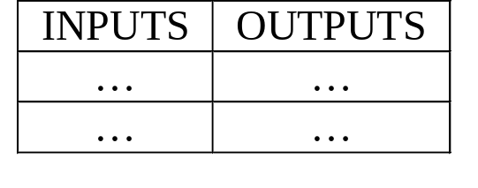
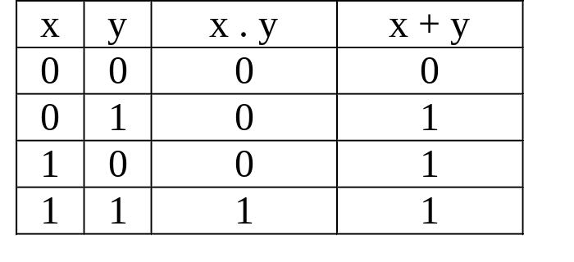
Truth Table
Provides a listing of every possible combination of inputs and its corresponding outputs.
Example (2 inputs, 2 outputs):

Slide 16
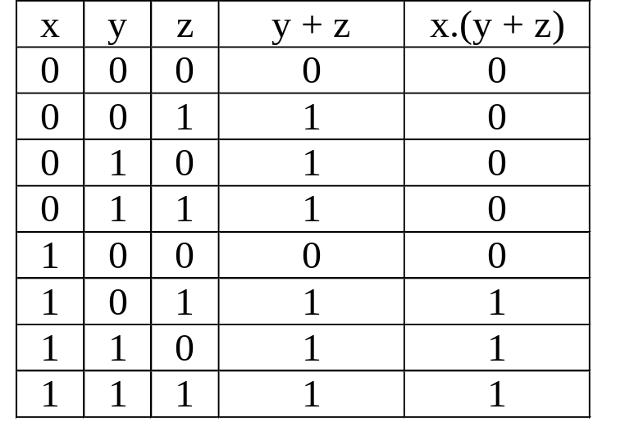
Truth Table
Example (3 inputs, 2 outputs):

Slide 17
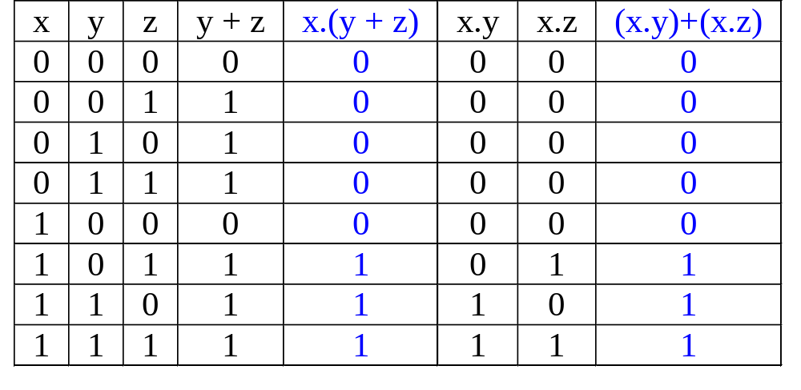
Proof using Truth Table
Can use truth table to prove by perfect induction.
Prove that: x . (y + z) = (x . y) + (x . z)
(i) Construct truth table for LHS & RHS of above equality.
(ii) Check that LHS = RHS
Postulate is SATISFIED because output column 2 & 5 (for LHS & RHS expressions) are equal for all cases.

Slide 18
Solving it yourself (Exercise 3.1)
Q. Use truth table to prove the following.
(a) A’.B’ + A.B’ + A.B = A + B’
(b) A.B.C + A’.B.C + A’.B.C’ = B.C + A’.B

Slide 19
Duality
Duality Principle – every valid Boolean expression (equality) remains valid if the operators and identity elements are interchanged, as follows:
+ ↔ .
1 ↔ 0
Example: Given the expression
a + (b.c) = (a+b).(a+c)
then its dual expression is
a . (b+c) = (a.b) + (a.c)

Slide 20
Duality
Duality gives free theorems – “two for the price of one”. You prove one theorem and the other comes for free!
If (x+y+z)' = x'.y.'z' is valid, then its dual is also valid:
(x.y.z)' = x'+y'+z’
If x + 1 = 1 is valid, then its dual is also valid:
x . 0 = 0

Slide 21
Basic Theorems of Boolean Algebra
Apart from the axioms/postulates, there are other useful theorems.
1. Idempotency.
(a) x + x = x (b) x . x = x
Proof of (a):
x + x = (x + x).1 (identity)
= (x + x).(x + x') (complementarity)
= x + x.x' (distributivity)
= x + 0 (complementarity)
= x (identity)

Slide 22
Basic Theorems of Boolean Algebra
2. Null elements for + and . operators.
(a) x + 1 = 1 (b) x . 0 = 0
3. Involution. (x')' = x
4. Absorption.
(a) x + x.y = x (b) x.(x + y) = x
5. Absorption (variant).
(a) x + x'.y = x+y (b) x.(x' + y) = x.y

Slide 23
Basic Theorems of Boolean Algebra
6. DeMorgan.
(a) (x + y)' = x'.y'
(b) (x.y)' = x' + y'
7. Consensus.
(a) x.y + x'.z + y.z = x.y + x'.z
(b) (x+y).(x'+z).(y+z) = (x+y).(x'+z)

Slide 24
Basic Theorems of Boolean Algebra
Theorems can be proved using the truth table method. (Exercise: Prove De-Morgan’s theorem using the truth table.)
They can also be proved by algebraic manipulation using axioms/postulates or other basic theorems.

Slide 25
Basic Theorems of Boolean Algebra
Theorem 4a (absorption) can be proved by:
x + x.y = x.1 + x.y (identity)
= x.(1 + y) (distributivity)
= x.(y + 1) (commutativity)
= x.1 (Theorem 2a)
= x (identity)
By duality, theorem 4b:
x.(x+y) = x
Try prove this by algebraic manipulation.

Slide 26
Boolean Functions
Boolean function is an expression formed with binary variables, the two binary operators, OR and AND, and the unary operator, NOT, parenthesis and the equal sign.
Its result is also a binary value.
We usually use . for AND, + for OR, and ' or ¬ for NOT. Sometimes, we may omit the . if there is no ambiguity.

Slide 27
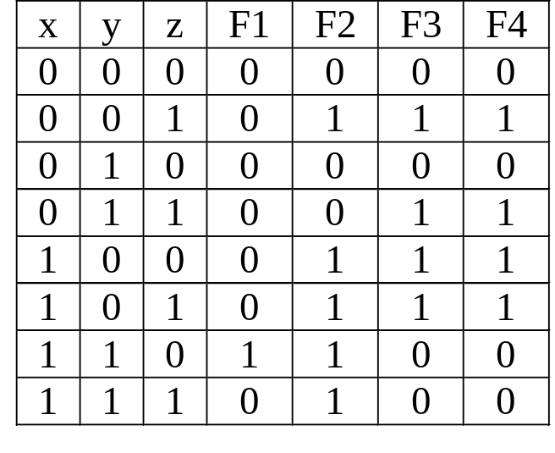
Boolean Functions
Examples:
F1= xyz'
F2= x + y'z
F3=(x'y'z)+(x'yz)+(xy')
F4=xy'+x'z
From the truth table, F3=F4.
Can you also prove by algebraic manipulation that F3=F4?

Slide 28
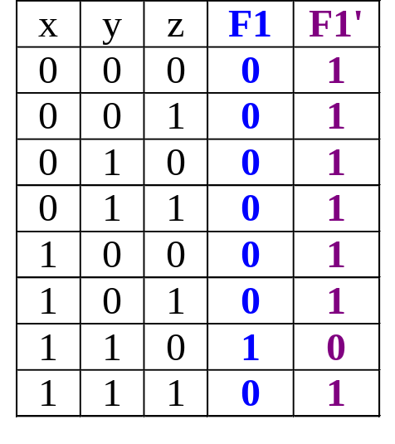
Complement of Functions
Given a function, F, the complement of this function, F', is obtained by interchanging 1 with 0 in the function’s output values.
Example: F1 = xyz'
Complement:
F1' = (xyz')'
= x' + y' + (z')' DeMorgan
= x' + y' + z Involution

Slide 29
Complement of Functions
More general DeMorgan’s theorems useful for obtaining complement functions:
(A + B + C + ... + Z)' = A' . B' . C' … . Z'
(A . B . C ... . Z)' = A' + B' + C' + … + Z'

Slide 30
Standard Forms
Certain types of Boolean expressions lead to gating networks which are desirable from implementation viewpoint.
Two Standard Forms: Sum-of-Products and Product-of-Sums
Literals: a variable on its own or in its complemented form. Examples: x, x' , y, y'
Product Term: a single literal or a logical product (AND) of several literals.
Examples: x, xyz', A'B, AB

Slide 31
Standard Forms
Sum Term: a single literal or a logical sum (OR) of several literals.
Examples: x, x+y+z', A'+B, A+B
Sum-of-Products (SOP) Expression: a product term or a logical sum (OR) of several product terms.
Examples: x, x+yz', xy'+x'yz, AB+A'B'
Product-of-Sums (POS) Expression: a sum term or a logical product (AND) of several sum terms.
Exampes: x, x(y+z'), (x+y')(x'+y+z), (A+B)(A'+B')

Slide 32
Standard Forms
Every boolean expression can either be expressed as sum-of-products or product-of-sums expression.
Examples:
SOP: x′y + xy′ + xyz
POS: (x + y′)(x′ + y)(x′ + z′)
both: x′ + y + z or xyz′
neither: x(w′ + yz) or z′ + wx′y + v(xz + w′)

Slide 33
Minterm & Maxterm
Consider two binary variables x, y.
Each variable may appear as itself or in complemented form as literals (i.e. x, x' & y, y' )
For two variables, there are four possible combinations with the AND operator, namely:
x'y', x'y, xy', xy
These product terms are called the minterms.
A minterm of n variables is the product of n literals from the different variables.

Slide 34
Minterm & Maxterm
In general, n variables can give 2^{n} minterms.
In a similar fashion, a maxterm of n variables is the sum of n literals from the different variables.
Examples: x'+y', x'+y, x+y',x+y
In general, n variables can give 2^{n} maxterms.

Slide 35
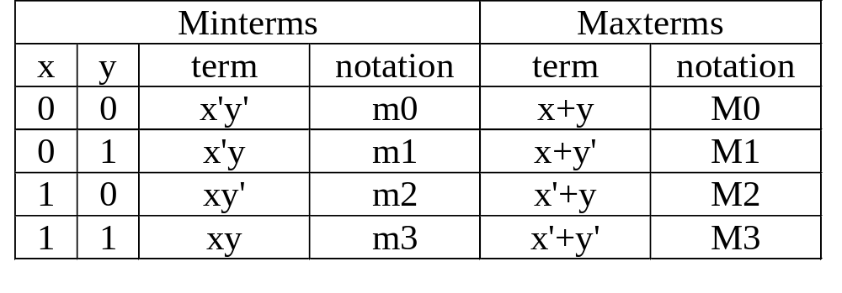
Minterm & Maxterm
The minterms and maxterms of 2 variables are denoted by m0 to m3 and M0 to M3 respectively:
Each minterm is the complement of the corresponding maxterm:
Example: m2 = xy'
m2' = (xy')' = x' + (y')' = x'+y = M2

Slide 36
Canonical Form: Sum of Minterms
What is a canonical/normal form?
  A unique form for representing something.
Minterms are product terms.
  Can express Boolean functions using Sum-of-Minterms form.

Slide 37
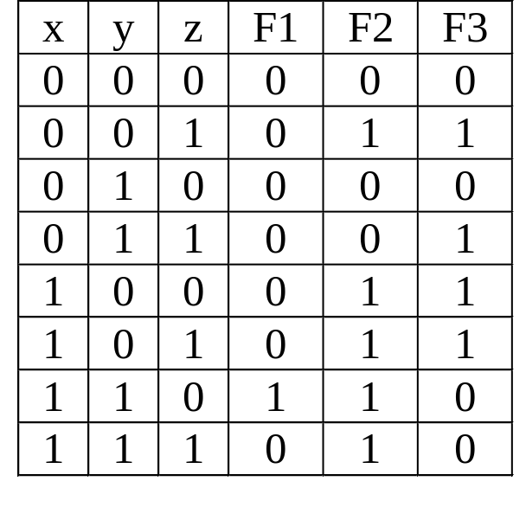
Canonical Form: Sum of Minterms
a) Obtain the truth table. Example:

Slide 38
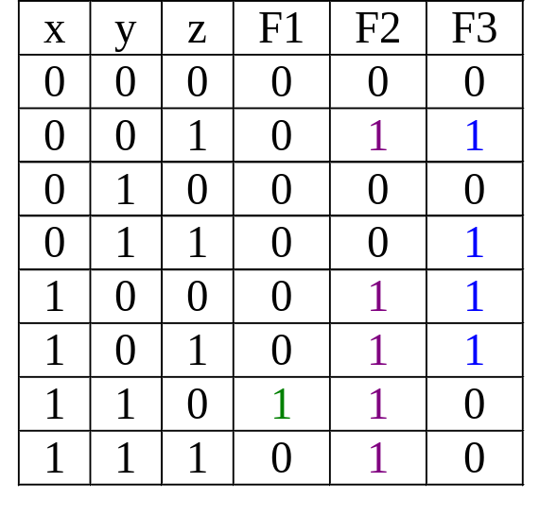
Canonical Form: Sum of Minterms
b) Obtain Sum-of-Minterms by gathering/summing the minterms of the function (where result is a 1)
F1 = xyz' = Σ(m6)
F2 = x'y'z+xy'z'+xy'z+xyz'+xyz = Σ(m1,m4,m5,m6,m7)
F3 = x'y'z+x'yz+xy'z'
+xy'z
= Σ(m1,m3,m4,m5)

Slide 39
Canonical Form: Product of Maxterms
Maxterms are sum terms.
For Boolean functions, the maxterms of a function are the terms for which the result is 0.
Boolean functions can be expressed as Products-of-Maxterms.

Slide 40
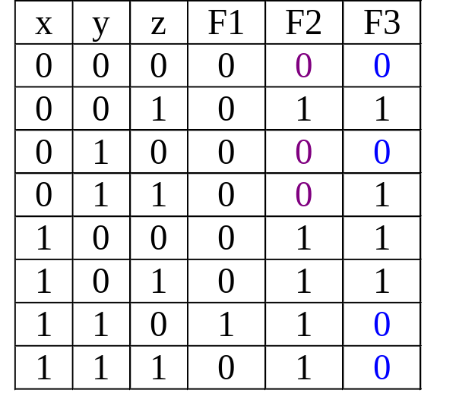
Canonical Form: Product of Maxterms
E.g.: F2 = Π(M0,M2,M3) = (x+y+z)(x+y'+z)(x+y'+z')
F3 = Π(M0,M2,M6,M7)
= (x+y+z)(x+y'+z)(x'+y'+z)(x'+y'+z')

Slide 41
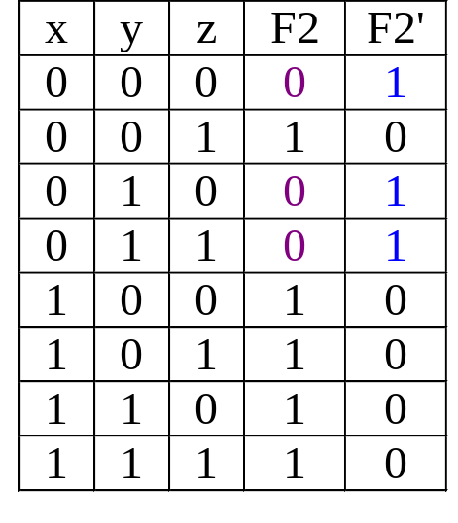
Canonical Form: Product of Maxterms
Why is this so? Take F2 as an example.
F2 = Σ(m1,m4,m5,m6,m7)
The complement function of F2 is:
F2' = Σ(m0,m2,m3)
= m0 + m2 + m3
(Complement functions’ minterms
are the opposite of their original
functions, i.e. when
original function = 0)

Slide 42
Canonical Form: Product of Maxterms
From previous slide, F2' = m0 + m2 + m3
Therefore:
F2 = (m0 + m2 + m3 )'
= m0' . m2' . m3' DeMorgan
= M0 . M2 . M3 mx' = Mx
= Π(M0,M2,M3)
Every Boolean function can be expressed as either Sum-of-Minterms or Product-of-Maxterms.

Slide 43
Solving it yourself (Exercise 3.2)
1. A Boolean function of 5 variables can have up to ___ minterms.
2. Given a Boolean function F (A,B,C) = Σ m(0, 5, 7).
Which of the following is correct?
a) F' (A,B,C) = Σm(0,5,7) b) F (A,B,C) = ΠM(1,2,3,4,6)
c) F (A,B,C) = ΠM(0,5,7) d) F' (A,B,C) = Σm(1,2,3)
e) None above
3. Given a Boolean function F (x,y,z) = y'.(x + z') + x'.z.
Which of the following is correct?
a) F (x,y,z) = Σm(0,1) b) F (x,y,z) = Σm(0,1,4,5)
c) F (x,y,z) = Σm(0,1,2,3,4) d) F (x,y,z) = Σm(0,1,3,4,5)
e) F (x,y,z) = Σm(1,2,3,4,5)

Slide 44
Solving it yourself (Exercise 3.2)
4. Given a Boolean function with 6 variables a, b, c, d, e, f.
What is maxterm M60?
a) a'.b'.c'.d'.e.f b) a'+b'+c'+d' c) a'+b'+c'+d'+e+f
d) a.b.c.d.e'.f' e) a+b+c+d+e'+f'
5. Given a Boolean function F (a,b,c) = S m(0, 2, 5, 6, 7).
If a=0, b=c=1, what is the value of F?
a) 0 b) 1 c) b.c d) a' e) Unknown
6. Which of the following is NOT a minterm of the Boolean function: F (w,x,y,z) = w.x.z' + x.y'.z + x.z
a) w.x.y.z' b) w'.x.y'.z c) w.x.y.z
d) w.x.y'.z' e) w.x'.y.z

Slide 45
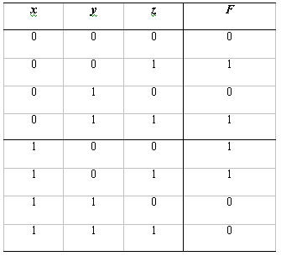
Solving it yourself (Exercise 3.2)
7. Identify the following function F(x,y,z).
a) x.y'.z' + x'.y.z + x.z'
b) x'.y.z + x.y' + x'.y'.z
c) x.y'.z + x'.y'.z + x.y
d) x.y.z + x'.y'.z' + x.y'
e) None above

Slide 46
Conversion of Canonical Forms
Sum-of-Minterms ⇒ Product-of-Maxterms
  Rewrite minterm shorthand using maxterm shorthand.
  Replace minterm indices with indices not already used.
Eg: F1(A,B,C) = ∑m(3,4,5,6,7) = ∏M(0,1,2)
Product-of-Maxterms ⇒ Sum-of-Minterms
  Rewrite maxterm shorthand using minterm shorthand.
  Replace maxterm indices with indices not already used.
Eg: F2(A,B,C) = ∏M(0,3,5,6) = ∑m(1,2,4,7)

Slide 47
Conversion of Canonical Forms
Sum-of-Minterms of F ⇒ Sum-of-Minterms of F'
  In minterm shorthand form, list the indices not already used in F.
Eg: F1(A,B,C) = ∑m(3,4,5,6,7)
F1'(A,B,C) = ∑m(0,1,2)
Product-of-Maxterms of F ⇒ Prod-of-Maxterms of F'
  In maxterm shorthand form, list the indices not already used in F.
Eg: F1(A,B,C) = ∏M(0,1,2)
F1'(A,B,C) = ∏M(3,4,5,6,7)

Slide 48
Conversion of Canonical Forms
Sum-of-Minterms of F ⇒ Product-of-Maxterms of F'
  Rewrite in maxterm shorthand form, using the same indices as in F.
Eg: F1(A,B,C) = ∑m(3,4,5,6,7)
F1'(A,B,C) = ∏M(3,4,5,6,7)
Product-of-Maxterms of F ⇒ Sum-of-Minterms of F'
  Rewrite in minterm shorthand form, using the same indices as in F.
Eg: F1(A,B,C) = ∏M(0,1,2)
F1'(A,B,C) = ∑m(0,1,2)

Slide 49
Solving it yourself (Exercise 3.3)
Q. Consider the function
f(A,B,Y,Z) = Σ m(0, 2, 5, 6, 8, 11, 15).
a) Write this as a Boolean expression in canonical SOP form.
b) Rewrite the expression in canonical POS form.
c) Write the complement of f in “little m” notation and in canonical SOP form.
d) Write the complement of f in “big M” notation and in canonical POS form.

Slide 50
Binary Functions
Given n variables, there are 2^{n} possible minterms.
As each function can be expressed as sum-of-minterms, there could be 2^{2n} different functions.
In the case of two variables, there are 2² =4 possible minterms; and 2⁴=16 different possible binary functions.
The 16 possible binary functions are shown in the next slide.

Slide 51
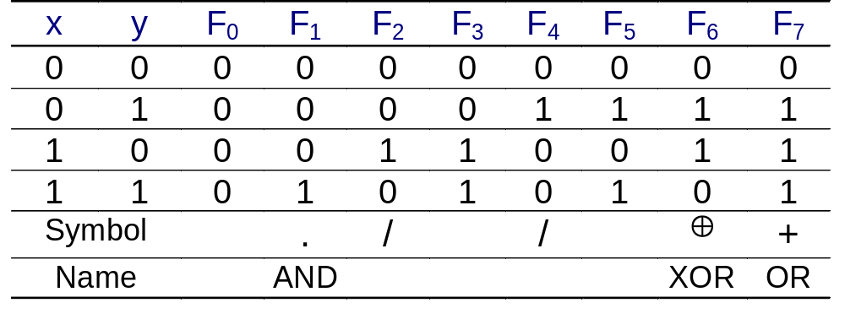
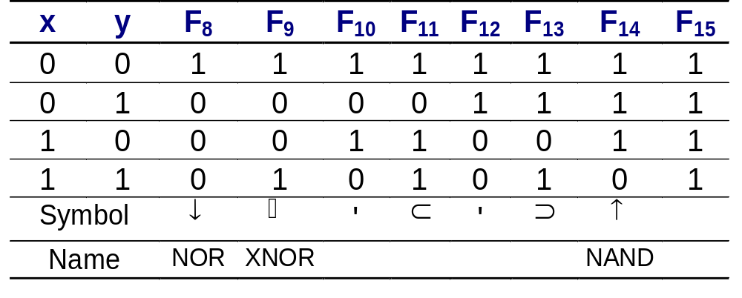
Binary Functions

Slide 52
End of segment

