Slide 1

Logic Design
Ch 5
Combinational Circuits
Instructor : Hasan Al Serhan
IT Department
Al Balqa Applied University

Slide 2
Combinational Circuits:
Design Methods/Arithmetic Circuits
Introduction
Analysis Procedure
Design Methods
Gate-level (SSI) Design
  Half Adder
  Full Adder
  BCD-to-Excess-3 Code Converter
Block-Level Design
  4-bit Parallel Adder
  BCD-to-Excess-3 Code Converter
  16-bit Parallel Adder
  4-bit Parallel Adder cum Subtractor

Slide 3
Combinational Circuits:
Design Methods/Arithmetic Circuits
Arithmetic Circuits
  Adders
  Parallel Adders
  Cascading Adders
  Parallel Adder-Subtractor
  Comparator

Slide 4
Introduction
Two classes of logic circuits:
  combinational
  sequential
Combinational Circuit:
inputs
: :
Combinational
Logic
: :
outputs
Each output depends entirely on the immediate (present) inputs.

Slide 5
Introduction
Sequential Circuit: (to be covered later)
inputs
: :
Combinational
Logic
: :
outputs
Memory
Output depends on both present and past inputs.
Memory (via feedback loop) contains past information.

Slide 6
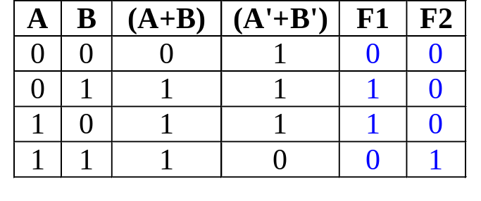
Analysis Procedure
Given a combinational circuit, can you analyze its function?
AB
A+B
F1
F2
= (A+B).(A'+B')
= (A'+B')' = A.B
A'+B'
Steps:
  1. Label the inputs and outputs.
  2. Obtain the functions of intermediate points and the outputs.
  3. Draw the truth table.
  4. Deduce the functionality of the circuit  half adder.

Slide 7
Design Methods
Different combinational circuit design methods:
  Gate-level method (with logic gates)
  Block-level design method
Design methods make use of logic gates and useful functional blocks.
  These are available as Integrated Circuit (IC) chips.

Slide 8
Design Methods
Type of IC chips (based on packing density) :
  Small-scale integration (SSI): up to 12 gates
  Medium-scale integration (MSI): 12-99 gates
  Large-scale integration (LSI): 100-9999 gates
  Very large-scale integration (VLSI): 10,000-99,999 gates
  Ultra large-scale integration (ULSI): > 100,000 gates
Main objectives of circuit design:
  (i) reduce cost
    reduce number of gates (for SSI circuits)
    reduce IC packages (for complex circuits)
  (ii) increase speed
  (iii) design simplicity (reuse blocks where possible)

Slide 9
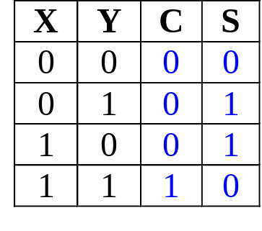
Gate-level (SSI) Design: Half Adder
Design procedure:
1) State Problem
Example: Build a Half Adder to add two bits
2) Determine and label the inputs & outputs of circuit.
Example: Two inputs and two outputs labelled, as follows:
X
Y
Half
Adder
S
C
(X + Y)
3) Draw truth table.

Slide 10
Gate-level (SSI) Design: Half Adder
4) Obtain simplified Boolean function.
Example: C = XY
S = X'Y + XY' = X⊕Y
5) Draw logic diagram.
X
Y
S
Half Adder
C

Slide 11
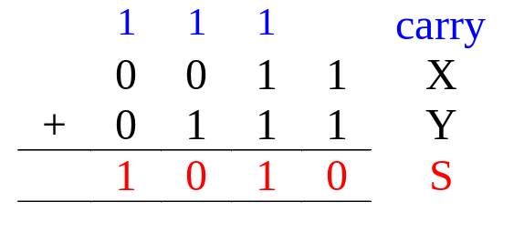
Gate-level (SSI) Design: Full Adder
Half-adder adds up only two bits.
To add two binary numbers, we need to add 3 bits (including the carry).
Example:
Need Full Adder (so called as it can be made from two half-adders).
X
Y
Z
Full
Adder
S
C
(X + Y + Z)

Slide 12
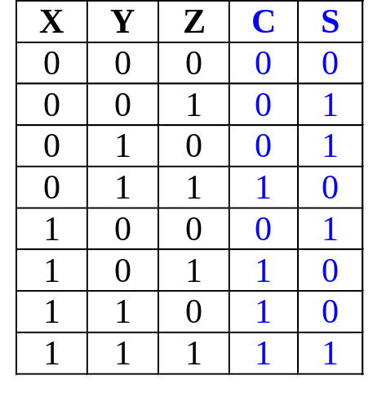
Gate-level (SSI) Design: Full Adder
Truth table:
Note:
  Z - carry in (to the current position)
  C - carry out (to the next position)
C
YZ
00 01 11 10
X
0
1
1
Using K-map, simplified SOP form:
C = XY + XZ + YZ
S = X'Y'Z + X'YZ'+XY'Z'+XYZ
1
1
1
S
YZ
00 01 11 10
X
0
1
1
1
1
1

Slide 13
Gate-level (SSI) Design: Full Adder
Alternative formulae using algebraic manipulation:
  C = XY + XZ + YZ
  = XY + (X + Y)Z
  = XY + ((X⊕Y) + XY)Z
  = XY + (X⊕Y)Z + XYZ
  = XY + (X⊕Y)Z
  S = X'Y'Z + X'YZ' + XY'Z' + XYZ
  = X'(Y'Z + YZ') + X(Y'Z' + YZ)
  = X'(Y⊕Z) + X(Y⊕Z)'
  = X⊕(Y⊕Z) or (X⊕Y)⊕Z

Slide 14
Gate-level (SSI) Design: Full Adder
Circuit for above formulae:
  C = XY + (X⊕Y)Z
  S = (X⊕Y)⊕Z
X
Y
(X⊕Y)
S
(XY)
C
Z
Full Adder made from two Half-Adders (+ OR gate).

Slide 15
Gate-level (SSI) Design: Full Adder
Circuit for above formulae:
  C = XY + (X⊕Y)Z
  S = (X⊕Y)⊕Z
Block diagrams.
X
Y
X
Y
(X⊕Y)
Sum
X
Y
Sum
S
Half
Adder
Half
Adder
Carry
(XY)
Carry
C
Z
Full Adder made from two Half-Adders (+ OR gate).

Slide 16
Code Converters
Code converters – take an input code, translate to its equivalent output code.
Input
code
Code
converter
Output
code
Example: BCD to Excess-3 Code Converter.
Input: BCD digit
Output: Excess-3 digit

Slide 17
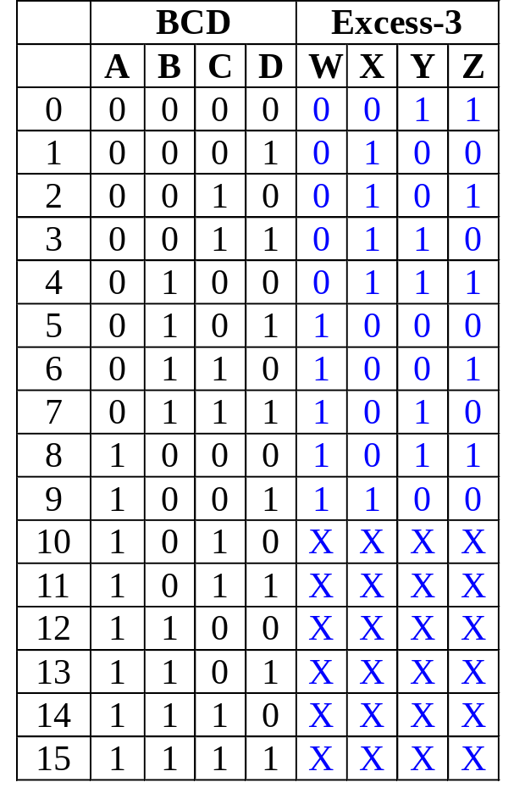
BCD-to-Excess-3 Code Converter
Truth table:
K-maps:
CD
C
CD
C
AB
00 01 11 10
AB
00 01 11 10
00
01
11
10
00
01
11
10
1
1
1
1
1
1
1
B
B
A
X
X
X
X
A
X
X
X
X
1
1
X
X
1
X
X
W
D
X
D
CD
C
CD
C
AB
00 01 11 10
AB
00 01 11 10
00
01
11
10
1
1
00
01
11
10
1
1
1
1
1
1
B
B
A
X
X
X
X
A
X
X
X
X
1
X
X
1
X
X
Y
D
Z
D

Slide 18
BCD-to-Excess-3 Code Converter
CD
C
CD
C
AB
00 01 11 10
AB
00 01 11 10
00
01
11
10
00
01
11
10
1
1
1
W = A + BC + BD
X = B'C + B'D + BC'D'
Y = CD + C'D'
Z = D'
1
1
1
1
B
B
A
X
X
X
X
A
X
X
X
X
1
1
X
X
1
X
X
W
D
X
D
CD
C
CD
C
AB
00 01 11 10
AB
00 01 11 10
00
01
11
10
1
1
00
01
11
10
1
1
1
1
1
1
B
B
A
X
X
X
X
A
X
X
X
X
1
X
X
1
X
X
Y
D
Z
D

Slide 19
Block-Level Design Method
More complex circuits can also be built using block-level method.
In general, block-level design method (as opposed to gate-level design) relies on algorithms or formulae of the circuit, which are obtained by decomposing the main problem to sub-problems recursively (until small enough to be directly solved by blocks of circuits).
Simple examples using 4-bit parallel adder as building blocks:
  (1) BCD-to-Excess-3 Code Conversion
  (2) 16-Bit Parallel Adder
  (3) Adder cum Subtractor

Slide 20
4-bit Parallel Adder
Consider a circuit to add two 4-bit numbers together and a carry-in, to produce a 5-bit result:
X₄
X₃
X₂
X₁
Y₄
Y₃
Y₂
Y₁
4-bit
Parallel Adder
C₅
C₁
Black-box view of 4-bit parallel adder
S₄
S₃
S₂
S₁
5-bit result is sufficient because the largest result is:
(1111)₂+(1111)₂+(1)₂ = (11111)₂

Slide 21
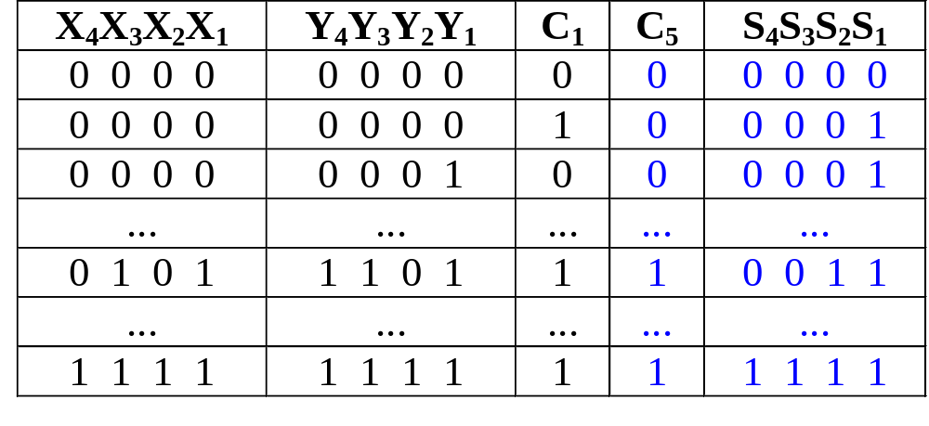
4-bit Parallel Adder
SSI design technique should not be used.
Truth table for 9 inputs very big, i.e. 2⁹=512 entries:
Simplification very complicated.

Slide 22
4-bit Parallel Adder
Alternative design possible.
Addition formulae for each pair of bits (with carry in),
C_{i+1}S_{i} = X_{i} + Y_{i} + C_{i}
has the same function as a full adder.
C_{i+1} = X_{i} Y_{i} + (X_{i} ⊕ Y_{i} ) C_{i}
S_{i} = X_{i} ⊕ Y_{i} ⊕ C_{i}

Slide 23
4-bit Parallel Adder
Cascading 4 full adders via their carries, we get:
Y₄ X₄
Y₃ X₃
Y₂ X₂
Y₁ X₁
C₄
C₃
C₂
C₅
FA
FA
FA
FA
C₁
S₄
S₃
S₂
S₁
Input
Output

Slide 24
Parallel Adders
Note that carry propagated by cascading the carry from one full adder to the next.
Called Parallel Adder because inputs are presented simultaneously (in parallel). Also, called Ripple-Carry Adder.

Slide 25
BCD-to-Excess-3 Code Converter
Excess-3 code can be converted from BCD code using truth table:
Gate-level design can be used since only 4 inputs.
However, alternative design possible.
Use problem-specific formulae:
Excess-3 Code
= BCD Code + (0011)₂

Slide 26
BCD-to-Excess-3 Code Converter
Excess-3 Code = BCD Code + (0011)₂
Block-level circuit:
unused
X₄
X₃
X₂
X₁
Cout
BCD
code
S₄
S₃
S₂
S₁
4-bit Parallel Adder
Excess-3
code
0
0
1
1
Y₄
Y₃
Y₂
Y₁
Cin
A BCD-to-Excess-3 Code Converter
0

Slide 27
16-bit Parallel Adder
Larger parallel adders can be built from smaller ones.
Example: a 16-bit parallel adder can be constructed from four 4-bit parallel adders:
X₁₆..X₁₃
Y₁₆..Y₁₃
X₁₂..X₉
Y₁₂..Y₉
X₈..X₅
Y₈..Y₅
X₄..X₁
Y₄..Y₁
4
4
4
4
4
4
4
4
C₁₇
4-bit // adder
C₁₃
4-bit // adder
C₉
4-bit // adder
C₅
4-bit // adder
C₁
4
4
4
4
S₁₆..S₁₃
S₁₂..S₉
S₈..S₅
S₄..S₁
A 16-bit parallel adder

Slide 28
16-bit Parallel Adder
Shortened notation for multiple lines.
4
is a shortened notation for
S₄ .. S₁
S₄ S₃ S₂ S₁
16-bit parallel adder ripples carry from one 4-bit block to the next.
Such ripple-carry circuits are “slow” because of long delays needed to propagate the carries.

Slide 29
4-bit Parallel Adder cum Subtractor
*Optional
Subtraction can be performed through addition using 2s-complement numbers.
Hence, we can design a circuit which can perform both addition and subtraction, using a parallel adder.
X₄
X₃
X₂
X₁
Y₄
Y₃
Y₂
Y₁
4-bit adder
cum subtractor
S: control signal for add/subtract
Result: either X+Y or X-Y

Slide 30
4-bit Parallel Adder cum Subtractor
The control signal S=0 means add
S=1 means subtract
Recall that:
X-Y = X + (-Y)
= X + (2’s complement of Y)
= X + (1’s complement of Y) +1
X+Y = X + (Y)

Slide 31
4-bit Parallel Adder cum Subtractor
Design requires:
  (i) XOR gates:
Y
Y
Y
Y'
S = 0
S = 1
such that: output = Y when S=0
= Y' when S=1
  (ii) S connected to carry-in.

Slide 32
4-bit Parallel Adder cum Subtractor
Adder cum subtractor circuit:
Y₄
Y₃
Y₂
Y₁
S
X₄
X₃
X₂
X₁
C
Cout
4-bit
parallel adder
Cin
Analysis:
If S=1, then
X + (1's complement of Y) +1
appears as the result.
If S=0, then X+Y appears as
the result.
S₄
S₃
S₂
S₁
A 4-bit adder cum subtractor

Slide 33
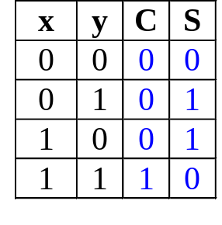
Arithmetic Circuits: Adders
Revision
Half adder
Σ
Input bits
X
Σ
Sum
Output bits
Y
Cout
Carry
x
y'
x'
y'
x'
y
S = xy' + x'y
x
y
S = (C+x'y')'
C
x
y
C
x
y
x
y
S = x ⊕ y
x'
y'
S = (x+y)(x'+y')
C
x
y
C

Slide 34
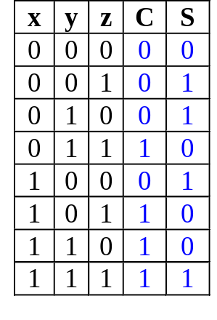
Arithmetic Circuits: Adders
Revision
Full adder
Σ
A
Σ
Sum
Input bits
Output bits
B
Cout
Carry
Cin
yz
00 01 11 10
yz
00 01 11 10
X'
y'
z
x
x
0
1
1
0
1
1
1
x'
y
z'
1
1
1
1
1
S
C = xy + xz + yz
S = x'y'z + x'yz' + xy'z' + xyz
x
y'
z'
x
y
z
x⊕y
x
y
S = (x⊕y)⊕z
x
y
xy
x
z
C = xy + (x⊕y)z
C
z
y
z

Slide 35
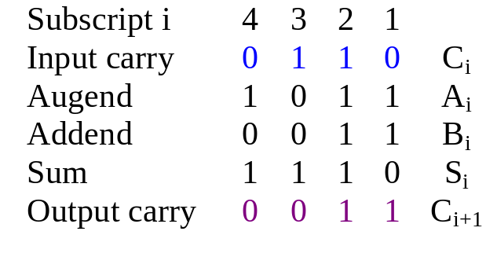
Arithmetic Circuits: Parallel Adders
Revision
Example: Adding two 4-bit numbers
2 ways:
  Serial (one FA)
  Parallel (n FAs for n bits)
Y₄ X₄
Y₃ X₃
Y₂ X₂
Y₁ X₁
C₄
C₃
C₂
C₅
FA
FA
FA
FA
C₁
Binary no. A
Σ
X
4-bit sum
S₄
S₃
S₂
S₁
S
Binary no. B
Y
Cout
Output carry
Input carry
Cin

Slide 36
Arithmetic Circuits: Cascading Adders
Revision
4-bit parallel adder:
  cascade 4 full adders
  classical method: 9 input variables  2⁹ = 512 rows in truth table!
Cascading method can be extended to larger numbers, example: 16-bit parallel adder.
X₁₆..X₁₃
Y₁₆..Y₁₃
X₁₂..X₉
Y₁₂..Y₉
X₈..X₅
Y₈..Y₅
X₄..X₁
Y₄..Y₁
4
4
4
4
4
4
4
4
C₁₇
4-bit // adder
C₁₃
4-bit // adder
C₉
4-bit // adder
C₅
4-bit // adder
C₁
4
4
4
4
S₁₆..S₁₃
S₁₂..S₉
S₈..S₅
S₄..S₁

Slide 37
Arithmetic Circuits: Cascading Adders
Application: 6-person voting system.
  Use FAs and a 4-bit binary parallel adder.
  Each FA can sum up to 3 votes.
Σ
Voter 1
A
Σ
Σ
1
2
3
4
Voter 2
B
A
1
2
3
4
3-bit Output
Cout
S
Voter 3
Cin
Full-adder 1
1
2
3
4
B
Cout
Σ
Cin
Voter 4
A
Σ
Parallel adder
Voter 5
B
Cout
Voter 6
Cin
Full-adder 2

Slide 38
Arithmetic Circuits: Adder-Subtractor
Revision
Make use of 2’s complement:
X - Y = X + (-Y)
2’s complement of Y = Inverting bits in Y and plus 1.
Y₄
Y₃
Y₂
Y₁
S
X₄
X₃
X₂
X₁
Z_{i} = S.Y_{i}' + S'.Y_{i}
Z₄
Z₃
Z₂
Z₁
4-bit
parallel adder
When S=0,
Cin=0, Z_{i} = Y_{i} ☑ S = X + Y
When S=1,
Cin=1, Z_{i} = Y_{i}' ☑ S = X + Y' + 1
C
Cout
Cin
S₄
S₃
S₂
S₁

Slide 39
Arithmetic Circuits: Comparator
Magnitude comparator: compares 2 values A and B, to see if A>B, A=B or A<B.
Classical method requires 2^{2n} rows in truth table!
We exploit regularity.
How do we compare two 4-bit values A (a₃a₂a₁a₀) and B (b₃b₂b₁b₀)?
If (a₃ > b₃) then A > B
If (a₃ < b₃) then A < B
If (a₃ = b₃) then if (a₂ > b₂) ….

Slide 40
Arithmetic Circuits: Comparator
Let A = A₃A₂A₁A₀ , B = B₃B₂B₁B₀; x_{i} = A_{i}.B_{i} + A_{i}'.B_{i}'
A₃
x₃
A₃'.B₃
B₃
A₃.B₃'
A₃'.B₃ + x₃.A₂'.B₂
+ x₃.x₂.A₁'.B₁
+ x₃. x₂.x₁.A₀'.B₀
A₂
x₂
B₂
(A < B)
A₁
x₁
B₁
A₃.B₃' + x₃.A₂.B₂'
+ x₃.x₂.A₁.B₁'
+ x₃. x₂.x₁.A₀.B₀'
A₀
x₀
(A > B)
B₀
(A = B)
x₃. x₂.x₁.x₀

Slide 41
Arithmetic Circuits: Comparator
0
1
1
0
A₃
A₂
A₁
A₀
4-bit comp
1
0
1
0
B₃
B₂
B₁
B₀
(A < B)
1
0
0
(A > B)
(A = B)
Block diagram of a 4-bit magnitude comparator

