Slide 1
Project Management:
Process, Technology, and Practice
Ganesh Vaidyanathan
Chapter 8
Scheduling

Slide 2
Learning objectives
Schedule projects
Construct project networks
Identify slack in projects
Crash projects
Fast-track projects

Slide 3
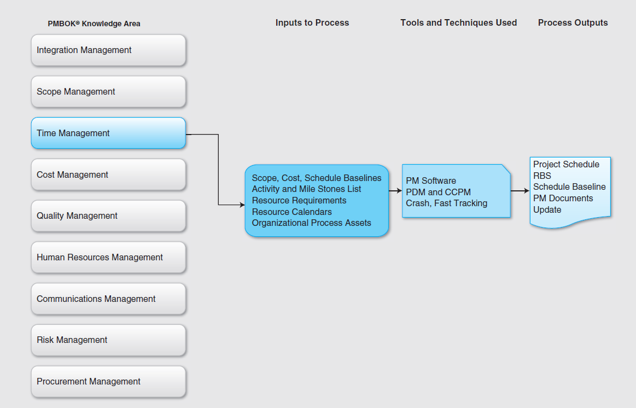

Slide 4
Scheduling
Scheduling is a plan to implement a project using an ordered sequence of activities with time allotted for each activity.
A project schedule is the delivery of a project scope.
Scheduling is a plan to implement a project using an ordered sequence of activities with time allotted for each activity.
In order to complete the schedule, a project manager should have access to:
WBS, the project plans, the project charter, the project scope, a list of all available resources, the process assets of the organization, and the requirements for the project

Slide 5
Scheduling
Several project management software packages are available to help the project manager calculate and schedule project activities automatically. The following are popular:
Microsoft Project
Primavera
Zoho
FastTrack
SAP PS

Slide 6
Scheduling
Scheduling is a very important facet of project management as it helps a project manager complete the project within scope, time, and budget as well as use the available resources effectively in order to perform and provide value to the organization.
Scheduling helps a project manager break down a complex project into simple activities.
Project manager has to input these simple activities in the right order along with the likely amount of time and resources needed to complete each activity. All such inputs have to be error-free for a project to be completed in time, under budget, and within the scope.

Slide 7
Scheduling
The order in which these activities have to be completed, i.e., the predecessors and successors of each activity, has to be determined.
Some of these activities may be completed in parallel and others in series. For example, two activities such as coding and testing can be accomplished only in series, i.e., testing can be started only after coding.
Scheduling helps a project manager overlap several activities by different members of the project team to complete the overall project in the shortest period of time possible.

Slide 8
Scheduling
A project manager can use the schedule to manage the project effectively. The goal of an effective project schedule is to answer the following questions:
What activities will be accomplished?
What is the sequence of those activities?
When will those activities be accomplished?
Who will accomplish those activities?

Slide 9
Scheduling
Scheduling involves everything needed to create a roadmap for the project including activities from the WBS, key project meetings, and important project communications.
The activities will include all project management tasks, functional tasks, technical tasks, and communication tasks.
The key project meetings will include team meetings, technical meetings, and meetings with stakeholders.
Communications include status reports, training sessions, and important project updates.
The activities in a project are networked during the scheduling.

Slide 10
Scheduling
The network provides many benefits to a project including:
An estimate of project completion time
An overview of how resources will be utilized in the project
All activities that must be critical to meet the schedule
A graphical representation of work to be performed
The progress that can be used to track the project
An estimation of time and cost at any point of a project
The start and end times of all activities in a project
All resource conflicts and which activities are to be coordinated in order to avoid such conflicts
The interdependence of the activities of a project
Project milestones

Slide 11
PERT
Project Evaluation and Review Technique (PERT) is a project management tool used to schedule, organize, and coordinate tasks within a project
From PERT we can get answers to questions like:
How long will it take to complete a project?
What are the risks involved in a project in terms of schedule?
Which are the critical activities or tasks in a project that can cause delay of the entire project?
If the project has to be finished earlier than planned, what is the most efficient and effective way at the least cost?
Is the project on schedule, behind schedule, or ahead of schedule?

Slide 12
PERT
PERT is used in project planning because it helps a project manager identify interdependencies and problems between various activities.
PERT can help project managers evaluate and shift resources from less critical activities to more critical activities.
PERT has disadvantages. It is complex, and this complexity may add to already existing implementation problems. It is also expensive to maintain and is employed mostly in large, complex projects.

Slide 13
PDM
Precedence Diagramming Method (PDM) is used to help project managers plan, schedule, monitor, and control their projects.
PDM is used to construct project schedule networks.
PDM is used to help project managers plan, schedule, monitor, and control their projects and is useful because it provides the following information:
Expected project completion time
Probability of completion at any given period during the project
Critical activities that directly affect the completion time
Activities that have extra time so that resources can be shifted to critical activities during those activities with extra time
The start and the end times of all activities

Slide 14
PDM
PDM is used to construct network diagrams for project scheduling.
Interdependencies between tasks can be shown by constructing networks such as the PDM.
The primary function of project networking is to pictorially represent the various activities of a project.
The network is a visual representation of a project’s schedule, with the PDM and Gantt charts as visual representations.
A network diagram is useful for all stakeholders to track the project from beginning to finish.

Slide 15
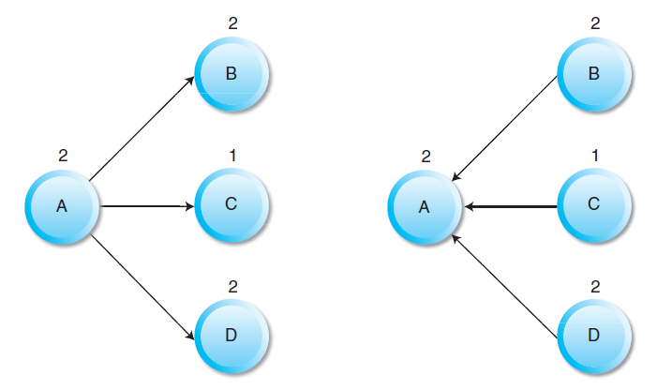
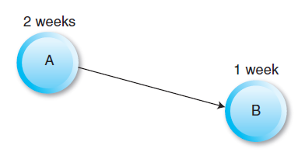
Networks

Slide 16
PERT and PDM
Activity: a specific task or set of tasks that is part of the scope of a project, uses up some of the resources of a project, and requires some finite time to be completed
Path: sequence of activities
Event: Beginning and End of activity
LS: Late Start time ES: Early Start time -----FORWARD PASS
LF: Late Finish time EF: Early Finish time ---BACKWARD PASS
Slack: Amount of play in the system; Difference between critical path time and time required for a given path.
=LS-ES or LF-EF
Crashing: reducing overall time required to complete project
Involves trading off costs of additional resources against the value of time saved to complete the project.

Slide 17
Sequencing activities
Mandatory Dependencies: These dependencies are part of the project and are inherent to the project.
Discretionary Dependencies: These dependencies are defined by the project team.
External Dependencies: These dependencies involve relationships between the project and the non-project activities.

Slide 18
PERT and CPM
Activity | Description | Activity Predecessor | Duration (Weeks)
A | Scope documentation |  | 2
B | Project planning | A | 3
C | Buy materials | B | 8
D | Prototype design | C | 3
E | Prototype analysis | C | 6
F | Prototype implementation | D, E | 5
G | Testing of prototype | F | 4
H | Presenting prototype to customer | G | 2

Slide 19
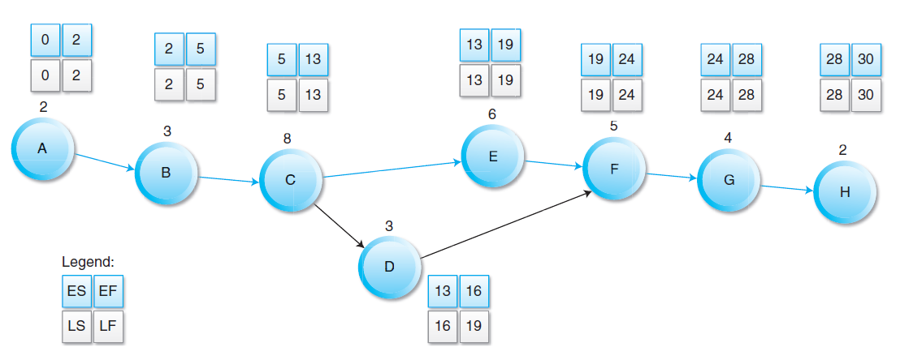
Forward and Backward Pass
Legend:
ES
EF
Slack: 3 weeks (16-13) or (19-16)
Critical Path: A-B-C-E-F-G-H

Slide 20
Uncertainty in Scheduling Activities
PDM and PERT can be used in times of uncertainty as well.
Instead of the duration for an activity, estimated duration as defined by PERT can be found using three estimates of time:
Optimistic time: The shortest time in which activity can be completed
Most likely time: The completion time having the highest probability
Pessimistic time: The longest time that an activity might require

Slide 21



Variance in Scheduling Activities
This expected time may be used in the network diagram instead of the normal duration period for each activity.
To calculate the variance for each activity duration:
Variance (σ²) for a single activity can be calculated as:
The total path standard deviation

Slide 22

Variance in Scheduling Activities
To calculate the probability of completing the project in a specified period of time:
where,
E is the sum of the expected time of the critical path
D is the desired due time
is the total path deviation

Slide 23
To Accelerate Project Completion
Adding Resources: Brookes Law: Adding manpower to a late software project may make it later
Outsourcing Project Work: Frees up resources that can be assigned to a critical activity
Scheduling Overtime: Has problems with direct and intangible costs yet the preferred choice
Establish a core team: Undivided attention to the project
Fast tracking: Critical activities done parallel
Critical Chain: Longest string of dependencies that exist on the project (Goldratt) – difficult to apply in the middle of a project
Reduce Project Scope: Customer satisfaction may suffer and quality may be compromised
Crash: Shortening an activity

Slide 24
Project Crash
Attempt to reduce the completion time of a project to a lesser amount of time
Daily crash cost: How much does it cost in resources to reduce the time by a day?
Crash limit: What is the lower limit of daily crash cost?
Cease crashing when
the target completion time is reached.
the crash cost exceeds the penalty cost.

Slide 25
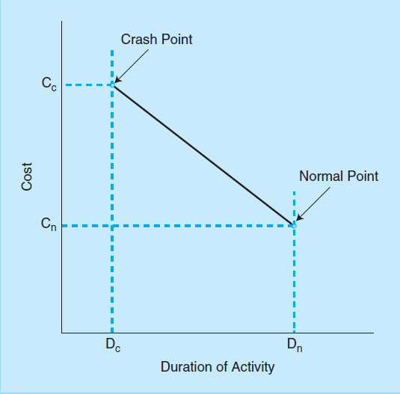
Project Crash

Slide 26
Project Crash
Activity | Cost | Maximum Crash Time | Normal |  | Crash
 |  |  | Time | Cost | Time | Cost
A | $20 | 1 | 3 | 50 | 2 | 70
B | $40 | 2 | 6 | 80 | 4 | 160
C | $30 | 1 | 10 | 60 | 9 | 90
D | $25 | 4 | 11 | 50 | 7 | 150
E | $30 | 2 | 8 | 100 | 6 | 160
F | $30 | 1 | 5 | 40 | 4 | 70
G | $0 | 0 | 6 | 70 | 6 | 70

Slide 27
Project Crash
A critical path can be computed using the network diagram. Let us assume the critical path is A-D-F-G. The project duration is 25 days.
Total normal cost: $450
Reducing activity A one-time costs $20 and increases the total cost to $470.
Cuts the project duration to 24 time units from 25 days.
It is not possible to reduce the last activity G
Reducing activity B one time = 80/2 = $40; the resulting project cost is $470+$40 = $510

Slide 28
Summary
The primary function of project networking is to pictorially represent the activities of a project.
PDM and Gantt charts are part of such visual representations of the project schedule. PDM is used in project planning since it helps a project manager identify interdependencies and problems between various activities of a project. PDM can help project managers evaluate and shift resources from less critical activities to more critical activities.
A network diagram in project management is useful for all stakeholders to track the project from beginning to finish. A network consists of activities and an event is either a start or an end of the occurrence of an activity in project. An activity is a piece of work to be performed in a project.

Slide 29
Summary
The critical path is the longest path through the network and determines the duration of the project. Critical path is also the shortest amount of time necessary to accomplish the project. There are three basic reasons for creating dependencies of project activities including mandatory dependencies, discretionary dependencies, and external dependencies.
Once the critical path is identified, rescheduling a task can be accomplished by shifting the ones with a slack time.
Slack, also called float, is the amount of time that an activity in a project network can be delayed without causing a delay to subsequent activities or project completion. Slack measures how early or late an activity can start or finish.

Slide 30
Summary
Causing a delay to subsequent activity is called free float or free slack and causing a delay to the whole project is called total float or total slack. An activity on the critical path has a zero free float but an activity that has zero free float may not be on the critical path. Trade-offs exists between the minimum cost and normal duration for the project.
PDM places an emphasis on cost and time to show the longest time period to complete a project. If costs can be increased for an activity, duration of the activity may shorten. This is called the crash point. The crash point is the most a project activity time can realistically be compressed with the available resources. Crash is shortening an activity.

Slide 31
Summary
Crash time is the shortest time an activity can be completed (assuming a reasonable level of resources).
Fast tracking is a technique to shorten the duration of a project to meet the target dates. This is accomplished by overlapping some of the project activities. A common method of fast tracking is to start two or more activities at the same time which were originally planned to start on a different time schedule.

Slide 32
Summary
Critical chain project management (CCPM) is a method of planning and managing projects stressing on the resources required to execute project tasks and is intended to keep the resources leveled but will require them to be flexible in their start times and to quickly switch between tasks and task chains to keep the whole project on schedule.

Slide 33
Class Discussions
Project scheduling using software is often a time-consuming process and one should avoid this as much as possible.
Project scheduling is good only for large projects.
Do team members often report incorrectly about the progress of their project activities? Why?
Should project managers force team members to report progress of their activities accurately?

Slide 34


