Slide 1
Developers
Nexus
Sonar
Selenium
G I T
Maven
JIRA
Jenkins
Ansible
Engineer
DEV
QA
PROD

Slide 2
DEV Compile & Deploy
GitLab
Maven Slave
Job1:
Make a Package
Job2:
Deploy to Dev Server
Pulling war file
Ansible-Server
Dev Node
Jenkins
If Success
Job1
Job2
Jenkins

Slide 3
QA WorkFlow
Deploy
Selenium
END Users
Nexus
Develope
GitLab
Jenkins
Ansible
QA Node

Slide 4
PROD-INFRA
Load Balancer
WEB + APP 1
WEB + APP 2
DB

Slide 5
PROD Work - FLOW
Package
Nexus
Jenkins
D’lper
GitLab
ANSIBLE
PROD
Change Request (CR)

Slide 6
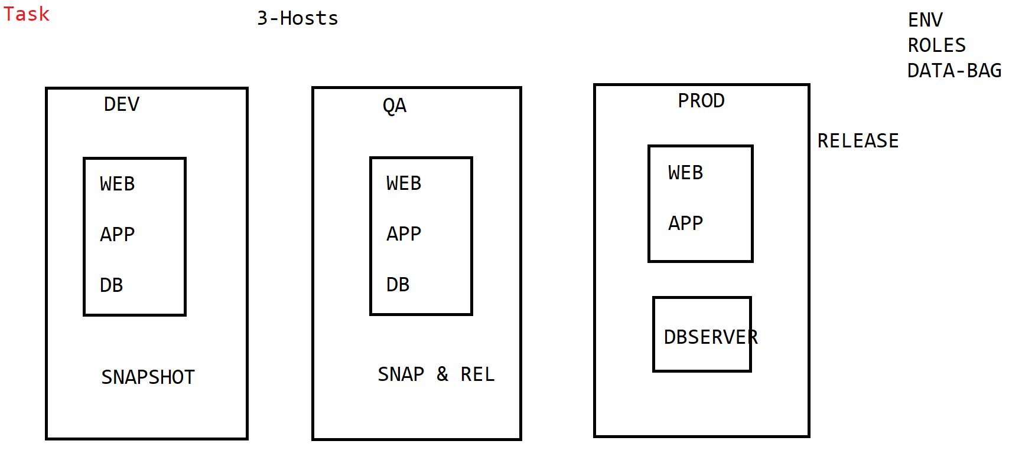

Slide 7
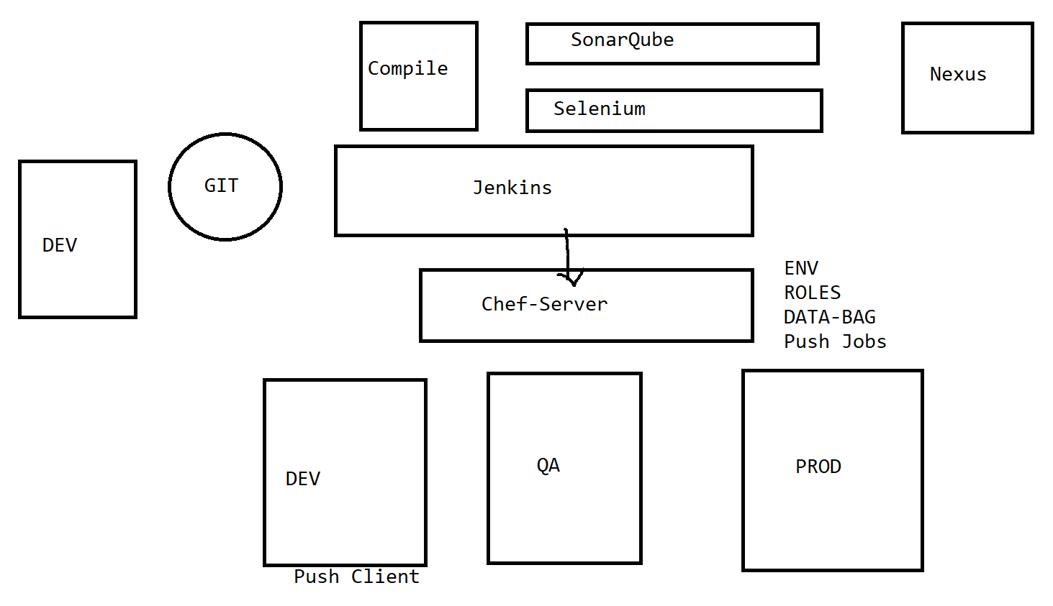

Slide 8
Selnium
SonarQube
Docker
Hub
DEV POD
QA
POD
GitLab
Developers
PROD
(DEPLOYMENT)
Multiple-PODS
Jenkins
Kubernetes

Slide 9
Terraform
AWS-CLI
Cloud Formation
CloudWatch
CloudTrail
Code
Build
Code
Deploy
S3
IAM
BeanStalk
Code
Commit
Code Pipeline
ECS
Lambda
EC2
EC2
C L B
RDS
SNS
VPC

Slide 10
Arun -> developer
Janardhan -> developer
Mohan -> DevOps
Murali -> DevOps
https://973714476881.signin.aws.amazon.com/console

