Slide 1

Al-Azhar University – Gaza
Faculty of Engineering and Information Technology Software Engineering Department
Field Training Management System (FTMS)
Submitted by : Mohanad Rafat Shahin 20180970
Esmail Ebrahem Al-Nbaheen 20181598 Mohammed Jehad Albaghdadi 20181730
Supervised By : Dr. Khaled Ismail
IV

Slide 2
Abstract
The project provides services to help the students and university for the administration, documentation, tracking, and reporting of instructor-led-training programs. FTMS is focused on back-office processes and are considered a tool for corporate training administrators as such, a training management system acts as a central enterprise resource planning (ERP) software specific to the training industry. They can be complemented by other learning technologies such as a
.The Field training management system FTMS is an learning management system
E-training system built on php Laravel framework technology. We used spiral model methodology in order to develop this project in addition to creating a responsive design interface that will allow the application to cater to different device interfaces.
IV

Slide 3
Acknowledgment
It has been a great opportunity to gain lots of experience in real time projects, followed by the knowledge of how to actually design and analyze real projects. Special thanks to University of AL-Azhar and software engineering faculty for the efforts they did to provide us with all useful information and making the path clear for the students to implement all the education periods in real-time project design and analysis. Furthermore, we all the professors and visiting industry for the interesting lectures they presented which had great benefit for all of us. We would like to express our deepest gratitude to our graduation project supervisor
Dr. Khaled Ismail for his patience and guidance along the semester. In addition, For that we want to thank our families .
Also , we would like to say many thanks for other teachers for endless support and their huge effort in providing us with all what we need regarding information for the graduation project needs.
Finally, but by no means least, we extend our acknowledgement and heartfelt love to our families, our loved ones, parents, brothers and sisters for almost unbelievable support who have been with us all the time to spur our spirits. They are the most important people in our world and we dedicate this thesis to them.
IV

Slide 4
CONTENTS
تايوتحملا
tcaAtsbA ......................................................................................................................................................... II
tbecgdekwonkcA ......................................................................................................................................... III
nostAkt r.ncAtgwebAigc...................................................................................................................................1
2 .......................................................................................................................................................................
.1.1 ncAtgwebAigc....................................................................................................................................... 2
.1.2 wrvvrivO .......................................................................................................................................... 2
.1.3 nvrjvvj orjirejirP........................................................................................................................... 2
.1.4 nvrmevo sjejvovPj .......................................................................................................................... 3
.1.5 nvrjvvj wmjvvjirv............................................................................................................................. 3
1.5.1. Project Objective................................................................................................................. 3
1.5.2. Project Sub Objectives........................................................................................................ 3
.1.6 nvrjvvj mvrpv ePe oioijejirPs ....................................................................................................... 4
.1.7 nrPjvimrjirP .................................................................................................................................... 4
.1.8 Trres ePe vnripovPj....................................................................................................................... 4
1.8.1. Hardware Requirements .................................................................................................... 4
.1.9 ytgjkbA tkAogwgegoP......................................................................................................................... 5
6 ...................................................................................................................nisP tePeevovPj neeP.1.10
.1.11 ......................................................................................................................................... nrPversirP
6
nostAkt 2 aiAktsAetk tkpikd.2 ...................................................................................................................... 8
.2.r ncAtgwebAigc....................................................................................................................................... 8
.2.2 mtswiAigcse aPaAkn............................................................................................................................. 8
.2.2.1Overview ..................................................................................................................................... 8
.2.2.2Advantages of Traditional system: ........................................................................................... 8
2.2.3. Disadvantage of Traditional system:................................................................................. 8
.2.3 :mekbAtgcib rPaAkn ............................................................................................................................ 9
2.3.1. Advantages: ......................................................................................................................... 9
2.3.2. Disadvantages:..................................................................................................................... 9
.2.4 ngntstiagc ....................................................................................................................................... 9
.2.5 cngcbeeaig ...................................................................................................................................... 10
nostAkt 3: ytgjkbA tkAogwge.3 .................................................................................................................... 12
.3.r ncAtgwebAigc..................................................................................................................................... 12
.3.2 mok swpscAsoka gp rtitse nkAogwgegoP........................................................................................... 12
IV

Slide 5
.3.3 mok ainiAsAigca gp rtitse nkAogwgegoP .......................................................................................... 12
.3.4 :skabtitAigc gp Aok nkAogwgegoP tosaka ......................................................................................... 13
3.4.1. First phase -Define requirements: ................................................................................... 13
3.4.2. Second Phase-Analysis: .................................................................................................... 13
3.4.3. Third phase-design............................................................................................................ 15
3.4.4. The fourth phase-Implementation: ................................................................................. 15
.3.4.5 ................................................................................................ :mkaAico scw nseiwsAigc -FipAo yosak
15
.3.5 ngcbeeaigc ...................................................................................................................................... 16
.4 .........................................................................................................................................................nostAkt
.................................................................................................................................................................... 18
.4.r ncAtgwebAigc..................................................................................................................................... 18
.4.2 igcse RkueitknkcAaFecbA ................................................................................................................ 18
4.2.1. Registration Management ................................................................................................ 18
4.2.2. Training Management ...................................................................................................... 19
4.2.3. Evaluation Management................................................................................................... 19
4.2.4. System Management ......................................................................................................... 19
4.2.5. User Management ............................................................................................................. 19
.4.3 FecbAigcse RkueitknkcAa-ngc ........................................................................................................ 19
4.3.1. Software Quality Attributes ............................................................................................. 20
.4.4 ttteibsAigc yktatkbAipk .................................................................................................................. 21
.4.5 RkueitknkcAa tcsePaia ................................................................................................................... 21
.5 ....................................................................................................... nostAkt 5: skaioc scw nnteknkcAsAigc
.................................................................................................................................................................... 39
.5.r ncAtgwebAigc..................................................................................................................................... 39
.5.2 rPaAkn ttboiAkbAetk........................................................................................................................ 39
.5.3 nesaa sisotsn................................................................................................................................. 41
.5.4 isotsnrQa s .................................................................................................................................. 43
.5.5 ssAscsak msceka .............................................................................................................................. 45
5.5.1. Students.............................................................................................................................. 45
5.5.2. Universities ........................................................................................................................ 46
5.5.3. Companies ......................................................................................................................... 47
5.5.4. Category............................................................................................................................. 48
rgpAdstk scw Aggea .5.6............................................................................................................................ 48
5.2.1. PHPSTORM 2017 ............................................................................................................. 49
5.2.2. XAMPP Server 2017......................................................................................................... 49
5.3.3 LARAVEL Framework.................................................................................................... 49
VIII

Slide 6
5.5.5. PHP Language................................................................................................................... 49
5.5.6. Java Script ......................................................................................................................... 49
5.5.7. JQuery................................................................................................................................ 50
5.5.8. CSS ..................................................................................................................................... 50
5.5.9. E-draw Max ....................................................................................................................... 50
5.5.10. SWEETALERT................................................................................................................. 50
.5.7 patstoibse rakt ncAktpsbk parn ...................................................................................................... 53
.5.8 ngcbeeaigc ...................................................................................................................................... 56
VIII

Slide 7
Figures
Figure1 : Spiral Model.................................................................................................................................. 5
Figure2 : Use Case Details.......................................................................................................................... 26
Figure 3 : Login Activity ............................................................................................................................... 28
Figure4 : Admin Activity............................................................................................................................. 29
Figure5 : Evaluation Activity ...................................................................................................................... 30
Figure6 : Evaluation Activity ...................................................................................................................... 30
Figure7 : Report Activity ............................................................................................................................ 31 Figure8 : Select company and add request Activity................................................................................... 32
Figure 9 : login sequence diagram .............................................................................................................. 33
Figure10 : add trainee sequence diagram ................................................................................................. 34
Figure 11 : add category sequence diagram............................................................................................... 35
Figure 12 : add report sequence diagram................................................................................................... 36
Figure13 : Client/Server Architecture ........................................................................................................ 39
Figure14 : Client/Server ............................................................................................................................. 40
Figure15 : Client/Server ............................................................................................................................. 40
Figure 16 : Class Diagram ............................................................................................................................ 42
Figure 17 : SQL Diagram.............................................................................................................................. 44
VIII

Slide 8
Tables
Table 1 : Risk Management Plan................................................................................................................... 6
Table 2 : Most important differences and advantages between new system ........................................... 10 Table 3 : Use Case List................................................................................................................................. 22
Table 4 : Users Classes and Characteristics................................................................................................. 23
Table 5 : Use Case Priority .......................................................................................................................... 24
Table6 : Use Case Details ........................................................................................................................... 27
Table 7 : users table .................................................................................................................................... 45
Table 8 : Universities table.......................................................................................................................... 46
Table 9 : companies table ........................................................................................................................... 47
Table 10 : categories table .......................................................................................................................... 48
VIII

Slide 9
List of abbreviations
FTMS: Field Training Management System. Electronic System:
Traditional System:
SDLC: System Development Life Cycle. ERP: enterprise resource planning.
Cookies: A piece of text stored by a user’s web browser. UML: Unified Modeling Language.
CSS: Cascading style sheets.
IIS: Internet Information Services Express. HTML: Hypertext Markup Language.
VIII

Slide 10
Chapter 1
Introduction
Overview
Project motivation
Problem statement
Project Scope and Limitations
Project Objective
Contribution
Conclusion
1

Slide 11
Chapter 1.Introduction
Introduction
This chapter introduces the reader, stakeholders and developers to the relevant information of this project by giving an overview about the project idea and explaining the objectives and motivations. Then it concentrate on clarifying the problem and how our project will solve this problem and sets the scope and the limitation of the solution.
1.2. Overview
Is a software application for the administration, documentation, tracking, and reporting of instructor-led-training programs. FTMS is focus on back-office processes and are considered a tool for corporate training administrators such as a training management system acts as a central enterprise resource planning (ERP) software specific to the training industry. They can be complemented by other learning technologies such as a learning management system.
During the period of university education, and in some cases in school, students in certain disciplines, such as engineering, medicine, etc., need field training. Part of the period of education in the field is considered a requirement for graduation and a certificate of study. In addition, the government in the state to train students before graduation. This training is of paramount importance; otherwise, it would not be a prerequisite for graduation from university.
1.3. Project motivation
The motivation of this project is facilitate and it derived from our need to develop a trainee’s skills to support students Improve the services that are providing to the trainees and trainers motivates to conduct this work.
2

Slide 12
This project is working to spread the idea in local area and work on found training companies in local markets and international markets at later time, and work on the application of electronic dissemination of thought in our society.
Problem statement
Many students in the Gaza Strip always look to find companies to training when graduation. They always want the lowest possible time to find the companies to training. On the other side, they use traditional approaches to announce training companies, also use the hardcopy to evaluate the student. Several trainees and companies recently began to use social media to search of training site. Accordingly, it would be better for both students and university to work through an organized and well-known channel to meet each other; this channel should be easy to reach and inexpensive.
The use of traditional training approaches entails high costs. Additionally, it does not reach all the targeted companies as the number of students is highly increasing in the Gaza Strip. In this project, we are trying to find solutions for these problems:
Project Objective
Project Objective
To design and implements a field training management system FTMS
Project Sub Objectives
To facilitate and regulate the processes of communication between trainees and trainers.
To replace all the traditional ways with modern technology
Correct orientation for the student.
Proper utilization of resources and private companies.
Enable students to create a strong opportunity to develop practical skills.
Developing students' skills in the right direction.
Facilitate and organize communication between students and training companies.
3

Slide 13
Facilitate the evaluation and supervision of the trainees by the university.
To develop an easier system and offer maximum flexibility in time management.
Quickly and easily to find a suitable training opportunity.
1.6. Project Scope and Limitations
FTMS is an online training system that will enable students to search their
training companies and services for students to facilitate the field training system.
The trainers and trainees simply requires Internet connection and a computer device to log in to the FTMS online system. The students will be enable to select the training companies, then approved the request by supervisor, and specify the deadline for each training. The project will enable trainers to add advertisements and select this advert by students and then approved the request by trainers.
Contribution
We made interviews with some companies with “ICT” and other universities in Gaza and a number of students from different specialties.
In addition, got requirements that help us in project and we found solutions for problems that faced them, and we aim to achieve their accuracy, The following are the features which can be a part of the system:
Correct orientation for the university student.
Facilitate the evaluation and supervision of the trainee by the university.
Training the student in a place that suits his specialization.
Tools and equipment
Hardware Requirements
The system has be hosted in a dedicated or high performance shared server to serve at least 1000 customers at the same time.
4

Slide 14
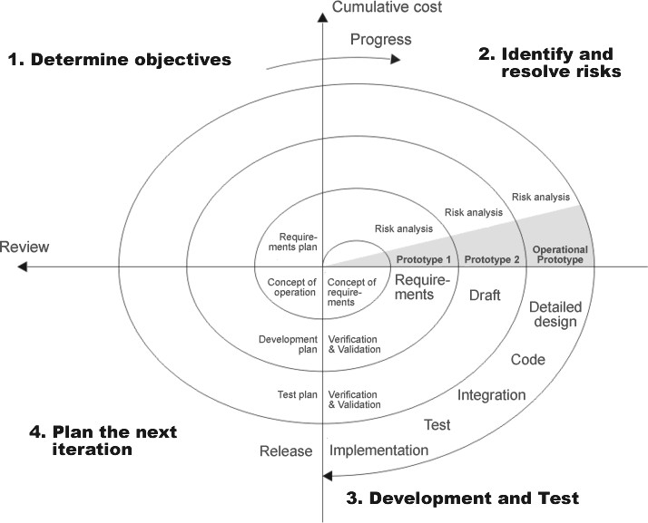
1.9. Project Methodology
The spiral model combines the idea of iterative development with the systematic, controlled aspects of the waterfall model.
Spiral model is a combination of iterative development process model and sequential linear development model i.e. waterfall model with very high emphasis on risk analysis.
It allows for incremental releases of the product, or incremental refinement through each iteration around the spiral.
Figure1 : Spiral Model
5

Slide 15
1.10. Risk Management Plan
Table 1 : Risk Management Plan
 | Proper Risks | Risk degree | Actions to be taken
contractual risks | one of the employees resigned | high | sign a contract with an outsourced employee
technological risks | change | moderate | --
size and complexity of the product | The complexity of the project is more than expected | low | plan B with duplicate time work, the employees will be paid for additional work
1.11. Conclusion
FTMS through the work of continuous contact between the professor and trainers, through the application of Website.
Our software helps training companies and training departments around the Gaza strip
manage their operations and market their course offerings. Because so many companies large and small will be depend on our service being available and reliable this is a responsibility we take extremely seriously.
6

Slide 16
Chapter 2
Introduction
Related Work
Traditional system
Electronic System
Comparison
Conclusion
7

Slide 17
2.Chapter 2 Literature review
Introduction
This chapter clarifies an overview of the project technologies, shows other related works that are similar to this project that already exist, clarifies each one of them, their advantages and disadvantages, how they compared to this project and what is this project added technologies and services more than the previous work.
Traditional system
Overview
In this traditional system, the student uses the hardcopy system so as to
receive the training field papers and requirements from the university. Afterward, the student begins his difficult journey to the training companies and institutions to find a training opportunity that may not be frequently suitable for his specialization in addition to wasting his time.
Advantages of Traditional system:
We do not see many advantages in this system, but it is characterize by:
Flexibility in choosing the place of training according to personal needs.
Reliance on acquaintance and friends in training.
Disadvantage of Traditional system:
Among the most important disadvantages faced by the student in this system:
Neglect in choosing the appropriate training venue.
Difficulty finding a suitable training opportunity.
Students are absent in the implementation of training instructions.
Difficulty of supervision by the university.
Doubts in the credibility of university training.
8

Slide 18
6. The student does not comply with all the training days for reasons due to non-acclimatization of the student.
Electronic System:
This system is a developed and updated system form old paper system, so that all the paper registration process is converting into a purely electronic process.
Advantages:
Saving time and effort.
Facilitate access to appropriate training for specialization.
Credibility and assurance of university training.
Plots of communication and communication between the student and the trained and university.
Ease of supervision of the student by the university.
Evaluate the student electronically on the intermediate site.
Submit a detailed report via the website about student performance and commitment.
The possibility of adopting the modern system in universities.
2.3.2. Disadvantages:
1. Difficulty adopting the intermediary site by universities or training companies
2.4.Comparison
This table shows the most important differences and advantages between new system and the similar systems that have already presented; it also summarizes the most important features of new system.
9

Slide 19
Table 2 : Most important differences and advantages between new system
 | Traditional | Electronic
Internet use | No | Yes
Credibility | Low | High
Efficiency | Low | High
find a place to train method | Difficult | Easy
Evaluation process for the student | Not Secure | Secure
prepare of reports | Paper (hardcopy) | Electronic
2.5.Conclusion
FTMS will be build based on the students and supervisor request, which has its advantages and disadvantages. There are traditional systems such as paper system and we have defined and compared some of their main features.
10

Slide 20
Chapter 3
Introduction
Project Methodology
The advantages of Spiral methodology
The Limitations of Spiral methodology
Description of the methodology phases
Conclusion

Slide 21
3. Chapter 3: Project Methodology
3.1.Introduction
This chapter will cover the details explanation of methodology that used to make this project complete and working well. Many methodology or findings from this field mainly generated into journal for others to take advantages and improve as upcoming studies. The method used to achieve the objective of the project that will accomplish a perfect result. In order to evaluate this project, the methodology based on System Development Life Cycle (SDLC), generally three major steps, which are planning, implementing and analysis.
The advantages of Spiral methodology
➲ Good for large and mission-critical projects.
➲ Strong approval and documentation control.
➲ Additional Functionality can added at later date.
➲ Software is producing early in the software life cycle.
The Limitations of Spiral methodology
➲ This model is time consuming and expensive.
➲ Can be a costly model to use.
➲ Risk analysis requires highly specific expertise.
➲ Project’s success is highly dependent on the risk analysis phase.

Slide 22
Description of the methodology phases:
This section will describe the phases of the methodology as the following:
First phase -Define requirements:
All possible requirements of the system to be developed are capturing in this phase and documented.
These requirements have been split into functional and non-functional requirement, which were documented in chapter 4. In addition, we have asked 4 stakeholders some basic questions by a survey and its details is available in the appendix.
Second Phase-Analysis:
The analysis phase of the project is representing by sets of diagrams and forms such as some of UML:
Use case Diagram.
Activity Diagram.
Use Case Diagram:
A use case diagram is a graphic depiction of the interactions among the elements of a system. A use case is a methodology used in system analysis to identify, clarify, and organize system requirements. In this context, Use case diagrams are employing in UML (Unified Modeling Language), a standard notation for the modeling of real-world objects and systems. Moreover, use case diagram provide system actors in our project, such that actor in E-Training project:
Trainee.
Trainers.
Supervisor.
Administrator.
"For more details will be shown in chapter 4".

Slide 23
Activity diagram
In UML, an activity diagram provides a view of the behavior of a system by describing the sequences of actions in a process. Activity diagrams are similar to flowcharts because they show the flow between the actions in an activity; however, activity diagrams can also show parallel or concurrent flows and alternate flows.
In activity diagrams, you use activity nodes and activity edges to model the flow of control and data between actions.
Activity diagrams are helpful in the following phases of a project:
➲ Before starting a project, you can create activity diagrams to model the most important workflows.
➲ During the requirements phase, you can create activity diagrams to illustrate
the flow of events that the use cases describe.
➲ During the analysis and design phases, you can use activity diagrams to help define the behavior of operations.
➲ The header of the activity frame displays the name of the activity, and the
body of the activity frame displays the nodes and edges that describe the activity. After you create the activity diagram, you cannot move it in the Project Explorer view.
"For more details will be shown in chapter 4".

Slide 24
Third phase-design
After analyzing the requirements of project. The design phase started, this phase represents sets of diagrams and forms such as Class diagram, data base schema, sketch, Database design and interface design.
"For more details will be shown in chapter 4".
The fourth phase-Implementation:
In this phase, the evaluation system was implemented by modern techniques and programming language to achieve goals, after finishing designing phase. The implementation depended on Server-Side Scripting Language (PHP) and HTML. and joining Database between PHP language.
For more details will be shown in chapter 4.
3.4.5. Fifth Phase - Testing and Validation:
Testing:
Testing in the spiral model needs to be exploratory in nature, at least in
the initial stages. The purpose of the early prototype is to understand risks and explore unknowns. Testing needs to be flexible as well as be able to go deeper to explore specific problem areas as needed. In subsequent stages, testing goals may change to more formal & standard testing including regression and related test types. The testing group needs to be able to handle the requirements of non-formal and formal standard testing requirements at different stages of the lifecycle, due to the very nature of the spiral model, involving repeated prototyping and dealing with unknowns, accurate test planning and estimating can be a challenge. Given the complexity and degree of experimenting involved, working with predictable time-lines is not usually possible.
For more details will be shown in chapter 5.

Slide 25
Validation:
The process of evaluating software during or at the end of the
development process to determine whether it satisfies specified business requirements.
To ensure that the product actually meets the user’s needs, and that the specifications were correct in the first place. In other words, to demonstrate that the product fulfills its intended use when placed in its intended environment.
Verification:
The process of evaluating work-products (not the actual final product) of a development phase to determine whether they meet the specified
requirements for that phase.
To ensure that the product is being built according to the requirements and
design specifications. In other words, to ensure that work products meet their specified requirements.
3.5.Conclusion
In summary, the success of a project is highly dependents on the project management plan. Keeping all members of the project team informed and information flowing is critical in minimizing mistakes, keeping schedule as well as making the team members feel that they are part of the project. Applying project management in a life cycle approach will allow the project team to be properly prepared for each phase. This step by step approach provides the ability to have consistent results.

Slide 26
Chapter 4: Software Requirement
Specifications and Analysis
FUNCTIONAL REQUIREMENTS
NON-FUNCTIONAL REQUIREMENTS
REQUIREMETS ANALYSIS ( UML )
USER ITNERFACE SKETCHES

Slide 27
4. Chapter
Introduction
A thorough discovery of business requirements is almost never readily available at an analyst’s fingertips—rarely can requirements be quickly looked up as one would gather information for a term paper or study for a test. Much of business or technical requirements is not documented anywhere—it resides in the minds of stakeholders, in feedback that has yet to be obtained from end users, and from a study of flowcharts and surveys that have yet to be created. And so requirements must be elicited, or drawn out, and the methodology in doing so must be logical and meticulous.
This section will define the functional and non-functional requirements by Unified Modelling Language (UML), which is a general-purpose modeling language in the field of software engineering designed to provide a standard way to visualize the design of a system.
Functional Requirements
Statements of services the system should provide how the system should react to particular inputs, and how the system should behave in particular situations.
Registration Management
The system allows student, University and Training companies to login to the system.
The students must sign up by university ID.
The university and training company must be registration by admin to validate login to the system after the can be change the password by users.
The system must validate the user’s login, so the user can enter valid username and password to login to the system.
The user can restore his username and password by entering his registered e- mail.

Slide 28
Training Management
Students can do the following operations for training request with their associated details:
Add new Request for training.
Edit/delete existing Request for training.
Activate / Deactivate Request for training by companies.
Student can search for training companies by name of company or department.
Evaluation Management
Trainer must evaluate all students, use training form, and answer the questions to evaluate the students and the form the results are sending automatically to university supervisor.
System Management
- Administrator can delete/search users.
User Management
Student profile:
Student can edit his basic information profile such as password, mobile, department and address.
Training company profile:
Company can edit his company information such as password, phone and address.
4.3.Non-Functional Requirements
Specifies criteria that can be used to judge the operation of a system, rather
than specific behaviors. This should be contrasted with functional requirements that define specific behavior or functions.

Slide 29
Software Quality Attributes
Safety and Security
Sensitive Data such as Password is encrypting by MD5 in the Database System.
The system shall not leave any cookies on the student's computer containing the user’s password.
The system’s back-end servers shall never display a customer’s password. The customer’s password may be reset by the manager.
Maintainability
Any updates or defect fixes shall be able to be made on server-side
computers only without any patches required by the user.
Portability
The system is based on PHP/Laravel Framework. So the end-user part
is fully portable and any system using any web browser should be able to use the features of the system, including any hardware platform that is available.
Usability
The system will be easy to use by simplifying the interface with a
responsive design to accurate all devices (laptop, smartphones).
Reliability
The system provides storage of all databases on redundant computers
with automatic backup.
The system has to provide accurate information about each deal (deal name, advertiser provider, price, coupon if available, the place of store, contact number and email).
20

Slide 30
Availability
The system should be available at all times, meaning the user can
access it using a web browser. Also, in case of database corruption,
backups of the database should be retrieved from the server and saved by the administrator. Then the service will be restarted. This means 24/7 availability.
Requirements Analysis
In this section, we use the modeling system “UML diagrams”, based on
requirements analysis through meetings and user stories, to describe the functions and processes that the system must perform.
4.4.Application Perspective
The system will use a database and webserver that can be accessed by any web browser on any platform with Internet connection. The buyers who can use this application are registered users that have usernames and passwords. After registering, students can edit profile details.
4.5.Requirements Analysis
In this section, we use the modeling system “UML diagrams”, based on requirements analysis through meetings and user stories, to describe the functions and processes that the system must perform.
Use case diagrams
A use case diagram is a graphic depiction of the interactions among the elements of a system. A use case is a methodology used in system analysis to identify, clarify, and organize system requirements.

Slide 31
FTMS system has four main actors including (Student, Trainer, University and Administrator), which have many different processes in three integrated systems to run the whole system.
Table 3 : Use Case List
Use Case List
U1 | Register | U18 | Edit Advert
U2 | Login | U19 | Manage Training
U3 | Edit profile | U20 | Logout
U4 | Manage Trainees | U21 | Trainees Request List
U5 | Add Trainee | U22 | Request approved
U6 | Update Trainee | U23 | Request Reject
U7 | Delete Trainee | U24 | Reports
U8 | Manage Training Companies | U25 | Evaluation
U9 | Add Company | U26 | View report list
U10 | Delete Company | U27 | Select Company
U11 | View List of Companies | U28 | Add Request
U12 | View List of Trainees | U29 | Delete Request
U13 | Manage University | U30 | View Category list
U14 | Add University | U31 | Add Category
U15 | View Adverts List | U32 | Edit Category
U16 | Add Advert
U17 | Delete Advert

Slide 32
Users Classes and Characteristics
The system includes different types of clients which every actor have different features
There are four types of clients:
Admin
Student
Company
University
Table 4 : Users Classes and Characteristics
Actor | Description | Goals
Admin | An actor who is a member and responsible for monitoring, managing the users and maintaining processes of the system. | This use case shows the main and full functions allowed for administrator actor that control all the website functions and permissions and how every function deals with others by include and extend relation.
Student | A person who can select the training company and find this company. This use case shows the training companies list and can be evaluate trainees from student page and add new training request this request has been sent to training companies to approved its. | Select category to show the training companies list, add new train request and evaluate company.
Company | A person who is responsible of train students and evaluate the students to send these reports to university. | Approved for student’s requests, evaluate trainees, send all evaluate reports to university.

Slide 33
University | An actor who is a member and responsible for monitoring and show all reports of students and show evaluate of students and trainers. | View all training companies list, show reports, show all evaluation and contact with training companies.
Use Case Priority
Table 5 : Use Case Priority
 |  | Actor
U1 | Register | Student
U2 | Login | Student, University, Admin, Trainer
U3 | Edit profile | Student, University, Admin, Trainer
U4 | Manage Trainees | University , Trainer
U5 | Add Trainee
U6 | Update Trainee | student
U7 | Delete Trainee | Admin
U8 | Manage Training Companies | company
U9 | Add Company | Admin
U10 | Delete Company | Admin
U11 | View List of Companies | University , Student , Admin
U12 | View List of Trainees | University, Admin, Trainer
U13 | Manage University | Admin
U14 | Add University | Admin

Slide 34
U15 | View Adverts List | Student , Admin
U16 | Add Advert | Trainer
U17 | Delete Advert | Trainer
U18 | Edit Advert | Trainer
U19 | Manage Training | Trainer
U20 | Logout | Student, University, Admin, Trainer
U21 | Trainees Request List | Trainer
U22 | Request approved | University , Trainer
U23 | Request Reject | Trainer
U24 | Reports | Trainer
U25 | Evaluation | Trainer , Student
U26 | View report list | University
U27 | Select Company | Student
U28 | Add Request | Student
U29 | Delete Request | Student
U30 | View Category list | Admin
U31 | Add Category | Admin
U32 | Edit Category | Admin
Use case Diagram
A use case diagram is a static description of some way in which the system is used.
This diagram shows how the system use cases are related to each other and how the
actors can get at them. Here is the main use case diagram, and the complete use cases diagrams in Appendix.

Slide 35
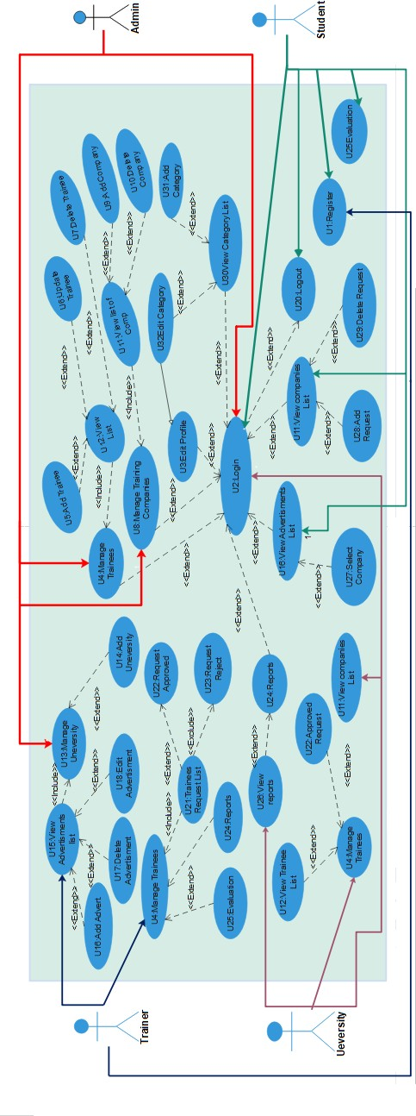
Use Case Details
Figure2 : Use Case Details

Slide 36
Table6 : Use Case Details
UC 1 : Login
Actor | Admin, Student, Trainer and University
Relation | Extended by U3-U32
Description | Actor logs in to authenticate his role in the system and be able to use the functionalities of the system.
Preconditions | A valid account has been created for the actor with specific permissions and privileges according to his role.
Post-conditions | The actor can successfully access the system and perform actions appropriate for his role.
Normal Path | The actor connects to the system. The actor enter his username and password. The system determines the role of the actor. The system displays the main user interface of the application to the actor.
Abnormal Path
Comments | Admin cannot have access to the user’s personal files to guarantee the users privacy.
Activity diagrams
Activity diagrams are graphical representations of workflows of stepwise activities and actions.
An activity is a methodology used in system analysis to identify, clarify, and organize workflow processes in the system.
FTMS system has six main activities that include (), which have many different processes to run the whole system.

Slide 37
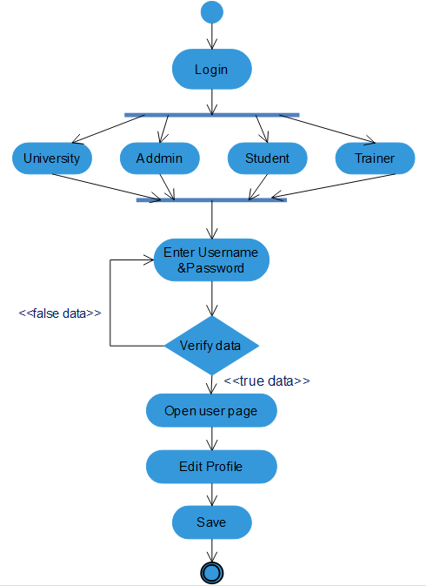
Login Activity:
Figure 3 : Login Activity

Slide 38
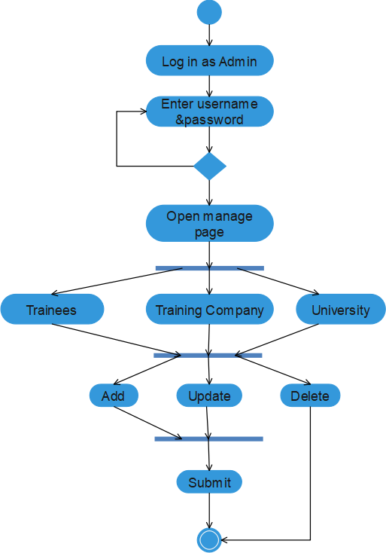
Admin Activity:
Figure4 : Admin Activity

Slide 39
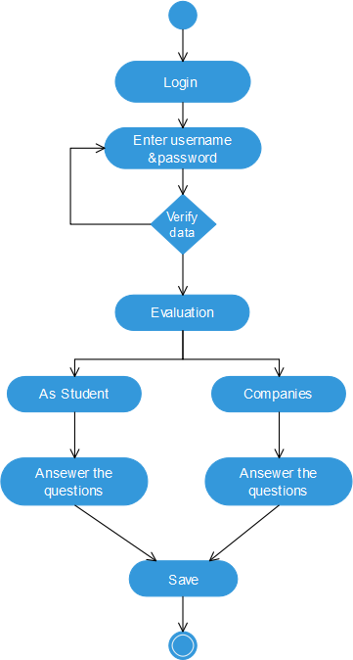
Evaluation Activity:
Figure6 : Evaluation Activity
Figure5 : Evaluation Activity
30

Slide 40
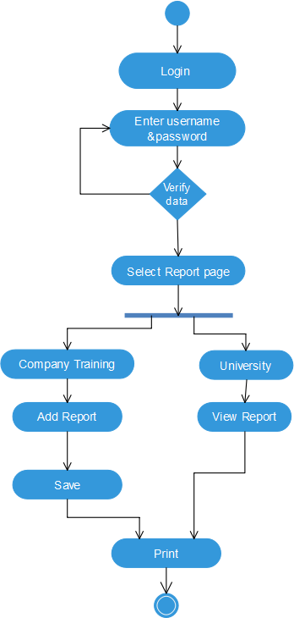
Report Activity:
31
Figure7 : Report Activity

Slide 41
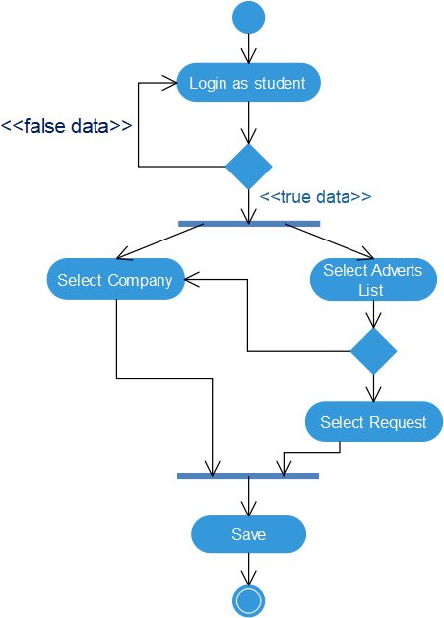
Select company and add request Activity:
Figure8 : Select company and add request Activity
32

Slide 42
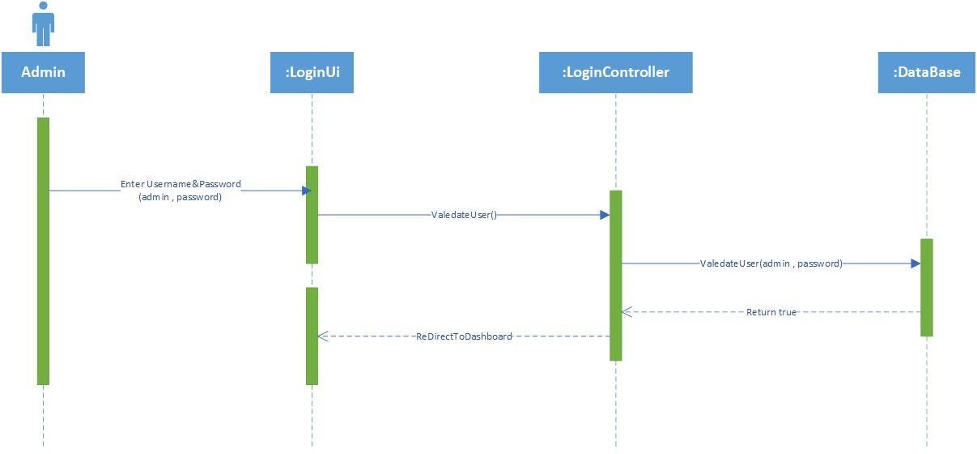
Sequence diagrams
A Sequence diagram is an interaction diagram that shows how processes operate with one another and in what order.
A sequence diagram shows object interactions arranged in time sequence. It depicts the objects and classes involved in the scenario and the sequence of messages exchanged between the objects needed to carry out the functionality of the scenario.
- Login Module
Figure 9 : login sequence diagram

Slide 43
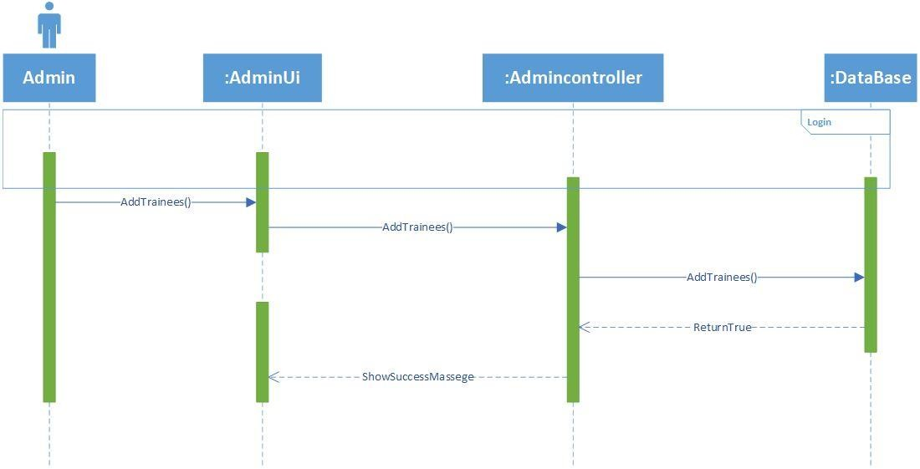
- Add Trainee Module
Figure10 : add trainee sequence diagram

Slide 44
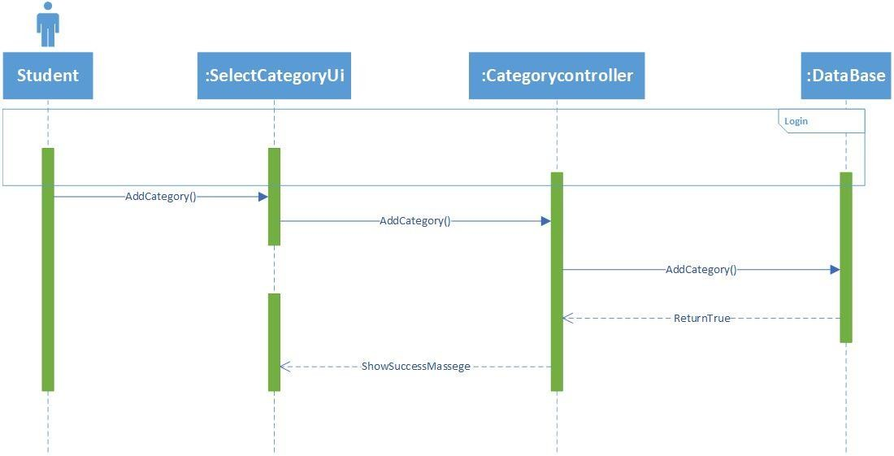
- Add Category Module
Figure 11 : add category sequence diagram

Slide 45
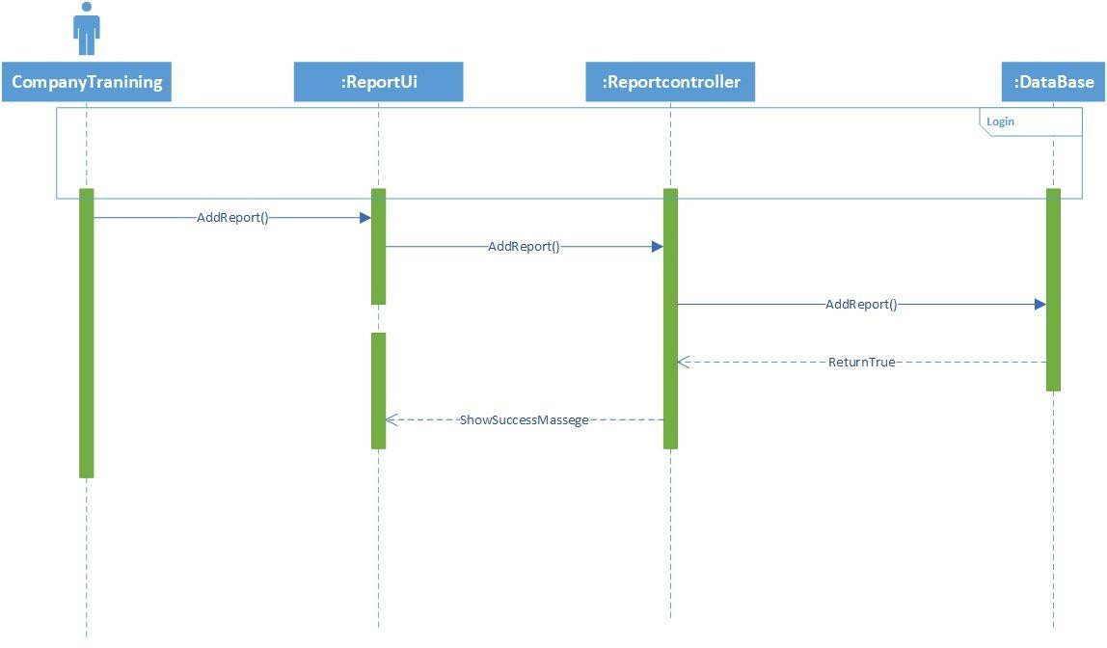
- Add Report From Company Module
Figure 12 : add report sequence diagram

Slide 46
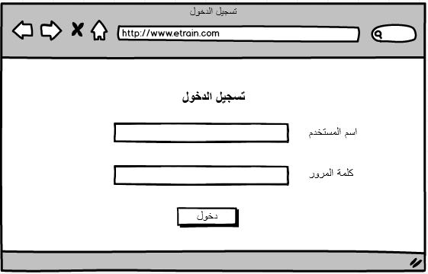
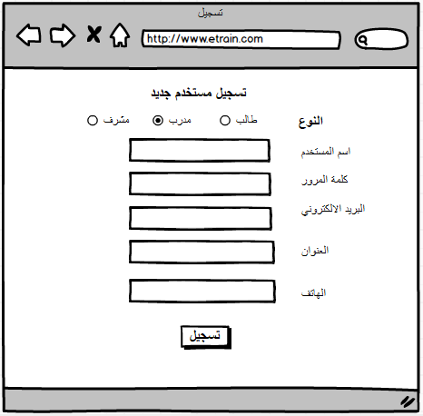
User Interface sketches

Slide 47
Chapter 5: Design and Implementation
SYSTEM ARCHITECTURE
SOFTWARE TOOLS
CLASS DIAGRAM
SQL DIAGRAMS
GRAPHICAL USER INTERFACES

Slide 48
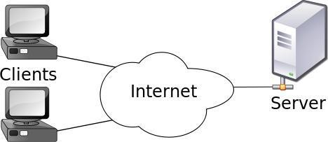
5. Chapter 5: Design and Implementation
5.1.Introduction
This chapter is concerned with Implementation tools which used in the project and design stage activities such as System Architecture, the entity relationship diagram, database details and users' interface.
5.2.System Architecture
A system architecture is the conceptual model that defines the structure, behavior, and more views of a system. An architecture description is a formal description and representation of a system, organized in a way that supports reasoning about the structures and behaviors of the system.
A system architecture can comprise of system components, the externally visible properties of those components, and the relationships (e.g. the behavior) between them. It can provide a plan from which Providing work opportunities, and systems developed, that will work together to implement the overall system.
Figure13 : Client/Server Architecture

Slide 49
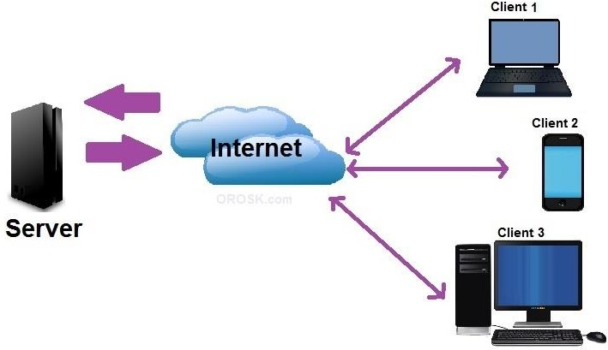
FTMS is using Client / Server Architecture Style: which is described in the following:
Description
Clients are remote processors that request and receive services from a centralized server. It is a distributed application structure used to demarcate between the providers of a service server) and requesters (clients). They usually communicate over a network and may or may not reside on the same system.
Design Diagram
Figure15 : Client/Server
Figure14 : Client/Server
40

Slide 50
Components
Clients – ( student, company, university )
Server – which will host the xampp, cs, image files and database
Relation- Ships
The clients and server are connected over a network. The client requests a service from the server.
The server provides service to multiple clients.
Pros
The pros are that the client-server networks afford you the ability to create a centralized location for all of your files. The advantages of having a place to store files are numerous. The client machines
(desktop computers, laptops, etc.) all get to stay clean, as there is no need to bog them down with files. This ultimately enhances the experience with clients.
Cons
Its con is that all files are in one location, which means that if the server goes down, you lose everything simultaneously.
5.3. Class Diagram
Class diagram is a type of static structure diagram that describes the structure of a system by showing the system's classes, their attributes, operations (or methods), and the relationships among objects.
The class diagram of the system shows in figure 5-2; the documentation of the class diagram is available in appendix.

Slide 51
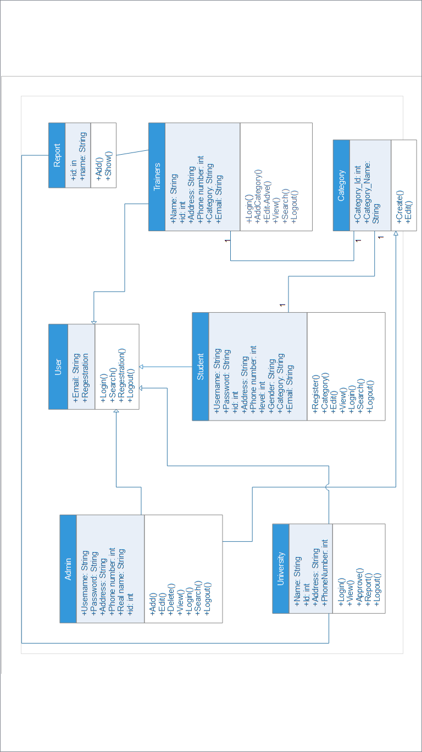
Figure 16 : Class Diagram

Slide 52
5.4. SQL Diagram
By using the existing tool for creating diagram in php my admin that shows the tables and relationships between the tables.

Slide 53
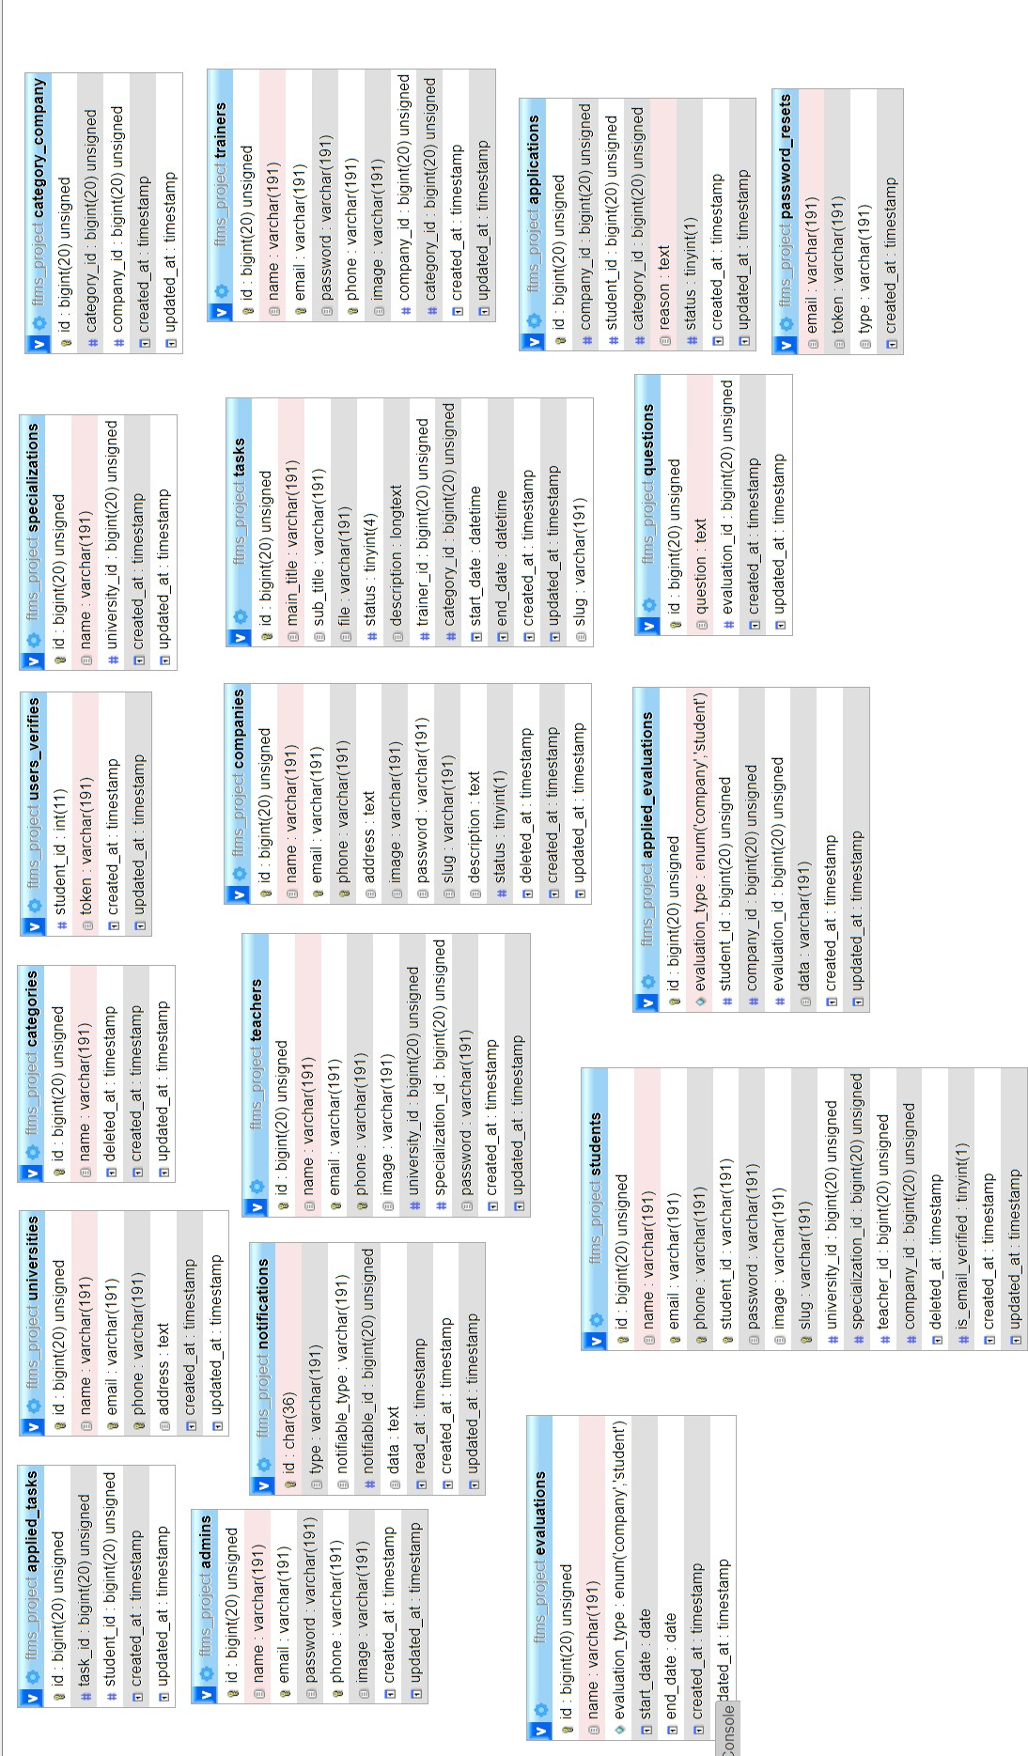
Figure 17 : SQL Diagram

Slide 54
Database Tables
Students
Table 7 : students table
Name of the table |  | students
Table description |  | This table will handle the student information
 | Attribute | Type | Examples of values
 | id | Int | 1
 | name | varchar(191) | Esmail
 | Email | varchar(191) | esmailnba@gmail.com
 | password | varchar(191) | ********
 | university_id | Int | 2
 | company_id | Int | 3
 | specialization_i d | Int | 2
 | student_id | Int | 2
 | image | varchar(191) | Esmail.jpg
Primary Key |  |  | id

Slide 55
5.5.2. Universities
Table 8 : Universities table
Name of the table | Universities
Table description | This table will handle the information for the deal
Attribute | Type | Examples of values
id | Int | 1
name | varchar(191) | University of Al-Azhar
email | varchar(191) | UN@azhar.com
phone | varchar(191) | 05664379
address | Text | Gaza
Primary Key | id

Slide 56
5.5.3. Companies
Table 9 : companies table
Name of the table | Companies
Table description | This table will handle the information for the bidding process when buyer start doing it.
Attribute | Type | Examples of values
Id | Int | 1
Name | varchar(191) | Unit One
Email | varchar(191) | Unitone@Unit.com
image | Varchar(191) | Image.png
Address | Text | Gaza
description | Text
Phone | Varchar(191) | 0599944433
status | boolean | 1
Primary Key | id

Slide 57
5.5.4. Category
Table 10 : categories table
Name of the table | Categories
Table description | This table will handle the information for the categories that will cover the deals.
Attribute | Type | Examples of values
id | Int | 1
name | varchar(255) | Computer
Primary Key |  | id
Software and tools
We will use the following software and tools in our application:
Visual Studio Code
Xamp Server
Laravel Framework
Php Language
Java Script
JQuery
CSS
- Html 5
- E-draw
- sweetalert

Slide 58
PHPSTORM 2017
PhpStorm is a commercial, cross-platform IDE for PHP built on JetBrains' IntelliJ IDEA platform. It supports PHP 5.3/5.4/5.5/5.6/7.0/7.1/7.2, provides on-
the-fly error prevention, best autocompletion & code refactoring, zero configuration debugging, and an extended HTML, CSS, and JavaScript editor.
XAMPP Server 2017
XAMPP is local web development environment. It is bundle of software like Apache - a HTTP server, M - Maria DB - Database, P- PHP - Scripting Language,
P- Perl Language , XAMPP is free to use. You can use XAMPP on your desktop to design, develop and test website.
5.3.3 LARAVEL Framework
Laravel is a prominent member of a new generation of web frameworks. It is
a free, open-source PHP web framework, created by Taylor Otwell back in 2011 and intended for the development of web applications following the MVC model.
PHP Language
PHP: Hypertext Preprocessor is a server-side scripting language designed for Web development, but also used as a general-purpose programming language
.[10]
Java Script
JavaScript is a scripting language developed initially by Netscape, but having
the capability to be used on all known browsers. It is an interpreted language that can be used both on the client and server side as a scripting language.

Slide 59
We use it to interact with the HTML elements, validate user input, and manage settings, such as the color and background color of different controls on a form.[11]
JQuery
JQuery is a new kind of JavaScript Library. JQuery is a fast and concise JavaScript Library that simplifies HTML document traversing, event handling,
animating, and Ajax interactions for rapid web development. JQuery is designed to change the way that you write JavaScript. Write less and do more.[12]
CSS
Cascading style sheets (CSS) is a language used for describing the look and formatting of document written in markup language.
We use it in responsive web design which is an approach to web design aimed at crafting sites to provide an optimal viewing experience—easy reading and navigation with a minimum of resizing, panning, and scrolling—across a wide range of devices (from desktop computer monitors to mobile phones) by using bootstrap technology.
E-draw Max
E-draw Max is a 2D business technical diagramming software which help create activity, sequence, class Diagram and much more in UML field; it
gives users a Visio-like, professional quality diagramming tool.
SWEETALERT
sweetAlert is a replacement for JavaScript’s window.alert() function that shows very pretty modal windows.
It’s a standalone library that has no dependencies, and it’s made from a JavaScript file plus a CSS file.
50

Slide 60
Overview about PHP language Application:
How does PHP work [7]?
To develop an understanding of how PHP works it is helpful to first explore
what happens when a web page is serving to a user's browser. When a user visits a web site or clicks on a link on a page the browser sends a request to the web server hosting the site asking for a copy of the web page. The web server receives the request, finds the corresponding web page file on the file system and sends it back, over the internet, to the user's browser. Typically, the web server does not pay any attention to the content of the file it has just transmitted to the web browser. As far as the web server is concerned, the web browser understands the content of the web page file and knows how to interpret and render it so that it appears as the web designer intended. Now let us consider what kind of web page content a web browser understands.
These days a web page is likely to consist of HTML, XHTML and JavaScript. The web browser contains code that tells it what to do with these types of content. For example, it understands the structure HTML in terms of rendering the page and it has a JavaScript interpreter built in that knows how to execute the instructions in a JavaScript script. A web browser, however, knows absolutely nothing about any PHP script that may be embed in an HTML document. If a browser were serving a web page containing PHP, it would not know how to interpret that code. Given that a web browser knows nothing about PHP in a web page, then clearly something has to be done with any PHP script in the page before it reaches the browser.
This is where the PHP pre-processing module comes in. The PHP module is, as
mentioned previously, integrated into the web server. The module tells the web server that when a page is to be served which contains PHP script (identified by special markers) that it is to pass that script to the PHP pre-processing module and wait for the PHP module to send it some content to replace that script fragment. The PHP processing module understands PHP, executes the PHP script written by

Slide 61
the web developer and, based on the script instructions, and creates output that the browser will understand. The web server substitutes the content provided by the PHP pre-processor module in place of the PHP script in the web page and sends it to the browser where it is rendering for the user to view.
Why We Used PHP Laravel framework?
Laravel is a PHP web framework. It was created by Taylor Otwell. This
framework was creating for the development of web applicators, which followed the MVC (model view controller) architectural pattern.
Laravel has expressive and elegant syntax. It was developing with the belief that web development must be an enjoyable and truly fulfilling creative experience. Laravel Web Development simplifies the web development process by easing the common tasks such as routing, authentication, sessions, and caching.

Slide 62
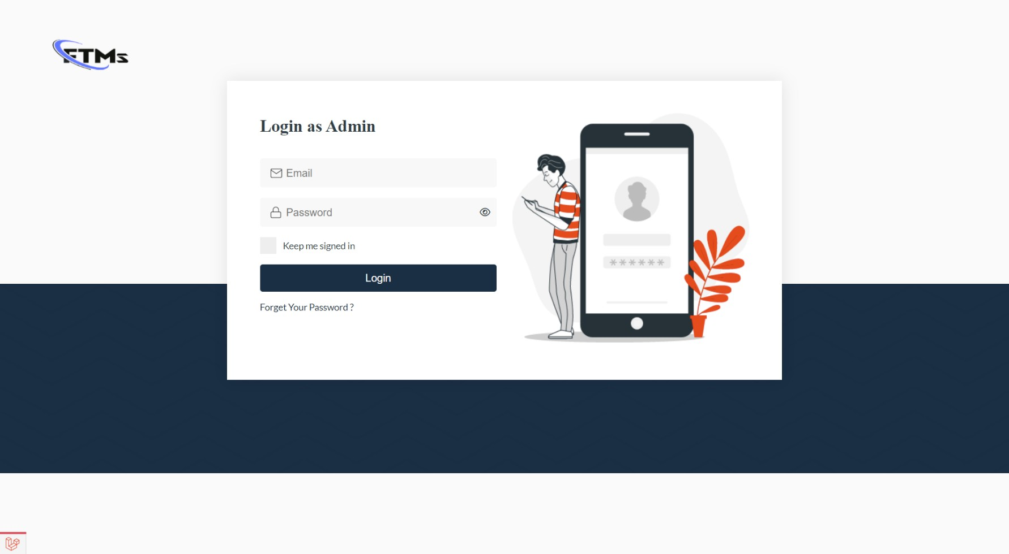
5.7. Graphical User Interface (GUI)

Slide 63
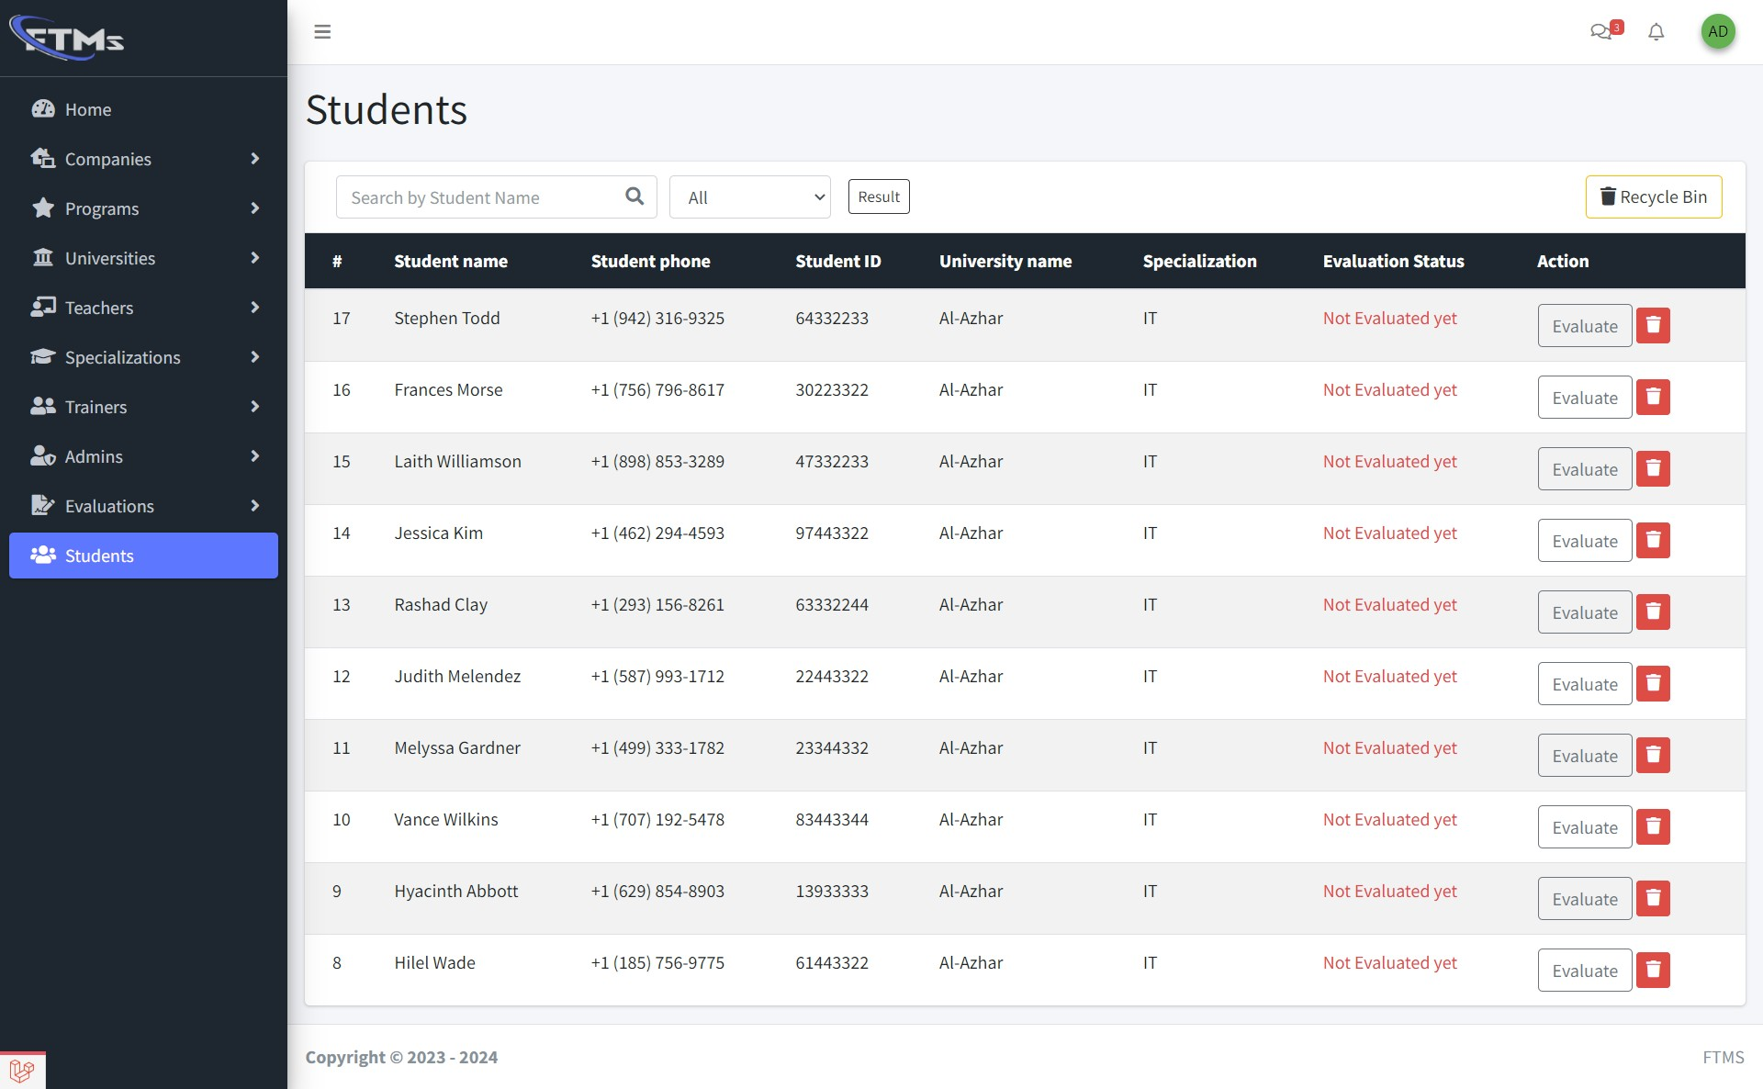
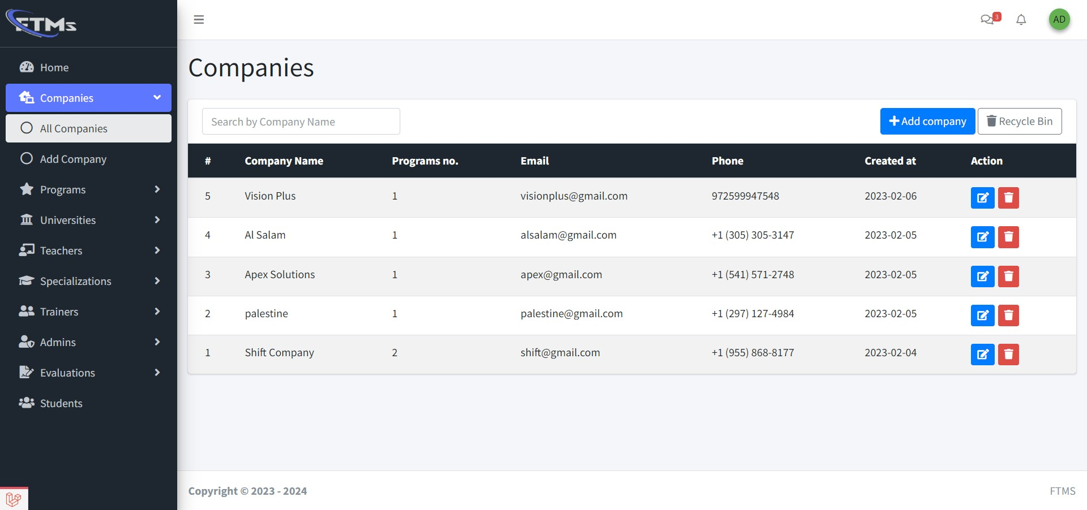

Slide 64
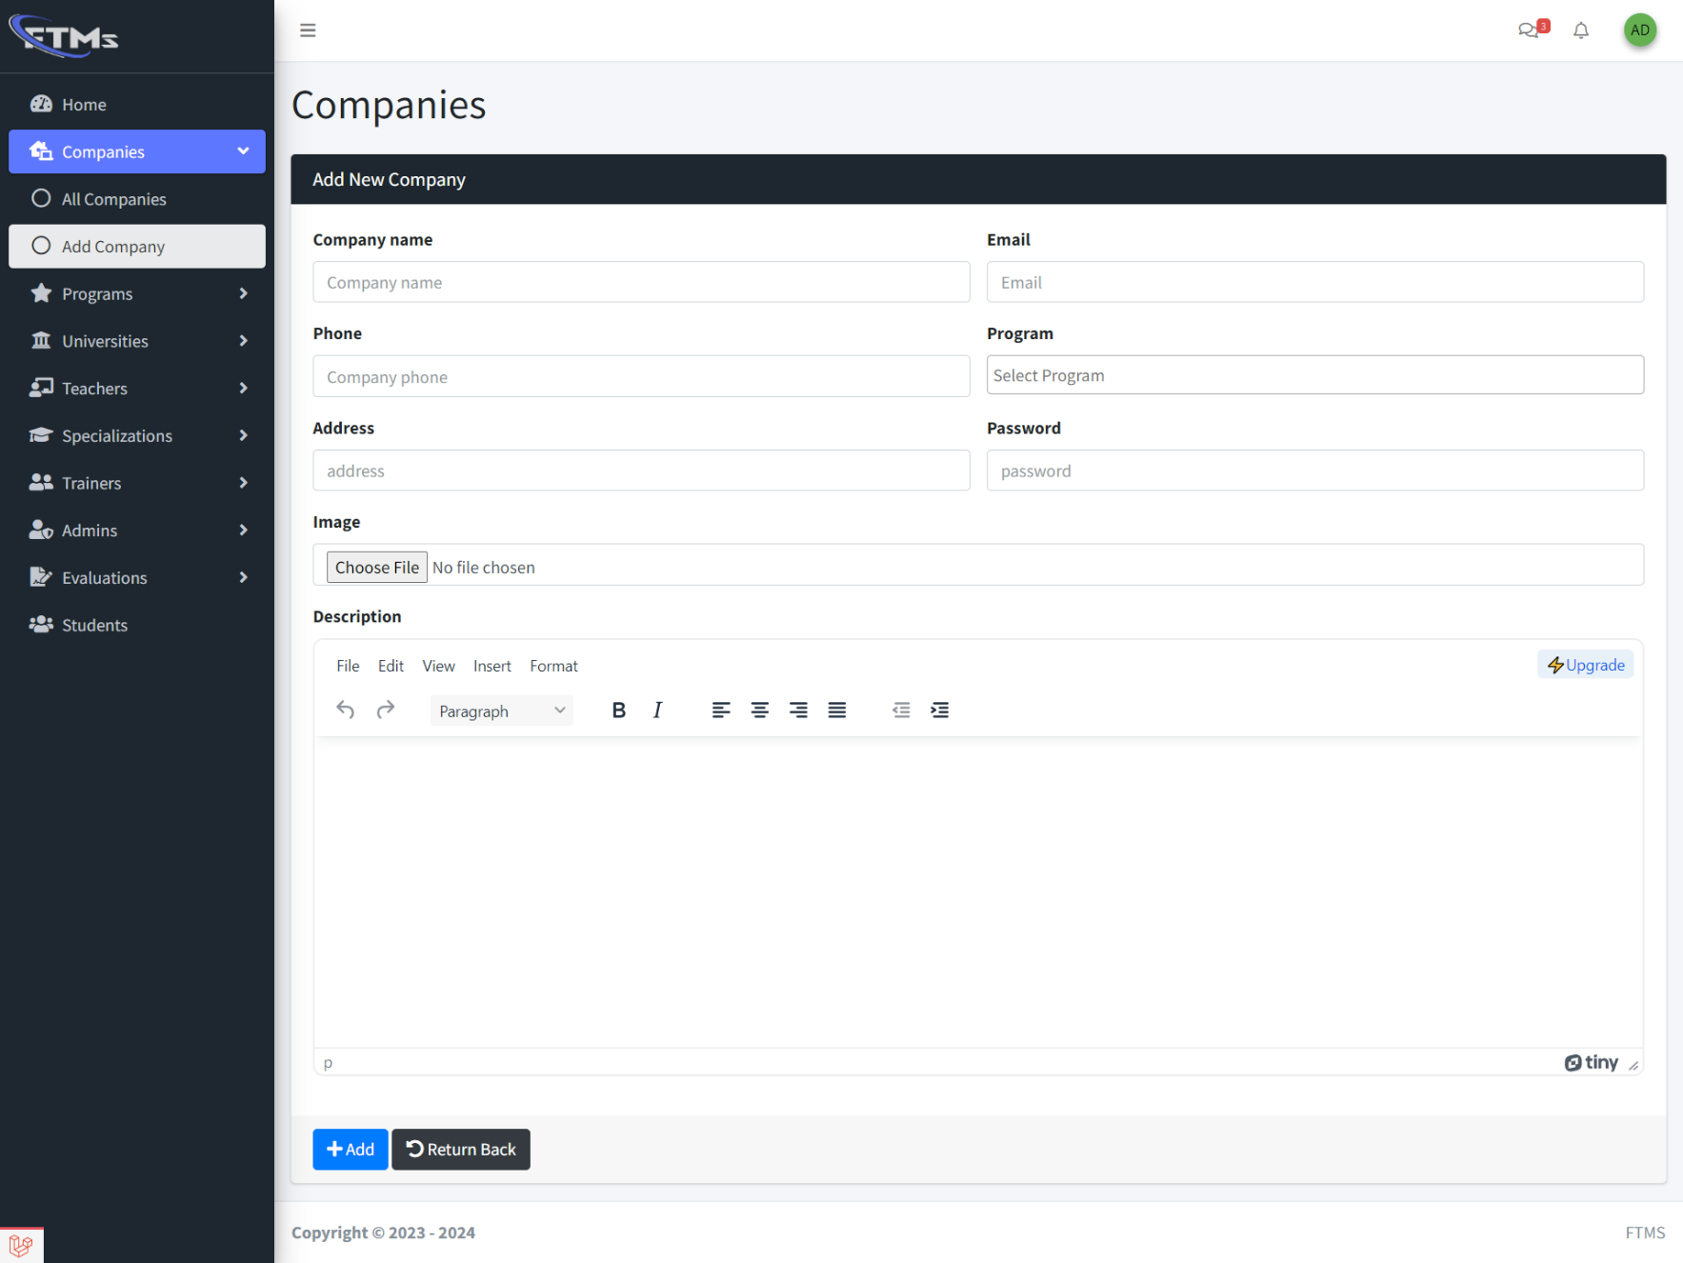

Slide 65
5.8.Conclusion
We start by introducing the system architecture which is used in the project, followed by the software and tools which are used in the implementation phase; we then identify the class diagram and SQL diagram, and finally present the graphic user interface for the project.

