Slide 1



DESIGNING AND IMPLEMENTING A SALES FORECASTING SOLUTION
By:
Abid Mohaned
Gaidi Lamjed
Framed by:
Ben Nasr Hafedh
Ben Letaifa Asma Ben Brahim Ali

Slide 2

TABLE OF CONTENTS
01
02
03
04
05
06
07
08
Problem
Solution
Tools
AI model
Architecture
Interface
Demonstration
Conclusion

Slide 3
Problem
Obsolete Stock: One of the biggest drains on your profitability is obsolete or dead stock.
Customer Demand: Customers are looking for more value and convenience from their favorite brands.

Slide 4
Solution
For a business to operate efficiently, it needs some idea of what the future will look like. A forecast provides this look as a foundation upon which to plan.
Our solution leverages a famous ML model “XGBoost” to perform forecasting.
With a simple user interface to interact with the model and observe results.

Slide 5




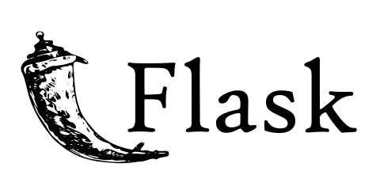




Tools

Slide 6
AI model
In order to find the right model that fits our data well and has the ability to generalize on new data, we cleaned and analyzed our dataset carefully looking for insights that can help us carry out our experiments with various types of models and data features.

Slide 7
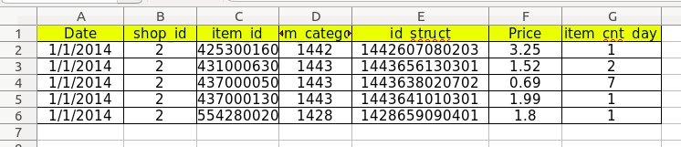
AI model: Exploratory Data Analysis
This is a sample from our dataset containing dates, shop and item id to identify all products as well as item category and id struct to categorize all items. Also we have the price of the item and the amount of sold units per day.
This dataset contains data for 4 years (2014-2018) representing 92 items in 5 different shops.

Slide 8
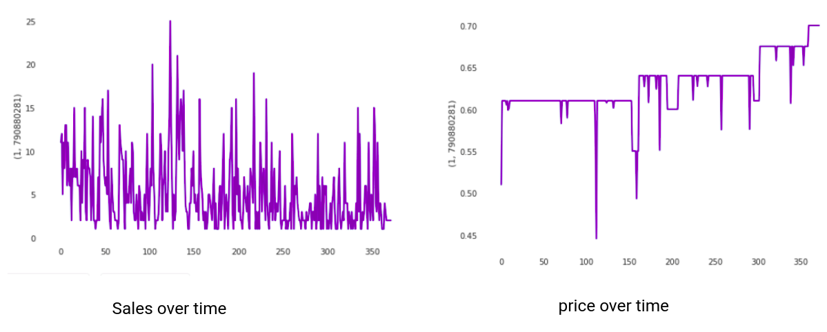
AI model: Exploratory Data Analysis

Slide 9
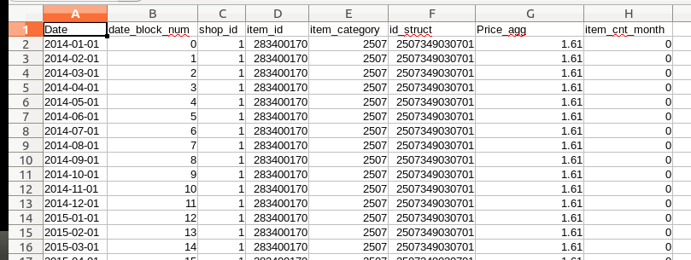
AI model: Data cleaning & Preprocessing
include for all shop,item pairs data points statiting 0 as sold units per day to force our model to account for the days that the product didn’t sell.
Aggregate the price on average per month and the sales as the sum of the sold quantities per month.
Adding “date_block_num” feature to play the role of the date since our models only accept numeric values.

Slide 10
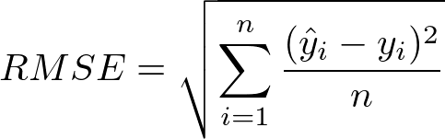
AI model: Benchmarking experiments
As an evaluation metric for our experiments we have used RMSE (Root Mean Squared Error) since our problem can be viewed as a regression supervised learning problem.

Slide 11
AI model: Modeling & feature engineering
The models that we tried can be categorized into :
Tree-based models : RandomForest, Adaboost , CatBoost , XGBoost
Time series models: Prophet , ARIMA
Deep learning models : RNN , LSTM , FASTAI TabularLearner

Slide 12
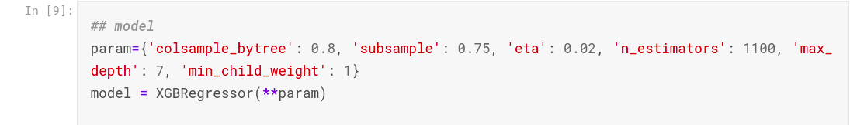
AI model: Modeling & feature engineering
After all experiments with models and features, This was our best model:

Slide 13
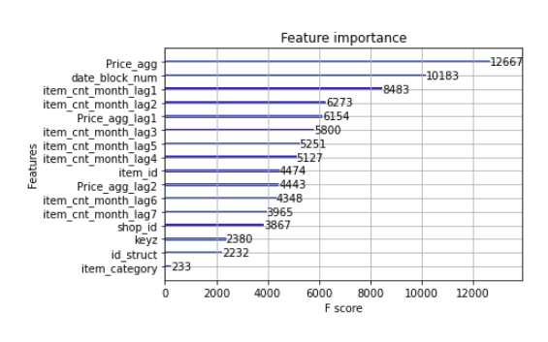
AI model: Modeling & feature engineering
Number of holidays per month
7 degrees of lag features for the sales counting
2 degrees of lag features for the price

Slide 14
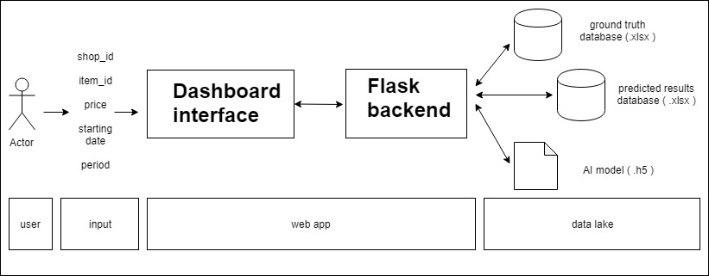
Architecture

Slide 15
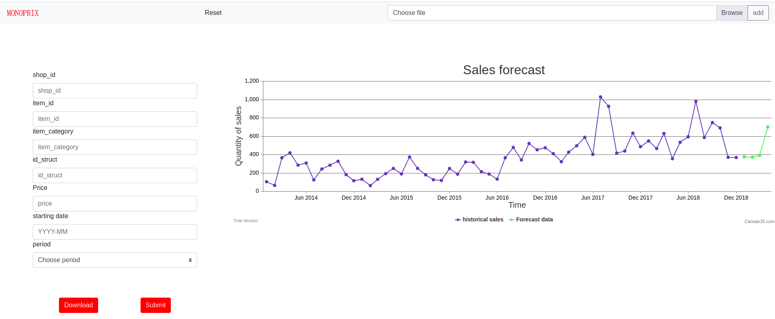
Interface

Slide 16
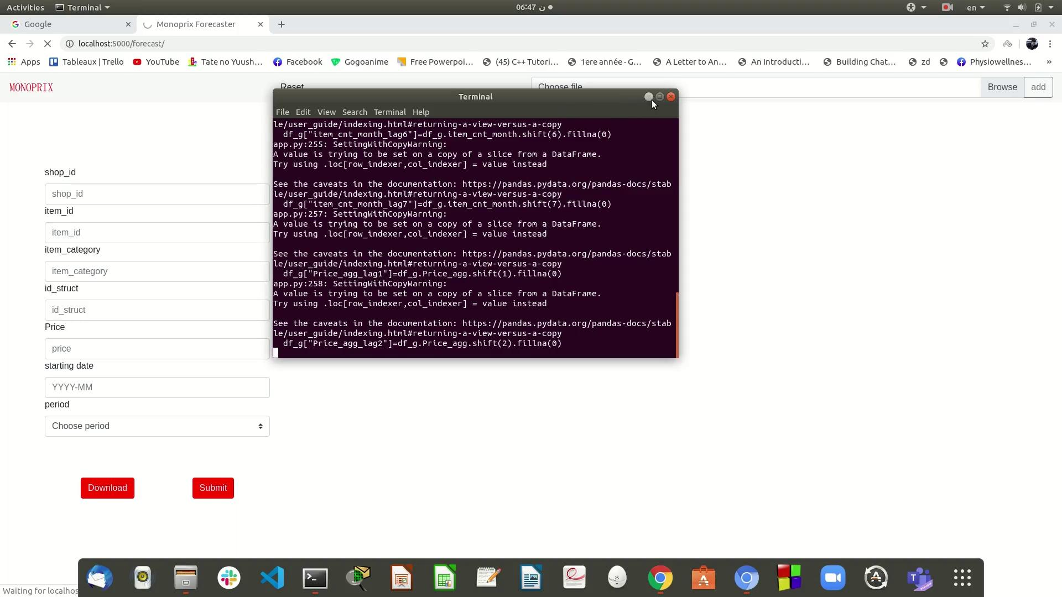
Demonstration

Slide 17
Conclusion
Despite the errors and the troubles we have encountered we consider our work to be satisfactory and we are proud of it but not to the point of considering it ideal. If the duration of the project was longer, we could have considered using different approaches like building an ARIMA model for each shop,item pair which can be more accurate but requires manual tuning and has scalability issues.

Slide 18
Conclusion
1000+ Lines of code
50+
Hours of Kaggle GPU resources
30+
Model Prototyping experiments
Github link: https://github.com/mohaned-abid/DEMAND-FORECASTING-for-RETAIL-in-collaboration-with-MONOPRIX-

Slide 19
Thank you !
Any questions ?

