Slide 1
One-Day-Ahead
PM2.5 Forecasting
CNN-LSTM | Group 16
Historical future result is frozen.
Development CV is scored; material limitations remain.
Notes:
Introduce the task and explain that development CV is now scored, while licensing and some rubric evidence remain open.

Slide 2
Why forecast PM2.5?
Daily forecasts can support air-quality monitoring.
A single split does not show whether performance holds across time or stations.
Inputs must be available when the forecast is issued.
GROUP 16 | CNN-LSTM | 02
Notes:
Explain the motivation and the importance of a clear forecast origin.

Slide 3
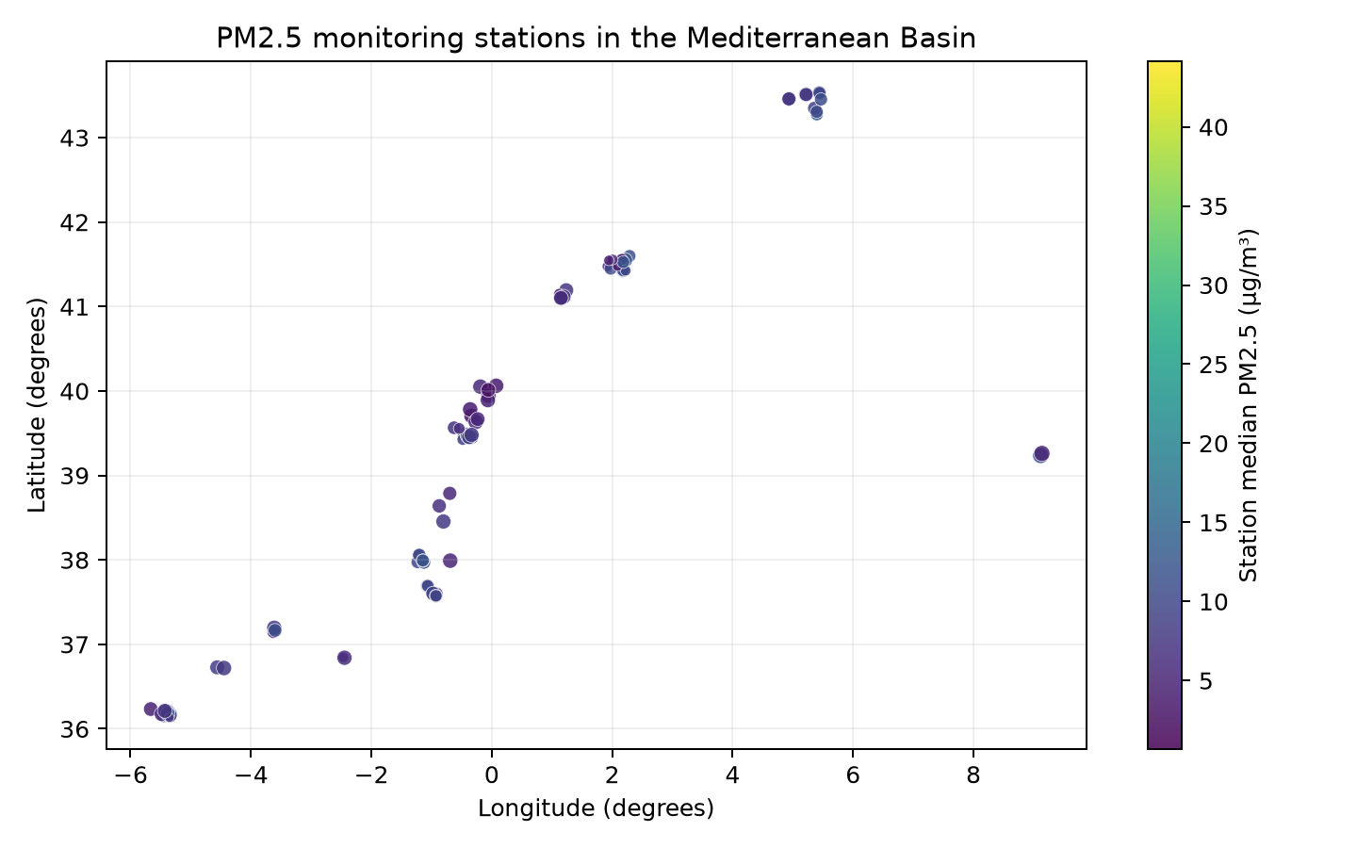
Dataset and coverage
40,983 cleaned observations
95 stations with finite coordinates
2016-11-25 to 2026-04-06
Target: PM2.5 (µg/m³)
Compiled-data redistribution terms remain unresolved.
GROUP 16 | CNN-LSTM | 03
Notes:
Name the source and be direct about the rights caveat. Coordinates show station coverage, not pollution concentration everywhere.

Slide 4
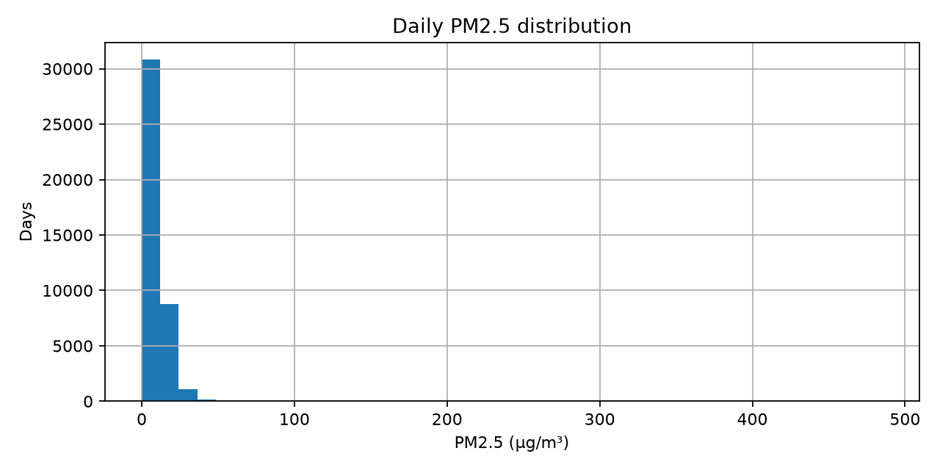
Data quality and EDA
735 target rows removed by stated bounds
No duplicate station-day keys after cleaning
NO2/CO: about 5.9% missing; O3: about 6.0%
Median: 7.85 µg/m³; 99th percentile: 33.56
352 station-relative high-value flags retained for review
No invalid targets/coordinates or duplicate station-days in dev.
GROUP 16 | CNN-LSTM | 04
Notes:
Explain the right-skew and missingness. Do not treat correlation as causation.

Slide 5
Forecast contract
End of day t → predict station PM2.5 at t+1
Seven consecutive daily history steps
Sequences stay within station and reject date gaps
Calendar terms + past target history
Future exogenous values excluded without availability evidence
GROUP 16 | CNN-LSTM | 05
Notes:
Describe exactly what the model receives and predicts.

Slide 6
CNN-LSTM architecture
Input 7 days × 7 features → causal Conv1D (16, kernel 3) → LayerNorm → ReLU → Dropout 0.347 → MaxPool → LSTM (64) → Dense (32, ReLU) → scalar PM2.5 output
Adam; MSE; learning rate 0.000775; 45 epochs on development data.
GROUP 16 | CNN-LSTM | 06
Notes:
This is the saved Optuna development model, not the unavailable historical model. Pooling can be disabled for future-step-preservation experiments.

Slide 7
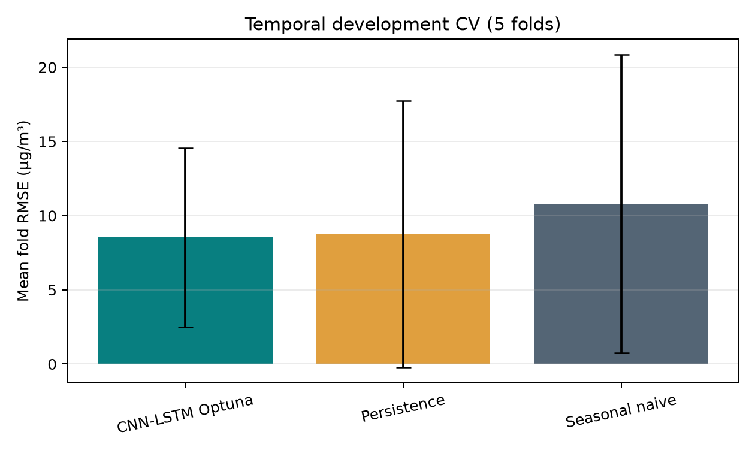
Development validation and baselines
Optuna temporal CV: 8.520 ± 6.034 µg/m³
Persistence: 8.771 ± 8.984
Weekly seasonal naive: 10.798 ± 10.039
Paired exact Wilcoxon p=.625
Five folds; no significant gain over persistence.
GROUP 16 | CNN-LSTM | 07
Notes:
Persistence uses PM2.5 at forecast origin t. The five-fold test is low power; report the result as inconclusive.

Slide 8
Frozen historical estimate
RMSE 6.0272 µg/m³
MAE 4.0240 µg/m³
R² 0.2394
N 1,716
Reconstruction reproduces all saved predictions (max |Δ| 7.1e-15).
GROUP 16 | CNN-LSTM | 08
Notes:
This is output equivalence from a development-only refit and a prediction-array check. No holdout labels were read. Original binary weights cannot be verified byte-for-byte.

Slide 9
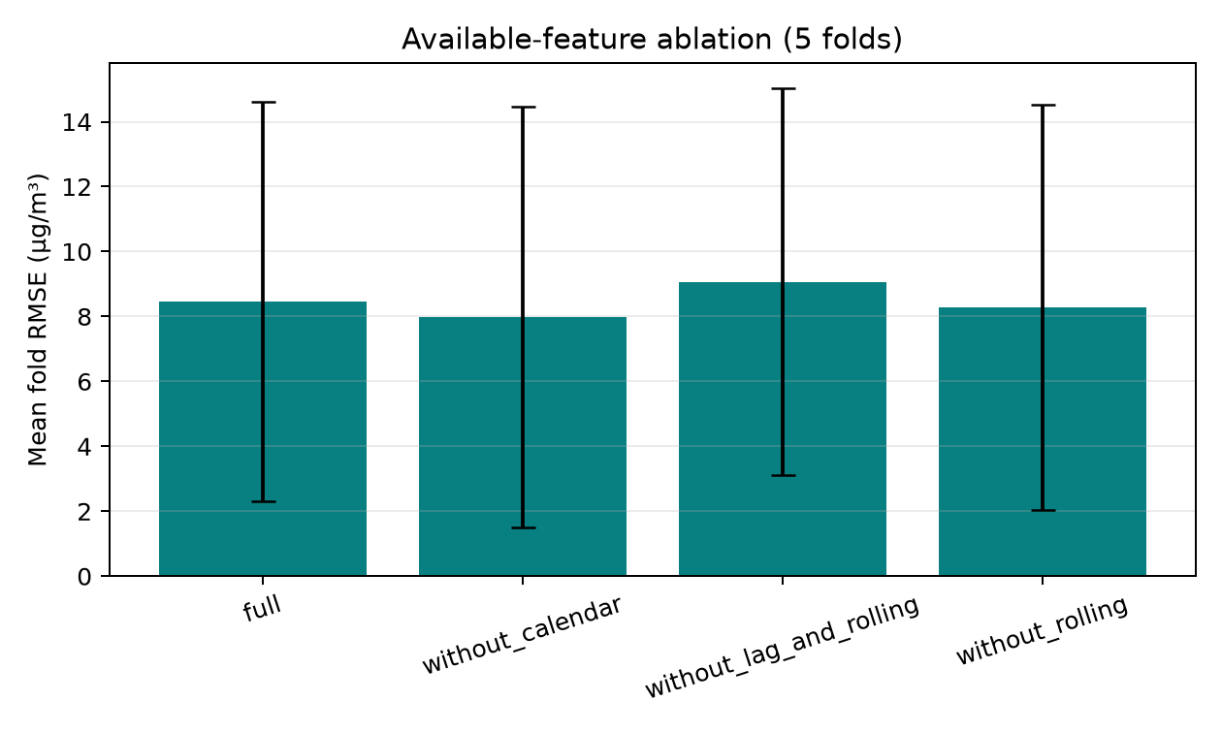
Available-feature ablation
Without calendar: ΔRMSE −0.467 (95% fold CI −0.957 to −0.088)
Without lag/rolling: ΔRMSE +0.617 (0.249 to 1.022)
Without rolling: ΔRMSE −0.177 (−0.337 to −0.043)
Five temporal folds; no retuning.
GROUP 16 | CNN-LSTM | 09
Notes:
These compare the approved lag/rolling set without retuning; unverified exogenous channels are tested separately in nested folds and did not improve results.

Slide 10
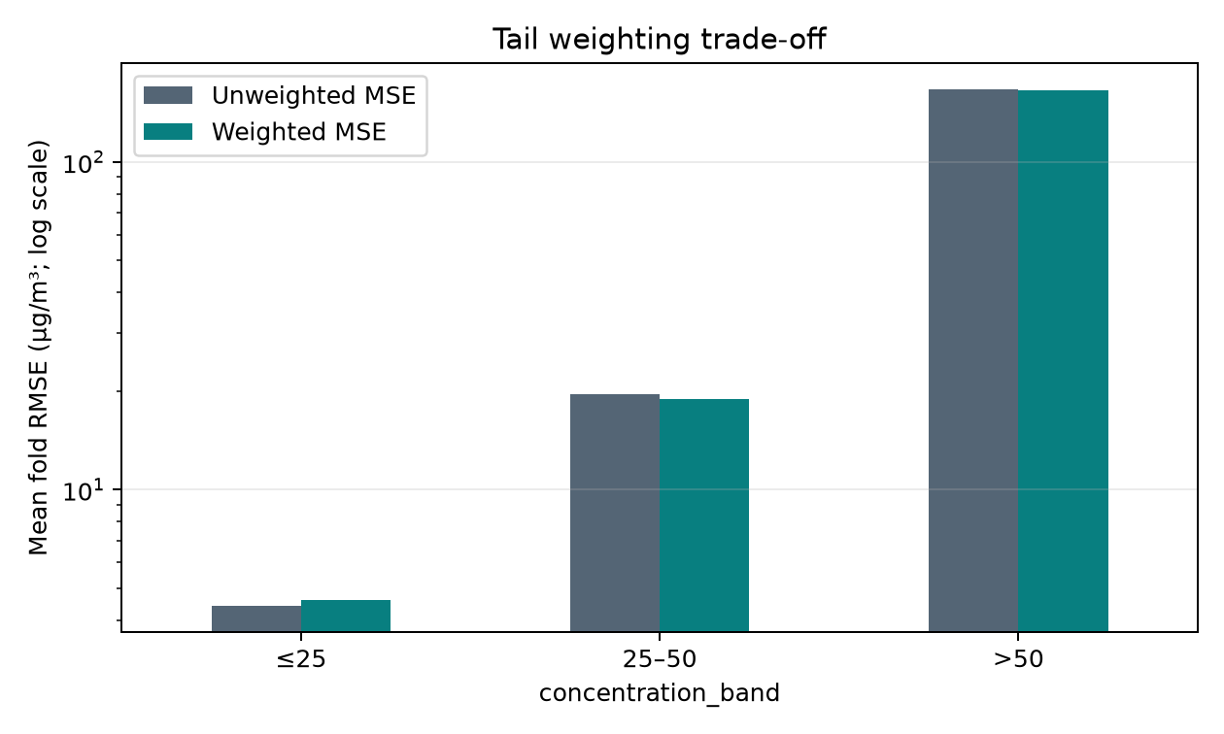
Extreme-event weighting
Weighted MSE helps the >25 bands slightly, but worsens overall RMSE 8.520 → 8.600 and ≤25 RMSE 4.423 → 4.622.
Only 7 OOF cases exceeded 50 µg/m³.
GROUP 16 | CNN-LSTM | 10
Notes:
The exploratory training weights were 1x for ≤25, 2x for >25–50, and 4x for >50. The small tail sample makes the apparent benefit unstable.

Slide 11
Sensitivity and feature-family experiments
Nested feature-family selection: mean-fold RMSE 8.378; MAE 3.784.
Fixed no-calendar + lag-1 + rolling-3: 7.894 / 3.396 vs reference 8.520 / 3.978.
Pooled ΔRMSE −0.250 (cluster CI −0.547 to −0.125); fold p=.063, Holm p=.313.
Vs persistence: p=.813, Holm p=1.00.
3-day vs 7-day RMSE 9.579 vs 9.571. Tail n>50 = 7; MAE 143.4 vs persistence 127.2.
GROUP 16 | CNN-LSTM | 11
Notes:
Feature selection varied across folds; this remains exploratory with only five dependent folds. Lagged environmental and same-day spatial neighbor predictors failed to improve target-only OOF scores. Architecture results were mixed; tail estimates are unstable.

Slide 12
Spatial validation and predictor checks
Held-out station groups (conditional on historical sequences):
RMSE 8.700 | MAE 3.287 | R² .154 | n=3,349
Adding 25/50/100-km same-day neighbor PM raised OOF RMSE to 9.361/9.439/9.408 vs target history 9.322.
Lagged environmental groups also failed to improve.
Temporal/spatial MAPE 50.14% / 42.13%; unstable near zero.
GROUP 16 | CNN-LSTM | 12
Notes:
Spatial grouped validation is conditional on historical station input. Same-origin neighbor PM summaries at 25/50/100 km raised pooled RMSE relative to target-only history. One-day-lagged environmental families also did not improve scores. MAPE is supplementary and unstable near zero; no exogenous input timing is certified.

Slide 13
Limitations and readiness
Compiled-data license and omitted-row rule unresolved
Exogenous AOD/gas/meteorology blocked pending timing evidence
Lead-lag associations exploratory, not predictive validation
Only six stations support the longer formal and lead-lag diagnostics
GROUP 16 | CNN-LSTM | 13
Notes:
The development cleaning QA used 30,651 development rows and found no duplicate station-days, invalid coordinates or invalid PM values under the configured bounds. The station-relative Q3+3IQR screen flagged 352 rows for review; none were automatically removed. The overall dataset has 95 stations; six support the longer formal and lead-lag diagnostics. Compiled-data rights and upstream inclusion logic remain unresolved.

Slide 14
Conclusion and readiness
Development CV, temporal and spatial baselines, nested feature-family comparisons, provenance audits and prediction-equivalent historical reconstruction are saved.
Predictive gain over persistence remains nonsignificant; high-concentration errors are poor.
Licensing, inclusion logic and issue-time feature availability remain open.
GROUP 16 | CNN-LSTM | 14
Notes:
Close with what is supported: correct one-day alignment, exact prediction reproduction and mixed, nonsignificant model results.

