Slide 1
One-Day-Ahead
PM2.5 Forecasting
CNN-LSTM | Group 16
Historical future result is frozen.
Development CV is scored; material limitations remain.
Notes:
Introduce the task and explain that development CV is now scored, while licensing and some rubric evidence remain open.

Slide 2
Why forecast PM2.5?
Daily forecasts can support air-quality monitoring.
A single split does not show whether performance holds across time or stations.
Inputs must be available when the forecast is issued.
GROUP 16 | CNN-LSTM | 02
Notes:
Explain the motivation and the importance of a clear forecast origin.

Slide 3
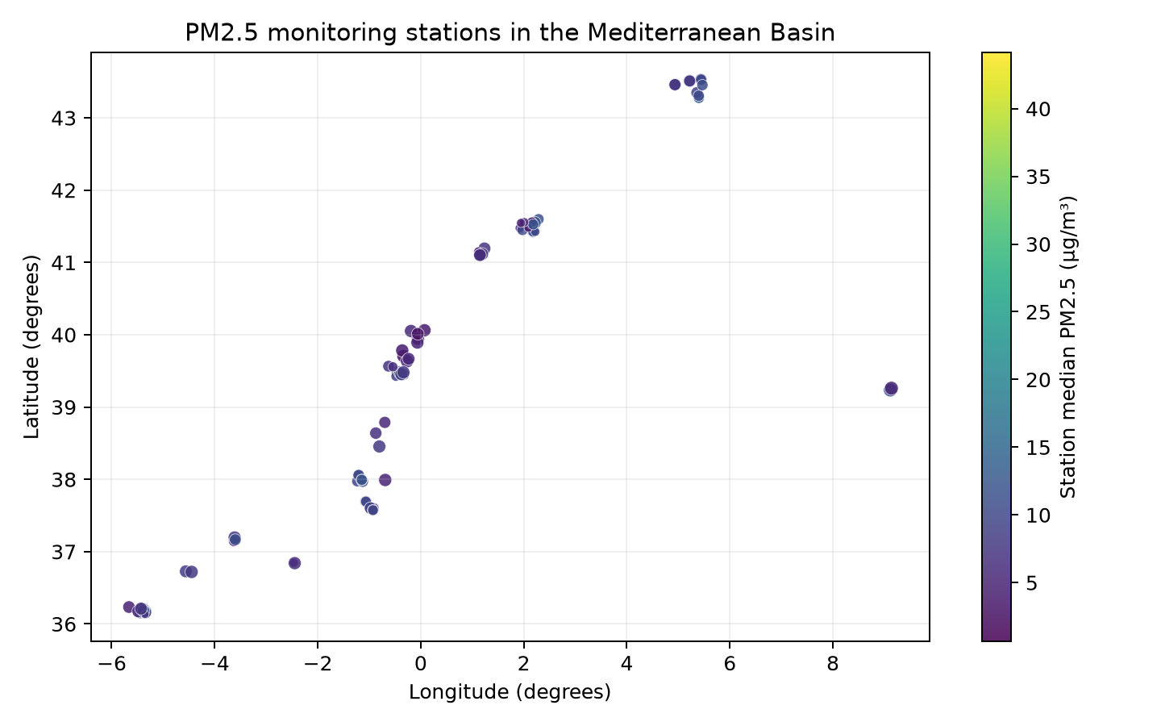
Dataset and coverage
40,983 cleaned observations
95 stations with finite coordinates
2016-11-25 to 2026-04-06
Target: PM2.5 (µg/m³)
Compiled-data redistribution terms remain unresolved.
GROUP 16 | CNN-LSTM | 03
Notes:
Name the source and be direct about the rights caveat. Coordinates show station coverage, not pollution concentration everywhere.

Slide 4
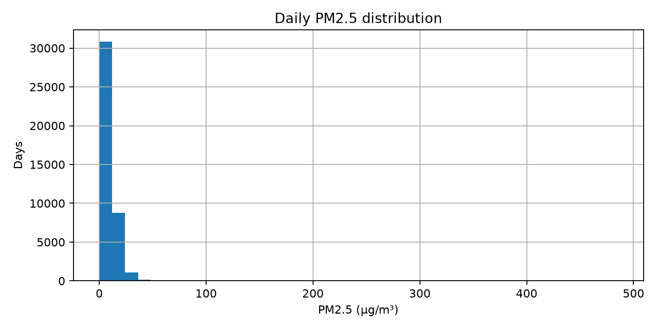
Data quality and EDA
735 target rows removed by stated bounds
No duplicate station-day keys after cleaning
NO2/CO: about 5.9% missing; O3: about 6.0%
Median: 7.85 µg/m³; 99th percentile: 33.56
Rare high values can influence RMSE.
GROUP 16 | CNN-LSTM | 04
Notes:
Explain the right-skew and missingness. Do not treat correlation as causation.

Slide 5
Forecast contract
End of day t → predict station PM2.5 at t+1
Seven consecutive daily history steps
Sequences stay within station and reject date gaps
Calendar terms + past target history
Future exogenous values excluded without availability evidence
GROUP 16 | CNN-LSTM | 05
Notes:
Describe exactly what the model receives and predicts.

Slide 6
CNN-LSTM architecture
Input 7 days × 7 features → causal Conv1D (16, kernel 3) → LayerNorm → ReLU → Dropout 0.347 → MaxPool → LSTM (64) → Dense (32, ReLU) → scalar PM2.5 output
Adam; MSE; learning rate 0.000775; 45 epochs on development data.
GROUP 16 | CNN-LSTM | 06
Notes:
This is the saved Optuna development model, not the unavailable historical model. Pooling can be disabled for future-step-preservation experiments.

Slide 7
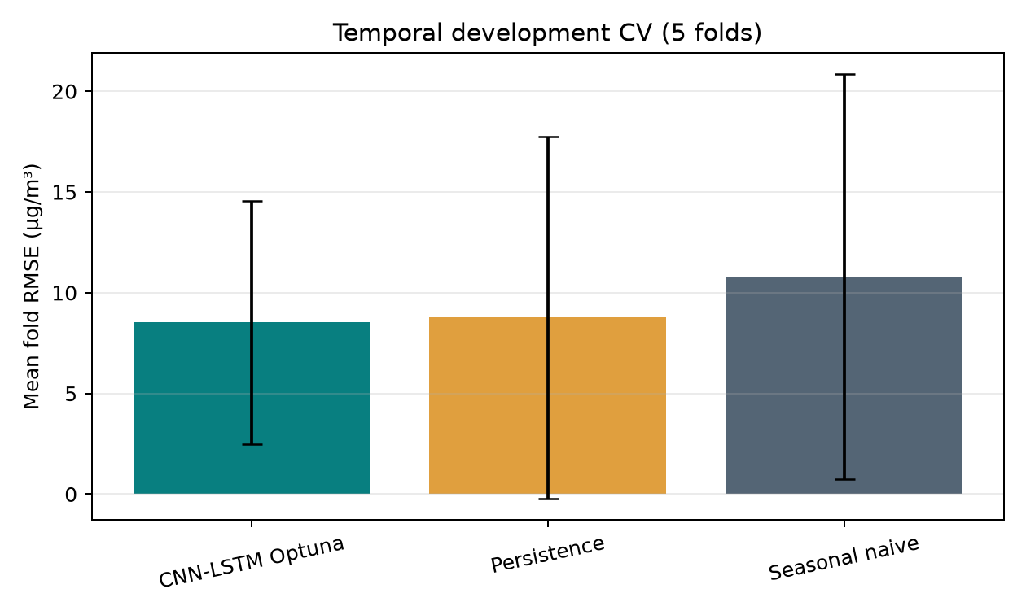
Development validation and baselines
Optuna temporal CV: 8.520 ± 6.034 µg/m³
Persistence: 8.771 ± 8.984
Weekly seasonal naive: 10.798 ± 10.039
CNN-LSTM vs persistence: Δ −0.251; Holm p=1.000
Five dependent folds; interval is wide.
GROUP 16 | CNN-LSTM | 07
Notes:
Persistence now uses the last observation at forecast origin t. The CNN-LSTM/persistence difference is not statistically significant after Holm correction.

Slide 8
Frozen historical estimate
RMSE 6.0272 µg/m³
MAE 4.0240 µg/m³
R² 0.2394
N 1,716
Saved predictions begin 2024-12-12; reserved block begins 2024-12-08. Historical checkpoint unavailable.
GROUP 16 | CNN-LSTM | 08
Notes:
Label these as historical saved metrics. No future evaluation was rerun and no saved checkpoint was found.

Slide 9
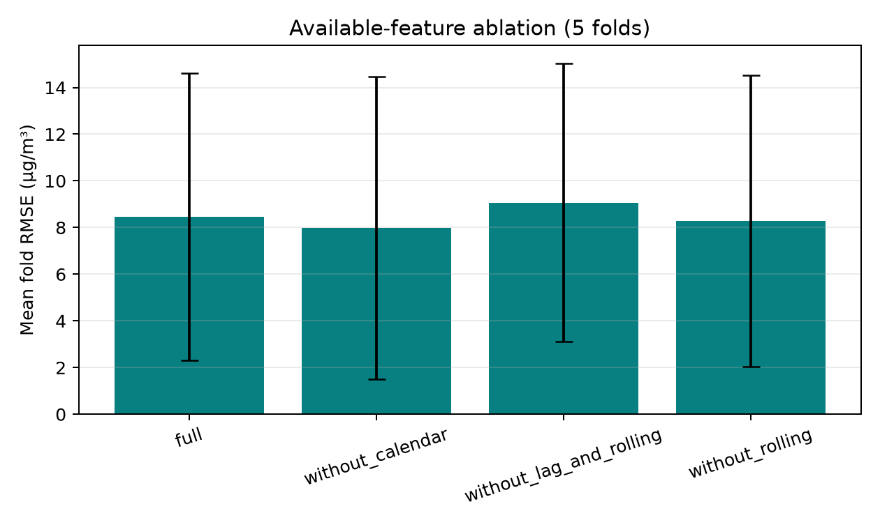
Available-feature ablation
Without calendar: ΔRMSE −0.467 (95% fold CI −0.957 to −0.088)
Without lag/rolling: ΔRMSE +0.617 (0.249 to 1.022)
Without rolling: ΔRMSE −0.177 (−0.337 to −0.043)
Five temporal folds; no retuning.
GROUP 16 | CNN-LSTM | 09
Notes:
These are ablations of the currently approved feature set only; unverified exogenous variables are excluded.

Slide 10
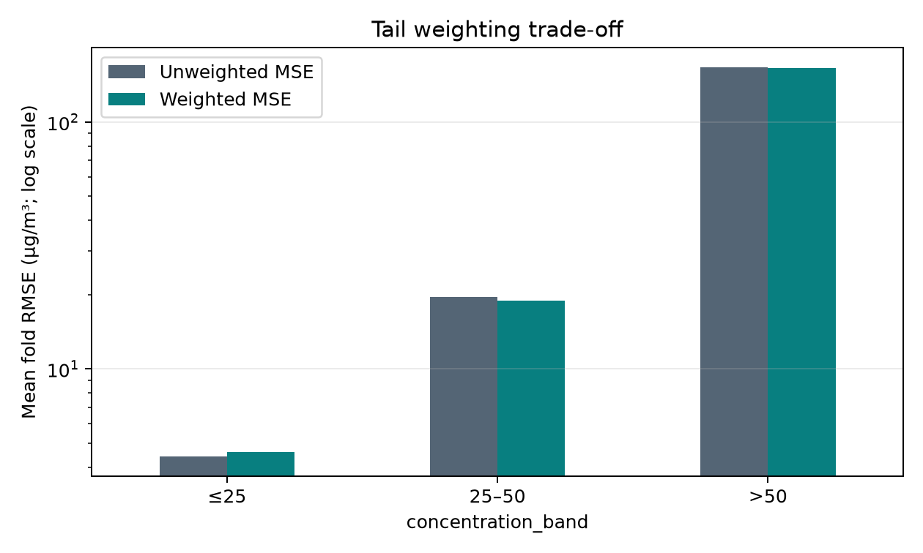
Extreme-event weighting
Weighted MSE helps the >25 bands slightly, but worsens overall RMSE 8.520 → 8.600 and ≤25 RMSE 4.423 → 4.622.
Only 7 OOF cases exceeded 50 µg/m³.
GROUP 16 | CNN-LSTM | 10
Notes:
The exploratory training weights were 1x for ≤25, 2x for >25–50, and 4x for >50. The small tail sample makes the apparent benefit unstable.

Slide 11
Limitations and next steps
Compiled-data license and upstream join remain unresolved
Exogenous AOD/gas/meteorology ablations blocked pending timing evidence
Lead-lag associations are descriptive and limited by pollutant coverage
Historical future checkpoint/configuration is unavailable
GROUP 16 | CNN-LSTM | 11
Notes:
ACF/PACF were computed on uninterrupted development segments for 63 stations. Formal stationarity tests and adequate pollutant lead-lag pairs were available for only six stations. Lead-lag correlations do not establish causation or forecast-time availability.

Slide 12
Conclusion and readiness
Development CV, nested tuning, diagnostics and a reloadable development checkpoint are saved. Predictive skill is modest; no significant improvement over persistence was established.
Historical future evidence remains frozen and is not reproducible from the available checkpoint.
Material limitations: compiled-data rights, upstream join provenance, forecast-time availability of exogenous features, and sparse lead-lag coverage.
GROUP 16 | CNN-LSTM | 12
Notes:
Close by distinguishing completed development evidence from unresolved provenance and legacy-evaluation limitations.

