Slide 1
SUBMISSION PART 1 OF 3 · GROUP 16
Data Exploration & Preprocessing
Audit, cleaning, EDA and leakage-safe preparation of a 40,983-record PM2.5 station panel
This deck documents where the data come from, what was removed and why, how the station-day panel behaves over time and space, and exactly how the modelling inputs are constructed so that no future information leaks into a forecast.
40,983
95
2,299
9
clean station-day records
coordinate-defined stations
distinct UTC daily dates
candidate environmental variables
Integrity note
Redistribution rights for the compiled Kaggle bundle are unresolved, and the publisher's row-inclusion rule cannot be reconstructed. Both are treated as first-class limitations.
Group 16 · Part 1 of 3 · Data Exploration & Preprocessing · deadline 14 November 2026

Slide 2
ROADMAP
Part 1
What this part covers
Section | Topic | Deliverable
01 | Objective and scope | Regression contract for one-day-ahead PM2.5
02 | Dataset and provenance | Source, licence status, dimensions, coverage
03 | Quality audit | Cleaning rule and the checks behind it
04–06 | EDA | Target distribution, seasonality, correlations, missingness
07 | Missing values | Fold-local median imputation plus indicators
08 | Feature engineering | Seven-day past-only sequence, no gap or station crossing
09 | Pipeline and leakage | Fold-local fit; withholding of unverified inputs
10 | Limitations and handoff | Frozen data contract consumed by Part 2
GROUP 16 · PM2.5 FORECASTING · PART 1 · DATA & PREPROCESSING
1
Notes:
Part 1 fixes the data contract used by every later part: cleaned panel, station identity, target bounds, seven-day past-only sequences, fold-local preprocessing.

Slide 3
01 / OBJECTIVE
Part 1
Objective and scope
Forecast the next-day PM2.5 concentration at a monitoring station from observations available at the end of the current day. The target is a continuous concentration in µg/m³, so the task is regression — not classification. Part 1 models nothing; it proves the data are trustworthy and the inputs leak-free.
What Part 1 must deliver
Research questions informed here
▸ A verified dataset description: source, licence, units, dimensions.
▸ A documented cleaning policy: what was removed and what was deliberately kept.
▸ A quantitative EDA of the target and its drivers.
▸ A fold-local missing-value strategy.
▸ A precise seven-day past-only feature definition.
▸ RQ1 — Is the panel clean enough for matched-fold baselines?
▸ RQ3 — Which available feature groups carry signal?
▸ RQ4 — How do seasonality, coverage and data rights constrain use?
▸ Framing: one learned family only — CNN–LSTM.
GROUP 16 · PM2.5 FORECASTING · PART 1 · DATA & PREPROCESSING
2
Notes:
Emphasise: Part 1 is the trust layer. Every downstream number traces to an audit file.

Slide 4
02 / DATASET
Part 1
Dataset, licence and coverage
Input: the publisher-prepared Air Quality – Mediterranean Basin (2016–2026) bundle, obtained from Kaggle and stored as data/raw/extracted/combined_gee_pm25.csv. Retrieval metadata and checksums are retained in data/manifest.yaml and data/provenance/.
Attribute | Value | Unit | Source of record
Source | Kaggle · Sarah Ameziane, v1 | — | data/manifest.yaml
Temporal span | 2016-11-25 → 2026-04-06 | UTC day | audit + EDA
Spatial span | lat 36.13–43.53 · lon −5.66–9.14 | degrees | EDA station summary
Target | PM2.5 concentration | µg/m³ | Exploratory_Data.csv
Target bounds | retain 0 < PM2.5 < 500 | µg/m³ | teacher cleaning rule
Rows removed | 735 sentinel / out-of-rule | rows | audit
Unresolved: redistribution rights
Kaggle labels the licence “Other (specified in description)”. No compiled-bundle licence and no field-to-upstream attribution map exist, so the bundle is not presented as cleared for redistribution.
GROUP 16 · PM2.5 FORECASTING · PART 1 · DATA & PREPROCESSING
3
Notes:
Be explicit that rights are unresolved; this is a limitation, not a footnote.

Slide 5
02 / VARIABLES
Part 1
Variable inventory and missingness
Variable | Family | Unit | Missing | Role in the project
pm25 | Target | µg/m³ | 0.00% | Forecast target
temperature_celsius | Meteorological | °C | 0.00% | Excluded — timing unverified
pressure_mb | Meteorological | hPa | 0.00% | Excluded — timing unverified
wind_u / wind_v | Meteorological | m/s | 0.00% | Excluded — timing unverified
no2 | Trace gas (GEE) | mol/m² | 5.87% | Excluded — timing unverified
co | Trace gas (GEE) | mol/m² | 5.87% | Excluded — timing unverified
o3 | Trace gas (GEE) | mol/m² | 5.97% | Excluded — timing unverified
aod | Satellite (GEE) | dimensionless | 0.00% | Excluded — timing unverified
Only the PM2.5 target and calendar terms enter the model. Environmental columns are audited for completeness but withheld because forecast-origin availability is undocumented.
GROUP 16 · PM2.5 FORECASTING · PART 1 · DATA & PREPROCESSING
4
Notes:
The exclusion of exogeneous variables is a deliberate, documented decision.

Slide 6
03 / QUALITY AUDIT
Part 1
Cleaning and quality controls
Only rows violating the teacher-specified physical rule were removed: PM2.5 ≤ 0 or ≥ 500 µg/m³ (735 rows). No row was deleted for being statistically unusual — extreme but plausible concentrations are kept.
735
727 / 8
0
0
rows removed (0 < y < 500)
low / high sentinel removals
out-of-rule values post-clean
invalid coordinates
Check | Result | Interpretation
Duplicate station-day keys | 0 | Each (station, date) pair is unique — a clean keyed table.
Out-of-rule targets | 0 | Every retained target is inside the physical rule.
Coordinate validity | 0 invalid | All 95 stations carry finite lat/lon.
Station identity | 98 → 95 | Three test entries removed; identity logic preserved.
Station Tukey screen | 352 flagged | Q3 + 3×IQR on 71 stations; retained, never auto-deleted.
GROUP 16 · PM2.5 FORECASTING · PART 1 · DATA & PREPROCESSING
5
Notes:
Key point: statistical extremeness alone cannot establish an instrument fault.

Slide 7
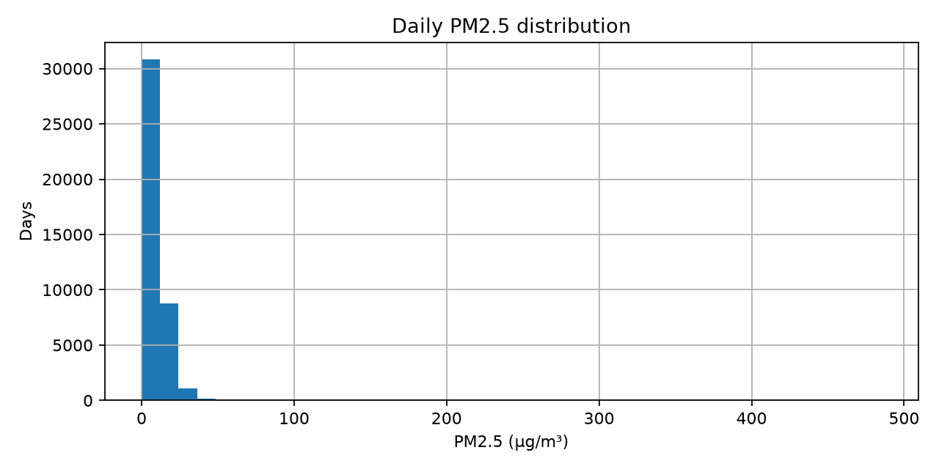
04 / EDA
Part 1
Target distribution
n | Mean | SD | Min | Median
40,983 | 9.458 | 9.730 | 0.007 | 7.851
P95 | P99 | Max | Skew | Kurt.
21.653 | 33.559 | 484.98 | 17.83 | 651.7
What the distribution implies
▸ Half of all station-days sit at or below 7.85 µg/m³.
▸ The top 1% exceeds 33.6; the maximum reaches 484.98 µg/m³.
▸ Because targets can approach zero, MAPE is unstable — use RMSE, MAE, R².
Figure 1. Distribution of cleaned daily PM2.5 (µg/m³).
GROUP 16 · PM2.5 FORECASTING · PART 1 · DATA & PREPROCESSING
6
Notes:
Heavy right tail drives every later metric choice.

Slide 8
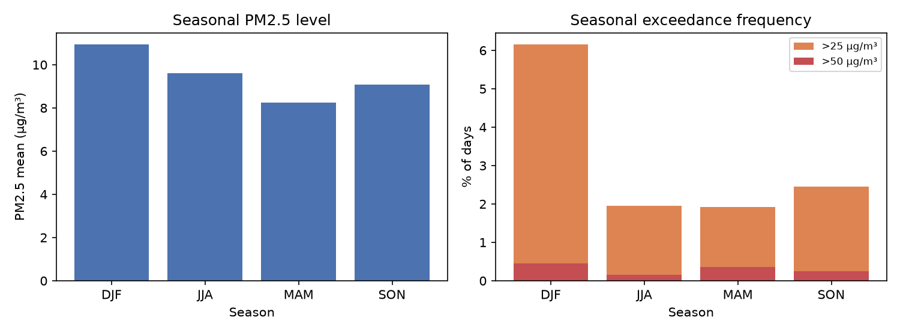
05 / TEMPORAL STRUCTURE
Part 1
Seasonality and coverage
Season | Records | Mean | Med. | >25 | >50
DJF | 8,938 | 10.94 | 8.77 | 6.15% | 0.45%
MAM | 9,276 | 8.25 | 6.83 | 1.92% | 0.36%
JJA | 12,766 | 9.59 | 8.50 | 1.95% | 0.15%
SON | 10,003 | 9.08 | 7.47 | 2.46% | 0.25%
Coverage is sparse and irregular
▸ Only 63 stations have ≥ 14 uninterrupted daily development observations.
▸ Only 6 stations have ≥ 30 days, the minimum for formal ADF/KPSS/Ljung-Box tests.
▸ Sequences never bridge a date gap, so irregular coverage is handled by construction.
Figure 2. Seasonal PM2.5 summaries (DJF, MAM, JJA, SON).
GROUP 16 · PM2.5 FORECASTING · PART 1 · DATA & PREPROCESSING
7
Notes:
Winter carries the highest means and the largest share of high days.

Slide 9
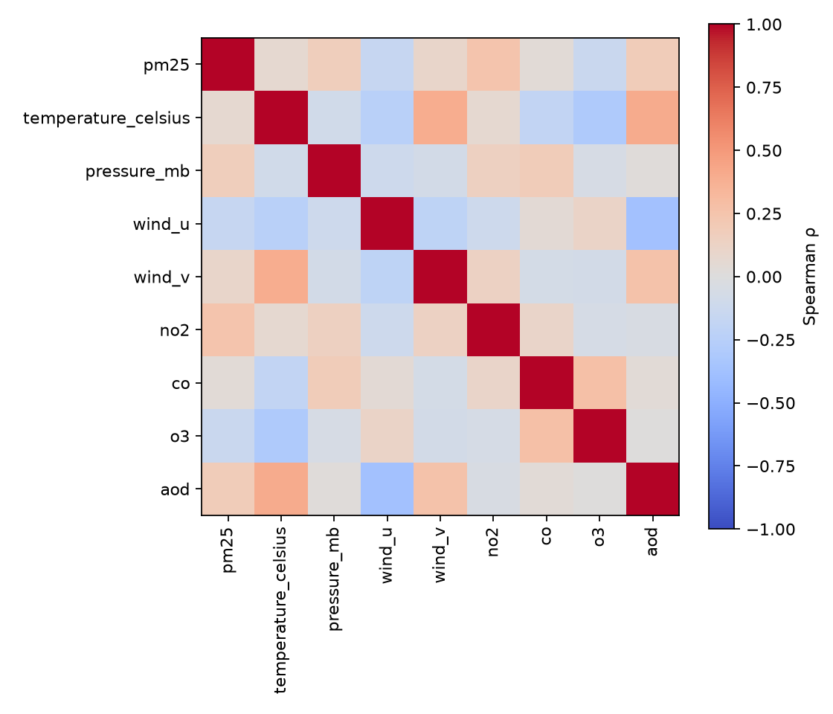
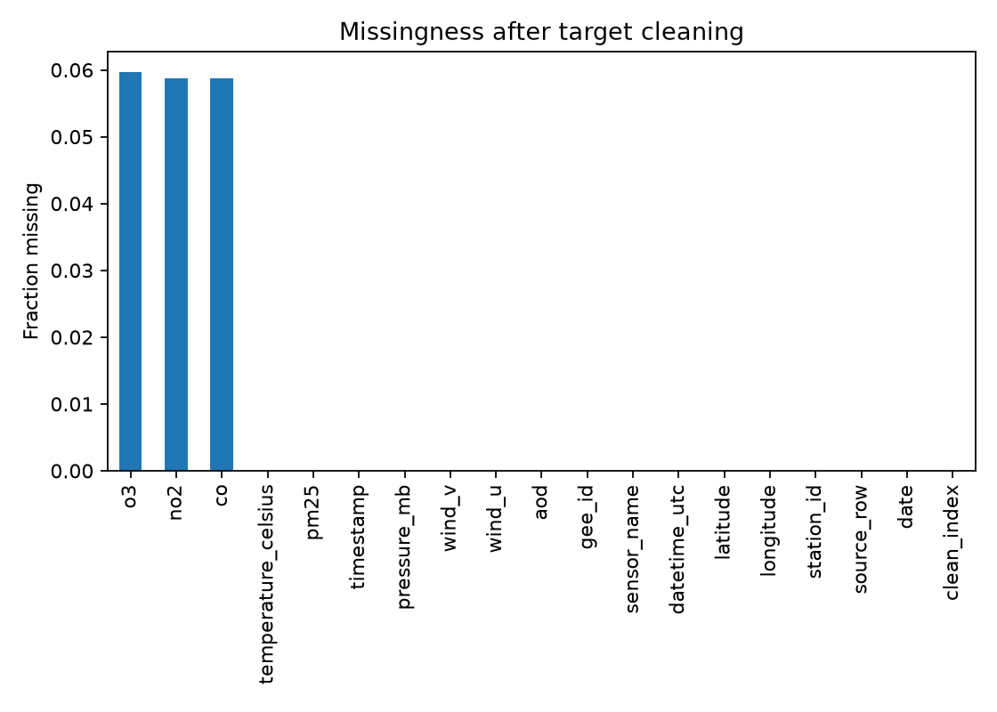
06 / RELATIONSHIPS
Part 1
Correlations and missing values
Figure 3. Spearman rank-correlation structure.
Figure 4. Missingness profile of the cleaned table.
Association with the target is weak
Missing values are confined to GEE gases
▸ Strongest rank correlation: NO₂, ρ = 0.247 — still weak in absolute terms.
▸ No pair reaches |r| > 0.9, so there is no multicollinearity red flag.
▸ These are context, not model inputs (availability unverified).
▸ no2 / co: 5.87% missing; o3: 5.97% missing.
▸ PM2.5 target and calendar terms: 0% missing.
▸ Any imputation happens inside a training fold — never dataset-wide.
GROUP 16 · PM2.5 FORECASTING · PART 1 · DATA & PREPROCESSING
8
Notes:
Weak exogenous signal is the reason the later model leans almost entirely on history.

Slide 10
07 / MISSING VALUES
Part 1
Missing-value strategy
Median
Fold-local
+ flags
imputation statistic
where it is fitted
indicator channels
robust to the heavy right tail
training partition only
record where a gap was filled
▸ Median imputation, not mean, because the target is heavily skewed.
▸ Imputer and scaler are fitted on each training fold's sequences, then applied to that fold's validation.
▸ Missingness indicators let the network distinguish a real low value from a filled one.
▸ Standardisation uses the same fold-local fit; the output head is inverse-transformed for scoring.
Why the reference preprocessing is frozen here
The target keeps its original µg/m³ scale, both missingness indicators are retained, and imputation and scaling stay fold-local — declared as the reference data contract, justified by leakage-safety and the target's skew, not by model scores.
GROUP 16 · PM2.5 FORECASTING · PART 1 · DATA & PREPROCESSING
9
Notes:
Fold-local fitting is a leakage control, not a convenience.

Slide 11
08 / FEATURES
Part 1
The seven-day sequence contract
7 past days
Past-only features
Target
[t−6 … t]
indexed per station
→
calendar cycles
PM2.5 lag & rolling
→
PM2.5 at t+1
(scalar µg/m³)
Channel | Type | Definition and why it is safe
pm25_lag1 | Past value | PM2.5 at the forecast origin t — the persistence signal.
pm25_roll3_mean | Past rolling | Mean of the three days ending at t.
pm25_roll7_mean | Past rolling | Mean of the seven days ending at t.
day_of_year_sin/cos | Calendar | Annual cycle as a smooth pair — known in advance.
day_of_week_sin/cos | Calendar | Weekly cycle as a smooth pair.
rolling missing flags | Indicator | Declare where a rolling summary was filled.
Three hard rules: no gap crossing · no station crossing · no future information. Each is enforced by an automated test.
GROUP 16 · PM2.5 FORECASTING · PART 1 · DATA & PREPROCESSING
10
Notes:
Nine processed channels: seven features plus two rolling missingness flags.

Slide 12
09 / PIPELINE
Part 1
Preprocessing pipeline and leakage control
Raw CSV
Cleaning
Split
Fold-local
Sequences
41,718 rows
→
target bounds + keys
→
date/station folds
→
impute + scale
→
7 days, no gaps
Control | Status | Evidence
Fold-local imputation and scaling | Pass | Fitted on the training partition of each fold only.
Past-only rolling features | Pass | Recomputed from values ≤ the forecast origin.
Origin/target alignment | Pass | Each label is exactly the next station-day.
Gap and station boundaries | Pass | Unit tests reject cross-station or gapped windows.
Environmental timing | Blocked | Exogenous channels withheld rather than assumed available.
Frozen holdout untouched | Pass | Reserved future block excluded from all selection.
GROUP 16 · PM2.5 FORECASTING · PART 1 · DATA & PREPROCESSING
11
Notes:
The verification boundary is stated honestly: the pipeline is clean, the publisher's upstream join cannot be reconstructed.

Slide 13
10 / HANDOFF
Part 1
Limitations and the frozen handoff
Area | Limitation carried into Parts 2 and 3
Licence | Compiled-bundle redistribution rights unresolved.
Upstream ETL | Publisher's omitted-row rule and tie handling remain unreconstructed.
Coverage | Sparse station-days limit formal temporal tests to six stations.
Environmental inputs | Meteorology, NO₂, CO, O₃ and AOD withheld (availability unverified).
Tail behaviour | Only a handful of development values exceed 100 µg/m³.
40,983 × 9
7 days
0 < y < 500
cleaned panel dimensions
past-only sequence length
target rule (µg/m³)
Part 1 verdict
The panel is clean enough to model and documented well enough to audit. It is not a dense grid and its licence is unresolved — so Part 2 must validate with temporal and station-grouped folds, keep preprocessing fold-local, and report uncertainty honestly.
GROUP 16 · PM2.5 FORECASTING · PART 1 · DATA & PREPROCESSING
12
Notes:
This is the handoff: Part 2 consumes exactly this contract.

