Slide 1
SUBMISSION PART 2 OF 3 · GROUP 16
Model Training, Validation & Evaluation
CNN–LSTM implementation, leakage-safe validation, tuning, baselines and honest performance testing
This deck turns Part 1's frozen data contract into a working forecasting system: the architecture, the training protocol, two leakage-safe validation designs, a nested tuning search, the required baselines, and measured out-of-fold and locked-future performance — with its uncertainty.
8.455
7.962
250
6.027
temporal CV RMSE (µg/m³)
station-grouped RMSE
tuning trials (5 × 50)
locked future RMSE
Integrity note
One-day-ahead PM2.5 is dominated by persistence. The network's edge over persistence is small and not statistically significant, and on the frozen future block persistence wins outright.
Group 16 · Part 2 of 3 · Model Training, Validation & Evaluation · deadline 12 December 2026

Slide 2
ROADMAP
Part 2
What this part covers
Section | Topic | Deliverable
01 | Objective and task | Regression contract and metric set
02 | Architecture | CNN–LSTM layer order and parameter budget
03 | Training protocol | Loss, schedule, early stopping, seeds
04 | Validation design | Expanding temporal + station-grouped folds
05 | Hyperparameter optimisation | Nested Optuna TPE, 5 × 50 trials
06 | Baselines | Persistence and weekly seasonal-naive
07–09 | Results | Out-of-fold scores, robustness, error structure
10–11 | Testing and handoff | Locked future block; what Part 3 receives
GROUP 16 · PM2.5 FORECASTING · PART 2 · MODEL TRAINING & EVALUATION
1
Notes:
Part 2 builds, tunes and tests; Part 3 tests statistically and explains.

Slide 3
01 / OBJECTIVE
Part 2
Objective, task and evaluation contract
Forecast next-day PM2.5 (µg/m³) at a station from the seven days ending at the forecast origin. Regression task; only values observed at or before the origin are admissible inputs.
Element | Definition fixed before any model was scored
Target | PM2.5 at station-day t+1, µg/m³, no transformation for scoring.
Inputs | Seven-day window ending at t: PM2.5 lag and rolling summaries + calendar cycles.
Primary metric | RMSE in µg/m³ — RMS-dominant because the tail matters.
Secondary metrics | MAE (robust central error) and R² (variance explained).
Excluded metric | MAPE — unstable because targets can approach zero.
Uncertainty | Fold SD, bootstrap CIs, paired significance tests (Part 3).
The metric set is deliberately small and pre-registered so that results cannot be chosen after the fact.
GROUP 16 · PM2.5 FORECASTING · PART 2 · MODEL TRAINING & EVALUATION
2
Notes:
Pre-registration protects against metric shopping.

Slide 4
02 / ARCHITECTURE
Part 2
The CNN–LSTM model
Input
Conv1D
LSTM
Dense → 1
7 days × 7 channels
→
causal kernel, k filters
→
recurrent summary
→
ReLU then scalar
Stage | Setting | Role
Causal Conv1D | filters 16/32/64, kernel 2/3/5 | Detects short local patterns; causal padding prevents future leakage.
LayerNorm + ReLU | per-channel | Stabilises activations on a heavy-tailed input.
Dropout | 0.05 – 0.35 | Regularises a small-data sequence model; tuned, not fixed.
LSTM | units 32/64, last step | Carries temporal state; compresses to one representation.
MaxPooling1D | optional | Kept only when it helped inside the inner loop.
Dense + ReLU → 1 | 32 units, linear out | Scalar forecast; inverted for scoring.
Reference model: 10,081 trainable parameters · lookback 7 · 7 input channels · ≈0.16 MB. TensorFlow 2.19.1, CPU only.
GROUP 16 · PM2.5 FORECASTING · PART 2 · MODEL TRAINING & EVALUATION
3
Notes:
Causal convolution is a leakage control, not a style choice.

Slide 5
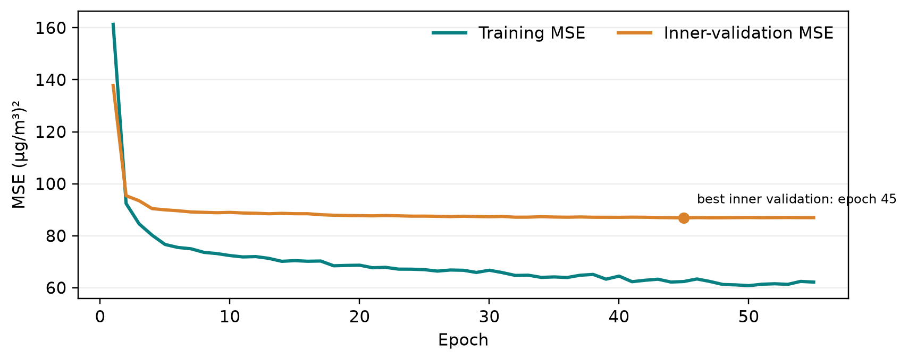
03 / TRAINING
Part 2
How the model is trained
MSE
Adam
Patience 10
Patience 3
training loss
optimiser
early stopping
LR schedule
weighted-MSE variant also tested
tuned lr ≈ 2e-4 to 1e-3
val MSE; best weights restored
ReduceLROnPlateau ×0.5, min 1e-5
▸ Early stopping halts when validation MSE plateaus for 10 epochs.
▸ The best-weight checkpoint is restored, never the last epoch.
▸ One fixed seed per outer fold (43–47) for paired comparability.
▸ Imputer and scaler fitted on that fold's training sequences only.
▸ Reference fit time 2.3 s on CPU; full nested search is 250 short trials.
▸ Environment: Python 3.12.10, TensorFlow 2.19.1, CPU only.
Figure 1. Representative training/validation loss curve.
GROUP 16 · PM2.5 FORECASTING · PART 2 · MODEL TRAINING & EVALUATION
4
Notes:
Validation loss flattening while training loss falls is the over-fitting signal.

Slide 6
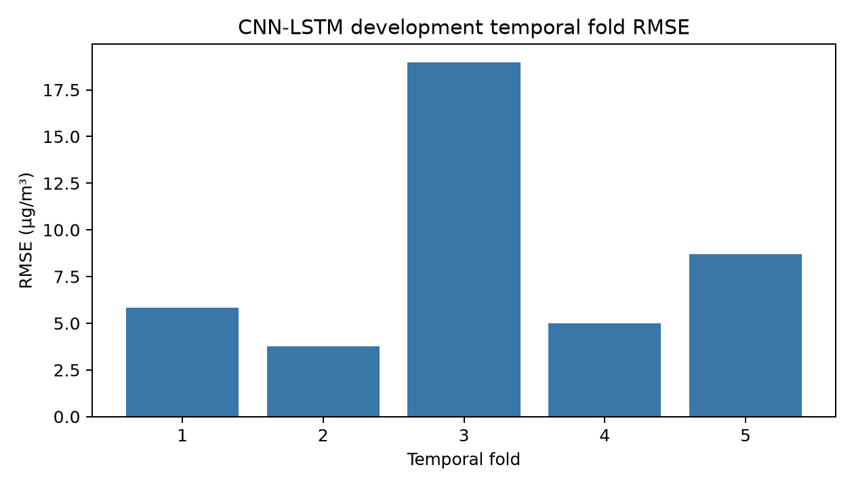
04 / VALIDATION
Part 2
Two honest validation schemes
Expanding temporal folds
Station-grouped folds
▸ Train on the past, validate on the next, later block.
▸ A one-day embargo prevents last-day bleed.
▸ Five folds; preprocessing refitted inside every fold.
▸ Split by composite station identity (name + coordinates).
▸ No instrument appears in both train and validation.
▸ Five folds; measures transfer to unseen locations.
The random-split diagnostic is not selection evidence
▸ Computed for one pre-declared architecture only.
▸ Random mean RMSE 8.091 vs temporal 8.301 — a −0.209 gap.
▸ Reported as a diagnostic; never used to select a model.
Figure 2. Per-fold RMSE under the expanding temporal scheme.
GROUP 16 · PM2.5 FORECASTING · PART 2 · MODEL TRAINING & EVALUATION
5
Notes:
Fold-level volatility is large — the SD is almost as large as the mean.

Slide 7
05 / TUNING
Part 2
Nested hyperparameter optimisation
TPE
50
250
Inner RMSE
sampler
trials per outer fold
completed trials
objective (µg/m³)
Optuna 5.0.0, seed 42
inner chronological split
5 outer folds
outer block never seen
Hyperparameter | Fold 1 | Fold 2 | Fold 3 | Fold 4 | Fold 5
Conv filters | 64 | 64 | 16 | 32 | 64
Kernel size | 5 | 2 | 3 | 5 | 2
LSTM units | 32 | 32 | 64 | 64 | 32
Dropout | 0.220 | 0.060 | 0.347 | 0.098 | 0.055
Learning rate | 7.4e-4 | 9.1e-4 | 7.7e-4 | 2.2e-4 | 9.99e-4
Reading the tuning result honestly
The optimum moves between folds: dropout spans 0.055–0.347 and filters 16–64. The search surface is shallow and the “best” point is only weakly separated from its neighbours — that instability is itself a finding.
GROUP 16 · PM2.5 FORECASTING · PART 2 · MODEL TRAINING & EVALUATION
6
Notes:
Nesting is what keeps the reported score honest.

Slide 8
06 / BASELINES
Part 2
Mandatory baselines
Persistence
Weekly seasonal-naive
▸ Forecast tomorrow = today's last observed PM2.5.
▸ No parameters, no fitting — and notoriously strong.
▸ Temporal RMSE 8.771 · Spatial 9.292 · Future block 5.846.
▸ Forecast tomorrow = the same weekday seven days earlier.
▸ Captures the weekly cycle without learning.
▸ Temporal RMSE 10.798 · Spatial 10.906 · Future block 8.027.
Why baselines are non-negotiable | Evidence
They establish the floor | A network that cannot beat persistence shows no skill.
They are paired | Identical fold membership removes fold-difficulty as a confounder.
They expose the MAE gap | Persistence MAE 3.158 / 3.119 vs network 3.978 / 4.024.
GROUP 16 · PM2.5 FORECASTING · PART 2 · MODEL TRAINING & EVALUATION
7
Notes:
Baselines are scored on identical folds and IDs, so every comparison is paired.

Slide 9
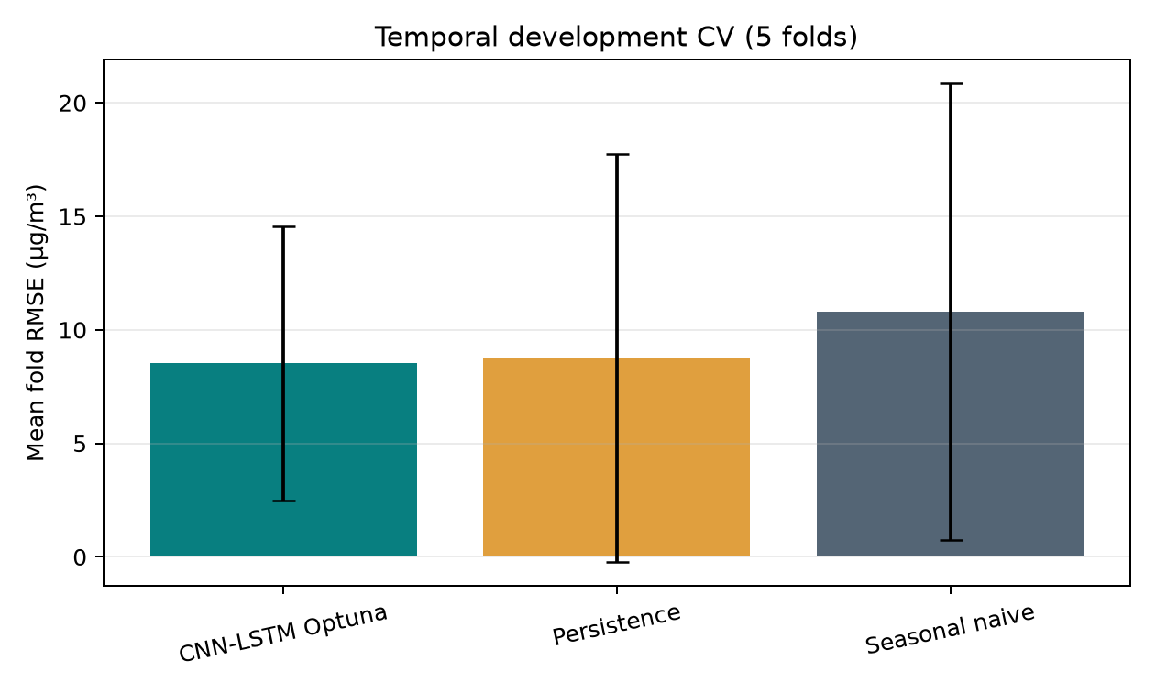
07 / DEVELOPMENT RESULTS
Part 2
Out-of-fold performance
8.455
3.911
7.962
0.212
temporal CV RMSE
temporal CV MAE
spatial CV RMSE
spatial CV R²
SD 6.161 · n = 2,867
SD 0.957
SD 4.143 · n = 3,349
temporal R² 0.106
Scheme / model | RMSE | SD | MAE | R² | Pooled RMSE | n
Temporal · CNN–LSTM | 8.455 | 6.161 | 3.911 | 0.106 | 9.582 | 2,867
Temporal · tuned (TPE) | 8.520 | 6.034 | 3.978 | 0.076 | 9.571 | 2,867
Temporal · persistence | 8.771 | — | 3.158 | — | — | 2,867
Temporal · seasonal-naive | 10.798 | — | — | — | — | 2,867
Spatial · CNN–LSTM | 7.962 | 4.143 | 3.292 | 0.212 | 8.700 | 3,349
How to read these numbers
▸ The network beats seasonal-naive decisively (≈ −2.28 temporal, −2.94 spatial).
▸ Against persistence the edge is small and not significant.
▸ R² is modest; fold SD is almost as large as the mean.
Figure 3. CNN–LSTM vs baselines on matched temporal folds.
GROUP 16 · PM2.5 FORECASTING · PART 2 · MODEL TRAINING & EVALUATION
8
Notes:
Do not over-claim: the honest story is a small, uncertain edge over persistence.

Slide 10
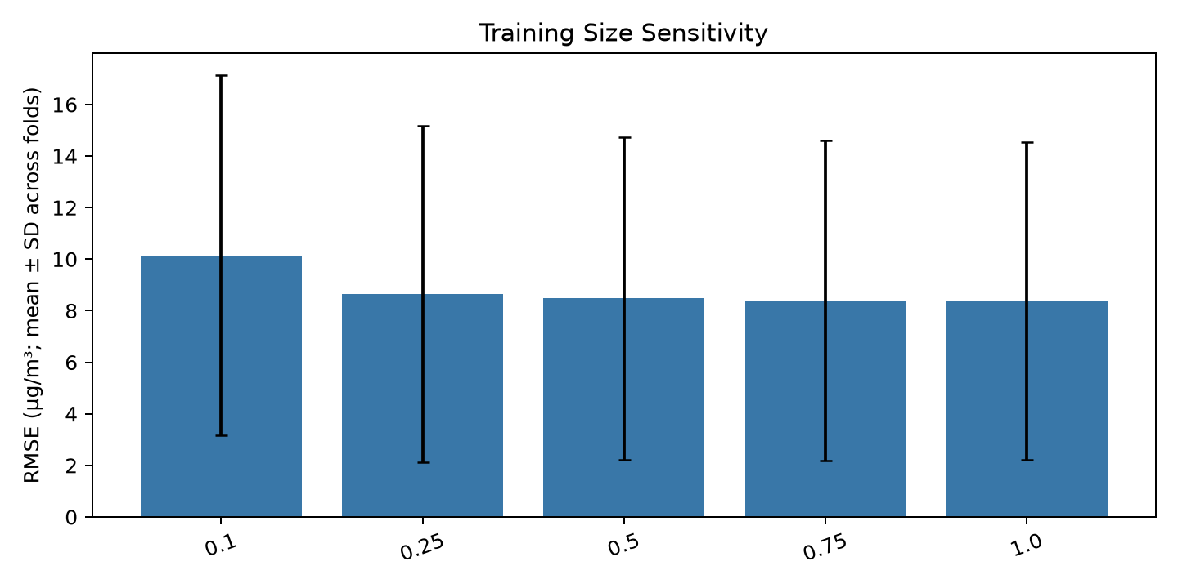
08 / ROBUSTNESS
Part 2
Stress-testing the result
Experiment | Result | Verdict
Training size 10% → 100% | 10.151 → 8.382 | Plateau — data-limited
Preprocessing: log1p target | 8.575 | Worse — reference kept
Preprocessing: drop indicators | 8.500 | Worse — flags kept
Extreme-event weighting | 8.600 | No material gain
Architecture ±1 step | mostly < 5% | Mostly stable
Figure 4. Learning curve: steep gain to 50%, then a plateau.
What the robustness panel establishes
▸ The result is not an artefact of one preprocessing or weighting choice.
▸ None of the tested alternatives improved on the reference materially.
▸ The one genuine sensitivity — filter count — is disclosed, not smoothed over.
GROUP 16 · PM2.5 FORECASTING · PART 2 · MODEL TRAINING & EVALUATION
9
Notes:
Every variant is scored on the same folds as the reference.

Slide 11
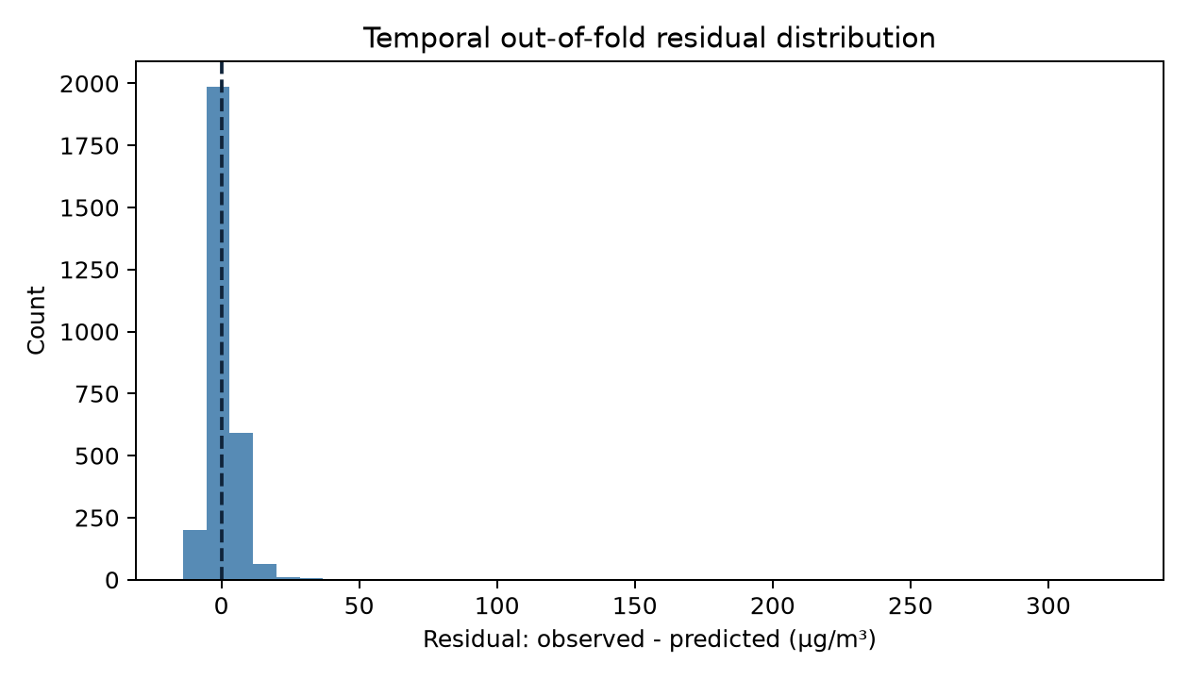
09 / ERROR STRUCTURE
Part 2
Where the model succeeds and fails
Season | n | RMSE | MAE
Spring | 244 | 3.600 | 2.886
Autumn | 652 | 6.273 | 3.921
Summer | 1,678 | 7.784 | 3.566
Winter | 293 | 21.285 | 6.404
Actual band | n | RMSE | Under-pred.
< 10 | 1,734 | 3.619 | 25%
10–25 | 1,070 | 5.045 | 80%
25–50 | 56 | 18.957 | 100%
> 50 | 7 | 166.120 | 100%
The core limitation, stated plainly
▸ Only 7 of 2,867 OOF points exceed 50 µg/m³ — and every one is under-predicted.
▸ The headline RMSE is governed by ordinary days; episode skill is unmeasured.
▸ Any operational claim on pollution episodes is unsupported by these data.
Figure 5. Out-of-fold residual distribution.
GROUP 16 · PM2.5 FORECASTING · PART 2 · MODEL TRAINING & EVALUATION
10
Notes:
Regression to the mean on the tail is the dominant failure mode.

Slide 12
10 / LOCKED FUTURE TEST
Part 2
The frozen independent estimate
A held-out future block (2024-12-08 → 2026-04-06) was scored once for the pre-locked model and then frozen; the record was written before scoring to prevent a second, opportunistic evaluation.
6.027
4.024
0.239
5.846
CNN–LSTM RMSE
CNN–LSTM MAE
CNN–LSTM R²
persistence RMSE
N = 1,716
same 1,716 IDs
Model (frozen block) | RMSE | MAE | R² | N
CNN–LSTM (locked) | 6.027 | 4.024 | 0.239 | 1,716
Persistence | 5.846 | 3.119 | — | 1,716
Weekly seasonal-naive | 8.027 | 5.361 | — | 1,716
The most important honest finding in Part 2
On the frozen block, persistence achieves a lower RMSE than the CNN–LSTM (5.846 vs 6.027) and a lower MAE. The network beats the weekly baseline comfortably but does not yet beat the no-model benchmark. This is the headline, not a footnote.
GROUP 16 · PM2.5 FORECASTING · PART 2 · MODEL TRAINING & EVALUATION
11
Notes:
Scored 2026-11-10 and locked in future_test_evaluation.json; read-only history.

Slide 13
11 / HANDOFF
Part 2
Limitations and what Part 3 receives
Area | Limitation carried into Part 3
Baseline parity | Persistence matches or beats the network on the locked block.
Inferential power | Only five dependent folds — p-values have low power.
Tail skill | Extreme days (> 50 µg/m³) are essentially unlearnable here (n = 7).
Validation realism | Temporal folds cannot model instrument drift or site relocation.
Exogenous inputs | Meteorology, trace gases and AOD remain excluded.
2,867 + 3,349
5 × 5
1,716
OOF predictions (temporal + spatial)
paired folds for testing
locked future IDs
Part 2 verdict
Built, tuned, validated and tested honestly. It beats a weekly baseline, does not significantly beat persistence, and its uncertainty is as large as its mean — Part 3 tests these three facts.
GROUP 16 · PM2.5 FORECASTING · PART 2 · MODEL TRAINING & EVALUATION
12
Notes:
The handoff is the OOF predictions plus the locked future estimate.

