Slide 1
GROUP 16 / TECHNICAL PRESENTATION
One-day-ahead
PM2.5 forecasting
A leakage-aware CNN–LSTM regression study
Bottom line
A plausible sequence model, but no statistically reliable overall gain over persistence; extreme-event errors remain large.
Historical future metrics are frozen; development validation is reported separately.
Notes:
Open by defining the forecast origin: use observations through the end of day t to predict station PM2.5 at t+1. State that this is a regression study. Development CV and previously saved future-period metrics are distinct.

Slide 2
01 / MOTIVATION
Forecast task and research questions
Why it matters
Short-horizon forecasts can help air-quality monitoring prioritize review and timely communication; forecasts are decision support, not health or regulatory determinations.
Regression, not classification
Target is continuous PM2.5 in µg/m³ at t+1. RMSE, MAE and R² retain concentration magnitude.
Main RQ | How accurately can issue-time history predict next-day PM2.5, and does CNN–LSTM beat past-only forecasts under leakage-safe validation?
Label | Research question
RQ1 | How does CNN–LSTM compare with persistence and seasonal-naive baselines?
RQ2 | What do temporal and station-grouped evaluations say about generalization?
RQ3 | Which available feature groups contribute, and how stable are they?
RQ4 | How do seasonality, sparse coverage, extreme events, missingness and rights limit use?
PM2.5 FORECASTING • 02
Notes:
Explain why monitoring can benefit from forecasts while avoiding an unsupported claim that the model itself improves health. Repeat that the target is a real-valued concentration, not a category. Introduce the main research question and the four labelled questions.

Slide 3
02 / DATA
Dataset and station identity
Item | Audited value
Prepared CSV rows | 41,718
After target cleaning | 40,983
Cleaned station IDs | 95
Date range | 2016-11-25 to 2026-04-06
Invalid PM2.5 removed | 735 (≤0 or ≥500)
Source | Kaggle, Mediterranean Basin, v1
Station key
Sensor name + latitude + longitude rounded to six decimals. Coordinates keep same-name sites distinct.
Count reconciliation
98 source IDs → 98 composite stations → 95 after cleaning. 94 sensor names; four names span two sites; three test entries removed.
Rights caveat: publisher metadata says “Other (specified in description)”; redistribution rights for the compiled bundle remain unresolved.
PM2.5 FORECASTING • 03
Notes:
The active file is a publisher-prepared combined table. Explain the composite station ID and why the source’s numeric-ID count differs from the cleaned station count. Be explicit that compiled-data redistribution rights remain unresolved.

Slide 4
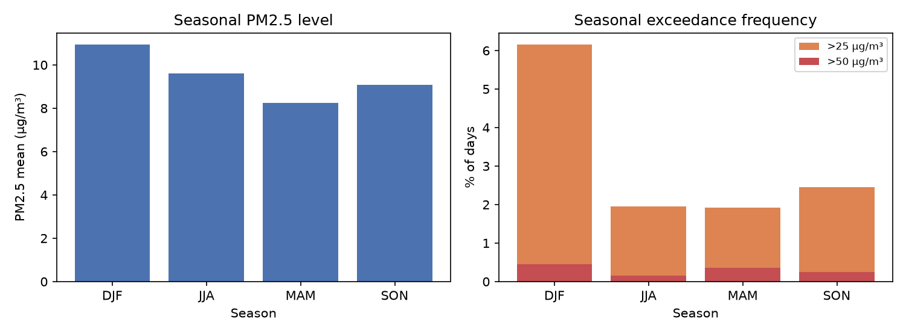
03 / EXPLORATORY ANALYSIS
Seasonality and PM2.5 thresholds
Season | Mean | Median | >25 | >50
DJF | 10.94 | 8.77 | 6.15% | 0.45%
MAM | 8.25 | 6.83 | 1.92% | 0.36%
JJA | 9.59 | 8.50 | 1.95% | 0.15%
SON | 9.08 | 7.47 | 2.46% | 0.25%
Winter has the highest mean and >25/>50 shares. Cutoffs are descriptive, not presented as compliance standards.
PM2.5 FORECASTING • 04
Notes:
Seasonal PM2.5 summaries show the highest mean and >25 and >50 shares in DJF. They are descriptive record-level statistics. The project’s 25 and 50 µg/m³ cutoffs are not described as normative thresholds.

Slide 5
04 / METHODOLOGY
Processing workflow and leakage prevention
Original CSV
41,718 rows
Cleaning
Target bounds
station-day audit
Preprocessing
Fold-local
imputer / scaler
Features
7-day past-only
sequences
Training
Inner TPE
outer scoring
→
→
→
→
• Temporal folds preserve date order and include a one-day raw-date embargo.
• Every sequence ends at day t; label is exactly station PM2.5 at t+1. Station changes and date gaps break sequences.
• Imputation and scaling are fitted only on each training fold. Hyperparameter selection uses chronological inner validation inside that fold.
• Inputs at/after cutoff were mutated in tests: earlier lag, rolling and sequence features remained unchanged.
• Meteorology, AOD, NO₂, CO and O₃ are excluded because forecast-issue-time availability is not verified.
PM2.5 FORECASTING • 05
Notes:
Walk through the workflow from prepared CSV to fold scoring. Emphasize the end-of-day origin and t+1 label, past-only features, embargo, fold-local preprocessing and inner-only tuning. Exogenous fields are excluded because observation dates alone do not prove availability to a forecaster.

Slide 6
05 / MODEL
CNN–LSTM architecture
7-day input
9 processed channels
(7 features + 2 flags)
Causal Conv1D
16 filters · k=3
local patterns
Norm + ReLU
Dropout 0.347
MaxPool
LSTM
64 units
gated memory
Dense → output
32 ReLU
scalar regression
→
→
→
→
CNN: local temporal patterns
Shared filters scan nearby days to learn short motifs such as local rises, falls and fluctuations.
LSTM: ordered dependencies
Gates update, retain or forget sequence information before a dense head maps the representation to PM2.5.
Why this architecture? It combines local pattern extraction with sequential memory. That makes it plausible for short temporal sequences—not automatically better than persistence.
PM2.5 FORECASTING • 06
Notes:
Explain causal convolution as local feature extraction over adjacent time positions. Explain the LSTM gates as a mechanism for retaining or updating sequential state. The scalar output is continuous regression. Justify the architecture as a hypothesis and note that evaluation does not prove it beats persistence.

Slide 7
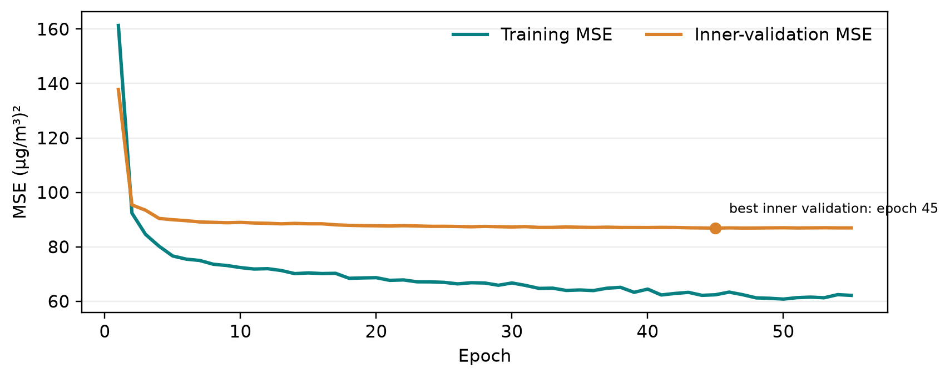
06 / FITTING
Training configuration and loss trace
Setting | Reference setting
History | 7 daily steps
Conv1D | 16 filters, kernel 3
LSTM / dense | 64 / 32 units
Dropout | 0.347
Optimizer | Adam
Loss | MSE
Search | 50 TPE trials/fold
Archived inner-fit history: best validation MSE 86.86 (µg/m³)² at epoch 45; training loss continues down. This is not an outer-fold score or the frozen historical checkpoint.
PM2.5 FORECASTING • 07
Notes:
Show both training and chronological inner-validation MSE. The best inner validation loss occurs at epoch 45, followed by modest improvement/flattening; the training loss continues lower, consistent with overfitting. This curve is a representative archived inner fit and must not be conflated with outer-fold metrics.

Slide 8
07 / ROBUSTNESS
Validation design
Fold | Validation dates | Train sequences | Validation n | Search
1 | 2019-04-30 – 2020-10-16 | 482 | 322 | 50 trials
2 | 2020-10-17 – 2021-10-24 | 801 | 172 | 50 trials
3 | 2021-10-25 – 2022-11-18 | 976 | 377 | 50 trials
4 | 2022-11-19 – 2024-01-30 | 1,353 | 733 | 50 trials
5 | 2024-01-31 – 2024-12-07 | 2,086 | 1,263 | 50 trials
Temporal CV
2,867 outer OOF predictions; expanding training windows.
Spatial CV
Held-out station groups; each has historical input sequences.
PM2.5 FORECASTING • 08
Notes:
Temporal folds test later periods with expanding training data. Spatial folds test held-out stations conditional on having historical sequences. These answer different questions and are not interchangeable. Hyperparameter search is nested in outer training data.

Slide 9
08 / RESULTS
Development metrics and baselines
Matched fixed diagnostic | RMSE, mean ± SD | MAE, mean ± SD | R², mean ± SD
CNN–LSTM | 8.301 ± 6.221 | 3.845 ± 0.921 | 0.156 ± 0.101
Persistence | 8.771 ± 8.984 | 3.158 ± 1.468 | 0.207 ± 0.476
Weekly seasonal-naive | 10.798 ± 10.039 | 4.721 ± 1.718 | −0.287 ± 0.525
TPE-selected temporal model
Mean-fold RMSE 8.520 ± 6.034
Mean-fold MAE 3.978 ± 0.892
Paired result vs persistence
Exact fold Wilcoxon p = .625
Holm-adjusted p = 1.00
Fixed-configuration baseline table and TPE-selected results are distinct analyses; five dependent folds imply low inferential power.
PM2.5 FORECASTING • 09
Notes:
The complete RMSE/MAE/R² table is a fixed predeclared CNN–LSTM compared with persistence and weekly seasonal-naive on matched folds. Separately, per-fold Optuna tuning gives mean-fold RMSE 8.520 and MAE 3.978. The paired test does not show a significant improvement over persistence.

Slide 10
09 / LOCKED RESULT
Frozen historical future estimate
6.0272
RMSE µg/m³
4.0240
MAE µg/m³
0.2394
R²
1,716
predictions
What this number is
Previously saved historical score; reported unchanged and separate from development CV.
What it is not
No new holdout evaluation or baseline comparison was run for this submission.
A development-only refit reproduces all saved predictions (max |Δ| = 7.1 × 10⁻¹⁵); original weight-file identity cannot be verified.
PM2.5 FORECASTING • 10
Notes:
State clearly that this is a previously saved score, not a new experiment in this turn. No future labels were read and no new baseline score was computed. Prediction equivalence does not prove that the absent original checkpoint has identical bytes.

Slide 11
10 / INTERPRETATION
Explainability and inactive pollutant indicators
Feature channel | Mean ΔRMSE | Mean rank
PM2.5 lag-1 | 0.651 | 1.0
Rolling-3 mean | 0.153 | 3.0
Rolling-7 missing flag | 0.052 | 4.8
Day-of-year sine | 0.033 | 5.6
Rolling-3 missing flag | 0.017 | 5.8
Interpretation
Lag-1 is consistently important; it also helps explain why persistence is hard to beat.
Why no pollutant flags?
NO₂/CO/O₃ values are excluded because issue-time availability is unverified. Their missingness flags are therefore not active in the final model.
Permutation importance is model-conditional, not causal. The final feature-selected refit uses PM2.5 lag-1 only.
PM2.5 FORECASTING • 11
Notes:
Permutation importance ranks lag-1 first in all five folds. Missingness indicators exist for derived rolling channels in the reference preprocessing. Pollutant-specific flags are not in the final selected model because the pollutants themselves are excluded pending issue-time availability evidence.

Slide 12
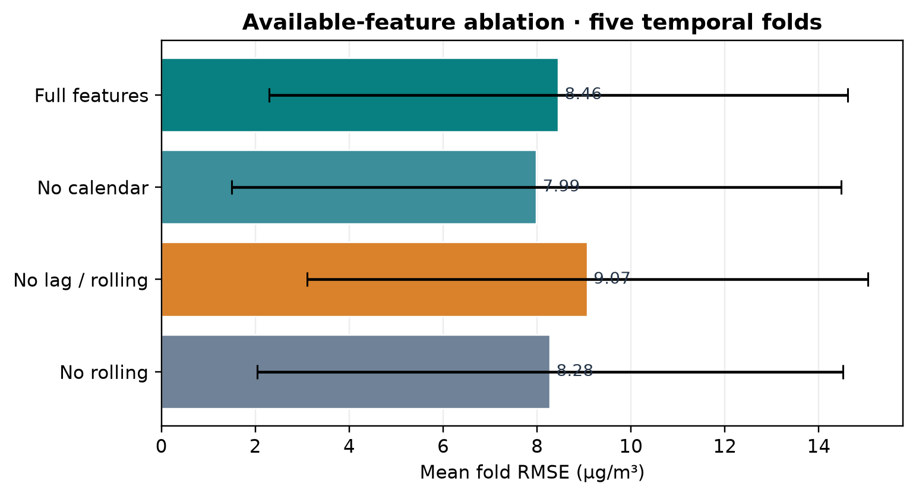
11 / SENSITIVITY
Ablation and robustness
Feature removal | Δ mean RMSE | 95% interval
No calendar | −0.467 | [−0.957, −0.088]
No lag/rolling | +0.617 | [+0.249, +1.022]
No rolling | −0.177 | [−0.337, −0.043]
Fixed folds, no retuning. Exogenous-family ablations are blocked, not negative results.
PM2.5 FORECASTING • 12
Notes:
Removing target lag and rolling features worsens fold RMSE. Removing calendar or rolling channels produces small improvements in this fixed no-retuning experiment. Do not treat this as an optimized feature search. Exogenous ablation variants are blocked because availability is unverified.

Slide 13
12 / FAILURE MODES
Error analysis: typical and extreme cases
OOF case | Actual | Predicted | |Error| | Reading
Low, 2020-06-28 | 5.00 | 3.96 | 1.04 | Small miss
Moderate, 2022-01-21 | 17.50 | 12.96 | 4.54 | Underpredicts rise
Elevated, 2022-02-04 | 37.92 | 13.88 | 24.04 | Large miss
Extreme, 2022-02-13 | 124.33 | 15.73 | 108.60 | Severe underprediction
Largest, 2022-02-14 | 338.80 | 16.16 | 322.64 | Far outside learned range
Tail limitation
Only seven OOF targets exceed 50 µg/m³; high-band estimates are unstable, but examples show the model can miss abrupt severe events.
PM2.5 FORECASTING • 13
Notes:
Use these examples as descriptive development OOF cases only. Positive actual-minus-predicted residual means the model underpredicts. There were only seven cases over 50 µg/m³, so tail error estimates are unstable, but missing severe events is an important practical limitation.

Slide 14
13 / GENERALIZATION
Coverage limitations and spatial validation
Temporal diagnostics
ACF/PACF: 63 stations with ≥14 uninterrupted daily observations.
ADF/KPSS/Ljung–Box: only 6 stations with ≥30 days.
Lead–lag diagnostics
Usable pollutant pairs at six stations; 2–6 stations per lag. Correlations are descriptive, sparse and non-causal.
Spatial-grouped pooled scores
RMSE 8.700 µg/m³ | MAE 3.287 µg/m³ | R² 0.154 | n=3,349
What the spatial split means
Test stations are held out, but historical inputs at those stations remain available. Not a cold-start evaluation.
Irregular gaps, sparse pollutant records and a pre-holdout development cutoff limit the number of long continuous station series. Six stations cannot support basin-wide claims.
PM2.5 FORECASTING • 14
Notes:
Explain that requiring uninterrupted daily segments avoids pretending missing days are consecutive. Most station series are too short for formal tests; only six meet the 30-day requirement and have adequate lead-lag pairs. Spatial validation allows history at each held-out station and therefore does not measure cold-start performance.

Slide 15
14 / EVIDENCE BOUNDARIES
Statistical interpretation and data limitations
Evidence | Estimate | Interpretation
Mean-fold RMSE | 8.520 vs 8.771 | CNN–LSTM vs persistence; small difference
Paired exact Wilcoxon | p=.625; Holm=1.00 | No significant gain established
Pooled RMSE delta | −1.131; 95% CI [−2.824, 0.797] | 72-station cluster interval includes zero
• Five dependent folds provide low power; intervals are conditional on this dataset and do not account for all model-search uncertainty.
• Compiled data redistribution rights, component attribution mapping and full upstream inclusion rule remain unresolved.
• The historical checkpoint is missing; prediction reproduction is not binary-weight identity.
PM2.5 FORECASTING • 15
Notes:
Describe the paired test and cluster-bootstrap interval with the sample limitations. The confidence interval includes zero, and only five temporal folds are available. Also disclose the data-rights caveat and missing original weights.

Slide 16
15 / SYNTHESIS
Discussion: direct answers to RQ1–RQ4
RQ1
No reliable advantage over persistence is established; RMSE is slightly lower, but MAE is higher and the paired test is nonsignificant.
RQ2
Performance changes sharply across periods; spatial folds are conditional on historical station sequences and do not prove cold-start transfer.
RQ3
Lag-1 carries the clearest signal. Calendar/rolling additions are not consistently useful; environmental predictors remain excluded.
RQ4
Winter is higher on average, but extreme events are underpredicted; diagnostics cover only six stations and reuse rights remain unresolved.
PM2.5 FORECASTING • 16
Notes:
Answer each question explicitly. For RQ1, say no significant improvement. For RQ2, separate temporal and spatial scopes. For RQ3, identify lag-1 and qualified ablation findings. For RQ4, connect seasonality, sparse diagnostics, extreme error and unresolved rights.

Slide 17
16 / TAKEAWAY
Conclusion and recommendation
The CNN–LSTM is a reasonable model to test—not a demonstrated winner.
• Keep persistence as the minimum operational benchmark.
• Do not deploy the CNN–LSTM as superior on current evidence.
• Before deployment: verify real-time availability, collect more severe-event examples, quantify uncertainty and run a prospective evaluation.
• Before redistribution: resolve the compiled dataset license and attribution chain.
Defense summary
Leakage-aware one-day-ahead regression; local CNN patterns plus LSTM memory; mixed results; conservative scientific conclusion.
PM2.5 FORECASTING • 17
Notes:
Conclude that the architecture is a plausible research candidate but not yet preferable to persistence for deployment. Give a clear answer to whether it is worth using: not as a claimed winner on these data. Mention the minimum evidence needed to revisit the decision.

