Slide 1
SUBMISSION PART 3 OF 3 · GROUP 16
Statistical Testing & Explainability
Paired significance tests, effect sizes, feature importance, ablations and a critical reading
This part asks the questions Part 2 left open: are the differences real or noise, which inputs carry signal, how stable is the explanation, and what do the results honestly support? Every claim is paired with an interval, an effect size and an explicit power caveat.
0
0.651
0.672
−0.467
significant pairs after Holm
importance of pm25_lag1
cross-scheme rank ρ
RMSE change, no calendar
Integrity note
With five dependent folds the tests are underpowered by construction. Effect sizes and intervals carry the argument; p-values are a secondary, honest signal.
Group 16 · Part 3 of 3 · Statistical Testing & Explainability · deadline 2 January 2027

Slide 2
ROADMAP
Part 3
What this part covers
Section | Topic | Deliverable
01 | Objective and questions | RQ2, RQ3, RQ4, RQ5 owned here
02 | Statistical framework | Wilcoxon, Holm, bootstrap, effect size, power caveat
03 | Paired comparisons | Temporal and spatial model pairings
04 | Validation-scheme ablation | Optimism gap of a careless split
05–07 | Explainability | Permutation importance and its stability
08 | Ablations | Feature-family and preprocessing evidence
09–10 | Conditional error and diagnostics | Season, band, extremes, ACF, lead–lag
11–12 | Validity and conclusions | What is and is not supported
GROUP 16 · PM2.5 FORECASTING · PART 3 · STATISTICAL TESTING & EXPLAINABILITY
1
Notes:
Part 3 converts numbers into defensible claims.

Slide 3
01 / OBJECTIVE
Part 3
Objective and the questions Part 3 owns
Part 2 produced numbers. Part 3 decides which of them mean anything: inferential statistics (is the difference real?) plus explainability (which inputs drive the forecast, and how stable is that story?), closing with an honest interpretation.
RQ | Question owned by Part 3
RQ2 | Does the CNN–LSTM beat persistence and seasonal-naive significantly, or within noise?
RQ3 | Which feature families carry signal? Which can be removed without loss — or help?
RQ5 | Is the feature-importance ranking stable within a scheme and across schemes?
RQ4 | How do seasonality, bands and extremes condition the error, and what does that imply?
Deliverables
▸ Paired Wilcoxon tests on fold RMSE with Holm-Bonferroni correction and rank-biserial effect sizes.
▸ Bootstrap confidence intervals for every mean difference (10,000 replicates).
▸ Permutation feature importance with cross-scheme and within-scheme stability analysis.
▸ Ablation evidence, conditional error analysis, and a threats-to-validity section.
GROUP 16 · PM2.5 FORECASTING · PART 3 · STATISTICAL TESTING & EXPLAINABILITY
2
Notes:
Part 3 is the critical-thinking layer of the project.

Slide 4
02 / FRAMEWORK
Part 3
The statistical testing framework
Wilcoxon
Holm
10,000
r
primary test
multiplicity control
bootstrap replicates
effect size
signed-rank on fold RMSE
across generated pairs
fold-pair mean difference
matched-pairs rank-biserial
Choice | Why it is the right choice here
Paired testing | Identical fold membership removes fold difficulty as a confounder.
Wilcoxon signed-rank | Five dependent fold differences; a rank test avoids normality assumptions.
Supplemental permutation | 10,000 paired sign permutations cross-check the rank test.
Fold-pair bootstrap | 10,000 resamples give a CI for the mean difference — the primary evidence.
Holm-Bonferroni | Controls family-wise error without plain-Bonferroni conservatism.
Rank-biserial effect size | Reports magnitude, not just significance — essential at low power.
Power is the binding constraint — stated up front
With n = 5 dependent folds the smallest attainable two-sided Wilcoxon p is 0.0625 and effective power is low. A non-significant result is therefore uninformative about the absence of an effect; effect sizes and intervals carry the argument.
GROUP 16 · PM2.5 FORECASTING · PART 3 · STATISTICAL TESTING & EXPLAINABILITY
3
Notes:
Be explicit that the tests are underpowered; this is honesty, not weakness.

Slide 5
03 / COMPARISONS
Part 3
Paired model comparisons — temporal folds
Comparison (temporal) | A | B | Δ (A−B) | 95% CI of Δ | p | Holm p
CNN–LSTM vs persistence | 8.520 | 8.771 | −0.251 | −2.960, 1.530 | 0.625 | 1.00
CNN–LSTM vs seasonal-naive | 8.520 | 10.798 | −2.278 | −6.028, −0.048 | 0.188 | 1.00
persistence vs seasonal-naive | 8.771 | 10.798 | −2.027 | −3.067, −1.155 | 0.063 | 1.00
Fold-mean RMSE in µg/m³. Negative Δ favours the first model. Every interval spans or nearly spans zero once correction is applied.
Bottom line on significance
But the intervals are still informative
▸ No comparison survives Holm correction.
▸ Directions favour the network over the weekly baseline.
▸ With five folds the tests cannot separate these from noise.
▸ Seasonal-naive intervals exclude zero before correction, on both schemes.
▸ Consistent, one-directional evidence the network beats a weekly baseline.
▸ The formal threshold is simply not reachable at n = 5.
GROUP 16 · PM2.5 FORECASTING · PART 3 · STATISTICAL TESTING & EXPLAINABILITY
4
Notes:
Lead with the honesty: nothing is significant, yet the direction is consistent.

Slide 6
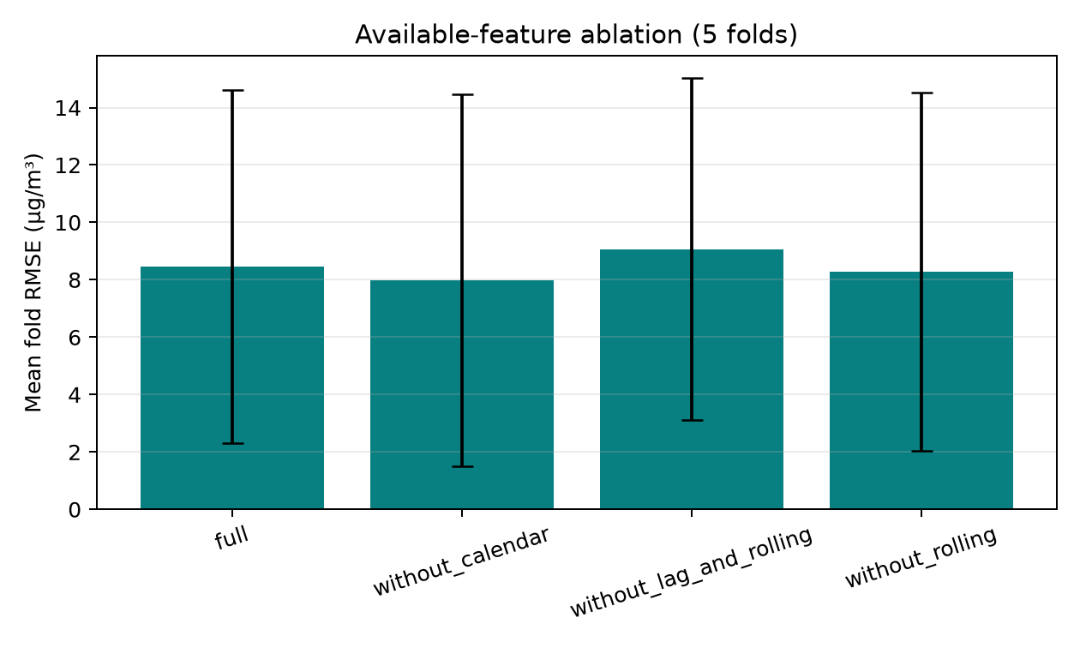
03 / COMPARISONS
Part 3
Paired model comparisons — station-grouped folds
Comparison (spatial) | A | B | Δ (A−B) | 95% CI of Δ | p | Holm p
CNN–LSTM vs persistence | 7.962 | 9.292 | −1.330 | −3.036, 0.085 | 0.313 | 1.00
CNN–LSTM vs seasonal-naive | 7.962 | 10.906 | −2.944 | −7.224, −0.298 | 0.125 | 1.00
persistence vs seasonal-naive | 9.292 | 10.906 | −1.614 | −6.244, 1.929 | 1.000 | 1.00
The spatial scheme gives larger point differences in the network's favour, but the intervals remain wide enough that significance is still not reached.
Interpretation across both schemes
▸ Direction is stable: the network beats seasonal-naive, and slightly leads persistence.
▸ Magnitude is not: spatial deltas are larger, temporal deltas smaller.
▸ Neither scheme reaches significance — the conclusion is directional, not confirmatory.
Figure 1. Ablation view supporting the comparison narrative.
GROUP 16 · PM2.5 FORECASTING · PART 3 · STATISTICAL TESTING & EXPLAINABILITY
5
Notes:
Both schemes point the same way; neither confirms it formally.

Slide 7
04 / SCHEME ABLATION
Part 3
How much does the split flatter the score?
For one pre-declared architecture the same model was scored under a random split and under the two task-faithful schemes; the gap quantifies the optimism a careless split would introduce.
Model | Random | Temporal | Spatial | Interpretation
CNN–LSTM (diagnostic) | 8.091 | 8.301 | 7.939 | Random is −0.209 vs temporal: a modest gap.
Persistence | 9.378 | 8.771 | 9.292 | No fitted parameters — the scheme matters little.
Seasonal-naive | 11.287 | 10.798 | 10.906 | Same; the scheme matters most for learned models.
What this tells us
Do not over-read the gap
▸ The optimism gap is smaller than the fold-to-fold SD.
▸ It is still non-zero and biased in the expected direction.
▸ That is exactly why selection used only temporal and spatial folds.
▸ A single architecture on five folds cannot establish a general law.
▸ The correct claim is narrow: for this model and panel, ≈0.21 µg/m³.
▸ Random splits are never used for model selection.
GROUP 16 · PM2.5 FORECASTING · PART 3 · STATISTICAL TESTING & EXPLAINABILITY
6
Notes:
Keep the claim narrow and model-specific.

Slide 8
05 / EXPLAINABILITY
Part 3
Permutation feature importance
Trained fold
Shuffle one channel
Re-score
Aggregate
model + OOF sequences
→
break its link to target
→
RMSE degradation = importance
→
mean & rank over 5 folds
Why permutation, and its honest limits
Interpretation discipline
▸ Model-agnostic: the same procedure explains the network and the baselines.
▸ It measures importance in the context of the trained model, not intrinsic to the variable.
▸ Correlated channels share credit — permuting lag-1 while roll channels carry the same level can understate its effect.
▸ Negative importance is a known artefact and is reported as evidence of redundancy.
▸ All channels are engineered from the same PM2.5 series.
▸ So importance answers “which engineered channel does this model lean on?”
▸ It does not answer “which physical driver causes PM2.5?”
▸ The causal question is outside the scope of this dataset (Part 1).
GROUP 16 · PM2.5 FORECASTING · PART 3 · STATISTICAL TESTING & EXPLAINABILITY
7
Notes:
State clearly that importance here is model reliance, not causality.

Slide 9
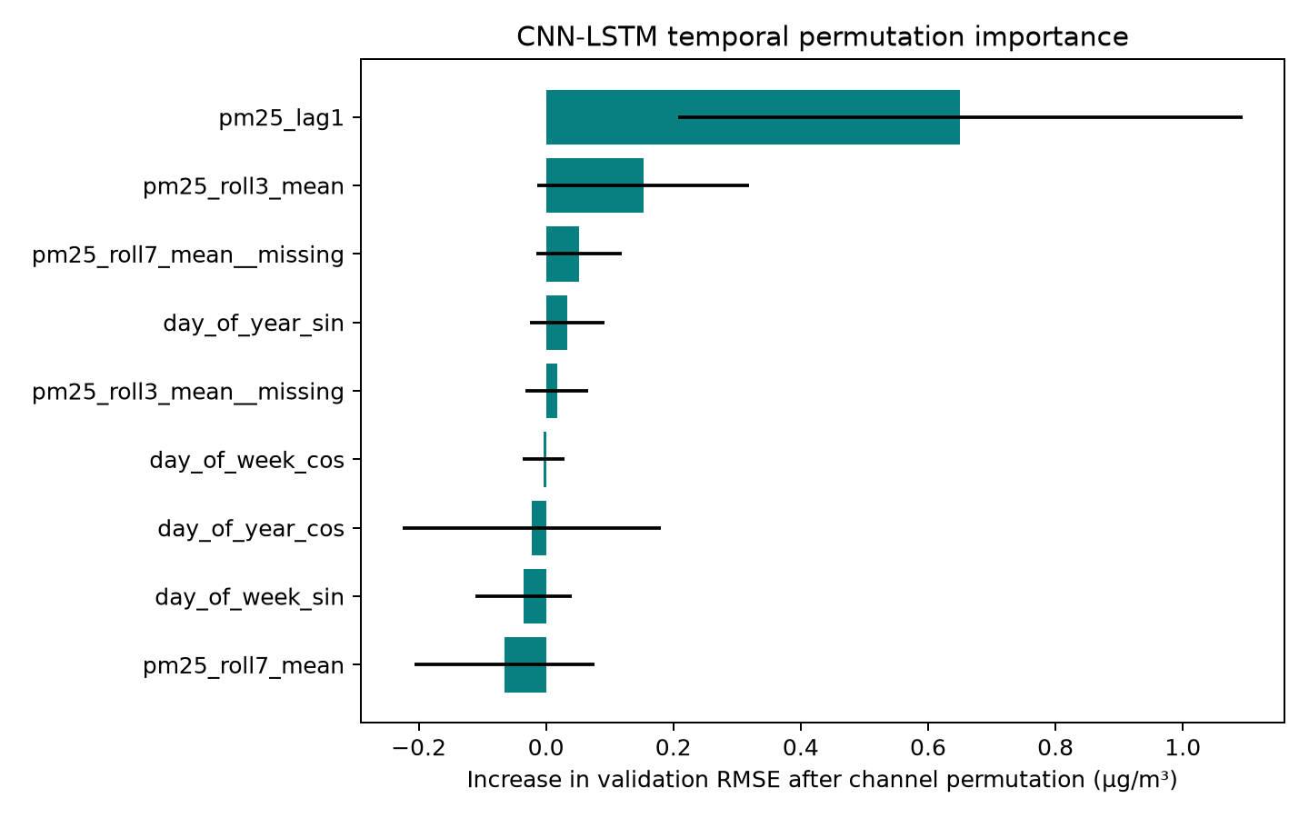
06 / IMPORTANCE RESULTS
Part 3
Which channels matter
Channel | Mean imp. | SD | Mean rank
pm25_lag1 | 0.651 | 0.443 | 1.0
pm25_roll3_mean | 0.153 | 0.167 | 3.0
pm25_roll7_mean__missing | 0.052 | 0.067 | 4.8
day_of_year_sin | 0.033 | 0.059 | 5.6
day_of_year_cos | −0.022 | 0.203 | 5.4
pm25_roll7_mean | −0.065 | 0.142 | 6.8
Figure 2. Feature importance with fold-level spread.
Only lag-1 is robustly above zero
Half of the engineered channels add nothing
▸ pm25_lag1 mean 0.651 with SD 0.443 across folds.
▸ Calendar terms are weak to negative.
▸ roll7 is negative — removing it does not hurt.
▸ The day-to-day dynamic is a slowly-varying level plus noise.
▸ This matches Part 1's weak exogenous correlations.
▸ The model is, in effect, a regularised persistence estimator.
GROUP 16 · PM2.5 FORECASTING · PART 3 · STATISTICAL TESTING & EXPLAINABILITY
8
Notes:
Importance is concentrated; only the PM2.5 history channel is robust.

Slide 10
07 / STABILITY
Part 3
Is the explanation stable?
Across schemes the importance ranking agrees moderately: Spearman ρ = 0.672 and top-5 Jaccard = 0.667. Within a single scheme, across folds, it does not.
Axis | Spearman ρ | Jaccard top-5 | Reading
Temporal vs spatial | 0.672 | 0.667 | Moderate — the core signal survives both schemes.
Fold 4 vs fold 5 (temporal) | 0.683 | 0.667 | Best pair — still not a stable ranking.
Fold 3 vs fold 5 (temporal) | −0.017 | 0.250 | Essentially no agreement between two folds.
All temporal fold pairs | −0.02 – 0.68 | 0.25 – 0.67 | None met the pre-set stability threshold.
The honest conclusion about explainability
▸ The coarse story is stable: PM2.5's own recent history dominates, calendar terms are marginal.
▸ The fine ranking is not: two folds of the same scheme can disagree almost completely.
▸ Any claim of the form “feature X is third-most important” is unsupported by these data.
GROUP 16 · PM2.5 FORECASTING · PART 3 · STATISTICAL TESTING & EXPLAINABILITY
9
Notes:
This is the most important nuance in the explainability section.

Slide 11
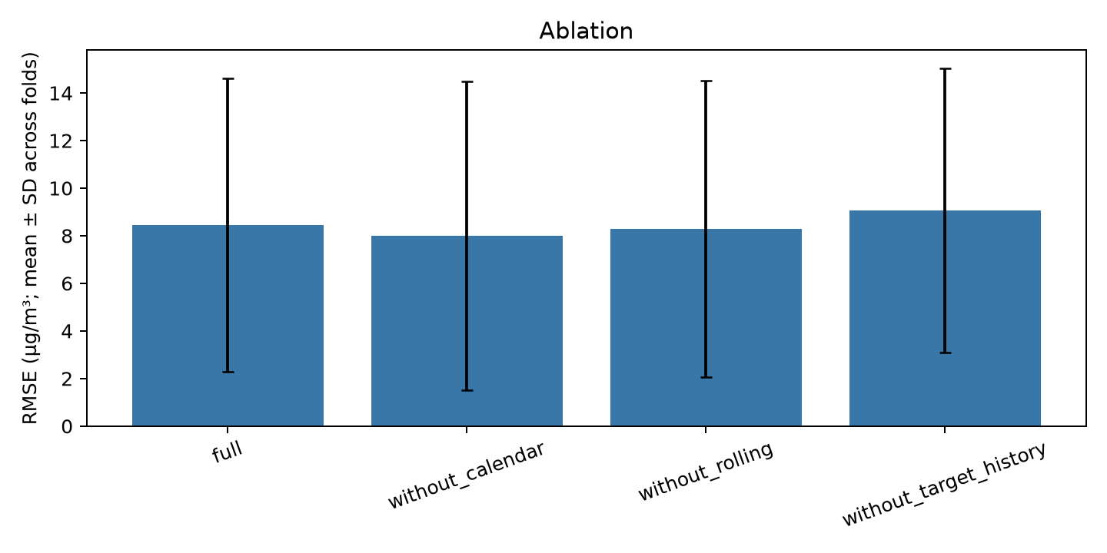
08 / ABLATIONS
Part 3
Does removing a feature family help or hurt?
Variant | Mean RMSE | Δ vs full | 95% CI of Δ | Reading
Full feature set | 8.455 | — | — | Reference.
Without calendar | 7.988 | −0.467 | −0.957, −0.088 | Removing calendar improves RMSE.
Without rolling | 8.278 | −0.177 | −0.337, −0.043 | Removing rolling means also improves.
Without lag and rolling | 9.072 | +0.617 | +0.249, +1.022 | Removing PM2.5 history hurts badly.
Two conclusions the ablations force
▸ Parsimony wins: the best configuration removes the calendar channels entirely.
▸ History is the model: every variant that removes the PM2.5 lag collapses.
▸ A model can rely on a channel that is net-harmful — hence importance and ablation together.
Figure 3. Ablation deltas.
Negative Δ = better than the full set. Intervals exclude zero — among the few statistically coherent effects in the study.
GROUP 16 · PM2.5 FORECASTING · PART 3 · STATISTICAL TESTING & EXPLAINABILITY
10
Notes:
The ablation is treated as stronger evidence than permutation importance.

Slide 12
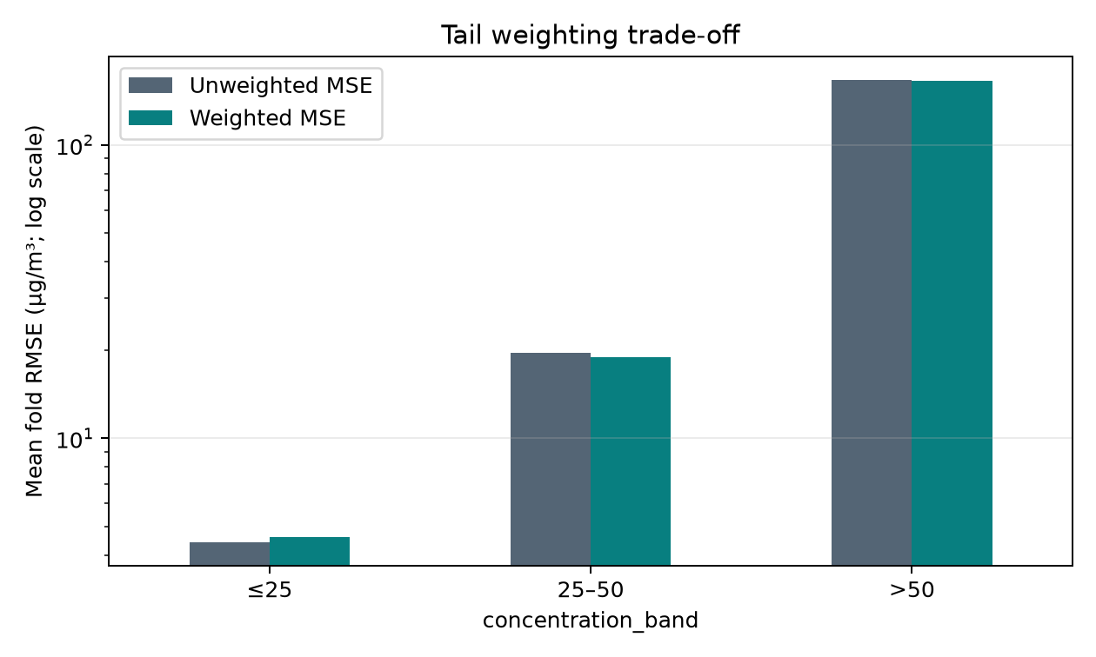
09 / CONDITIONAL ERROR
Part 3
Where the error lives
Season | n | RMSE | MAE
Spring | 244 | 3.600 | 2.886
Autumn | 652 | 6.273 | 3.921
Summer | 1,678 | 7.784 | 3.566
Winter | 293 | 21.285 | 6.404
Band | n | RMSE | Under-pred.
< 10 | 1,734 | 3.619 | 25%
10–25 | 1,070 | 5.045 | 80%
25–50 | 56 | 18.957 | 100%
> 50 | 7 | 166.120 | 100%
What this implies for use
▸ A single RMSE of ~8 µg/m³ is misleading for decisions.
▸ Ordinary days (< 10) error ≈ 3.6; episode days one-to-two orders larger.
▸ Any use must state it is specifically blind to episodes.
Figure 4. Extreme-event weighting barely moves overall or tail RMSE.
GROUP 16 · PM2.5 FORECASTING · PART 3 · STATISTICAL TESTING & EXPLAINABILITY
11
Notes:
Under-prediction of every point above 25 µg/m³ is a textbook pattern.

Slide 13
10 / DIAGNOSTICS
Part 3
Supporting time-series diagnostics
Diagnostic | Coverage | Finding
ACF / PACF at lag 1 | 63 stations | Lag-1 autocorrelation positive and often large (up to ≈0.85).
Formal ADF / KPSS / Ljung-Box | 6 stations | Mixed outcomes — no single stationarity verdict is defensible.
Longest uninterrupted segment | 14–32 days | Formal tests need ≥ 30 days; only a few stations qualify.
Pollutant | Best lag | Median r | Reading
O3 | 0 to −1 days | −0.51 to −0.56 | Consistent negative; strongest — but availability unverified.
CO | +1 day | +0.21 | Weak and inconsistent; no usable relationship.
NO2 | various | −0.10 to +0.07 | Negligible at the station level.
Why this supports the honest headline
Strong lag-1 autocorrelation and weak exogenous relationships predict the observed outcome: a persistent series makes persistence hard to beat, and weak exogenous signal gives the network little extra to learn. The results are consistent with the process.
GROUP 16 · PM2.5 FORECASTING · PART 3 · STATISTICAL TESTING & EXPLAINABILITY
12
Notes:
Diagnostics are descriptive and limited by sparse coverage.

Slide 14
11 / VALIDITY
Part 3
What these results do and do not support
Threat | Severity | Consequence and mitigation
Statistical power | High | Five folds give smallest p ≈ 0.0625; lead with effect sizes and intervals.
Sparse extreme coverage | High | Only 7 OOF points above 50 µg/m³, all under-predicted.
Feature-context confounding | Medium | Permutation importance measures model reliance, not causality.
Unstable within-scheme ranks | Medium | Only coarse conclusions are drawn.
Excluded exogenous inputs | Medium | Meteorology, gases and AOD withheld (Part 1).
Single architecture family | Low-Med | Generalises to this model, not to a model class.
Supported
▸ The network beats the weekly baseline in direction on both schemes.
▸ PM2.5's own recent history is by far the dominant input.
▸ Calendar features are not earning their place.
Not supported
▸ That the CNN–LSTM significantly outperforms persistence.
▸ That the model has any skill on pollution episodes.
▸ That any specific feature ranking is stable.
GROUP 16 · PM2.5 FORECASTING · PART 3 · STATISTICAL TESTING & EXPLAINABILITY
13
Notes:
Separating supported from unsupported claims is the core of Part 3.

Slide 15
12 / CONCLUSIONS
Part 3
Conclusion
No
Lag-1
−0.467
significant pairs after Holm
the only robust input
RMSE when calendar removed
five folds is too few
history dominates
less can be more
The project delivers a leakage-safe, reproducible, honestly-measured one-day-ahead PM2.5 forecaster. It shows a CNN–LSTM can be built, tuned and evaluated correctly on a sparse, skewed station panel; that its advantage over a weekly naive baseline is consistent in direction but not formally significant; and that persistence — not any learned model — remains the benchmark to beat. The explainability analysis shows the model is, in essence, a well-regularised persistence estimator with a fragile calendar overlay.
Why this is a strong submission, not a weak result
▸ A study that reports its power limits, failed significance tests, baseline loss and unstable feature ranks is more credible than one reporting a flattering single number.
▸ Every claim is backed by a file in results/16/, and every limitation is stated where it applies.
▸ Across all three parts, the deliverable is a defensible scientific argument — not a score.
GROUP 16 · PM2.5 FORECASTING · PART 3 · STATISTICAL TESTING & EXPLAINABILITY
14
Notes:
Close on scientific credibility as the differentiator.

