Slide 1
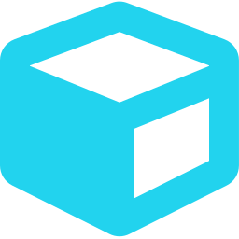


LAB REWARD TOKEN COHORT · SESSION 2
From Web2 to Web3: Building dApps
What a dApp actually is, the tools we build with, and designing our first reward system.
UNL cybersecurity research cohort · security-led · notes only, no recordings
Notes:
Open: one-line recap of Session 1 (we threat-modeled a lab token and deployed one live on Hardhat). Then revive last week's tease: 'I promised you an attack class from the SIEM world that maps onto token issuance — hold it, we walk into it when we design rewards.' Tonight is high-level on purpose: concepts, the toolkit, and a design challenge they own. No recordings, notes only.

Slide 2

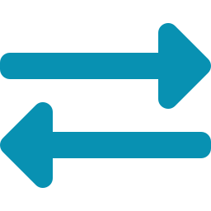


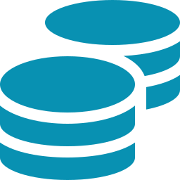
Where we're going tonight
Last week: we threat-modeled a lab token and deployed one live on Hardhat. Tonight we zoom out.
The big shift Web2 vs Web3 — in one analogy you'll remember
1
The stack What changes when you build a dApp, and what doesn't
2
The toolkit The libraries and tools we'll actually build with
3
Tokens & tokenomics How rewards work — plus your design challenge
4
Notes:
Set the map so the room never feels lost. We end on the design challenge — that's the part they take home. Keep this slide to ~60 seconds.

Slide 3
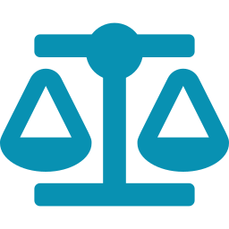


Two ways to build an app
WEB2
WEB3
The bank
The shared notebook
You trust the institution.
Your records live in a back office you never see.
They issue your login — and can reset or freeze it.
They can change the terms, or shut it down.
It works because you trust the company.
Everyone keeps their own copy of the same notebook.
You can only add new lines — never erase old ones.
Change a past line and every other copy disagrees.
No manager owns it — the notebook itself is the authority.
The catch: every page is public — including to attackers.
Notes:
Say it first, then unfold: 'Web2 is a bank — you trust the institution to hold your records. Web3 is a shared notebook everyone has a copy of, where you can only add lines, never erase.' Land the last bullet on the right — every page is public, so attackers read your logic before you ship. That's the security hook for the whole night.

Slide 4
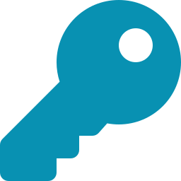



What really changed
Web2 moves trust to a company. Web3 moves it to public code.
Public forever
No reset
No referee
It's an integrity machine, not a secrecy one. Never put anything on-chain you wouldn't put on a billboard.
Your key is the whole identity. Lose it, you're gone. Steal it, you're someone else.
The code is the final word. So the code has to be right — which is why we audit.
Notes:
Three consequences for security people. The 'billboard' rule is the one to repeat — it pre-empts the classic mistake of treating a public chain as private storage. ANCHOR THE BOSS here: '[Boss], from a SIEM seat, what changes when your audit log is public and append-only by default?' Credit his answer by name.

Slide 5
The stack, side by side
Layer | Web2 | Web3 dApp
Frontend | React, HTML / CSS / JS | Same — React + viem / wagmi
Identity / login | Username + password | Wallet + a signature
Backend logic | Your server (Node, Django) | A smart contract (Solidity)
Data / state | Postgres, Mongo — you can edit | The blockchain — public, permanent
The bridge | — (frontend talks to server) | RPC node + viem / ethers
Hosting | AWS / Azure / GCP | Network hosts contract; CDN / IPFS hosts site
Payments | Stripe / card processor | Native — the token IS the money
Same frontend skills. Everything underneath gets swapped.
Notes:
Walk top to bottom. Point out the top row first — a React dev already owns the frontend. Then the swaps: server→contract, database→ledger, login→key. This de-scares Web3.

Slide 6

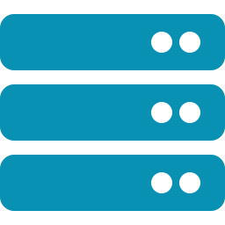
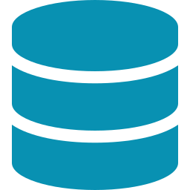
Only three layers actually changed
Server
Database
Login
↓
↓
↓
Smart contract
Blockchain
Key
A private box you control → public, immutable code anyone can read and call.
Editable rows you own → a permanent public ledger you can't quietly rewrite.
A resettable account → one secret, no password reset, no recovery.
Your React frontend? Barely changes. Web3 is less new than it looks.
Notes:
This is the reassurance slide. The goal is to convert 'a whole new world' into 'three components got swapped.' Lowers the intimidation, raises confidence going into the build sessions.

Slide 7
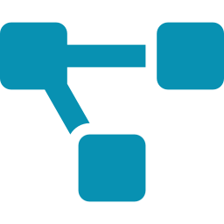



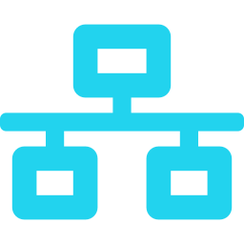


Anatomy of a dApp
OFF-CHAIN · you build & host this
ON-CHAIN
the network hosts this
→
→
→
→
User
Wallet
(MetaMask)
Frontend
(React + viem)
RPC node
(Alchemy)
Smart contract
(Solidity)
Blockchain
The whole security discipline is one question: which part actually needs to be on-chain?
Notes:
Trace a transaction live with your finger: user signs in the wallet → frontend sends it → RPC node relays it → contract runs on-chain. Note that the frontend and even the node are off-chain trust points (a malicious frontend can lie about what you're signing). Most 'dApps' are ~80% off-chain — knowing the on-chain 20% is the security job. This is the publicly-defensible off-chain-first philosophy; let them feel it, don't hand them a UNL conclusion.

Slide 8
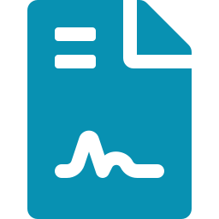





The dApp builder's toolkit
Contracts
Libraries
Build & test
Frontend
Solidity · Vyper
OpenZeppelin
Foundry · Hardhat · Remix
viem · wagmi · RainbowKit
Wallets
Nodes & RPC
Data & storage
Security
MetaMask · WalletConnect
Alchemy · Infura · QuickNode
The Graph · IPFS · Arweave
Slither · Aderyn · Echidna
Notes:
Overview before detail. Don't read every tool — just name the categories and that security gets its own box because this is a security-led cohort. The amber security card foreshadows audit week (Session 7).

Slide 9

The 2026 stack — what we'll actually use
Layer | What we use | Notes / status
Smart contracts | Solidity + OpenZeppelin | Industry standard; audited primitives
Dev & testing | Foundry (forge / anvil) + Hardhat | Foundry now leads; Hardhat still common
Prototyping | Remix IDE | Browser, zero setup
Frontend ↔ chain | viem + wagmi (React hooks) | Replaced ethers.js for most new builds
Wallet connect | MetaMask · WalletConnect · RainbowKit | Standardized
RPC / nodes | Alchemy · Infura · QuickNode | Or run your own (Geth / Reth)
Indexing | The Graph | Query on-chain data without pain
Security / CI | Slither · Aderyn · Echidna · OZ Defender | In CI — not the night before launch
Standards | ERC-20 · 721 · 1155 · 4337 | Tokens, NFTs, multi-token, smart accounts
Legacy | Truffle · Ganache · web3.js | Know them; don't start new work here
Notes:
This is the reference slide — tell them to photograph it. Two credibility lines: (1) Foundry overtaking Hardhat is the real 2024-26 shift; (2) security tools belong in CI, which is exactly how auditors tell serious teams from hobbyists. The 'Legacy' row signals you know what's dated — cheap authority (Cialdini, relevant expertise).

Slide 10





Security tooling is our home-field advantage
Same contract code earns a different audit when it ships with static analysis and fuzzing already in CI. This is where a security-led cohort pulls ahead.
Static analysis
Fuzzing & invariants
Monitoring
Practice grounds
Slither · Aderyn
Echidna · Foundry
OZ Defender · Tenderly
Ethernaut · DVDeFi
Catch known bug classes automatically, every commit.
Find the breakage you didn't think to test for.
Watch the contract once it's live in the wild.
CTFs that teach the attacks by making you run them.
Notes:
Tie forward to Session 7 (peer audit week). ANCHOR THE BOSS: '[Boss], in SIEM terms, static analysis in CI is basically a detection rule that fires before deploy — what's the equivalent you'd want on a SOC pipeline?' Public credit for his framing. Hold-back reminder: do NOT reveal the criticality-binding research angle here; that's 1:1 content, not group.

Slide 11

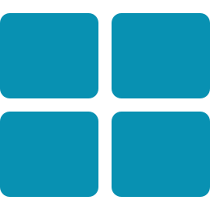
What a token actually is
A token is just a smart contract that keeps a ledger of who owns how much. That's the whole idea.
Fungible ERC-20
Non-fungible ERC-721
Multi-token ERC-1155
Interchangeable units. Points, currency — and reward tokens like ours.
Unique items. Certificates, credentials, badges, reputation.
Many types in one contract. Mixed or game-like systems.
Two flavors by purpose: utility (lets you do something) vs governance (lets you vote on something).
Notes:
Keep it dead simple: a token is a ledger in a contract. Our Lab Reward Token is an ERC-20. Plant the seed that reputation might be better as non-fungible (ERC-721) — but DON'T resolve it; that's their design challenge two slides from now.

Slide 12
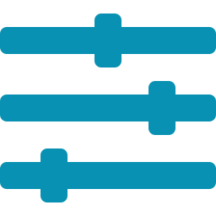


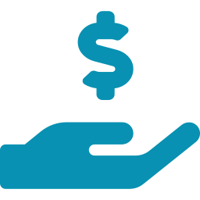

Tokenomics — the six levers
Supply
Distribution
Utility / demand
Fixed, inflationary, or deflationary?
Who earns tokens — and how do you stop gaming?
Why would anyone actually want to hold it?
Sinks
Incentive alignment
Governance
Where tokens leave. No sink → value inflates to zero.
Does the reward drive the behavior you wanted?
Who's allowed to change the rules later?
Watch the alignment lever — Goodhart's law: when a metric becomes a target, people game the metric instead of doing the work.
Notes:
These six levers are the research scaffold for their assignment. Pose each as an open question — do NOT give your UNL answers (payout amounts, governance composition, the real sink). The Goodhart line is the trap most reward systems fall into; flag it, let them wrestle with it.

Slide 13



Your challenge: design the reward system
Design a token-based reward system for a university cybersecurity lab. You're the architects — bring a proposal next session.
Constraints (must-haves)
Research these (open questions)
Reward genuine security work — bugs, audits, writeups
Resist gaming, Sybil, and collusion
Have a real sink an institution can actually control
Don't accidentally build a financial security
Fungible points or non-fungible reputation — or both?
Fixed supply or mint-on-demand? What breaks each way?
How do you Sybil-resist on a campus?
What rules would a campus token trip? Go find them.
Deliverable: one page + a simple diagram. Present it next week — be ready to defend your choices.
Notes:
This is the heart of the night (Aronson: people defend what they built). They design it, they own it, they get invested in the cohort succeeding — patron-making by genuine upskilling. Keep every prompt an OPEN question; your real UNL implementation stays off the table. If anyone pushes 'what's the actual UNL plan?', the line, warmly, identical every time: 'That's part of my research — happy to discuss generic principles, but the specific UNL implementation goes through proper channels.' Have them claim a piece to own and present.

Slide 14





Before next session
Install Foundry (forge, anvil), keep Hardhat, MetaMask, and a free Alchemy or Infura key.
Read The OpenZeppelin ERC-20 source. It's short — read it like a security reviewer.
Think Your reward-system proposal. One page + a diagram, ready to defend.
Next week: we write the token from scratch — and I'll show you the one line almost everyone gets wrong, the one that quietly turns a reward contract into a free money printer. I've seen the cleanup.
Notes:
Close on the tease, then walk — don't explain it (Greene Law 6, court attention via mystery). LOG the tease tonight so you actually pay it off next session (unauthorized-mint / free-money-printer bug). After session: written recap naming every contributor; 2-line DM to the boss ('Appreciated you being there — was the SIEM/CI angle useful, or want a different lens next week?'); push repo + assignment brief to Slack.

